Slide 1
CS6501
Embedded Operating Systems for the IoT
Introduction – August 29, 2018
Brad Campbell – bradjc@virginia.edu
http://www.cs.virginia.edu/~bjc8c/class/cs6501-f18/

Slide 2

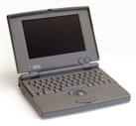
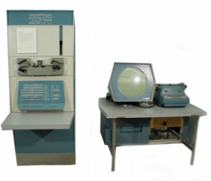
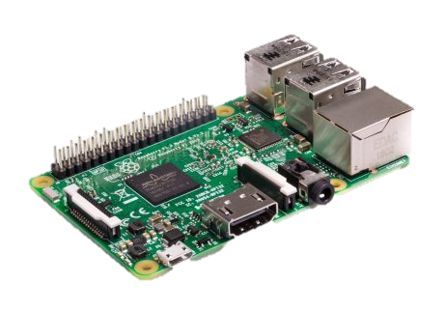
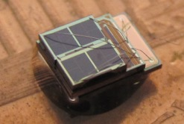

Bell’s Law of Computer Classes:
A new computer class emerges roughly every decade
“Roughly every decade a new, lower priced computer class forms based on a new programming platform, network, and interface resulting in new usage and the establishment of a new industry.”
Mainframe
1 per Enterprise
Workstation
[Bell et al. Computer, 1972, ACM, 2008]
1 per Engineer
log (people per computer)
Laptop
Single-board Computers
1 per Professional
10 per person
Mini Computer
1 per Company
Personal Computer
1 per Family
1 per person
Smart Sensors
Smartphone
100 – 1000s per person

Slide 3
The Internet of Things
“Internet”: Networking, connections
“Thing”: Cyber-physical devices
“Things”: Implies some scale
Huge scope
  Let’s focus on the software platforms for the things
  Grounded by what operations the software must support

Slide 4
This Course
Lecture-style
  What is an OS for embedded systems
  Case studies of embedded OSes from the research community
Research-style
  Why IoT
  Key properties that require software support
Key outcomes
  Understand the design and challenges for embedded operating systems
  Learn to critically analyze research papers
  Apply these skills to a project

Slide 5
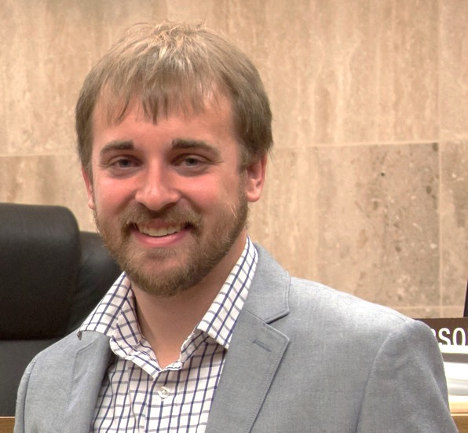
A little about me
Brad Campbell
  Assistant professor
    Joint appointment: 75% CS, 25% ECE
    Link Lab
  bradjc@virginia.edu
Ph.D. from the University of Michigan
Research interests
  Energy-harvesting systems
  Embedded operating systems
  New sensing systems
  IoT systems programming

Slide 6
Ubiquitous Computing
Are we there yet?

Slide 7
Main topics in this course
Applications
Hardware platforms
Case Studies: Embedded OSes from research
Requirements: IoT use cases

Slide 8
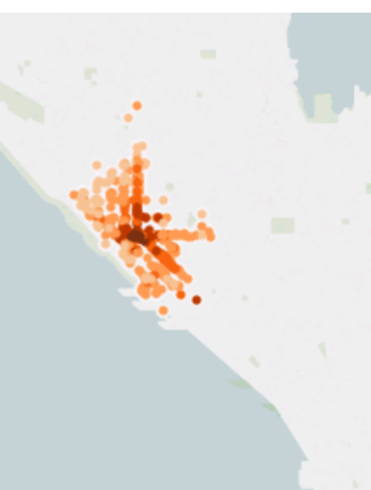
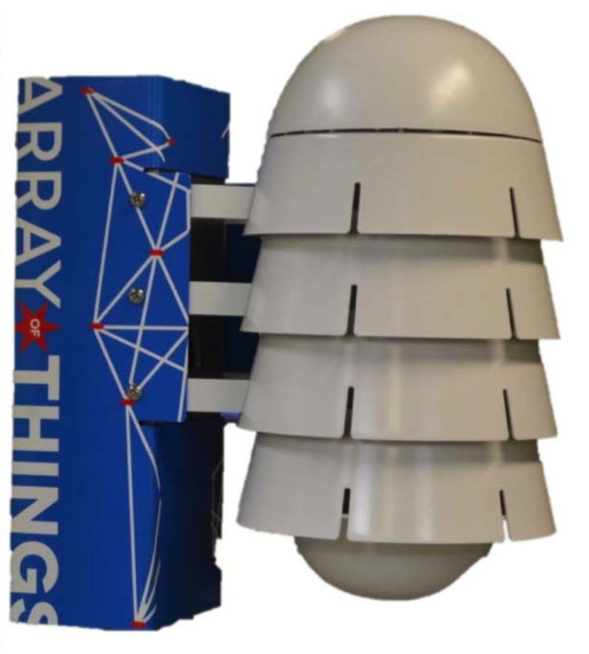
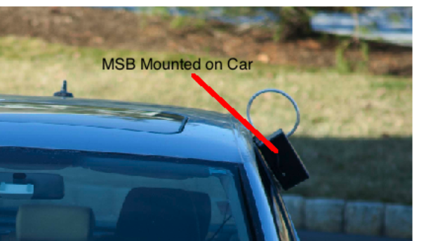
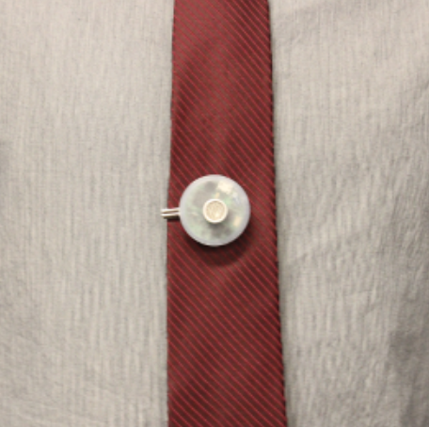
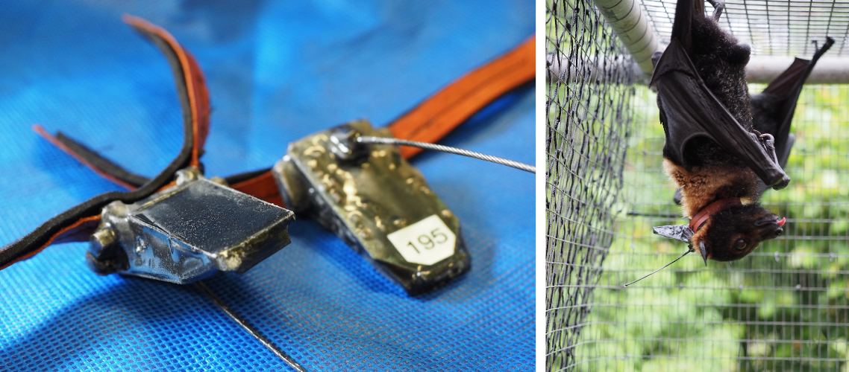
Applications
“Applications are of course the whole point”
– Mark Weiser [paraphrased]
Many areas
  Outdoor and environment monitoring
  Buildings and energy
  Safety and security
  Industrial and infrastructure
  Urban areas
  Person health
Not just application overviews, but
research systems that address specific
aspects of the larger problem.

Slide 9
Application driven research
Motivated by actual problems in key domains.
Why?
  Monetary: Government (and hence tax payers) invest not just for learning but also for societal benefit.
  Practical: The real-world is a great testbed. Provides obvious evaluation metrics.
  Impact: Real problems have more interested parties.
However, must balance with making a CS contribution.
Culture here at UVA to facilitate cross-cutting application-driven research.

Slide 10
This is a graduate class
Assumes
  Familiarity with general operating system concepts
  Interest in learning more about research
We will learn
  About the specific constraints inherent to programming embedded systems
We will practice
  Identifying the scientific method in research papers
  Analyzing and critiquing existing research
  Presenting and communicating clearly existing research
  Applying those techniques to your own work

Slide 11
Scientific Method
Observation/topic/idea
Related work
Hypothesis
Experiments
Analysis
Conclusion
Independent and dependent variables.

Slide 12
Paper reviews
~2 reviews due before each class
Not long, but answer the following questions:
  What is the problem this paper addresses, and why is it important?
  What is the hypothesis of this paper?
  What are two key assumptions that this paper makes?
  What are the two main strengths of this paper?
  What are the two main weaknesses of this paper?
  Which figure or experiment was most compelling in support of the hypothesis, and why?
Sometimes the authors make these easy, other times you have to infer.
Being able to do this in your own work will make you a stronger researcher, communicator, and engineer.

Slide 13
Paper reviews cont.
Also fill in a quick survey about each paper:
  Presentation (1-5):
  Interest (1-5):
  Impact (1-5):
  Overall (1-5):
  Confidence (1-5):
We’ll see how each paper ranks at the end of the semester.

Slide 14
In-class discussion lead
Each student must pick one class (or paper) to be discussion lead.
Leads must
  Introduce the papers.
  Discuss the paper review questions.
  Facilitate a discussion about the approach, merit, and impact of the papers.
I’ll do the first couple to give one approach to being discussion lead.

Slide 15
Homeworks / Quizzes
~3 over the semester
Will cover the material from class and papers
Reinforce key concepts

Slide 16
Semester project
Use an embedded operating system
  Choose application
  Implement the idea
  Analyze the impact of the operating system
- or -
Do a research project
  Explore a new idea involving embedded operating systems
  6 page paper
  Implementation optional

Slide 17
Semester project presentation
Each person/group will present their project/findings at the end of the semester

Slide 18
Grading
Breakdown
  15%: Discussion Lead
  15%: Paper Reviews
  15%: In-class Participation and Discussion
  15%: Quizzes
  40%: Final Project and Presentation

Slide 19
Office hours
Tuesdays 2 pm – 3 pm
Wednesdays noon – 1 pm
241 Olsson (Link Lab)

Slide 20
Check the website for reading list
http://www.cs.virginia.edu/~bjc8c/class/cs6501-f18/

