Slide 1
CS6501
IoT OS
September 3, 2018
Brad Campbell – bradjc@virginia.edu
http://www.cs.virginia.edu/~bjc8c/class/cs6501-f18/

Slide 2
Array of Things: A Scientific Research Instrument in the Public Way
SCOPE 2017

Slide 3
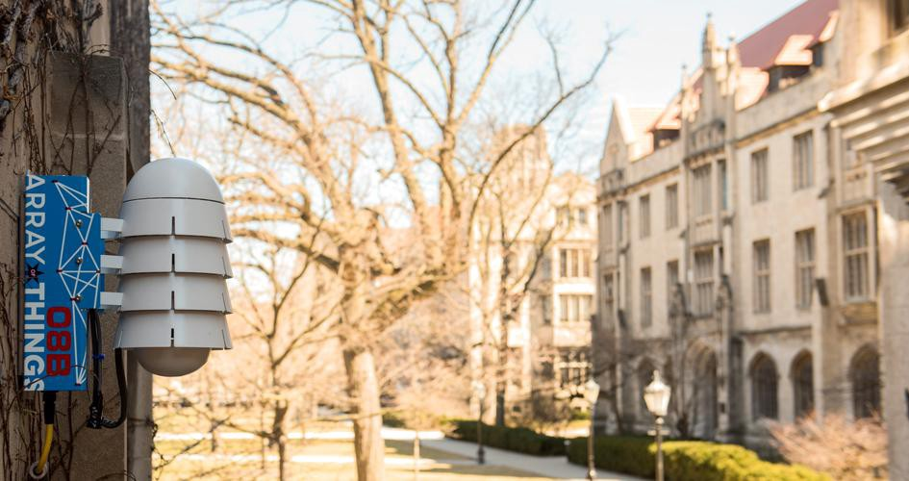

Slide 4
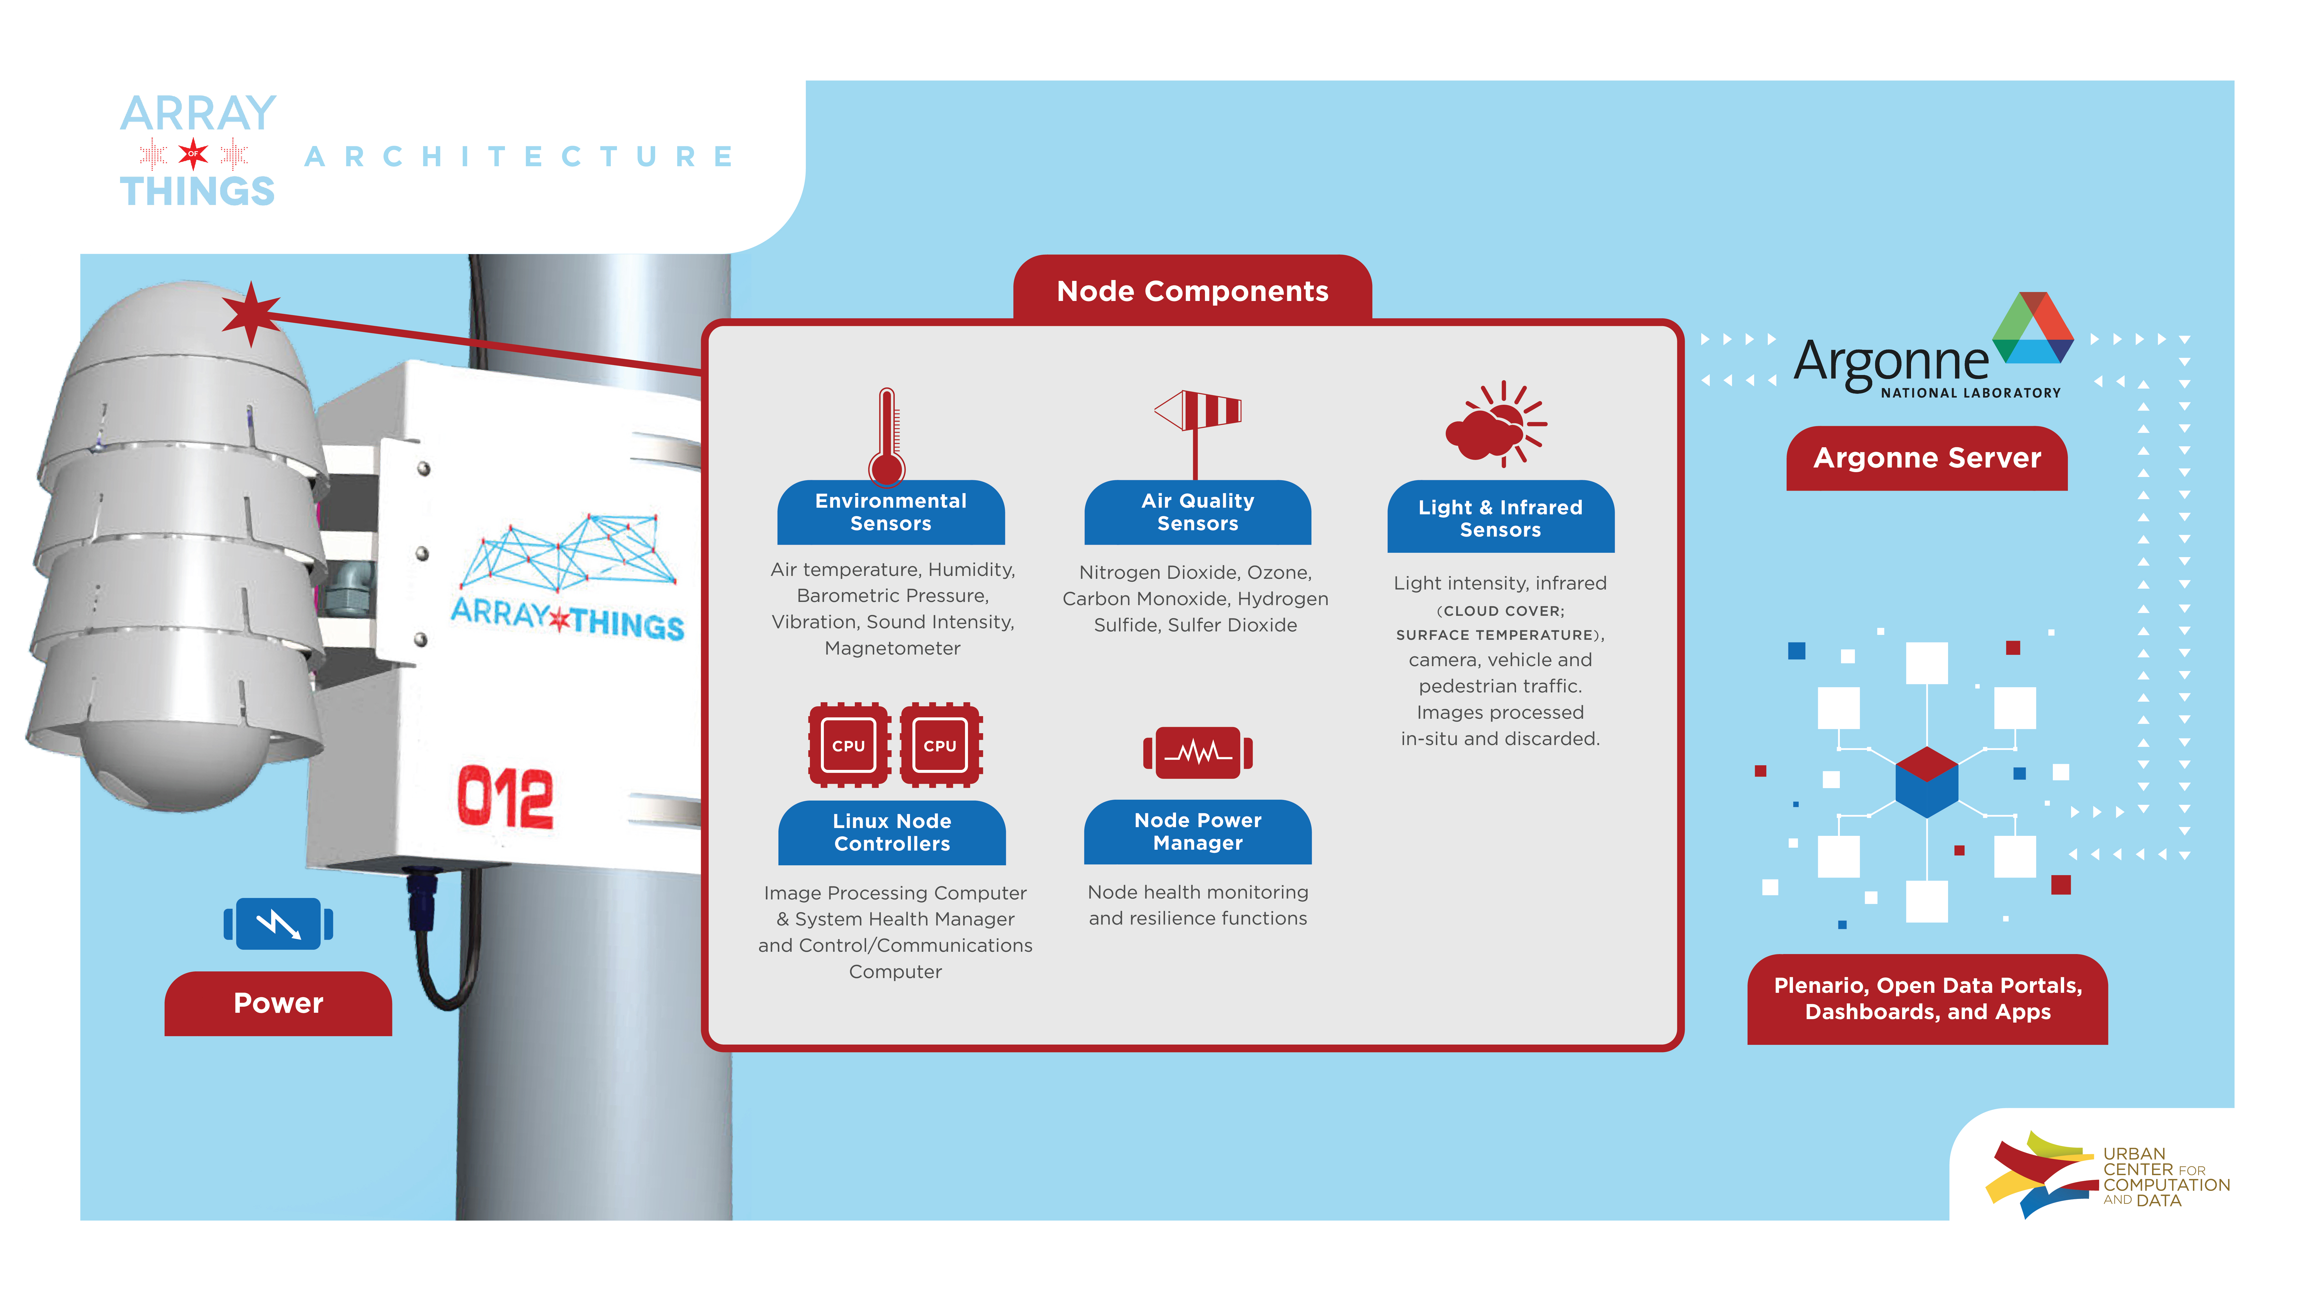

Slide 5
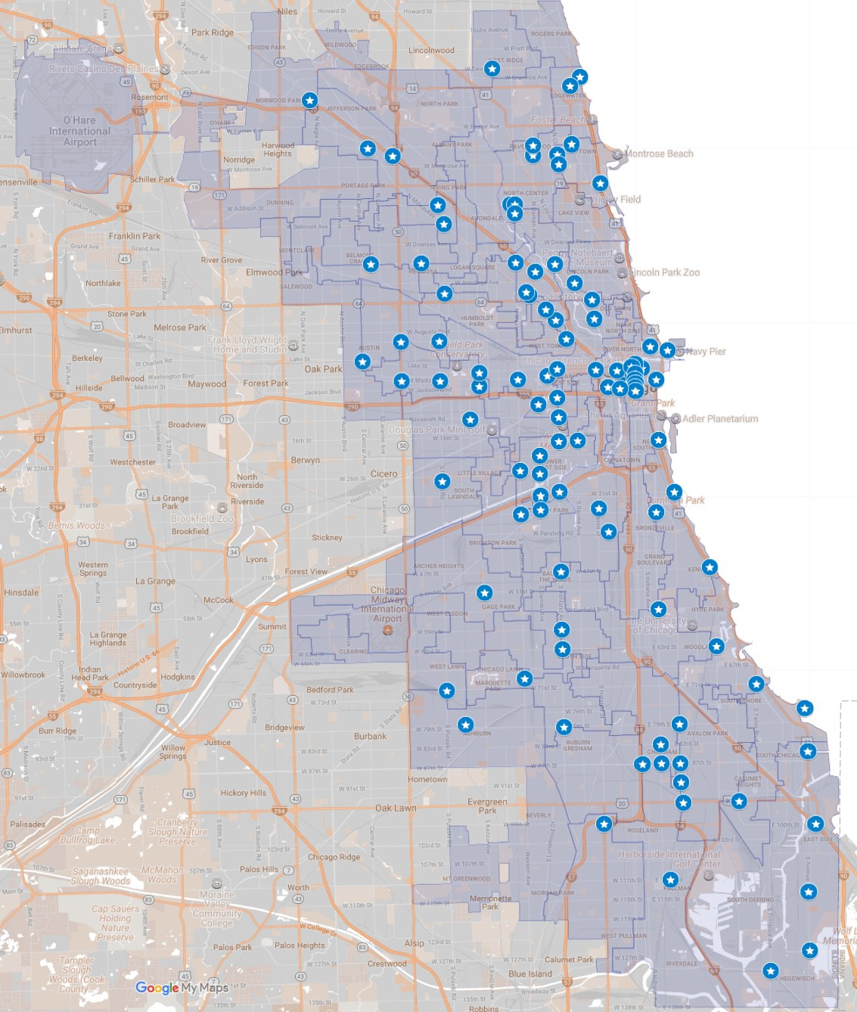

Slide 6
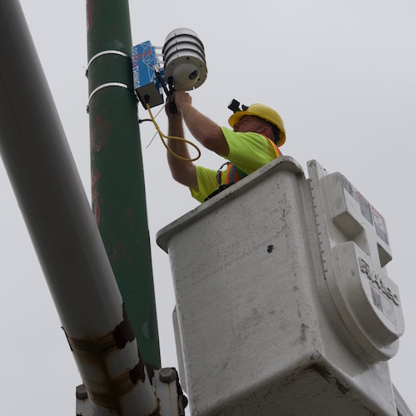

Slide 7
SeaGlass: Enabling City-Wide IMSI-Catcher
Detection
Peter Ney, Ian Smith, Gabriel Cadamuro, and Tadayoshi Kohno
Privacy Enhancing Technologies 2017

Slide 8
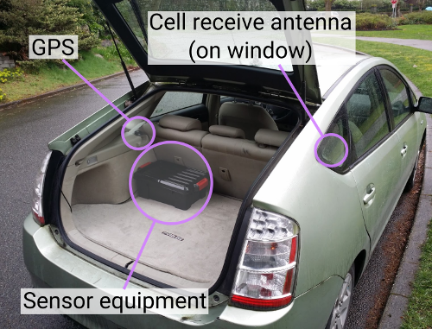
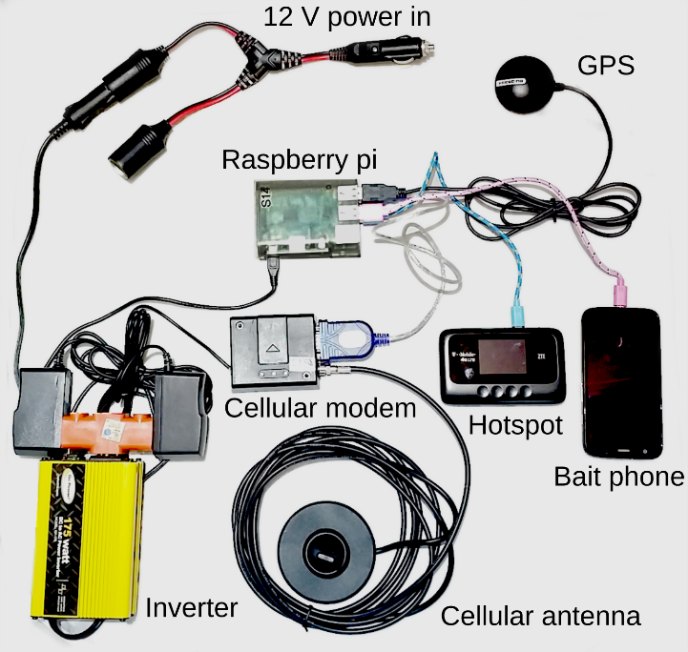

Slide 9
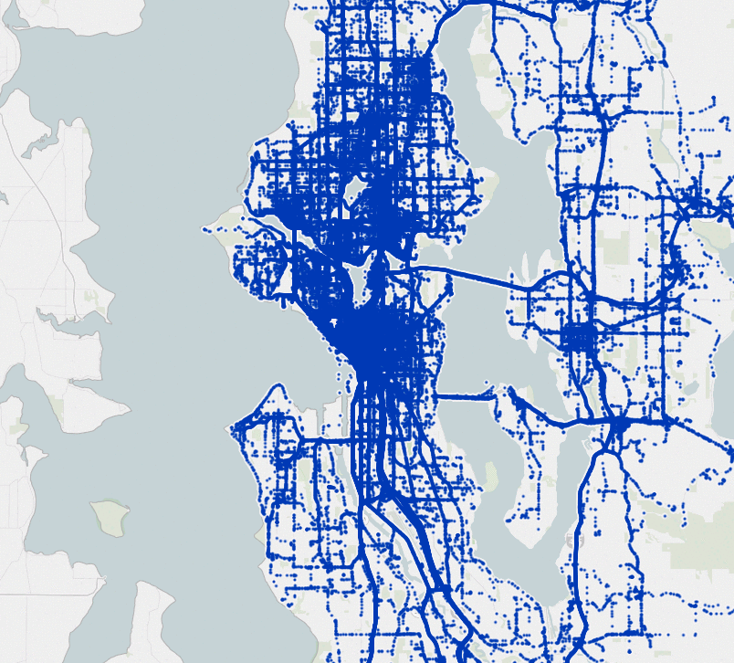
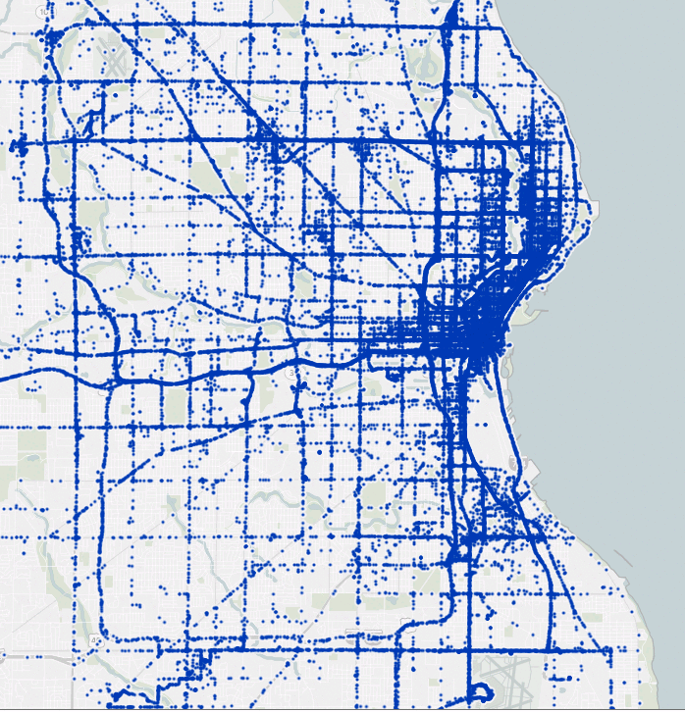

Slide 10
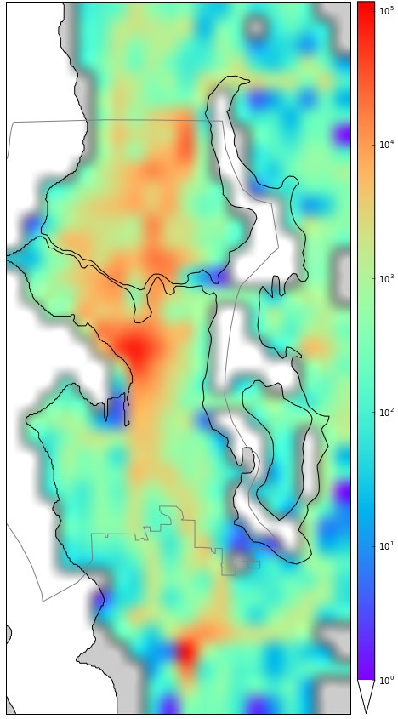

Slide 11
Why?
To try to detect IMSI-catchers
Generate a data set that is currently hidden from the public

Slide 12
Hypotheses
“We argue that the community—and those engaged in the policy debate surrounding cell-site simulator usage—would benefit from additional, independent sources of information on cell-site simulators.”
A crowd-sourced scan of normal 2G basestations will have predictable and stable characteristics, and anomalies in signal strength, duration, consistency, and settings can be detected and will identify IMSI-catchers.

Slide 13
How?

Slide 14
Challenges?
Why is this hard?
What would you have done differently?

Slide 15
Did they find one?

Slide 16
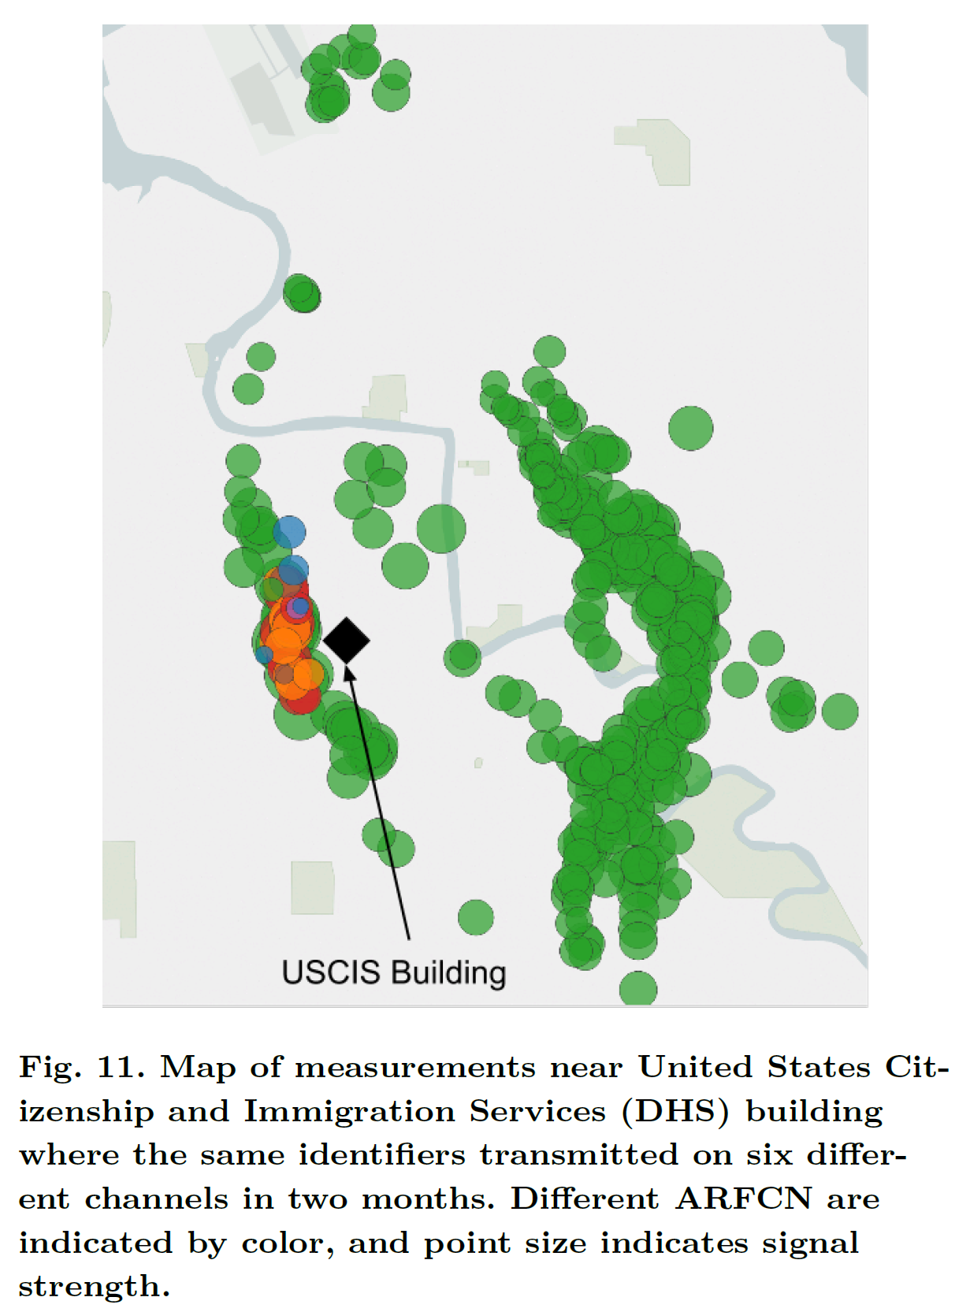

Slide 17
Other thoughts
Is 2G enough? What about Verizon?
Can you pay an Uber driver (with the sensor) to go to a spot to get more measurements?
Is four weeks enough?

