Slide 1
A WONDERFUL
COMPUTING CHRISTMAS
By:
Deidre Regan
Deeksha Kola
Julia Dangtran
Samah Hasan

Slide 2
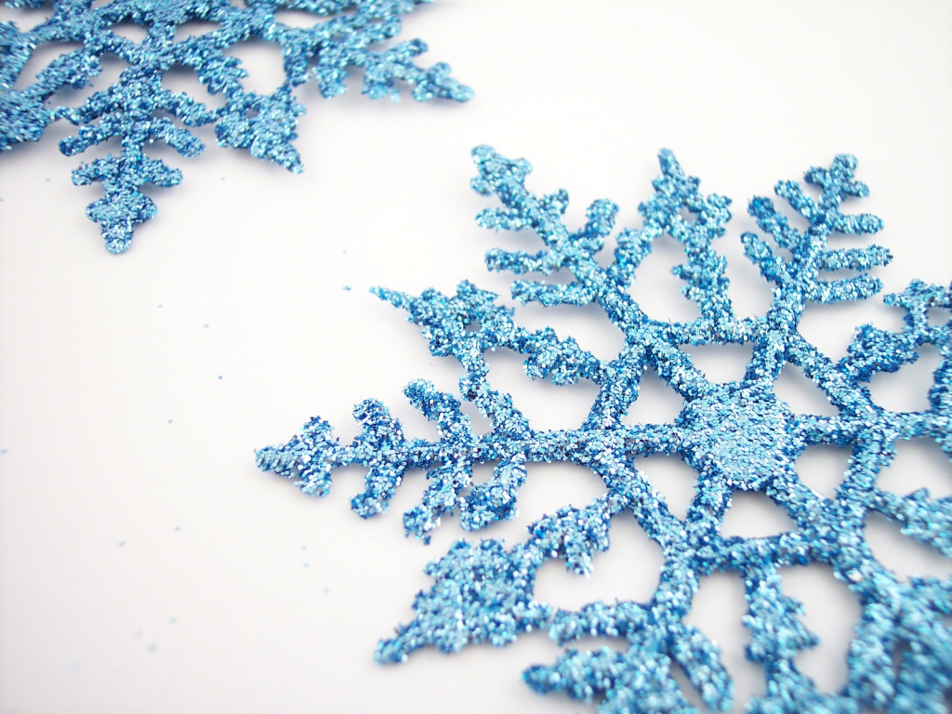
This presentation consists of a collection of computer science terms we have learned
throughout the semester.
This story is meant to introduce computer science terms to children, and
Show them how magical the computing world can be.
This presentation consists of a collection of computer science terms we have learned
Throughout the semester.

Slide 3
Naughty...
meval
mcons
mlist
A List can
be 2 or
more things
Where the second is
A list….

Slide 4
Nice...
(null...)
... Or null.

Slide 5
Rudolph comes first, because he is the car
The first element in any good list...
Then comes the cdr, or those just behind
Without them the list wouldn’t exist!

Slide 6
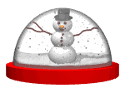
The Global Environment is Santa’s Wonderland, where all
magical creatures work hard to make dreams come true
every Christmas.
Global Environment: a special environment that has no parent environment and where all other environments descend from.

Slide 7
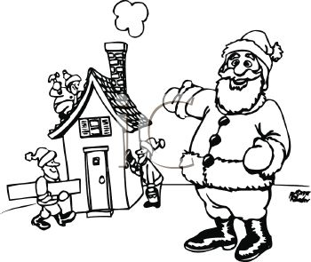
The Parent Environments are
Santa’s Workshop…

Slide 8
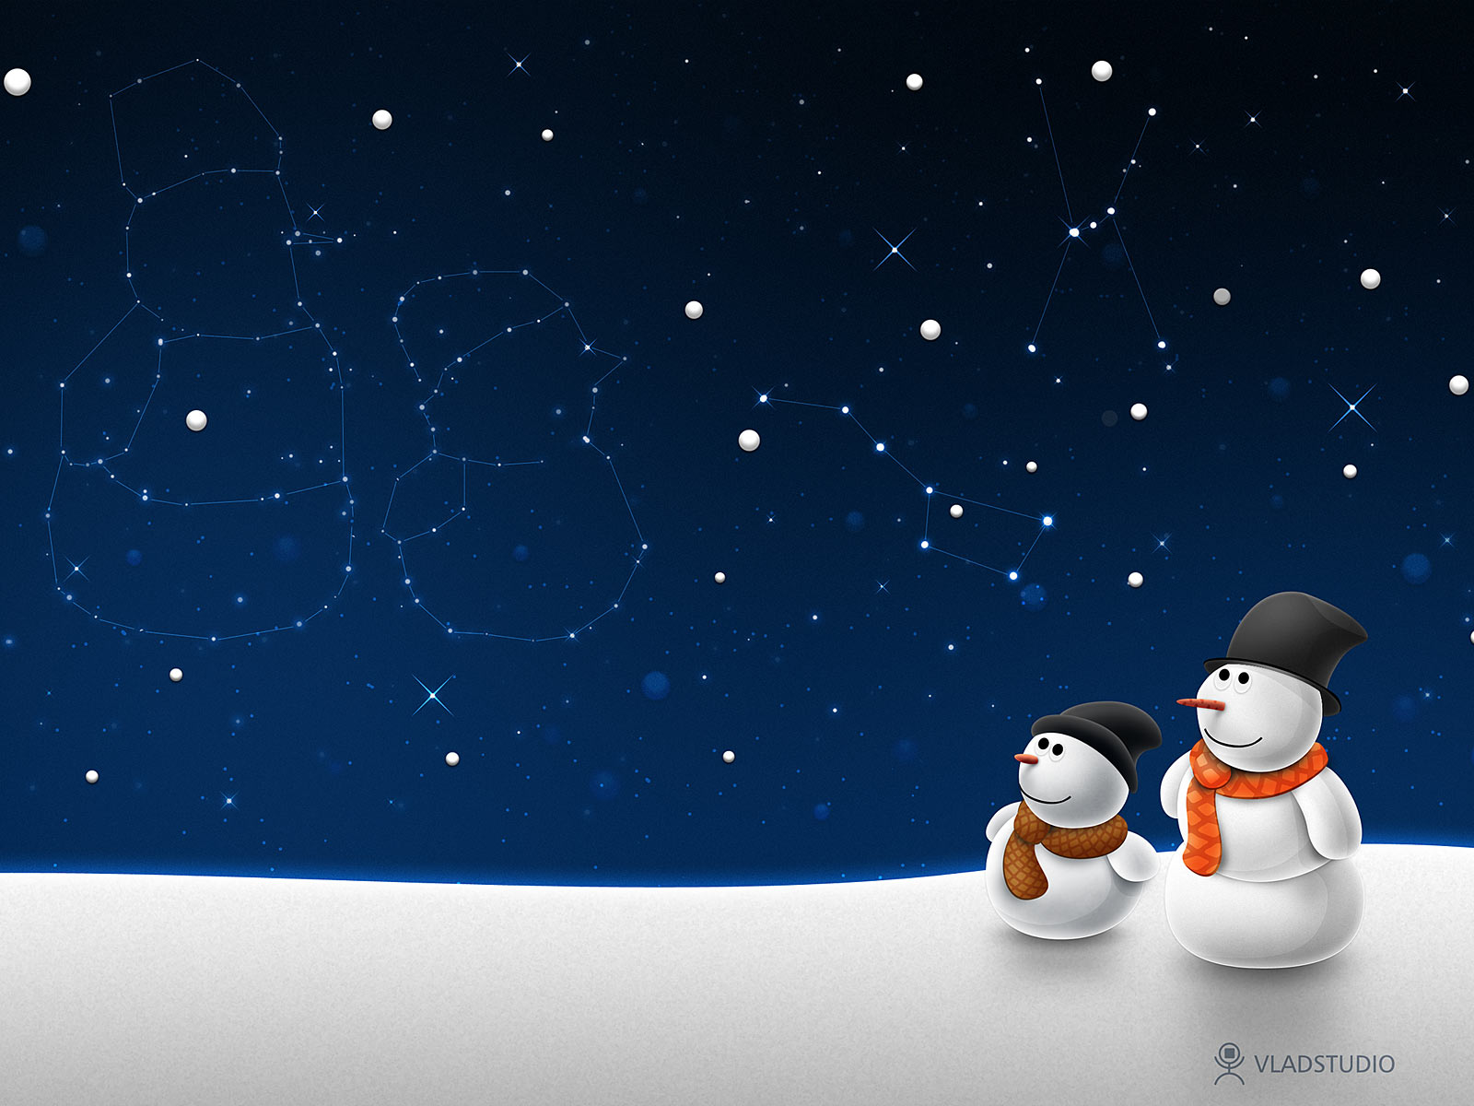
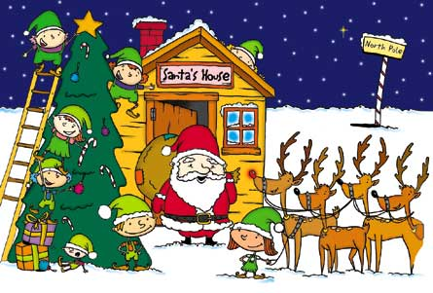
… Santa’s Home, where Santa spends time
with Mrs. Clause…

Slide 9
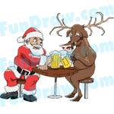
… the Reindeer Farm, where all the reindeer
rest up for their long journey on Christmas Eve…

Slide 10
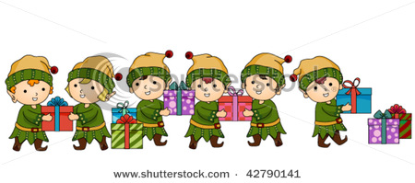
…and the Elf Lodge, where all of
Santa’s helpers live.

Slide 11
List Map

Slide 12
Procedure: Bow
List Map
List map takes a procedure and list as its input…..
List: Gifts

Slide 13
List Map
….and outputs a list whose elements are the results of applying the input procedure to each element of the input list

Slide 14
IfExpression::=>
if Expression_{Predicate}
Expression_{Consequent}
Expression_{Alternate}
Expression that provides a way of using the result of one expression to select which of two possible expressions to evaluate

Slide 15
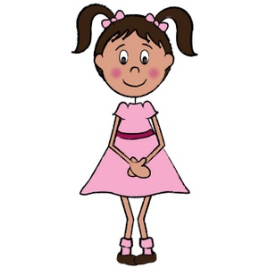
If
Wrap in
Else Wrap In
(define (wrapping paper) (if (= girl) pink blue))

Slide 16
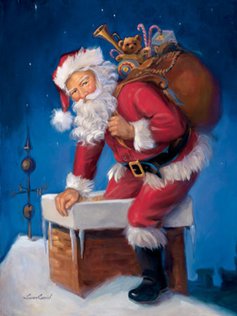
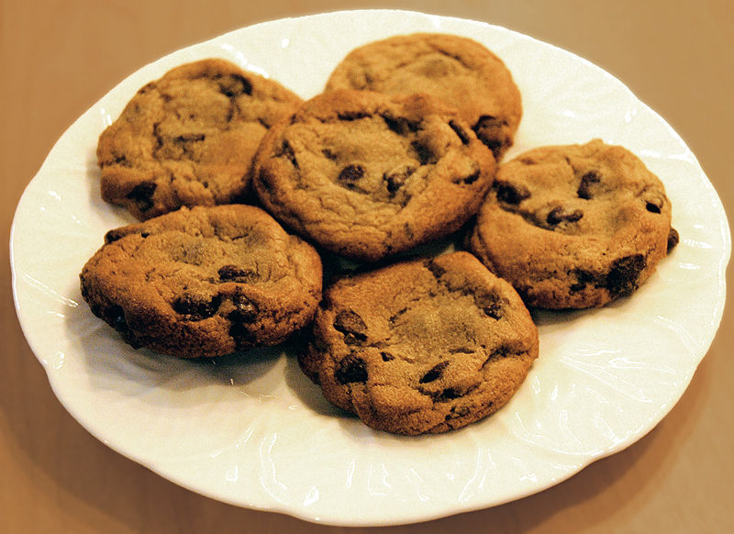
If
then
Else
(define (Did Santa Come) (if (= Santa came) emptyplate fullplate))

Slide 17
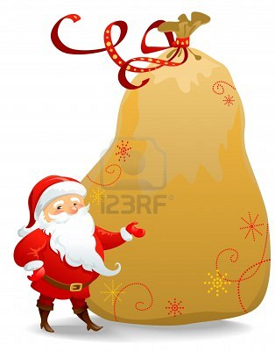
If Santa wants to see how many gifts he has to deliver, he can use list-sum…..
?
Define (list-sum p) (if (null? p) 0
(+ (car p) (list-sum (cdr p))))

Slide 18
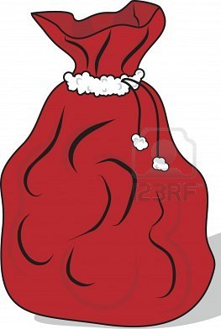
List sum adds the value of the first number in the list to the sum of the rest of the numbers.
150
200
90
210
= 650
So if you had a list of numbers that told you how many presents Santa has in each bag, list-sum will tell you the total number of presents he has to deliver!
Define (list-sum presents-in-bag) (if (null? presents-in-bag) 0 (+ (car presents-in-bag) (list-sum (cdr presents-in-bag))))

Slide 19
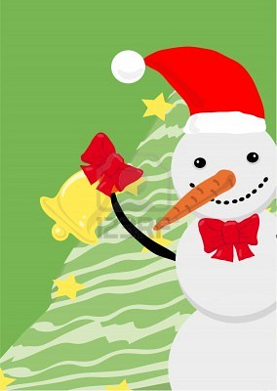
Remember, always be optimistic if you
want Santa to bring
presents ☺
THE END.

