Slide 1
cs2220: Engineering Software Class 1: Engineering Software?
Fall 2010
University of Virginia
David Evans

Slide 2
Menu
Can we engineer software?
About this Course
Managing Complexity

Slide 3
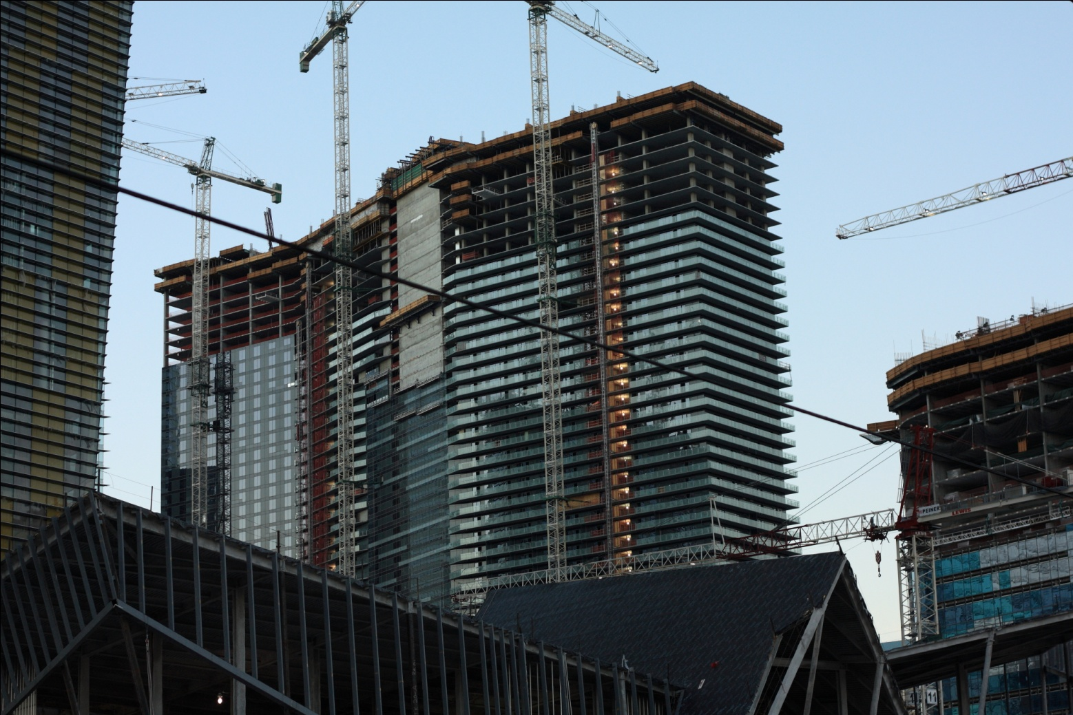
Can we engineer software?

Slide 4
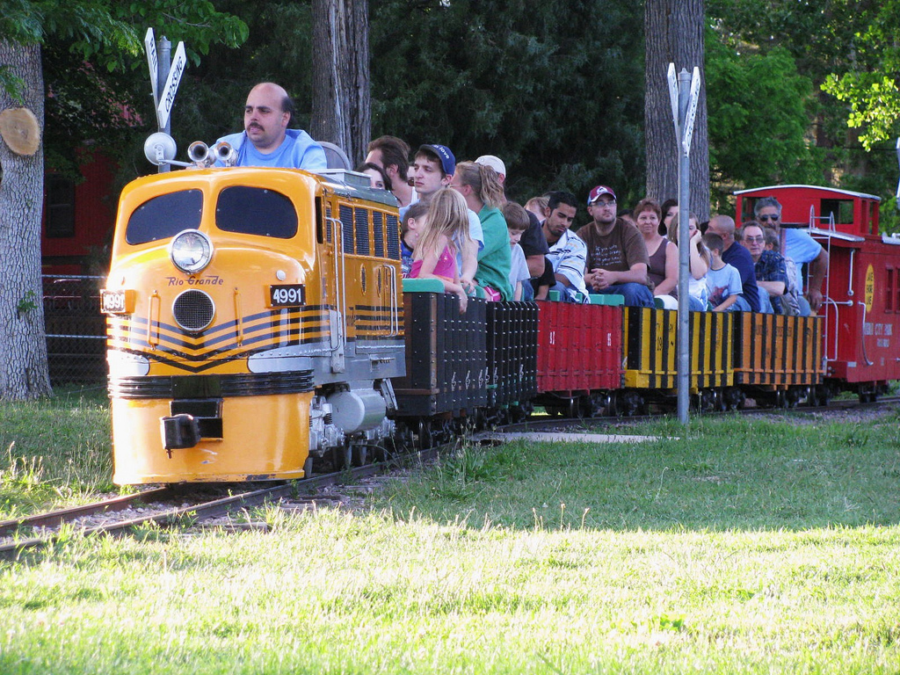
What is engineering?
flickr cc:dpblackwood

Slide 5
Webster’s Definitions
en·gi·neer·ing ( n j -nîr ng) n.
1a. The application of scientific and mathematical principles to practical ends such as the design, manufacture, and operation of efficient and economical structures, machines, processes, and systems.
b. The profession of or the work performed by an engineer.
2. Skillful maneuvering or direction: geopolitical engineering; social engineering.

Slide 6
Design Under Constraint
“Engineering is design under constraint… Engineering is synthetic - it strives to create what can be, but it is constrained by nature, by cost, by concerns of safety, reliability, environmental impact, manufacturability, maintainability and many other such 'ilities.' ...”
William Wulf and George Fisher

Slide 7
Computing Power 1969-2010
Moore’s “Law”: computing power roughly doubles every 18 months!

Slide 8
Constraints Software Engineers Face
Not like those for “real” engineers:
Weight, physics, etc.
Complexity of what we can understand
Most important constraints:
Limits of human memory
Cost of human effort
This class is about managing complexity to efficiently produce reliable complex software systems.

Slide 9
How is engineering software different from engineering bridges?

Slide 10
Bridges
Software

Slide 11
Bridges
Software
Discrete
Logic, Discrete Mathematics
Testing/analysis is difficult
Continuous
Calculus
Testing/analysis is “easy” if the bridge holds for 1M kg,
it also probably holds 0.99M kg
Made of physical stuff
Most costs are obvious
Changes after construction are hard
Made of virtual stuff
All costs are non-obvious
Changes should be easy (but they’re not)

Slide 12
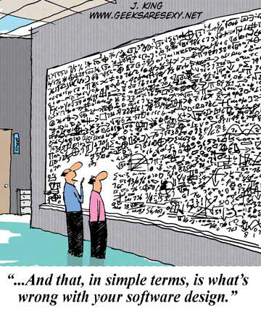
Bridges
Software
Requirements are (usually) obvious and easy to describe
A good design is apparent to everyone immediately
Requirements are mysterious and hard to describe
A good design is only apparent to “experts” but has impact later on

Slide 13
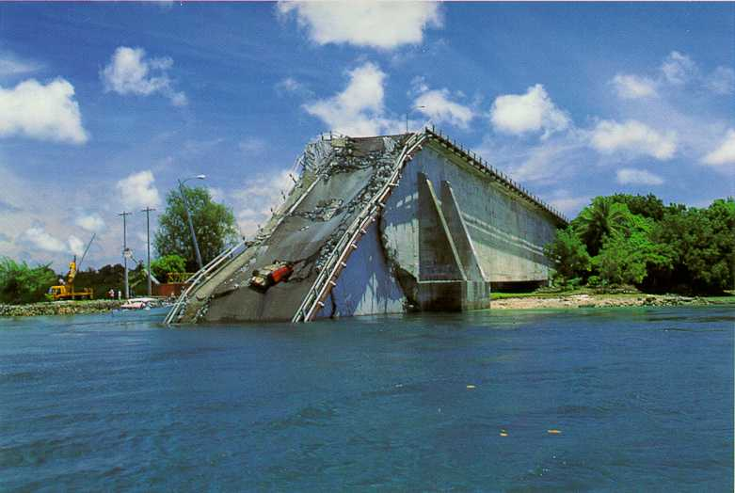
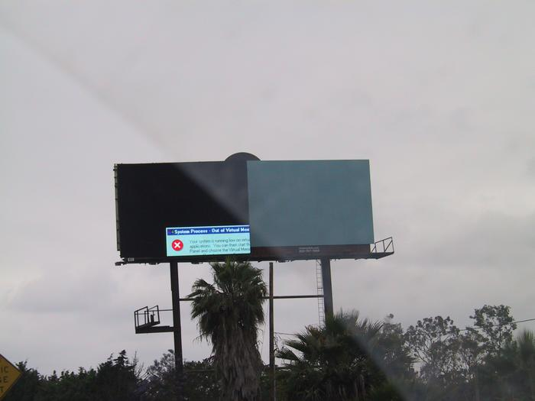
Bridges
Software
Obvious when it fails
Bridge makers get sued
Architects need licenses
Sibley & Walker (~30 years between failures)
Falls down quietly (usually)
Software vendors blame user, charge for upgrades
Anyone can make software, no one gets sued
Notes:
Paul Sibley and Alistair Walker, bridge catastrophe every 30 years – designers push new design to tipping point, new generation gets overconfident

Slide 14
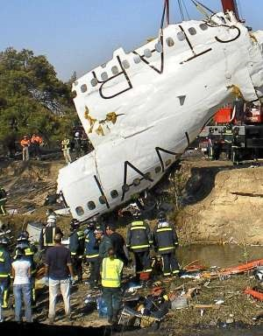
Software Failures
Ariane 5 (1996)
Spanair flight 5022 (2008)

Slide 15
Course Overview
Introductions Thursday

Slide 16
where cs1120 ends…
I think that it’s extraordinarily important that we in computer science keep fun in computing. When it started out, it was an awful lot of fun. Of course, the paying customer got shafted every now and then, and after a while we began to take their complaints seriously. We began to feel as if we really were responsible for the successful, error-free perfect use of these machines. I don't think we are. I think we’re responsible for stretching them, setting them off in new directions, and keeping fun in the house. I hope the field of computer science never loses its sense of fun…. What’s in your hands, I think and hope, is intelligence: the ability to see the machine as more than when you were first led up to it, that you can make it more.
Alan Perlis, preface to Abelson & Sussman,
Structure and Interpretation of Computer Programs
Computer Science
Software Engineering: taking “customer” complaints seriously!
but, it should still be fun and stretching what one can do with computers!

Slide 17
Small, Fun Programs (“cs1120”) vs. Big, Important Programs (simulated in “cs2220”)

Slide 18
Small, Fun Programs
Important Programs

Slide 19
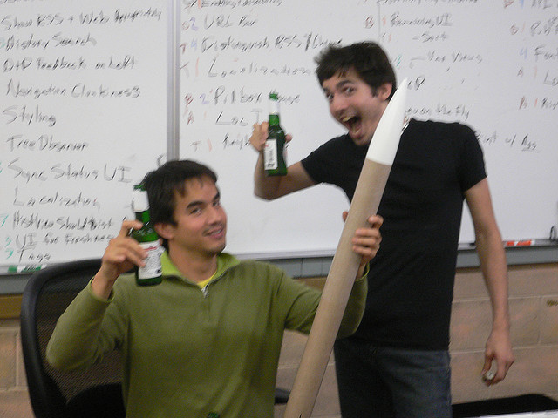
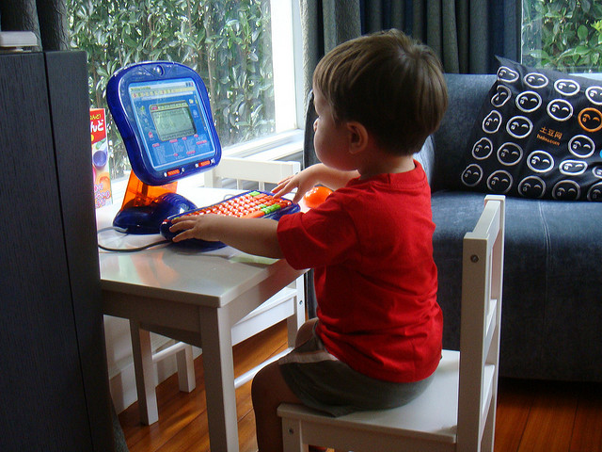
Small, Fun Programs
Important Programs
If it doesn’t work on some input, no big deal
Happy if it works once
If it doesn’t work on just one input people may die, $$$$ lost
Must work on all inputs
flickr cc:foolswisdom
flickr cc: scottvanderchijs

Slide 20
Small, Fun Programs
Important Programs
Manage complexity mostly by memory
Written by a few people over a short period of time
Written by many people over many years
Need to design and document well to manage complexity

Slide 21
How Big are Big Programs?
Largest program in cs1120: ~1000 lines of code
F-22 Steath Fighter Avionics Software: 1.5M loc
Linux: 10M lines of code
Windows (XP): ~50M lines of code
Amazon.com: ~100M lines of code
Modern automobile: ~100M lines of code
Typical estimate: $18 per line of code
Typical estimate: 1 bug per 1000 lines of (production) code

Slide 23
Goal of cs2220
Develop the concepts and skills necessary to successfully build important software.

Slide 24
Grading
A+: I would be willing to fly in a plane running software you designed and wrote
A: I would be willing to shop in an ecommerce store you built
B: I would trust you to manage programmers working on important software
(See syllabus for grading details.)

Slide 25
Course Summary
Main ideas:
Abstraction
Using and designing data abstractions
Specification
Understanding and writing declarative specifications
Analysis
Static: reasoning about behavior
Dynamic: developing and executing testing strategies
Learn by doing:
5 smallish software projects (problem sets 1-5)
individually, in small teams, 1-2.5 weeks each
1 larger team project: (almost) anything you want

Slide 26
Expected Background
Prerequisite: cs1120/cs150
You should be able to:
Write and understand short programs
Write and understand recursive definitions
Use procedures as parameters and results
Analyze the asymptotic running-time of a procedure
Understand replacement (BNF) grammars
If you don’t have this background, you may still be able to take the class (talk to me).

Slide 27
Course History
2002: First offered (cs201j)
Developed with support from National Science Foundation
Spring 2006: BACS Degree launched
Fall 2006: cs205
Fall 2007, 2008, 2009: cs205 (taught by Paul Reynolds)
Fall 2010: cs2220

Slide 28
Course Pledge
Not the classroom pledge!
The whole point of being at a University is so you can:
Learn from your classmates
Learn better by teaching your classmates
READ, sign and return the cs2220 Pledge next class (Thursday)
If you disagree with anything, this is your chance to object
There may be questions about the pledge on a quiz!

Slide 29
Help Available
Me: David Evans
Office hours: Mondays, 1:15-2:30pm
Thursdays, 11am-noon
Blog comments: http://www.cs.virginia.edu/cs2220
Please use this for things that would be useful for everyone
Email: evans@cs.virginia.edu (anytime)
Assistant Teacher:
Web site: http://www.cs.virginia.edu/cs2220
Almost Everything goes on the web
Don’t be afraid to ask for help!

Slide 30
Charge
This class is about:
Managing complexity: modularity, abstraction, specification
Engineering dependability: analysis, redundancy, design
By 5pm Tomorrow: submit registration survey
Thursday: Print, read, and return cs2220 pledge
Beginning of class Tuesday: Problem Set 1 Due
If you do not satisfy the prereq for this course but want to stay in it, please talk to me now (or Thursday 11-noon, or arrange another time.

