Slide 1
cs2220: Engineering Software Class 11: Subtyping and Inheritance
Fall 2010
University of Virginia
David Evans

Slide 2
Schedule Updates
PS4 is now due on Monday, October 11
(October 12: Reading day)
Start thinking about project ideas
Once you have an idea for your project, can substitute parts of your project for programming parts of PS

Slide 3
Kinds of Abstraction
Procedural Abstraction
Abstraction hides details of computations
One procedure abstracts many information processes
Abstraction by Specification
Abstraction hides how a computation is done
One specification can be satisfied by many procedures
Data Abstraction
Abstraction hides how data is represented
One datatype can be implemented many ways

Slide 4
Subtyping
Filter
BlurFilter is a subtype of Filter
Filter is the supertype of BlurFilter
BlurFilter ⊆ Filter
Subtype Abstraction allows us to abstract many possible datatypes with their supertype.
BlurFilter

Slide 5
Subtype Substitution
If B is a subtype of A, everywhere the code expects an A, a B can be used instead.
Filter f;
BlurFilter bf;
...
f = bf;
bf = f;
Filter f = new BlurFilter();

Slide 6
Applying a Filter
// EFFECTS: Returns a Filter object
// associated with the input name.
private Filter loadFilter(String fname);
Filter f = loadFilter(command);
int idx = images.getSelectedIndex();
if (idx < 0) {
reportError("An image must be selected to apply an effect.");
return;
}
f.setImage(workingImages.get(idx), (String) imagesModel.get(idx));
Image result = f.apply();
if (result == null) {
reportError("Error applying filter");
} else {
addImage(result, f.getImageName() + "/" + f.getFilterName());
}
from ps4/GUI.java

Slide 7
Supertype Specification
public abstract class Filter {
// OVERVIEW: A Filter represents an image and provides a technique for altering it.
// A Filter may be in one of three states: uninitialized, initialized,
// and applied. An initialized or applied filter has an associated image;
// and a Pixels object that represents the pixel data (possibly modified
// by the filter) in the image.
public Filter()
// EFFECTS: Initializes this to an uninitialized filter.
final public void setImage(Image p_image, String p_name)
// REQUIRES: this is uninitialized
// MODIFIES: this
// EFFECTS: Sets the image for this to p_image; sets this to the initialized state.
public String getImageName()
// EFFECTS: Returns the image name associated with the filter.
public String getFilterName()
// EFFECTS: Returns the name of the filter.
...
All subtypes must implement the supertype’s specification. But, they can provide different implementations.

Slide 8
Method Dispatch
Assume B is a subtype of A
If both A and B have a method filter which method should be called?
A a = new A ();
B b = new B ();
a.filter();
b.filter();
a = b;
a.filter()
Calls class A’s filter method
Calls class B’s filter method
Calls class B’s filter method

Slide 9
Dynamic Dispatch
Search for the method up the type hierarchy, starting from the actual (dynamic) type of the object
apparent type
a
A a = new A ();
B b = new B ();
a.filter();
b.filter();
A
actual type
b
B
apparent type
actual type

Slide 10
Dynamic Dispatch
apparent type
A a = new A ();
B b = new B ();
a.display ();
b.display ();
a = b;
a
A
actual type
B
b
apparent type
actual type
Now: apparent type of a is A,
actual type of a is B

Slide 11
Apparent and Actual Types
Apparent types are associated with declarations
Never change
Actual types are associated with objects
Always a subtype of the apparent type
Can change which subtype it is
Compiler does type checking using apparent type
JVM does method dispatch using actual type
How can we change the actual type of a variable?
How can we change the apparent type of an expression?

Slide 12
Downcasting
Filter f = new Filter();
BlurFilter bf = new BlurFilter();
f = bf;
bf = f;
bf = (BlurFilter) f;
bf = (AddFilter) f;
Compiler type mismatch error
ClassCastException
Casting changes the apparent type.
The VM must check at runtime that the actual type is a subtype of the cast type (if not, ClassCastException).

Slide 13
Implementing a Subtype
public abstract class Filter {
...
public String getFilterName() {
return "basic";
}
...
}
Supertype
public class BlurFilter extends Filter {
...
@Override
public String getFilterName() {
return "blur";
}
...
}
Subtype

Slide 14
Dynamic Dispatch
Filter f = loadFilter(command);
int idx = images.getSelectedIndex();
if (idx < 0) {
reportError("An image must be selected to apply an effect.");
return;
}
f.setImage(workingImages.get(idx), (String) imagesModel.get(idx));
Image result = f.apply();
if (result == null) {
reportError("Error applying filter");
} else {
addImage(result, f.getImageName() + "/" + f.getFilterName());
}
from ps4/GUI.java

Slide 15
Overriding Methods
public abstract class Filter {
...
protected abstract void filter();
// REQUIRES: this must be initialized
// MODIFIES: this
// EFFECTS: alters the image in a manner specified by the filter.
...
}
public class BlurFilter extends Filter {
...
@Override
protected void filter()
// MODIFIES: this
// EFFECTS: Blurs the pixels in this by averaging their colors
// with those of the surrounding pixels.
{
...
}
}
public class FlipFilter extends Filter {
@Override
protected void filter()
// MODIFIES: this
// EFFECTS: Replaces the pixels in image with their mirror image
// (flips horizontally around center).
public abstract class MultiFilter extends Filter
{
...
protected void addImage (Image p_image) ;
}
public class AddFilter extends MultiFilter {
...
@Override
protected void filter()
// MODIFIES: this
// EFFECTS: Replaces each pixel in the image with the
// bitwise or of the corresponding pixels in all the images.

Slide 16
Subtyping vs. Inheritance
Inheritance
Reusing the implementation of one type to build a new datatype
Subtyping
Defining a new type that can be used everywhere the supertype is expected
These are very different notions, but often confused! It is possible to have inheritance without subtyping, and to have subtyping without inheritance.

Slide 17
Subtyping/Inheritance in Java
extends: both subtyping and inheritance
implements: just subtyping
class B extends A { ... }
B is a subtype of A
B inherits from A
class C implements D { ... }
C is a subtype of D

Slide 18
Is it possible to get inheritance without subtyping?
public class A {
// rep is a B
private B rep;
public A() { rep(); }
public int method(int x) { return rep.method(x); }
... // same for all B methods you want to “inherit”
}
Not conveniently. But, this reuses most of B’s implementation without
allowing A objects to be used where B is expected.

Slide 19
Java’s Type Hierarchy
java.lang.Object is the ultimate supertype of
every object type.
java.lang.Object
java.util.AbstractCollection<E>
java.lang.String
java.util.AbstractList<E>
java.util.ArrayList<E>

Slide 20
http://download.oracle.com/javase/6/docs/api/java/util/TreeSet.html

Slide 21
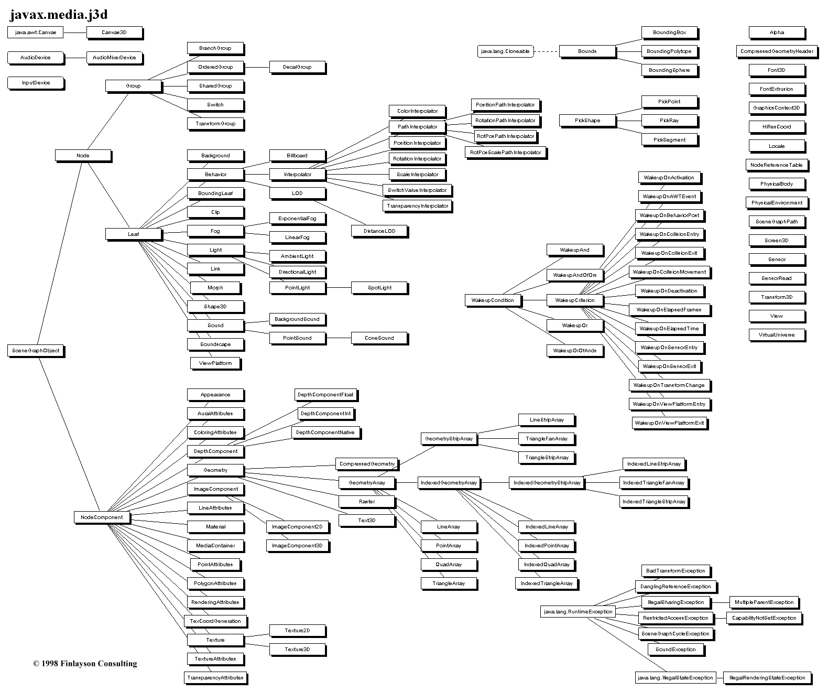
PathInterpolator
RotationPathInterpolator
Interpolator
Node
Selector
Leaf
SceneGraphObject
Not at all uncommon to have
class hierarchies like this!
Java 3D Class Hierarchy Diagram
http://java.sun.com/products/java-media/3D/collateral/j3dclass.html

Slide 22
All Classes are Subtypes
public class Graph {
...
}
really means:
public class Graph extends Object {
...
}
public class java.lang.Object {
public boolean equals(Object o) { ... }
public String toString() { ... }
... // 7 other methods
}

Slide 23
Why Subtyping is Scary
Reasoning about correct code now requires thinking about all possible subtypes!
Substitution Principle (Behavioral Subtyping): imposing limits on the possible specifications of subtypes to make this possible!

Slide 24
Charge
Subtyping
Allow one type to be used where another type is expected
Inheritance
Reuse implementation of the supertype to implement a subtype
Thursday:
When is it safe to say B is a subtype of A?
Now: project ideas!

