Slide 1
cs2220: Engineering Software Class 13: Behavioral Subtyping
Fall 2010
University of Virginia
David Evans

Slide 2
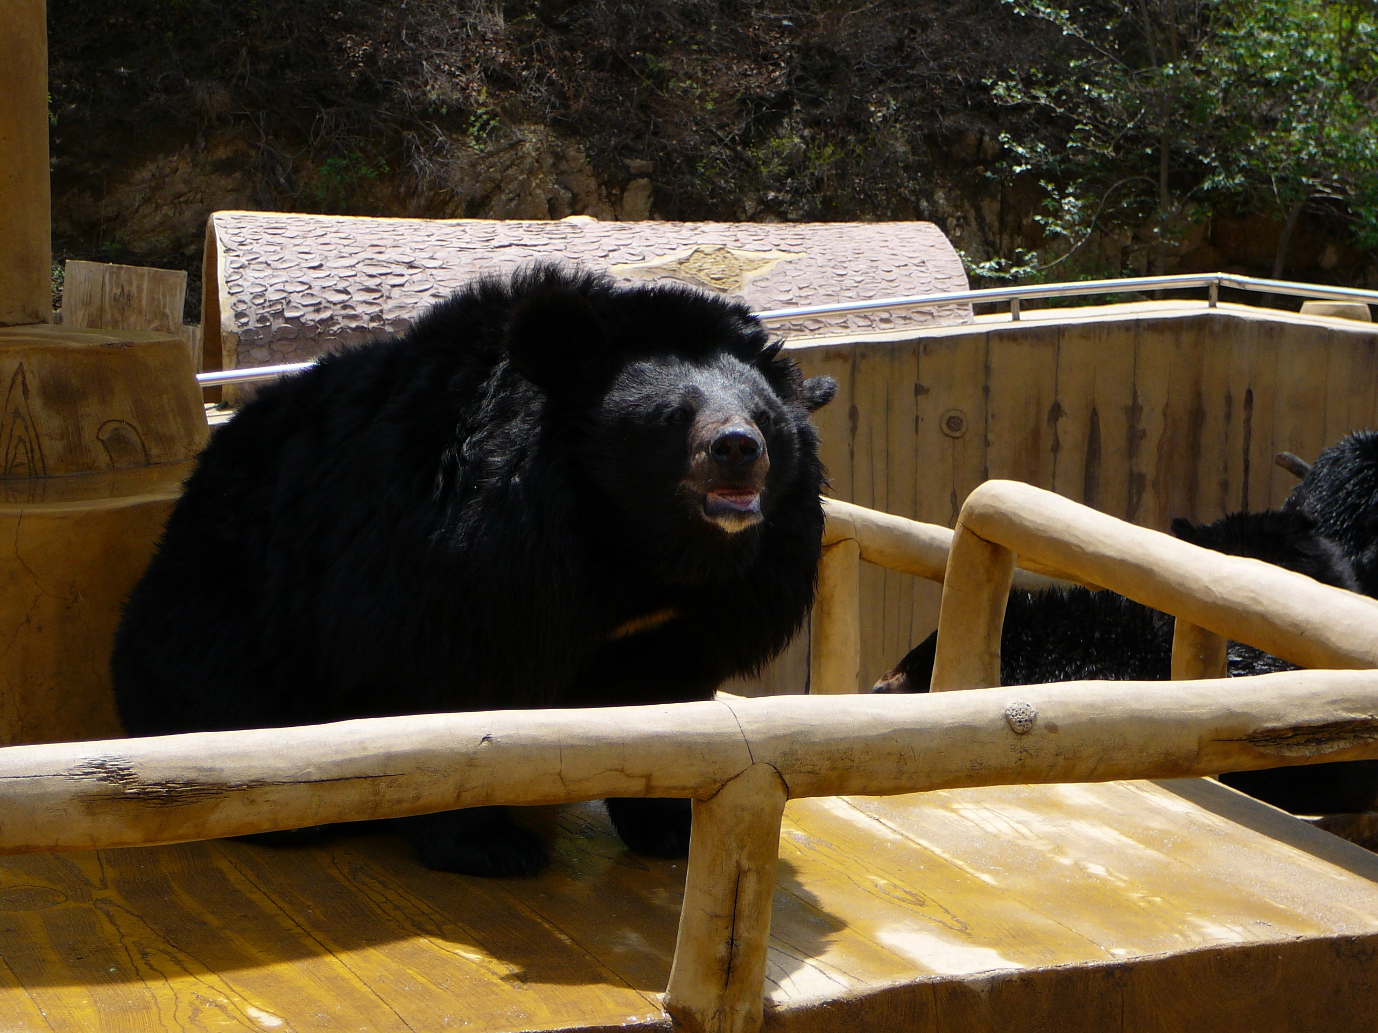
What’s the difference between a black bear and a grizzly bear?

Slide 4
Killer
Bear
Climber
KillingBear
BlackBear
GrizzlyBear

Slide 5
Exam 1

Slide 6
Question 1
Give one concrete example where the Java programming language designers sacrificed expressiveness for truthiness. An ideal answer would illustrate your example with code snippets showing something that is difficult to express concisely because of the Java language’s emphasis on truthiness.
public class HelloWorld {
public static void main (String [] args) {
System.out.println(“Hello!”);
}
}
What are the language design decisions Java made differently from Scheme to explain why this is so long?

Slide 7
What Java language design decisions make this so long?
public class HelloWorld {
public static void main (String [] args) {
System.out.println(“Hello!”);
}
}

Slide 8
Question 1
public class HelloWorld {
public static void main (String [] args) {
System.out.println(“Hello!”);
}
}
Static typing: big win for truthiness
All procedures must be inside a class
Default visibility is not public (package protected)
Use squiggly brackets to denote blocks, semi-colons to end statements
Not providing a special, convenient way to print output, but requiring an I/O object and invoking a method

Slide 9
Exam 1
Score Distribution
90-100 | 9
80-89 | 5
70-79 | 0
<=70 | 4
I will re-ask (in slightly different from) at least some of the questions on Exam 1 on Exam 2.

Slide 10
Recap: Substitution Principle Summary
contravariant
for inputs
Param Types Psub ≥ Psuper
Preconditions pre_sub ⇒ pre_super
Result Type Rsub ≤ Rsuper
Postconditions post_sub ⇒ post_super
Properties properties_sub ⇒ properties_super
covariant
for outputs
These properties ensure code that is correct using an object of supertype is correct using an object of subtype.

Slide 11
Killer
Bear
What should the spec of the KillingBear class’
kill (Object o)
method be?
Climber
KillingBear
BlackBear
GrizzlyBear
BlackBear:
public boolean kill(Object o)
// MODIFIES: this, o
// EFFECTS: If o is up a tree, climbs the tree,
// eats o, and returns true. Otherwise,
// if o is reachable, eats o. Otherwise,
// returns false.
GrizzlyBear:
public boolean kill(Object o)
// MODIFIES: this, o, nearby trees and
// incidentals
// EFFECTS: If o is up a tree, knocks down
// the tree, eats o, and returns true.
// Otherwise, returns false.
// REQUIRES: o is yummy to a GrizzlyBear

Slide 12
Substitution Principle
Is this the only way?

Slide 13
Eiffel’s Rules
(Described in Bertrand Meyer paper for ps4)

Slide 14
Eiffel Rules
The types of the parameters in the subtype method may be subtypes of the supertype parameters.
How can Girl override set_roomate?
set_roommate (Girl g)
set_roommate (Boy b)
Opposite of substitution principle!
Skier
set_roommate (Skier)
Boy
Girl

Slide 15
Eiffel and I Can’t Get Up?
s: skier; g: girl; b: boy;
s := g;
...
s.set_roommate (b);
Skier
set_roommate (Skier)
Boy
Girl
set_roomate (Girl)
Meyer’s paper is all about the contortions Eiffel needs to deal with non-substitutable subtypes

Slide 16
Substitution Principle vs. Eiffel
Skier
set_roommate (Skier)
Skier
set_roommate (Skier)
Boy
set_roomate (Object)
Boy
set_roomate (Boy)
Substitution Principle Eiffel
Parameters PB >= PA PB <= PA
Preconditions pre_A ⇒ pre_B pre_B ⇒ pre_A
Result RB <= RA RB <= RA
Postconditions post_B ⇒ post_A post_B ⇒ post_A

Slide 17
Substitution Rules vs. Java
Skier
set_roommate (Skier)
Skier
set_roommate (Skier)
Boy
set_roomate (Object)
Boy
@Override
void set_roommate(Skier)
// Overloads
void set_roommate (Object)

Slide 18
Overloading and Overriding
Overriding: replacing a supertype’s method in a subtype
Dynamic dispatch finds method of actual type
Overloading: providing two methods with the same name but different parameter types
Statically select most specific matching method of apparent type

Slide 19
Overloading Example
public class Overloaded extends Object {
public int tryMe (Object o) {
return 17;
}
public int tryMe (String s) {
return 23;
}
public boolean equals (String s) {
return true;
}
}
public boolean equals (Object)
is inherited from Object

Slide 20
Overloading
public class Overloaded {
public int tryMe (Object o) {
return 17;
}
public int tryMe (String s) {
return 23;
}
public boolean equals (String s) {
return true;
}
}
static public void main (String args[]) {
Overloaded over = new Overloaded ();
System.err.println (over.tryMe (over));
System.err.println (over.tryMe (new String ("test")));
Object obj = new String ("test");
System.err.println (over.tryMe (obj));
System.err.println (over.equals (new String ("test")));
System.err.println (over.equals (obj));
Object obj2 = over;
System.err.println (obj2.equals (new String ("test")));
}
17
23
17
true
false
false

Slide 21
Overloading 2
public class Overwhelming {
public int tryMe (Object o, String s) {
return 17;
}
public int tryMe (String s, Object o) {
return 23;
}
public static void main(String[] args) {
Overwhelming over = new Overwhelming ();
System.err.println (over.tryMe ("test1", "test2"));
}
}
Compiler error:
The method tryMe(Object, String) is ambiguous for the type Overwhelming

Slide 22
Overkill
Overloading and overriding together can be overwhelming!
Avoid overloading whenever possible: names are cheap and plentiful
One place you can’t easily avoid it: constructors (they all have to have the same name)
But, can make static “factory” methods instead (this is usually better)
Use @Override annotations so compiler will check that you are actually overriding!

Slide 23
Java Buzzword Description
from Class 2...
“A simple, object-oriented, distributed, interpreted, robust, secure, architecture neutral, portable, high-performance, multithreaded, and dynamic language.”
[Sun95]
Later in the course, we will discuss how well it satisfies these “buzzwords”.

