Slide 1

Class 15:
Threads and Concurrency
cs2220: Engineering Software
Fall 2010
University of Virginia
Robbie Hott

Slide 2
PS5
Team requests due tonight by midnight
Teams of 2-3

Slide 3
Remember:
  “A simple, object-oriented, distributed, interpreted, robust, secure, architecture neutral, portable, high-performance, multithreaded, and dynamic language.”
  [Sun95]

Slide 4
Concurrent Programming
Our computer can only do one instruction at a time, why would we want to program pretending it can do many things at once?
Concurrency: having several computations interleaved or executing simultaneously, potentially interacting with each other

Slide 5
Threading Concept
Multiple Threads of execution at once
One set of shared data
Web
Server
Process
Listen();
Respond();
//
//
//
Listen();
Respond();
//
…
Web
Server
Process
Listen();
Thread();
Listen();
Thread();
Listen();
Request
Request
Respond();
//
//
//
Respond();
//
//
//

Slide 6
Concurrent Programming
Why?
Some problems are clearer to program concurrently
  Modularity: Don’t have to explicitly interleave code for different abstractions (especially: user interfaces)
  Modeling: Closer map to real world problems: things in the real world aren’t sequential

Slide 7
Simple Example: Counter (in Java)
One Counter with two operations, increment and decrement.
Two Threads, one calls increment, the other calls decrement.
After each call, they sleep.
What do you think will happen?

Slide 8
Example: Scheduling Meetings
Alice wants to schedule a meeting with Bob and Colleen
Bob
“When can you meet Friday?”
Alice
“When can you meet Friday?”
Colleen
“11am or 3pm”
“9am or 11am”
Picks meeting time
Reserves 11am
for meeting
Reserves 11am
for meeting
“Let’s meet at 11am”
“Let’s meet at 11am”

Slide 9
Partial Ordering of Events
Sequential programs give use a total ordering of events: everything happens in a determined order
Concurrency gives us a partial ordering of events: we know some things happen before other things, but not total order
  Alice asks to schedule meeting before Bob replies
  Alice asks to schedule meeting before Colleen replies
  Bob and Colleen both reply before Alice picks meeting time
  Alice picks meeting time before Bob reserves time on calendar

Slide 10
Race Condition
Doug
Bob
“When can you meet Friday?”
Alice
“When can you meet Friday?”
Colleen
“When can you meet Friday?”
“9, 11am or 3pm”
“9am or 11am”
“9, 11am or 3pm”
Picks meeting time
Reserves 11am
for Doug
“Let’s meet at 11am”
“Let’s meet at 11am”
“Let’s meet at 11am”
“I’m busy then…”

Slide 11
Preventing Race Conditions
Use locks to impose ordering constraints
After responding to Alice, Bob reserves all the times in his response until he hears back (and then frees the other times)

Slide 12
Locking
Doug
Bob
“When can you meet Friday?”
Alice
“When can you meet Friday?”
Colleen
“When can you meet Friday?”
“9, 11am or 3pm”
“9am or 11am”
Locks calendar
Picks meeting time
“3pm”
“Let’s meet at 11am”
“Let’s meet at 11am”
“Let’s meet at 3”

Slide 13
Deadlocks
“When can you meet Friday?”
Doug
Bob
Alice
Colleen
Locks calendar
for Doug, can’t
respond to Alice
“When can you meet Friday?”
“When can you meet Friday?”
“When can you meet Friday?”
“9, 11am or 3pm”
Can’t schedule
meeting, no
response from
Bob
Locks calendar
for Alice, can’t
respond to Doug
Can’t schedule
meeting, no
response from
Colleen

Slide 14
Deadlocks
Deadlock: when computation has stalled because execution units are blocked and waiting on a circular dependency chain. For example, when 2 or more threads wait for the other’s response to finish. Therefore, neither does.
  Other examples?
    “When two trains approach each other at a crossing, both shall come to a full stop and neither shall start up again until the other has gone.”
    —statute passed by the Kansas Legislature (wikipedia)

Slide 15
Concurrency in Java
public class Thread implements Runnable {
// OVERVIEW: A thread is a thread of execution in a program.
// The Java Virtual Machine allows an application to have
// multiple threads of execution running concurrently.
public Thread (Runnable target)
// Creates a new Thread object that will run the target.
public void start ()
// Starts a new thread of execution. Calls the target’s run().
… many other methods
}

Slide 16
Concurrency in Java
public interface Runnable {
public void run()
  When an object implementing interface Runnable is
  used to create a thread, starting the thread causes the
  object's run method to be called in that separately
  executing thread. The general contract of the method run is that it may take any action
  whatsoever.
  }

Slide 17
Simple Java Example: Counter
One Counter with two operations, increment and decrement.
Two Threads, one calls increment, the other calls decrement.
After each call, they sleep.
What do you think will happen?

Slide 18
Why are threads hard?
Too few ordering constraints: race conditions
Too many ordering constraints: deadlocks
Hard/impossible to reason modularly
  If an object is accessible to multiple threads, need to think about what any of those threads could do at any time!
Testing is even more impossible than it is for sequential code
  Even if you test all the inputs, don’t know it will work if threads run in different order

Slide 19


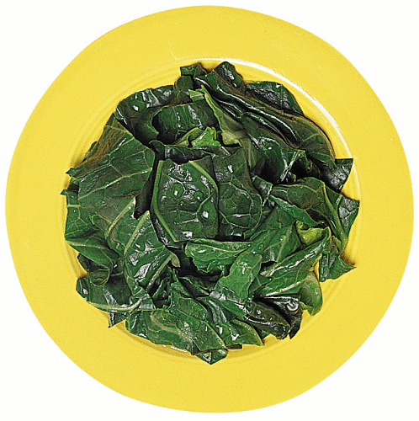

The Dining Philosopher’s Problem

Slide 20
The Dining Philosopher’s Problem
What are the issues to avoid?
  Deadlock
  Starvation

Slide 21
The Dining Philosopher’s Problem
How does it look in Java?

