Slide 1
Class 17: Concurrency and OOP
cs2220: Engineering Software
Fall 2010
UVa
David Evans
Yixin Sun

Slide 2
PS5 Designs [Throughout the Day]
1. Blanton, James Kalish, Michael
2. Borja, Joseph Oh, Uyn Noh, Brian
3. Brown, Jeremy Hearn, Charles
4. Chen, Jiamin Sparkman, Elisabeth Sun, Yixin
5. Dewey-Vogt, Michael Lopez, Erik
6. Dilorenzo, Jonathan Featherston, Joseph
7. Dollhopf, Niklaus Marion, John
8. Herder, Samuel Wallace, Alexander

Slide 3
Partial Ordering of Events
Sequential programs give use a total ordering of events: everything happens in a determined order
Concurrency gives us a partial ordering of events: we know some things happen before other things, but not total order
How is concurrency a kind of abstraction?

Slide 4
Value of Concurrency
As an abstraction: hides the details of exactly when things happen
Program thinking about objects
Interleaving of events
Opportunity for implementations:
Execute faster by using multiple cores

Slide 5
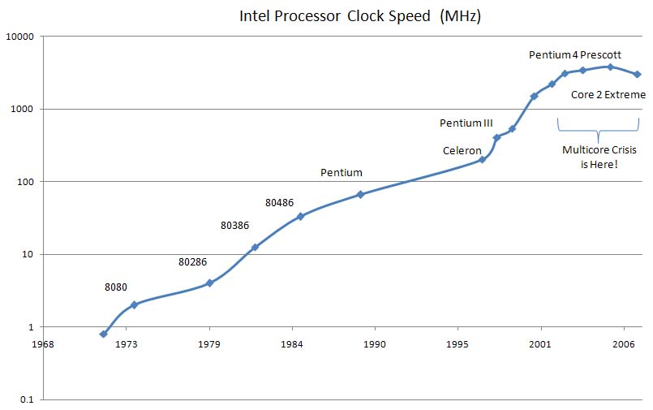
A Picture of the Multicore Crisis
http://smoothspan.wordpress.com/2007/09/06/a-picture-of-the-multicore-crisis/

Slide 6
The Free Lunch Is Over: A Fundamental Turn Toward Concurrency in Software,
Herb Sutter
http://www.gotw.ca/publications/concurrency-ddj.htm

Slide 7
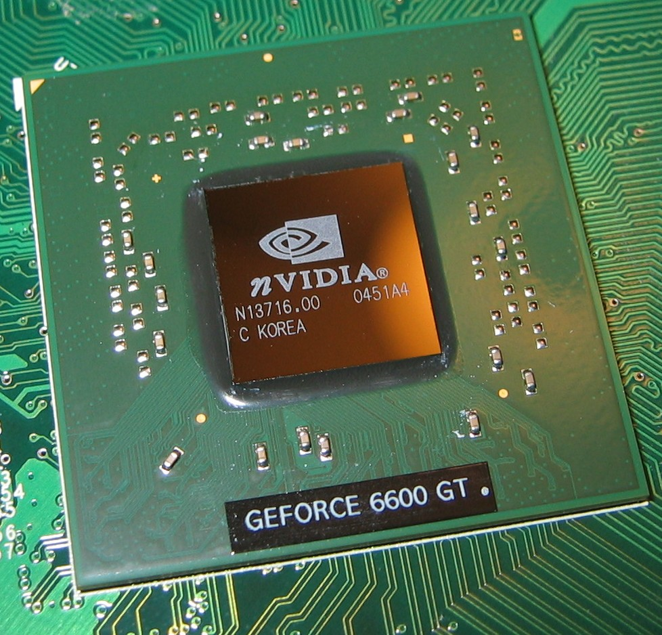
Where is most of the processing power on your PC?
nVIDIA GeForce GTX 470
448 Cores
nVIDIA QuadroPlex 7000 DHIC
1792 cores

Slide 8
Challenge of Concurrency
Server
Listener
Request 1
Store
Request 2
Request 3
Shared Data
Instruction Streams

Slide 9
public class BankAccount {
private int balance;
..
public void transfer(BankAccount b, int amount) throws InsufficientFundsException {
// MODIFIES: this, b
// EFFECTS: If this account has more than amount value, transfers amount from
// this account to b. Otherwise, throws InsufficientFundsException.
if (this.getBalance() > amount) {
b.addFunds(amount);
this.balance = this.balance – amount;
} else { throw new InsufficientFundsException(); }
}
synchronized(this) {
synchronized(b) {
b1.balance = 1001;
b2.balance = 0;
b1.transfer(b2, 1000);
b1.transfer(b2, 1000);
Request 1
if (this.getBalance() > amount)
Request 2
b.addFunds(amount);
if (this.getBalance() > amount)
b2.balance = 1000;
b.addFunds(amount);
this.balance = this.balance – amount;
b2.balance = 2000;
b1.balance = 1;

Slide 10
Why are threads hard?
Too few ordering constraints: race conditions
Too many ordering constraints: deadlocks
poor performance, livelocks, starvation
Hard/impossible to reason modularly
If an object is accessible to multiple threads, need to think about what any of those threads could do at any time!
Testing is even more impossible than it is for sequential code
Even if you test all the inputs, don’t know it will work if threads run in different order

Slide 11
Solutions
No shared store
Functional programming
Scheme without set!, set-car!, set-cdr!
Use analysis tools and locking discipline
http://findbugs.sourceforge.net/
Force determinism
Require thread interleavings to happen in a predictable way

Slide 12
PS5 Designs [Throughout the Day]
1. Blanton, James Kalish, Michael
2. Borja, Joseph Oh, Uyn Noh, Brian
3. Brown, Jeremy Hearn, Charles
4. Chen, Jiamin Sparkman, Elisabeth Sun, Yixin
5. Dewey-Vogt, Michael Lopez, Erik
6. Dilorenzo, Jonathan Featherston, Joseph
7. Dollhopf, Niklaus Marion, John
8. Herder, Samuel Wallace, Alexander

Slide 13
Buzzword Description
from Class 2...
“A simple, object-oriented, distributed, interpreted, robust, secure, architecture neutral, portable, high-performance, multithreaded, and dynamic language.” [Sun95]
As the course proceeds, we will discuss how well it satisfies these “buzzwords”. You should especially be able to answer how well it satisfies each of the blue ones in your final interview.

Slide 14
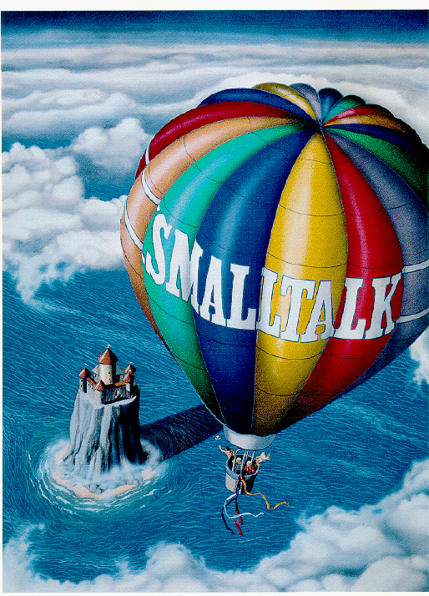
What does is mean for a language to be “Object-Oriented”?

Slide 15
What is an Object?
Packaging state and procedures
state: the rep
What a thing is
procedures: methods and constructors
What you can do with it

Slide 16
Bjarne Stroustrup (C++)’s Answer
“Object-oriented programming is programming with inheritance. Data abstraction is programming using user-defined types. With few exceptions, object-oriented programming can and ought to be a superset of data abstraction. These techniques need proper support to be effective. Data abstraction primarily needs support in the form of language features and object-oriented programming needs further support from a programming environment. To be general purpose, a language supporting data abstraction or object-oriented programming must enable effective use of traditional hardware.”

Slide 17
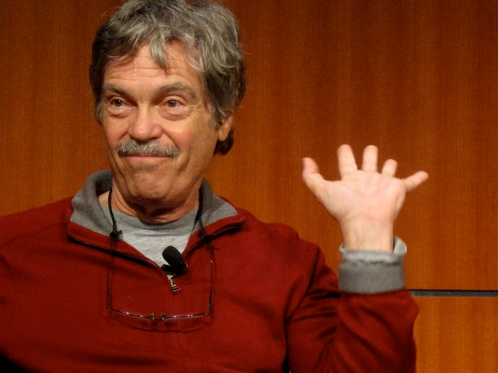
“I invented the term Object-Oriented and I can tell you I did not have C++ in mind.”
Alan Kay

Slide 18
Programming Language History
Before 1954: twidling knobs, machine code, assembly code
FORTRAN (John Backus, UVa dropout, 1954) – Formula Translation
Algol (Peter Naur, Alan Perlis, et. al., 1958-1960)
Most influential programming language
Many of the things Algol did first (types, while, blocks) are in Java
BNF Grammar

Slide 19
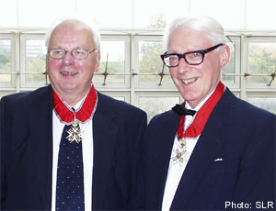
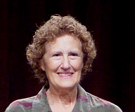
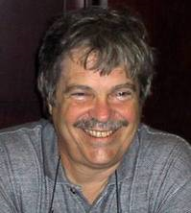
Programming Language History
Simula (Dahl and Nygaard, 1962-7)
First language with subtyping and inheritance
CLU (Liskov et. al., 1970s)
First language with good support for data abstraction (but no subtyping or inheritance)
Smalltalk (Kay et. al., 1970s)
First successful language and programming system to support subtyping and inheritance
2002 Turing Award
2008 Turing Award
2003 Turing Award

Slide 20
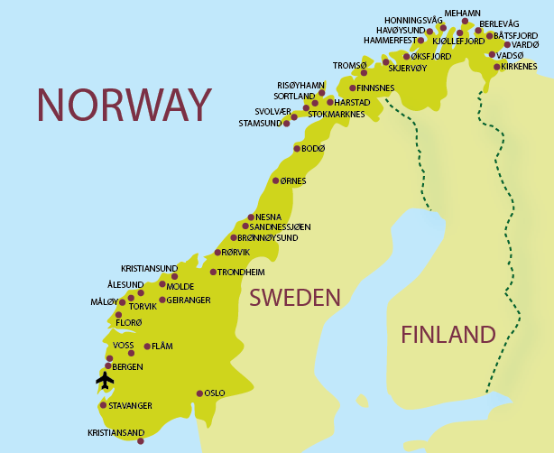
Simula
Considered the first “object-oriented” programming language
Language designed for simulation by Kristen Nygaard and Ole-Johan Dahl (Norway, 1962)
Had special syntax for defining classes that packages state and procedures together

Slide 21
Counter in Simula
class counter;
integer count;
begin
procedure reset(); count := 0; end;
procedure next();
count := count + 1; end;
integer procedure current();
current := count; end;
end
Does this have everything we need for “object-oriented programming”?

Slide 22
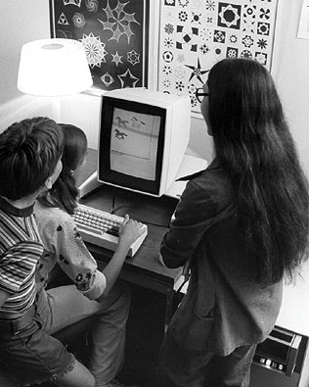
XEROX Palo Alto Research Center (PARC)
1970s:
Bitmapped display
Graphical User Interface
Steve Jobs paid $1M to visit and PARC, and returned to make Apple Lisa/Mac
Ethernet
First personal computer (Alto)
PostScript Printers
Object-Oriented Programming

Slide 23
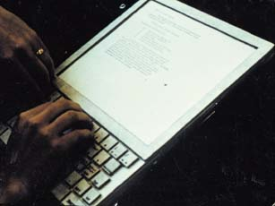
Dynabook, 1972
“Don’t worry about what anybody else is going to do… The best way to predict the future is to invent it. Really smart people with reasonable funding can do just about anything that doesn't violate too many of Newton's Laws!”
— Alan Kay, 1971
(Just a model)

Slide 24
Dynabook 1972
Tablet computer intended as tool for learning
Alan Kay wanted children to program it also
Hallway argument, Kay claims you could define “the most powerful language in the world in a page of code”
Proof: Smalltalk
Scheme is as powerful, but takes two pages
Simple Java compiler and VM requires thousands of pages

Slide 25
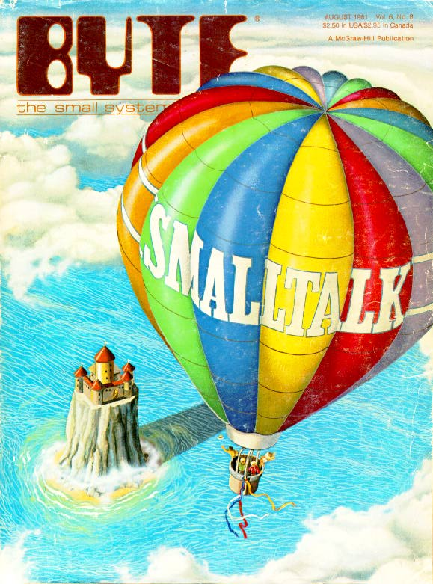
BYTE Magazine, August 1981

Slide 26
Smalltalk
Everything is an object
Objects communicate by sending and receiving messages
Objects have their own state (which may contain other objects)
How do you do 3 + 4?
send the object 3 the message “+ 4”

Slide 27
Counter in Smalltalk
class name counter
instance variable names count
new count <- 0
next count <- count + 1
current ^ count

Slide 28
CLU
Developed by Barbara Liskov and colleagues at MIT (1973-1978)
First language to provide real support for data abstraction
Encapsulation
Abstract data types: hide representation outside data type implementation
Parameterized types (generics), iteration abstraction, exceptions

Slide 29
Problems in Simula that motivated CLU
“Simula did not support encapsulation, so its classes could be used as a data abstraction mechanism only if programmers obeyed rules not enforced by the language.”
Simula did not provide support for user-defined type "generators." These are modules that define groups of related types, e.g., a user-defined set module that defines set[int], set[real], etc.
It associated operations with objects, not with types.
“It treated built-in and user-defined types non-uniformly. Objects of user-defined types had to reside in the heap, but objects of built-in type could be in either the stack or the heap.”
Barbara Liskov, A History of CLU, 1992
CLU “solved” all of these…how many do Java solve?

Slide 30
counter in CLU
counter = cluster is create, next, current
rep = record [count: int];
create = proc () returns (counter);
return up(rep${count: 0});
end create;
next = proc (c: counter);
val : rep := down(c);
val.count := val.count + 1;
end next;
current = proc (c: counter) returns (int);
return (down(c).count);
end current;
end counter;

Slide 31
Programming Language Design Space
high
Scheme
Where do Smalltalk,
Simula, and CLU belong?
Python
Expressiveness
BASIC
C++
strict typing,
static
C
Java
Ada
low
Spec#
more mistake prone
less mistake prone
“Truthiness”

Slide 32
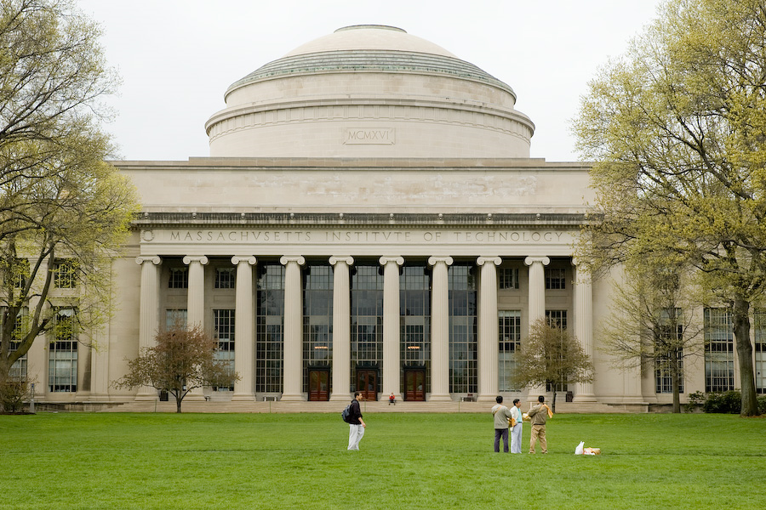
So, who really was the first object-oriented programmer?

Slide 33
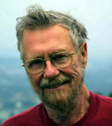
Object-oriented programming is an exceptionally bad idea which could only have originated in California.
Edsger Dijkstra (1930-2002)
1972 Turing Award Winner

Slide 34
Object-Oriented Programming
Object-Oriented Programming is a state of mind where you program by thinking about objects
It is difficult to reach that state of mind if your language doesn’t have:
Mechanisms for packaging state and procedures
Subtyping
Other things can help: dynamic dispatch, inheritance, automatic memory management, everything is an object, mixins, good donuts, etc.
Java has class
Java has extends and implements

Slide 35
Who was the first object-oriented programmer?

Slide 36
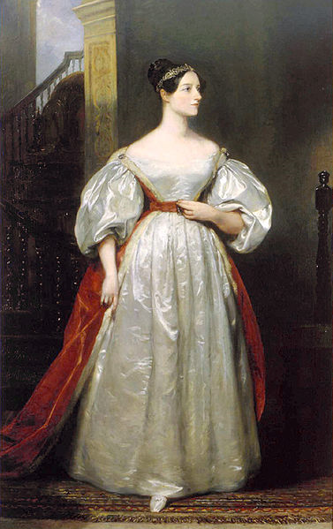
By the word operation, we mean any process which alters the mutual relation of two or more things, be this relation of what kind it may. This is the most general definition, and would include all subjects in the universe. Again, it might act upon other things besides number, were objects found whose mutual fundamental relations could be expressed by those of the abstract science of operations... Supposing, for instance, that the fundamental relations of pitched sounds in the science of harmony and of musical composition were susceptible of such expression and adaptations, the engine might compose elaborate and scientific pieces of music of any degree of complexity or extent.
Ada, Countess of Lovelace,
around 1843

