Slide 1
Class 18: Concurrency on Mars
cs2220: Engineering Software
Fall 2010
UVa
David Evans
Image: Michael Dewey-Vogt

Slide 2
Plan for Today
wait and notify
Concurrency on Mars!
Project Time
Scheduling Update:
Exam 2 (originally scheduled for Oct 28-Nov 2) will
now be: Nov 18-Nov 23
Project Team Requests: 11:59pm Friday
Project Idea Proposals: 11:59pm, Wednesday, Nov 3
Project Design Document: Class, Tuesday, Nov 9
Design Reviews: Nov 10-17 (scheduled by team)
Project Progress Reports: Tuesday, Nov 30
Project Demos/Presentations: 7 December (last class)

Slide 3
Synchronizing
synchronized(obj) { code }
Provides mutual exclusion: code inside synchronized can only run when lock of obj is held
obj.wait()
Gives up lock on obj; puts current thread in waiting set for obj
obj.notify(), obj.notifyAll()
Don’t give up lock; selects one (notify) or all (notifyAll) threads in waiting set for obj and wakes them up (to be scheduled)

Slide 4
Wait, Wait Don’t Notify Me!
http://download.oracle.com/javase/6/docs/api/java/lang/Object.html#wait%28%29
public final void wait() throws InterruptedException
Causes the current thread to wait until another thread invokes the notify() method or the notifyAll() method for this object. In other words, this method behaves exactly as if it simply performs the call wait(0).
public final void wait(long timeout) throws InterruptedException
Causes the current thread to wait until either another thread invokes the notify() method or the notifyAll() method for this object, or a specified amount of time has elapsed.
public final void notify()
Wakes up a single thread that is waiting on this object's monitor. If any threads are waiting on this object, one of them is chosen to be awakened. The choice is arbitrary and occurs at the discretion of the implementation. A thread waits on an object's monitor by calling one of the wait methods.
The awakened thread will not be able to proceed until the current thread relinquishes the lock on this object

Slide 5
wait and notify
Thread A
Thread B
synchronized (o)
o.wait ()
synchronized (o) {
waiting
o.notify ()
awake, but not running
} // end synchronized
can reclaim o lock

Slide 6
wait and notify
Thread C
Thread A
Thread B
synchronized (o)
If multiple threads are waiting on the same object, any one of them can be awakened
o.wait ()
synchronized (o)
waiting
o.wait ()
synchronized (o) {
waiting
o.notify ()
awake,
not running
still waiting
} // end synchronized

Slide 7
class IncThread extends Thread {
private Counter c;
public IncThread (Counter p_c) { c = p_c; }
public void run () {
while (true) {
synchronized (c) {
c.increment ();
System.err.println ("Running inc thread: " + currentThread () + …);
c.notify ();
} } } }
class DecThread extends Thread {
…
public void run () {
while (true) {
synchronized (c) {
while (c.getValue () <= 0) {
try { c.wait (); } catch (InterruptedException e) { ; }
}
c.decrement ();
System.err.println ("Running dec thread: " + …);
} } } }

Slide 8
Counter c = new Counter ();
IncThread ithread = new IncThread (c);
DecThread dthread = new DecThread (c);
ithread.setPriority (Thread.NORM_PRIORITY);
ithread.start ();
dthread.setPriority (Thread.MAX_PRIORITY);
dthread.start ();
Running inc thread: Thread[Thread-0,5,main] / Value: 1
Running dec thread: Thread[Thread-1,10,main] / Value: 0
Running inc thread: Thread[Thread-0,5,main] / Value: 1
Running dec thread: Thread[Thread-1,10,main] / Value: 0
Running inc thread: Thread[Thread-0,5,main] / Value: 1
Running dec thread: Thread[Thread-1,10,main] / Value: 0
Running inc thread: Thread[Thread-0,5,main] / Value: 1
Running dec thread: Thread[Thread-1,10,main] / Value: 0

Slide 9
Priorities
In general, threads with higher priorities will be scheduled preferentially.
There are no guarantees: up to Java scheduler
Thread class:
void setPriority (int newPriority)
// MODIFIES: this
// EFFECTS: Changes the priority of this
// thread to newPriority.

Slide 10
Priorities, Priorities
ithread.setPriority (Thread.NORM_PRIORITY);
ithread.start ();
dthread.setPriority (Thread.MIN_PRIORITY);
dthread.start ();
The ithread should run more than the dthread, but there is no guarantee.
Thread.MIN_PRIORITY
Thread.NORM_PRIORITY
Thread.MAX_PRIORITY

Slide 11
Stopping Threads
public class java.lang.Thread {
public final void stop()
Deprecated. This method is inherently unsafe.
Forces the thread to stop executing. …The thread represented by this thread is forced to stop whatever it is doing abnormally and to throw a newly created ThreadDeath object as an exception. …

Slide 12
Why deprecate stop?
What should happen to all the locks a thread owns when it is stopped?
What if an invariant is temporarily broken in a method?

Slide 13
Suspending Threads
public final void suspend()
Suspends this thread. If the thread is alive, it is suspended and makes no further progress unless and until it is resumed.
Deprecated. This method has been deprecated, as it is inherently deadlock-prone. If the target thread holds a lock on the monitor protecting a critical system resource when it is suspended, no thread can access this resource until the target thread is resumed. If the thread that would resume the target thread attempts to lock this monitor prior to calling resume, deadlock results. Such deadlocks typically manifest themselves as "frozen" processes.

Slide 14
Can’t stop, can’t suspend, what can you do?
in java.lang.Thread
public void interrupt()
Interrupts this thread.
If this thread is blocked in an invocation of the wait(), wait(long), or wait(long, int) methods of the Object class, or of the join(), join(long), join(long, int), sleep(long), or sleep(long, int), methods of this class, then its interrupt status will be cleared and it will receive an InterruptedException.
…
If none of the previous conditions hold then this thread's interrupt status will be set.

Slide 15
Being Interrupted
public boolean isInterrupted()
MODIFIES: nothing
EFFECTS: Returns true iff this thread
has been interrupted.

Slide 16
Counter c = new Counter ();
IncThread ithread = new IncThread (c);
DecThread dthread = new DecThread (c);
ithread.setPriority (Thread.NORM_PRIORITY);
ithread.start ();
dthread.setPriority (Thread.MAX_PRIORITY);
dthread.start ();
dthread.interrupt ();
Interrupts are just “polite” requests!
The thread can ignore it and keep going…
Running inc thread: Thread[Thread-0,5,main] / Value: 1
Running dec thread: Thread[Thread-1,10,main] / Value: 0
Running inc thread: Thread[Thread-0,5,main] / Value: 1
Running dec thread: Thread[Thread-1,10,main] / Value: 0
Running inc thread: Thread[Thread-0,5,main] / Value: 1
Running dec thread: Thread[Thread-1,10,main] / Value: 0
Running inc thread: Thread[Thread-0,5,main] / Value: 1
Running dec thread: Thread[Thread-1,10,main] / Value: 0

Slide 17
Mars Pathfinder
Landed on Mars
July 4, 1997
Sojourner Rover

Slide 18
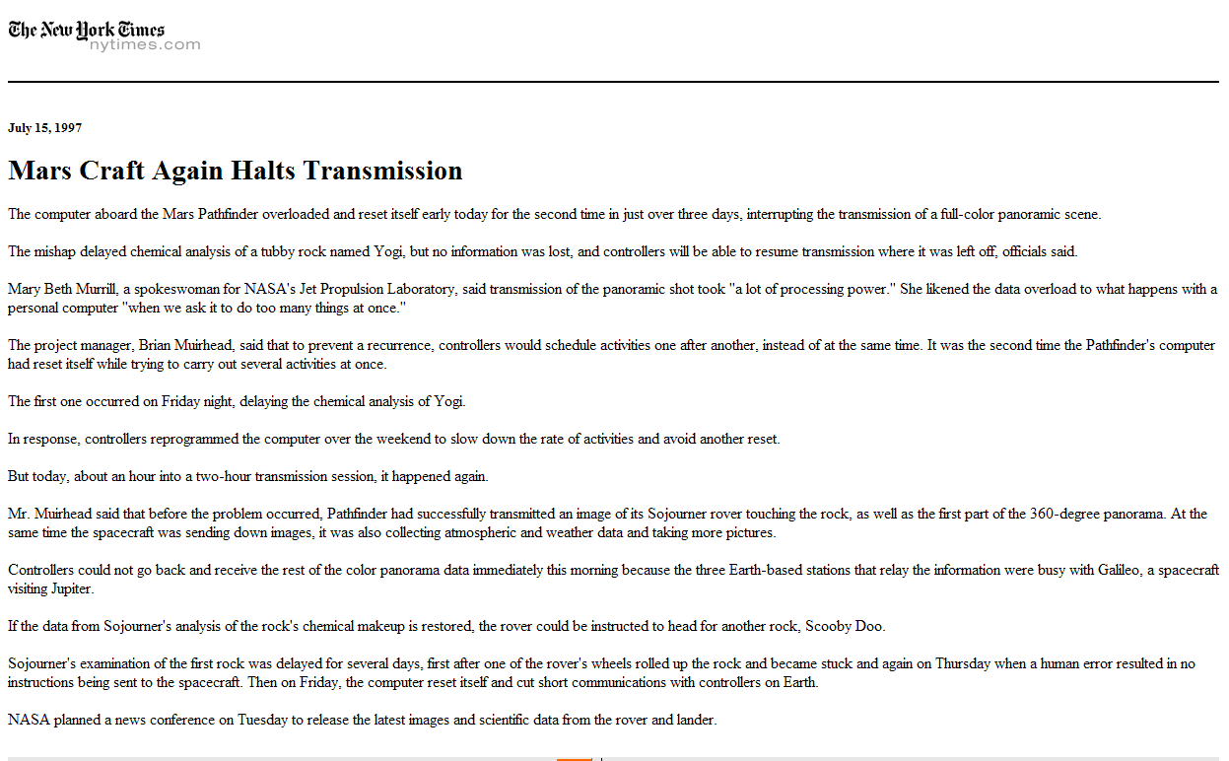
New York Times, 15 July 1997
Mary Beth Murrill, a spokeswoman for NASA's Jet Propulsion Laboratory, said transmission of the panoramic shot took “a lot of processing power.” She likened the data overload to what happens with a personal computer “when we ask it to do too many things at once.”
The project manager, Brian Muirhead, said that to prevent a recurrence, controllers would schedule activities one after another, instead of at the same time. It was the second time the Pathfinder's computer had reset itself while trying to carry out several activities at once.
In response, controllers reprogrammed the computer over the weekend to slow down the rate of activities and avoid another reset. But today, about an hour into a two-hour transmission session, it happened again.

Slide 19
Priority-Based Scheduling
Scheduler ensures that the highest priority task that can run is always running
Lower priority tasks run only when no higher priority task can run
Standard JavaVM scheduler does not do this, but many operating Systems for embedded systems do including the vxWorks used on the PathFinder.
What could go wrong with priority-based scheduling?

Slide 20
Priority Inversion
Low
Medium
High
synchronized(r)
synchronized(r)
Pre-empts low-priority thread
Waiting on lock r (held by low-priority task)

Slide 21
Priority Inversion on Mars
Meterological data task
(low priority)
Bus Management Task
(high priority)
Data collection task
(medium priority)
For details, see Glenn Reeves account:
http://research.microsoft.com/~mbj/Mars_Pathfinder/Authoritative_Account.html

Slide 22
Solutions?
Priority Inheritance
If a low priority task holds a resource needed by a high priority task, the low priority task temporarily inherits the high task’s priority
Priority Ceilings
Associate minimum priorities with resources: only a high priority task can acquire the lock on an important resource

Slide 23
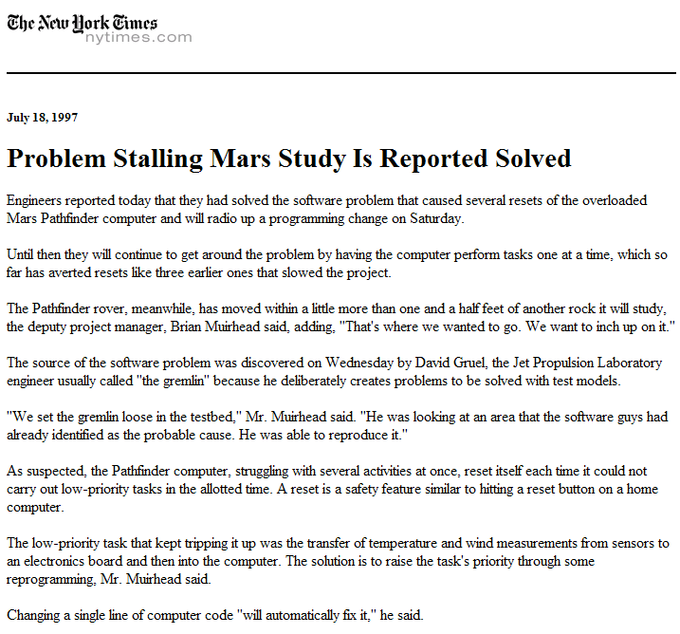
As suspected, the Pathfinder computer, struggling with several activities at once, reset itself each time it could not carry out low-priority tasks in the allotted time. A reset is a safety feature similar to hitting a reset button on a home computer.
The low-priority task that kept tripping it up was the transfer of temperature and wind measurements from sensors to an electronics board and then into the computer. The solution is to raise the task's priority through some reprogramming, Mr. Muirhead said.

Slide 24
Charge
Computers are single-threaded (or 2/4/8+-threaded) machines that provide their owner the illusion of infinite threads.
Brains are massively multi-threaded machines that provide their owner with the illusion of a single thread.
Thread work = new Thread (project);
work.setPriority (Thread.MAX_PRIORITY);
work.start ();

