Slide 1
Class 19: Java Security
cs2220: Engineering Software
Fall 2010
UVa
David Evans
Image: Elisabeth Sparkman

Slide 2
Plan for Today
Java Security
Java Byte Codes (JVML) and Verification
Reminder:
Project Team Requests are due before midnight tomorrow
Project Idea Proposals are due in class Tuesday

Slide 3
Buzzword Description
from Class 2...
“A simple, object-oriented, distributed, interpreted, robust, secure, architecture neutral, portable, high-performance, multithreaded, and dynamic language.” [Sun95]
As the course proceeds, we will discuss how well it satisfies these “buzzwords”. You should especially be able to answer how well it satisfies each of the blue ones in your final interview.

Slide 4
What is a secure programming language?
Language is designed so it cannot express certain computations considered insecure.
Language is designed so that (accidental) program bugs are likely to be caught by the compiler or run-time environment instead of leading to security vulnerabilities.
A few attempt to do this: PLAN, packet filters

Slide 5
Safe Programming Languages
Type Safety
Compiler and run-time environment ensure that bits are treated as the type they represent
Memory Safety
Compiler and run-time environment ensure that program cannot access memory outside defined storage
Control Flow Safety
Can’t jump to arbitrary addresses
Sometimes people use
“type safety” to mean all of these.
Is Java the first language to have them?
No way! LISP had them all before 1960.

Slide 6
What happens if you don’t have type/memory safety?
Image: Elisabeth Sparkman

Slide 7
Lack of Safety in C++
> g++ -o bounds bounds.cc
> bounds
> bounds
cs205
s is: cs205
x is: 9
> bounds
cs2220
s is: cs2220
x is: 9
> bounds
cs2222222220
s is: cs2222222220
x is: 0
> bounds
aaaaaaaaaaaaaaaaaaaaaaaaaaaaaaaaa
s is: aaaaaaaaaaaaaaaaaaaaaaaaaaaaaaaaa
x is: 1633771873
Segmentation fault (core dumped)
# include <iostream>
using namespace std;
int main (void) {
int x = 9;
char s[4];
cin >> s;
cout << "s is: " << s << endl;
cout << "x is: " << x << endl;
}
User input

Slide 8
# include <iostream>
using namespace std;
int main (void) {
int x = 9;
char s[4];
cin >> s;
cout << "s is: " << s << endl;
cout << "x is: " << x << endl;
}
s
‘a’
‘a’
‘a’
‘a’
x
‘a’
> bounds
aaaaaaaaaaaaaaaaaaaaaaaaaaaaaaaaa
s is: aaaaaaaaaaaaaaaaaaaaaaaaaaaaaaaaa
x is: 1633771873
Segmentation fault (core dumped)
9
‘a’
‘a’
9
When main returns, execution jumps to
the return address stored on the stack.
But, the input overwrote that return address!
‘a’
return
address
‘a’

Slide 9
When things go really bad…
If person entering input is clever and mean, they can put what they want in the return address, and their own code after that to jump to!
Buffer Overflow Attack
“Stack Smashing”

Slide 10
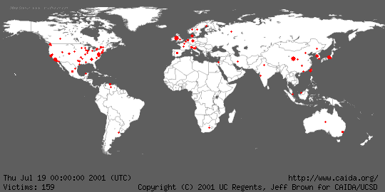
Code Red

Slide 11
Buffer Overflows
Code Red: exploited buffer overflow in Microsoft’s IIS (web server)
Attacker sends excessively long request to web server, overflows buffer and puts virus code on stack
Until about 5 years ago: cause of most security problems
Now: still a serious problem

Slide 12
Is the Java Programming Language safe?
Type Safety
Compiler and run-time environment ensure that bits are treated as the type they represent
Memory Safety
Compiler and run-time environment ensure that program cannot access memory outside defined storage
Control Flow Safety
Can’t jump to arbitrary addresses

Slide 13
Is the Java Programming Language safe?
Java Programming Language
Type Safety
Compiler and run-time environment ensure that bits are treated as the type they represent
Memory Safety
Compiler and run-time environment ensure that program cannot access memory outside defined storage
Control Flow Safety
Can’t jump to arbitrary addresses
Most types checked statically
Coercions, array assignments type checked at run time
No direct memory access (e.g., pointers)
Primitive array type with mandatory run-time bounds checking
Structured control flow, no arbitrary jumps

Slide 14
Malicious Code
Can a safe programming language protect you from malicious code?
Code your servers in it to protect from buffer overflow bugs
Only allow programs from untrustworthy origins to run if the are programmed in the safe language

Slide 15
Safe Languages?
But how can you tell program was written in the safe language?
Get the source code and compile it (most vendors, and all malicious attackers refuse to provide source code)
Special compilation service cryptographically signs object files generated from the safe language (SPIN, [Bershad96])
Verify object files preserve safety properties of source language (Java)

Slide 16
JVML
malcode.java
Java
Source
Code
javac
Compiler
malcode.class
JVML
Object
Code
JavaVM
Alice User
Alice wants to know JVML code satisfies Java PL’s safety properties.

Slide 17
Does JVML satisfy Java PL’s safety properties?

Slide 18
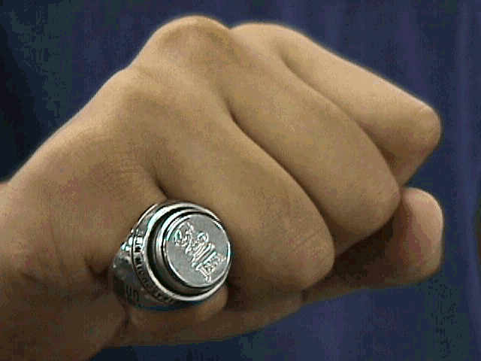
Java Virtual Machine
Small and simple to implement
All VMs will run all programs the same way
Secure

Slide 19
Implementing the JavaVM
load class into memory
set the instruction pointer to point to the beginning of main
while (there is more to do) {
fetch the next instruction
execute that instruction
}
Some other issues we will talk about later... (e.g., Garbage collection – need to reclaim unused storage)

Slide 20
Java Byte Codes
Stack-based virtual machine
Small instruction set: 202 instructions (all are 1 byte opcode + operands)
Intel x86: ~280 instructions (1 to 17 bytes long!)
Memory is typed (but imprecisely)
Every Java class file begins with magic number 3405691582
= 0xCAFEBABE in base 16

Slide 21
Stack-Based Computation
push – put something on the top of the stack
pop – get and remove the top of the stack
Stack
push 2
2
5
push 3
3
add
Does 2 pops, pushes sum

Slide 22
Some Java Instructions
Opcode | Mnemonic | Description
0 | nop | Does nothing
1 | aconst_null | Push null on the stack
3 | iconst_0 | Push int 0 on the stack
4 | iconst_1 | Push int 1 on the stack
…

Slide 23
Some Java Instructions
Opcode | Mnemonic | Description
18 | ldc <value> | Push a one-word (4 bytes) constant onto the stack
Constant may be an int, float or String
ldc “Hello”
ldc 2220
The String is really a reference to an entry in the string constant table! The strange String semantics should make more sense now.

Slide 24
Arithmetic
Opcode | Mnemonic | Description
96 | iadd | Pops two integers from the stack and pushes their sum
iconst_2
iconst_3
iadd

Slide 25
Arithmetic
Opcode | Mnemonic | Description
96 | iadd | Pops two integers from the stack and pushes their sum
97 | ladd | Pops two long integers from the stack and pushes their sum
…
106 | fmul | Pops two floats from the stack and pushes their product
…
119 | dneg | Pops a double from the stack, and pushes its negation

Slide 26
Java Byte Code Instructions
0: nop
1-20: putting constants on the stack
96-119: arithmetic on ints, longs, floats, doubles
What other kinds of instructions do we need?

Slide 27
Other Instruction Classes
Control Flow (~20 instructions)
if, goto, return
Method Calls (4 instructions)
Loading and Storing Variables (65 instructions)
Creating objects (1 instruction)
Using object fields (4 instructions)
Arrays (3 instructions)

Slide 28
public class Sample1 {
static public void main (String args[]) {
System.err.println ("Hello!");
System.exit (1); } }
> javap -c Sample1
Compiled from Sample1.java
public class Sample1 extends java.lang.Object {
public Sample1();
public static void main(java.lang.String[]);
}
Method Sample1()
0 aload_0
1 invokespecial #1 <Method java.lang.Object()>
4 return
Method void main(java.lang.String[])
0 getstatic #2 <Field java.io.PrintStream err>
3 ldc #3 <String "Hello!">
5 invokevirtual #4 <Method void println(java.lang.String)>
8 iconst_1
9 invokestatic #5 <Method void exit(int)>
12 return

Slide 29
Does JVML satisfy Java^{PL}’s safety properties?
iconst_2 push integer constant 2 on stack
istore_0 store top of stack in variable 0 as int
aload_0 load object reference from variable 0
No! This code violates Java’s type rules.

Slide 30
JVML
malcode.java
Java
Source
Code
javac
Compiler
malcode.class
JVML
Object
Code
JavaVM
Bytecode
Verifier
if OK
Alice User
Alice wants to know JVML code satisfies Java PL’s safety properties.

Slide 31
Charge
Next: what the verifier does, security policies in Java
Remember to send your team requests by Friday, and be ready to present your project ideas next class.

