Slide 1
cs2220: Engineering Software Class 2: Introduction Java
Fall 2010
University of Virginia
David Evans

Slide 2
Course Announcements
Assistant Teacher: Robbie Hott
Help for PS1: Friday, 2:30-3:30pm (Thornton Stacks)
Office Hours
Extended Thursday to be 11am-12:30pm
Extended Monday to be 1:30-3:30pm
Added Wednesday, noon-1pm
My door is (almost) always open – feel free to stop by outside of office hours

Slide 3
Survey Responses
See the web post for my answers to your questions.
Java Experience

Slide 4
Survey Responses
We will not have assignments involving Twitter or Instant Messaging!
but…if you don’t like the assigned project, you can always propose your own.

Slide 5
Late Policy

Slide 6
Why Java?

Slide 7
Why learn a new language?

Slide 8
Money?
According to http://www.simplyhired.com

Slide 9
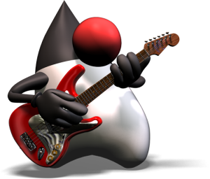
New Ways of Thinking

Slide 10
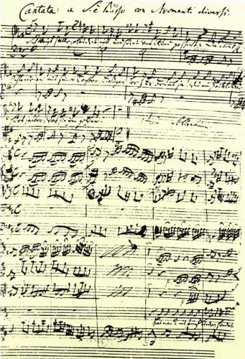
“Jamais Jamais Jamais” from Harmonice Musices Odhecaton A. (1501)
J S Bach, “Coffee Cantata”, BWV 211 (1732)
www.npj.com/homepage/teritowe/jsbhand.html

Slide 11
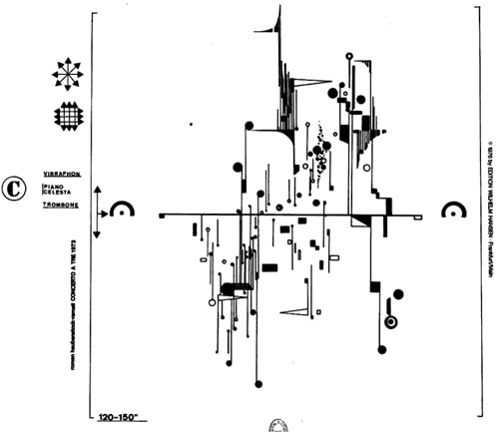
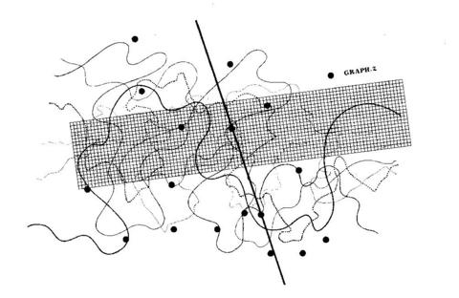
Modern Music Notation
Roman Haubenstock-Ramati, Concerto a Tre
John Cage, Fontana Mix
http://www.medienkunstnetz.de/works/fontana-mix/audio/1/

Slide 12
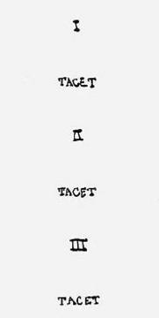
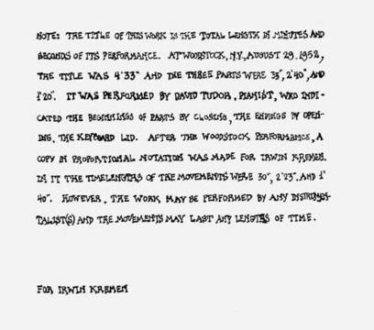

Slide 13
Thought and Action
Languages change the way we think
BASIC: think about GOTO
Scheme: think about procedures
Algol, Pascal: think about assignments, control blocks
Java: think about types, objects
Languages provide abstractions of machine resources
Hide dangerous/confusing details: memory locations, instruction opcodes, number representations, calling conventions, etc.
Hiding more increases simplicity, but limits expressiveness

Slide 14
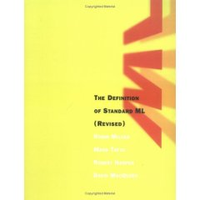
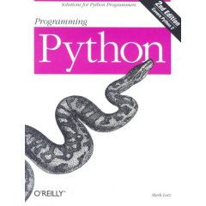
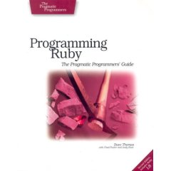
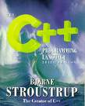
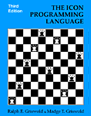
Why so many programming languages?

Slide 15
Fundamental Differences
All equivalently powerful!
Universal languages: all capable of simulating each other
Fundamental differences
Expressiveness: how easy it is to describe a computation
“Truthiness”: likelihood that a program means what a programmer things it means
Safeness: impact of programmer mistakes
There is a fundamental conflict between expressiveness and truthiness/safeness

Slide 16
Programming Language Design Space
high
Scheme
(display “Hello!”)
Python
print ("Hello!")
Expressiveness
BASIC
C++
strict typing,
static
C
Java
Ada
low
Spec#
more mistake prone
less mistake prone
“Truthiness”

Slide 18
Shortest HelloWorld in Java
public class HelloWorld {
public static void main(String[] args) {
System.out.println ("Hello!");
}
}
class header
method header
class
object
Actual computation
Structural punctuation

Slide 19
Pragmatic Differences
Performance of available compilers, interpreters
Tools available
Libraries
Portability
Availability/cost of programmers

Slide 20
What is Java?
Island in Indonesia known for coffee and volcanoes
A Programming Language (Java™)
A Portable Low-Level Language (JVML)
A Platform (JavaVM)
A (semi-)successful marketing strategy
JavaScript is not related to Java or Java™
All of the above

Slide 21
Programming Languages Phylogeny
Fortran (1954), IBM (Backus)
LISP (1957)
Algol (1958)
BASIC (1963)
CPL (1963), U Cambridge
Combined Programming Language
Scheme (1975)
Simula (1967)
BCPL (1967), MIT
Basic Combined Programming Language
ABC (~1980)
B (1969), Bell Labs
Smalltalk (1971), PARC
C (1970), Bell Labs
C++ (1983), Bell Labs
Objective-C (1986)
Python (1990),
Guido van Rossum
Java (1995),
James Gossling, Sun (Oracle)

Slide 22
Java History
1991: “Stealth Project” formed at Sun
Computing for consumer electronics market
James Gosling tasked with selecting a programming language for project
Started with C++, but found inadequate
In later classes, we’ll talk about why
Developed extensions and subtractions that led to new language “Oak”
1993: Web arrives
1995: Sun releases HotJava browser and Java PL, Netscape incorporated into browser

Slide 23
Buzzword Description
“A simple, object-oriented, distributed, interpreted, robust, secure, architecture neutral, portable, high-performance, multithreaded, and dynamic language.” [Sun95]
As the course proceeds, we will discuss how well it satisfies these “buzzwords”. You should especially be able to answer how well it satisfies each of the blue ones in your final interview.

Slide 24
Non-Buzzword Description
Java sacrifices expressiveness for “truthiness”: A Java program is ~5x larger than the corresponding Scheme or Python program
Java sacrifices performance for safety, “truthiness”, and portability: A Java program is ~3x slower than a comparable C++ program (but 10x faster than the comparable Python program)
C++
Java
Python
Computer Language Benchmarks Game
Caveat: these numbers are “guesses” and gross simplifications. Real numbers depend on the program (and programmer!).

Slide 25
Java Programming Language
Syntax
Similar to C++
Designed to be easy for C++ programmers to learn
Semantics (what programs mean)
Similar to Scheme
Designed to make it easier to reason about properties of programs

Slide 26
Programming Systems
C++ Program
Scheme Program
C++ Compiler
Scheme Interpreter
Object Files
Machine
Interpreted
Compiled

Slide 27
Java VM
Why use a virtual machine?
Java Program
Portability
If you can implement a Java VM on your machine, then you can run all Java programs
Security
A VM can limit what programs can do to the real machine
Simplicity
VM instructions can be simpler than machine instructions
Java Compiler
Class Files
Java Virtual Machine

Slide 28
Summary
Languages change the way we think
Programming languages must trade-off expressiveness and “truthiness”
cs2220 uses a language designed primarily for truthiness because that makes it easier to build dependable, complex, maintainable programs
Beginning of class Tuesday: Problem Set 1 Due

