Slide 1
Class 20: Verifying Bytecodes
cs2220: Engineering Software
Fall 2010
UVa
David Evans
Image: Joseph Featherston

Slide 2
Plan for Today
Project Ideas
Low-level security: “Type Safety”
Trusted Computing Base (Voting)
High-level security: Policy
Project Teams
James Blanton, Sam Herder, Michael Kalish
Jeremy Brown, Klaus Dollhopf, Joseph Featherston, Charles Hern, John Marion
Joseph Borja, Erik Lopez, Brian Noh, Jonathan DiLorenzo
Jiamin Chen, Elisabeth Sparkman, Yixin Sun
Michael Dewey-Vogt
Hanna Oh
Alex Wallace

Slide 3
Recap: Java Platform
malcode.java
Java
Source
Code
javac
Compiler
malcode.class
JVML
Object
Code
JavaVM
Bytecode
Verifier
if OK
Alice User

Slide 4
JVML Instruction Set
pushing constants | 20 | getstatic, putstatic | 2
loads, stores | 66 | newarray, anewarray, multianewarray,arraylength | 4
pop, dup, swap, etc. | 9 | invoke methods, throw | 5
arithmetic | 37 | new | 1
conversion (e.g., i2l) | 15 | getfield, putfield | 2
comparisons (lcmp) | 5 | checkcast | 1
goto, jsr, goto_w, jsr_w, ret | 5 | instanceof | 1
tableswitch, lookupswitch | 2 | monitorenter, monitorexit | 2
returns (e.g., ireturn) | 6 | wide | 1
conditional jumps (ifeq, ifnull, ifnonnull) | 16 | nop, breakpoint, unused, implementation dependent | 5
(205 out of 256 possible opcodes used)

Slide 5
Why so many loads and stores?
Instructions are typed
aload <index> load Object from variable index
iload <index> load int from variable index
fload <index> load float from variable index
dload <index> load double from variable index
Minimizing class file size
aload_0, aload_1, aload_2, aload_3
same for other types and stores
Array loads and stores
Even more types (char, boolean, short)

Slide 6
Bytecode Verifier
Checks class file is formatted correctly
Checks JVML code satisfies safety properties
Simulates program execution to know types are correct, but doesn’t need to examine any instruction more than once
This is what we win by having static typing!

Slide 7
Running Mistyped Code
> java Simple
Exception in thread "main" java.lang.VerifyError:
(class: Simple, method: main signature:
([Ljava/lang/String;)V)
Register 0 contains wrong type

Slide 8
Verifying Safety Properties
Type safe
Stack and variable slots must store and load as same type
Memory safe
Must not attempt to pop more values from stack than are on it
Doesn’t access private fields and methods outside class implementation
Control flow safe
Jumps must be to valid addresses within function, or call/return

Slide 9
Wait a sec…
from Class 6:

Slide 10
Making Verification Easier
Class files include lots of extra information to make verification easier
> javac Simple.java
> javap -verbose -c Simple
public class Simple extends java.lang.Object {
public Simple();
/* Stack=1, Locals=1, Args_size=1 */
public static int add(int, int);
/* Stack=2, Locals=2, Args_size=2 */
}
Method Simple()
0 aload_0
1 invokespecial #1 <Method java.lang.Object()>
4 return
Method int add(int, int)
0 iload_0
1 iload_1
2 iadd
3 ireturn
public class Simple {
static public int add (int a, int b) {
return a + b;
}
}
Even with this help there are many “correct” JVML programs that would not pass the verifier! (but every program produced by Java compiler should pass)

Slide 11
Trusted Computing Base
malcode.java
Java
Source
Code
javac
Compiler
malcode.class
JVML
Object
Code
JavaVM
Bytecode
Verifier
if OK
Alice User

Slide 12
Project Ideas
Project Teams
James Blanton, Sam Herder, Michael Kalish
Jeremy Brown, Klaus Dollhopf, Joseph Featherston,
Charles Hern, John Marion
Joseph Borja, Erik Lopez, Brian Noh, Jonathan DiLorenzo
Jiamin Chen, Elisabeth Sparkman, Yixin Sun
Michael Dewey-Vogt
Hanna Oh
Alex Wallace

Slide 13
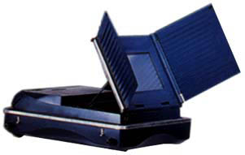
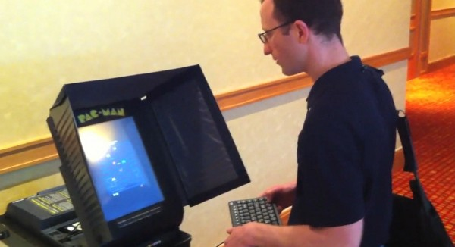
Voting

Slide 14
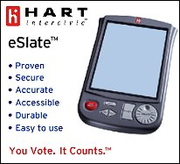
What is the Trusted Computing Base for an election?
“We do have people complain and say they don’t get it, I completely understand what they’re saying, but it’s not something I can control.”
Sheri Iachetta,
Charlottesville general registrar (on 2006 problems with voting machines displaying “James H. ‘Jim’”)

Slide 15
How do I know my voting equipment is accurate?
Under the Code of Virginia, the State Board of Elections must approve any mechanical or electronic voting system or equipment before it can be used by any locality.
Each system must successfully complete three distinct levels of testing:
Qualification testing (testing of hardware and software that may be conducted by Independent Testing Authority);
Certification testing (to ensure it meets all applicable requirements of the Code of Virginia); and,
Acceptance testing (conducted by the locality to assure it meets their needs and is identical to the certified system).
www.sbe.virginia.gov/cms/Election_Information/Election_Procedures/Index.html

Slide 16
“Independent” Testing
Done by ITAs paid by vendors
No vulnerability analysis
No source code analysis
“Program testing can be used to show the presence of bugs, but never to show their absence!”
Edsger W. Dijkstra

Slide 17
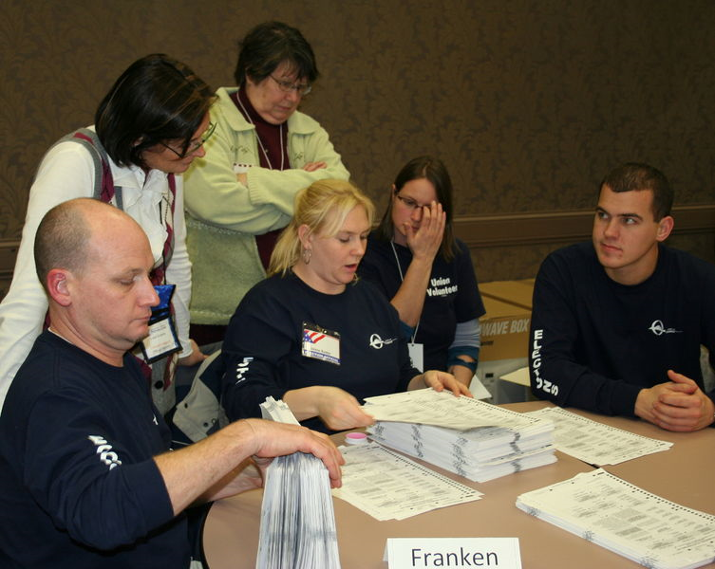
How could we design elections with smaller Trusted Computing Base?
Optical Scan ballots
Can be recounted by humans

Slide 18
Project Ideas
Project Teams
James Blanton, Sam Herder, Michael Kalish
Jeremy Brown, Klaus Dollhopf, Joseph Featherston,
Charles Hern, John Marion
Joseph Borja, Erik Lopez, Brian Noh, Jonathan DiLorenzo
Jiamin Chen, Elisabeth Sparkman, Yixin Sun
Michael Dewey-Vogt
Hanna Oh
Alex Wallace

Slide 19
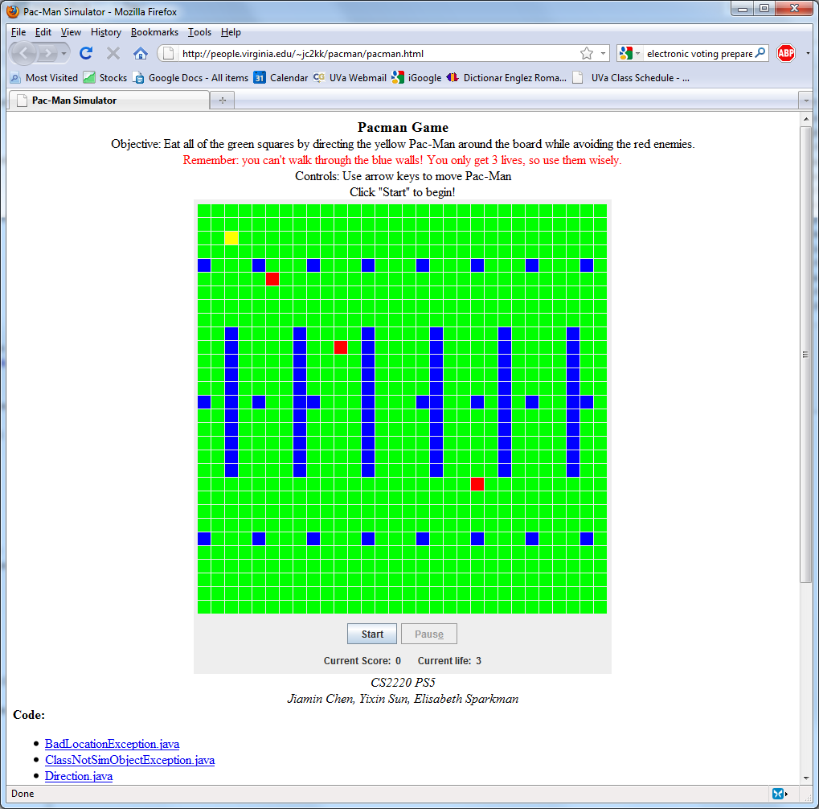
Java Applet Security

Slide 20
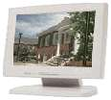
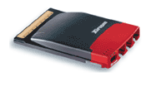
Program Execution
Monitor
Program
Speakers
Network
Disk
Memory
SuperSoaker 2000

Slide 21
Program Execution
Reference Monitor
Monitor
Program
Speakers
Network
Disk
Memory
SuperSoaker 2000

Slide 22
Ideal Reference Monitor
Sees everything a program is about to do before it does it
Can instantly and completely stop program execution (or prevent action)
Has no other effect on the program or system
Can we build this?
Probably not unless we can build a time machine...

Slide 23
Ideal Reference Monitor
Sees everything a program is about to do before it does it
Can instantly and completely stop program execution (or prevent action)
Has no other effect on the program or system

Slide 24
Operating Systems
Provide reference monitors for most security-critical resources
When a program opens a file in Unix or Windows, the OS checks that the principal running the program can open that file
Doesn’t allow different policies for different programs
No flexibility over what is monitored
OS decides for everyone
Hence, can’t monitor inexpensive operations

Slide 25
Java Security Manager
(Non-Ideal) Reference monitor
Limits how Java executions can manipulate system resources
User/host application creates a subclass of SecurityManager to define a policy

Slide 26
JavaVM Policy Enforcment
[JDK 1.0 – JDK 1.1]
From java.io.File:
public boolean delete() {
SecurityManager security =
System.getSecurityManager();
if (security != null) {
security.checkDelete(path);
}
if (isDirectory()) return rmdir0();
else return delete0();
}
checkDelete throws a SecurityExecption if the delete would violate the policy (re-thrown by delete)
What could go seriously wrong with this?!

Slide 27
HotJava’s Policy (JDK 1.1.7)
public class AppletSecurity
extends SecurityManager {
...
public synchronized void checkDelete(String file)
throws Security Exception {
checkWrite(file);
}
}

Slide 28
AppletSecurity.checkWrite (some exception handling code removed)
public synchronized void checkWrite(String file) {
if (inApplet()) {
if (!initACL) initializeACLs();
String realPath = (new File(file)).getCanonicalPath();
for (int i = writeACL.length ; i-- > 0 ;) {
if (realPath.startsWith(writeACL[i])) return;
}
throw new AppletSecurityException
("checkwrite", file, realPath);
}
}
Note: no checking if not inApplet!
Very important this does the right thing.

Slide 29
inApplet
boolean inApplet() {
return inClassLoader();
}
Inherited from java.lang.SecurityManager:
protected boolean inClassLoader() {
return currentClassLoader() != null;
}

Slide 30
currentClassLoader
/**
Returns an object describing the most recent class loader executing on the stack.
Returns the class loader of the most recent occurrence on the stack of a method from a class defined using a class loader; returns null if there is no occurrence on the stack of a method from a class defined using a class loader.
*/
protected native ClassLoader currentClassLoader();

Slide 31
Recap
java.io.File.delete calls SecurityManager.checkDelete before deleting
HotJava overrides SecurityManager with AppletSecurity to set policy
AppletSecurity.checkDelete calls AppletSecurity.checkWrite
AppletSecurity.checkWrite checks if any method on stack has a ClassLoader
If not, no checks; if it does, checks ACL list

Slide 32
JDK 1.0 Trust Model
When JavaVM loads a class from the CLASSPATH, it has no associated ClassLoader (can do anything)
When JavaVM loads a class from elsewhere (e.g., the web), it has an associated ClassLoader

Slide 33
JDK Evolution
JDK 1.1: Signed classes from elsewhere and have no associated ClassLoader
JDK 1.2:
Different classes can have different policies based on ClassLoader
Explict enable/disable/check privileges
SecurityManager is now AccessController

Slide 34
Policy and Mechanism
AccessController provides a mechanisms for enforcing a security policy
Can insert checking code before certain operations are allowed
A security policy determines what the checking code allows

Slide 35
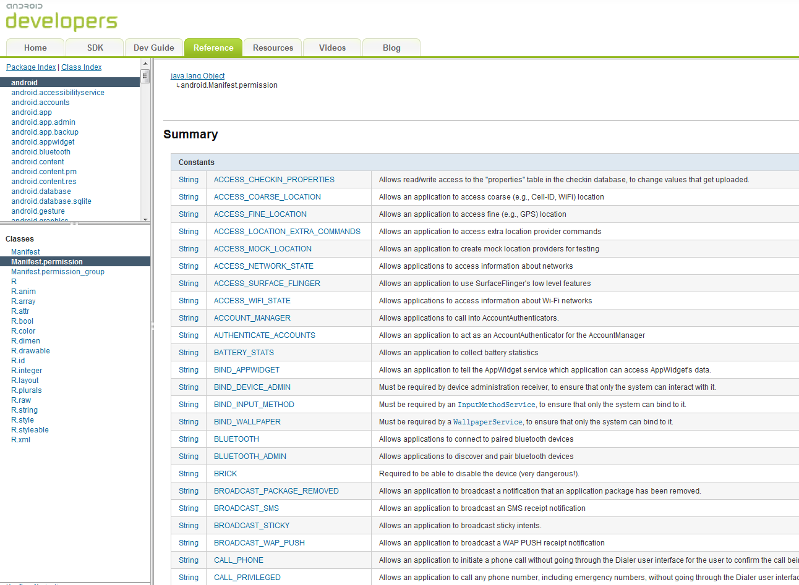
Android Permissions

Slide 36
Charge
Only ask for the Brick permission if you really need it!
Only grant the Brick permission to code that you really trust!
“It’s better to beg forgiveness than ask permission.”
Grace Hopper
(Applies to most things, but not Java applets.)

