Slide 1

Class 21:
Hair-Dryer Attacks
cs2220: Engineering Software
Fall 2010
UVa
David Evans
Image from www.clean-funny.com, GoldenBlue LLC.

Slide 2
Plan for Today
Recap: Java Platform Security
Trusted Computing Base: should we trust Java’s?
Hair-Dryer Attacks

Slide 3
Project Design Documents
Due: on paper, beginning of class Tuesday
A description of your project: what it will do and why it is useful, fun, or interesting.
A high-level description of your design, including a module dependency diagram showing the most important modules.
A description of your implementation and testing strategy including:
  how you will divide the work amongst your team
  how you will order the work to support incremental development
  how you will do unit testing and integration testing
  a list of milestones and a schedule for achieving them, leading to a completed project on December 7
A list of questions
Schedule Design Review meetings (link on course site)

Slide 4

Recap: Java Platform
malcode.java
Java
Source
Code
javac
Compiler
malcode.class
JVML
Object
Code
JavaVM
Bytecode
Verifier
if OK
Alice User

Slide 5
Running Mistyped Code
.method public static main([Ljava/lang/String;)V
…
iconst_2
istore_0
aload_0
iconst_2
iconst_3
iadd
…
return
.end method
> java Simple
Exception in thread "main" java.lang.VerifyError:
(class: Simple, method: main signature:
([Ljava/lang/String;)V)
Register 0 contains wrong type
> java –noverify Simple
result: 5

Slide 6
Running Mistyped Code
.method public static main([Ljava/lang/String;)V
…
ldc 2220
istore_0
aload_0
iconst_2
iconst_3
iadd
…
.end method
> java –noverify Simple
Unexpected Signal : EXCEPTION_ACCESS_VIOLATION
(0xc0000005) occurred at PC=0x809DCEB
Function=JVM_FindSignal+0x1105F
Library=C:\j2sdk1.4.2\jre\bin\client\jvm.dll
Current Java thread:
at Simple.main(Simple.java:7)
…
#
# HotSpot Virtual Machine Error : EXCEPTION_ACCESS_VIOLATION
# Error ID : 4F530E43505002EF
# Please report this error at
# http://java.sun.com/cgi-bin/bugreport.cgi
#
# Java VM: Java HotSpot(TM) Client VM (1.4.2-b28 mixed mode)

Slide 7
Recap: Trusted Computing Base
malcode.java
Java
Source
Code
javac
Compiler
malcode.class
JVML
Object
Code
Trusted Computing Base
JavaVM
Bytecode
Verifier
if OK
Alice User
Policy

Slide 8
Trusted Computing Base
The part of the system that must be trusted to behave correctly for the desired security properties to be guaranteed
Should we trust the Java platform TCB?

Slide 9
Building Trust
Simplicity
Extensive validation
Design Process
There are two ways of constructing a software design: One way is to make it so simple there are obviously no deficiencies and the other way is to make it so complicated that there are no obvious deficiencies. Tony Hoare
Boeing 787 Dreamliner delay conspiracy theories
“Rather, he thinks avionics software is hung up by the effects of the RTCA/DO-178b standard, which certifies avionics software and in his opinion causes unnecessary delays in the delivery of same. In yesterday’s call, Boeing executives … downplayed the avionics software lag, but conceded they welcome more time to test it.”

Slide 10
Verifier (should be) Conservative
JVML programs
Safe programs
Verifiable programs
(Slide from Nate Paul’s ACSAC talk)

Slide 11
Complexity Increases Risk
JVML programs
Safe programs
Verifiable programs
Bug
(Slide from Nate Paul’s ACSAC talk)
Notes:
7/8 titles confusing

Slide 12
The Worst JVML Instruction
jsr
Operation
Jump subroutine
Format
jsr
branchbyte1
branchbyte2
jsr [branchbyte1] [branchbyte2]
Operand Stack
... ⇒ ..., address
Description
The address of the opcode of the instruction immediately following this jsr instruction is pushed onto the operand stack as a value of type returnAddress. The unsigned branchbyte1 and branchbyte2 are used to construct a signed 16-bit offset, where the offset is (branchbyte1 << 8) | branchbyte2. Execution proceeds at that offset from the address of this jsr instruction. The target address must be that of an opcode of an instruction within the method that contains this jsr instruction.
Notes
Note that jsr pushes the address onto the operand stack and ret gets it out of a local variable. This asymmetry is intentional.
http://java.sun.com/docs/books/vmspec/2nd-edition/html/Instructions2.doc7.html

Slide 13
Try-Catch-Finally
public class JSR {
static public void main (String args[]) {
try {
System.out.println("hello");
} catch (Exception e) {
System.out.println ("There was an exception!");
} finally {
System.out.println ("I am finally here!");
}
}
}

Slide 14
Method void main(java.lang.String[])
0 getstatic #2 <Field java.io.PrintStream out>
3 ldc #3 <String "hello">
5 invokevirtual #4 <Method void println(java.lang.String)>
8 jsr 35
11 goto 46
14 astore_1
15 getstatic #2 <Field java.io.PrintStream out>
18 ldc #6 <String "There was an exception!">
20 invokevirtual #4 <Method void println(java.lang.String)>
23 jsr 35
26 goto 46
29 astore_2
30 jsr 35
33 aload_2
34 athrow
35 astore_3
36 getstatic #2 <Field java.io.PrintStream out>
39 ldc #7 <String "I am finally here!">
41 invokevirtual #4 <Method void println(java.lang.String)>
44 ret 3
46 return
public class JSR {
static public void main (String args[]) {
try {
System.out.println("hello");
} catch (Exception e) {
System.out.println (“... exception!");
} finally {
System.out.println ("I am finally");
}
}
}
Exception table:
from to target type
0 8 14 <Class java.lang.Exception>
0 11 29 any
14 26 29 any
29 33 29 any

Slide 15
Vulnerabilities in JavaVM
45
40
35
30
25
Vulnerabilities Reported
20
15
10
5
0
0
1
2
3
4
5
6
7
8
9
July 1996
Years Since First Release
July 2005
From Nathanael Paul and David Evans, Comparing Java and .NET security: Lessons Learned and Missed, Computers & Security, 2006. http://www.cs.virginia.edu/~evans/pubs/cs06/

Slide 16
Where are They?
Verification | 12
API bugs | 10
Class loading | 8
Other or unknown | 2
Missing policy checks | 3
Configuration | 4
DoS attacks (crash, consumption) | 5
several of these were because of jsr complexity

Slide 17
Low-level vs. Policy Security
Low-level Code Safety
  Type safety, memory safety, control flow safety
  Enforced by Java bytecode verifier and run-time checks in VM
  Needed to prevent malcode from circumventing any policy mechanism
Policy Security
  Control access and use of resources (files, network, display, etc.)
  Enforced by Java class
  Hard part is deciding on a good policy

Slide 18

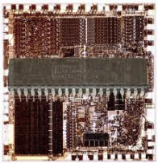
Is this really the whole TCB?
malcode.java
Java
Source
Code
javac
Compiler
malcode.class
JVML
Object
Code
Trusted Computing Base
JavaVM
Bytecode
Verifier
if OK
Alice User
Policy

Slide 19
Bytecode Verifier
Checks JVML code satisfies safety properties:
  Simulates program execution to know types are correct, but doesn’t need to examine any instruction more than once
  After code is verified, it is trusted: is not checked for type safety at run time (except for casts, array stores)
Key assumption: when a value is written to a memory location, the value in that memory location is the same value when it is read.

Slide 20

Violating the Assumption
…
// The object on top of the stack is a SimObject
astore_0
// There is a SimObject in location 0
aload_0
// The value on top of the stack is a SimObject
If a cosmic ray hits the right bit of memory, between the astore and aload, the assumption might be wrong.

Slide 21
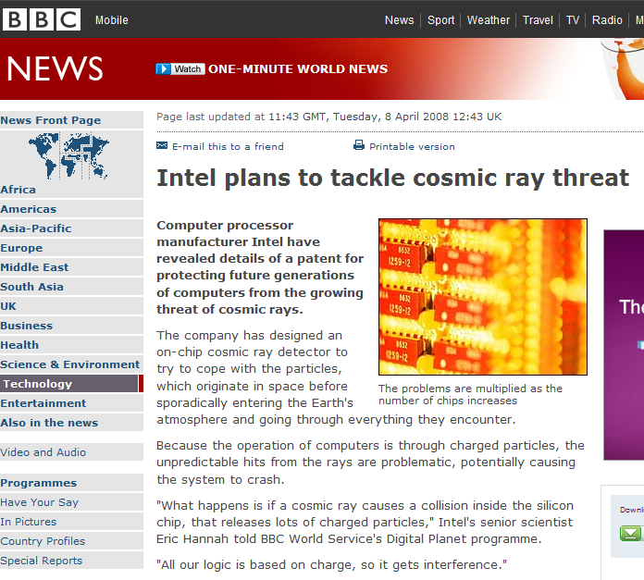
Can you really blame cosmic rays when your program crashes?
IBM estimate: one cosmic-ray bit error per 256 megabytes per month
For people running big datacenters, this is a real problem
If your processor is in an airplane or in space risk is much higher
But, can an attacker take advantage of this?

Slide 22
Improving the Odds
Set up memory so that a single bit error is likely to be exploitable
Mistreat the hardware memory to increase the odds that bits will flip
Following slides adapted (with permission) from Sudhakar Govindavajhala and Andrew W. Appel, Using Memory Errors to Attack a Virtual Machine, July 2003.

Slide 23
Making Bit Flips Useful
Fill up memory with Filler objects, and one Pointee object:
class Filler { class Pointee {
Pointee a1; Pointee a1;
Pointee a2; Pointee a2;
Pointee a3; Filler f;
Pointee a4; int b;
Pointee a5; Pointee a5;
Pointee a6; Pointee a6;
Pointee a7; Pointee a7;
} }

Slide 24
Filling Up Memory
a1
a2
a3
a4
Filler Object
a5
Pointee p = new Pointee ();
ArrayList<Filler> fillers = new ArrayList<Filler> ();
try {
while (true) {
Filler f = new Filler ();
f.a1 = p; f.a2 = p; f.a3 = p; …; f.a7 =p;
fillers.add (f);
}
} catch (OutOfMemoryException e) { ; }
a6
a7
a1
a2
f
b
Pointee Object
a5
a6
a7
a1
Filler Object
a2
a3
a4
a5
a6
a7

Slide 25
Wait for a bit flip…
a1
a2
a3
a4
Filler Object
Remember: there are lots of Filler objects (fill up all of memory)
When a bit flips, good chance (~70%) it will be in a field of a Filler object and it will now point to a Filler object instead of a Pointee object
a5
a6
a7
a1
a2
f
b
Pointee Object
a5
a6
a7
a1
Filler Object
a2
a3
a4
a5
a6
a7

Slide 26
Type Violation
a1
a2
a3
a4
Filler Object
a5
After the bit flip, the
value of f.a2 is a
Filler object, but
f.a2 was declared
as a Pointee object!
a6
a7
a1
a2
f
b
Pointee Object
a5
a6
Can an attacker exploit this?
a7
a1
Filler Object
a2
a3
a4
a5
a6
a7

Slide 27
Finding the Bit Flip
Pointee p = new Pointee ();
ArrayList<Filler> fillers = new ArrayList<Filler> ();
try {
while (true) {
Filler f = new Filler ();
f.a1 = p; f.a2 = p; f.a3 = p; …; f.a7 =p;
fillers.add (f);
}
} catch (OutOfMemoryException e) { ; }
while (true) {
for (Filler f : fillers) {
}

Slide 28
Finding the Bit Flip
Pointee p = new Pointee ();
ArrayList<Filler> fillers = new ArrayList<Filler> ();
try {
while (true) {
Filler f = new Filler ();
f.a1 = p; f.a2 = p; f.a3 = p; …; f.a7 =p;
fillers.add (f);
}
} catch (OutOfMemoryException e) { ; }
while (true) {
for (Filler f : fillers) {
if (f.a1 != p) { // bit flipped!
…
} else if (f.a2 != p) {
…
}
}

Slide 29
Violating Type Safety
class Filler { class Pointee {
Pointee a1; Pointee a1;
Pointee a2; Pointee a2;
Pointee a3; Filler f;
Pointee a4; int b;
Pointee a5; Pointee a5;
Pointee a6; Pointee a6;
Pointee a7; Pointee a7;
} }
Filler f = (Filler) e.nextElement ();
if (f.a1 != p) { // bit flipped!
Object r = f.a1; //
Filler fr = (Filler) r; // Cast is checked at run-time
Declared Type
f.a1 Pointee
f.a1.b int
fr == f.a1 Filler
fr.a4 == f.a1.b Pointee

Slide 30
Violating Type Safety
class Filler { class Pointee {
Pointee a1; Pointee a1;
Pointee a2; Pointee a2;
Pointee a3; Filler f;
Pointee a4; int b;
Pointee a5; Pointee a5;
Pointee a6; Pointee a6;
Pointee a7; Pointee a7;
} }
Filler f = (Filler) e.nextElement ();
if (f.a1 != p) { // bit flipped!
Object r = f.a1;
Filler fr = (Filler) r; // Cast is checked at run-time
f.a1.b = 1524383; // Address of the SecurityManager
fr.a4.a1 = null; // Set it to a null
// Do whatever you want! No security policy now…
new File (“C:\thesis.doc”).delete ();

Slide 31
Getting a Bit Flip
Wait for a Cosmic Ray
  You have to be really, really patient… (or move machine out of Earth’s atmosphere)
X-Rays
  Expensive, not enough power to generate bit-flip
High energy protons and neutrons
  Work great - but, you need a particle accelerator
Hmm….

Slide 32
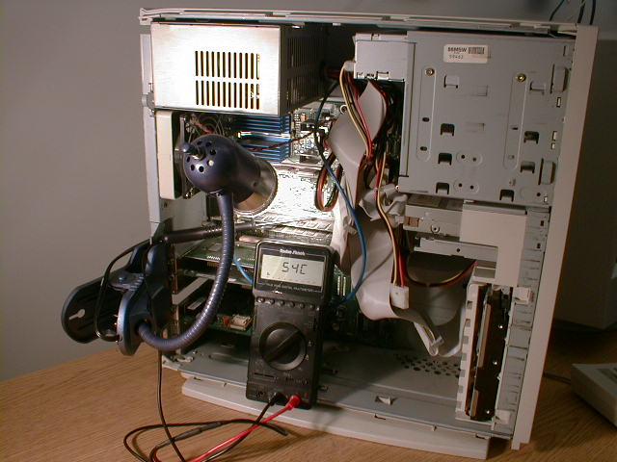
Using Heat
50-watt spotlight bulb
Between 80° -100°C, memory starts to have a few failures
Attack applet is successful (at least half the time)!
Hairdryer works too, but it fries too many bits at once
Picture from Sudhakar Govindavajhala

Slide 33
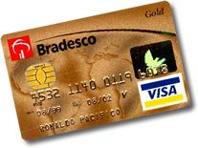

Should Anyone be Worried?
Java virtual machine

Slide 34
Recap
Verifier assumes the value you write is the same value when you read it
By flipping bits, we can violate this assumption
By violating this assumption, we can violate type safety: get two references to the same storage that have inconsistent types
By violating type safety, we can get around all other security measures
Project Design Descriptions due Tuesday
Sign up for design review meetings

