Slide 1
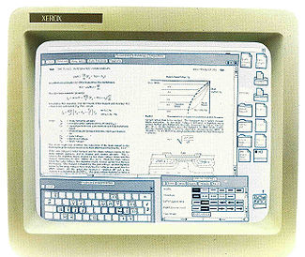
Class 22: Graphical User Interfaces
cs2220: Engineering Software
Fall 2010
UVa
David Evans
Xerox Star

Slide 2
Plan for Today
History of Interactive Computing
Building GUIs in Java
Design Reviews this week!

Slide 3
Univac 1956

Slide 4
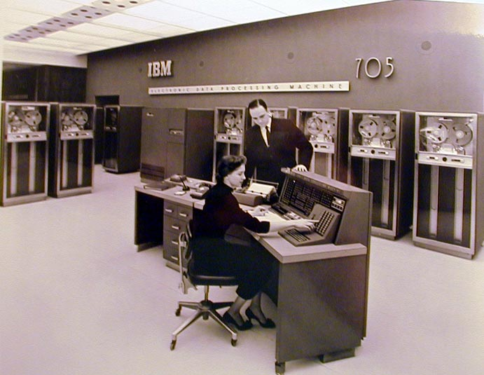
IBM 705 (1954)

Slide 5
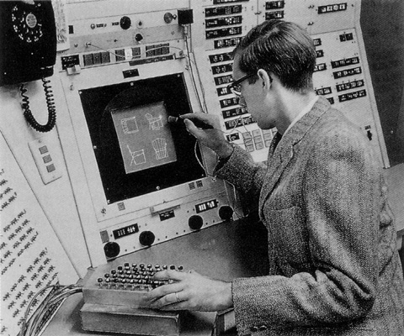
Sketchpad
Ivan Sutherland, 1963 (PhD thesis supervised by Claude Shannon)
Interactive drawing program, light pen
http://www.cl.cam.ac.uk/TechReports/UCAM-CL-TR-574.pdf

Slide 6
Computer as “Clerk”: Augmenting Human Intellect
In such a future working relationship between human problem-solver and computer 'clerk,’ the capability of the computer for executing mathematical processes would be used whenever it was needed. However, the computer has many other capabilities for manipulating and displaying information that can be of significant benefit to the human in nonmathematical processes of planning, organizing, studying, etc. Every person who does his thinking with symbolized concepts (whether in the form of the English language, pictographs, formal logic, or mathematics) should be able to benefit significantly.
Douglas Engelbart, Augmenting Human Intellect (1962)

Slide 7
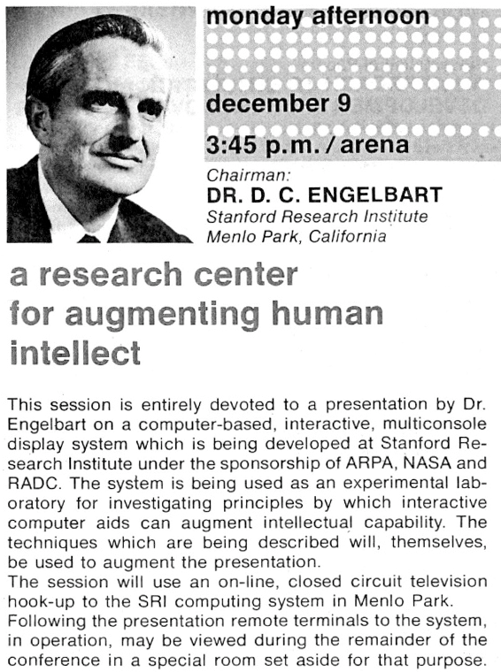
Engelbart’s Demo (1968)
First Mouse
Papers and folders
Videoconferencing
Email
Hypertext
Collaborative editing
http://www.sri.com/news/storykits/1968video.html

Slide 8
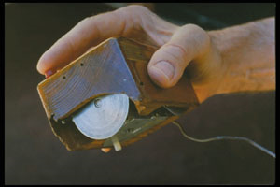
Doug Engelbart’s Mouse (1968)

Slide 9
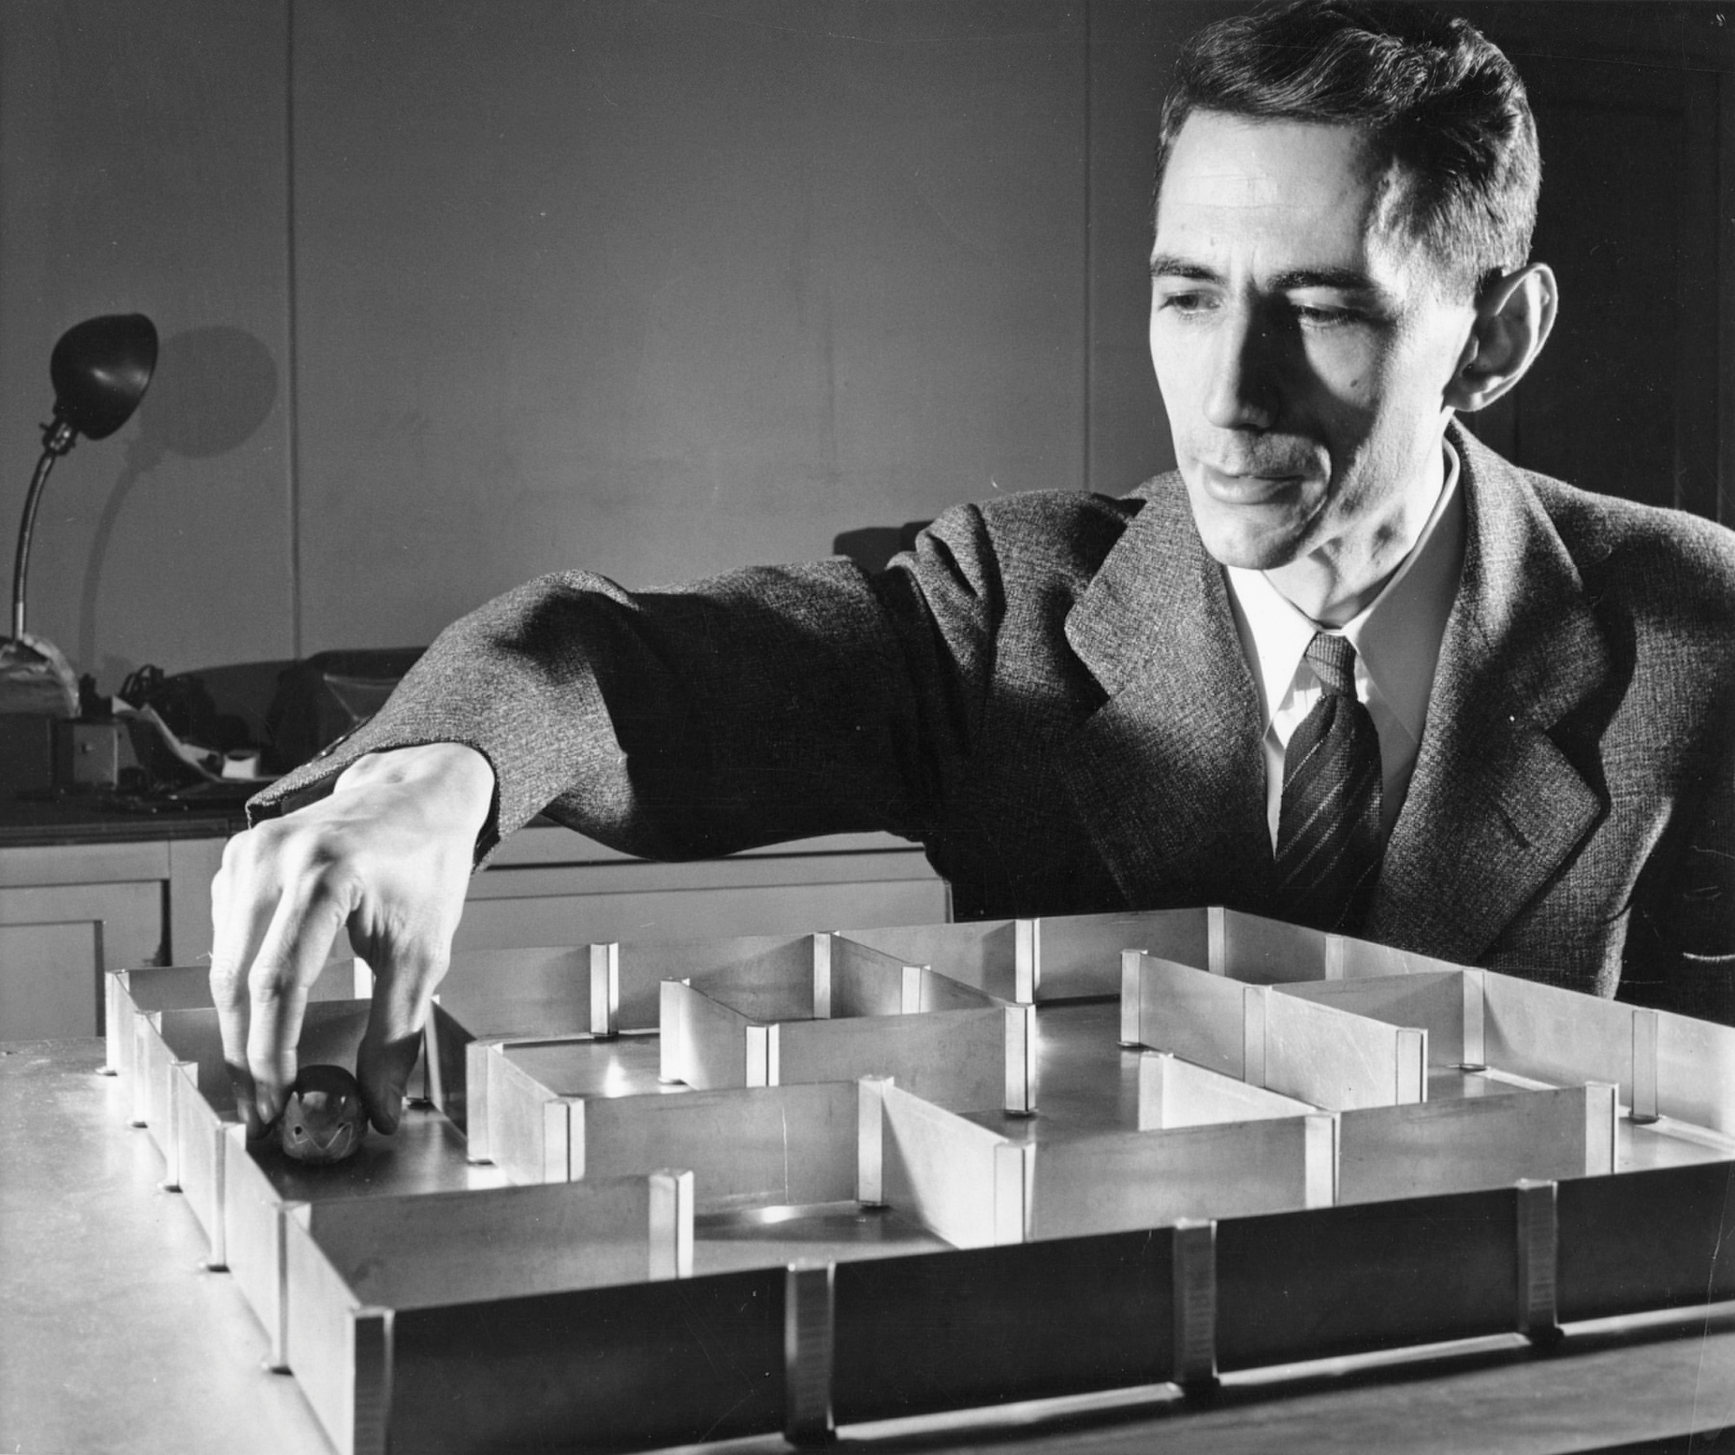
Claude Shannon, “Theseus” (1950)

Slide 10
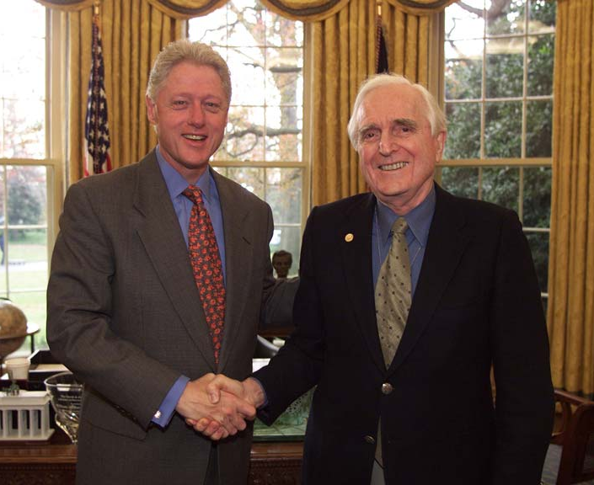
“We see the quickest gains emerging from (1) giving the human the minute-by-minute services of a digital computer equipped with computer-driven cathode-ray-tube display, and (2) developing the new methods of thinking and working that allow the human to capitalize upon the computer’s help. By this same strategy, we recommend that an initial research effort develop a prototype system of this sort aimed at increasing human effectiveness in the task of computer programming.”
Medal of Technology 2000
Douglas Engelbart, Augmenting Human Intellect (1962)

Slide 11
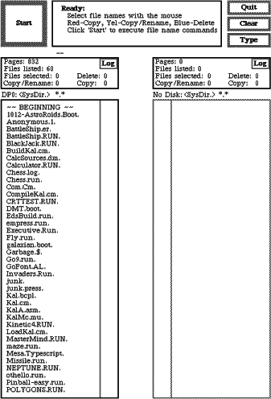
Xerox Alto
Xerox PARC, 1973

Slide 12
Apple Lisa
1983

Slide 13
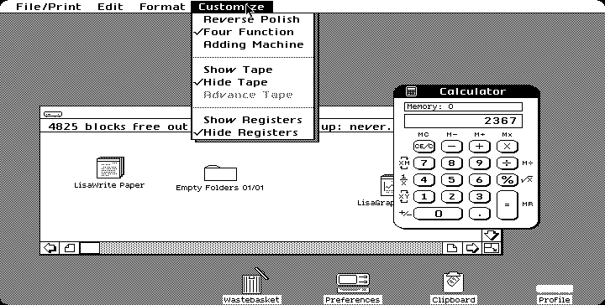
Lisa Interface
http://www.guidebookgallery.org/screenshots/lisaos10

Slide 14
Any real progress since then?
Mac OSX

Slide 15
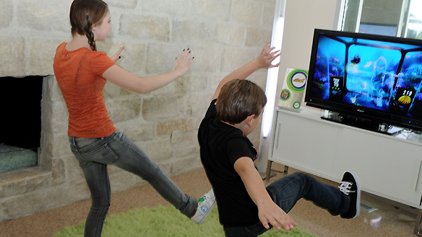
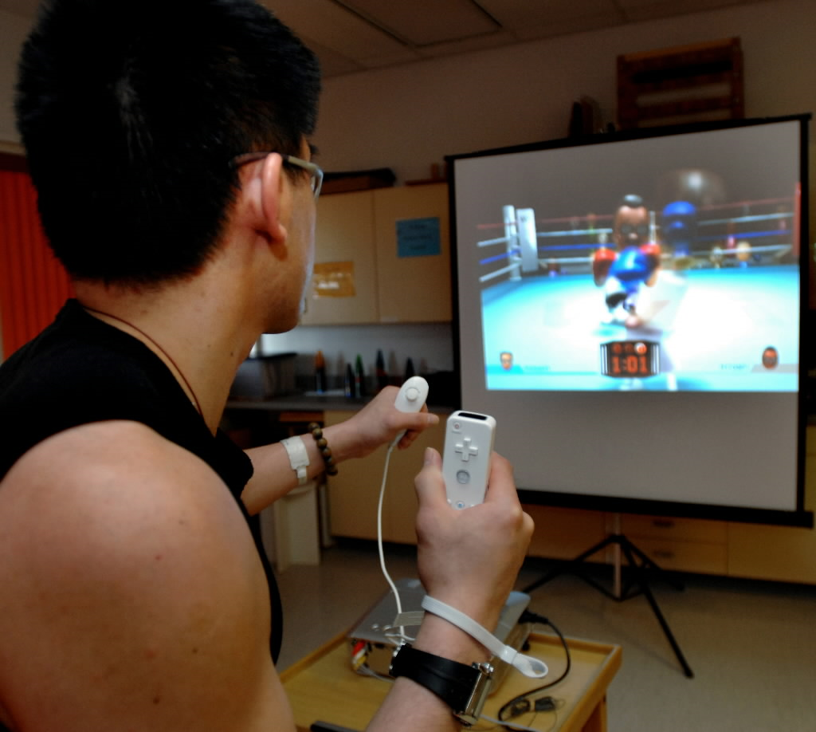
Microsoft Kinect
Nintendo Wii
Microsoft Surface

Slide 16
Designing GUIs
Requires lots of skill
Psychology, Cognitive Science
User studies
Good taste
Read Donald Norman’s and Ed Tufte’s books
Look at what SIS does and do the opposite!

Slide 17
Building GUIs
Like all Programming
Encapsulation, Abstraction, Specification
Testing: especially hard
Unique-ish Aspects
Event-Driven (network programming also like this)
Multi-Threaded (network, others)
Huge APIs

Slide 18
Model-View-Controller
Invented at PARC in 1970s (Smalltalk)
Model: domain data and logic
View: presents model
Controller: receives input and alters model
Goal: abstraction
separate display from model
separate control interface

Slide 19
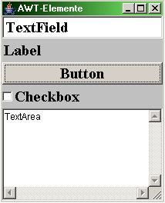
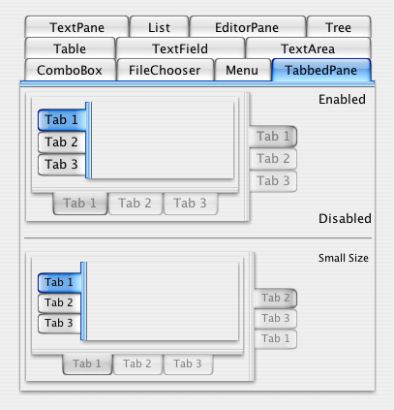
Java GUI Toolkits
AWT
Abstract Window Toolkit
Looks like Java
Swing
(since JDK 1.2)
real reason for Swing coming later...

Slide 20
Frames
java.lang.Object
Main windows are JFrame objects
java.awt.Component
java.awt.Container
java.awt.Window
JFrame frame = new JFrame("Swing GUI");
java.awt.Frame
Window Title
javax.swing.JFrame

Slide 21
JFrame Methods
// inherited from java.awt.Window
public void pack()
MODIFIES: this
EFFECTS: Causes this Window to be sized to fit the preferred size and layouts of its subcomponents.
// inherited from java.awt.Component
public void setVisible(boolean b)
MODIFIES: this, display
EFFECTS: If b, shows this. Otherwise, hides this.

Slide 22
Swing Application
import javax.swing.*;
public class Main {
private static void showGUI() {
//Create and set up the window.
JFrame frame = new JFrame("Swing GUI");
frame.pack();
frame.setVisible(true);
}
public static void main(String args[]) {
javax.swing.SwingUtilities.invokeLater(new Runnable() {
public void run() { showGUI(); }
});
}
}
Based on Sun’s Swing tutorials:
http://java.sun.com/docs/books/tutorial/uiswing/learn/example1.html
Notes:
22

Slide 23
Adding to a Frame
public java.awt.Container getContentPane()
EFFECTS: Returns the contentPane object for this.
in java.awt.Containter:
public Component add(Component c)
MODIFIES: this
EFFECTS: Appends c to the end of this container.

Slide 24
What can you add?
in java.awt.Container:
public Component add(Component c)
Component
Container
JComponent
Window
JLabel
AbstractButton
Frame
JPanel
JButton
JFrame
...and hundreds (?) more subtypes in API

Slide 25
GUIs and Subtyping
In the process of making the Sketchpad system operate, a few very general functions were developed which make no reference at all to the specific types of entities on which they operate. These general functions give the Sketchpad system the ability to operate on a wide range of problems. The motivation for making the functions as general as possible came from the desire to get as much result as possible from the programming effort involved. For example, the general function for expanding instances makes it possible for Sketchpad to handle any fixed geometry subpicture. The rewards that come from implementing general functions are so great that the author has become reluctant to write any programs for specific jobs.
Each of the general functions implemented in the Sketchpad system abstracts, in some sense, some common property of pictures independent of the specific subject matter of the pictures themselves.
Ivan Sutherland, Sketchpad: a Man-Machine Graphical Communication System, 1963 (major influence on Alan Kay inventing OOP in 1970s)

Slide 26
Components in Sketchpad

Slide 27
Adding Components
import javax.swing.*;
public class Main {
private static void showGUI() {
//Create and set up the window.
JFrame frame = new JFrame("Swing GUI");
java.awt.Container content = frame.getContentPane();
content.add(new JLabel ("Yo!"));
content.add(new JButton ("Click Me"));
frame.pack();
frame.setVisible(true);
}
public static void main(String args[]) {
...
}
}
What happened to “Yo!”?

Slide 28
Layout
// in Container:
public void setLayout(LayoutManager mgr)
MODIFIES: this
EFFECTS: sets the layout manager to mgr
for this container.

Slide 29
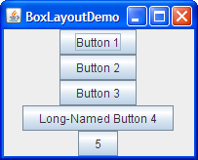
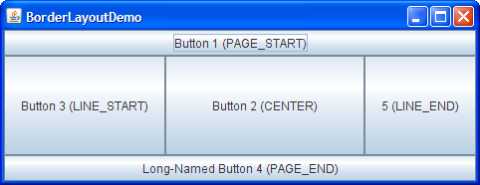
LayoutManager Implementations
LayoutManager
(interface)
FlowLayout
BoxLayout
BorderLayout
...about 30 more in API!
http://java.sun.com/docs/books/tutorial/uiswing/layout/visual.html

Slide 30
Adding Components
import javax.swing.*;
import java.awt.FlowLayout;
public class Main {
private static void showGUI() {
//Create and set up the window.
JFrame frame = new JFrame("Swing GUI");
java.awt.Container content = frame.getContentPane();
content.setLayout(new FlowLayout());
content.add(new JLabel ("Yo!"));
content.add(new JButton ("Click Me"));
frame.pack();
frame.setVisible(true);
}

Slide 31
Don’t try this at home?
import javax.swing.*;
import java.awt.*;
public class Main {
private static void showGUI() {
//Create and set up the window.
JFrame frame = new JFrame("Swing GUI");
java.awt.Container content = frame.getContentPane();
content.setLayout(new FlowLayout());
content.add(frame);
frame.pack();
frame.setVisible(true);
}
Exception in thread "AWT-EventQueue-0"
java.lang.IllegalArgumentException: adding container's parent to itself

Slide 32
Making Buttons Do Something
public void addActionListener(ActionListener l) MODIFIES: this
EFFECTS: Adds an ActionListener l to the button.
java.awt.event
interface ActionListener extends EventListener {
void actionPerformed (ActionEvent e)
EFFECTS: anything
Note: this method is called when an action occurs.
}

Slide 33
import javax.swing.*;
import java.awt.*;
import java.awt.event.*;
class ButtonListener implements ActionListener {
public void actionPerformed (ActionEvent e) {
System.out.println ("Got a button press:” + e);
}
}
public class Main {
private static void showGUI() {
JFrame frame = new JFrame("Swing GUI");
java.awt.Container content = frame.getContentPane();
content.setLayout(new FlowLayout());
content.add(new JLabel ("Yo!"));
JButton button = new JButton ("Click Me");
button.addActionListener(new ButtonListener());
content.add(button);
frame.pack();
frame.setVisible(true);
}

Slide 34
Action Events
Got a button press: java.awt.event.ActionEvent[ACTION_PERFORMED,cmd=Click Me, when=1163559916342,modifiers=Button1] on javax.swing.JButton[,27,5,82x26,alignmentX=0.0,alignmentY=0.5, border=javax.swing.plaf.BorderUIResource$CompoundBorderUIResource@29ab3e,flags=296,maximumSize=,minimumSize=, preferredSize=,defaultIcon=,disabledIcon=,disabledSelectedIcon=, margin=javax.swing.plaf.InsetsUIResource[top=2,left=14,bottom=2,right=14],paintBorder=true,paintFocus=true, pressedIcon=,rolloverEnabled=true,rolloverIcon=,rolloverSelectedIcon=, selectedIcon=,text=Click Me,defaultCapable=true]

Slide 35
class ButtonListener implements ActionListener {
public void actionPerformed (ActionEvent e) {
if (e.getActionCommand().equals ("On")) {
System.out.println("On!");
} else if (e.getActionCommand().equals("Off")) {
System.out.println("Off!");
} else {
System.out.println("Unrecognized button press!");
}
}
}
public class Main {
private static void showGUI() {
…
ButtonListener bl = new ButtonListener();
JButton onButton = new JButton ("On");
onButton.addActionListener(bl);
content.add(onButton);
JButton offButton = new JButton ("Off");
offButton.addActionListener(bl);
content.add(offButton);
…

Slide 36
Activating/Deactivating
// in JButton:
void setEnabled(boolean b)
MODIFIES: this
EFFECTS: If b, enables this.
Otherwise, disables this.

Slide 37
class ButtonListener implements ActionListener {
public void actionPerformed (ActionEvent e) {
if (e.getActionCommand().equals ("On")) {
System.out.println("On!");
} else if (e.getActionCommand().equals("Off")) {
System.out.println("Off!");
} else {
System.out.println("Unrecognized button press!"); } } }
public class Main {
private static void showGUI() {
…
ButtonListener bl = new ButtonListener();
JButton onButton = new JButton ("On");
onButton.addActionListener(bl);
content.add(onButton);
JButton offButton = new JButton ("Off");
offButton.addActionListener(bl);
content.add(offButton);
…
Can we make clicking “On” enable the “Off” button (and vice versa)?

Slide 38
Inner Classes
Added to JDK 1.1 (no JavaVM support)
Define a class inside a scope
It has access to variables in the containing scope including private instance variables!
What deficiency in Java is this making up for?
No lambda! There is no way in Java to dynamically construct a procedure. Inner classes provide a more cumbersome, less expressive (but easier to typecheck statically) substitute.

Slide 39
public class Main {
private static void showGUI() {
JFrame frame = new JFrame("Swing GUI");
java.awt.Container content = frame.getContentPane();
content.setLayout(new FlowLayout());
final JButton onButton = new JButton ("On");
final JButton offButton = new JButton ("Off");
class ButtonListener implements ActionListener {
public void actionPerformed (ActionEvent e) {
if (e.getActionCommand().equals ("On")) {
onButton.setEnabled(false);
offButton.setEnabled(true);
} else if (e.getActionCommand().equals("Off")) {
onButton.setEnabled(true);
offButton.setEnabled(false);
}
}
};
ButtonListener bl = new ButtonListener();
onButton.addActionListener(bl);
content.add(onButton);

Slide 40
Anonymous Classes
No need to give inner classes names!
var = new Superclass ( ) {
// override methods here
}

Slide 41
public class Main {
private static void showGUI() {
JFrame frame = new JFrame("Swing GUI");
java.awt.Container content = frame.getContentPane();
content.setLayout(new FlowLayout());
final JButton onButton = new JButton ("On");
final JButton offButton = new JButton ("Off");
ActionListener bl = new ActionListener () {
public void actionPerformed (ActionEvent e) {
if (e.getActionCommand().equals ("On")) {
onButton.setEnabled(false);
offButton.setEnabled(true);
} else if (e.getActionCommand().equals("Off")) {
onButton.setEnabled(true);
offButton.setEnabled(false);
}
}
};
onButton.addActionListener(bl);
content.add(onButton);
What is the actual type of bl?

Slide 42
Not just Buttons
Component
JComponent
AbstractButton
JToggleButton
JButton
JCheckBox
JRadioButton
http://java.sun.com/docs/books/tutorial/uiswing/components/button.html

Slide 43
Menus Too...
Awkward design:
JMenu is a button – action is to popup JPopupMenu
JMenu contains a list of JMenuItem’s
Why is JMenu a subtype of JMenuItem?
JComponent
AbstractButton
JMenuBar
JPopupMenu
JButton
JMenuItem
JMenu
JRadioButtonMenuItem
JCheckboxMenuItem
http://java.sun.com/docs/books/tutorial/uiswing/components/menu.html

Slide 44
Concurrency in GUIs
Responsiveness of GUI depends on multiple threads
Swing thread types:
Initial threads (start program)
One event dispatch thread (all event-handling code)
Worker threads (do time-consuming tasks in background)
Swing framework does most of the work – programmer doesn’t need to create threads

Slide 45
Event Dispatch
Why is there only one event dispatch thread?
Hint: did we need to synchronize?
One event thread means all compute-intensive work should be done in worker threads. (Otherwise interface freezes like ps4 ImageChop).

Slide 46
Worker Threads
Create a background thread to do compute-intensive tasks
class javax.swing.SwingWorker<T,V>
http://download.oracle.com/javase/6/docs/api/javax/swing/SwingWorker.html (added to JDK 1.6)

Slide 47
Charge
GUI APIs are subtyping and inheritance paradises, concurrency morasses
GUI APIs are huge and complex
Java’s is especially complex because of AWT + Swing, and portability
Creating a simpler GUI requires more complex programming

