Slide 1
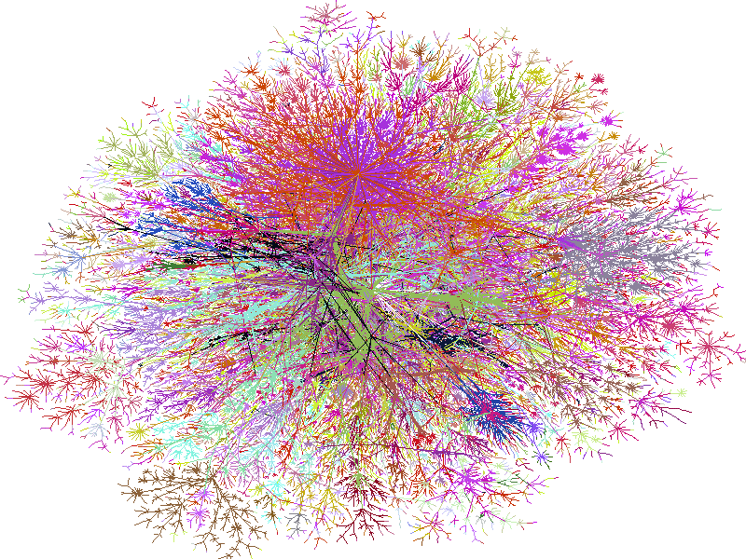
Class 23: Network Programming (just enough to make you dangerous)
cs2220: Engineering Software
Fall 2010
UVa
David Evans
Bill Cheswick’s map of the Internet (1999)

Slide 2
Plan for Today
PS5 (finally!)
Networking
Excuse
Excuse

Slide 3
Philosopher Deadlock
public class Philosopher {
private Philosopher colleague;
…
public synchronized void setColleague(Philosopher p) {
colleague = p;
}
public synchronized void philosophize() {
System.err.println(name + " says " + quote);
if (colleague != null) { // Need a colleague to start an argument.
colleague.argue();
}
}
public synchronized void argue() // REQUIRES: this.colleague != null
{
System.err.println(name + " argues: No! " + quote);
}
}

Slide 4
Philosopher Deadlock
public class Philosopher {
private Philosopher colleague;
…
public synchronized void setColleague(Philosopher p) {
colleague = p;
}
public synchronized void philosophize() {
System.err.println(name + " says " + quote);
if (colleague != null) {
colleague.argue();
}
}
public synchronized void argue()
{
System.err.println(name + " argues: No! " + quote);
}
}
Decartes
Plato
setColleague(plato);
setColleague(decartes);
philosophize()
philosophize()
colleague.argue()
Deadlock
Decartes thread:
holds Decartes lock
needs Plato lock to continue
Plato thread:
holds Plato lock
needs Decartes lock to continue
colleague.argue()

Slide 5
Attempted Fix: Locking Discipline
public void philosophize () {
Object lock1, lock2;
if (colleague != null) {
if (name.compareTo (colleague.name) < 0) {
lock1 = this;
lock2 = colleague;
} else {
lock1 = colleague;
lock2 = this;
}
synchronized (lock1) {
synchronized (lock2) {
colleague.argue ();
}
}
}
Decartes
Plato
setColleague(plato);
setColleague(decartes);
philosophize()
philosophize()
colleague.argue()
colleague.argue()

Slide 6
5. (Tricky, extra credit if you can answer this) Our new Philosopher class now has a race condition that could lead to a deadlock or run-time exception (but it would never be apparent from our current main class). Explain what the race condition is, and construct code that reveals it. Feel free to insert sleep pauses as necessary to make it easier to reveal.
public void philosophize () {
Object lock1, lock2;
if (colleague != null) {
if (name.compareTo (colleague.name) < 0) {
lock1 = this;
lock2 = colleague;
} else {
lock1 = colleague;
lock2 = this;
}
synchronized (lock1) {
synchronized (lock2) {
colleague.argue ();
}
}
}
Decartes
Plato
setColleague(plato);
setColleague(decartes);
philosophize()
philosophize()
name.compareTo(…)
plato.name = “Bob”;
name.compareTo(…)
synchronized (lock1)
synchronized (lock1)

Slide 7
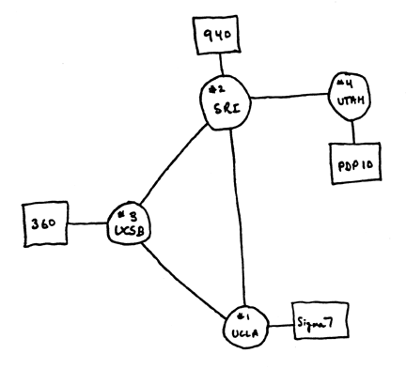
Networking
Internet 1969

Slide 8
Client-Server Networking
Listening Socket
Client
Server
request
connection
Same host can be both a client and
a server (peer-to-peer networking)

Slide 9
Network Topologies
Client
Client
Server
Server
Node
Node
Node
Client
Client
“Mesh”
“Star”

Slide 10
Skype
SuperNodes: form a mesh overlay network
Client/SuperNode: star network
Client-Login Server: client-server
Client
Client
Client
Super Node
Super Node
Client
Client
Super Node
Client
Client
Client
Skype Login Server

Slide 11
Facebook
Client
API calls, FBML
Client
Application Server
Adrienne Felt’s paper:
Privacy Protection for Social Networking Platforms

Slide 12
How can you run skype, browsers, YouTube, etc. all on one host?

Slide 13
Ports
Client
Listening
Server
request
connection
Port
Port
Server
One host can be involved in several simultaneous network connections:
use ports to direct traffic to the right process

Slide 14
Port Numbers
Ports 0-1023: assigned by Internet Assigned Numbers Authority
Privileged programs (administrator/root)
25: smtp, 80: http, 110: pop3, 205: appletalk
http://www.iana.org/assignments/port-numbers
Ports 1024-49151: registered
Any application can use these
Ports 49152-65535: dynamic/private

Slide 15
GUIs and Networks
GUIs: great problem for subtyping and inheritance
OOP was invented to program GUIs (and build simulations)
Network programming: great problem for data abstraction
Why are GUIs great for OOP and networks great for data abstraction?

Slide 16
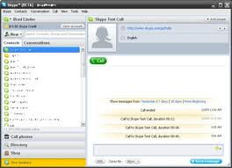
Application
Application
Data
Presentation
Presentation
Transformed Data
Session
Session
“Dialog” Data
Network
Network
Segments
Transport
Transport
Packets
Data Link
Data Link
Frames
Physical
Bits
Physical

Slide 17
OSI Abstraction Layers
Layer | Abstraction Level | Example Protocols
Application | semantic objects | HTTP, SMTP, Skype, …
Presentation | data representation, encryption, machine-independent data | SSL, TLS, MIME
Session | host-host communication | sockets
Transport | end-to-end connections, flow control | TCP, UDP
Network | routing, logical addressing | IP
Data Link | physical addressing | Ethernet, 802.11
Physical | binary transmission | X25, RS-232, POTS
What do we gain/lose by viewing network in these abstraction layers?

Slide 18
Java Sockets
java.net. Socket
java.net.ServerSocket
Client
Listening
Server
request
connection
Port
Port
Server

Slide 19
java.net.ServerSocket
public ServerSocket(int port) throws IOException
EFFECTS: Initializes this to a new server socket on port. If the
socket cannot be created, throws IOException.

Slide 20
import java.net.ServerSocket;
import java.io.IOException;
public class Network {
static public void main(String args[]) {
ServerSocket ss1, ss2;
try {
ss1 = new ServerSocket (8000);
} catch (IOException ioe) {
System.err.println ("Exception 1: " + ioe);
}
try {
ss2 = new ServerSocket (8000);
} catch (IOException ioe) {
System.err.println ("Exception 2: " + ioe);
}
}
}

Slide 21
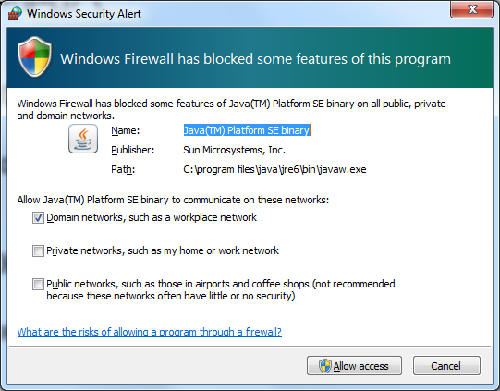
import java.net.ServerSocket;
import java.io.IOException;
public class Network {
static public void main(String args[]) {
ServerSocket ss1, ss2;
try {
ss1 = new ServerSocket (8000);
} catch (IOException ioe) {
System.err.println ("Exception 1: " + ioe);
}
try {
ss2 = new ServerSocket (8000);
} catch (IOException ioe) {
System.err.println ("Exception 2: " + ioe);
}
}
}
Exception 2: java.net.SocketException:
Unrecognized Windows Sockets error: 0: JVM_Bind

Slide 22
Java Sockets
java.net. Socket
java.net.ServerSocket
Client
Listening
Server
request
connection
Port
Port
Server

Slide 23
Accepting Connections
public Socket accept() throws IOException
Listens for a connection to be made to this socket
and accepts it. The method blocks until a connection
is made. A new Socket s is created and, if there
is a security manager, the security manager's
checkAccept method is called with
s.getInetAddress().getHostAddress() and s.getPort()
as its arguments to ensure the operation is allowed.
This could result in a SecurityException.

Slide 24
Server
public class Server {
static public void main(String args[]) {
ServerSocket listener;
try {
listener = new ServerSocket (8000);
} catch (IOException ioe) {
System.err.println ("Cannot open server socket: " + ioe);
return;
}
System.out.println("Server: waiting for connection...");
try {
Socket sock = listener.accept();
...
} catch (IOException ioe) {
System.err.println ("Cannot accept: " + ioe);
}

Slide 25
Sockets
Socket(String host, int port) throws IOException, UnknownHostException EFFECTS: Creates a stream socket and connects it to the specified port
number on the named host. If the specified host is null it is the loopback
address.
public void close () throws IOException
EFFECTS: Closes this socket.

Slide 26
Creating a Socket
import java.net.Socket;
import java.io.*;
import java.net.UnknownHostException;
public class Client {
public static void main(String[] args) {
Socket connect;
try {
connect = new Socket ("www.microsoft.com", 80);
System.out.println ("Connected: " + connect);
} catch (UnknownHostException uhe) {
System.err.println("Cannot find host: " + uhe);
} catch (IOException ioe) {
System.err.println ("Cannot open connection: " + ioe);
}
}
}
Port 80 = http (web server)

Slide 27
Connected to Microsoft
import java.net.Socket;
import java.io.*;
import java.net.UnknownHostException;
public class Client {
public static void main(String[] args) {
Socket connect;
try {
connect = new Socket ("www.microsoft.com", 80);
System.out.println ("Connected: " + connect);
} catch (UnknownHostException uhe) {
System.err.println("Cannot find host: " + uhe);
} catch (IOException ioe) {
System.err.println ("Cannot open connection: " + ioe);
}
}
}
Connected: Socket[addr=www.microsoft.com/207.46.19.30, port=80,localport=1359]
Connected: Socket[addr=www.microsoft.com/207.46.225.60, port=80,localport=1371]

Slide 28
Communicating
Socket methods:
public OutputStream getOutputStream() throws IOException
EFFECTS: Returns an output stream for this socket.
public InputStream getInputStream() throws IOException
EFFECTS: Returns an input stream for this socket.

Slide 29
Input Streams
public abstract class InputStream
public abstract int read() throws IOException
EFFECTS: Returns the next byte
in the input stream and advances the
stream.
other methods: close, available, skip, etc.
Reads the next byte of data from the input stream. The value byte is returned as an int in the range 0 to 255. If no byte is available because the end of the stream has been reached, the value -1 is returned. This method blocks until input data is available, the end of the stream is detected, or an exception is thrown. A subclass must provide an implementation of this method.
Returns:the next byte of data, or -1 if the end of the stream is reached. Throws: IOException - if an I/O error occurs.
Why an int not a byte?

Slide 30
Lots of InputStreams
java.io.InputStream
java.io.FilterInputStream
java.io.FileInputStream
java.io.BufferedInputStream

Slide 31
Readers
java.io.InputStreamReader extends java.io.Reader
Higher level abstraction on an InputStream
InputStreamReader(InputStream in)
EFFECTS: Initializes this to an
InputStreamReader on stream in.
int read()
EFFECTS: Reads a single character.

Slide 32
Buffering
BufferedReader extends Reader {
BufferedReader(Reader r)
int read ()
String readLine ()
EFFECTS: Returns the next line
and advances the reader.

Slide 33
Cookbook...
Socket connect;
…
BufferedReader in =
new BufferedReader (
new InputStreamReader (
connect.getInputStream()));
PrintWriter out =
new PrintWriter
(connect.getOutputStream(), true);

Slide 34
A Simple Web Browser
import java.net.Socket;
import java.io.*;
import java.net.UnknownHostException;
public class Client {
public static void main(String[] args) {
Socket connect;
try {
connect = new
Socket("www.virginia.edu", 80);
System.out.println("Connected");
} catch (UnknownHostException uhe) {
...
return;
} catch (IOException ioe) {
System.err.println("Cannot open ... ");
return;
}
try {
PrintWriter out = new PrintWriter
(connect.getOutputStream(), true);
BufferedReader in = new
BufferedReader (new
InputStreamReader(
connect.getInputStream()));
out.println("GET / HTTP/1.0\r\n");
String inString;
while ((inString = in.readLine()) != null) {
System.out.println (inString);
}
} catch (IOException ioe) {
System.err.println("IO Exception: " + ioe);
}
System.out.println ("Closing connection...");
try {
connect.close();
} catch (IOException ioe) {
System.err.println("Error closing: " + ioe);
}

Slide 35
Higher Abstraction Levels
java.net.HttpURLConnection
URLConnection (URL url)
Constructs a URL connection to the specified URL.
void connect()
Object getContent(Class [] classes)
http://java.sun.com/docs/books/tutorial/networking/urls/

Slide 36
public class WebServer {
static public void main(String args[]) {
ServerSocket listener;
try {
listener = new ServerSocket(80);
} catch (IOException ioe) {
System.err.println("Cannot open server socket: " + ioe); return;
}
while (true) {
try {
System.out.println("Server: waiting for connection...");
Socket connect = listener.accept();
PrintWriter out = new PrintWriter(connect.getOutputStream(), true);
BufferedReader in = new BufferedReader(new InputStreamReader(connect.getInputStream()));
String inString;
while ((inString = in.readLine()) != null) {
// HTTP request: GET <file> <protocol>
... // Process request by printing to out
}
connect.close();
} catch (IOException ioe) {
// log error
}
...
}
What would need to be different in a real web server?

Slide 37
Building Web Applications
Don’t hand code a server like this!
Lots of powerful frameworks available
Java
Other Languages
Python
Apache Tomcat
Ruby
PHP
JSP (JavaServer Pages)

Slide 38
Charge
Exam 2: out Thursday, due Tuesday, Nov 23
If you have topics you want me to review before the exam, send them by Monday afternoon.

