Slide 1
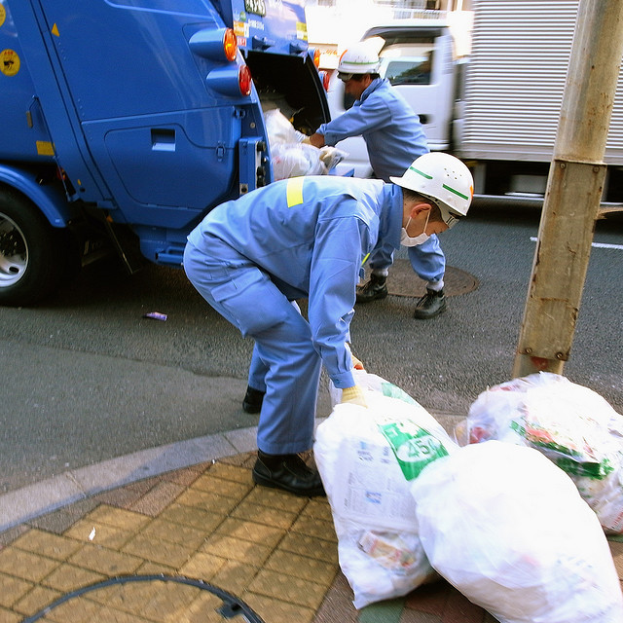
Class 24:
Garbage Collection
cs2220: Engineering Software
Fall 2010
UVa
David Evans
flickr cc: kiksbalayon

Slide 2
Menu
Memory review: Stack and Heap
Garbage Collection
Mark and Sweep
Stop and Copy
Reference Counting
Java’s Garbage Collector

Slide 3
Exam 2
Out Thursday, due next Tuesday
Coverage: anything in the class up to last lecture
Main Topics
Type Hierarchy: Subtyping, Inheritance, Dynamic Dispatch, behavioral subtyping rules, substitution principle
Concurrency abstraction: multi-threading, race conditions, deadlocks
Java Security: bytecode verification, code safety, policy enforcement
You will have 5 days for Exam 2, but it is designed to be short enough that you should still have plenty time to work on your projects while Exam 2 is out.

Slide 4
Stack and Heap Review
Stack
Heap
public class Strings {
public static void test () {
StringBuffer sb = new StringBuffer("hello");
}
static public void main (String args[]) {
test ();
test ();
}
}
A
B
1
sb
java.lang.StringBuffer
2
3
“hello”
When do the stack and heap look like this?

Slide 5
Stack and Heap Review
Stack
Heap
public class Strings {
public static void test () {
StringBuffer sb = new StringBuffer ("hello");
}
static public void main (String args[]) {
test ();
test ();
}
}
B
sb
java.lang.StringBuffer
2
“hello”

Slide 6
Garbage Heap
Stack
Heap
public class Strings {
public static void test () {
StringBuffer sb = new StringBuffer ("hello");
}
static public void main (String args[]) {
while (true) test ();
}
}
“hello”
“hello”
“hello”
“hello”
“hello”
“hello”
“hello”
“hello”
“hello”
“hello”
“hello”
“hello”
“hello”
“hello”
“hello”
“hello”
“hello”
“hello”
“hello”
“hello”
“hello”
“hello”
“hello”
“hello”
“hello”
“hello”
“hello”
“hello”

Slide 7
Explicit Memory Management
C/C++: programmer uses
free (pointer)
to indicate that the storage pointer points to should be reclaimed.
public class Strings {
public static void test () {
StringBuffer sb =
new StringBuffer ("hello");
free (sb);
}
static public void main (String args[]) {
while (true) test ();
}
}
Very painful!
Missing free: memory leak
Dangling references: to free’d objects

Slide 8
Garbage Collection
System needs to reclaim storage on the heap used by garbage objects
How can it identify garbage objects?
How come we don’t need to garbage collect the stack?

Slide 9
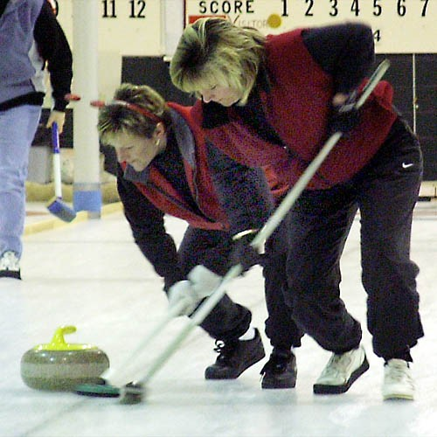
Mark and Sweep

Slide 10
Mark and Sweep
John McCarthy, 1960 (first LISP implementation)
Start with a set of root references
Mark every object you can reach from those references
Sweep up the unmarked objects
In a Java execution, what are the root references?
References on the stack.

Slide 11
public class Phylogeny {
static public void main (String args[]) {
SpeciesSet ss = new SpeciesSet ();
… (open file for reading)
while (…not end of file…) {
Species current = new Species (…name from file…,
…genome from file…);
ss.insert (current);
}
}
public class SpeciesSet {
private ArrayList<Species> els;
public void insert (Species s) {
if (getIndex (s) < 0) els.add (s);
}
}

Slide 12
“in.spc”
Stack
Bottom of Stack
name:
genome:
Phylogeny.main
String[]: args
root: Species
“Duck”
els:
ss: SpeciesSet
“CATAG”
name:
genome:
current: Species
SpeciesSet.insert
this: SpeciesSet
“Goat”
s: Species
“CAGTG”
Top of Stack
name:
genome:
name:
genome:
public class Phylogeny {
static public void main (String args[]) {
SpeciesSet ss = new SpeciesSet ();
… (open file for reading)
while (…not end of file…) {
Species current = new Species (…name from file…, …genome from file…);
ss.insert (current); } }
public class SpeciesSet {
private ArrayList<Species> els;
public void insert (Species s) { if (getIndex (s) < 0) els.add (s); } }
“Elf”
“Frog”
“CGGTG”
“CGATG”

Slide 13
After els.add (s)…
“in.spc”
Stack
Bottom of Stack
name:
genome:
Phylogeny.main
String[]: args
root: Species
“Duck”
els:
ss: SpeciesSet
“CATAG”
name:
genome:
current: Species
SpeciesSet.insert
this: SpeciesSet
“Goat”
s: Species
“CAGTG”
Top of Stack
name:
genome:
name:
genome:
public class Phylogeny {
static public void main (String args[]) {
SpeciesSet ss = new SpeciesSet ();
… (open file for reading)
while (…not end of file…) {
Species current = new Species (…name from file…, …genome from file…);
ss.insert (current); } }
public class SpeciesSet {
private ArrayList<Species> els;
public void insert (Species s) { if (getIndex (s) < 0) els.add (s); } }
“Elf”
“Frog”
“CGGTG”
“CGATG”

Slide 14
SpeciesSet.insert returns…
“in.spc”
Stack
Bottom of Stack
name:
genome:
Phylogeny.main
String[]: args
root: Species
“Duck”
els:
ss: SpeciesSet
“CATAG”
name:
genome:
current: Species
SpeciesSet.insert
this: SpeciesSet
“Goat”
s: Species
“CAGTG”
Top of Stack
name:
genome:
name:
genome:
public class Phylogeny {
static public void main (String args[]) {
SpeciesSet ss = new SpeciesSet ();
… (open file for reading)
while (…not end of file…) {
Species current = new Species (…name from file…, …genome from file…);
ss.insert (current); } }
public class SpeciesSet {
private ArrayList<Species> els;
public void insert (Species s) { if (getIndex (s) < 0) els.add (s); } }
“Elf”
“Frog”
“CGGTG”
“CGATG”

Slide 15
Finish while loop…
“in.spc”
Stack
Bottom of Stack
name:
genome:
Phylogeny.main
String[]: args
root: Species
“Duck”
els:
ss: SpeciesSet
“CATAG”
name:
genome:
current: Species
Top of Stack
“Goat”
“CAGTG”
name:
genome:
name:
genome:
public class Phylogeny {
static public void main (String args[]) {
SpeciesSet ss = new SpeciesSet ();
… (open file for reading)
while (…not end of file…) {
Species current = new Species (…name from file…, …genome from file…);
ss.insert (current); } }
public class SpeciesSet {
private ArrayList<Species> els;
public void insert (Species s) { if (getIndex (s) < 0) els.add (s); } }
“Elf”
“Frog”
“CGGTG”
“CGATG”

Slide 16
Garbage Collection
“in.spc”
Stack
Bottom of Stack
name:
genome:
Phylogeny.main
String[]: args
root: Species
“Duck”
els:
ss: SpeciesSet
“CATAG”
Top of Stack
name:
genome:
“Goat”
“CAGTG”
name:
genome:
name:
genome:
public class Phylogeny {
static public void main (String args[]) {
SpeciesSet ss = new SpeciesSet ();
… (open file for reading)
while (…not end of file…) {
Species current = new Species (…name from file…, …genome from file…);
ss.insert (current); } }
public class SpeciesSet {
private ArrayList<Species> els;
public void insert (Species s) { if (getIndex (s) < 0) els.add (s); } }
“Elf”
“Frog”
“CGGTG”
“CGATG”

Slide 17
Garbage Collection
“in.spc”
Stack
Bottom of Stack
name:
genome:
Phylogeny.main
String[]: args
root: Species
“Duck”
els:
ss: SpeciesSet
“CATAG”
Top of Stack
name:
genome:
“Goat”
Initialize Mark and Sweeper:
active = all objects on stack
“CAGTG”
name:
genome:
name:
genome:
“Elf”
“Frog”
“CGGTG”
“CGATG”

Slide 18
Mark and Sweep Algorithm

Slide 19
Mark and Sweep Algorithm
active = all objects on stack
while (!active.isEmpty ())
newactive = { }
foreach (Object a in active)
mark a as reachable (non-garbage)
foreach (Object o that a points to)
if o is not marked
newactive = newactive U { o }
active = newactive

Slide 20
Garbage Collection
“in.spc”
Stack
Bottom of Stack
name:
genome:
Phylogeny.main
String[]: args
root: Species
“Duck”
els:
ss: SpeciesSet
“CATAG”
Top of Stack
name:
genome:
active = all objects on stack
while (!active.isEmpty ())
newactive = { }
foreach (Object a in active)
mark a as reachable (non-garbage)
foreach (Object o that a points to)
if o is not marked
newactive = newactive U { o }
active = newactive
“Goat”
“CAGTG”
name:
genome:
name:
genome:
“Elf”
“Frog”
“CGGTG”
“CGATG”

Slide 21
Garbage Collection
“in.spc”
Stack
Bottom of Stack
name:
genome:
Phylogeny.main
String[]: args
root: Species
“Duck”
els:
ss: SpeciesSet
“CATAG”
Top of Stack
name:
genome:
active = all objects on stack
while (!active.isEmpty ())
newactive = { }
foreach (Object a in active)
mark a as reachable (non-garbage)
foreach (Object o that a points to)
if o is not marked
newactive = newactive U { o }
active = newactive
“Goat”
“CAGTG”
name:
genome:
name:
genome:
“Elf”
“Frog”
“CGGTG”
“CGATG”

Slide 22
Garbage Collection
“in.spc”
Stack
Bottom of Stack
name:
genome:
Phylogeny.main
String[]: args
root: Species
“Duck”
els:
ss: SpeciesSet
“CATAG”
Top of Stack
name:
genome:
active = all objects on stack
while (!active.isEmpty ())
newactive = { }
foreach (Object a in active)
mark a as reachable (non-garbage)
foreach (Object o that a points to)
if o is not marked
newactive = newactive U { o }
active = newactive
“Goat”
“CAGTG”
name:
genome:
name:
genome:
“Elf”
“Frog”
“CGGTG”
“CGATG”

Slide 23
Garbage Collection
“in.spc”
Stack
Bottom of Stack
name:
genome:
Phylogeny.main
String[]: args
root: Species
“Duck”
els:
ss: SpeciesSet
“CATAG”
Top of Stack
name:
genome:
active = all objects on stack
while (!active.isEmpty ())
newactive = { }
foreach (Object a in active)
mark a as reachable (non-garbage)
foreach (Object o that a points to)
if o is not marked
newactive = newactive U { o }
active = newactive
“Goat”
“CAGTG”
name:
genome:
name:
genome:
“Elf”
“Frog”
“CGGTG”
“CGATG”

Slide 24
Garbage Collection
“in.spc”
Stack
Bottom of Stack
name:
genome:
Phylogeny.main
String[]: args
root: Species
“Duck”
els:
ss: SpeciesSet
“CATAG”
Top of Stack
name:
genome:
active = all objects on stack
while (!active.isEmpty ())
newactive = { }
foreach (Object a in active)
mark a as reachable (non-garbage)
foreach (Object o that a points to)
if o is not marked
newactive = newactive U { o }
active = newactive
“Goat”
“CAGTG”
name:
genome:
name:
genome:
“Elf”
“Frog”
“CGGTG”
“CGATG”

Slide 25
Garbage Collection
“in.spc”
Stack
Bottom of Stack
name:
genome:
Phylogeny.main
String[]: args
root: Species
“Duck”
els:
ss: SpeciesSet
“CATAG”
Top of Stack
name:
genome:
active = all objects on stack
while (!active.isEmpty ())
newactive = { }
foreach (Object a in active)
mark a as reachable (non-garbage)
foreach (Object o that a points to)
if o is not marked
newactive = newactive U { o }
active = newactive
sweep () // remove unmarked objects on heap
“Goat”
“CAGTG”
name:
genome:
name:
genome:
“Elf”
“Frog”
“CGGTG”
“CGATG”

Slide 26
After main returns…
“in.spc”
Stack
Bottom of Stack
name:
genome:
Phylogeny.main
String[]: args
root: Species
“Duck”
els:
ss: SpeciesSet
“CATAG”
Top of Stack
name:
genome:
active = all objects on stack
while (!active.isEmpty ())
newactive = { }
foreach (Object a in active)
mark a as reachable (non-garbage)
foreach (Object o that a points to)
if o is not marked
newactive = newactive U { o }
active = newactive
sweep () // remove unmarked objects on heap
“Goat”
“CAGTG”
name:
genome:
name:
genome:
“Elf”
“Frog”
“CGGTG”
“CGATG”

Slide 27
Garbage Collection
“in.spc”
Stack
Bottom of Stack
name:
genome:
Top of Stack
“Duck”
els:
“CATAG”
name:
genome:
active = all objects on stack
while (!active.isEmpty ())
newactive = { }
foreach (Object a in active)
mark a as reachable (non-garbage)
foreach (Object o that a points to)
if o is not marked
newactive = newactive U { o }
active = newactive
sweep () // remove unmarked objects on heap
“Goat”
“CAGTG”
name:
genome:
name:
genome:
“Elf”
“Frog”
“CGGTG”
“CGATG”

Slide 28
Problems with Mark and Sweep
Fragmentation: free space and alive objects will be mixed
  Harder to allocate space for new objects
  Poor locality means bad memory performance
    Caches make it quick to load nearby memory
Multiple Threads
  One stack per thread, one heap shared by all threads
  All threads must stop for garbage collection

Slide 29
Stop and Copy
Stop execution
Identify all reachable objects (as in Mark and Sweep)
Copy all reachable objects to a new memory area
After copying, reclaim the whole old heap
Solves fragmentation problem
Disadvantages:
  More complicated: need to change stack and internal object pointers to new heap
  Need to save enough memory to copy
  Expensive if most objects are not garbage

Slide 30
Generational Collectors
Observation:
  Most objects are short-lived
    Temporary objects that get garbage collected right away
  Other objects are long-lived
    Data that lives for the duration of execution
Separate storage into regions
  Short term: collect frequently
  Long term: collect infrequently
Stop and copy, but move copies into longer-lived areas

Slide 31
Reference Counting
What if each object kept track of the number of references to it?
If the object has zero references, it is garbage!

Slide 32
Reference Counting
class Recycle {
private String name; private Vector pals;
public Recycle (String name) { this.name = name; pals = new Vector (); }
public void addPal (Recycle r) { pals.addElement (r); }
}
public class Garbage {
static public void main (String args[]) {
Recycle alice = new Recycle ("alice");
Recycle bob = new Recycle ("bob");
bob.addPal (alice);
alice = new Recycle ("coleen");
bob = new Recycle ("dave");
}
}
“Alice”
name:
pals:
refs:
1
2
“Bob”
name:
pals:
refs:
1

Slide 33
Reference Counting
class Recycle {
private String name; private Vector pals;
public Recycle (String name) { this.name = name; pals = new Vector (); }
public void addPal (Recycle r) { pals.addElement (r); }
}
public class Garbage {
static public void main (String args[]) {
Recycle alice = new Recycle ("alice");
Recycle bob = new Recycle ("bob");
bob.addPal (alice);
alice = new Recycle ("coleen");
bob = new Recycle ("dave");
}
}
“Alice”
name:
pals:
refs:
1
2
“Coleen”
“Bob”
name:
pals:
refs:
name:
pals:
refs:
1
1

Slide 34
Reference Counting
class Recycle {
private String name; private Vector pals;
public Recycle (String name) { this.name = name; pals = new Vector (); }
public void addPal (Recycle r) { pals.addElement (r); }
}
public class Garbage {
static public void main (String args[]) {
Recycle alice = new Recycle ("alice");
Recycle bob = new Recycle ("bob");
bob.addPal (alice);
alice = new Recycle ("coleen");
bob = new Recycle ("dave");
}
}
“Alice”
name:
pals:
refs:
1
0
“Bob”
name:
pals:
refs:
0
1

Slide 35
Can reference counting ever fail to reclaim unreachable storage?

Slide 36
Circular References
class Recycle {
private String name; private Vector pals;
public Recycle (String name) { this.name = name; pals = new Vector (); }
public void addPal (Recycle r) { pals.addElement (r); }
}
public class Garbage {
static public void main (String args[]) {
Recycle alice = new Recycle ("alice");
Recycle bob = new Recycle ("bob");
bob.addPal (alice);
alice.addPal (bob);
alice = null;
bob = null;
}
}
“Alice”
name:
pals:
refs:
1
“Bob”
name:
pals:
refs:
1

Slide 37
Reference Counting Summary
Advantages
  Can clean up garbage right away when the last reference is lost
  No need to stop other threads!
Disadvantages
  Need to store and maintain reference count
  Some garbage is left to fester (circular references)
  Memory fragmentation

Slide 38
Java’s Garbage Collector
Mark and Sweep collector
Generational
Can call garbage collector directly: System.gc ()
but, this should hardly ever be done (except for “fun”)
Python’s Garbage Collector
Reference counting:
  To quickly reclaim most storage
Mark and sweep collector (optional, but on by default):
  To collect circular references

Slide 39
java.lang.Object.finalize()
protected void finalize() throws Throwable
Called by the garbage collector on an object when garbage collection determines that there are no more references to the object. A subclass overrides the finalize method to dispose of system resources or to perform other cleanup. The general contract of finalize is that it is invoked if and when the JavaTM virtual machine has determined that there is no longer any means by which this object can be accessed by any thread that has not yet died, except as a result of an action taken by the finalization of some other object or class which is ready to be finalized. The finalize method may take any action, including making this object available again to other threads; the usual purpose of finalize, however, is to perform cleanup actions before the object is irrevocably discarded. For example, the finalize method for an object that represents an input/output connection might perform explicit I/O transactions to break the connection before the object is permanently discarded.
The finalize method of class Object performs no special action; it simply returns normally. Subclasses of Object may override this definition.
The Java programming language does not guarantee which thread will invoke the finalize method for any given object. It is guaranteed, however, that the thread that invokes finalize will not be holding any user-visible synchronization locks when finalize is invoked. If an uncaught exception is thrown by the finalize method, the exception is ignored and finalization of that object terminates.
After the finalize method has been invoked for an object, no further action is taken until the Java virtual machine has again determined that there is no longer any means by which this object can be accessed by any thread that has not yet died, including possible actions by other objects or classes which are ready to be finalized, at which point the object may be discarded.
The finalize method is never invoked more than once by a Java virtual machine for any given object.
Any exception thrown by the finalize method causes the finalization of this object to be halted, but is otherwise ignored.
Summary:
finalize is called when garbage collector reclaims object
no guarantee when it will be called
after finalizer, JVM has to check you didn’t do something stupid
its protected because subclasses need to override it (but no one other than the JVM itself should ever call it!)
You should probably never need to override finalize in your code. Only excuse for using it is if you have objects with unknown lifetimes that have associated (non-memory) resources.

Slide 40
class Recycle {
private String name;
private ArrayList<Recycle> pals;
public Recycle (String name) {
this.name = name; pals = new ArrayList<Recycle> (); }
public void addPal (Recycle r) { pals.add (r); }
protected void finalize () { System.err.println (name + " is garbage!"); }
}
public class Garbage {
static public void main (String args[]) {
Recycle alice = new Recycle ("alice");
Recycle bob = new Recycle ("bob");
bob.addPal (alice);
alice = new Recycle ("coleen");
System.out.println("First collection:");
System.gc ();
bob = new Recycle ("dave");
System.out.println("Second collection:");
System.gc ();
}
}
> java Garbage
First collection:
Second collection:
alice is garbage!
bob is garbage!

Slide 41
class Recycle {
private String name;
private ArrayList<Recycle> pals;
public Recycle (String name) { this.name = name; pals = new ArrayList<Recycle> (); }
public void addPal (Recycle r) { pals.add (r); }
protected void finalize () { System.err.println (name + " is garbage!"); }
}
public class Garbage {
static public void main (String args[]) {
System.err.println(Runtime.getRuntime().freeMemory() + " bytes free!");
Recycle alice = new Recycle ("alice");
Recycle bob = new Recycle ("bob");
bob.addPal (alice);
alice = new Recycle ("coleen");
System.err.println("First collection:");
System.err.println(Runtime.getRuntime().freeMemory() + " bytes free!");
System.gc ();
System.err.println(Runtime.getRuntime().freeMemory() + " bytes free!");
bob = new Recycle ("dave");
System.err.println("Second collection:");
System.gc ();
System.err.println(Runtime.getRuntime().freeMemory() + " bytes free!");
}
}
125431952 bytes free!
First collection:
125431952 bytes free!
125933456 bytes free!
Second collection:
125933216 bytes free!
bob is garbage!
alice is garbage!
Note running the garbage collector itself uses memory!

Slide 42
class Recycle {
private String name;
private ArrayList<Recycle> pals;
public Recycle (String name) {
this.name = name; pals = new ArrayList<Recycle> (); }
public void addPal (Recycle r) { pals.add (r); }
protected void finalize () {
Garbage.truck = this;
System.err.println (name + " is garbage!" + this.hashCode()); }
}
public class Garbage {
static public Recycle truck;
static public void main (String args[]) {
printMemory();
while (true) {
Recycle alice = new Recycle ("alice");
printMemory();
System.gc ();
}
}
}

Slide 43
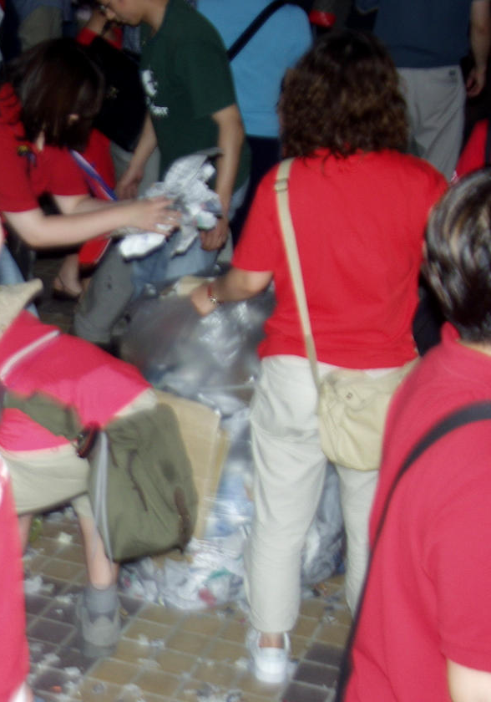
Charge
In Java: be happy you have a garbage collector to clean up for you
In C/C++: need to deallocate storage explicitly
  Why is it hard to write a garbage collector for C?
In the real world: clean up after yourself and others!
Keep working on your projects
Exam 2 out Thursday
Garbage Collectors
(COAX, Seoul, 18 June 2002)

