Slide 1
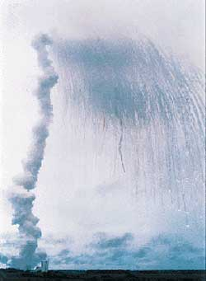
Class 25: Software Disasters
cs2220: Engineering Software
Fall 2010
UVa
David Evans

Slide 2
Why Study Software Disasters?
Exam 2 out today, due at beginning of class Thursday.
It should not be a disaster!

Slide 4
//
// Copyright (c) Microsoft Corporation. All rights reserved.
//
//
// Use of this source code is subject to the terms of the Microsoft end-user
// license agreement (EULA) under which you licensed this SOFTWARE PRODUCT.
// If you did not accept the terms of the EULA, you are not authorized to use
// this source code. For a copy of the EULA, please see the LICENSE.RTF on your
// install media.
//
//------------------------------------------------------------------------------
//
// Copyright (C) 2004-2007, Freescale Semiconductor, Inc. All Rights Reserved.
// THIS SOURCE CODE, AND ITS USE AND DISTRIBUTION, IS SUBJECT TO THE TERMS
// AND CONDITIONS OF THE APPLICABLE LICENSE AGREEMENT
//
//------------------------------------------------------------------------------
//
// Module: rtc.c
//
// PQOAL Real-time clock (RTC) routines for the MC13783 PMIC RTC.
//
//------------------------------------------------------------------------------
http://pastie.org/349916

Slide 5
//------------------------------------------------------------------------------
// Global Variables
//These macro define some default information of RTC
#define ORIGINYEAR 1980 // the begin year
#define MAXYEAR (ORIGINYEAR + 100) // the maxium year
#define JAN1WEEK 2 // Jan 1 1980 is a Tuesday
static const UINT8 monthtable[12] = {31, 28, 31, 30, 31, 30, 31, 31, 30, 31, 30, 31};
static const UINT8 monthtable_leap[12] = {31, 29, 31, 30, 31, 30, 31, 31, 30, 31, 30, 31};
…

Slide 6
//------------------------------------------------------------------------------
//
// Function: IsLeapYear
//
// Local helper function checks if the year is a leap year
//
// Parameters:
//
// Returns:
//
//
//------------------------------------------------------------------------------
static int IsLeapYear(int Year)
{
int Leap;
Leap = 0;
if ((Year % 4) == 0) {
Leap = 1;
if ((Year % 100) == 0) {
Leap = (Year%400) ? 0 : 1;
}
}
return (Leap);
}

Slide 7
#define ORIGINYEAR 1980
…
// Function: ConvertDays
//
// Local helper function that split total days since Jan 1, ORIGINYEAR into
// year, month and day
//
// Parameters:
//
// Returns:
// Returns TRUE if successful, otherwise returns FALSE.
BOOL ConvertDays(UINT32 days, SYSTEMTIME* lpTime)
{
int month, year;
year = ORIGINYEAR;
while (days > 365) {
if (IsLeapYear(year)) {
if (days > 366) {
days -= 366;
year += 1;
}
} else {
days -= 365;
year += 1;
}
}
…
http://pastie.org/349916

Slide 8
We contacted a Microsoft spokesperson, who confirmed the issue with this official statement: "Early this morning we were alerted by our customers that there was a widespread issue affecting our 2006 model Zune 30GB devices (a large number of which are still actively being used). The technical team jumped on the problem immediately and isolated the issue: a bug in the internal clock driver related to the way the device handles a leap year. That being the case, the issue should be resolved over the next 24 hours as the time change moves to January 1, 2009. We expect the internal clock on the Zune 30GB devices will automatically reset tomorrow (noon, GMT). By tomorrow you should allow the battery to fully run out of power before the unit can restart successfully then simply ensure that your device is recharged, then turn it back on."
http://www.pcworld.com/article/156240/microsoft_says_leap_year_bug_caused_zune_failures.html

Slide 9
Questions about Bugs
Immediate
What is going wrong?
What is the bug?
Systemic
Is this bug a symptom of larger problems in the software design?
Why didn’t testing catch this?
Is this bug a symptom of larger problems in the development process, team, etc.?
In this case, the code came from Freescale, integrated into
Microsoft Project (without going through MS development process)

Slide 10
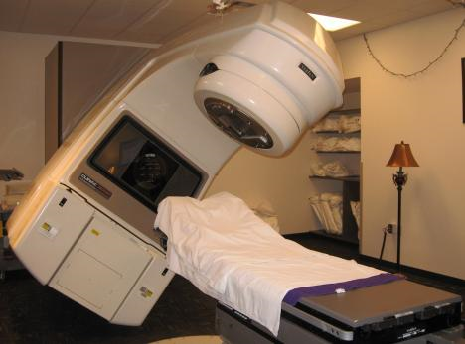
Therac-25
Radiation Therapy Machine
Atomic Energy of Canada
1985-1987: gave six patients massive overdoses of radiation (3 died)
Nancy Levenson, Medical Devices: The Therac-25
http://sunnyday.mit.edu/papers/therac.pdf

Slide 11
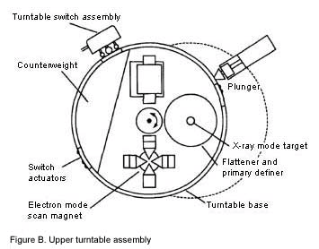

Slide 12
Assumptions in AECL’s safety analysis:
Programming errors have been reduced by extensive testing on a hardware simulator and under field conditions on teletherapy units. Any residual software errors are not included in the analysis.
Program software does not degrade due to wear, fatigue, or reproduction process.
Computer execution errors are caused by faulty hardware components and by "soft" (random) errors induced by alpha particles and electromagnetic noise.
Nancy Levenson, Medical Devices: The Therac-25
http://sunnyday.mit.edu/papers/therac.pdf

Slide 13
Ariane 5 Movie

Slide 14
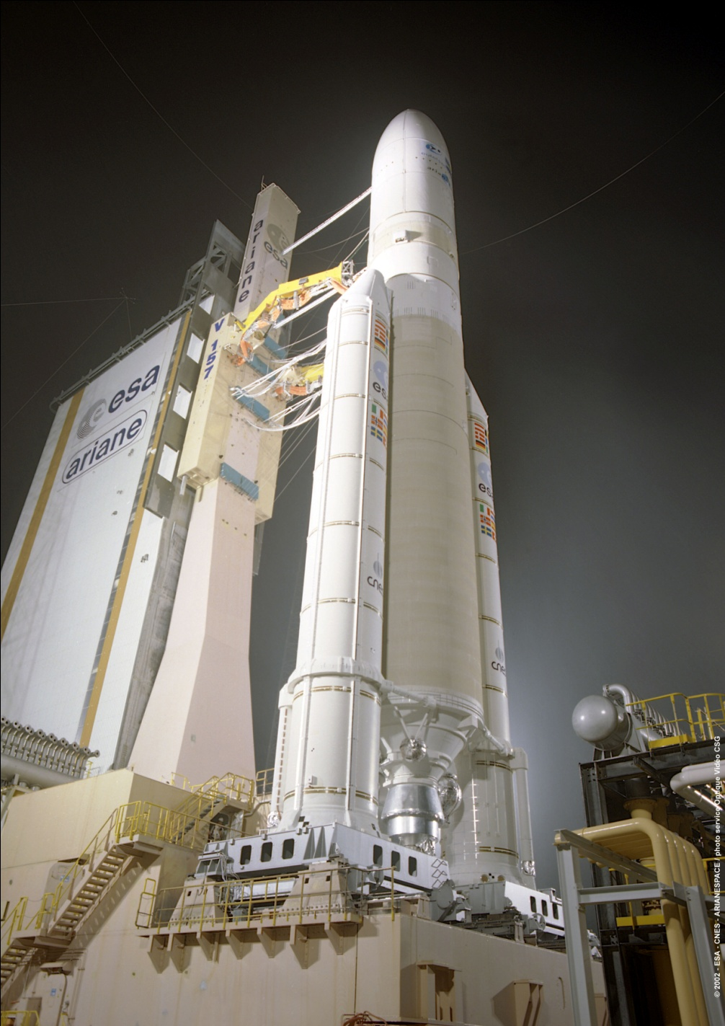
Ariane 5
$500M rocket developed by European Space Agency
June 4, 1996: first launch
37s after ignition: lost guidance
40s: exploded

Slide 15
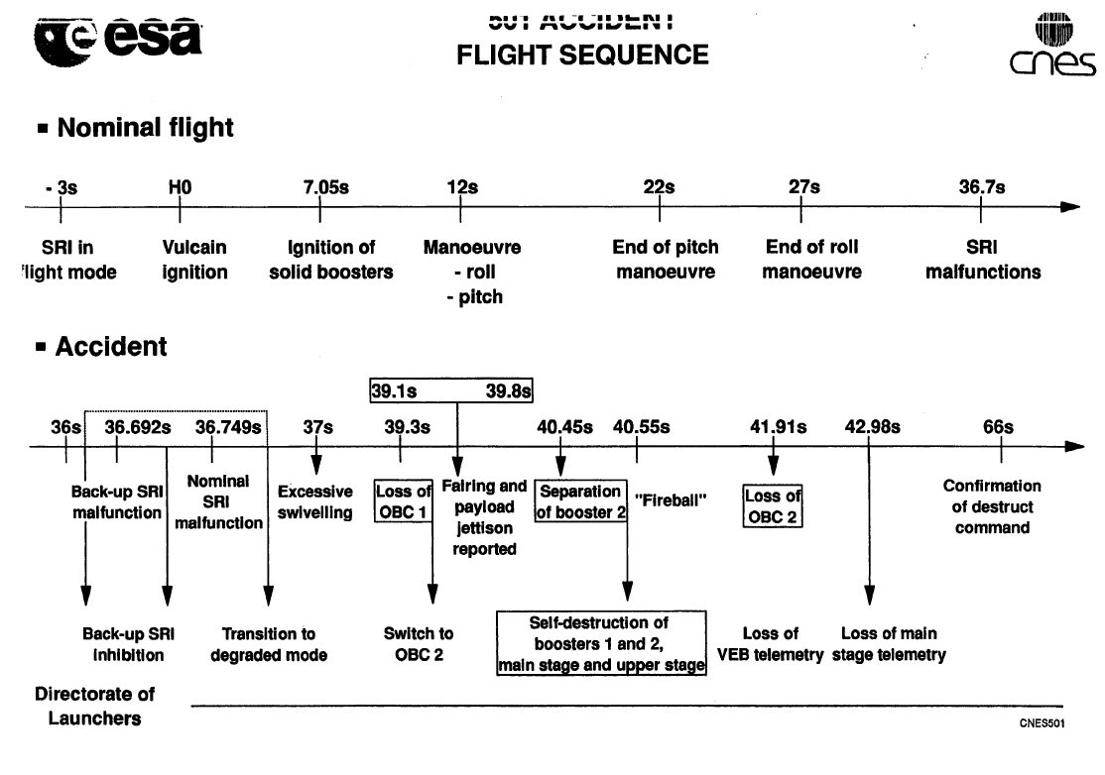
Ariane 5 Inquiry Board Report (Jacques-Louis Lions): http://esamultimedia.esa.int/docs/esa-x-1819eng.pdf

Slide 16
Flight Control System
Inertial Reference System (SRI)
Calculates angles and velocities from on-rocket sensors (gryos, accelerometers)
Data sent to On-Board Computer that executes flight program (controls booster nozzles, valves)
Redundancy in design to improve reliability
Two separate computers running SRIs in parallel (same hardware and software) – one is “hot” stand-by used if OBC detects failure in “active” SRI
Design based on Ariane 4
Software for SRI mostly reused from Ariane 4 implementation

Slide 17
Number Overflow Problems
16-bit signed integer
2¹⁶ = 65536 different values
(-32768 – 32767)
Alignment code converted the horizontal velocity (64-bit floating point value from sensors = up to ~10³⁰⁸) to a 16-bit signed integer
Overflow produces exception (Operand Error)

Slide 18
Defensive Programming
“The data conversion instructions were not protected from causing an Operand Error, although other conversions of comparable variables in the same place in the code were protected.”

Slide 19
It has been stated to the Board that not all the conversions were protected because a maximum workload target of 80% had been set for the SRI computer. To determine the vulnerability of unprotected code, an analysis was performed on every operation which could give rise to an exception, including an Operand Error. In particular, the conversion of floating point values to integers was analysed and operations involving seven variables were at risk of leading to an Operand Error. This led to protection being added to four of the variables, evidence of which appears in the Ada code. However, three of the variables were left unprotected. No reference to justification of this decision was found directly in the source code. Given the large amount of documentation associated with any industrial application, the assumption, although agreed, was essentially obscured, though not deliberately, from any external review.
The reason for the three remaining variables, including the one denoting horizontal bias, being unprotected was that further reasoning indicated that they were either physically limited or that there was a large margin of safety, a reasoning which in the case of the variable BH turned out to be faulty. It is important to note that the decision to protect certain variables but not others was taken jointly by project partners at several contractual levels.

Slide 20
Although the source of the Operand Error has been identified, this in itself did not cause the mission to fail. The specification of the exception-handling mechanism also contributed to the failure. In the event of any kind of exception, the system specification stated that: the failure should be indicated on the databus, the failure context should be stored in an EEPROM memory (which was recovered and read out for Ariane 501), and finally, the SRI processor should be shut down.
It was the decision to cease the processor operation which finally proved fatal. Restart is not feasible since attitude is too difficult to re-calculate after a processor shutdown; therefore the Inertial Reference System becomes useless. The reason behind this drastic action lies in the culture within the Ariane programme of only addressing random hardware failures. From this point of view exception - or error - handling mechanisms are designed for a random hardware failure which can quite rationally be handled by a backup system.

Slide 21
Java Version
public class Overflow {
public static void main (String args[]) {
int x;
double d = 5000000000.0;
x = (int) d;
System.out.println ("d = " + d + " / " + "x = " + x);
}
}
d = 5.0E9 / x = 2147483647
What is 2147483647 + 1?
-2147483648

Slide 22
Ada Programming Language
Developed by a 1970s US DoD effort to create a safe, high-level, modular programming language
1987-1997: All DoD software projects required to use Ada
Still fairly widely used in safety-critical software
Boeing 777
SPARK/Ada (subset with verification)

Slide 23
Ada Package Declaration
package Rational_Numbers is
type Rational is record Numerator : Integer; Denominator : Positive; end record;
function "="(X,Y : Rational) return Boolean;
function "/" (X,Y : Integer) return Rational;
function "+" (X,Y : Rational) return Rational; function "-" (X,Y : Rational) return Rational; function "*" (X,Y : Rational) return Rational; function "/" (X,Y : Rational) return Rational; end Rational_Numbers;

Slide 24
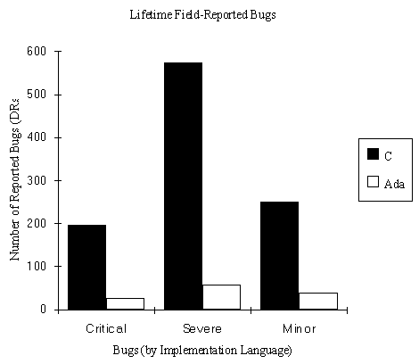
Zeigler, 1995 http://www.adaic.com/whyada/ada-vs-c/cada_art.html
Type safety and information hiding are valuable: Ada code has 1/10th as many bugs as C code, and cost ½ as much to develop

Slide 25
Ada Exception Handling
begin
... --- raises exception
end
exception
when Exception: action
If exception raised in block B
If there is a handler, jumps to its action; if not, exception propagates to call site (and up)

Slide 26
Inertial Reference System
Exception in alignment code for number conversion
No handler in procedure
Propagated up to top level
SRI response to exception is to shutdown and put error on databus

Slide 27
Why was the alignment code still running?
The error occurred in a part of the software that only performs alignment of the strap-down inertial platform. This software module computes meaningful results only before lift-off. As soon as the launcher lifts off, this function serves no purpose.

Slide 28
p. 36 (appendix of report)

Slide 29
The original requirement accounting for the continued operation of the alignment software after lift-off was brought forward more than 10 years ago for the earlier models of Ariane, in order to cope with the rather unlikely event of a hold in the count-down e.g. between - 9 seconds, when flight mode starts in the SRI of Ariane 4, and - 5 seconds when certain events are initiated in the launcher which take several hours to reset. The period selected for this continued alignment operation, 50 seconds after the start of flight mode, was based on the time needed for the ground equipment to resume full control of the launcher in the event of a hold. This special feature made it possible with the earlier versions of Ariane, to restart the count-down without waiting for normal alignment, which takes 45 minutes or more, so that a short launch window could still be used. In fact, this feature was used once, in 1989 on Flight 33.
The same requirement does not apply to Ariane 5, which has a different preparation sequence and it was maintained for commonality reasons, presumably based on the view that, unless proven necessary, it was not wise to make changes in software which worked well on Ariane 4.

Slide 30
Why didn’t testing find this?

Slide 32
What was the real problem?

Slide 34
What are the lessons?

Slide 35
Recommendations

Slide 38
Bertrand Meyer’s Analysis
“Reuse without a contract is sheer folly! Without a precise specification attached to each reusable component -- precondition, postcondition, invariant -- no one can trust a supposedly reusable component.”
http://archive.eiffel.com/doc/manuals/technology/contract/ariane/page.html

Slide 39
Ken Garlington’s Critique
Design contracts unlikely to solve this problem:
Specification would need to correctly identify precondition
Code review would need to correctly notice unsatisfied precondition
Or, run-time handler would need to recover correctly
http://home.flash.net/~kennieg/ariane.html

Slide 40
Charge
Avoid a software disaster for your projects
Coordinate with your team closely: all your code should be working together now
Make sure simple things work before implementing “fancy features”
Subscribe to RISKS to get a regular reminder of software disasters: http://catless.ncl.ac.uk/Risks
Exam 2 is out now, due at beginning of class Tuesday
(it should not be a software disaster either!)

