Slide 1
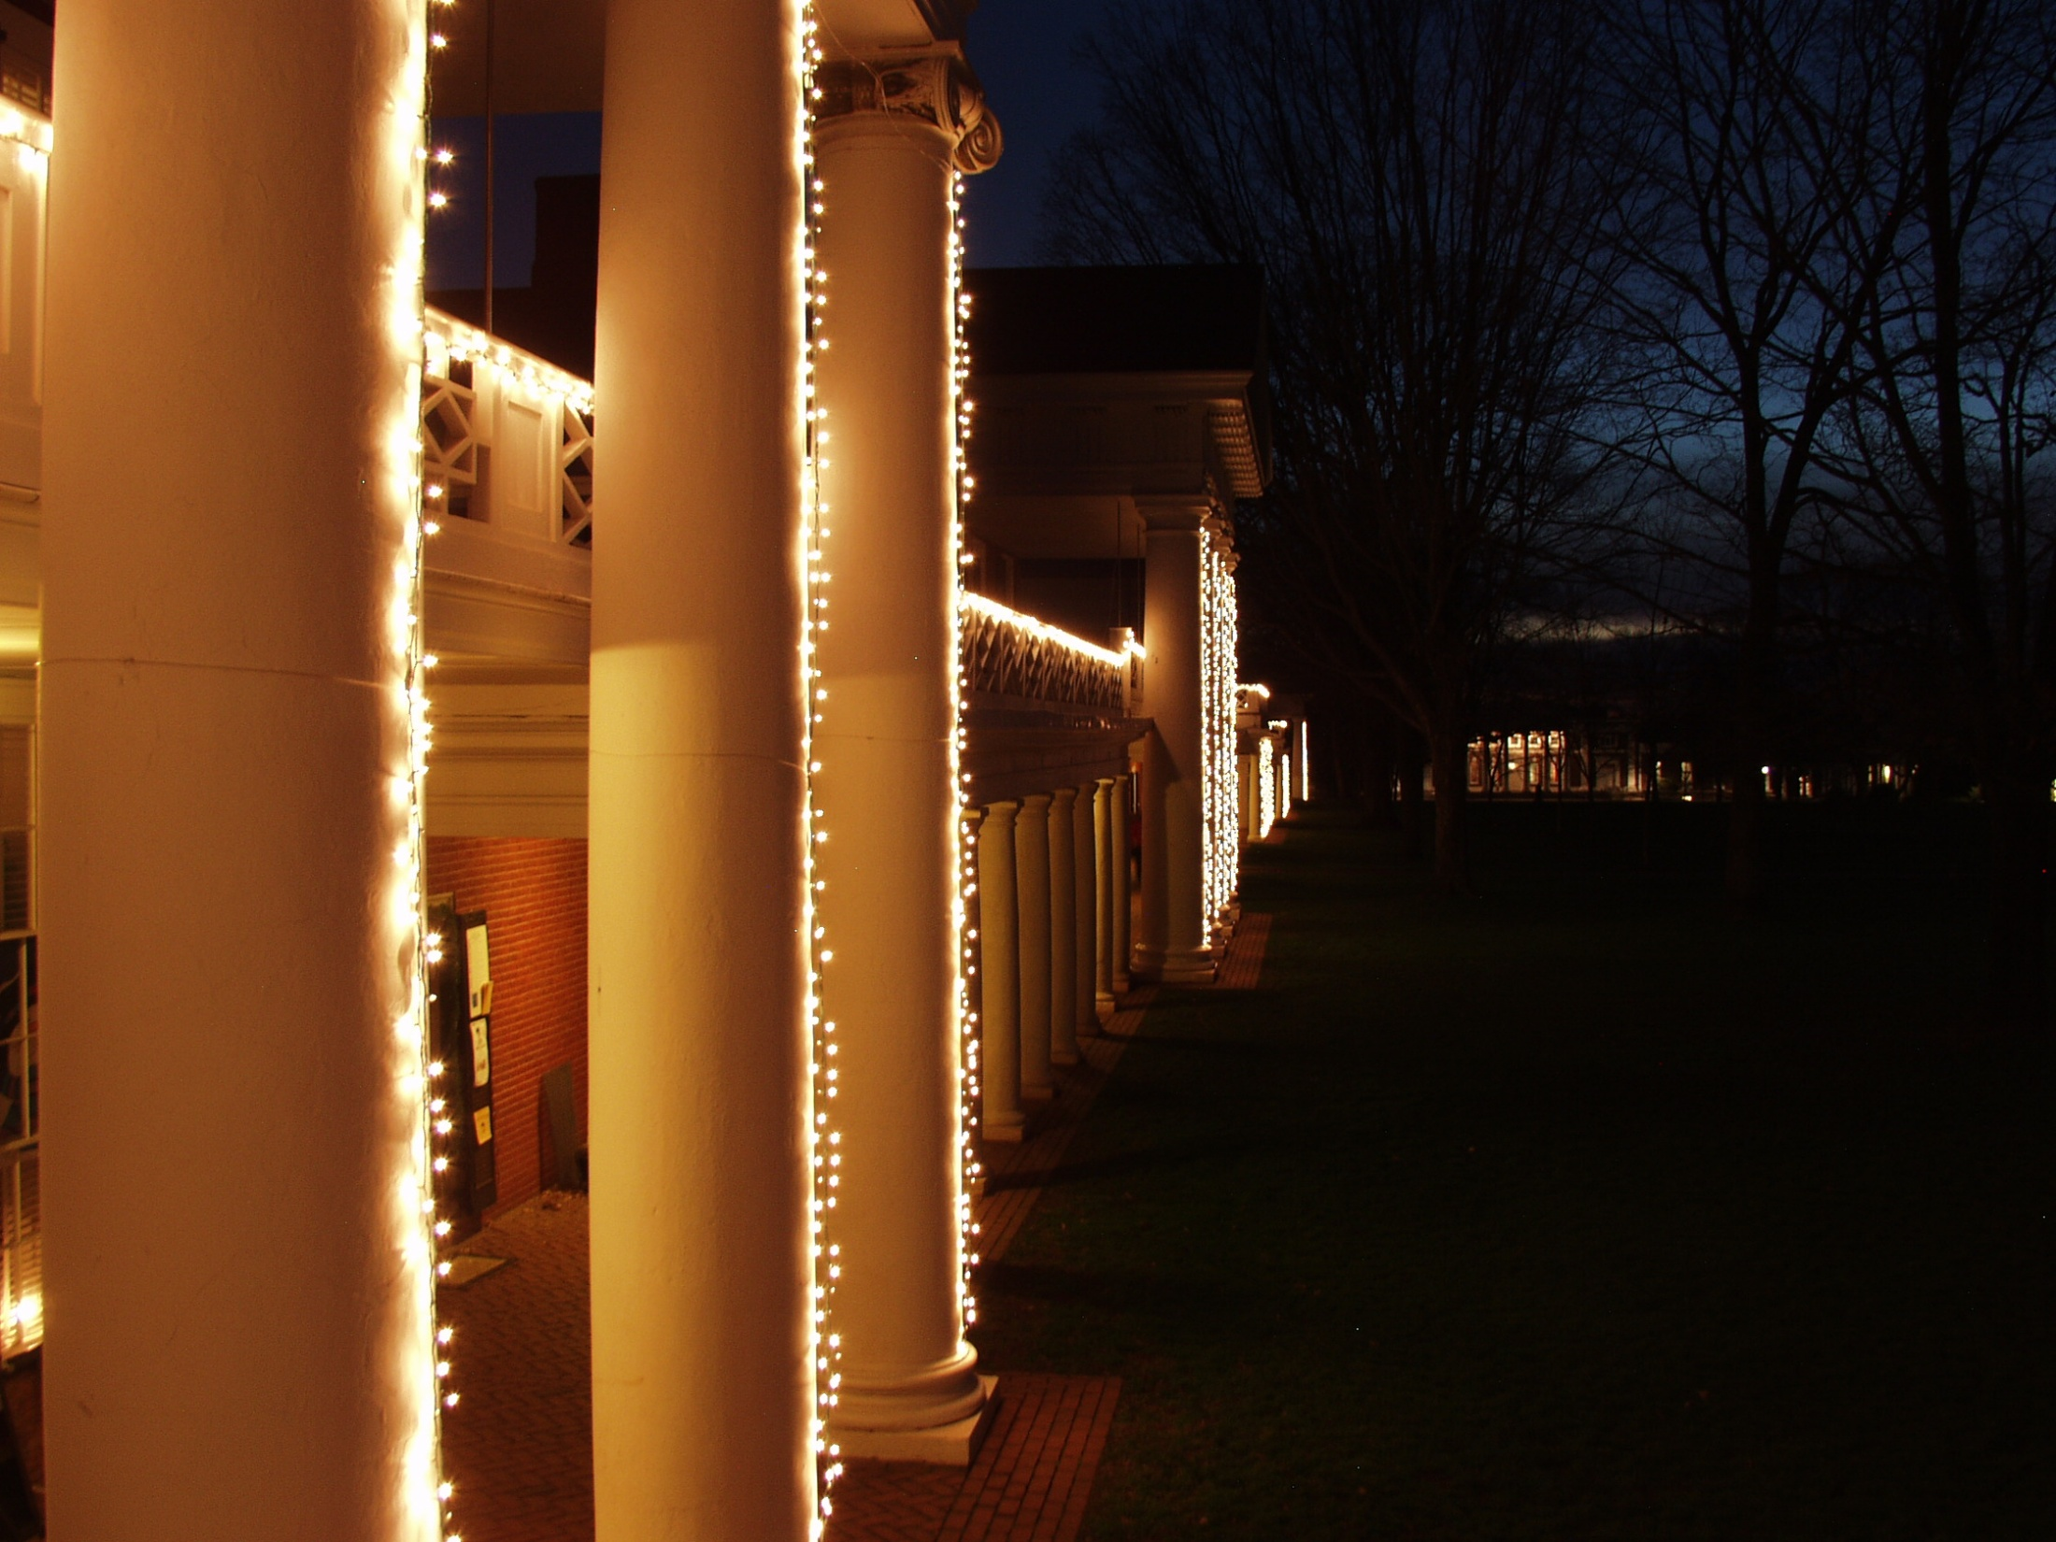
Class 28: Past and Future
cs2220: Engineering Software
Fall 2010
UVa
David Evans

Slide 2
Menu
One Word Course Summary
Is this a Computer Science course?
Presentations Tuesday
Parenthesizing

Slide 3
One Word Course Summary?

Slide 4
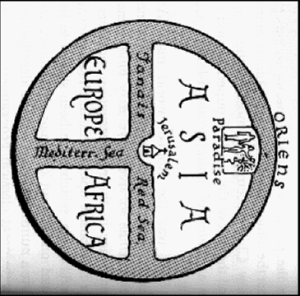
Abstraction
Adapted from Gerard Holzmann’s FSE Slides

Slide 5
Abstraction in cs2220
Abstraction by Specification
Abstract away how by saying what a procedure does
Procedural Abstraction
Abstract away specific inputs from what is done
Data Abstraction
Abstract away representation details by specifying what you can do with something
Subtyping
Abstract away actual type details by allowing many types to be used in the same way
Concurrency Abstraction
Abstract away (some) when details

Slide 6
Is cs2220 a Computer Science course?

Slide 7
cs1120 Class 1

Slide 8
cs1120 Class 1

Slide 9
My Estimate
Computer Science
Programming Languages
cs2220
Software Engineering
Donuts

Slide 10
Project Deliverables
Project Demos/Presentations: Tuesday, 7 December (last class)
Project Final Reports and Teammate Assessments: 11:59pm, Friday, 10 December

Slide 11
Project Presentations
Like all good presentations, your presentation should tell a story not convey a list.
Find a way to present a coherent and compelling story, not just list what you have done!
Provide a clear motivation for the software you have built, explain what problem it solves, and show how someone would use it to solve that problem.
Your presentation should be prepared. There should be a plan for how you will use your time effectively to get the main points across well and how to fit in what you say with your demo.
Up to 10 minutes per team.

Slide 12
Project Reports
Due by 11:59pm Friday, 10 December
Zip file containing all of your code
A single PDF file or paper document:
An updated description of your project idea.
An updated design document.
A description of your testing strategy,
An explanation of what is working and what problems remain. For the problems, explain as much as you understand what the problem is.
If you do an excellent project presentation Tuesday (including a working demo of your project) your team does not need to submit a project report! (You will be notified shortly after class Tuesday.)

Slide 13
Parenthesizing Question
Given an arithmetic expression involving addition, subtraction, and multiplication of natural numbers, add parentheses to maximize the value of the expression.

