Slide 1
cs2220: Engineering Software Class 6: Defensive Programming
Fall 2010
University of Virginia
David Evans

Slide 2
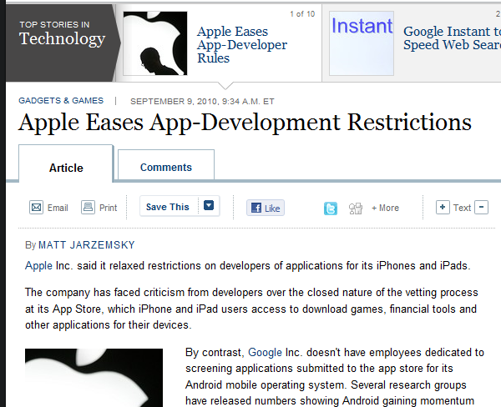
Menu
Recap Validation
Hopelessness of both testing and analysis!
Defensive Programming

Slide 3
Testing
Fishing for Bugs
Each test examines one path through the program
Exhaustive
All possible inputs: infeasible for all non-trivial programs
Path-Complete
All possible paths through the program

Slide 4
Path-Complete Testing?
public static int [] histogram (int [] a)
// unspecified
{
int maxval = 0;
for (int i = 0; i < a.length; i++) {
if (a[i] > maxval) {
maxval = a[i];
}
}
int histo [] = new int [maxval + 1];
for (int i = 0; i < a.length; i++) {
histo[a[i]]++;
}
return histo;
}
How many paths?
Arrays are bounded in java: maximum size is 2³¹-1
First loop:
1 + 2 + 2² + … + 2²³¹⁻¹
Second loop: path completely determined by first loop

Slide 5
Path-Complete Testing
Insufficient
One execution of a path doesn’t cover all behaviors
Often bugs are missing paths
Impossible
Most programs have an “infinite” number of paths
Branching
Can test all paths
Loops and recursion
Test with zero, one and several iterations

Slide 6
Coverage Testing
Statement Coverage:
number of statements executed on at least one test number of statements in program
Can we achieve 100% statement coverage?

Slide 7
Testing Recap
Testing can find problems, but cannot prove your program works
Since exhaustive testing is impossible, select test cases with maximum likelihood of finding bugs
A successful test case is one that reveals a bug in your program!
Typically at least 40% of cost of software project is testing, often >80% of cost for safety-critical software

Slide 8
Is it really hopeless?
Since we can’t test all possible paths through a program, how can we increase our confidence that it works?

Slide 9
Analysis
Make claims about all possible paths by examining the program code directly
Testing (dynamic analysis): checks exactly one program path
Static analysis: reasons about all possible program paths
Use formal semantics of programming language to know what things mean
Use formal specifications of procedures to know that they do

Slide 10
Hopelessness of Analysis
It is impossible to correctly determine if any interesting property is true for an arbitrary program!
The Halting Problem: it is impossible to write a program that determines if an arbitrary program halts.

Slide 11
Compromises
Use imperfect automated tools:
Accept unsoundness and incompleteness
False positives: sometimes an analysis tool will report warnings for a program, when the program is actually okay (unsoundness)
False negatives: sometimes an analysis tool will report no warnings for a program, even when the program violates properties it checks (incompleteness)
Java compiler warnings attempt to do this
Use informal reasoning

Slide 12
Dealing with Hopelessness
Since both testing and analysis are hopeless in general what can we do?
Design for Testability
Design for Analyzability

Slide 13
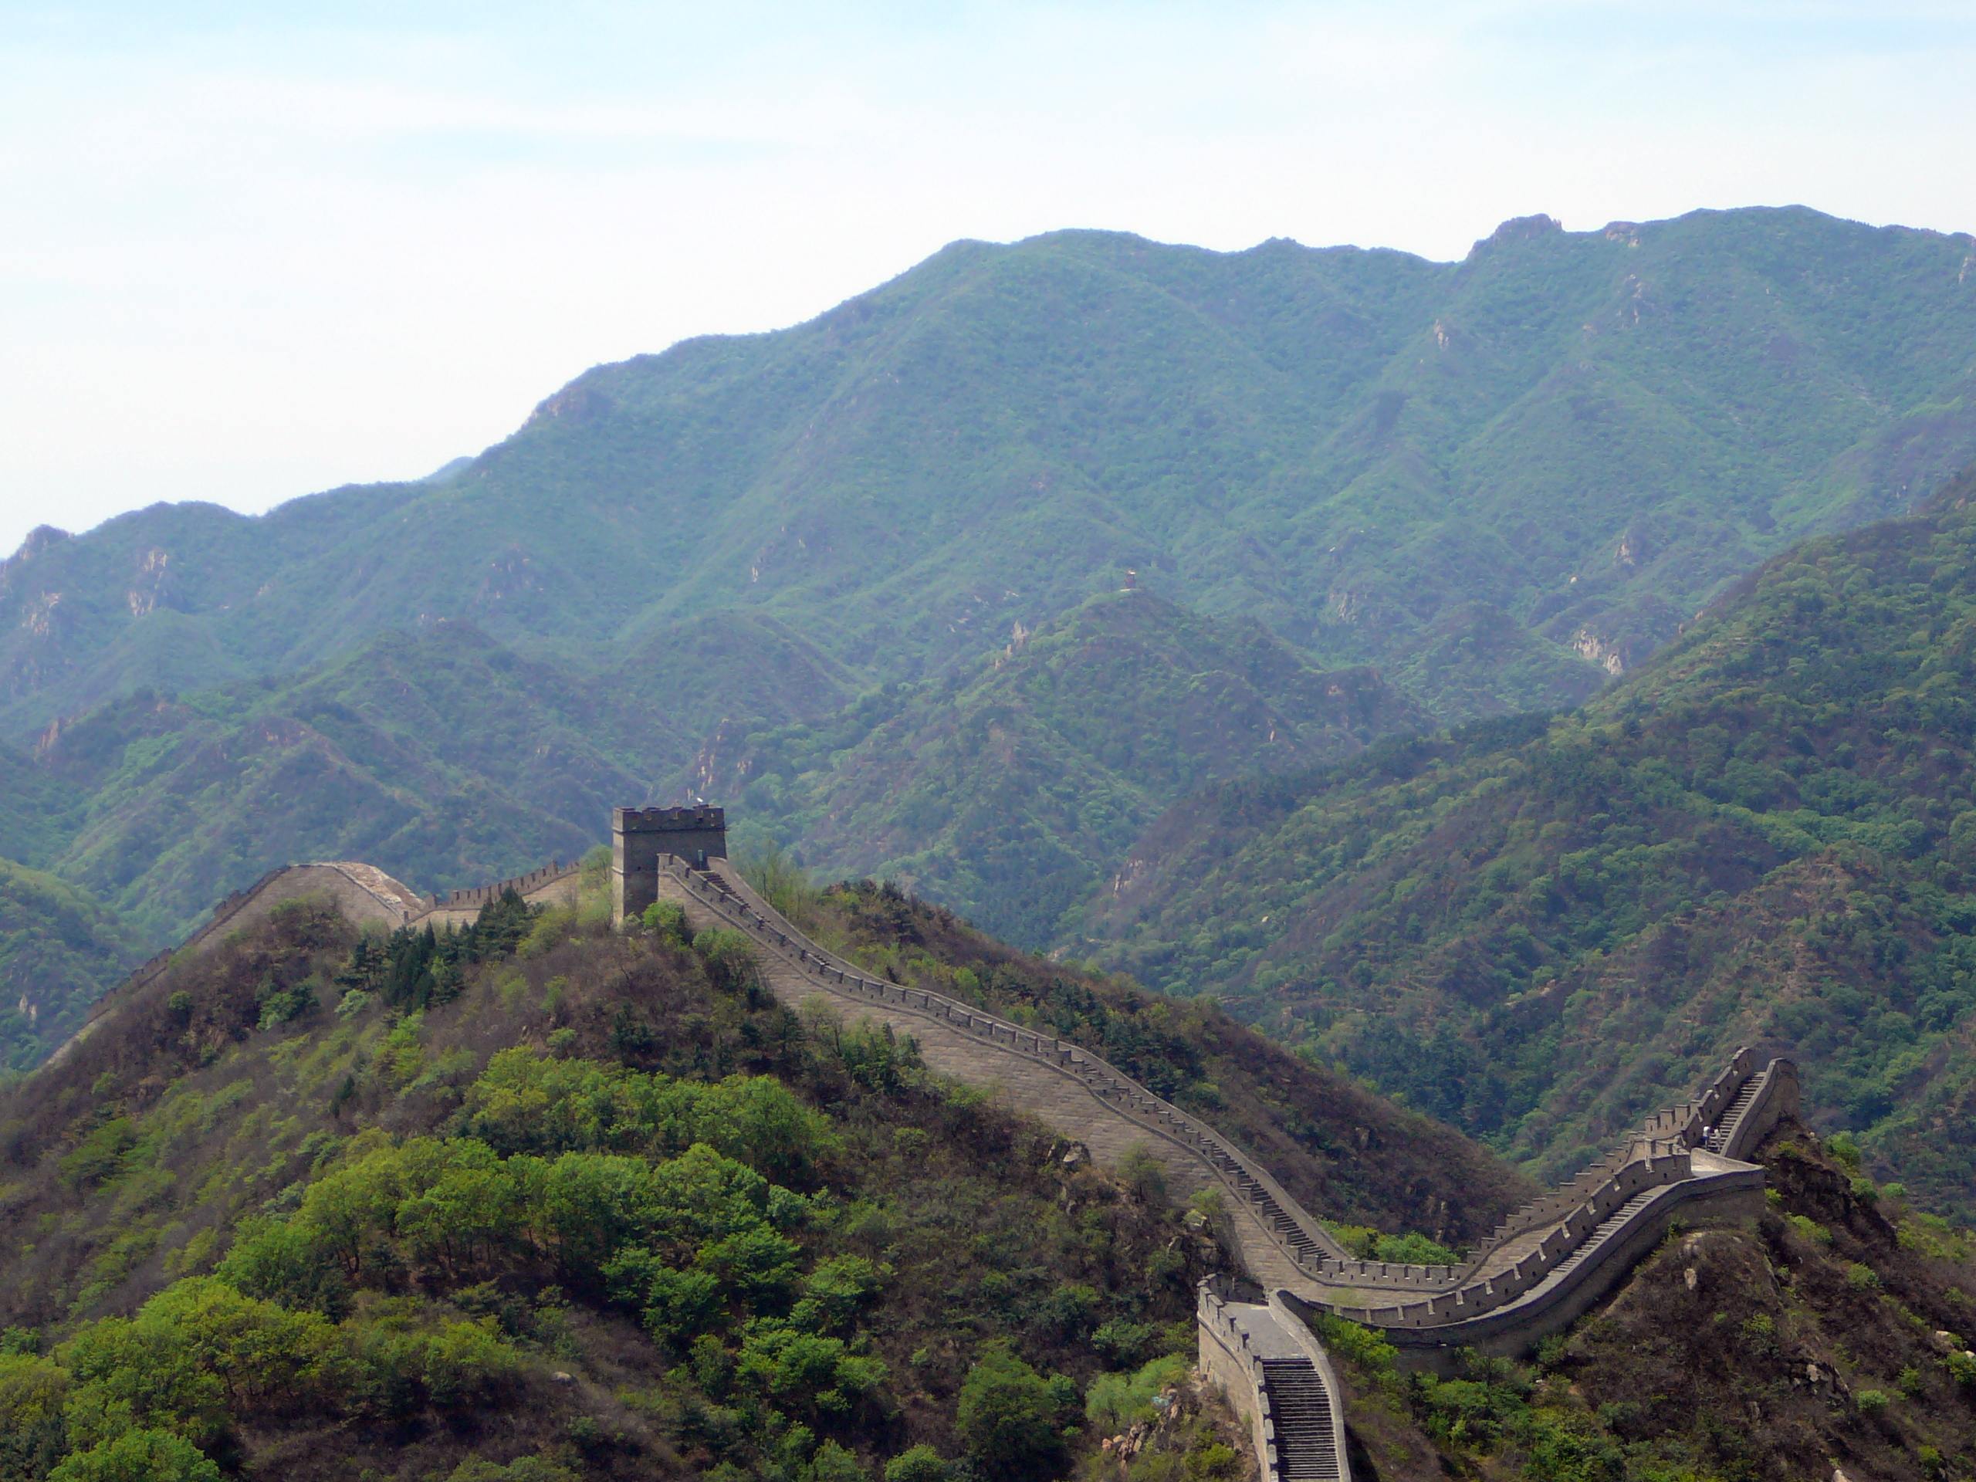
Programming Defensively

Slide 14
Assertions
Statement ::= assert booleanExpression optStringExpression;
booleanExpression ::=
[any Java expression that evaluates to a boolean value]
optStringExpression ::= ε | : stringExpression
stringExpression ::=
[any Java expression that can be converted to a String
value]
Semantics: To evaluate an assert statement, evaluate the booleanExpression.
If the booleanExpression evaluates to true, do nothing. If it is false, the assertion fails and an AssertionException thrown. If there is an optional stringExpression, it is evaluated (and converted to a String) and included in the AssertionException.

Slide 15
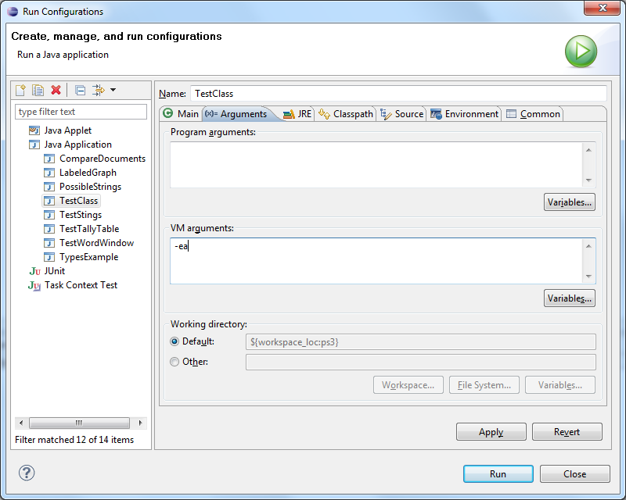
Enabling Assertions
Without this, assert does nothing!

Slide 16
Examples
public class TestClass {
public static double divide(int a, int b) {
assert b != 0;
return (double) a / b;
}
public static void main(String[] args) {
System.out.println (divide (3, 4));
System.out.println (divide (3, 0));
}
0.75
Exception in thread "main" java.lang.AssertionError
at ps3.TestClass.divide(TestClass.java:6)
at ps3.TestClass.main(TestClass.java:16)

Slide 17
Examples
public class TestClass {
public static double divide(int a, int b) {
assert b != 0 : "Division by zero";
return (double) a / b;
}
public static void main(String[] args) {
System.out.println (divide (3, 4));
System.out.println (divide (3, 0));
}
0.75
Exception in thread "main" java.lang.AssertionError: Division by zero
at ps3.TestClass.divide(TestClass.java:6)
at ps3.TestClass.main(TestClass.java:16)

Slide 18
Tricky Example
public static double divide(int a, int b) {
assert b != 0 : divide(a, b);
return (double) a / b;
}
public static void main(String[] args) {
System.out.println (divide (3, 4));
System.out.println (divide (3, 0));
}
0.75
Exception in thread "main" java.lang.StackOverflowError
at ps3.TestClass.divide(TestClass.java:6)
at ps3.TestClass.divide(TestClass.java:6)
at ps3.TestClass.divide(TestClass.java:6)
at ps3.TestClass.divide(TestClass.java:6)
at ps3.TestClass.divide(TestClass.java:6)
…

Slide 19
Where should we use assert?
public static int [] histogram (int [] a)
{
int maxval = 0;
for (int i = 0; i < a.length; i++) {
if (a[i] > maxval) {
maxval = a[i];
}
}
int histo [] = new int [maxval + 1];
for (int i = 0; i < a.length; i++) {
histo[a[i]]++;
}
return histo;
}
To give useful debugging information when a REQUIRES precondition is violated.
To check assumptions on which our code relies.
Judicious use of asserts:
saves debugging time
provides useful documentation
increases confidence in results

Slide 20
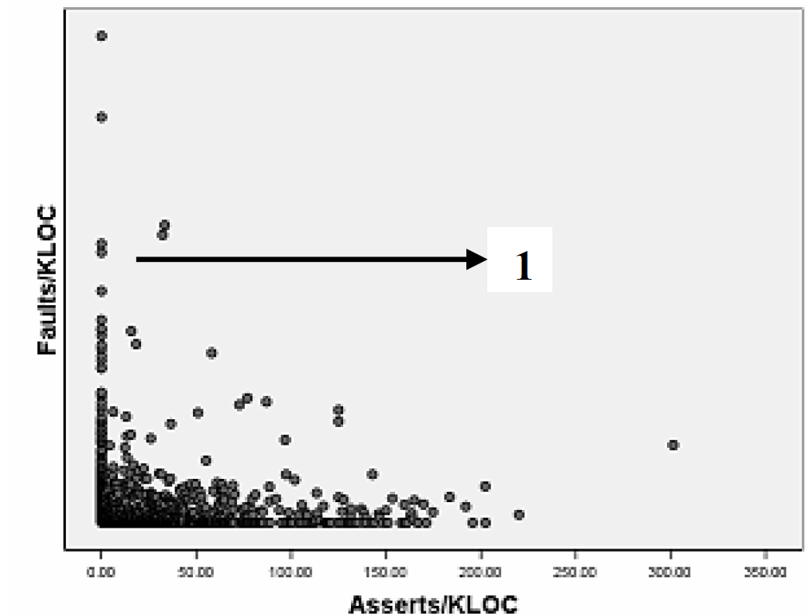
How many assertions?
Gunnar Kudrjavets, Nachiappan Nagappan, Thomas Ball. Assessing the Relationship between Software Assertions and Code Quality: An Empirical Investigation
http://research.microsoft.com/pubs/70290/tr-2006-54.pdf
200 assertions per 1000 lines of code
About 5% of the statements in a good Java program should be asserts!

Slide 21
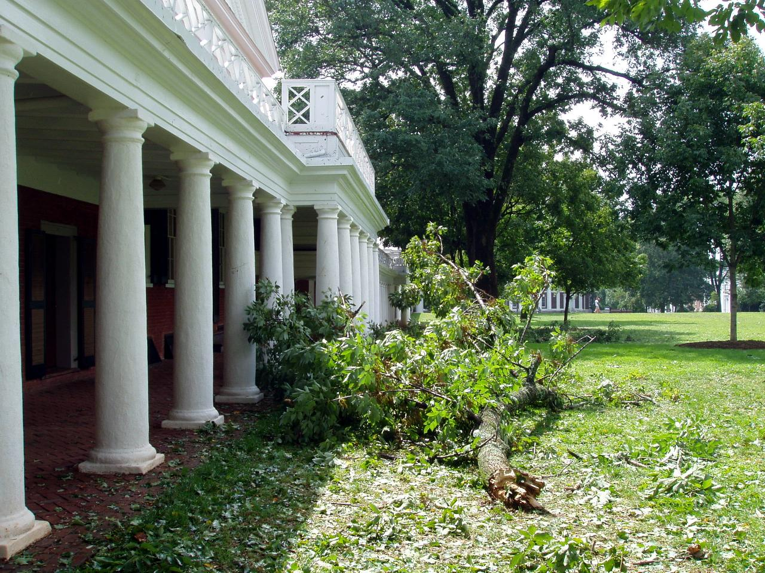
Exceptions

Slide 22
Violating Requires
In C/C++: can lead to anything
Machine crash
Security compromise
Strange results
In Java: often leads to runtime exception
When an assert fails, it generates an Exception.
Other failures also generate Exceptions.

Slide 23
Use Exceptions to Remove Preconditions
public static int biggest (int [ ] a)
// REQUIRES: a has at least one element
// EFFECTS: Returns the value biggest
// element of a.
public static int biggest (int [ ] a)
throws NoElementException
// REQUIRES: true
// EFFECTS: If a has at least one element, returns the
// value biggest element of a. Otherwise, throws
// NoElementException.

Slide 24
Using Biggest with Requires
public static int biggest (int [ ] a)
// REQUIRES: a has at least one element
// EFFECTS: Returns the value biggest
// element of a.
public static void main(String[] args) {
int [] x = new int [0];
System.out.println ("Biggest: " + biggest(x));
…
Exception in thread "main" java.lang.ArrayIndexOutOfBoundsException: 0
at ps3.TestClass.biggest(TestClass.java:6)
at ps3.TestClass.main(TestClass.java:37)

Slide 25
Implementation
public static int biggest (int [] a) {
int res = a[0];
for (int i = 1; i < a.length; i++) {
if (a[i] > res) res = a[i];
}
return res;
}
public static int biggest (int [] a) {
assert a != null && a.length > 0;
int res = a[0];
for (int i = 1; i < a.length; i++) {
if (a[i] > res) res = a[i];
}
return res;
}
Exception in thread "main" java.lang.ArrayIndexOutOfBoundsException: 0
at ps3.TestClass.biggest(TestClass.java:6)
at ps3.TestClass.main(TestClass.java:37)
Exception in thread "main" java.lang.AssertionError
at ps3.TestClass.biggest(TestClass.java:9)
at ps3.TestClass.main(TestClass.java:46)

Slide 26
Using Biggest with Exception
public static int biggest (int [ ] a)
throws NoElementException
// REQUIRES: true
// EFFECTS: If a has at least one element, returns the
// value biggest element of a. Otherwise, throws
// NoElementException.
public static void main(String[] args) {
int [] x = new int [0];
System.out.println ("Biggest: " + biggest(x));
…
TestClass.java:line 41 Unhandled exception type NoElementException
This is a compile-time error: you cannot even run this code.

Slide 27
Catching Exceptions
public static int biggest (int [ ] a) throws NoElementException
// EFFECTS: If a has at least one element, returns the
// value biggest element of a. Otherwise, throws
// NoElementException.
Statement ::= CatchStatement
CatchStatement ::= try Block Handler* OptFinally
Handler ::= catch (ExceptionType Var) Block
OptFinally ::= finally Block | ε
Block ::= { Statement* }
try {
System.out.println ("Biggest: " + biggest(x));
} catch (NoElementException e) {
System.err.println ("No element exception: " + e);
}

Slide 28
Throwing Exceptions
public static int biggest (int [] a) throws NoElementException {
if (a == null || a.length == 0) {
throw new NoElementException();
}
int res = a[0];
for (int i = 1; i < a.length; i++) {
if (a[i] > res) res = a[i];
}
return res;
}
What is NoElementException?

Slide 29
Exceptions are Objects
java.lang.Object
class NoElementException
extends Exception { }
java.lang.Throwable
java.lang.Exception
ps2.NoElementException
We will cover subtyping and inheritance soon.

Slide 30
public Document(String fname, int window)
REQUIRES fname is the pathname for a
readable file
EFFECTS Creates a new document from the
file identified by fname using window size
window.
public Document(String fname, int window)
throws FileNotFoundException
EFFECTS If fname is a readable file, creates a
new document from that file using
window size window. Otherwise, throws
FileNotFoundException.

Slide 31
Using Document
LabeledGraph g = new LabeledGraph();
Document d;
try {
d = new Document(file, window);
g.addNode(file);
} catch (FileNotFoundException fnfe) {
System.err.println("Error: cannot open file: " + file + " [" + fnfe + "]");
} catch (DuplicateNodeException e) {
System.err.println("Error: duplicate file: " + file);
}

Slide 32
Mantra
Be Assertive!
Use assertions judiciously
Exception Exceptionally
Use exceptions to deal with exceptional circumstances
Handling exceptions is tricky: code can jump from anywhere inside to the catch handler!

Slide 33
Charge
Next class: designing and using exceptions exceptionally
Reading: finish Chapter 5 and Chapter 10
“Surprise” quiz possible on Tuesday
Problem Set 3: Designing and Implementing Data Abstractions
will be posted by tomorrow, due Sept 21

