Slide 1
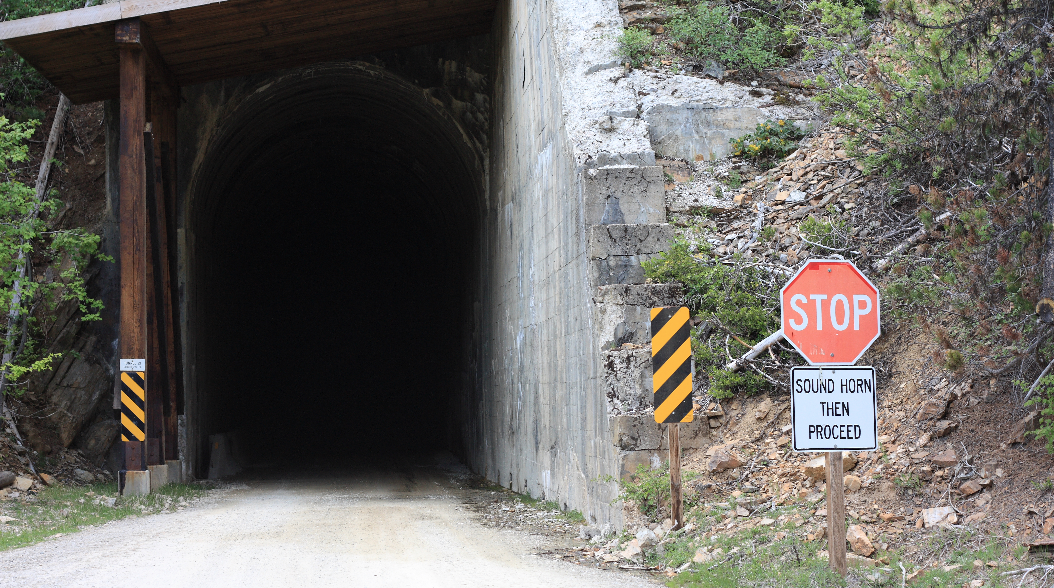
Class 11
Smarter Scheduling (Priorities)
cs4414 Fall 2013
David Evans

Slide 2
Plan for Today
Recap: Scheduling
First Come, First Served / Round-Robin
Priorities
Lottery and Stride Scheduling
Scheduling in Linux

Slide 3

Wil Thomason

Slide 4
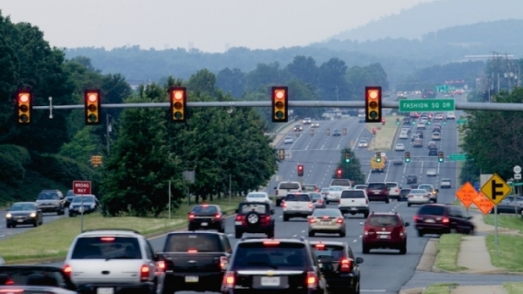
Recap
Main Goals of Scheduling
Maximize Resource Use
Fairness
Switching is Expensive
Fundamental tradeoff between
maximizing usage and fairness

Slide 5
Planned vs. On-Demand
Planned: schedule in advance
Supervisor/developer plans schedule given
a priori knowledge about all tasks and deadlines
On-Demand: schedule on-the-fly
Supervisor runs periodically and makes decision based on current information
Where is planned used?

Slide 6
Real-Time Systems
Hard Real-Time
Missing a deadline is a total system failure.
Soft Real-Time
Undesirable to miss too many deadlines too badly.

Slide 7
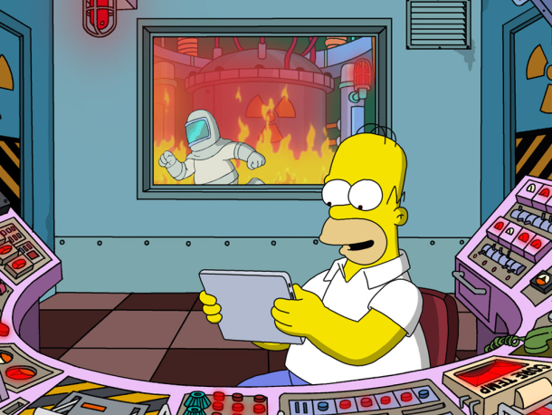
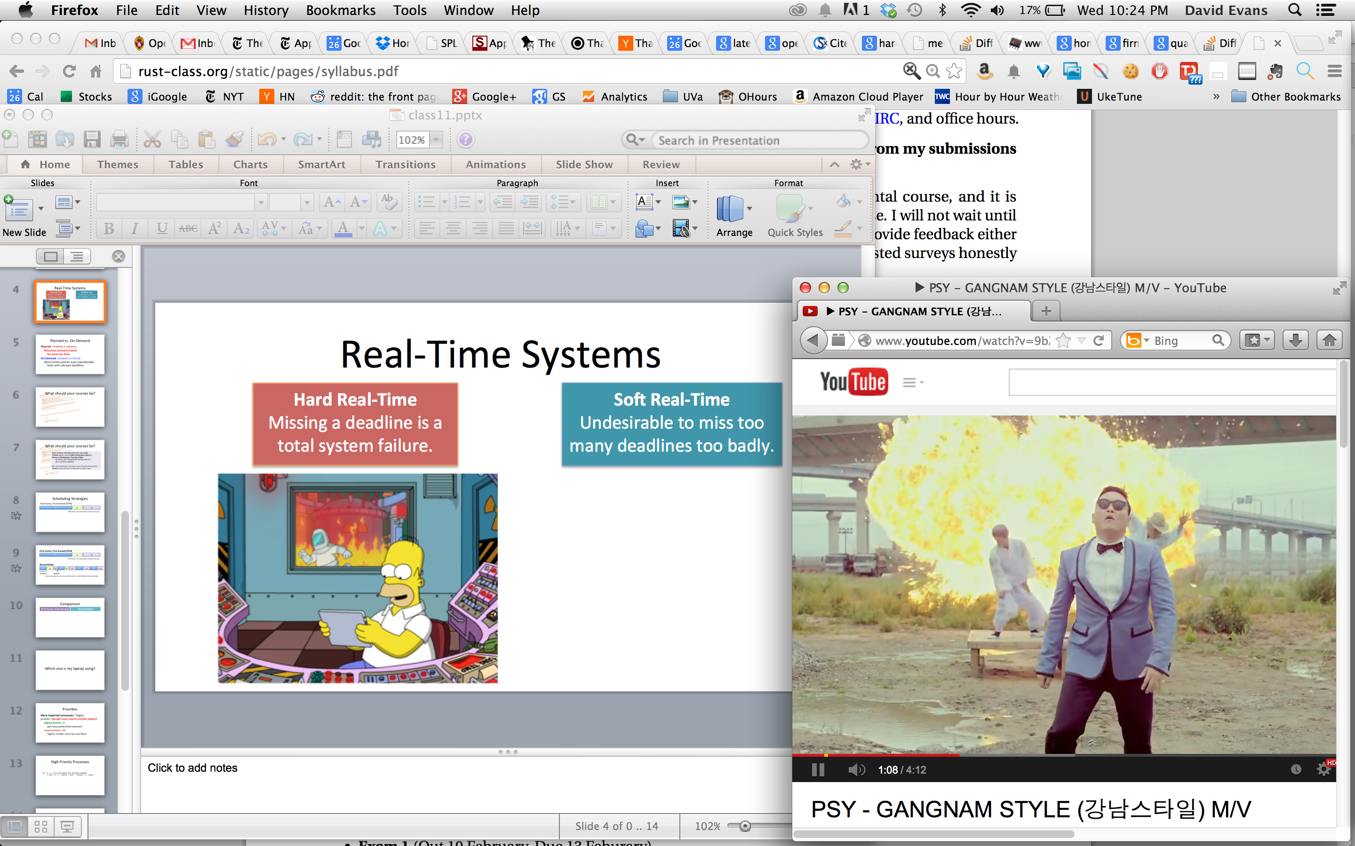
Hard Real-Time
Missing a deadline is a total system failure.
Soft Real-Time
Undesirable to miss too many deadlines too badly.

Slide 8
What must programs be able to do to have guaranteed schedules?

Slide 9
Planned vs. On-Demand
Planned: schedule in advance
Necessary (at least in part)
for hard real time
On-Demand: schedule on-the-fly
Most normal systems have unpredictable tasks with unknown deadlines

Slide 10
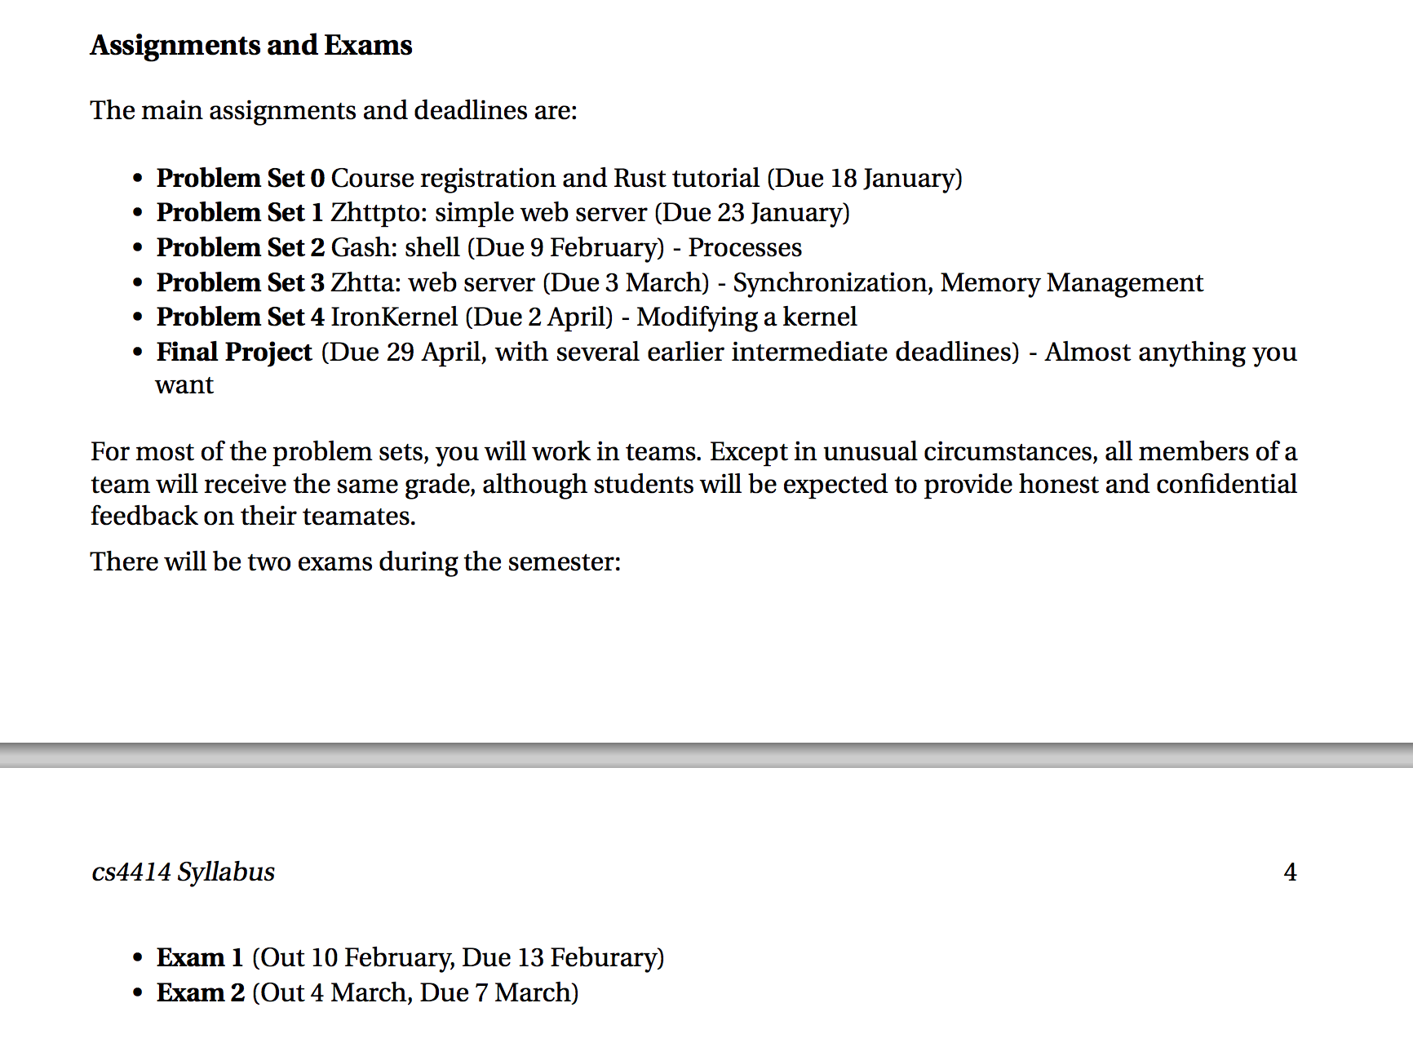
What should your courses be?

Slide 11
What should your courses be?
Exam 2 will be scheduled later (not next week)
Problem Set 3 is due 11:59pm Wednesday, March 5
Demos on Wednesday, Thursday, Friday
No demos after Spring Break barring snow-out
(firm real-time deadline)
But…if you planned a schedule around the previously posted deadlines, you can stick to them (see me after class)

Slide 12
Scheduling Strategies
First Come, First Served (FIFO)
P1
P2
P3
(effectively: non-preemptive multi-processing)

Slide 13
First Come, First Served (FIFO)
P1
P2
P3
(effectively: non-preemptive multi-processing)
Round-Robin
P1
P2
P3
P1
P2
P3
P1
P3
P1
P3
Time Slice
Blocked
Each process gets to run for a set time slice, or until it finished or gets blocked.

Slide 14
Comparison
First Come, First Served
Round Robin

Slide 15
Which one is my laptop using?

Slide 16
Priorities
More important processes: “higher priority” (except Linux inverts priority values!)
Highest priority = 0
gets most preferential treatment
Lowest priority = 99
highest number varies by Linux flavor

Slide 17
High Priority Processes
ps -w -e -o pri,pid,pcpu,vsz,cputime,command
| sort -n -r --key=5 | sort --stable -n --key=1

Slide 18
Pre-emptive Priority Scheduling
Always run the highest priority process that is ready to run
Round-robin schedule among equally high, ready to run, highest-priority processes
P 629
P 124
Waiting:
Priority 0:
Memory Read
P 131
Priority 1:
P 528
Network Data
P 221
Priority 2:
P 44
P 815
P 516
Shared Bus
P 1209

Slide 19

Mars Curiosity (2012)

Slide 20
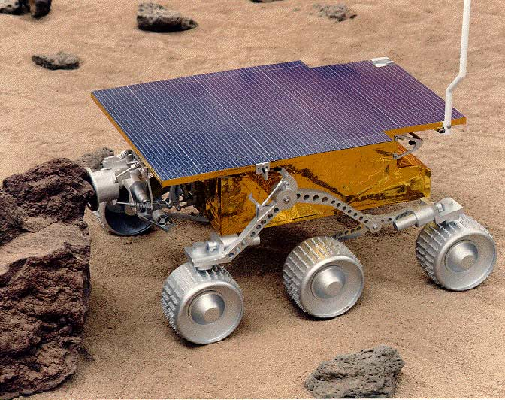
Mars Pathfinder (1997)

Slide 21

Pathfinder OS: Pre-emptive Priority
Always run the highest priority process that is ready to run
Round-robin schedule among equally high, ready to run, highest-priority processes
CPU
Shared Bus
Radio
Camera
Flash Memory
Actuators

Slide 22
Priority Inversion
Task 1 (scheduler) – highest priority (Priority = 1)
Task 2 (send data) – (Priority = 4)
Task 3 (science analysis) – lowest priority (Priority = 97)
CPU
Shared Bus
Radio
Camera
Flash Memory
Actuators

Slide 23
How should we solve priority inversion?

Slide 24
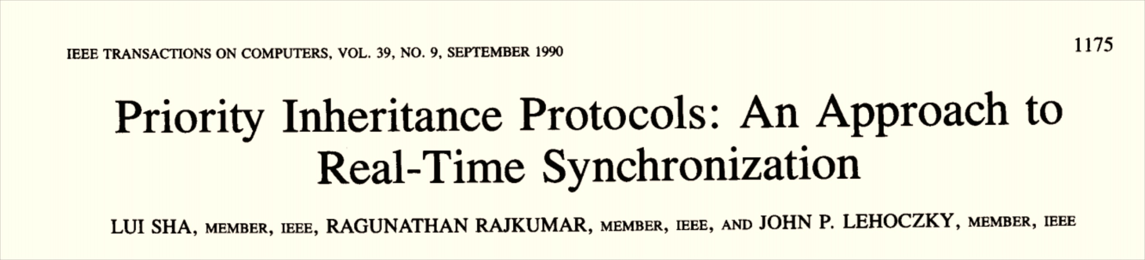
Waiting:
Priority 0:
Memory Read
P 131
Priority 1:
P 528
Network Data
P 221
Priority 2:
P 44
P 815
P 516
Shared Bus
P 1209
PRI: 0
Holds Bus Lock

Slide 25
Should my MacBook use a priority pre-emptive scheduler with priority inheritance?

Slide 26
Should my MacBook use a priority pre-emptive scheduler with priority inheritance?

Slide 27
Kinds of Processes
“Compute-Bound”
P1
“I/O-Bound”
P2
P2
P2
wait for disk…
wait for network…
wait for user…
“Real Time”
P3
P3
P3
P3
need frame ^ need frame ^ need frame ^ need frame ^

Slide 28
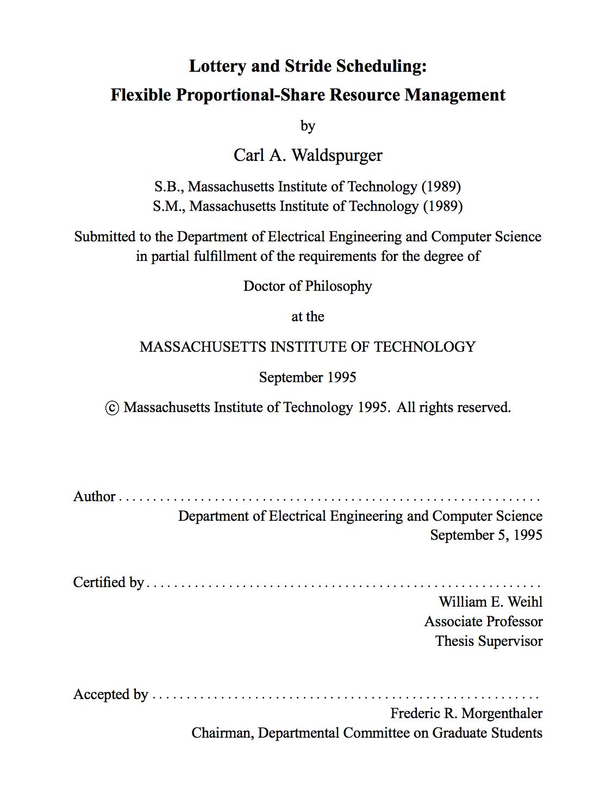

Carl Waldspurger

Slide 29

Lottery Scheduling

Slide 30
Lottery Scheduling
Each user (process) gets a share of the “tickets”
e.g., 1000 total tickets, 20 processes each get 50 tickets (or more/less weighted by priority)
User/process can distribute tickets however it wants
Among its own threads, can “loan” to other processes’ threads
Scheduler: randomly picks a ticket
Associated thread gets to run for that time slice

Slide 31
Priority Pre-Emptive
Lottery Scheduling

Slide 32

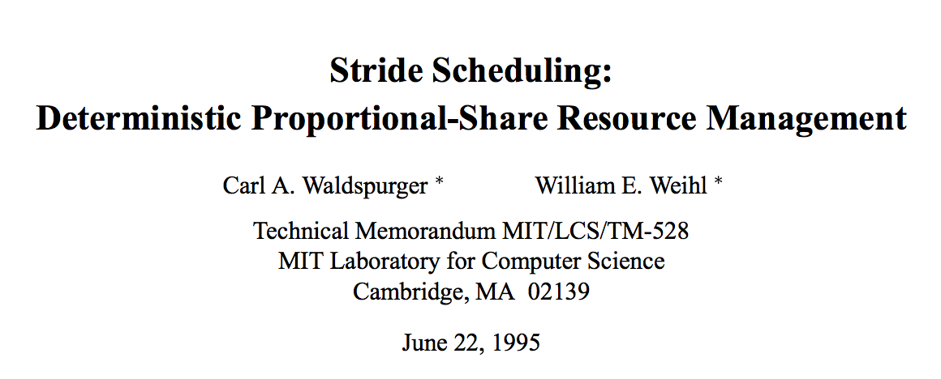

Slide 33
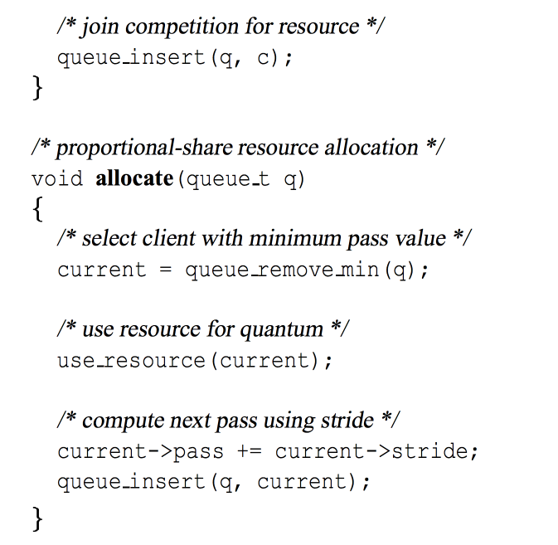
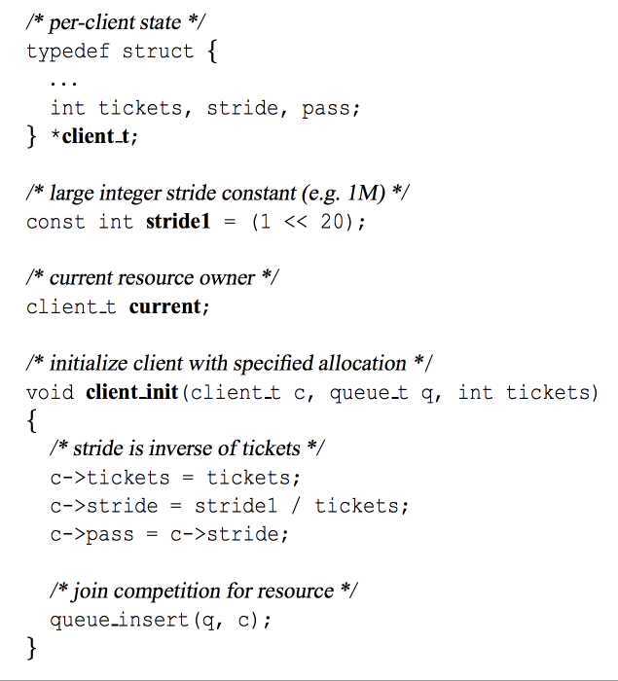

Slide 34
What is the running time?

Slide 35
> uname -a
Linux power2 3.2.0-49-generic #75-Ubuntu SMP Tue Jun 18 17:39:32 UTC 2013 x86_64 x86_64 x86_64 GNU/Linux
> sysctl kernel.pid_max
kernel.pid_max = 32768
What is the running time?

Slide 36
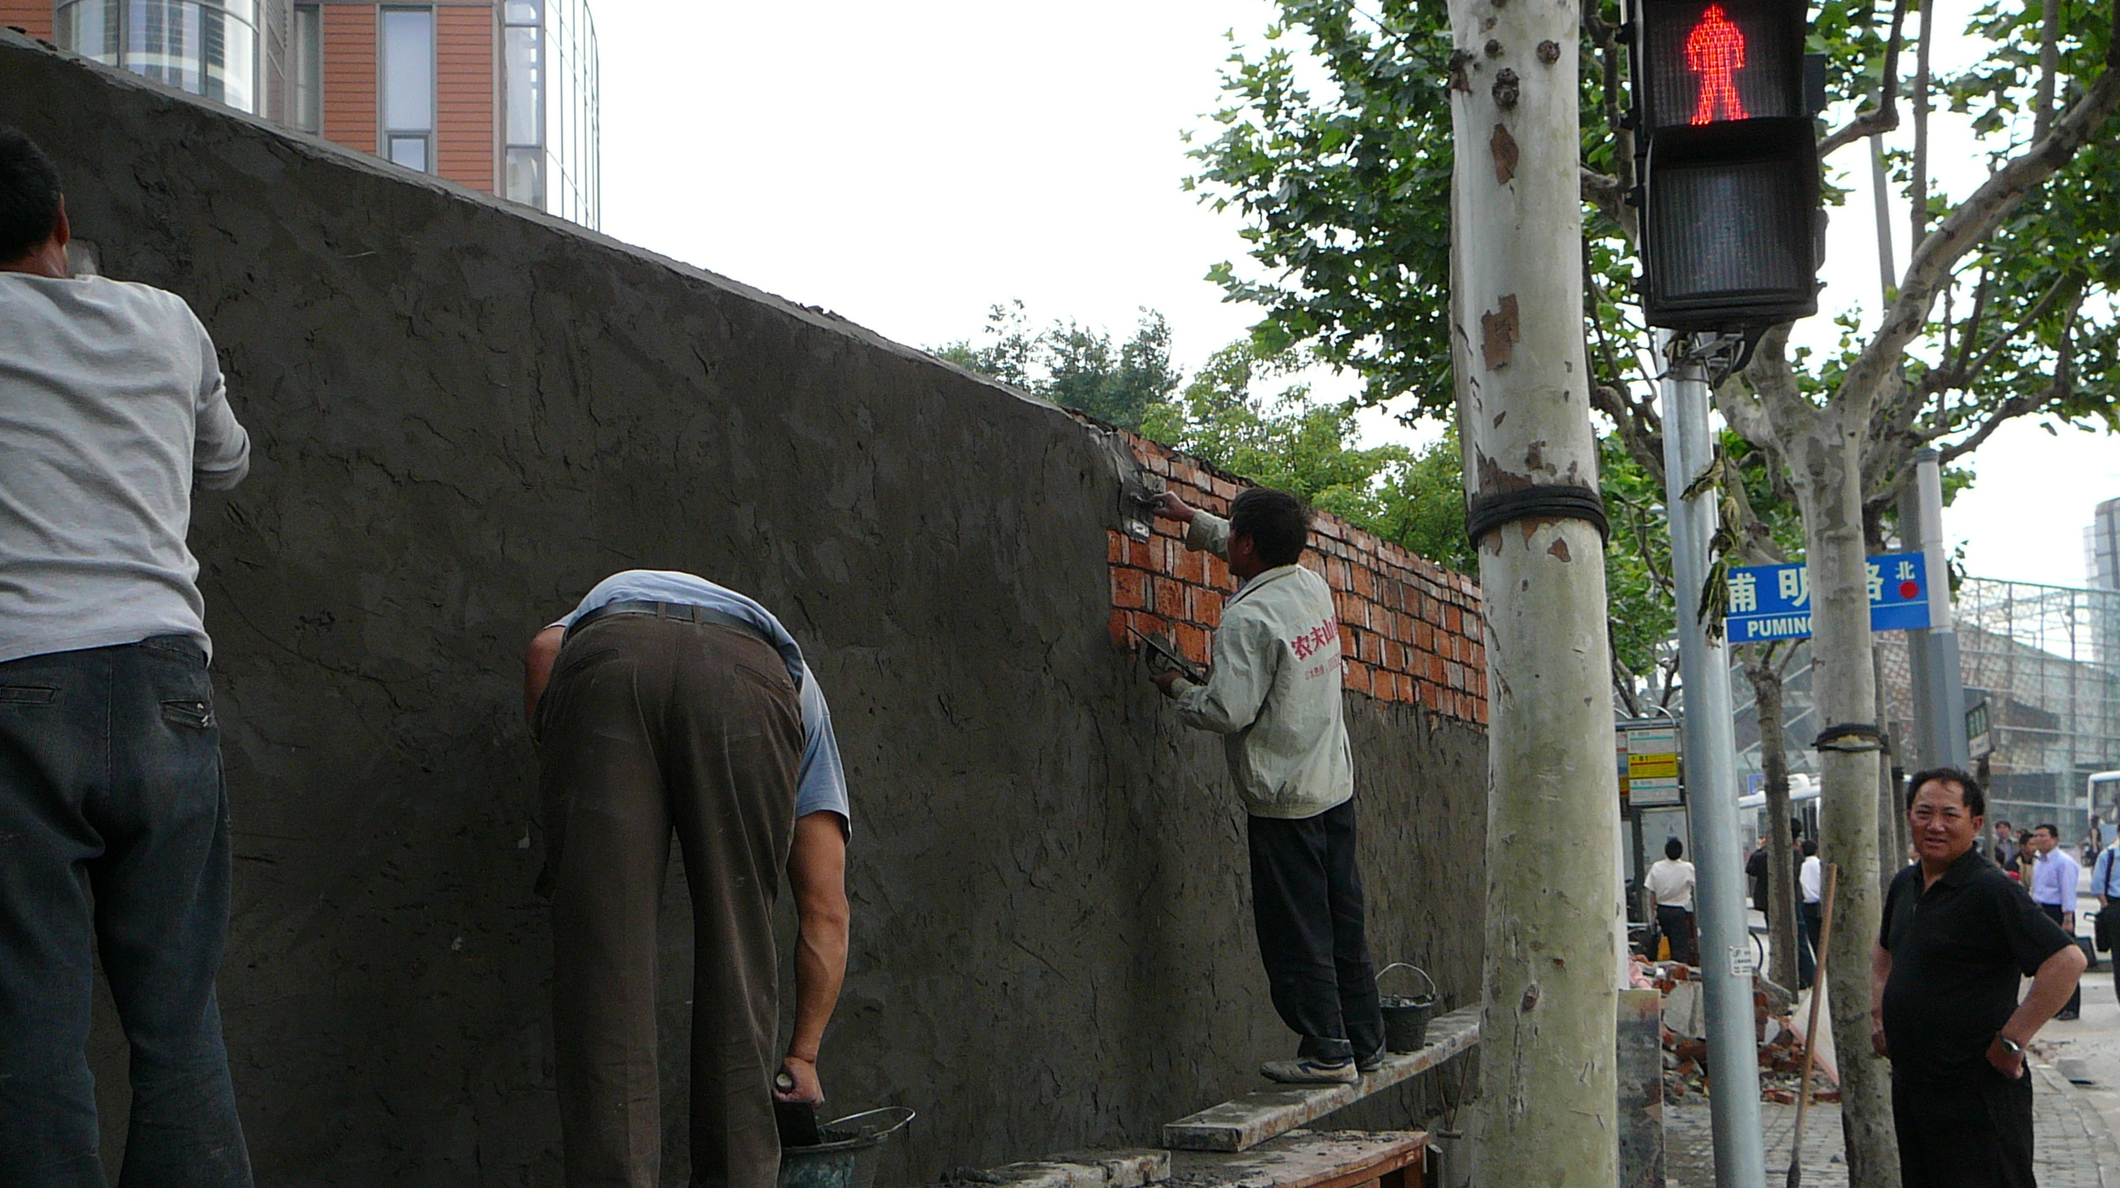
Scheduling in Linux

Slide 37
Linux Scheduler before V2.6 (2002)
Three types of processes:
#define SCHED_OTHER 0
#define SCHED_FIFO 1
#define SCHED_RR 2
Not (fully) pre-emptive:
only user-level processes could be pre-empted
Select next process according to “goodness” function
Normal user processes
Non-prementable
Real-time round-robin
Notes:
http://www.linuxjournal.com/article/3910

Slide 38
/* linux/kernel/sched.c
* This is the function that decides how desirable a process is.
* You can weigh different processes against each other depending
* on what CPU they've run on lately etc to try to handle cache
* and TLB miss penalties.
*
* Return values:
* -1000: never select this
* 0: out of time, recalculate counters (but it might still be selected)
* +ve: "goodness" value (the larger, the better)
* +1000: realtime process, select this.
*/
static inline int goodness(struct task_struct * p, int this_cpu, struct
mm_struct *this_mm)
{
int weight;
/*
* Realtime process, select the first one on the
* runqueue (taking priorities within processes
* into account).
*/
if (p->policy != SCHED_OTHER) {
weight = 1000 + p->rt_priority;
goto out;
}
/*
* Give the process a first-approximation goodness value
* according to the number of clock-ticks it has left.
*
* Don't do any other calculations if the time slice is
* over..
*/
weight = p->counter;
if (!weight)
goto out;
#ifdef __SMP__
/* Give a largish advantage to the same processor... */
/* (this is equivalent to penalizing other processors) */
if (p->processor == this_cpu)
weight += PROC_CHANGE_PENALTY;
#endif
/* .. and a slight advantage to the current MM */
if (p->mm == this_mm)
weight += 1;
weight += p->priority;
out:
return weight;
}
/* linux/kernel/sched.c
* This is the function that decides how desirable a process is.
* You can weigh different processes against each other depending
* on what CPU they've run on lately etc to try to handle cache
* and TLB miss penalties.
*
* Return values:
* -1000: never select this
* 0: out of time, recalculate counters (but it might still be selected)
* +ve: "goodness" value (the larger, the better)
* +1000: realtime process, select this.
*/
static inline int goodness(struct task_struct * p, int this_cpu,
struct mm_struct *this_mm)
{
…

Slide 39
static inline int goodness(struct task_struct * p, int this_cpu, struct mm_struct *this_mm)
{
int weight;
/* Realtime process, select the first one on the runqueue (taking priorities into account). */
if (p->policy != SCHED_OTHER) {
weight = 1000 + p->rt_priority;
goto out;
}
/* Give the process a first-approximation goodness value according to the number of clock-ticks it has left. Don't do any other calculations if the time slice is over.. */
weight = p->counter;
if (!weight)
goto out;
#ifdef __SMP__
/* Give a largish advantage to the same processor... (equivalent to penalizing other processors) */
if (p->processor == this_cpu)
weight += PROC_CHANGE_PENALTY;
#endif
/* .. and a slight advantage to the current MM (memory segment) */
if (p->mm == this_mm) weight += 1;
weight += p->priority;
out:
return weight;
}

Slide 40
What is the running time of the Linux 2.2-2.5 Scheduler?

Slide 41

What is the running time of the Linux 2.2-2.5 Scheduler?

Slide 42
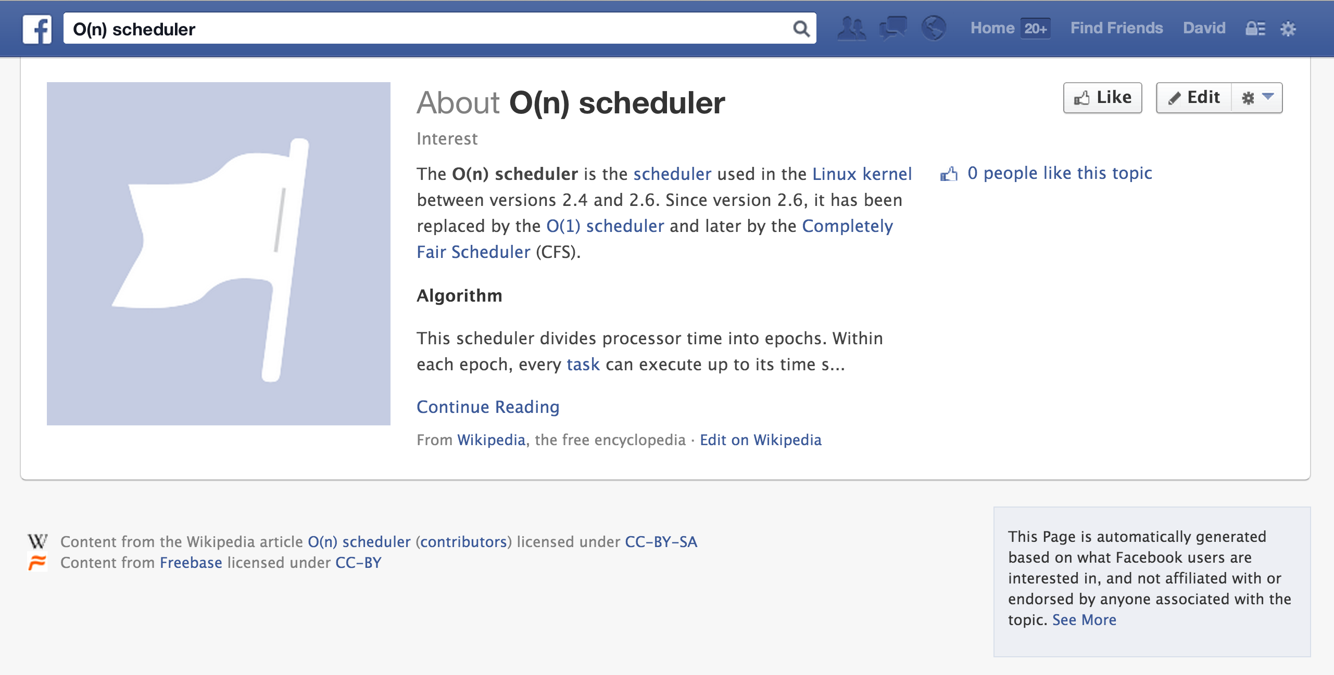
It was called the “O(n) scheduler”

Slide 43
Linux 2.6 Scheduler (2003-2007)
140 different queues (for each processor)
0-99 for “real time” processes
100-139 for “normal” processes
Bit vector keeps track of which queues have ready to run process
Scheduler picks first process from highest priority queue with a ready process
Give it time quantum that scales with priority

Slide 44
struct runqueue {
struct prioarray *active;
struct prioarray *expired;
struct prioarray arrays[2];
};
struct prioarray
{
int nr_active; /* # Runnable */
unsigned long bitmap[5];
struct list_head queue[140];
};

Slide 45
What is the running time of the Linux 2.6 Scheduler?

Slide 46
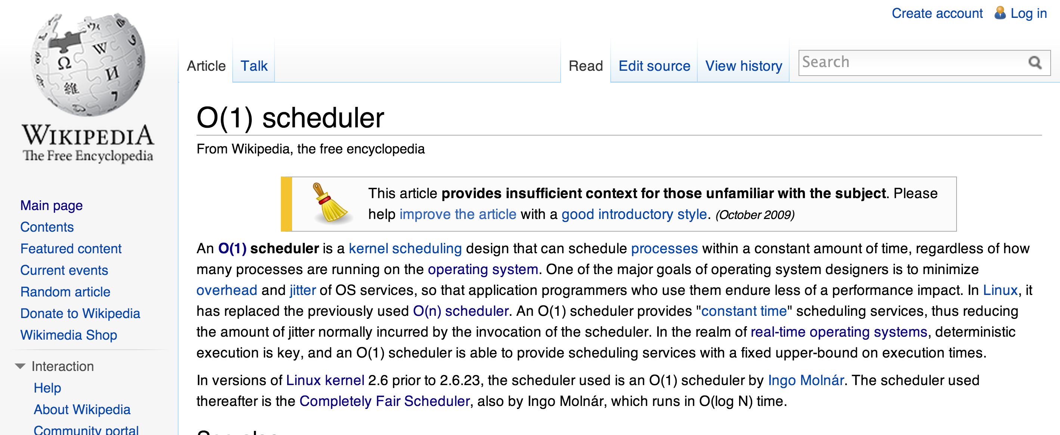
(Sadly, O(1) scheduler has no Facebook page.)

Slide 47
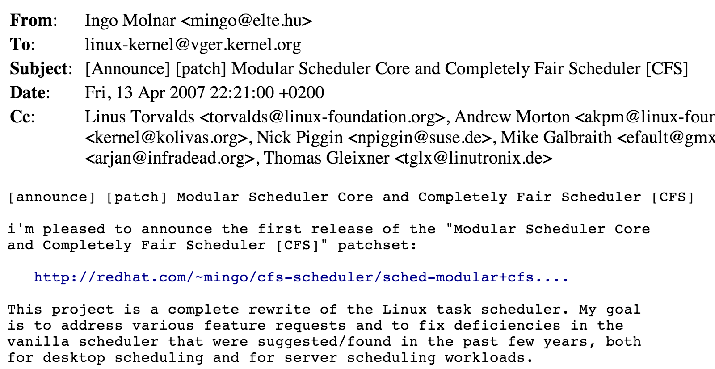
Linux V2.6.23+ Scheduler

Slide 48
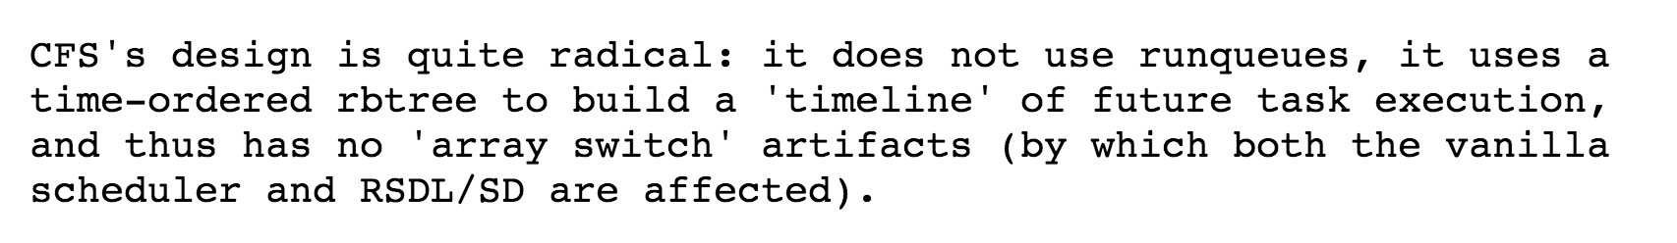
Rotating Staircase Deadline Scheduler
This is exactly stride scheduling (but with different terminology)!

Slide 49
What is the running time of the Linux 2.6.23+ Scheduler?
Not called the θ(log N) scheduler – by Linux 2.6.23 marketing
matters: “Completely Fair Scheduler”

Slide 50
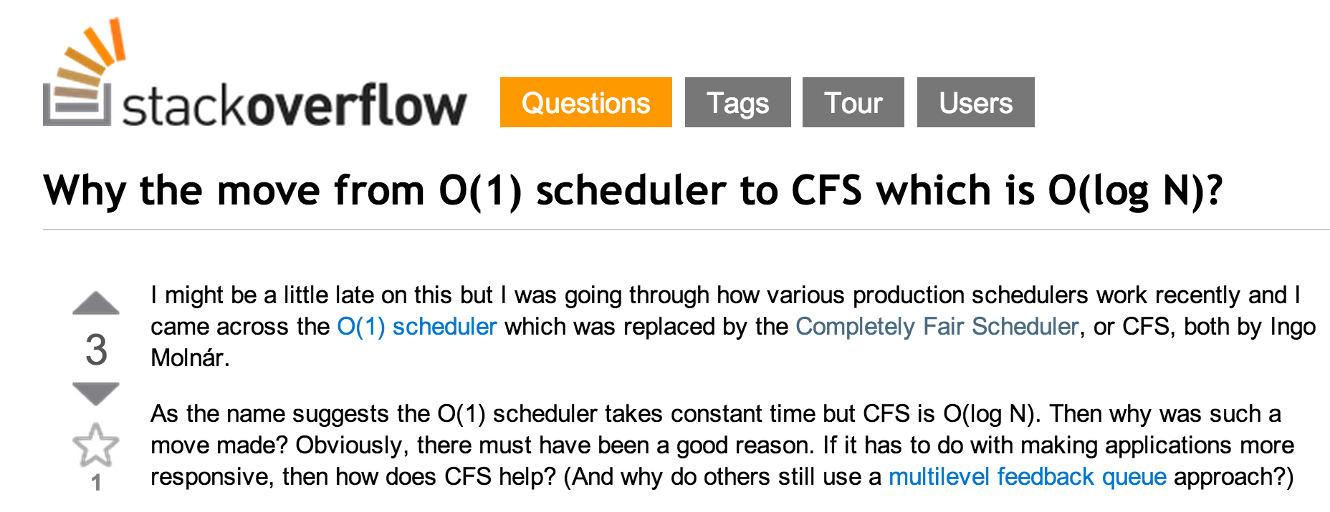
(In practice) What is log₂ N?

Slide 51
Charge
Stride scheduling works (in real life also)!
Much smarter than priority pre-emptive (never finish anything) or first-come first-served or earliest-deadline-first. (Unless you like to live serendipitously: then you should use lottery scheduling)
Problem Set 3 should have high (but not quite hard real-time) priority! (and try to turn off interrupts when you work on it!)

