Slide 1

The Internet
Class 13
cs4414 Fall 2013
David Evans

Slide 2
Plan for Today
PS3 Benchmarking
Networking

Slide 3
Plan for Rest of Course
Spring Break!
March 18-April 3: Problem Set 4
Hacking a Kernel (Entering Ring 0!)
April 29 (Final Project Due)
You get a real break for Spring Break! (Unless you have catching up to do…)
But, use it to think of project ideas – if you come up with something good, can substitute for PS4

Slide 4
Project
Do something that is:
fun (for you to do, and others to see)
relevant (to the class)
technically interesting (to you and me)
useful (at least to you, hopefully to many)
You probably can’t maximize all of these! It is okay to sacrifice one or two of them to increase others. A good project should be strong on at least 2 of these, which is much better than being mediocre of all four.

Slide 5
Project Teams
Anyone you want
Size: 1-65+ people (recommended: 2-5)
Okay to include people not in class “Impressiveness” should scale as sqrt(N)
(N = # of teammates in class)
Choose your teammates carefully and manage it well.
You don’t need to finalize your team or project idea until April (after PS4), but
if you know what you want to do, and want to substitute for PS4, can start early

Slide 6
Ideas for Projects
Some interesting systems-level program
Some contribution to Rust
Some contribution to computing
Doesn’t have to be a program
See http://rust-class.org/pages/final-projects.html for what students did last semester

Slide 7

Benchmarking “Competitions” vs. Useful Benchmarking

Slide 8
Why Benchmark?

Slide 9
“Customer” Benchmarks
Allow fair and accurate comparisons between different solutions
Standard accepted by all/many vendors
Goal is a benchmark that represents well the (anticipated) actual usage for “typical” users

Slide 10
“Cheating” on Benchmarks
How could you “cheat” on a benchmark?

Slide 11


Slide 12
On the Exynos 5410, Samsung was detecting the presence of certain benchmarks and raising thermal limits (and thus max GPU frequency) in order to gain an edge on those benchmarks, and
On both Snapdragon 600 and Exynos 5410 SGS4 platforms, Samsung was detecting the presence of certain benchmarks and automatically driving CPU voltage/frequency to their highest state right away. Also on Snapdragon platforms, all cores are plugged in immediately upon benchmark detect.

Slide 13
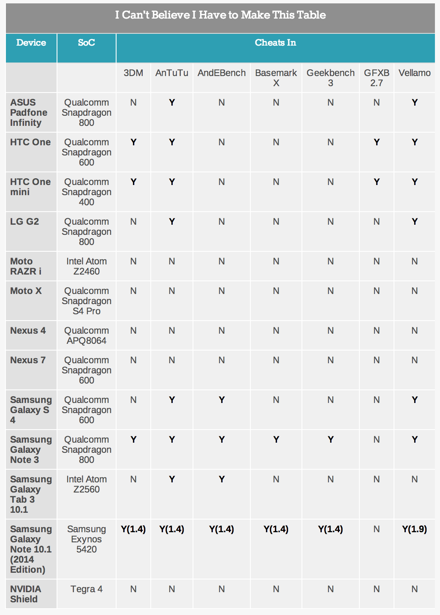
Everyone (except Google and NVidia) is cheating!
Samsung is just better at it than anyone else.

Slide 14
Is It Possible to Prevent Benchmark “Cheating”?

Slide 15

Benchmarking Zhttas

Slide 16
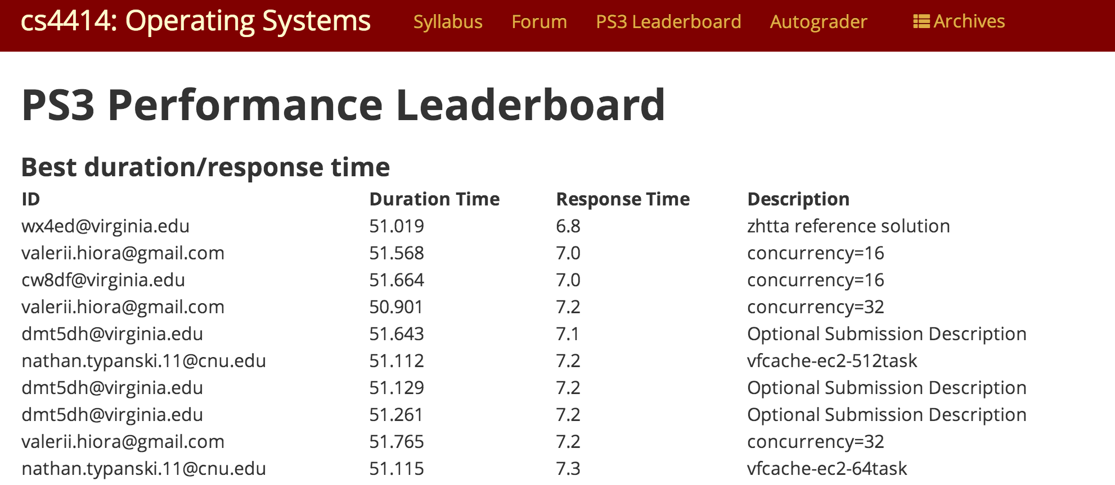
http://128.143.136.170:4414/leaderboard.html at 14-03-06-00-00-24

Slide 17
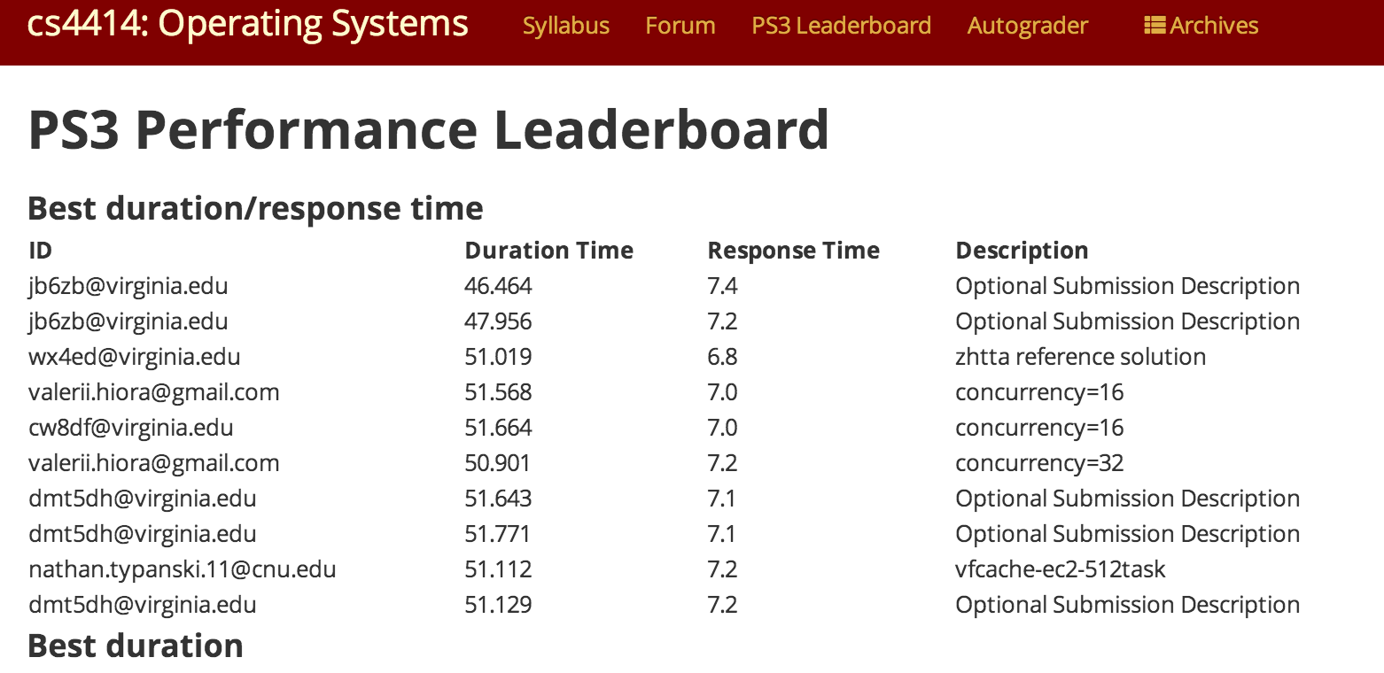
submitted at 6:26am
Jyotiska Biswas
Anat Gilboa
Mike Recachinas

Slide 18
Crash Course in Networking

Slide 19
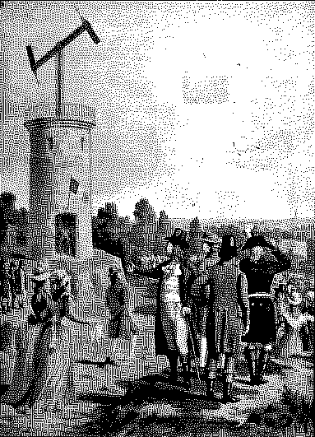

Chappe’s Semaphore Network
First Line (Paris to Lille), 1794

Slide 20
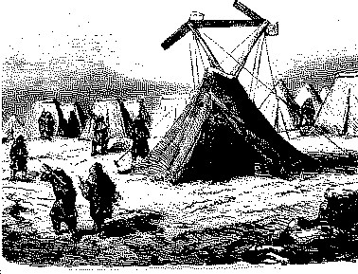
Mobile Semaphore Telegraph Used in the Crimean War 1853-1856

Slide 21
Measuring Networks
Latency
Time from sending a bit until it arrives
seconds (or seconds per geographic distance)
Bandwidth
Rate at which can you transmit
bits per second

Slide 22
Measuring Networks
Latency
Bandwidth
seconds
milliseconds

Slide 23
Measuring Networks
Latency
Bandwidth
Best: 6.8ms/request
Total bytes: 280MB / 46.46s
Bandwidth: ~ 6.0 MB/second
seconds
milliseconds

Slide 24
Latency: 13 minutes
(1.6s per mile)
Virginia to California:
~1 hour
Bandwidth: 2 symbols per minute
(98 symbols: ~13 bits/min)
Get http://rust-class.org:
18 days
Napoleon’s Network
Paris to Toulon, 475 miles

Slide 25
Improving Latency

Slide 26
Improving Latency
Fewer Transfers
Longer distances between transfers
Taller towers (or use wires!)
Faster Transfers
Faster Inter-Transfer Travel
Electrons in copper: about 1/3rd speed of light

Slide 27
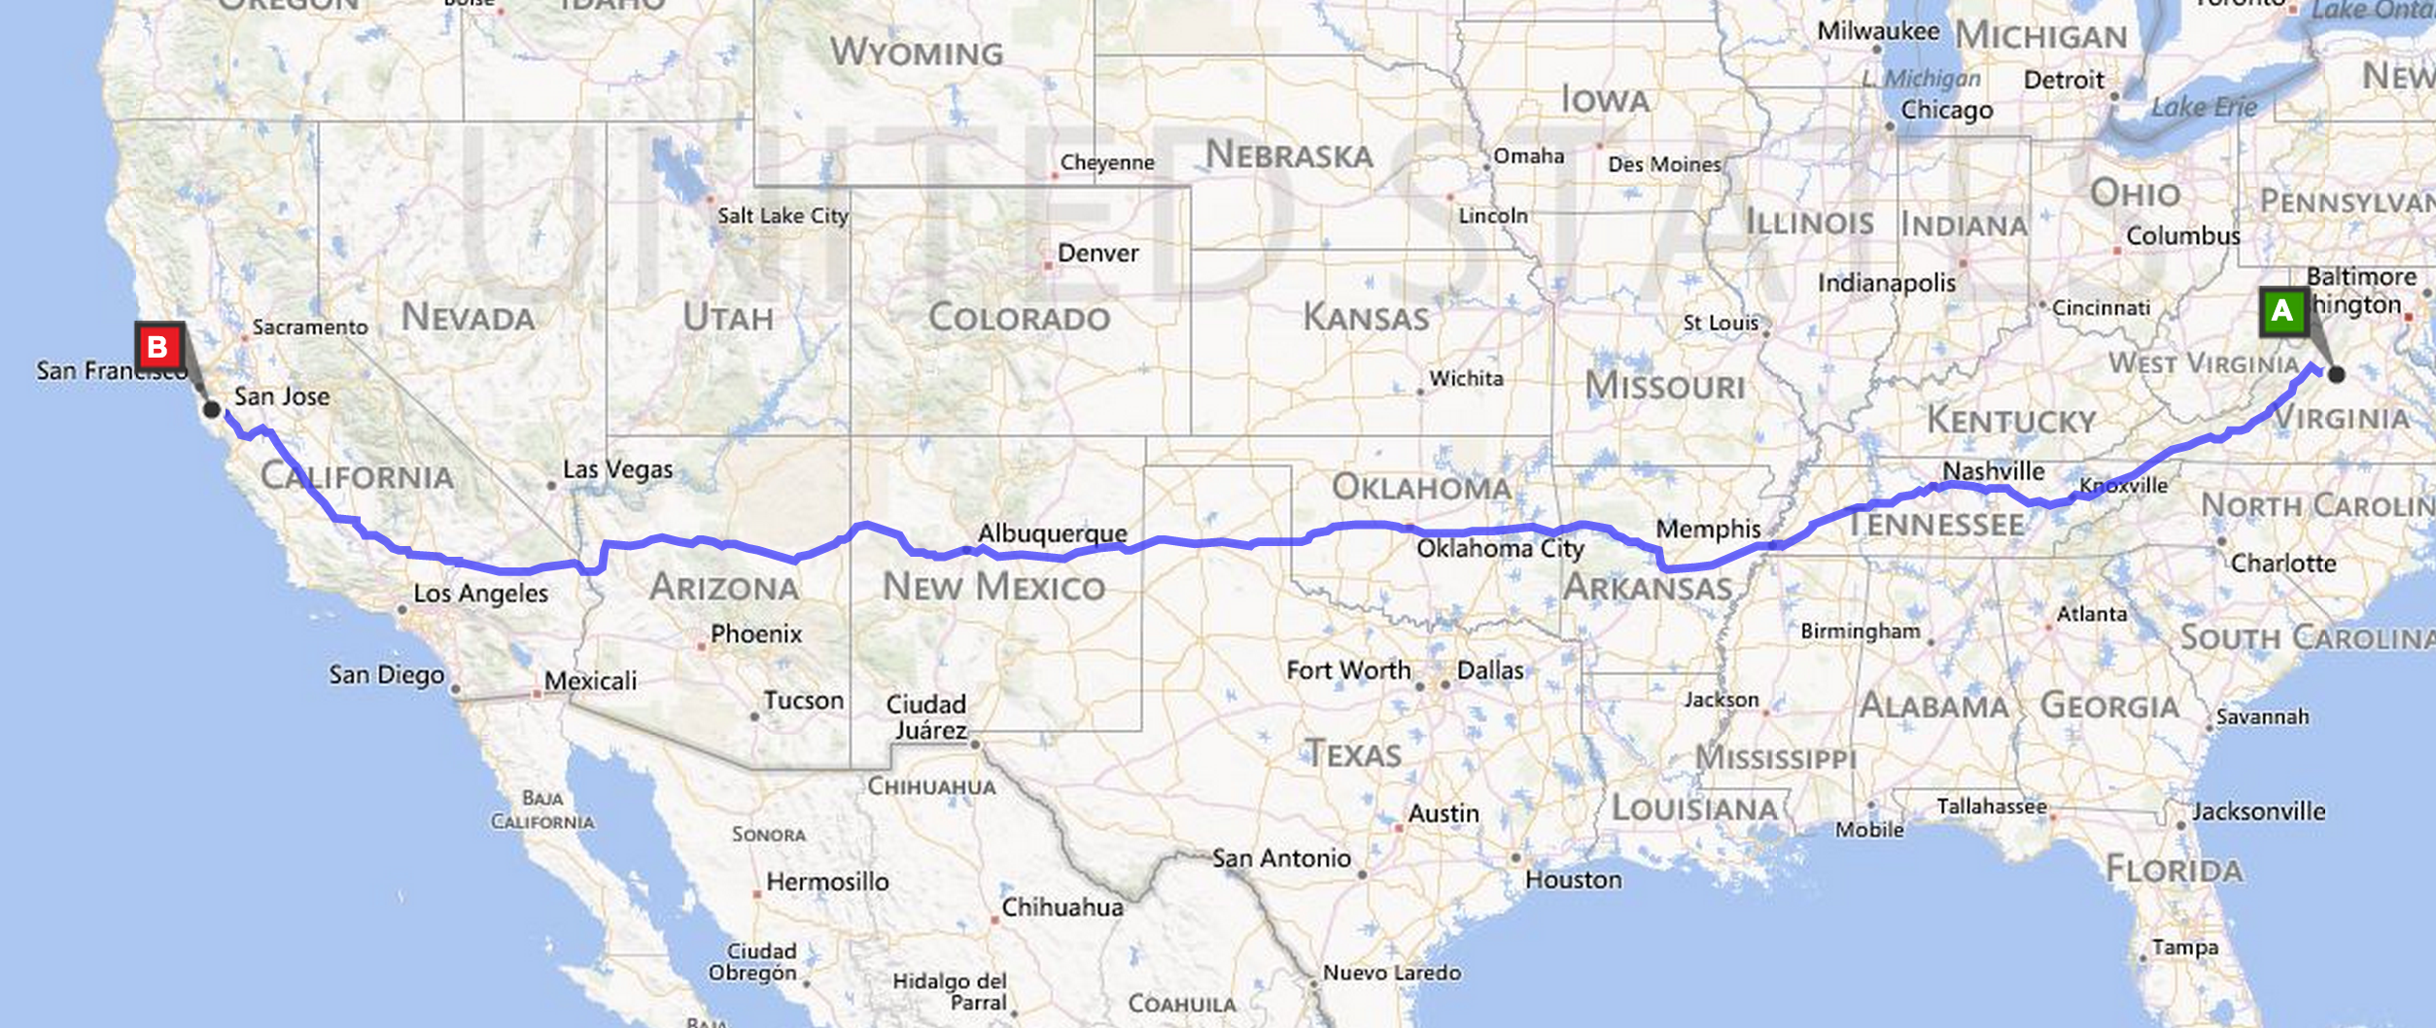
How many network transfer points between here and California?

Slide 28
gash> traceroute -q 1 www.berkeley.edu
traceroute to www.w3.berkeley.edu (169.229.216.200), 64 hops max, 52 byte packets
1 dd-wrt (192.168.1.1) 9.779 ms
2 c-24-127-51-1.hsd1.va.comcast.net (24.127.51.1) 24.139 ms
3 te-2-3-ur01.charlville.va.richmond.comcast.net (68.85.226.149) 11.955 ms
4 xe-11-3-0-0-sur01.charlville.va.richmond.comcast.net (68.86.172.185) 10.321 ms
5 xe-4-1-1-0-ar02.charlvilleco.va.richmond.comcast.net (69.139.165.57) 17.717 ms
6 pos-0-8-0-0-cr01.charlotte.nc.ibone.comcast.net (68.86.94.29) 26.774 ms
7 pos-0-5-0-0-pe01.ashburn.va.ibone.comcast.net (68.86.87.14) 14.784 ms
8 as11164-pe01.ashburn.va.ibone.comcast.net (75.149.228.82) 12.095 ms
9 64.57.20.247 (64.57.20.247) 88.728 ms
10 64.57.20.247 (64.57.20.247) 103.851 ms
11 64.57.20.227 (64.57.20.227) 96.655 ms
12 dc-lax-core2--lax-peer1-10ge.cenic.net (137.164.46.119) 104.106 ms
13 sfo-agg1--svl-agg2-10g.cenic.net (137.164.22.26) 90.415 ms
14 dc-ucb--sfo-agg1-10ge.cenic.net (137.164.50.17) 92.749 ms
15 dc-ucb--sfo-agg1-10ge.cenic.net (137.164.50.17) 99.847 ms
16 t1-3.inr-201-sut.berkeley.edu (128.32.0.65) 99.923 ms
17 t5-5.inr-210-srb.berkeley.edu (128.32.255.37) 101.742 ms
18 *
Unix: traceroute
Windows: tracert

Slide 29
Packet speed: (2 * 3813 km) / (100 ms) = 76,000 km/s
Speed of light: 299,792 km/s
Light-speed across the country: ~25ms
Time “wasted” in routers and slow interconnects: ~75ms

Slide 30
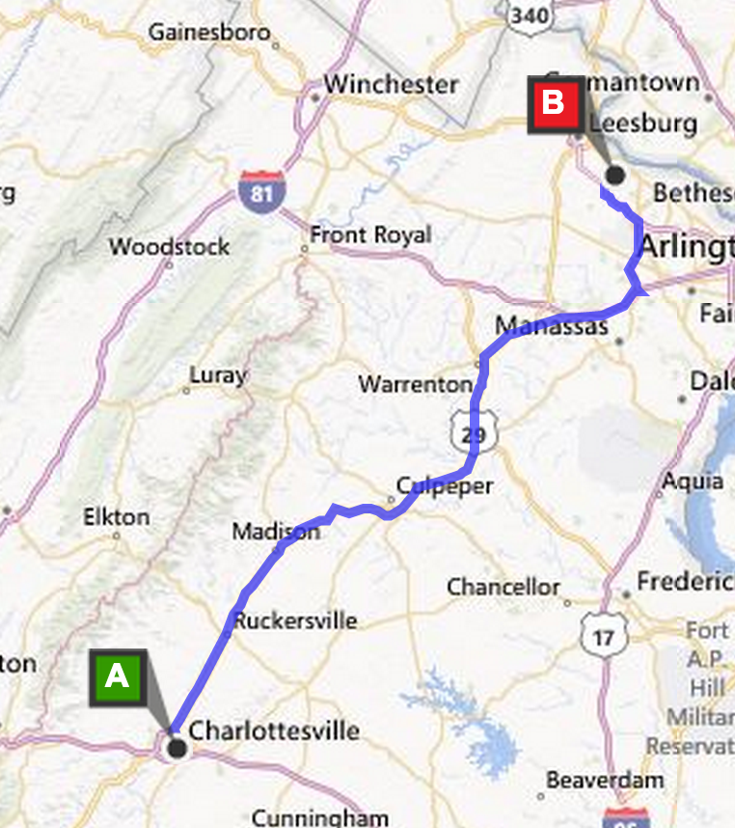
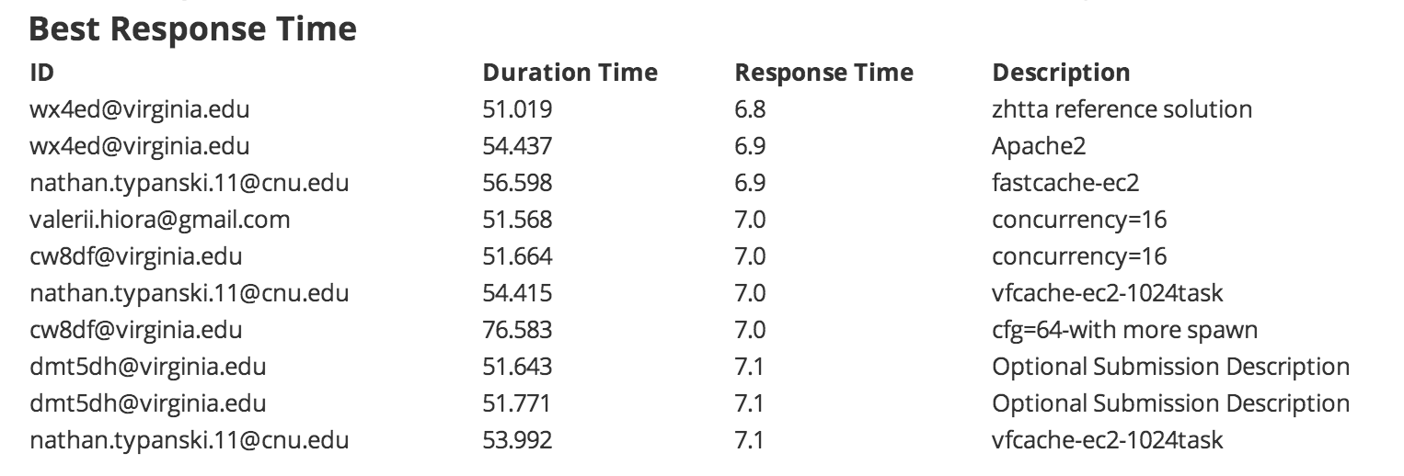
Amazon’s EC2 servers: Ashburn, VA
355km (roundtrip)
1.1 ms at lightspeed

Slide 31
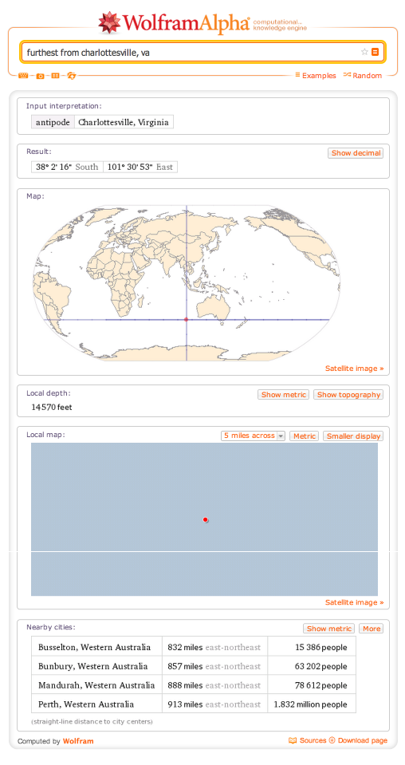
http://www.wolframalpha.com/input/?i=furthest+from+charlottesville+virginia

Slide 33


Slide 34
$ traceroute -q 1 -w 30 www.busselton.wa.gov.au
traceroute to busselton.wa.gov.au (203.41.180.233), 64 hops max, 52 byte packets
1 dd-wrt (192.168.1.1) 11.156 ms
2 c-24-127-51-1.hsd1.va.comcast.net (24.127.51.1) 32.497 ms
3 te-2-3-ur01.charlville.va.richmond.comcast.net (68.85.226.149) 13.971 ms
4 xe-11-2-0-0-sur01.charlville.va.richmond.comcast.net (69.139.165.221) 12.312 ms
5 xe-4-1-2-0-ar02.charlvilleco.va.richmond.comcast.net (69.139.165.65) 12.395 ms
6 pos-1-2-0-0-cr01.ashburn.va.ibone.comcast.net (68.86.91.53) 25.624 ms
7 pos-3-10-0-0-cr01.56marietta.ga.ibone.comcast.net (68.86.86.221) 31.483 ms
8 pos-1-9-0-0-cr01.dallas.tx.ibone.comcast.net (68.86.87.233) 52.515 ms
9 he-0-12-0-0-cr01.losangeles.ca.ibone.comcast.net (68.86.86.117) 83.242 ms
10 as4637-cr01.losangeles.ca.ibone.comcast.net (75.149.228.222) 78.134 ms
11 i-0-2-0-11.tlot-core01.bi.telstraglobal.net (202.40.149.185) 86.131 ms
12 i-0-0-0-0.sydo-core01.bx.telstraglobal.net (202.84.140.5) 287.302 ms
13 tengige0-1-0-14.oxf-gw2.sydney.telstra.net (203.50.13.133) 300.060 ms
14 bundle-ether2.oxf-gw1.sydney.telstra.net (203.50.6.85) 274.270 ms
15 bundle-ether1.ken-core4.sydney.telstra.net (203.50.6.5) 270.694 ms
16 bundle-ether10.win-core1.melbourne.telstra.net (203.50.11.13) 275.252 ms
17 bundle-ether6.fli-core1.adelaide.telstra.net (203.50.11.90) 405.600 ms
18 bundle-ether5.wel-core3.perth.telstra.net (203.50.11.19) 411.510 ms
19 gigabitethernet0-1.wel13.perth.telstra.net (203.50.115.151) 406.044 ms
20 *

Slide 35
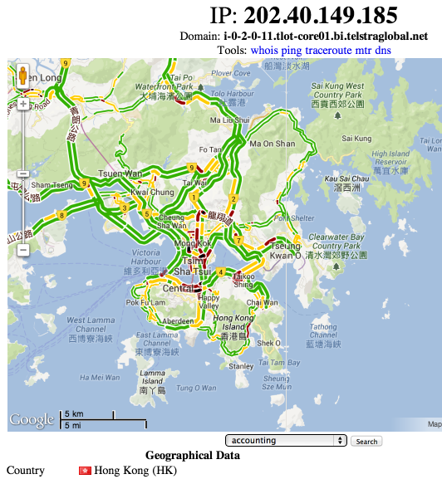
10 as4637-cr01.losangeles.ca.ibone.comcast.net (75.149.228.222) 78.134 ms
11 i-0-2-0-11.tlot-core01.bi.telstraglobal.net (202.40.149.185) 86.131 ms
12 i-0-0-0-0.sydo-core01.bx.telstraglobal.net (202.84.140.5) 287.302 ms
13 tengige0-1-0-14.oxf-gw2.sydney.telstra.net (203.50.13.133) 300.060 ms
Do you believe
http://www.infobyip.com/ip-202.84.140.5.html?

Slide 36
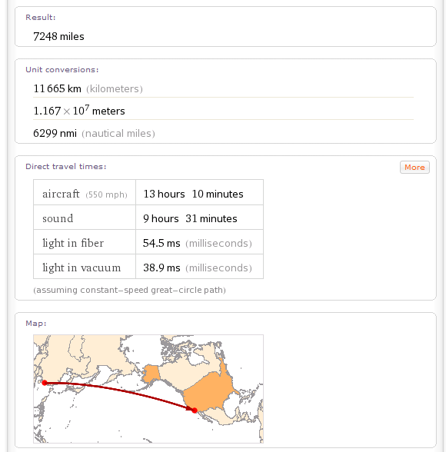
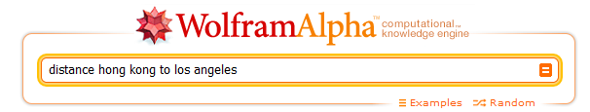

Slide 37



How does traceroute work?

Slide 38
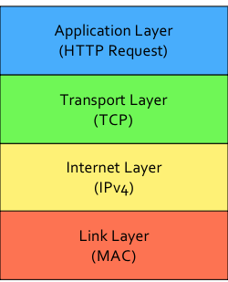
Protocol Layers

Slide 39
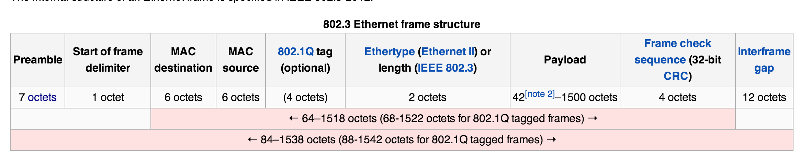
MAC Layer (LAN): Ethernet
42-1500 octets (bytes) of payload
37 octets of overhead
Interframe gap: 96 bits of time between packets
at 1Gbps = 96/1B = 96 ns < 0.1 ms

Slide 40
Protocol Layers
LAN: Ethernet (97.6% efficient for 12Kb packets)
WAN: PPP (99.9% efficient – only 1-2 bytes overhead)

Slide 41
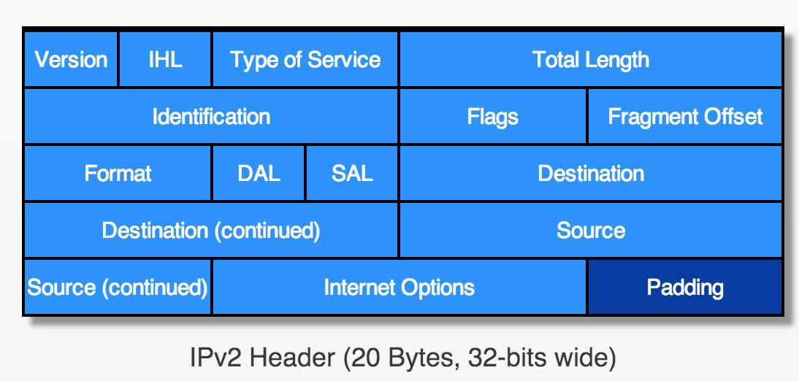
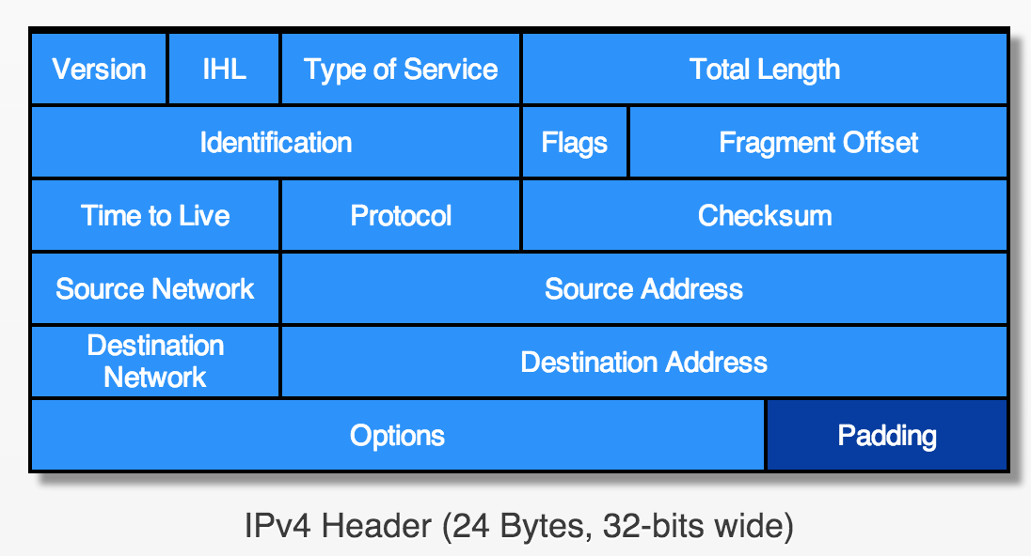
IP Layer
Version 3.1
(February 1978)
From Robbie Hott’s
History of Packets
packets.robbiehott.com
Version 4
(June 1978)

Slide 42
Avoiding Zombie Packets
Router
TTL - 1

Slide 43
Avoiding Zombie Packets
Router
if TTL = 0:
Destination = original Source

Slide 44
gash> traceroute -q 1 www.berkeley.edu
traceroute to www.w3.berkeley.edu (169.229.216.200), 64 hops max, 52 byte packets
1 dd-wrt (192.168.1.1) 9.779 ms
2 c-24-127-51-1.hsd1.va.comcast.net (24.127.51.1) 24.139 ms
3 te-2-3-ur01.charlville.va.richmond.comcast.net (68.85.226.149) 11.955 ms
4 xe-11-3-0-0-sur01.charlville.va.richmond.comcast.net (68.86.172.185) 10.321 ms
5 xe-4-1-1-0-ar02.charlvilleco.va.richmond.comcast.net (69.139.165.57) 17.717 ms
6 pos-0-8-0-0-cr01.charlotte.nc.ibone.comcast.net (68.86.94.29) 26.774 ms
7 pos-0-5-0-0-pe01.ashburn.va.ibone.comcast.net (68.86.87.14) 14.784 ms
8 as11164-pe01.ashburn.va.ibone.comcast.net (75.149.228.82) 12.095 ms
9 64.57.20.247 (64.57.20.247) 88.728 ms
10 64.57.20.247 (64.57.20.247) 103.851 ms
11 64.57.20.227 (64.57.20.227) 96.655 ms
12 dc-lax-core2--lax-peer1-10ge.cenic.net (137.164.46.119) 104.106 ms
13 sfo-agg1--svl-agg2-10g.cenic.net (137.164.22.26) 90.415 ms
14 dc-ucb--sfo-agg1-10ge.cenic.net (137.164.50.17) 92.749 ms
15 dc-ucb--sfo-agg1-10ge.cenic.net (137.164.50.17) 99.847 ms
16 t1-3.inr-201-sut.berkeley.edu (128.32.0.65) 99.923 ms
17 t5-5.inr-210-srb.berkeley.edu (128.32.255.37) 101.742 ms
18 *
traceroute is sending packets to destination, with TTL = 1, 2, 3, … and recording the death notices it receives

Slide 45
How efficient is IPv4?
1 byte
1 byte
1 byte
1 byte
Biggest packet: 2¹⁶ bytes (including overhead)
Overhead of header: 24 bytes
((2 ** 16) - 24) / (2 ** 16) = 0.999633…
Sending 1 KB: 0.954
Sending 16 bytes: 0.40

Slide 46
What’s below all this?
IPv4: up to 99.96% efficient
LAN: Ethernet (97.6% efficient for 12Kb packets)
WAN: PPP (99.9% efficient – only 1-2 bytes overhead)

Slide 47
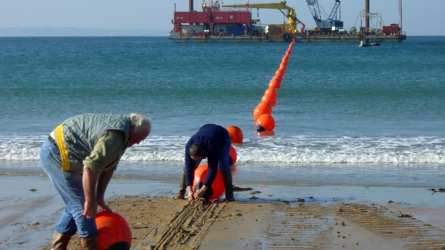
Below all this: Physical Layer

Slide 48



Bandwidth
How much data can you transfer in a given amount of time?

Slide 49
Improving Bandwidth

Slide 50
Improving Bandwidth
Bigger Pipes
Multiple signalers on each tower
Faster Transmission
Move arms faster
Better Encoding
Most bits per symbol

Slide 51
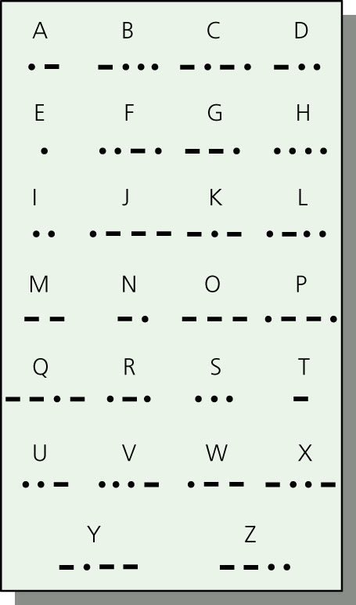
Morse Code
Represent letters with series of
short and long electrical pulses

Slide 52
Circuit Switching
Paris
Bourges
Lyon
Toulon
Reserve a whole path through the network for the whole message transmission
Nantes

Slide 53
Packet Switching
Paris
Bourges
Lyon
Toulon
Interleave messages – send whenever the next link is free.
Nantes

Slide 54
internetwork
A collection of multiple networks connected together, so messages can be transmitted between nodes on different networks.

Slide 55
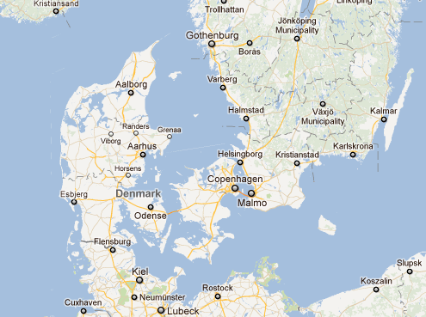
The First (international) internet
1800: Edelcrantz links Sweden and Denmark telegraph networks to coordinate defense

Slide 56
End of First (international) internet
1801: British attach Copenhagen; Sweden doesn’t help Denmark; network disconnected

Slide 57

The (capital-I) Internet
Packet Switching: Leonard Kleinrock (UCLA) thinks he did, Donald Davies and Paul Baran, Edelcrantz’s signalling network (1809)
Internet Protocol: Vint Cerf, Bob Kahn
Vision, Funding (DARPA): J.C.R. Licklider, Bob Taylor
Government: Al Gore
First politician to promote Internet, 1986; act to connect government networks to form “Interagency Network”
Vint Cerf (in the Rotunda, 2010)

Slide 58
First Use of the Internet
October 1969: First packets on the ARPANet from UCLA to Stanford. Starts to send "LOGIN", but it crashes on the G.
How impressive is this compared to communications event 3 months earlier?

Slide 59
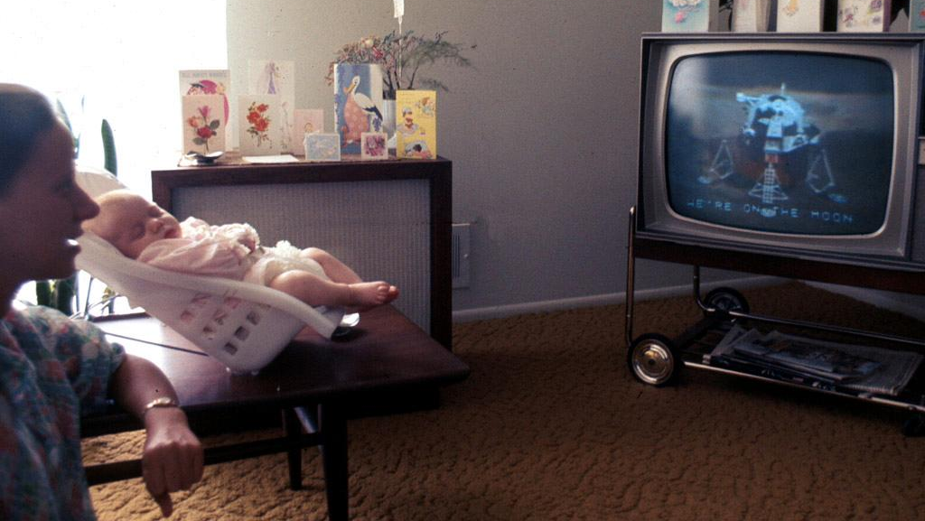
20 July 1969:
Live b/w video from the moon, transmitted live to millions of televisions worldwide

Slide 60

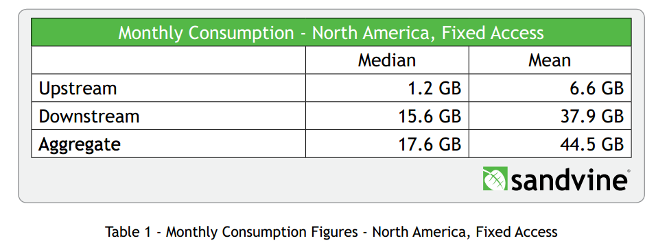
Today’s Internet: Bandwidth
Ethernet:
up to 100 Mbits/sec
My office:
~50 M bits / sec
UVa Wireless:
57 M bits / sec
Cable modem at home:
~ 30 M bits / sec
Wireless: < 0.44GB/month
What percentage of Internet traffic is HTTP?

Slide 61
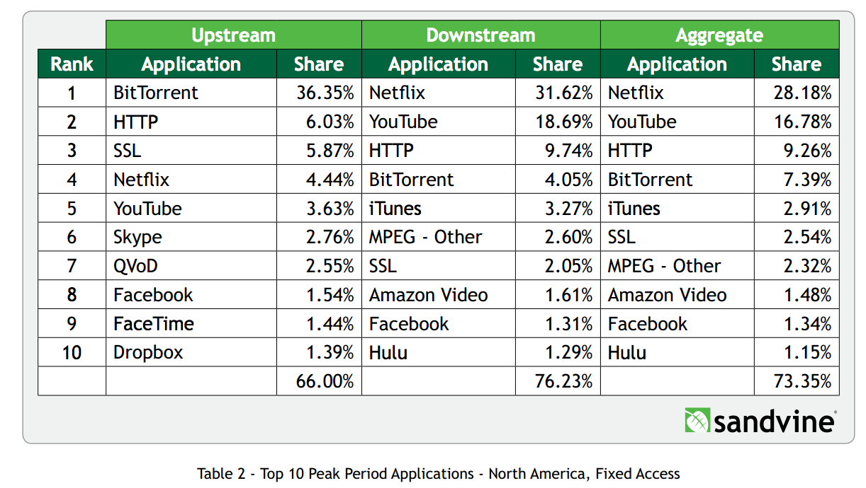

Slide 62
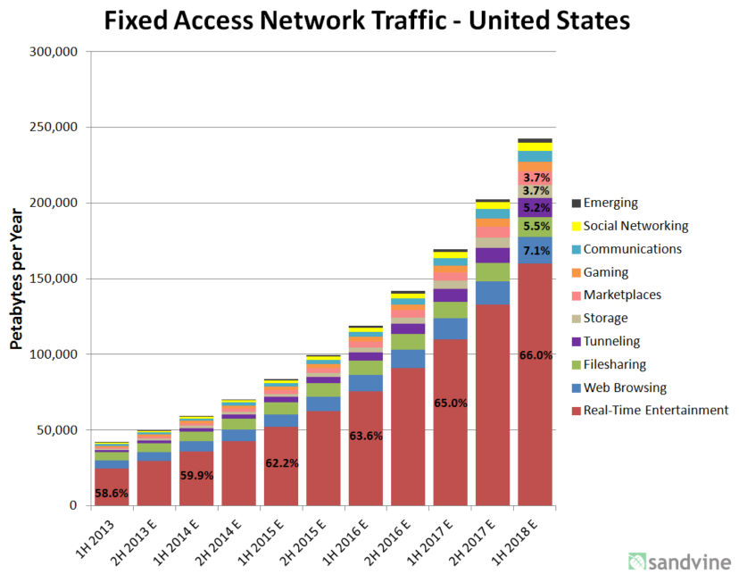
1 Petabyte = 10¹⁵ bytes
1 Million petabytes
= 1 Zettabyte
projections

Slide 63
Charge
From Tim Berners-Lee’s “Answers for Young People” http://www.w3.org/People/Berners-Lee/Kids.html
I think the main thing to remember is that any really powerful thing can be used for good or evil. Dynamite can be used to build tunnels or to make missiles. Engines can be put in ambulances or tanks. … So what is made of the Web is up to us. You, me, and everyone else.
Here is my hope: The Web is a tool for communicating. With the Web, you can find out what other people mean. You can find out where they are coming from. The Web can help people understand each other. Think about most of the bad things that have happened between people in your life. Maybe most of them come down to one person not understanding another. Even wars.
Let’s use the Web to create neat new exciting things.
Let’s use the Web to help people understand each other.

Slide 64

Bonus Theory Movies!
P=NP Downfall Parody!
Non-Deterministic Mario!
cs3102 Assignment

