Slide 1

Class 14: Web Server Scheduling
cs4414 Fall 2013
University of Virginia
David Evans

Slide 2
Plan for Today
Scheduling Web Servers
Networks
PS3 is due 11:59pm on Monday, October 28.
Please don’t wait to make progress on it!

Slide 3
Web Server Overload!
healthcare.gov
Rate of incoming requests > Rate server can process requests

Slide 4
Solutions

Slide 5
Strategy 1: Shrink and Simplify Your Content

Slide 6


5 September 2001
11 September 2001
archive.org captures of New York Times (http://www.nytimes.com)

Slide 7
11 September 2001
5 September 2001

Slide 8
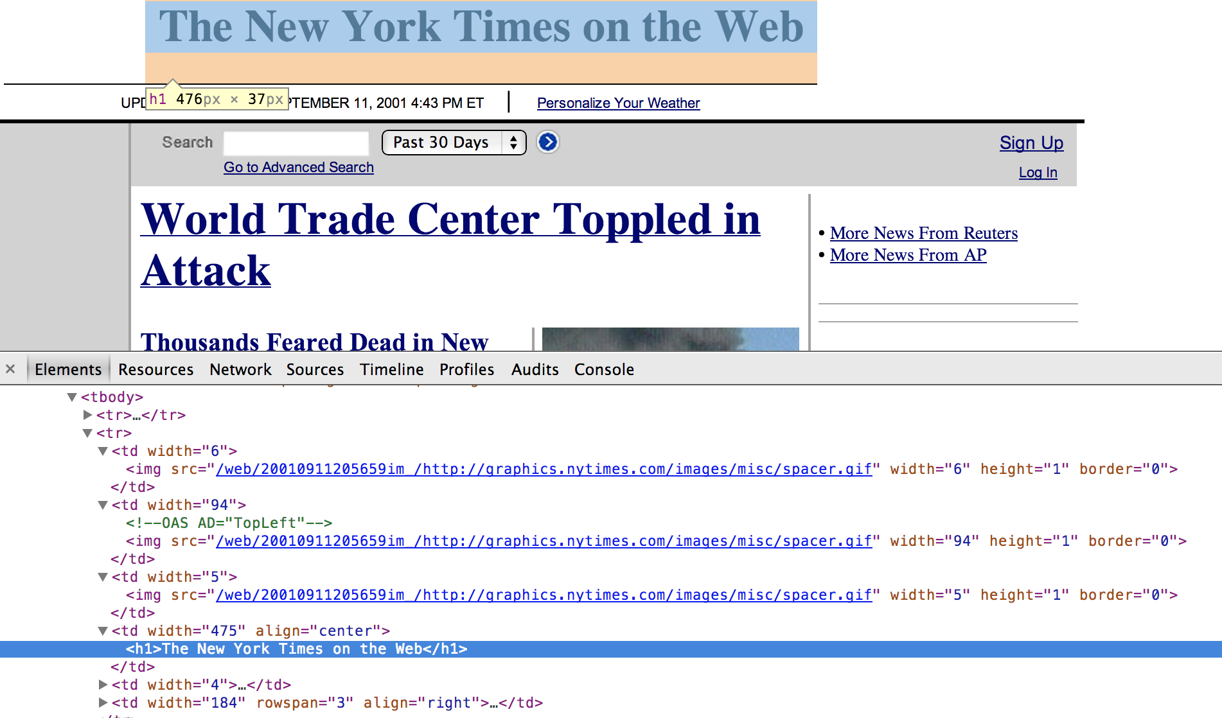

Slide 9
Strategy 2: Buy (Rent) More Servers

Slide 10

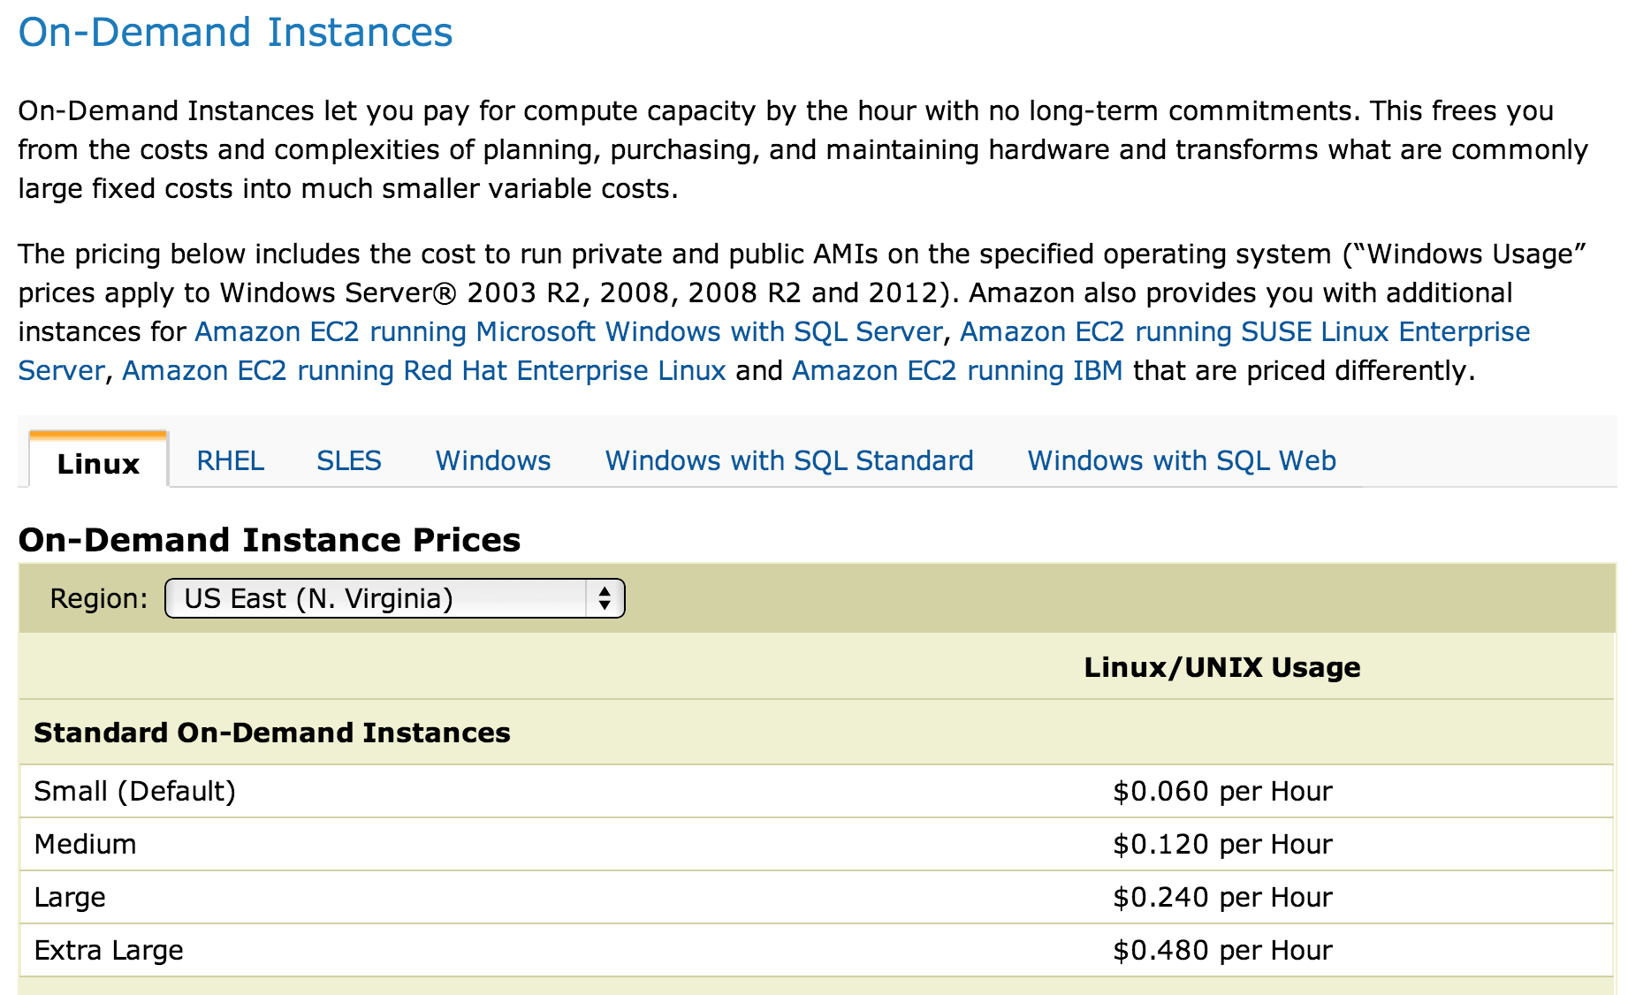
Amazon’s Elastic Compute Cloud (EC2)

Slide 11
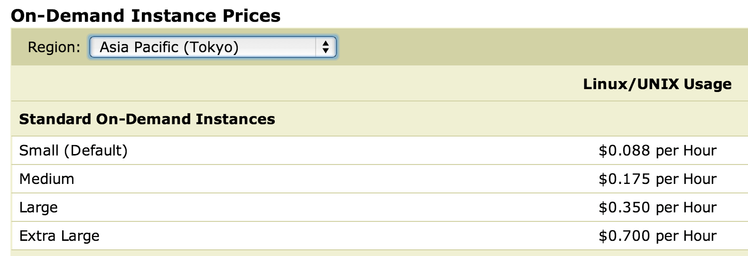
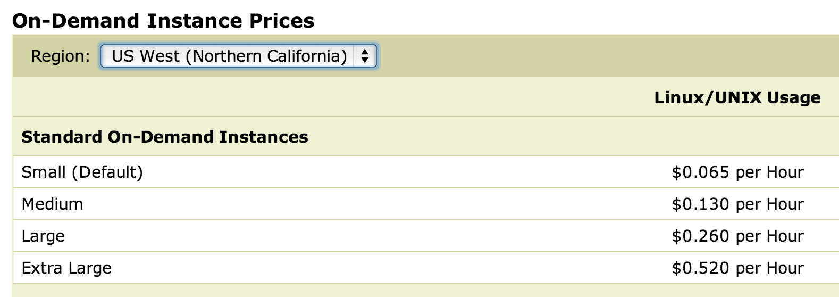
Why does it cost more in California?

Slide 12
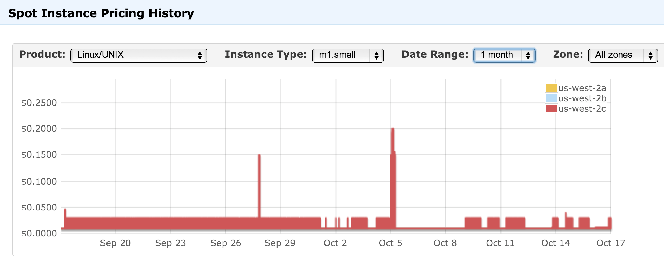

Slide 13
Using More Servers
Server 1
Dispatcher
Server 2
Server 3

Slide 14
Sharing State
Server 1
Dispatcher
Database
Server 2
Server 3

Slide 15
Distributed Database
Database
Server 1
Dispatcher
Database
Server 2
Database
Server 3
Database

Slide 16
Maintaining Consistency
Database
Server 1
Dispatcher
Database
Server 2
Database
Server 3
Database

Slide 17
Maintaining Consistency
Database
Server 1
Replication
Reads are efficient
Writes are complex and risky
Vertical Partitioning
Split database by columns
Horizontal Partitioning (“Sharding”)
Split database by rows
Give up on consistency and functionality
“NoSQL” (e.g., Cassandra, MongoDB, BigTable)
Dispatcher
Database
Server 2
Database
Server 3
Database

Slide 18
Scalable Enough?
Database
Server 1
Dispatcher
Database
Server 2
Database
Server 3
Database

Slide 19
Distributed Denial-of-Service
Database
Server 1
Dispatcher
Database
Server 2
Database
Server 3
x 2000 machines
Database
Botnet

Slide 20
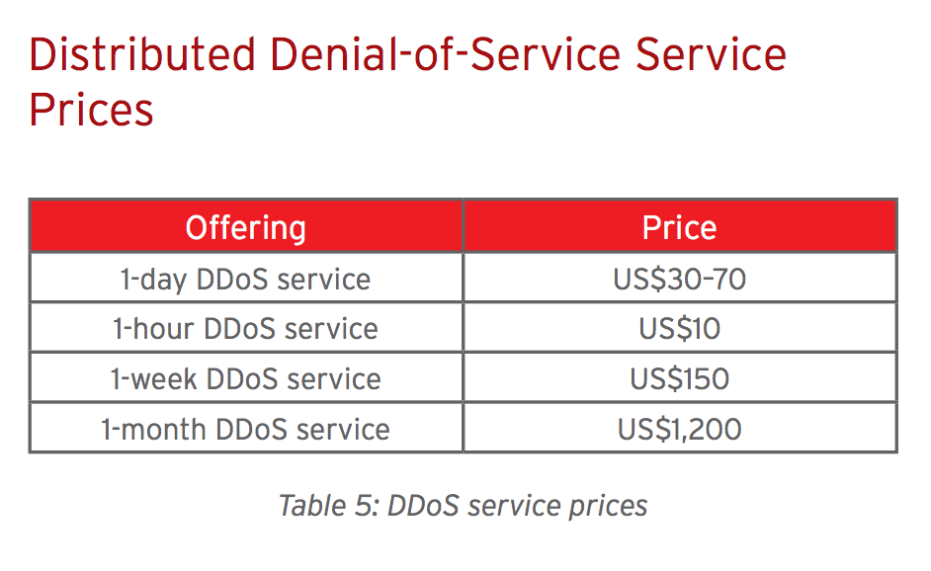

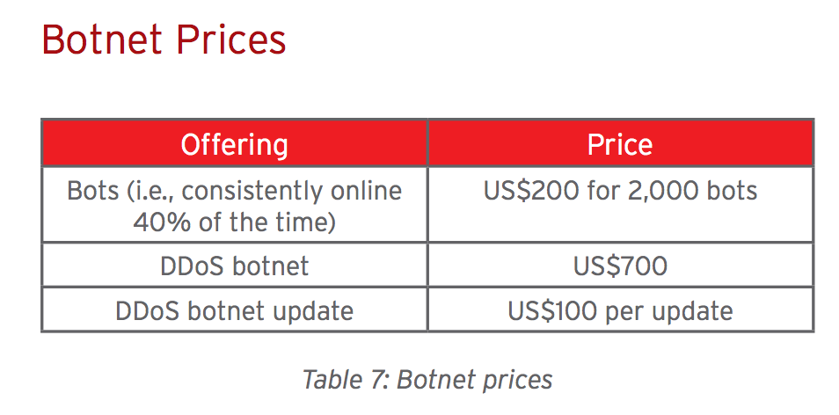
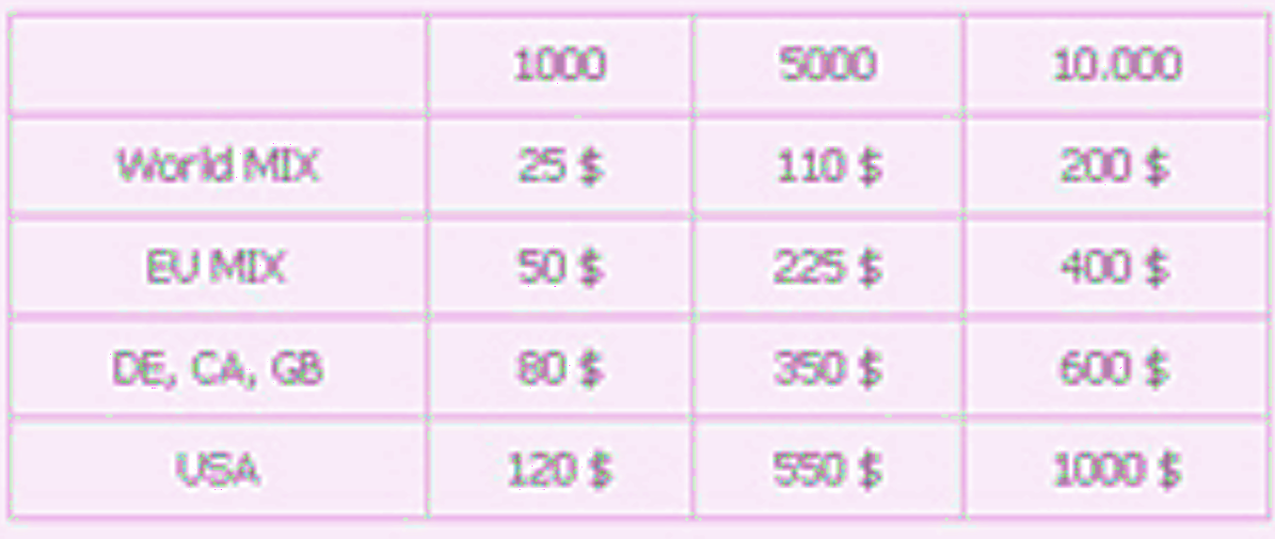
http://www.trendmicro.com/cloud-content/us/pdfs/security-intelligence/white-papers/wp-russian-underground-101.pdf

Slide 21

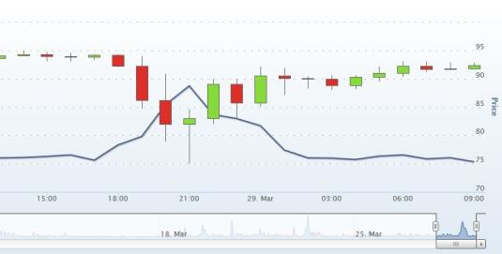
Financially-Motivated DDoS

Slide 22

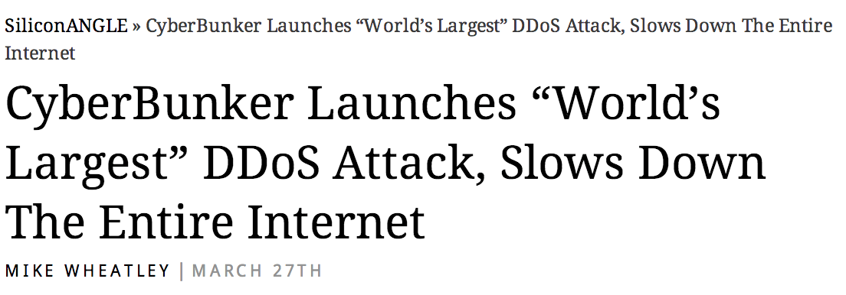
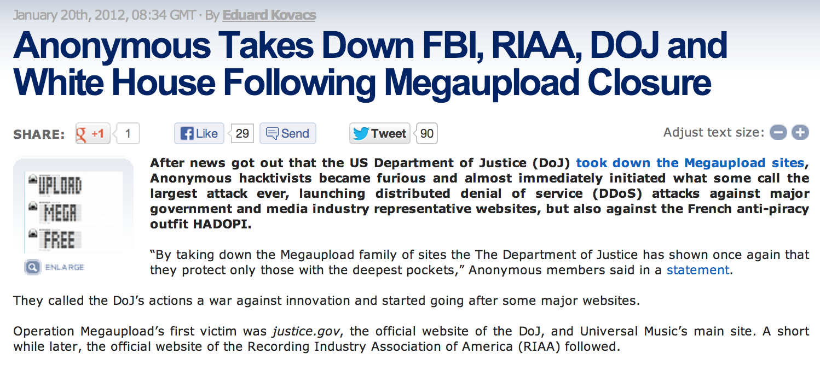
Politically-Motivated DDoS

Slide 23
Strategy 3: Smarter Scheduling (PS3)

Slide 24
What should the server’s goal be?

Slide 25
What is the bottleneck resource?
zhtta
Disk (files)

Slide 26
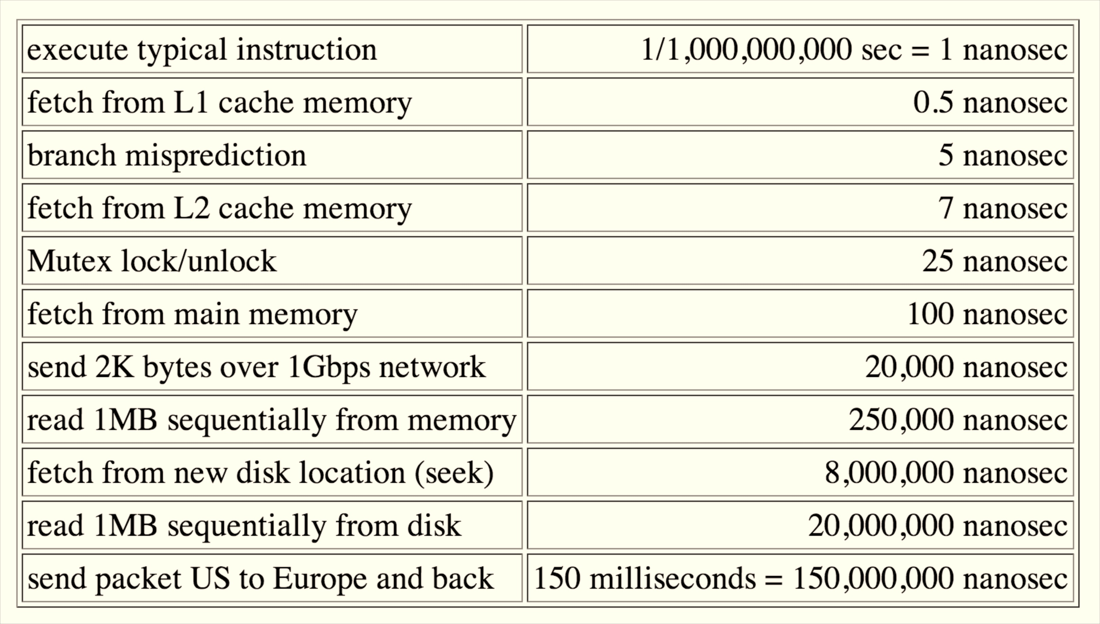
Norvig Numbers (Much in need of updating!)

Slide 27
What is the bottleneck resource?
zhtta
Disk (files)
Cache

Slide 28
Connecting to the Network
ISP Router
zhtta
Cache
Disk (files)

Slide 29
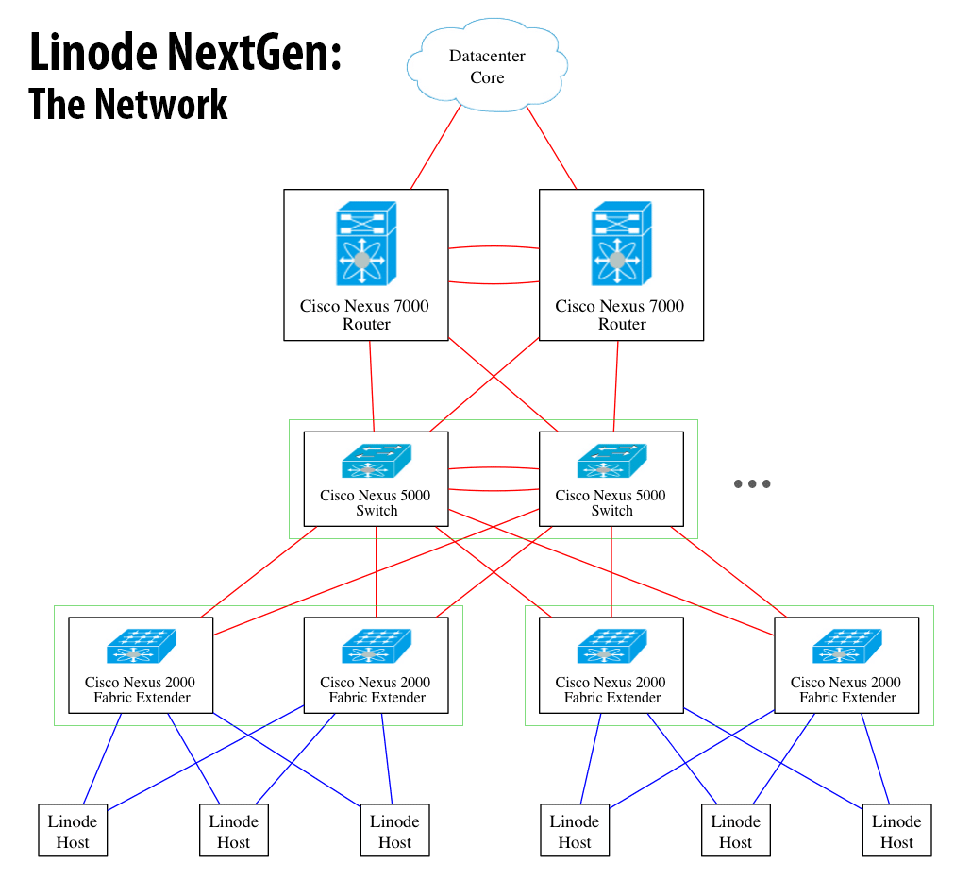
Cisco Nexus 7000 (~$100K)
48 Gb/s per slot x 10
10 Gb/s x 4 per switch
Your server
250 Mbits/s
$20/month

Slide 30
Crash Course in Networking

Slide 31
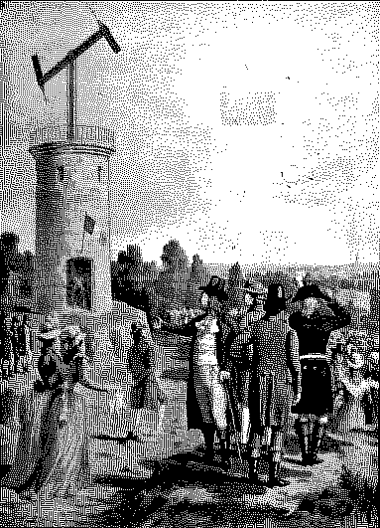
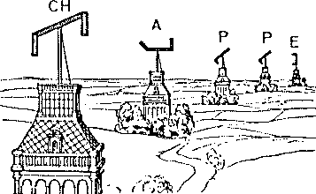
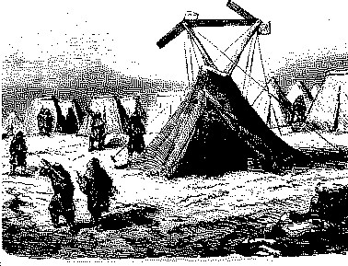
Chappe’s Semaphore Network
Mobile Semaphore Telegraph Used in the Crimean War 1853-1856
First Line (Paris to Lille), 1794

Slide 32
Measuring Networks
Latency
Time from sending a bit until it arrives
seconds (or seconds per geographic distance)
Bandwidth
Rate at which can you transmit
bits per second

Slide 33
Latency and Bandwidth
Napoleon’s Network: Paris to Toulon, 475 miles
Latency: 13 minutes (1.6s per mile)
What is the delay at each signaling station, how many stations to reach destination
At this rate, it would take ~1 hour to get a bit from here to California
Bandwidth: 2 symbols per minute (98 possible symbols, so that is ~13 bits per minute
How fast can signalers make symbols
At this rate, it would take about 18 days to get http://rust-class.org

Slide 34
Improving Latency
Less transfer points
Longer distances between transfer points
Semaphores: how far can you see clearly
Curvature of Earth is hard to overcome
Use wires (electrical telegraphs, 1837)
Faster transfers
Replace humans with machines
Faster travel between transfers
Hard to beat speed of light (semaphore network)
Electrons in copper: about 1/3rd speed of light

Slide 35
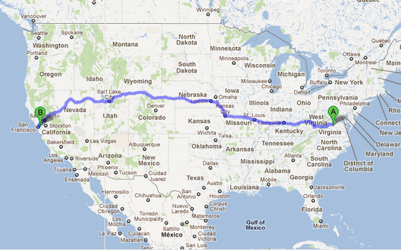
How many network transfer points between here and California?

Slide 36
gash> traceroute -q 1 www.berkeley.edu
traceroute to www.w3.berkeley.edu (169.229.216.200), 64 hops max, 52 byte packets
1 dd-wrt (192.168.1.1) 9.779 ms
2 c-24-127-51-1.hsd1.va.comcast.net (24.127.51.1) 24.139 ms
3 te-2-3-ur01.charlville.va.richmond.comcast.net (68.85.226.149) 11.955 ms
4 xe-11-3-0-0-sur01.charlville.va.richmond.comcast.net (68.86.172.185) 10.321 ms
5 xe-4-1-1-0-ar02.charlvilleco.va.richmond.comcast.net (69.139.165.57) 17.717 ms
6 pos-0-8-0-0-cr01.charlotte.nc.ibone.comcast.net (68.86.94.29) 26.774 ms
7 pos-0-5-0-0-pe01.ashburn.va.ibone.comcast.net (68.86.87.14) 14.784 ms
8 as11164-pe01.ashburn.va.ibone.comcast.net (75.149.228.82) 12.095 ms
9 64.57.20.247 (64.57.20.247) 88.728 ms
10 64.57.20.247 (64.57.20.247) 103.851 ms
11 64.57.20.227 (64.57.20.227) 96.655 ms
12 dc-lax-core2--lax-peer1-10ge.cenic.net (137.164.46.119) 104.106 ms
13 sfo-agg1--svl-agg2-10g.cenic.net (137.164.22.26) 90.415 ms
14 dc-ucb--sfo-agg1-10ge.cenic.net (137.164.50.17) 92.749 ms
15 dc-ucb--sfo-agg1-10ge.cenic.net (137.164.50.17) 99.847 ms
16 t1-3.inr-201-sut.berkeley.edu (128.32.0.65) 99.923 ms
17 t5-5.inr-210-srb.berkeley.edu (128.32.255.37) 101.742 ms
18 *
Unix: traceroute
Windows: tracert

Slide 37
Packet speed: (2 * 3813 km) / (100 ms) = 76,000 km/s
Speed of light: 299,792 km/s
Light-speed across the country: ~25ms
Time “wasted” in routers and slow interconnects: ~75ms

Slide 38
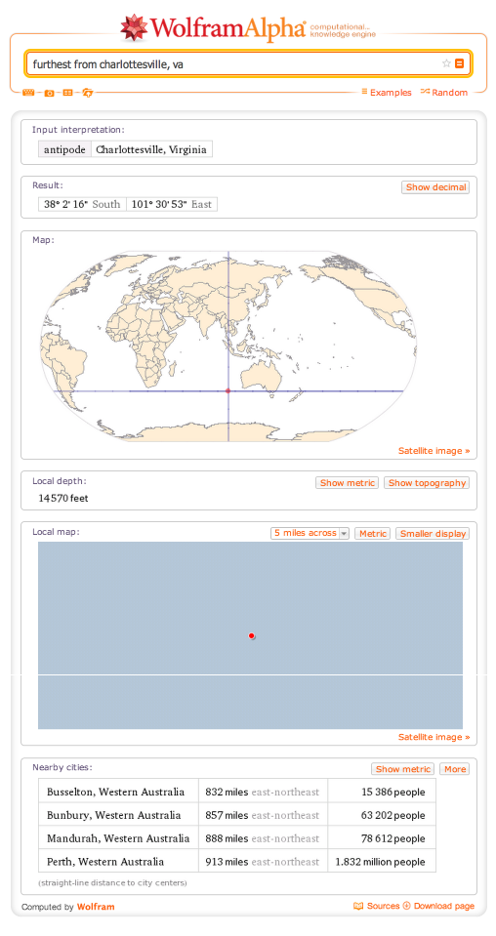

Slide 40
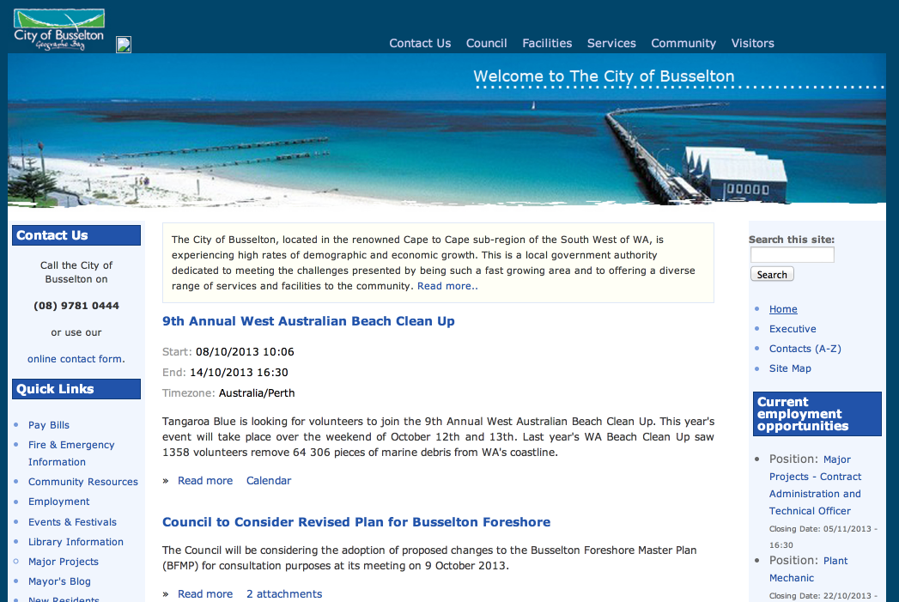

Slide 41
$ traceroute -q 1 -w 30 www.busselton.wa.gov.au
traceroute to busselton.wa.gov.au (203.41.180.233), 64 hops max, 52 byte packets
1 dd-wrt (192.168.1.1) 11.156 ms
2 c-24-127-51-1.hsd1.va.comcast.net (24.127.51.1) 32.497 ms
3 te-2-3-ur01.charlville.va.richmond.comcast.net (68.85.226.149) 13.971 ms
4 xe-11-2-0-0-sur01.charlville.va.richmond.comcast.net (69.139.165.221) 12.312 ms
5 xe-4-1-2-0-ar02.charlvilleco.va.richmond.comcast.net (69.139.165.65) 12.395 ms
6 pos-1-2-0-0-cr01.ashburn.va.ibone.comcast.net (68.86.91.53) 25.624 ms
7 pos-3-10-0-0-cr01.56marietta.ga.ibone.comcast.net (68.86.86.221) 31.483 ms
8 pos-1-9-0-0-cr01.dallas.tx.ibone.comcast.net (68.86.87.233) 52.515 ms
9 he-0-12-0-0-cr01.losangeles.ca.ibone.comcast.net (68.86.86.117) 83.242 ms
10 as4637-cr01.losangeles.ca.ibone.comcast.net (75.149.228.222) 78.134 ms
11 i-0-2-0-11.tlot-core01.bi.telstraglobal.net (202.40.149.185) 86.131 ms
12 i-0-0-0-0.sydo-core01.bx.telstraglobal.net (202.84.140.5) 287.302 ms
13 tengige0-1-0-14.oxf-gw2.sydney.telstra.net (203.50.13.133) 300.060 ms
14 bundle-ether2.oxf-gw1.sydney.telstra.net (203.50.6.85) 274.270 ms
15 bundle-ether1.ken-core4.sydney.telstra.net (203.50.6.5) 270.694 ms
16 bundle-ether10.win-core1.melbourne.telstra.net (203.50.11.13) 275.252 ms
17 bundle-ether6.fli-core1.adelaide.telstra.net (203.50.11.90) 405.600 ms
18 bundle-ether5.wel-core3.perth.telstra.net (203.50.11.19) 411.510 ms
19 gigabitethernet0-1.wel13.perth.telstra.net (203.50.115.151) 406.044 ms
20 *

Slide 42
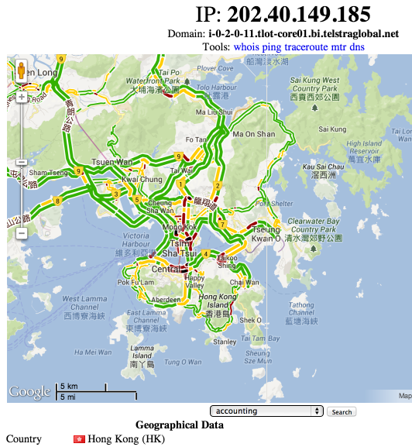
10 as4637-cr01.losangeles.ca.ibone.comcast.net (75.149.228.222) 78.134 ms
11 i-0-2-0-11.tlot-core01.bi.telstraglobal.net (202.40.149.185) 86.131 ms
12 i-0-0-0-0.sydo-core01.bx.telstraglobal.net (202.84.140.5) 287.302 ms
13 tengige0-1-0-14.oxf-gw2.sydney.telstra.net (203.50.13.133) 300.060 ms
Do you believe
http://www.infobyip.com/ip-202.84.140.5.html
?

Slide 43
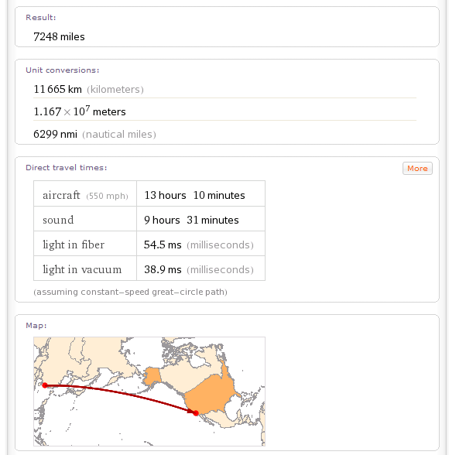
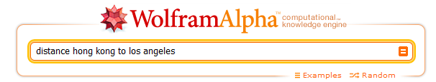

Slide 44
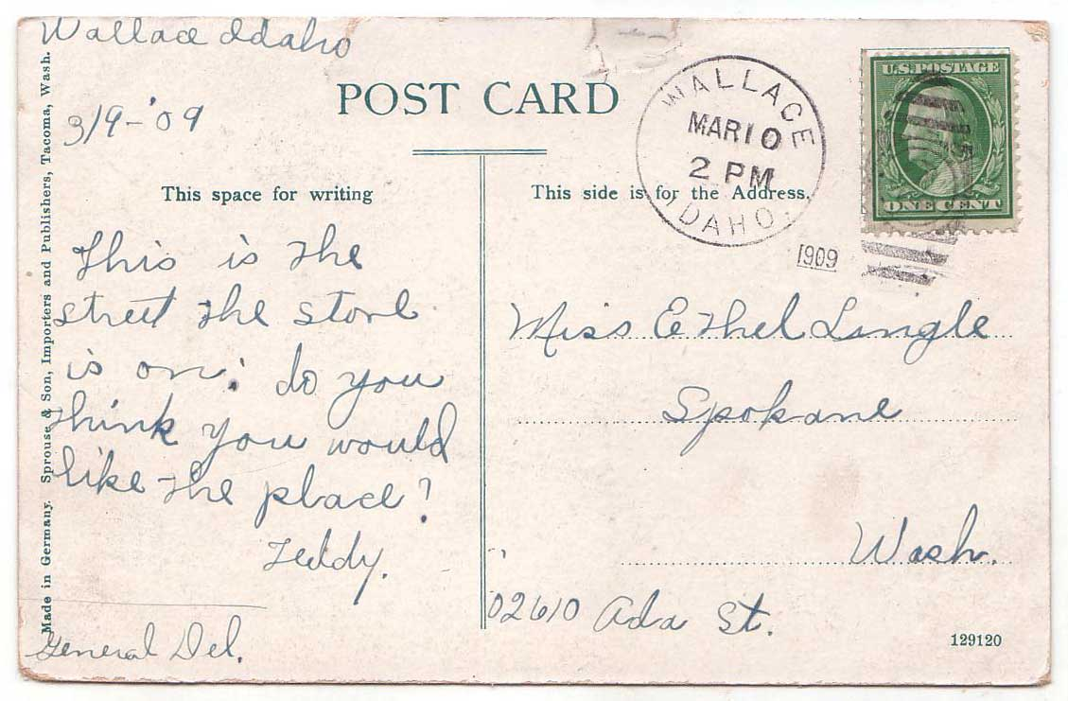
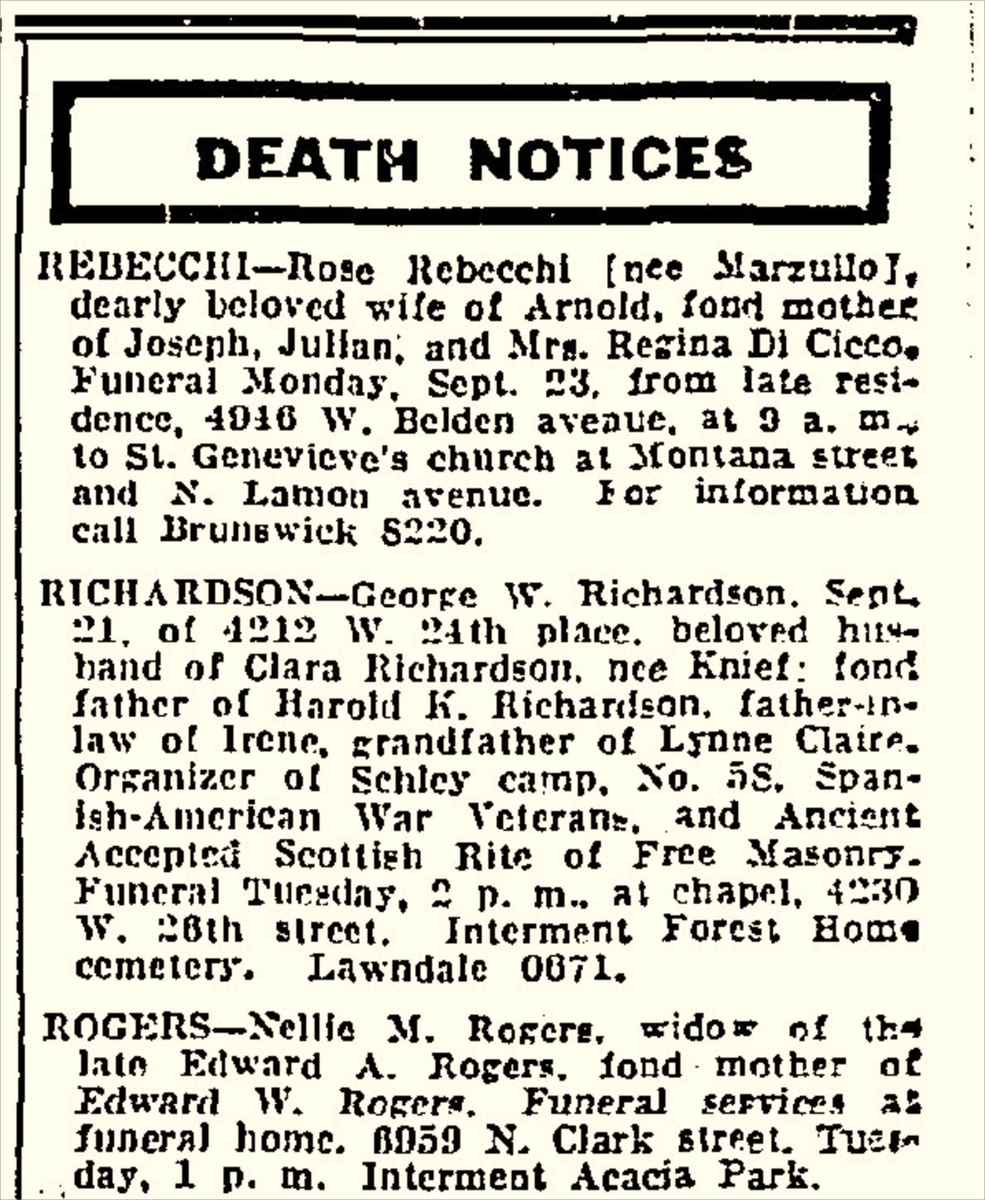

How does traceroute work?

Slide 45
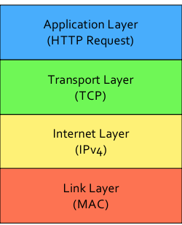
Protocol Layers

Slide 46
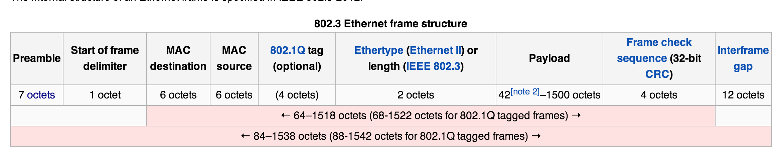
MAC Layer (LAN): Ethernet
42-1500 octets (bytes) of payload
37 octets of overhead
Interframe gap: 96 bits of time between packets
at 1Gbps = 96/1B = 96 ns < 0.1 ms

Slide 47
Protocol Layers
LAN: Ethernet (97.6% efficient for 12Kb packets)
WAN: PPP (99.9% efficient – only 1-2 bytes overhead)

Slide 48
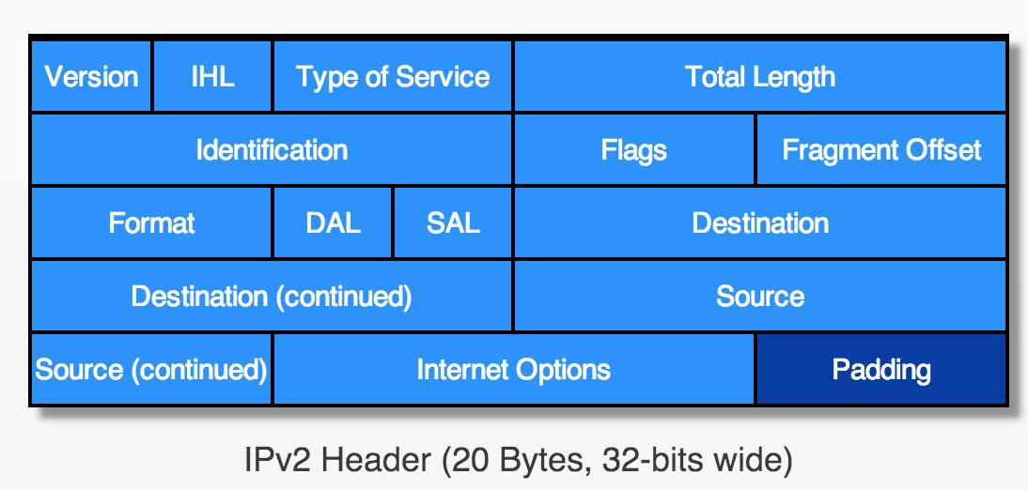
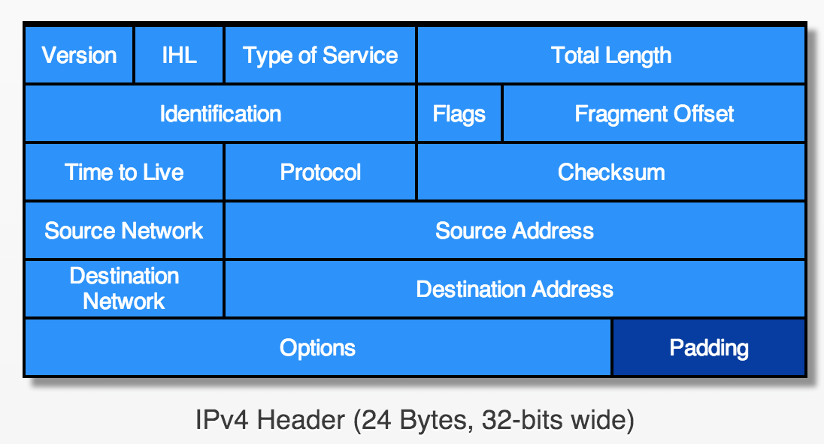
IP Layer
Version 3.1 (February 1978)
Version 4 (June 1978)
From Robbie Hott’s
History of Packets
packets.robbiehott.com

Slide 49
Avoiding Zombie Packets
Router
TTL - 1

Slide 50
Avoiding Zombie Packets
Router
if TTL = 0:
Destination = original Source

Slide 51
gash> traceroute -q 1 www.berkeley.edu
traceroute to www.w3.berkeley.edu (169.229.216.200), 64 hops max, 52 byte packets
1 dd-wrt (192.168.1.1) 9.779 ms
2 c-24-127-51-1.hsd1.va.comcast.net (24.127.51.1) 24.139 ms
3 te-2-3-ur01.charlville.va.richmond.comcast.net (68.85.226.149) 11.955 ms
4 xe-11-3-0-0-sur01.charlville.va.richmond.comcast.net (68.86.172.185) 10.321 ms
5 xe-4-1-1-0-ar02.charlvilleco.va.richmond.comcast.net (69.139.165.57) 17.717 ms
6 pos-0-8-0-0-cr01.charlotte.nc.ibone.comcast.net (68.86.94.29) 26.774 ms
7 pos-0-5-0-0-pe01.ashburn.va.ibone.comcast.net (68.86.87.14) 14.784 ms
8 as11164-pe01.ashburn.va.ibone.comcast.net (75.149.228.82) 12.095 ms
9 64.57.20.247 (64.57.20.247) 88.728 ms
10 64.57.20.247 (64.57.20.247) 103.851 ms
11 64.57.20.227 (64.57.20.227) 96.655 ms
12 dc-lax-core2--lax-peer1-10ge.cenic.net (137.164.46.119) 104.106 ms
13 sfo-agg1--svl-agg2-10g.cenic.net (137.164.22.26) 90.415 ms
14 dc-ucb--sfo-agg1-10ge.cenic.net (137.164.50.17) 92.749 ms
15 dc-ucb--sfo-agg1-10ge.cenic.net (137.164.50.17) 99.847 ms
16 t1-3.inr-201-sut.berkeley.edu (128.32.0.65) 99.923 ms
17 t5-5.inr-210-srb.berkeley.edu (128.32.255.37) 101.742 ms
18 *
traceroute is sending packets to destination, with TTL = 1, 2, 3, … and recording the death notices it receives

Slide 52
How efficient is IPv4?
1 byte
1 byte
1 byte
1 byte
Biggest packet: 2¹⁶ bytes (including overhead)
Overhead of header: 24 bytes
((2 ** 16) - 24) / (2 ** 16) = 0.999633…
Sending 1 KB: 0.954
Sending 16 bytes: 0.40

Slide 53
What’s below all this?
IPv4: up to 99.96% efficient
LAN: Ethernet (97.6% efficient for 12Kb packets)
WAN: PPP (99.9% efficient – only 1-2 bytes overhead)

Slide 54
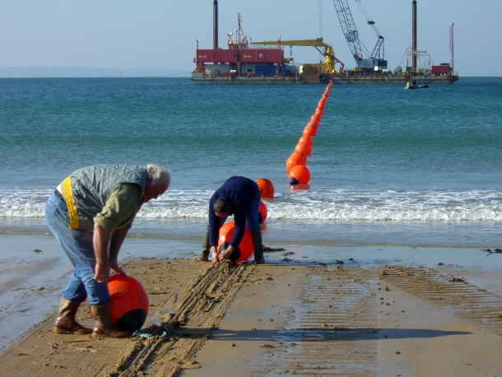
Below all this: Physical Layer

Slide 55

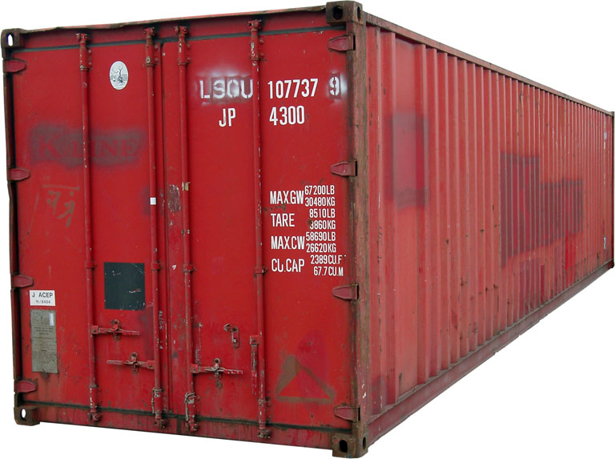
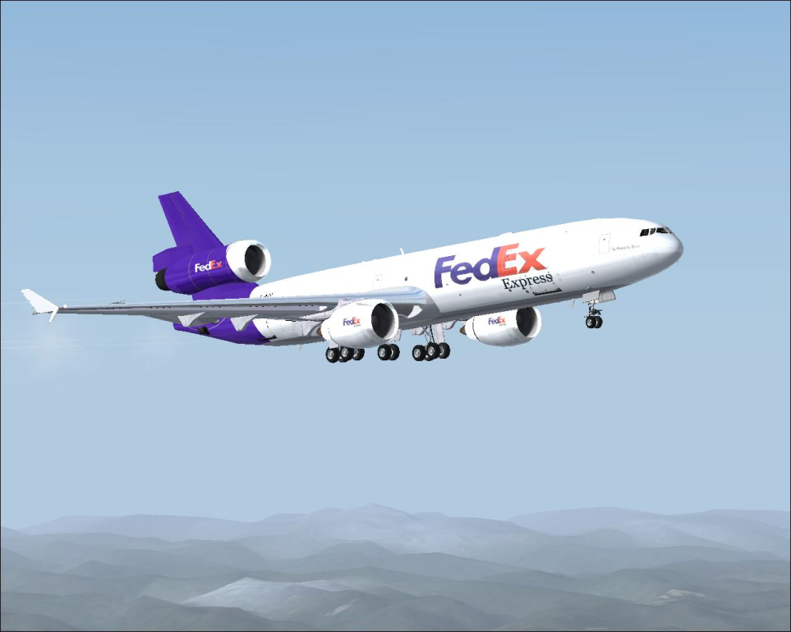
Bandwidth
How much data can you transfer in a given amount of time?

Slide 56
Improving Bandwidth
Faster transmission
Train signalers to move semaphore flags faster
Use something less physically demanding to transmit
Bigger pipes
Have multiple signalers transmit every other letter at the same time
Better encoding
Figure out how to code more than 98 symbols with semaphore signal
Morse code (1840s)

Slide 57
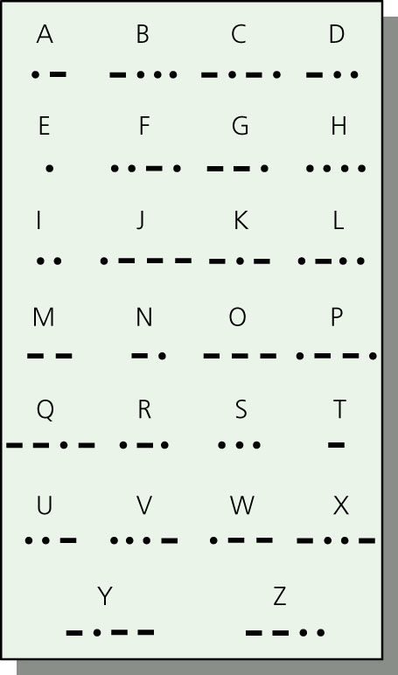
Morse Code
Represent letters with series of
short and long electrical pulses

Slide 58
Circuit Switching
Reserve a whole path through the network for the whole message transmission
Paris
Bourges
Lyon
Toulon
Once you start a transmission,
know you will have use of the network until it is finished. But,
wastes network resources.
Nantes

Slide 59
Packet Switching
Use one link at a time
Paris
Bourges
Lyon
Toulon
Interleave messages – send whenever the next link is free.
Nantes

Slide 60
internetwork
A collection of multiple networks connected together, so messages can be transmitted between nodes on different networks.

Slide 61
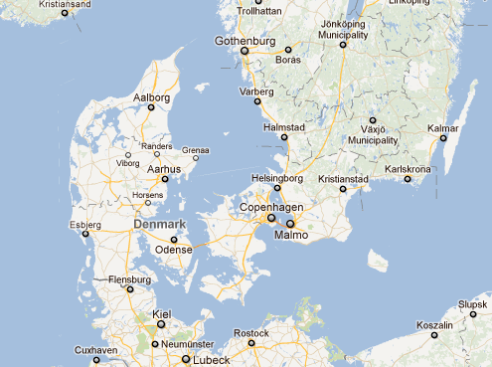
The First (international) internet
1800: Edelcrantz links Sweden and Denmark telegraph networks to coordinate defense

Slide 62
End of First (international) internet
1801: British attach Copenhagen; Sweden doesn’t help Denmark; network disconnected

Slide 63

The (capital-I) Internet
Packet Switching: Leonard Kleinrock (UCLA) thinks he did, Donald Davies and Paul Baran, Edelcrantz’s signalling network (1809)
Internet Protocol: Vint Cerf, Bob Kahn
Vision, Funding (DARPA): J.C.R. Licklider, Bob Taylor
Government: Al Gore
First politician to promote Internet, 1986; act to connect government networks to form “Interagency Network”
Vint Cerf (in the Rotunda, 2010)

Slide 64
First Use of the Internet
October 1969: First packets on the ARPANet from UCLA to Stanford. Starts to send "LOGIN", but it crashes on the G.
How impressive is this compared to communications event 3 months earlier?

Slide 65
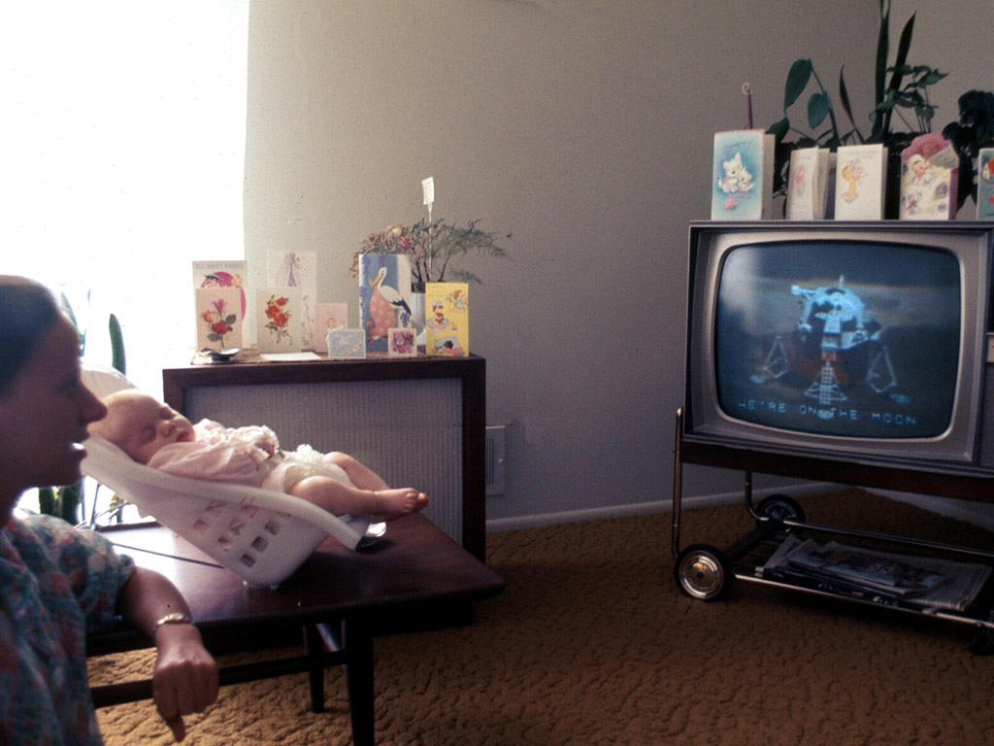
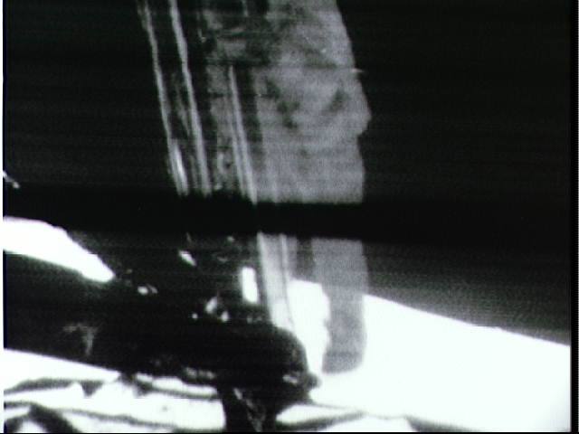
20 July 1969:
Live b/w video from the moon, transmitted live to millions of televisions worldwide

Slide 66
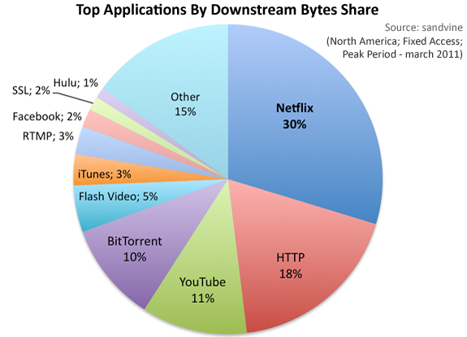
Today’s Internet: Bandwidth
Ethernet:
up to 100 Mbits/sec
My office:
~50 M bits / sec
UVa Wireless:
57 M bits / sec
Cable modem at home:
~ 30 M bits / sec

Slide 67
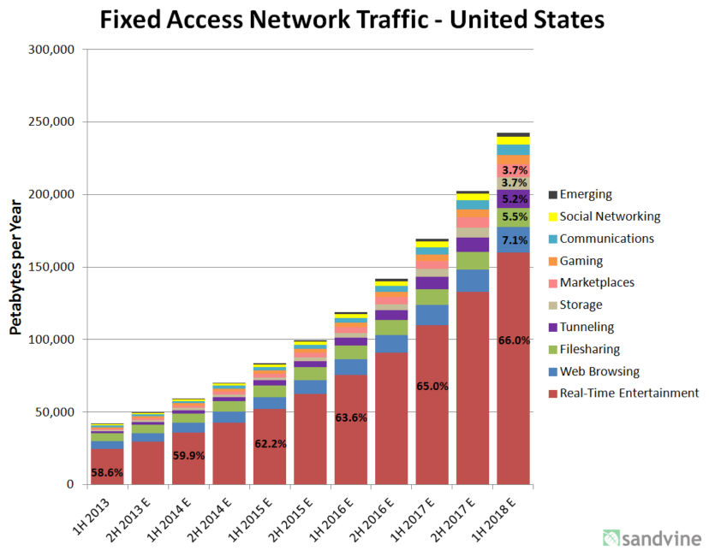
1 Petabyte = 10¹⁵ bytes
1 Million petabytes = 1 zettabyte
(NSA’s Utah facility is storing “Zbytes”?)
projections

Slide 68
What Matters for PS3
You are not expected to do anything below the level of scheduling which web request to process
No need to modify lower levels of network stack (but doing so would provide lots of performance-improvement opportunities!)
No expectation to alter tasks once spawned (but doing so could be very useful)
But, understanding more what is going on underneath should help you use resources more wisely!

Slide 69
Charge
From Tim Berners-Lee’s “Answers for Young People” http://www.w3.org/People/Berners-Lee/Kids.html
I think the main thing to remember is that any really powerful thing can be used for good or evil. Dynamite can be used to build tunnels or to make missiles. Engines can be put in ambulances or tanks. Nuclear power can be used for bombs or for electrical power. So the what is made of the Web is up to us. You, me, and everyone else.
Here is my hope: The Web is a tool for communicating. With the Web, you can find out what other people mean. You can find out where they are coming from. The Web can help people understand each other.
Think about most of the bad things that have happened between people in your life. Maybe most of them come down to one person not understanding another. Even wars.
Let’s use the web to create neat new exciting things.
Let’s use the Web to help people understand each other.

