Slide 1
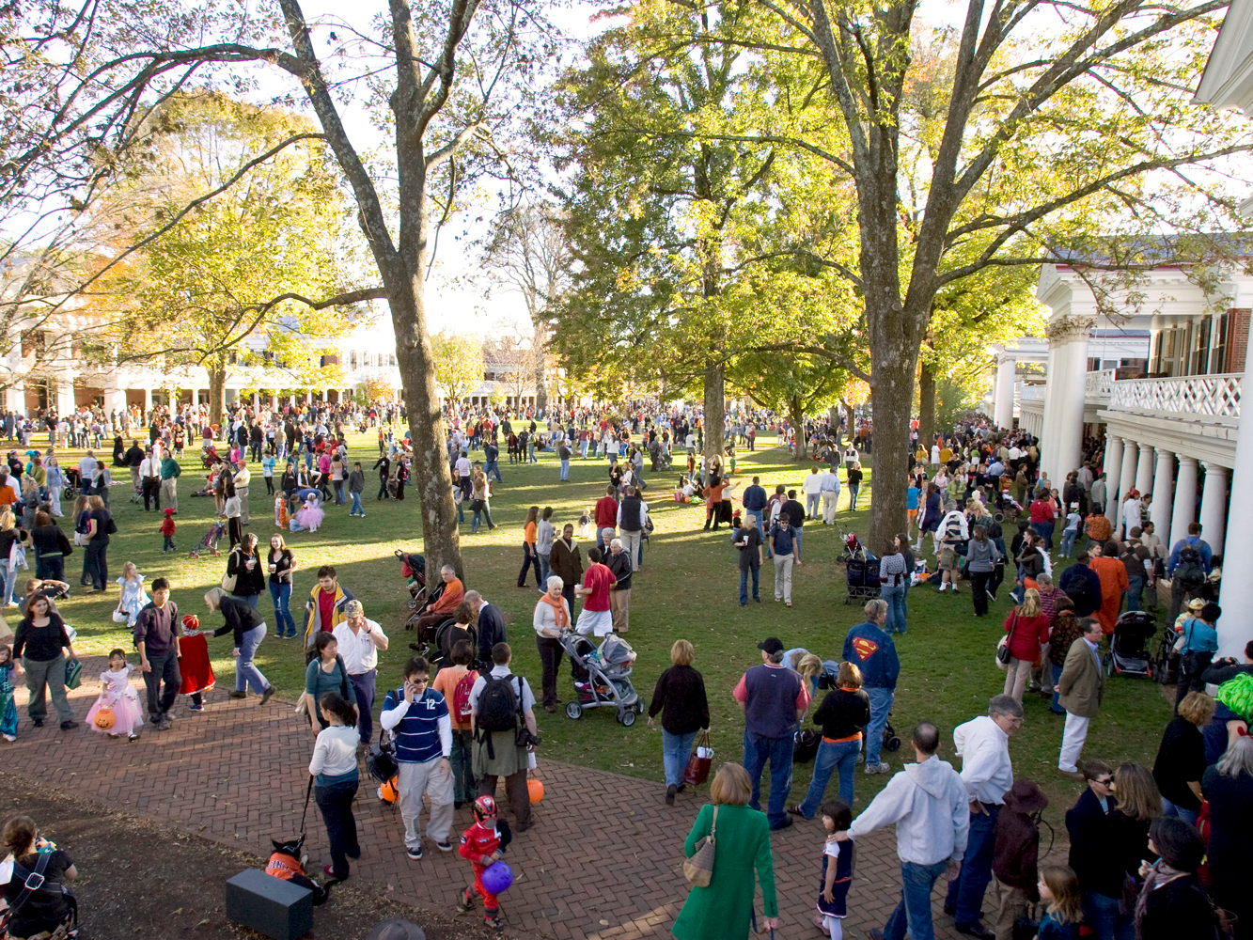
Class 17: Trick-or-Treat Protocols
cs4414 Fall 2013
University of Virginia
David Evans

Slide 2

Plan for Today
Developing a Security Mindset
But first…
“Trick-or-Treat” Protocols!
PS3 is due at 11:59pm tonight!

Slide 3

“Trick or Treat” Protocols

Slide 4
“Trick or Treat” Protocols
Two parties:
Tricker initiates the protocol by making a terrorist threat and demanding tribute
Victim either pays tribute (usually in the form of sugary snack) or risks being tricked
Tricker must convince Victim that she poses a credible threat: prove she is a qualified tricker

Slide 5
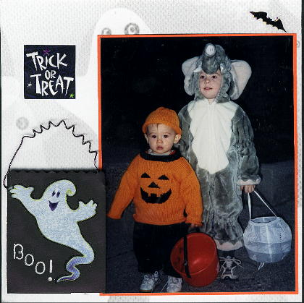


Trick-or-Treat
“Trick or Treat?”
Victim
“Prove it!”
Trickers?
“The magic word is: shazam!”
Any problems with this?

Slide 6

Authentication
How can the tricker prove their trickability, without allowing the victim to now impersonate a tricker?

Slide 7
One-Way Functions
f is a one-way function if it is a function y = f(x) that satisfies these two properties:
Invertible: there exists an f ⁻¹ such that,
for all x in range: f ⁻¹ (f (x)) = x
One-way: it is much, much, much easier to compute f (x) than to compute f ⁻¹ (y)

Slide 8
Example One-Way-ish Function: Factoring
Forward: given p and q are 200-digit prime numbers, output n = pq
Backward: given n, output (p, q)
Forward: given (p, q) easy to calculate f (p, q).
Backward: given n = f (p, q) hard to find p and q.
Easy means we know is an algorithm with running time in Θ(N²) where N is number of digits.
Hard means (we hope) the fastest possible procedure has running time that is not polynomial in N

Slide 9
Best Known Factoring Algorithm
General Number Field Sieve: running time is in
where N is the number of bits in input.
Θ(e^{log N⅓ log log N⅔})
Note: unless you have a big quantum computer! Then the running time is in
O((log N)³).

Slide 10
“Trick or Treat?”
“Prove it by factoring n = 2129024631825875754749788201627151749780670396327721627823338321538194 9984056495911366573853021918316783107387995317230889569230873441936471” ”
3398717423028438554530123627613875835633986495969597423490929302771479
* 6264200187401285096151654948264442219302037178623509019111660653946049
Checks the factors
multiply to produce n
Problems with this?

Slide 11
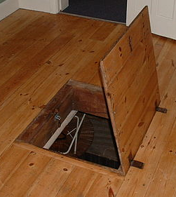
Providing Asymmetry
Need a function f that is:
Easy to compute:
given x, easy to compute f (x)
Hard to invert:
given f (x), hard to compute x
Has a trap-door:
given f (x) and t,
easy to compute x
No function (publicly) known with these properties until 1977…

Slide 12
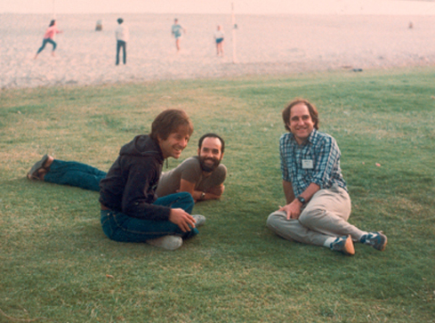
Len Adleman
Adi Shamir
Ron Rivest

Slide 13
RSA Cryptosystem
E_{e}(M ) = Me mod n
D_{d}(C ) = C^{d} mod n
n = pq p, q are prime
d is relatively prime to (p – 1)(q – 1)
ed ≡ 1 mod (p – 1)(q – 1)

Slide 14
Correctness of RSA
E_{e}(M ) = Me mod n
D_{d}(C ) = C^{d} mod n
D_{d}(E_{e}(M )) = (Me mod n)^{d} mod n
= M^{ed} mod n
= M
This step depends on choosing e and d to have this property: uses Fermat’s little theorem and Euler’s Totient theorem

Slide 15
Hard to Invert
Given E_{e}(M ) and e and n, hard to compute M.
If attacker can factor n = pq, easy to find d:
d = e⁻¹ mod (p – 1)(q – 1)
All other attacks are equivalent to factoring n.
No one seems to know a fast way to factor, except with a quantum computer (and no one seems to yet know how to build a large one).
For reasonable security, n should be 2048 bits (comparable to 112-bit symmetric key) – believed sufficient until 2030.

Slide 16
Easy to Invert with Trapdoor
E_{e}(M ) = Me mod n
D_{d}(C ) = C^{d} mod n

Slide 17
“Trick or Treat?”
“Prove it by producing D(x) for my challenge x”
D(x) = C^{d} mod n
Checks that
D(x)^{e} mod n = x
How does victim know e and n?

Slide 18
“Trick or Treat?”
“What is your Ticker ID No?”
“tricker@virginia.edu”
Help me verify
“tricker@virginia.edu”
Trickers
Bureau
e_{T@V}, n_{T@V}
Challenge: x
M = D(x) = C^{dT@V} mod n_{T@V}
Checks that
^{MeT@V} mod n_{T@V} = x
How does victim know e and n?

Slide 19
Except on Halloween, this is called a
challenge-response
authentication protocol.

Slide 20
“Trick or Treat?”
“What is your Ticker ID No?”
Modification #1:
Don’t send x in clear – this would be vulnerable to relay attacks
“tricker@virginia.edu”
Help me verify
“tricker@virginia.edu”
Trickers
Bureau
e_{T@V}, n_{T@V}
Challenge: x
D(x) = C^{dT@V} mod n_{T@V}
Checks that
^{D(x)eT@V} mod n_{T@V} = x
How does victim know e and n?

Slide 21
“Trick or Treat?”
“What is your Ticker ID No?”
Modification #1:
Don’t send x in clear – this would be vulnerable to relay attacks
“tricker@virginia.edu”
Help me verify
“tricker@virginia.edu”
Trickers
Bureau
Challenge: E_{T@V}(x) = x^{eT@V} mod n_{T@V}
e_{T@V}, n_{T@V}
x
Verifies x
How does victim know e and n?

Slide 22
“Trick or Treat?”
“What is your Ticker ID No?”
Modification #2:
Set up a conversation, not just one authentication
“tricker@virginia.edu”
Help me verify
“tricker@virginia.edu”
Trickers
Bureau
Challenge: E_{T@V}(x) = x^{eT@V} mod n_{T@V}
e_{T@V}, n_{T@V}
x
Verifies x
How does victim know e and n?

Slide 23
“Trick or Treat?”
“What is your Ticker ID No?”
Modification #2:
Set up a conversation, not just one authentication
“tricker@virginia.edu”
Help me verify
“tricker@virginia.edu”
Trickers
Bureau
Challenge: E_{T@V}(x) = x^{eT@V} mod n_{T@V}
e_{T@V}, n_{T@V}
Learn x and use it as a symmetric (e.g., AES) key
AES_{x}[“I like M&Ms”]
AES_{x}[“Pretzel or Coconut?”]
How does victim know e and n?

Slide 24
Should your Zhtta server implement this protocol?

Slide 25
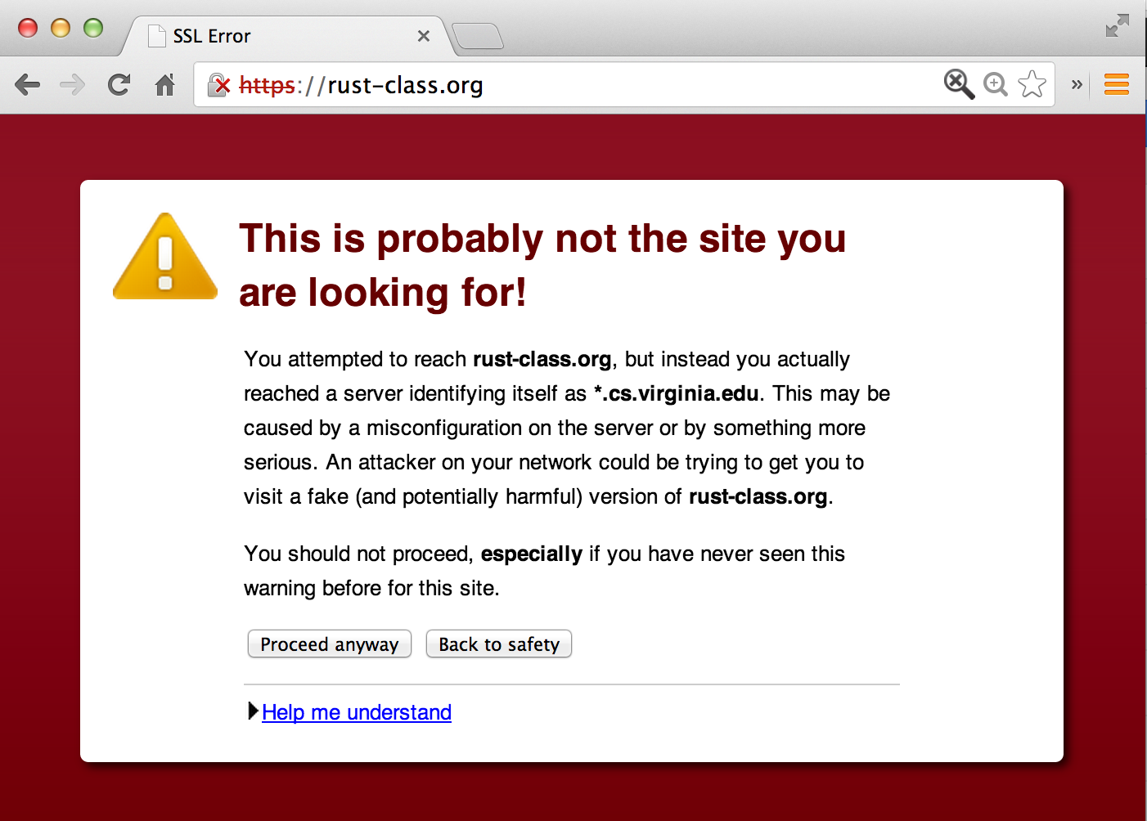

Slide 26
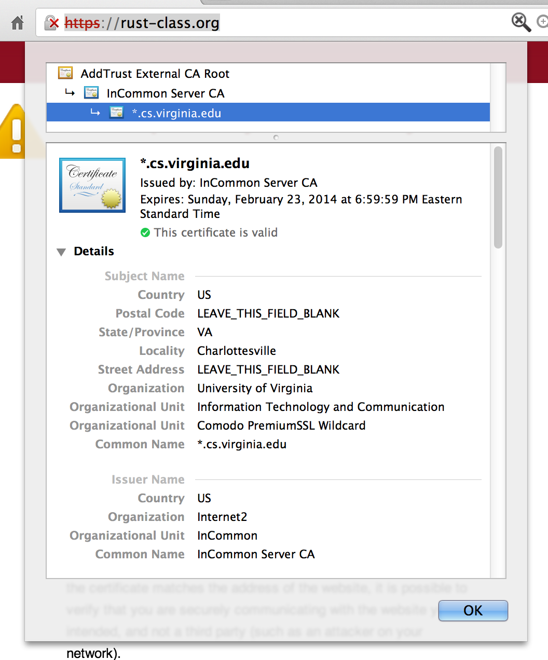

Slide 27
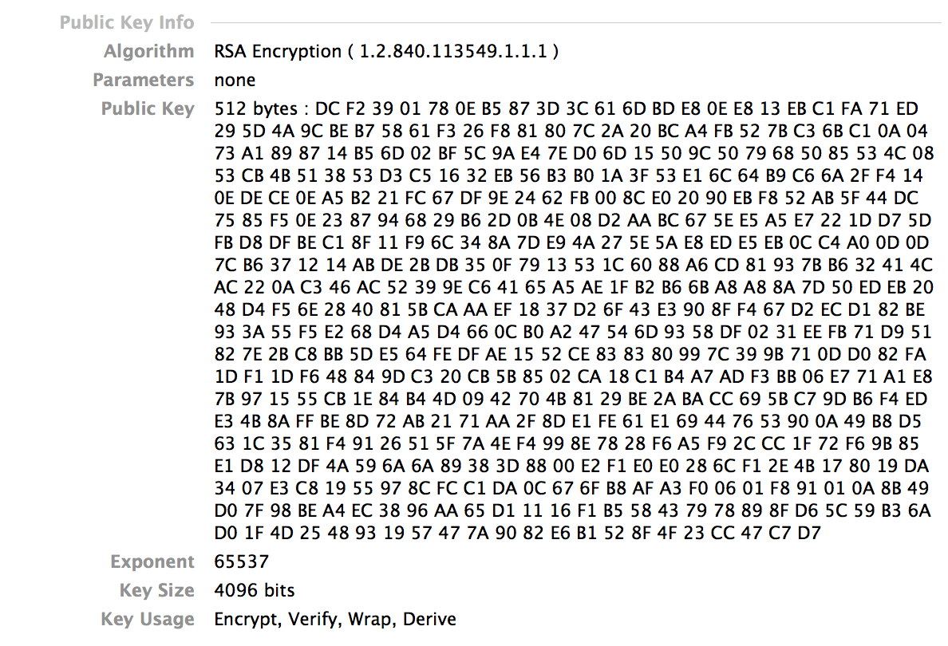

Slide 28
SSL (Secure Sockets Layer) Simplified TLS Handshake Protocol
Client
Server
Hello
Verify Certificate using KU_{CA}
Check identity matches URL
Generate random K
KR_{CA}[Server Identity, KU_{S}]
Decryptusing KR_{S}
E_{KUS} (K)
Secure channel using K

Slide 29
SSL (Secure Sockets Layer) Simplified TLS Handshake Protocol
Client
Server
Hello
Verify Certificate using KU_{CA}
Check identity matches URL
Generate random K
KR_{CA}[Server Identity, KU_{S}]
How did client get KU_{CA}?
Decryptusing KR_{S}
E_{KUS} (K)
Secure channel using K

Slide 30
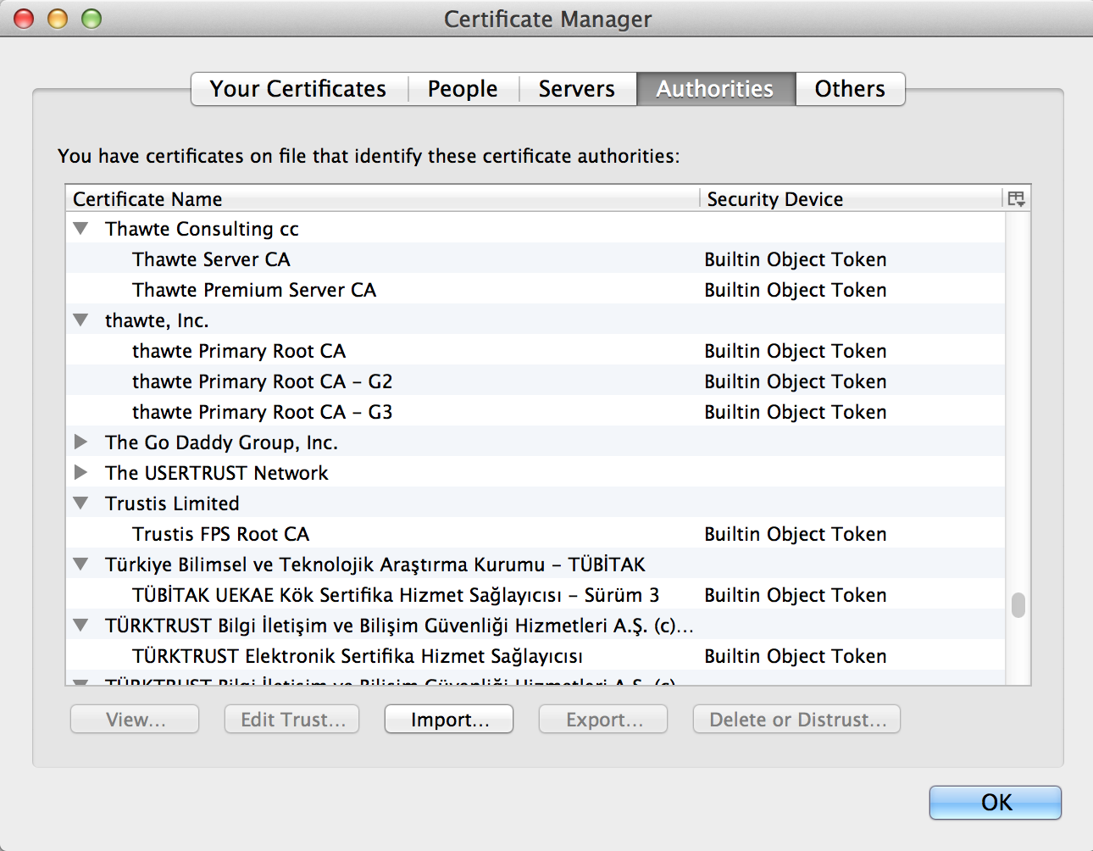

Slide 31
Certificates
How does VarySign decide if it should give certificate to requester?
VarySign.com
rust-class.org, KU_{rust-class.org}
C_{P} = KR_{VarySign}[“rust-class.org”, KU_{rust-class.org}]
TJ
C_{P}
Verifies using KU_{VarySign}
rust-class.org

Slide 32
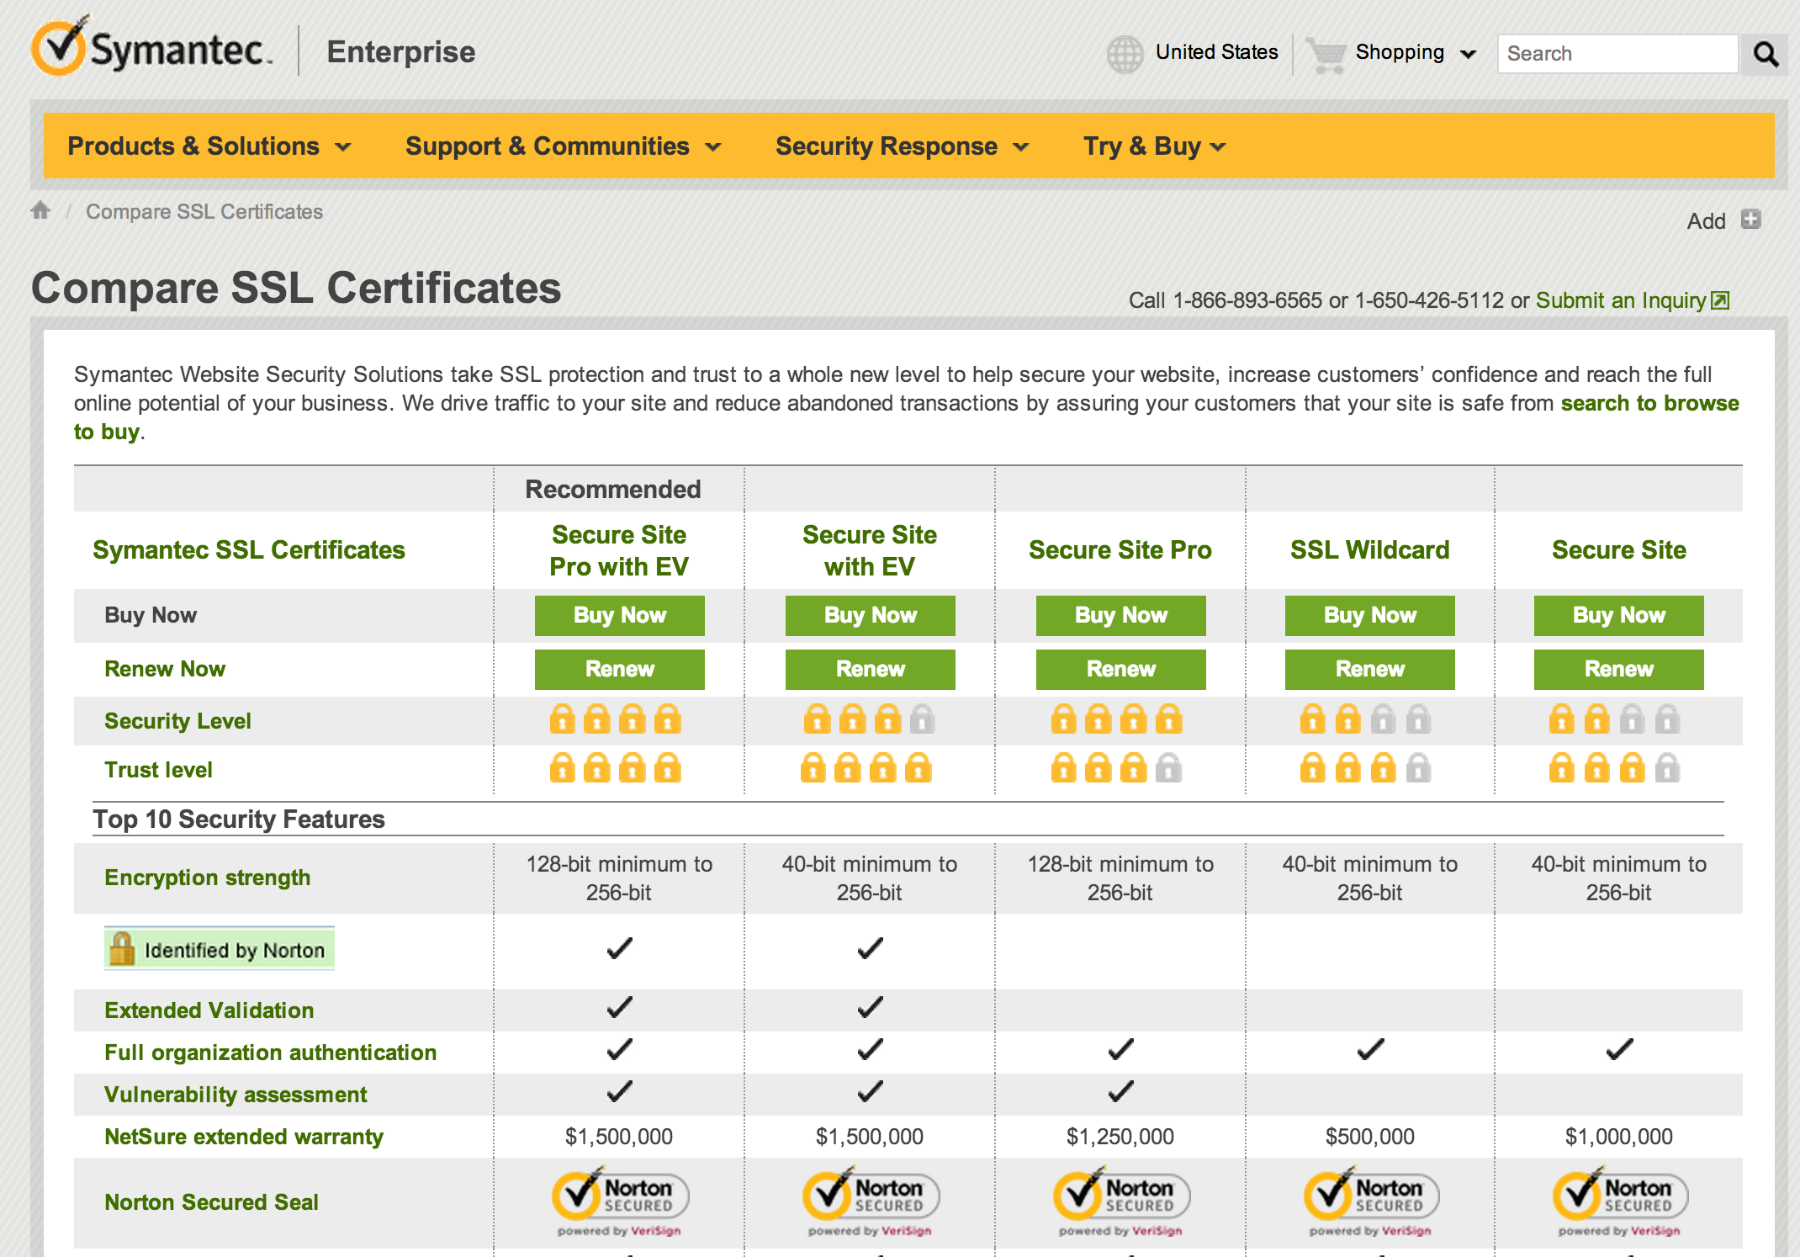
$1500 for 1 year
$399

Slide 33
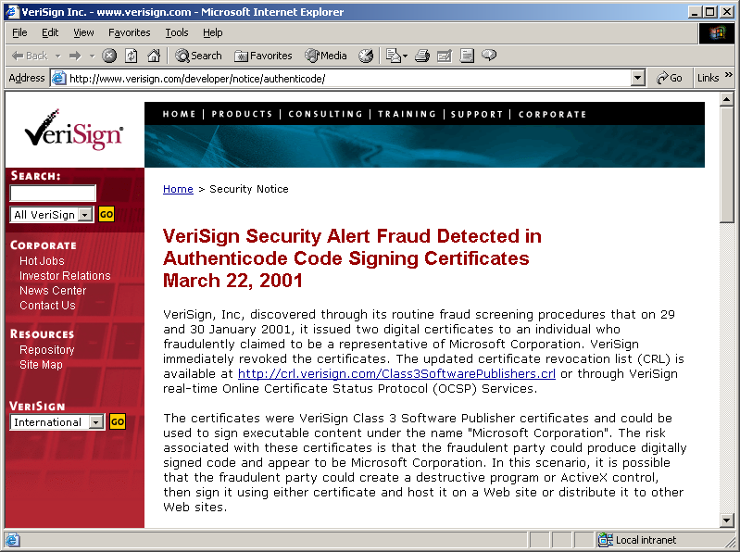
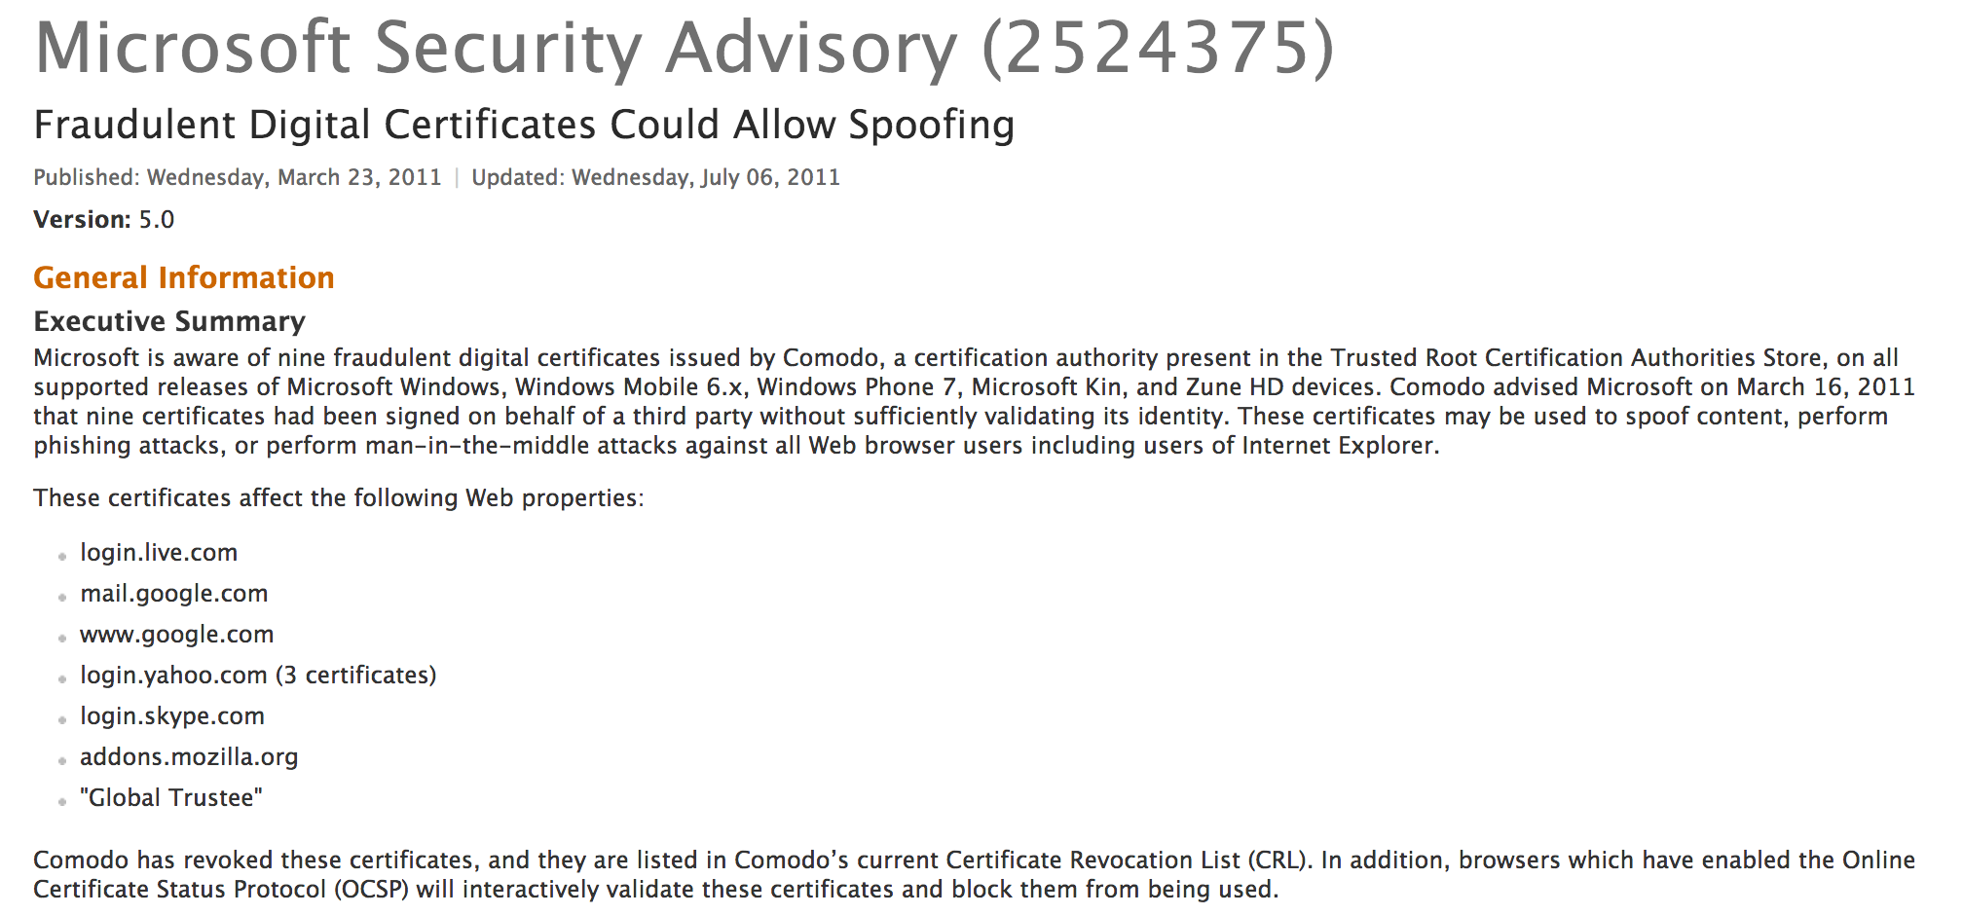
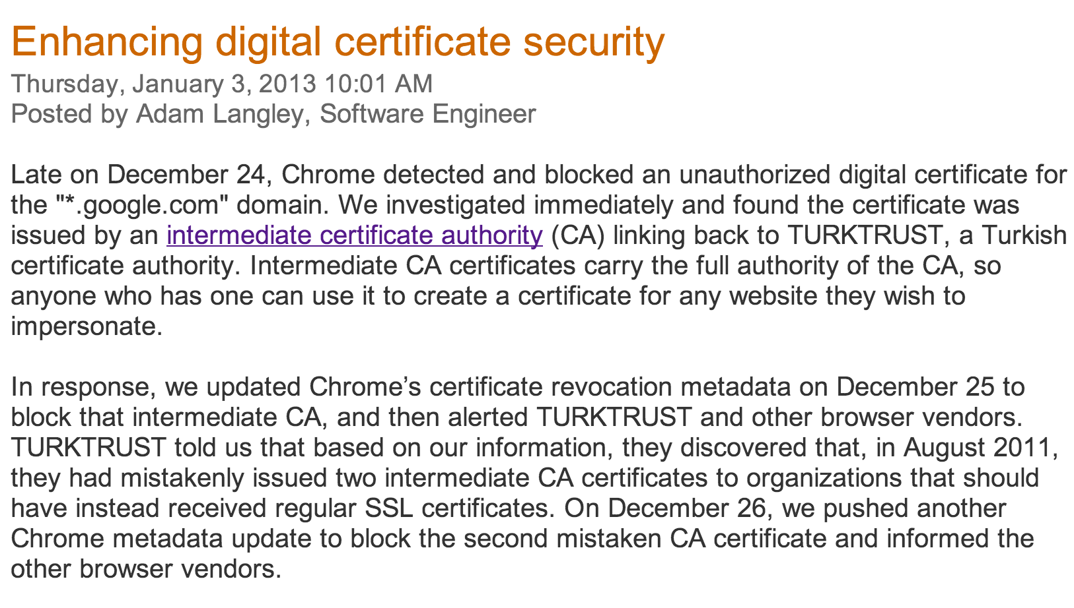

Slide 34
Certificate Revocation
VarySign.com
Certificate Revocation List (CRL)
<cert ID, date>
…
petitions.gov, KU_{Petitions}
C_{P} = KR_{VarySign}[“petitions.gov”, cert ID, Expiration, KU_{Petitions}]
Client
C_{P}
Verifies using KU_{VarySign}
Petitions

Slide 35
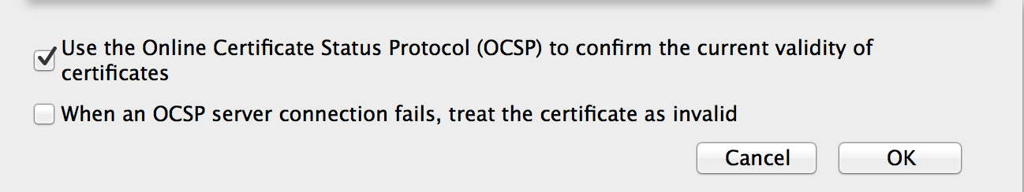
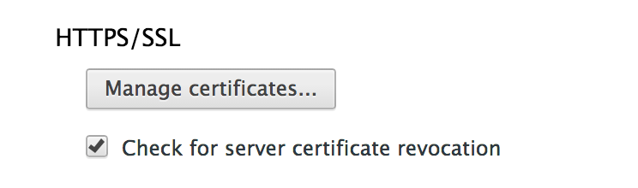
CRL Checking
Mozilla Firefox
Google Chrome
On-line checking is expensive and may fail
Attacker-in-the-middle can make it fail

Slide 36
SSL (Secure Sockets Layer) Simplified TLS Handshake Protocol
Client
Server
Hello
Actual TLS has some extra steps:
Negotiate versions
Agree on which ciphers to use (many options, but beware!)
Can authenticate client also
Verify Certificate using KU_{CA}
Check identity matches URL
Generate random K
KR_{CA}[Server Identity, KU_{S}]
Decryptusing KR_{S}
E_{KUS} (K)
KU_{S} [K]
Secure channel using K

Slide 37
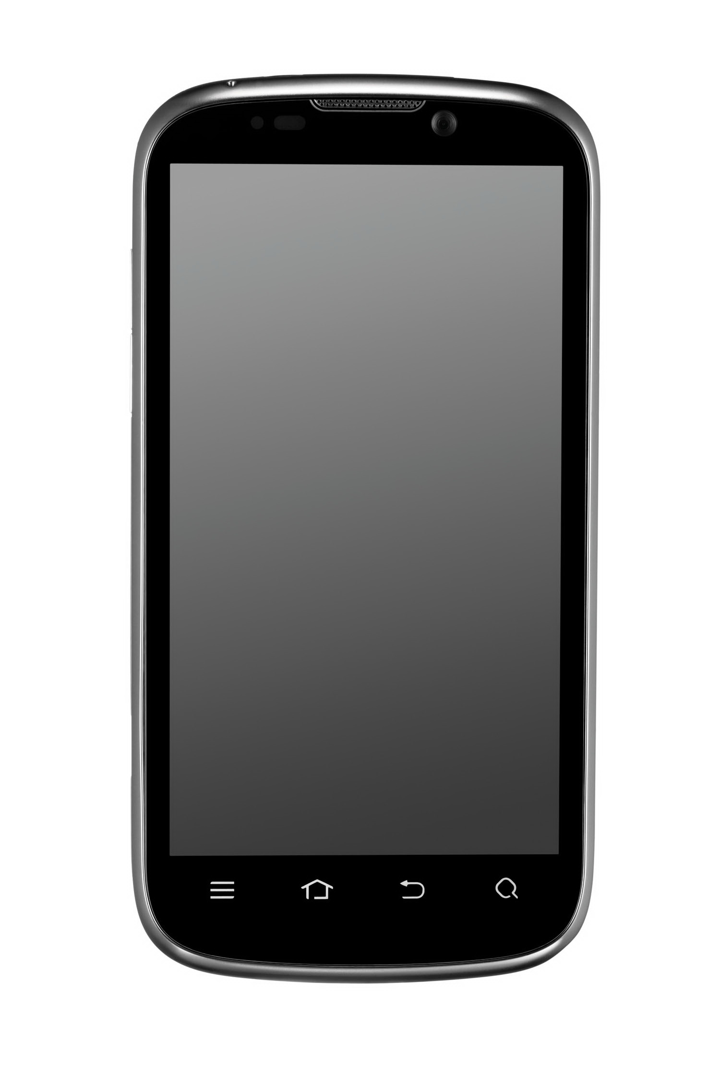
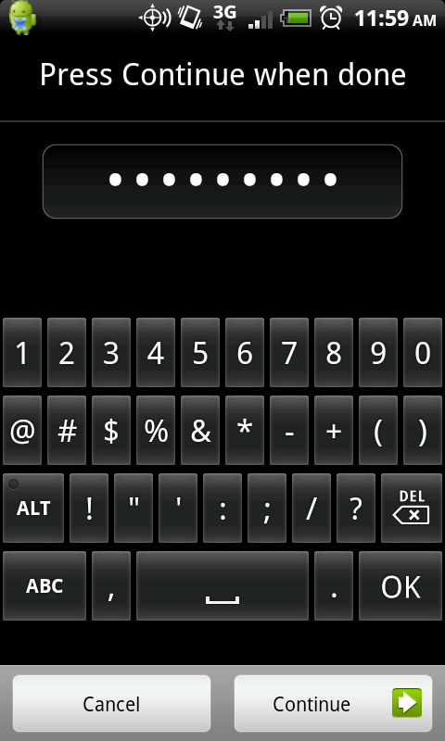
How should the Tricker store her private key?

Slide 38
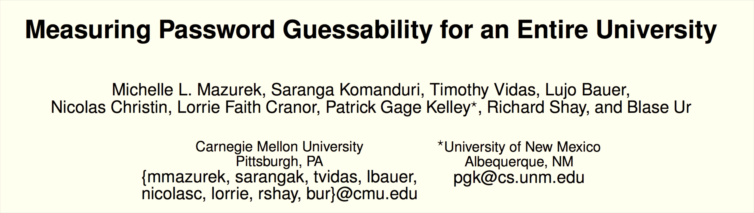
Passwords
CCS 2013

Slide 39
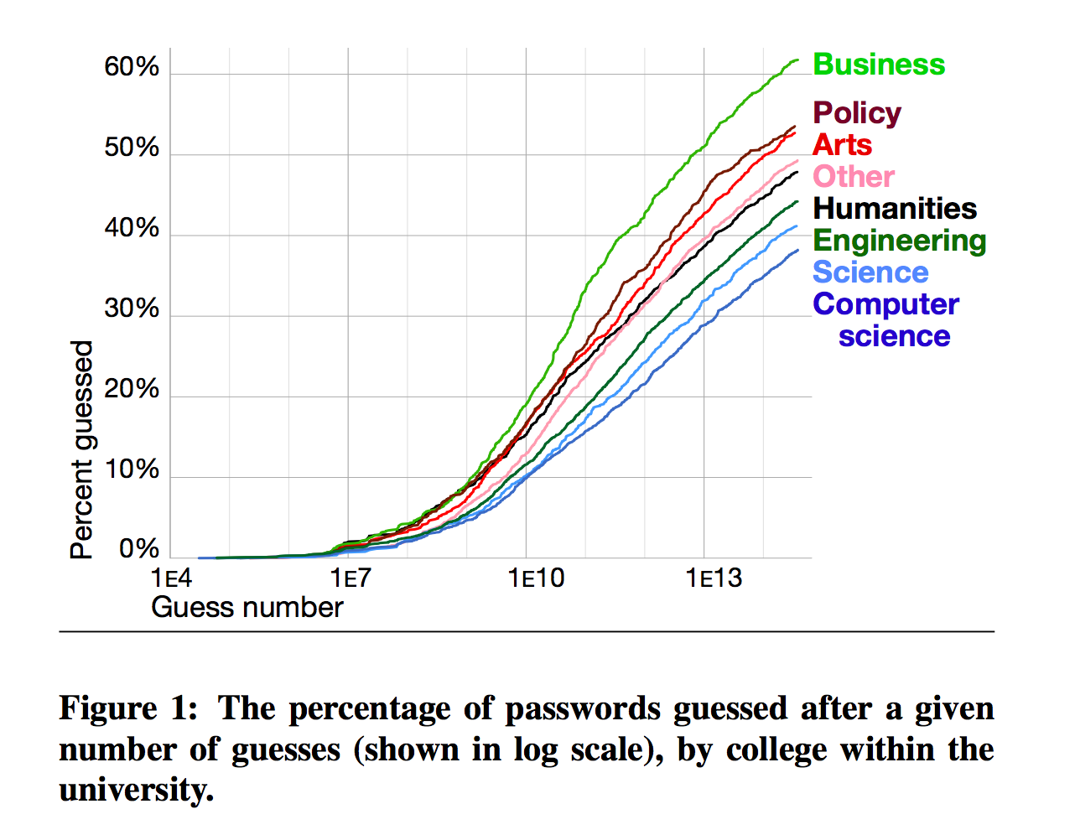
Colleges at CMU:
Arts
Business
Computer Science
Engineering
Humanities
Other
Policy
Business
Policy
Computer Science

Slide 40
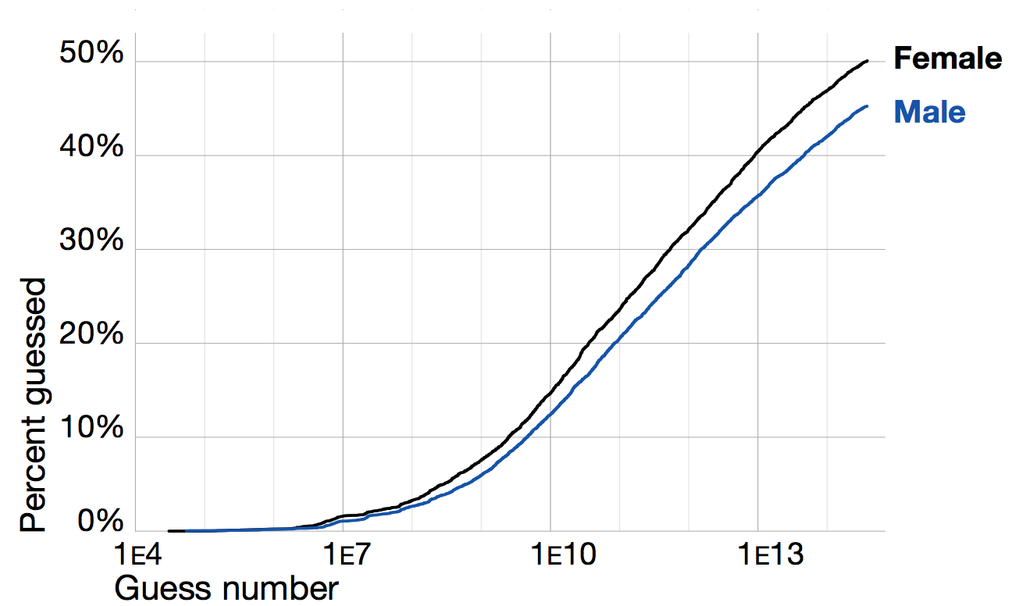

Slide 41

Hair-Dryer Attacks
Image from www.clean-funny.com, GoldenBlue LLC.

Slide 42

Java Platform
malcode.java
Java
Source
Code
javac
Compiler
malcode.class
JVML
Object
Code
JavaVM
Bytecode
Verifier
if OK
Alice User

Slide 43
What the Verifier Does
.method public static main([Ljava/lang/String;)V
…
iconst_2
istore_0
aload_0
iconst_2
iconst_3
iadd
…
return
.end method
> java Simple
Exception in thread "main" java.lang.VerifyError:
(class: Simple, method: main signature:
([Ljava/lang/String;)V)
Register 0 contains wrong type
> java –noverify Simple
result: 5

Slide 44
Running Mistyped Code
.method public static main([Ljava/lang/String;)V
…
ldc 2220
istore_0
aload_0
iconst_2
iconst_3
iadd
…
.end method
> java –noverify Simple
Unexpected Signal : EXCEPTION_ACCESS_VIOLATION
(0xc0000005) occurred at PC=0x809DCEB
Function=JVM_FindSignal+0x1105F
Library=C:\j2sdk1.4.2\jre\bin\client\jvm.dll
Current Java thread:
at Simple.main(Simple.java:7)
…
#
# HotSpot Virtual Machine Error : EXCEPTION_ACCESS_VIOLATION
# Error ID : 4F530E43505002EF
# Please report this error at
# http://java.sun.com/cgi-bin/bugreport.cgi
#
# Java VM: Java HotSpot(TM) Client VM (1.4.2-b28 mixed mode)

Slide 45
Trusted Computing Base
malcode.java
Java
Source
Code
javac
Compiler
malcode.class
JVML
Object
Code
Trusted Computing Base
JavaVM
Bytecode
Verifier
if OK
Alice User
Policy

Slide 46
TCB Should be Small
There are two ways of constructing a software design: One way is to make it so simple there are obviously no deficiencies and the other way is to make it so complicated that there are no obvious deficiencies.
Tony Hoare
How big is the TCB for Android?

Slide 47

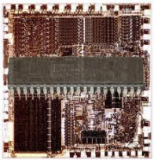
Is this really the whole TCB?
malcode.java
Java
Source
Code
javac
Compiler
malcode.class
JVML
Object
Code
Trusted Computing Base
JavaVM
Bytecode
Verifier
if OK
Alice User
Policy

Slide 48
Bytecode Verifier
Checks JVML code satisfies safety properties:
Simulates program execution to know types are correct, but doesn’t need to examine any instruction more than once
After code is verified, it is trusted: is not checked for type safety at run time (except for casts, array stores)
Key assumption: when a value is written to a memory location, the value in that memory location is the same value when it is read.

Slide 49

Violating the Assumption
…
// The object on top of the stack is a SimObject
astore_0
// There is a SimObject in location 0
aload_0
// The value on top of the stack is a SimObject
If a cosmic ray hits the right bit of memory, between the astore and aload, the assumption might be wrong.

Slide 50
Can you really blame cosmic rays when your program crashes?

Slide 51
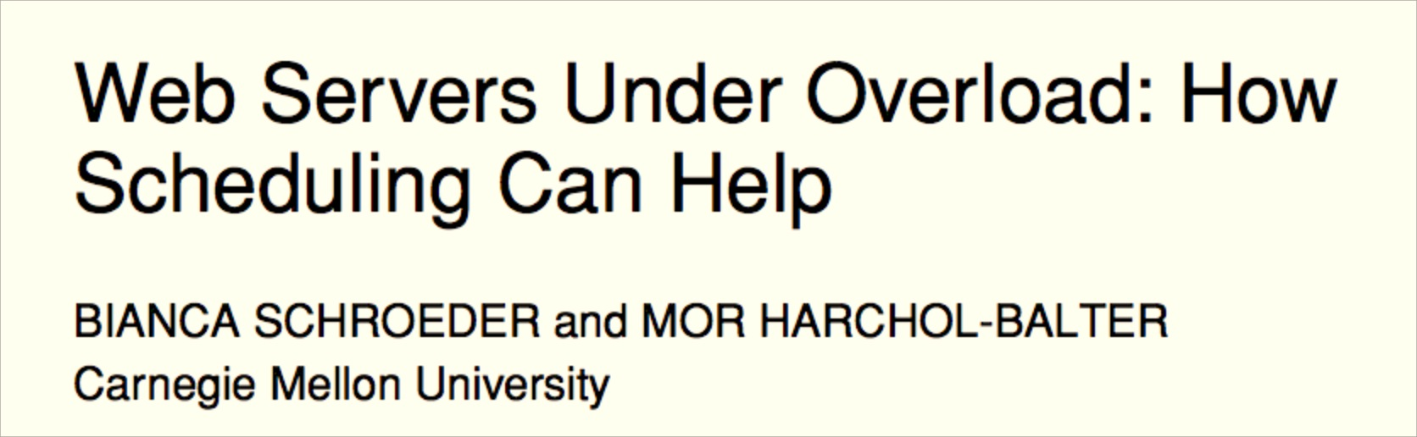
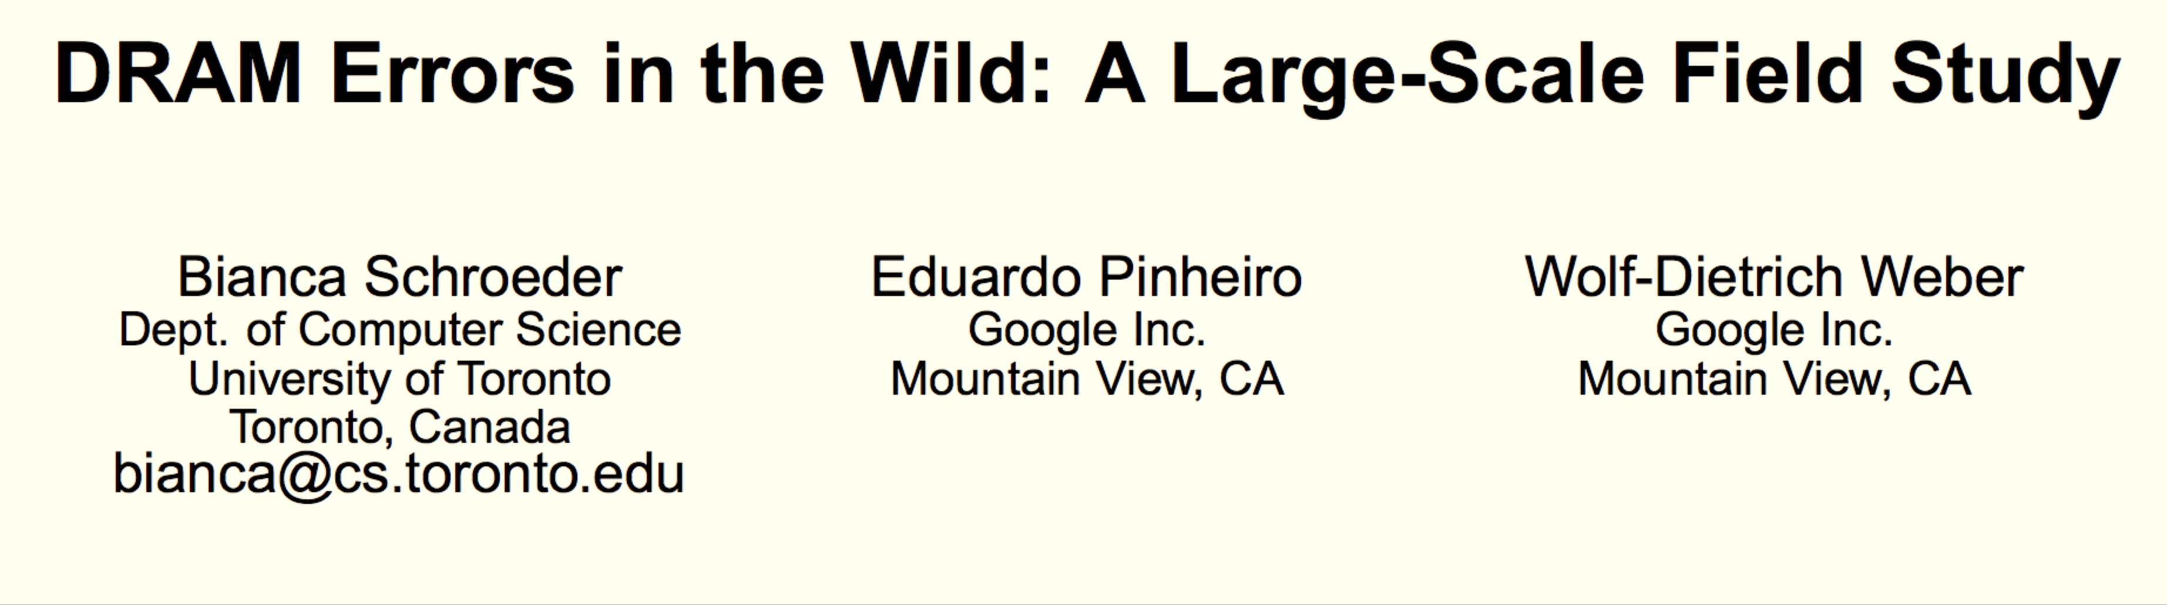

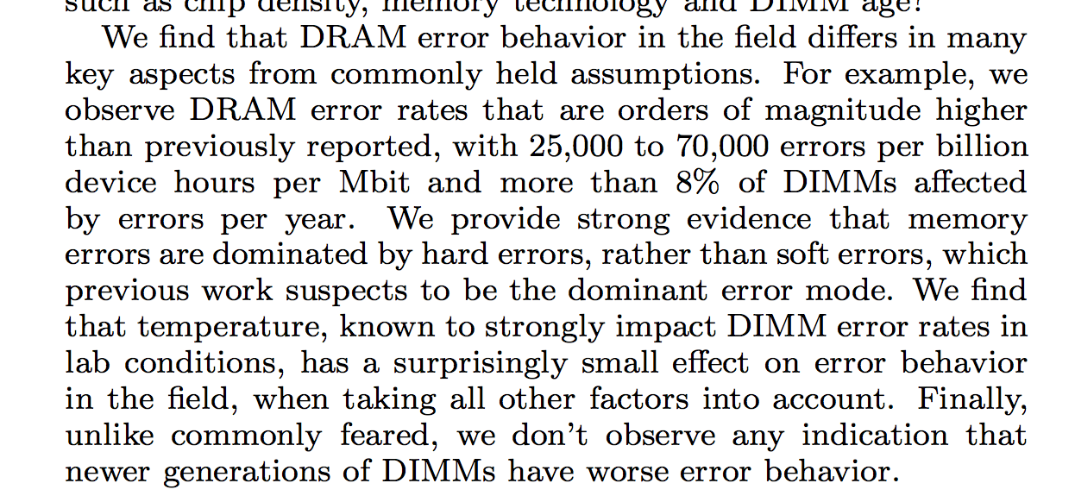

Slide 52
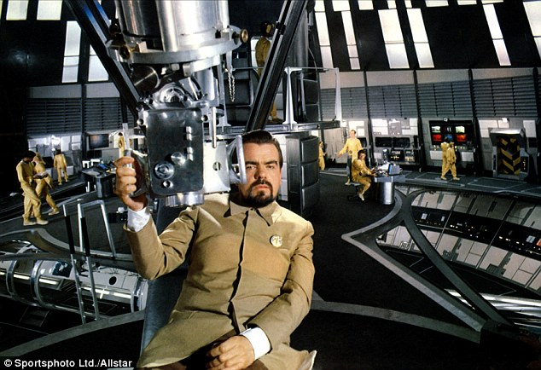
Can an attacker use this to break into your SIM card?

Slide 53
Improving the Odds
Set up memory so that a single bit error is likely to be exploitable
Mistreat the hardware memory to increase the odds that bits will flip
Following slides adapted (with permission) from Sudhakar Govindavajhala and Andrew W. Appel, Using Memory Errors to Attack a Virtual Machine, July 2003.

Slide 54
Making Bit Flips Useful
Fill up memory with Filler objects, and one Pointee object:
class Filler { class Pointee {
Pointee a1; Pointee a1;
Pointee a2; Pointee a2;
Pointee a3; Filler f;
Pointee a4; int b;
Pointee a5; Pointee a5;
Pointee a6; Pointee a6;
Pointee a7; Pointee a7;
} }

Slide 55
Filling Up Memory
a1
a2
a3
a4
Filler Object
a5
Pointee p = new Pointee ();
ArrayList<Filler> fillers = new ArrayList<Filler> ();
try {
while (true) {
Filler f = new Filler ();
f.a1 = p; f.a2 = p; f.a3 = p; …; f.a7 =p;
fillers.add (f);
}
} catch (OutOfMemoryException e) { ; }
a6
a7
a1
a2
f
b
Pointee Object
a5
a6
a7
a1
Filler Object
a2
a3
a4
a5
a6
a7

Slide 56
Wait for a bit flip…
a1
a2
a3
a4
Filler Object
Remember: there are lots of Filler objects (fill up all of memory)
When a bit flips, good chance (~70%) it will be in a field of a Filler object and it will now point to a Filler object instead of a Pointee object
a5
a6
a7
a1
a2
f
b
Pointee Object
a5
a6
a7
a1
Filler Object
a2
a3
a4
a5
a6
a7

Slide 57
Type Violation
a1
a2
a3
a4
Filler Object
a5
After the bit flip, the
value of f.a2 is a
Filler object, but
f.a2 was declared
as a Pointee object!
a6
a7
a1
a2
f
b
Pointee Object
a5
a6
Can an attacker exploit this?
a7
a1
Filler Object
a2
a3
a4
a5
a6
a7

Slide 58
Finding the Bit Flip
while (true) {
for (Filler f : fillers) {
if (f.a1 != p) { // bit flipped!
…
} else if (f.a2 != p) {
…
}
}

Slide 59
Violating Type Safety
class Filler { class Pointee {
Pointee a1; Pointee a1;
Pointee a2; Pointee a2;
Pointee a3; Filler f;
Pointee a4; int b;
Pointee a5; Pointee a5;
Pointee a6; Pointee a6;
Pointee a7; Pointee a7;
} }
Filler f = (Filler) e.nextElement ();
if (f.a1 != p) { // bit flipped!
Object r = f.a1; //
Filler fr = (Filler) r; // Cast is checked at run-time
Declared Type
f.a1 Pointee
f.a1.b int
fr == f.a1 Filler
fr.a4 == f.a1.b Pointee

Slide 60
Exploiting Type Unsafety
class Filler { class Pointee {
Pointee a1; Pointee a1;
Pointee a2; Pointee a2;
Pointee a3; Filler f;
Pointee a4; int b;
Pointee a5; Pointee a5;
Pointee a6; Pointee a6;
Pointee a7; Pointee a7;
} }
Filler f = (Filler) e.nextElement ();
if (f.a1 != p) { // bit flipped!
Object r = f.a1;
Filler fr = (Filler) r; // Cast is checked at run-time
f.a1.b = 1524383; // Address of the SecurityManager
fr.a4.a1 = null; // Set it to a null
// Do whatever you want! No security policy now…
new File (“C:\thesis.doc”).delete ();

Slide 61
Getting a Bit Flip
Wait for a Cosmic Ray
You have to be really, really patient… (or move machine out of Earth’s atmosphere)
X-Rays
Expensive, not enough power to generate bit-flip
High energy protons and neutrons
Work great - but, you need a particle accelerator
Hmm….

Slide 62
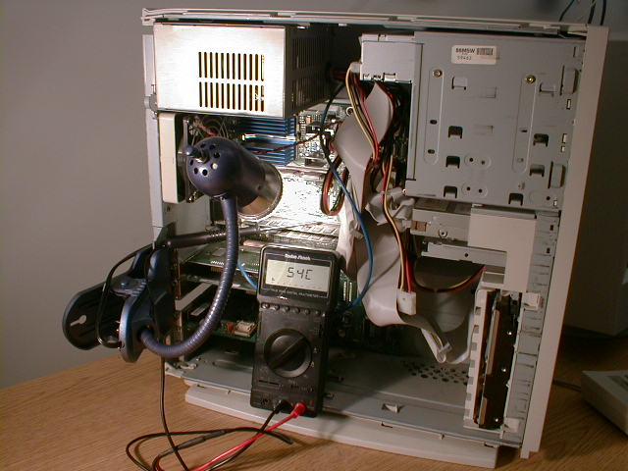
Using Heat
50-watt spotlight bulb
Between 80° -100°C, memory starts to have a few failures
Attack applet is successful (at least half the time)!
Hairdryer works too, but it fries too many bits at once
Picture from Sudhakar Govindavajhala

Slide 63
Attacks Violate Assumptions
Verifier assumes the value you write is the same value when you read it
By flipping bits, we can violate this assumption
By violating this assumption, we can violate type safety: get two references to the same storage that have inconsistent types
By violating type safety, we can get around all other security measures

Slide 64
Charge
PS3 is due at 11:59pm tonight!
Karsten Nohl will talk about actual practical ways to attack SIM card VMs in class Thursday!
If you want to learn more about “Trick-or-Treat” protocols, take MoMa’s cs4501 course in the Spring. (If you just want to Trick-or-Treat, you can come by my lab Rice 442 Thursday afternoon.)

