Slide 1
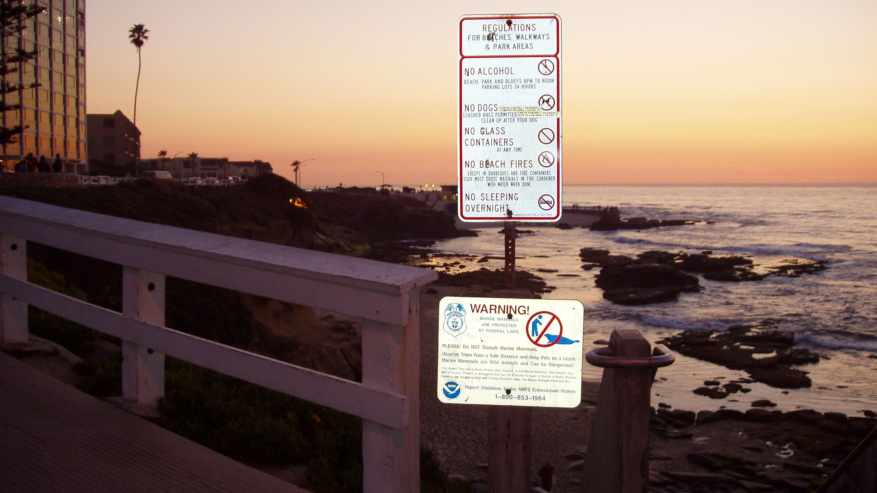
Class 18:
System Calls
cs4414 Spring 2014
University of Virginia
David Evans

Slide 2
Plan for Today
Sign up for PS4 demos today!
PS4 is due 11:59pm Sunday, 6 April
Access Control
User IDs
System Calls

Slide 3



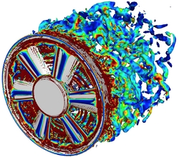


Minimizing Magic
Class 1:
Cool Computing Stuff
Its all magic!
Its all understandable!
(and I can do magical things!)
Four Years Studying Computing at an Elite Public University
Physics

Slide 4
Course Goal Reminder: Minimizing Magic
Class 1:
Cool Computing Stuff
Its all magic!
electives
cs4414
cs3102
cs2110
cs1110
cs4610
cs2150
cs4414
cs3330
cs2150
cs4414
cs2330
Physics

Slide 5
Course Goal Reminder: Minimizing Magic
Class 1:
Cool Computing Stuff
Its all magic!
electives
cs4414
cs3102
If you have any gaps left (other than synchronization primitives), post then in comments or email me.
cs2110
cs1110
cs4610
cs2150
cs4414
cs3330
cs2150
cs4414
cs2330
Physics

Slide 6
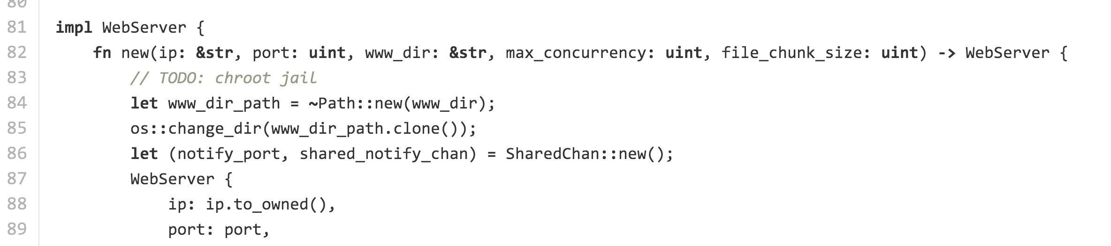
What’s wrong with Zhtta?

Slide 7
What’s wrong with Zhtta?
Note: because of the way pathnames are handled, I think it is probably actually secure (except for links in www/).

Slide 8
Why Might Letting Anyone Read Any File on your Machine Be a Bad Idea?
LMGTFY

Slide 9
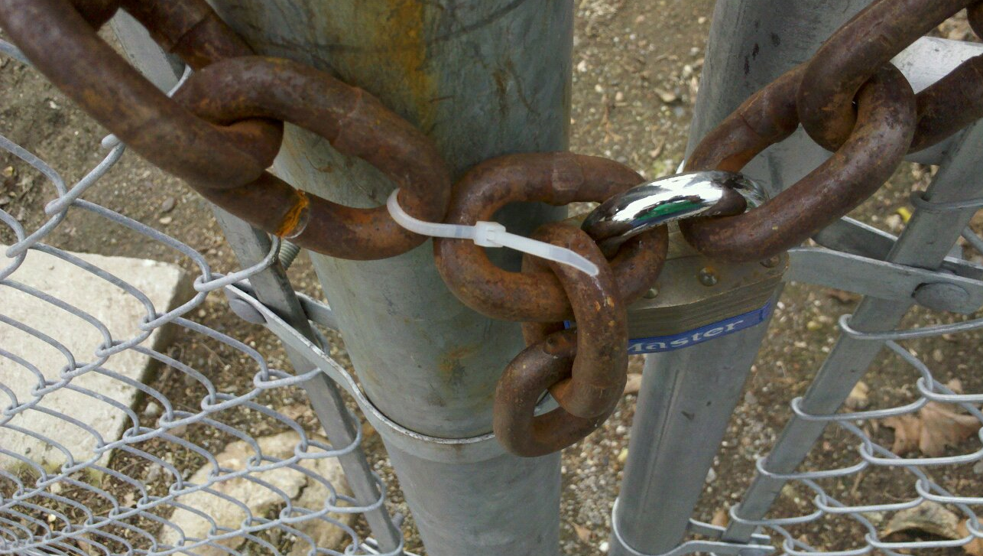
This is serious: actually trying the passwords would be wrong and criminal.*
* Just because someone “broadcasts” their password or uses laughable security, doesn’t mean the FBI considers it “authorized” access. Whether it is you or Google that is breaking the law in this case is unclear.

Slide 10
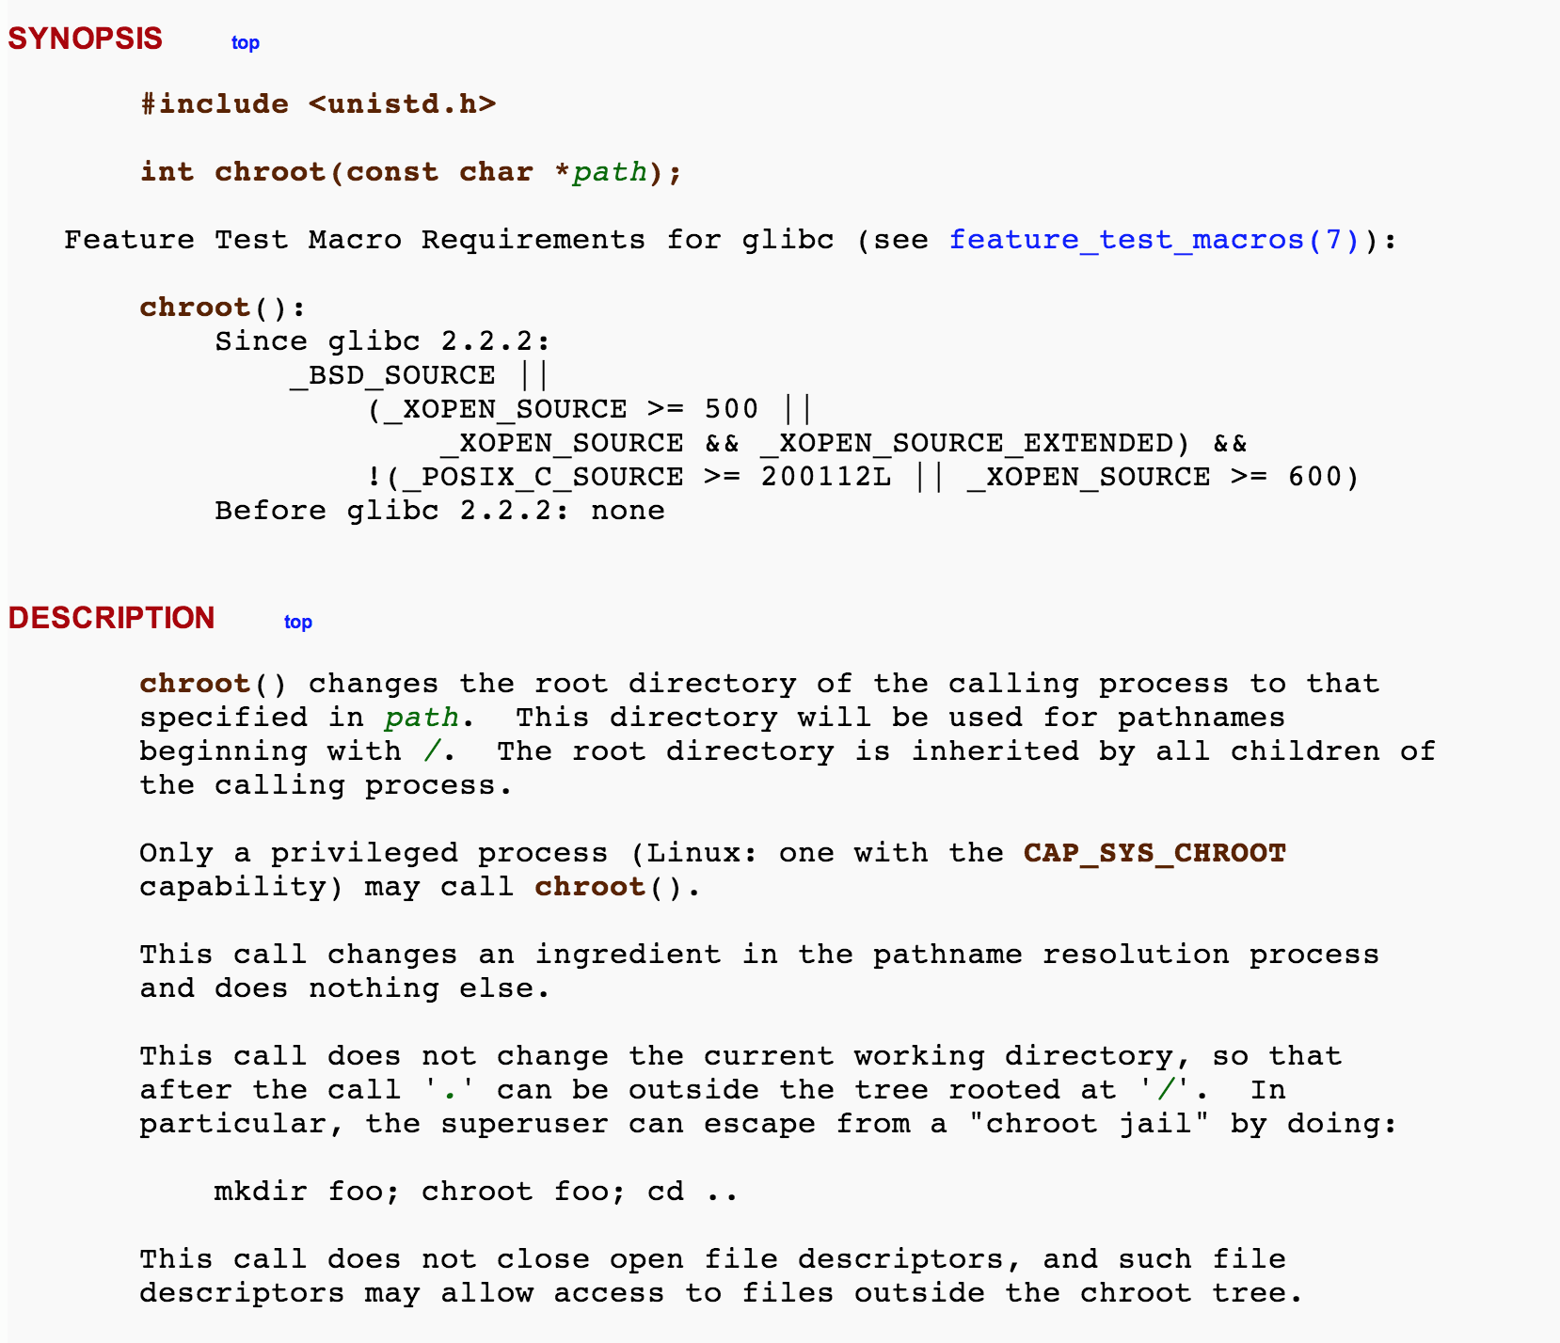
Unix (Sort-of) “Solution”

Slide 11
Zhtta and Apache’s (Partial) Solution
in httpd.conf:
DocumentRoot /home/evans/htdocs/
Apache will only serve files in DocumentRoot’s subtree.

Slide 12
Apache’s (Partial) Solution
in httpd.conf:
DocumentRoot /home/evans/htdocs/
<Directory />
Options FollowSymLinks
</Directory>
Opps! Now it will follow symlinks inside DocumentRoot subtree to anywhere…

Slide 13
Apache’s (Further) Solution
in httpd.conf:
User #-1
Apache starts running as root (uid = 0) to be able to listen on port 80, which is default web port.
By default, switches to run as uid = -1 (“nobody”) when processing requests.

Slide 14
bash-3.2$ ps aux | grep httpd
dave 20926 0.0 0.0 2423356 208 p0 R+ 10:15PM 0:00.00 grep httpd
_www 20923 0.0 0.0 2437400 700 ?? S 10:15PM 0:00.00 httpd
root 20922 0.0 0.0 2437400 2376 ?? Ss 10:15PM 0:00.05 httpd
# after one request
bash-3.2$ ps aux | grep httpd
dave 20934 0.0 0.0 2432768 620 p0 S+ 10:16PM 0:00.00 grep httpd
_www 20932 0.0 0.0 2437400 700 ?? S 10:16PM 0:00.00 httpd
_www 20931 0.0 0.0 2437400 700 ?? S 10:16PM 0:00.00 httpd
_www 20930 0.0 0.0 2437400 896 ?? S 10:16PM 0:00.00 httpd
_www 20923 0.0 0.0 2437400 1800 ?? S 10:15PM 0:00.01 httpd
root 20922 0.0 0.0 2437400 2376 ?? Ss 10:15PM 0:00.05 httpd

Slide 15
Access Control
How does the OS know whether or not the (effective) user can read a file?

Slide 16
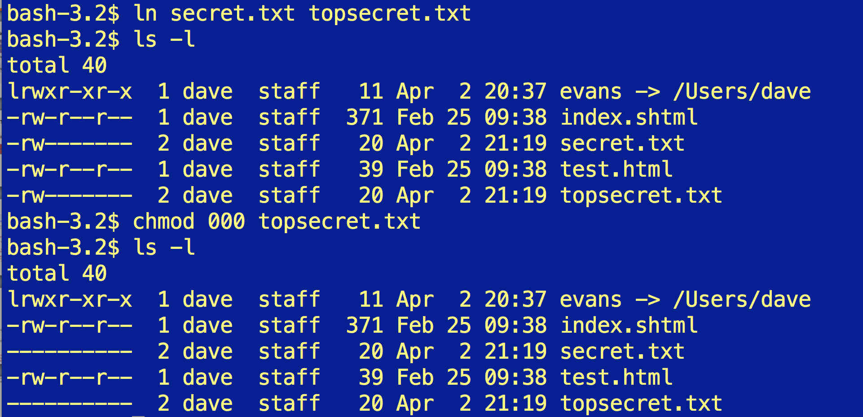

Slide 18
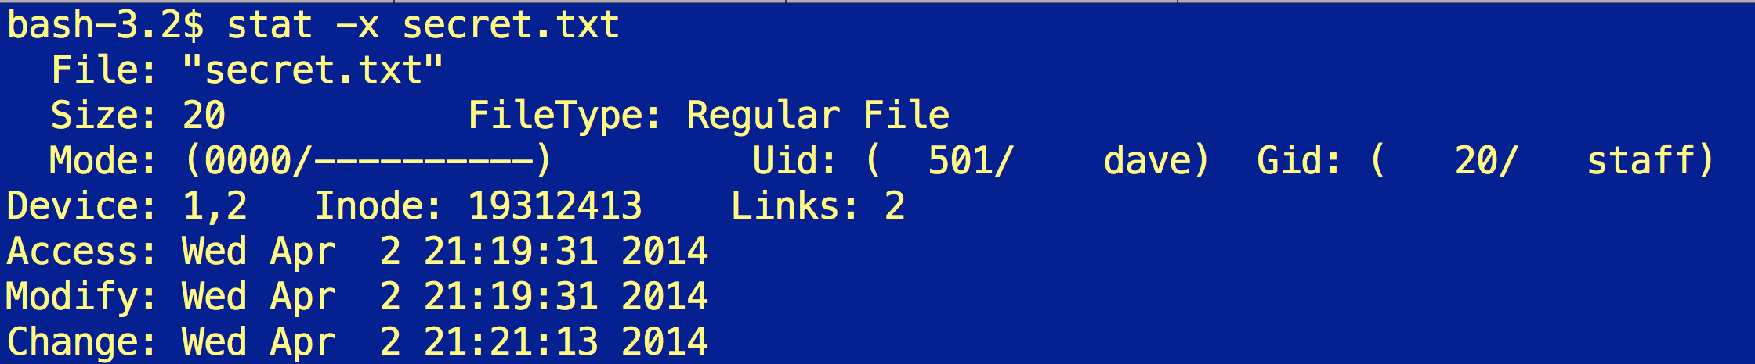

Slide 19
Size of File (bytes)
Device ID
User ID
Group ID
File Mode (permission bits)
Link count (number of hard links to node)
…
Diskmap

Slide 20
Access Control Matrix
Users | Files
 | /alice/www/index.html | /dave/secrets.txt | /alice/secrets.txt
root | read, write | read, write | read, write
dave | read | read, write | -
www | read | - | -
Can Unix-like file system support this?

Slide 21
Size of File (bytes)
Device ID
User ID
Group ID
File Mode (permission bits)
Link count (number of hard links to node)
…
Diskmap

Slide 22
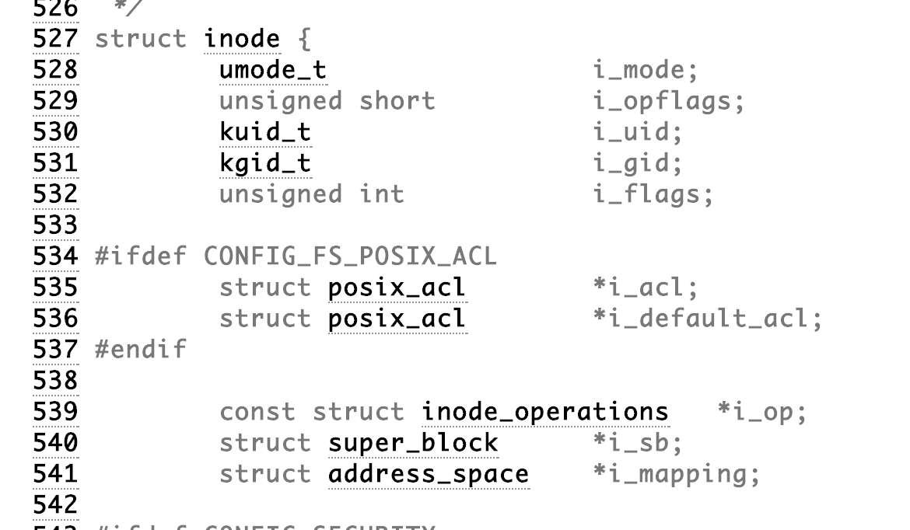
http://lxr.free-electrons.com/source/include/linux/fs.h (Linux Version 3.14)

Slide 23
include/linux/types.h#L18
short: at least 16 bits
http://lxr.free-electrons.com/source/include/linux/fs.h (Linux Version 3.14)

Slide 24
Unix File Mode Permission Bits
owner
group
others
+ 7 bits for
other stuff:
file/directory
symbolic link
etc.
666
644
000
755
execute
write
read
execute
write
read
execute
write
read

Slide 25
How does Apache create processes running as different users?
bash-3.2$ ps aux | grep httpd
dave 20926 0.0 0.0 2423356 208 p0 R+ 10:15PM 0:00.00 grep httpd
_www 20923 0.0 0.0 2437400 700 ?? S 10:15PM 0:00.00 httpd
root 20922 0.0 0.0 2437400 2376 ?? Ss 10:15PM 0:00.05 httpd
# after one request
bash-3.2$ ps aux | grep httpd
dave 20934 0.0 0.0 2432768 620 p0 S+ 10:16PM 0:00.00 grep httpd
_www 20932 0.0 0.0 2437400 700 ?? S 10:16PM 0:00.00 httpd
_www 20931 0.0 0.0 2437400 700 ?? S 10:16PM 0:00.00 httpd
_www 20930 0.0 0.0 2437400 896 ?? S 10:16PM 0:00.00 httpd
_www 20923 0.0 0.0 2437400 1800 ?? S 10:15PM 0:00.01 httpd
root 20922 0.0 0.0 2437400 2376 ?? Ss 10:15PM 0:00.05 httpd

Slide 26
Changing Users
int setuid(uid_t uid);
real user id (ruid) = owner of the process
effective user id (euid) = ID used in access control decisions
saved user id (suid) = previous user ID that may be restored

Slide 27
Using setuid
httpd
euid: 0 (root)
pid_t handler = fork();
if (handler == 0) {
setuid(-1);
…
}
HTTP GET ./../../../user/dave/secrets.txt
handler
fopen(pathname, ‘r’)
Error: secrets.txt not readable to user nobody

Slide 28
Using setuid
httpd
euid: 0 (root)
pid_t handler = fork();
if (handler == 0) {
setuid(-1);
…
}
Principle of Least Privilege
Running code should have as little power as possible to get the job done.
HTTP GET ./../../../user/dave/secrets.txt
handler
fopen(pathname, ‘r’)
Error: secrets.txt not readable to user nobody

Slide 29
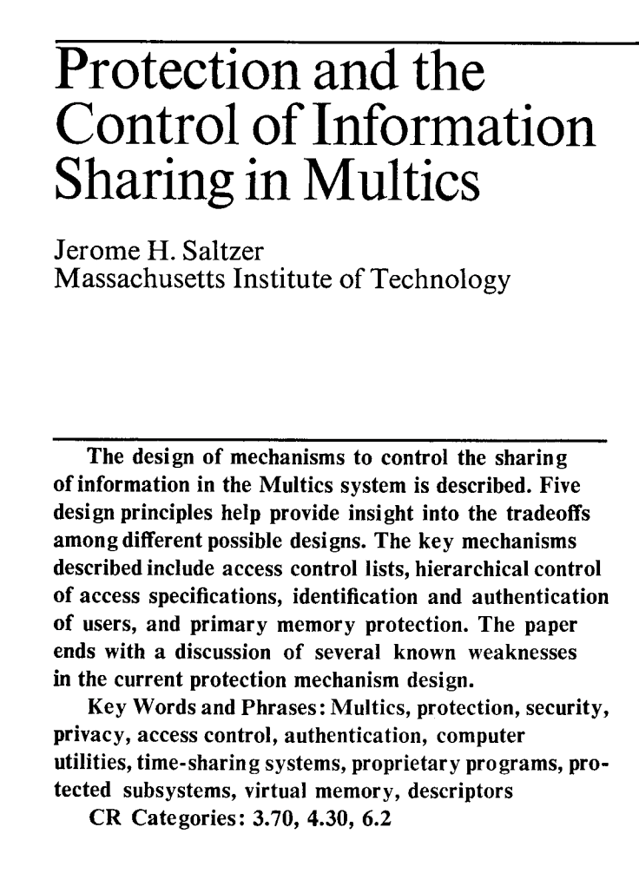
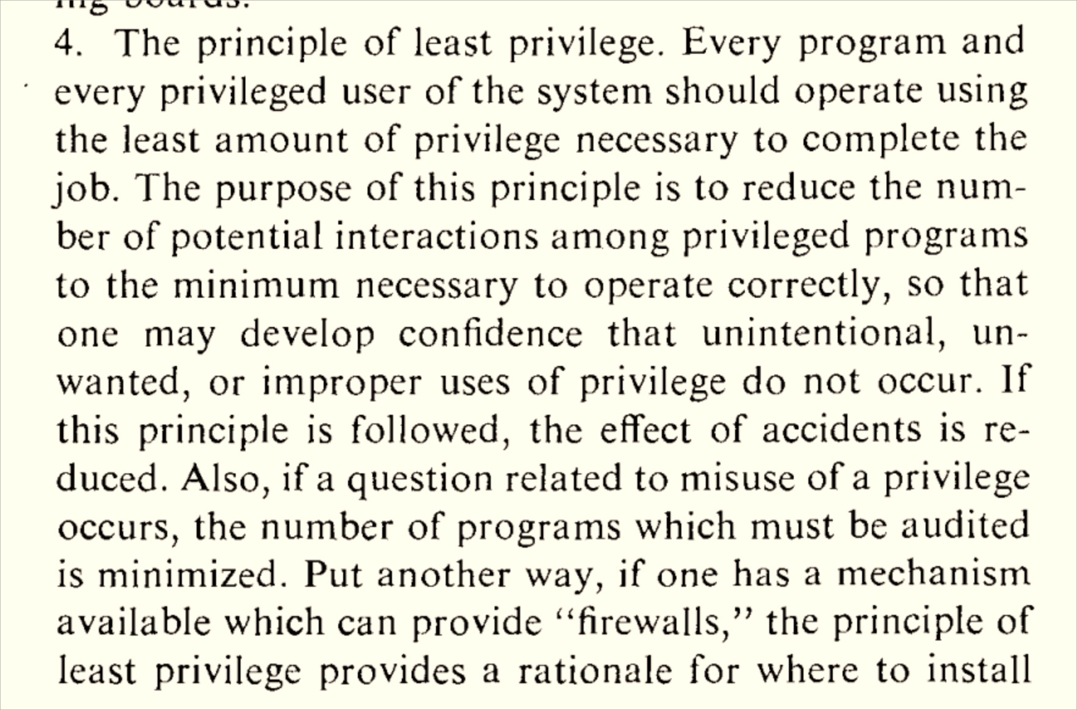
SOSP 1973

Slide 30
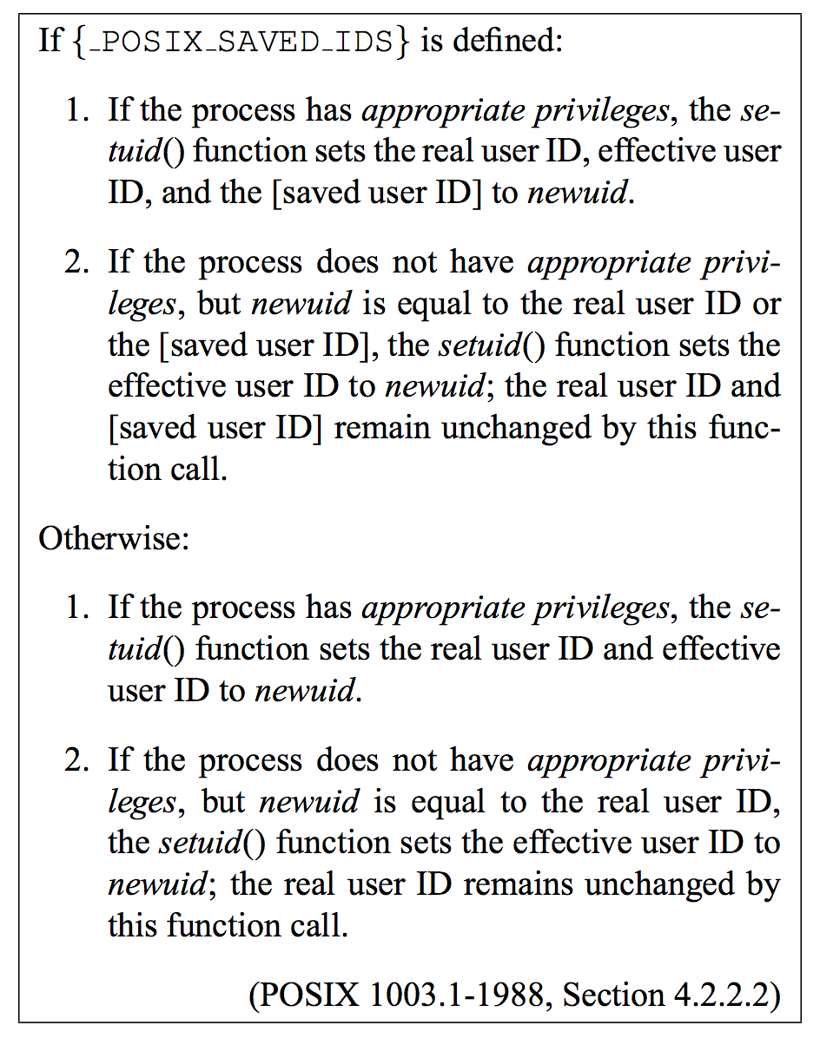
POSIX Spec for setuid

Slide 31
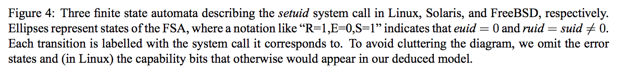
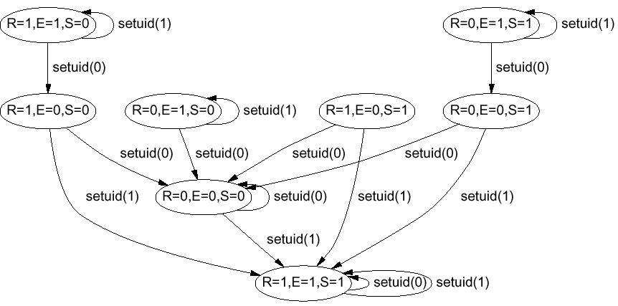
Hao Chen,
David Wagner,
Drew Dean.
Setuid Deymystified
USENIX Security 2002

Slide 32
Where should Apache httpd call setuid?

Slide 33
gash> curl http://apache.mirrors.tds.net//httpd/httpd-2.4.9.tar.gz | tar xz
gash> cd httpd-2.4.9/
gash> find . -name "*.c" -print | xargs grep "setuid("
./modules/arch/unix/mod_privileges.c: if (cfg->uid && (setuid(ap_unixd_config.user_id) == -1)) {
./modules/arch/unix/mod_privileges.c: if (cfg->uid && (setuid(cfg->uid) == -1)) {
./modules/arch/unix/mod_unixd.c: setuid(ap_unixd_config.user_id) == -1)) {
./modules/arch/unix/mod_unixd.c: setuid(ap_unixd_config.user_id) == -1)) {
./os/bs2000/os.c:/* This routine complements the setuid() call: it causes the BS2000 job
./os/bs2000/os.c:/* BS2000 requires a "special" version of fork() before a setuid() call */
./os/unix/unixd.c:/* This routine complements the setuid() call: it causes the BS2000 job
./os/unix/unixd.c:/* BS2000 requires a "special" version of fork() before a setuid() call */
./server/mpm/prefork/prefork.c: /* BS2000 requires a "special" version of fork() before a setuid() call */
./support/suexec.c: * before we setuid().
./support/suexec.c: * setuid() to the target user. Error out on fail.
./support/suexec.c: if ((setuid(uid)) != 0) {

Slide 34
in mod_privileges.c:
/* if either user or group are not the default, restore them */
if (cfg->uid || cfg->gid) {
if (setppriv(PRIV_ON, PRIV_EFFECTIVE, priv_setid) == -1) {
ap_log_rerror(APLOG_MARK, APLOG_ERR, 0, r, APLOGNO(02136)
"PRIV_ON failed restoring default user/group");
}
if (cfg->uid && (setuid(ap_unixd_config.user_id) == -1)) {
ap_log_rerror(APLOG_MARK, APLOG_ERR, 0, r, APLOGNO(02137)
"Error restoring default userid");
}
if (cfg->gid && (setgid(ap_unixd_config.group_id) == -1)) {
ap_log_rerror(APLOG_MARK, APLOG_ERR, 0, r, APLOGNO(02138)
"Error restoring default group");
}
}

Slide 35
Apache’s (Further) Solution
A few minutes ago…
in httpd.conf:
User #-1
Apache starts running as root (uid = 0) to be able to listen on port 80, which is default web port.
By default, switches to run as uid = -1 (“nobody”) when processing requests.

Slide 36
in mod_unixd.c:
static int
unixd_drop_privileges(apr_pool_t *pool, server_rec *s)
{
…
/* Only try to switch if we're running as root */
if (!geteuid() && (setuid(ap_unixd_config.user_id) == -1)) {
rv = errno;
ap_log_error(APLOG_MARK, APLOG_ALERT, errno, NULL, APLOGNO(02162)
"setuid: unable to change to uid: %ld",
(long) ap_unixd_config.user_id);
return rv;
}

Slide 37
in support/suexec.c:
… copyright and license
/*
* suexec.c -- "Wrapper" support program for suEXEC behaviour for Apache
*
***********************************************************************
*
* NOTE! : DO NOT edit this code!!! Unless you know what you are doing,
* editing this code might open up your system in unexpected
* ways to would-be crackers. Every precaution has been taken
* to make this code as safe as possible; alter it at your own
* risk.
*
***********************************************************************
*
*
*/

Slide 38
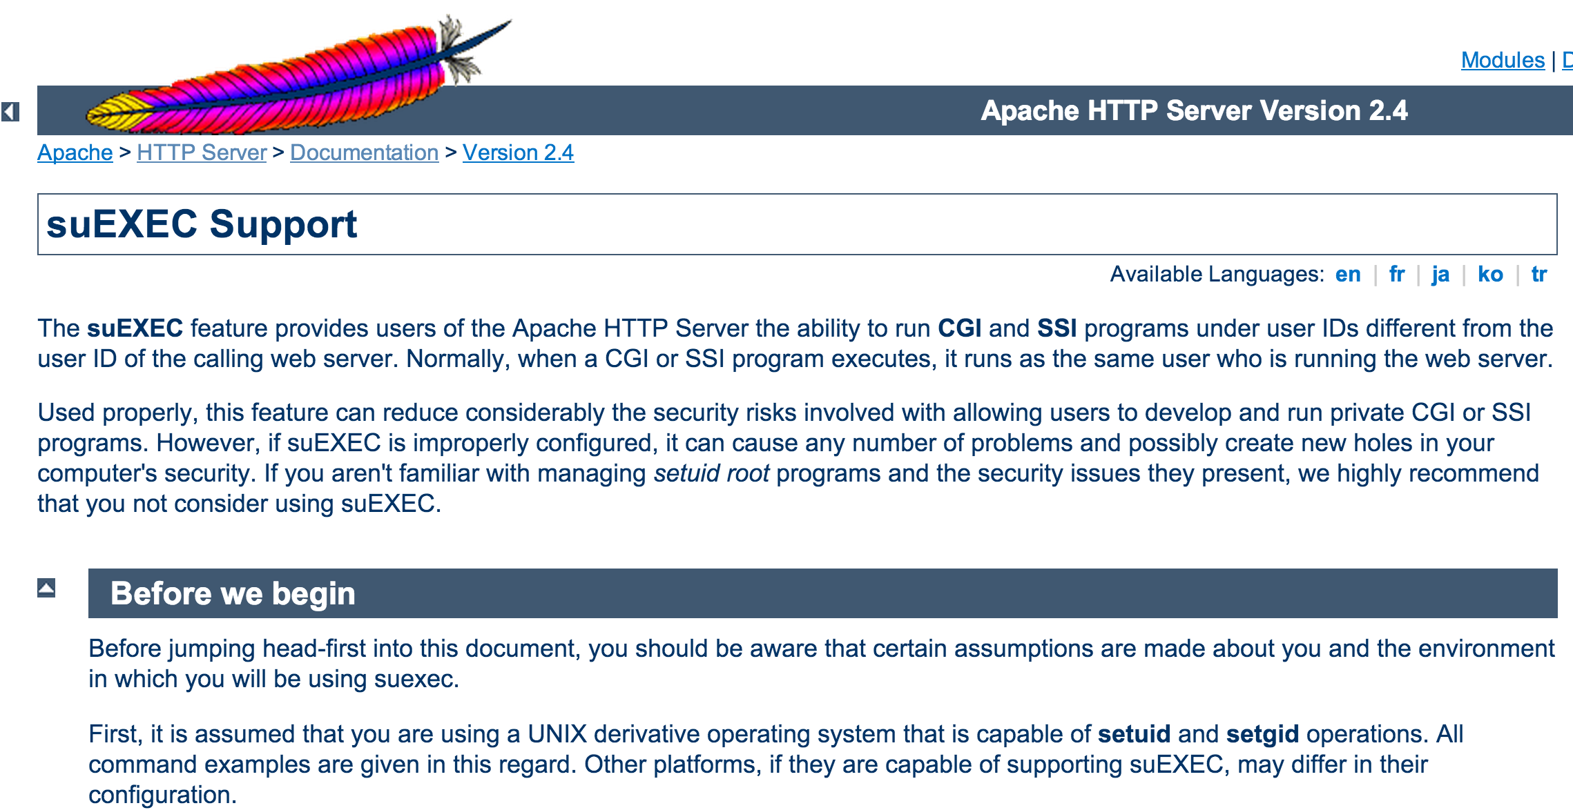
/*
* setuid() to the target user. Error out on fail.
*/
if ((setuid(uid)) != 0) {
log_err("failed to setuid (%lu: %s)\n", (unsigned long)uid, cmd);
exit(110);
}

Slide 39
/*
* setuid() to the target user. Error out on fail.
*/
if ((setuid(uid)) != 0) {
log_err("failed to setuid (%lu: %s)\n", (unsigned long)uid, cmd);
exit(110);
}
…
/*
* Stat the cwd and verify it is a directory, or error out.
*/
if (((lstat(cwd, &dir_info)) != 0) || !(S_ISDIR(dir_info.st_mode))) {
log_err("cannot stat directory: (%s)\n", cwd);
exit(115);
}
…

Slide 40
/*
* Error out if the file is setuid or setgid.
*/
if ((prg_info.st_mode & S_ISUID) || (prg_info.st_mode & S_ISGID)) {
log_err("file is either setuid or setgid: (%s/%s)\n", cwd, cmd);
exit(119);
}
/*
* Error out if the target name/group is different from
* the name/group of the cwd or the program.
*/
if ((uid != dir_info.st_uid) || …) {
…
exit(120);
}
/*
* Error out if the program is not executable for the user.
* Otherwise, she won't find any error in the logs except for
* "[error] Premature end of script headers: ..."
*/
if (!(prg_info.st_mode & S_IXUSR)) {
log_err("file has no execute permission: (%s/%s)\n", cwd, cmd);
exit(121);
}
/*
* Error out if cwd is writable by others.
*/
if ((dir_info.st_mode & S_IWOTH) || … {
log_err("directory is writable by others: (%s)\n", cwd);
exit(116);
}
/*
* Error out if we cannot stat the program.
*/
if (((lstat(cmd, &prg_info)) != 0) || …) {
log_err("cannot stat program: (%s)\n", cmd);
exit(117);
}
/*
* Error out if the program is writable by others.
*/
if ((prg_info.st_mode & S_IWOTH) || …) {
log_err("file is writable by others: (%s/%s)\n", cwd, cmd);
exit(118);
}

Slide 41
/*
* Execute the command, replacing our image with its own.
*/
...
execv(cmd, &argv[3]);
/*
* (I can't help myself...sorry.)
*
* Uh oh. Still here. Where's the kaboom? There was supposed to be an
* EARTH-shattering kaboom!
*
* Oh well, log the failure and error out.
*/
log_err("(%d)%s: exec failed (%s)\n", errno, strerror(errno), cmd);
exit(255);
}

Slide 42
/*
* suexec.c -- "Wrapper" support program for suEXEC behaviour for Apache
***********************************************************************
*
* NOTE! : DO NOT edit this code!!! Unless you know what you are doing,
* editing this code might open up your system in unexpected
* ways to would-be crackers. Every precaution has been taken
* to make this code as safe as possible; alter it at your own risk.
*/
…
if ((setuid(uid)) != 0) {
log_err("failed to setuid (%lu: %s)\n", (unsigned long)uid, cmd);
exit(110);
}
…
/*
* Error out if the program is writable by others.
*/
if ((prg_info.st_mode & S_IWOTH) || …) {
log_err("file is writable by others: (%s/%s)\n", cwd, cmd);
exit(118);
}
…
/*
* Error out if the program is not executable for the user.
* Otherwise, she won't find any error in the logs except for
* "[error] Premature end of script headers: ..."
*/
if (!(prg_info.st_mode & S_IXUSR)) {
log_err("file has no execute permission: (%s/%s)\n", cwd, cmd);
exit(121);
}
…
execv(cmd, &argv[3]);
log_err("(%d)%s: exec failed (%s)\n", errno, strerror(errno), cmd);
exit(255);
}

Slide 43
/*
* suexec.c -- "Wrapper" support program for suEXEC behaviour for Apache
***********************************************************************
*
* NOTE! : DO NOT edit this code!!! Unless you know what you are doing,
* editing this code might open up your system in unexpected
* ways to would-be crackers. Every precaution has been taken
* to make this code as safe as possible; alter it at your own risk.
*/
…
if ((setuid(uid)) != 0) {
log_err("failed to setuid (%lu: %s)\n", (unsigned long)uid, cmd);
exit(110);
}
…
/*
* Error out if the program is writable by others.
*/
if ((prg_info.st_mode & S_IWOTH) || …) {
log_err("file is writable by others: (%s/%s)\n", cwd, cmd);
exit(118);
}
…
Well done Apache!
/*
* Error out if the program is not executable for the user.
* Otherwise, she won't find any error in the logs except for
* "[error] Premature end of script headers: ..."
*/
if (!(prg_info.st_mode & S_IXUSR)) {
log_err("file has no execute permission: (%s/%s)\n", cwd, cmd);
exit(121);
}
…
execv(cmd, &argv[3]);
log_err("(%d)%s: exec failed (%s)\n", errno, strerror(errno), cmd);
exit(255);
}

Slide 44
How is setuid implemented?
if ((setuid(uid)) != 0) {
log_err("failed to setuid (%lu: %s)\n", …);
exit(110);
}

Slide 45
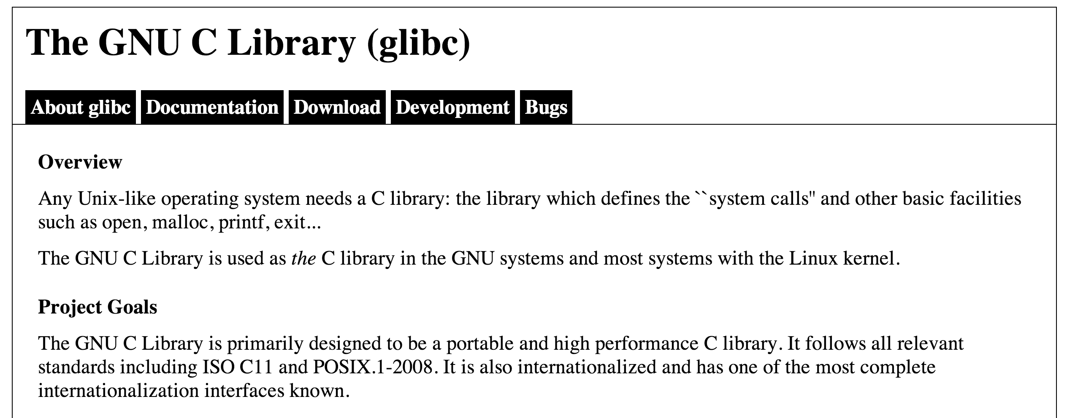
libc

Slide 46
glibc/sysdeps/unix/sysv/linux/setuid.c:
int
__setuid (uid_t uid)
{
return INLINE_SETXID_SYSCALL (setuid, 1, uid);
}
#ifndef __setuid
weak_alias (__setuid, setuid)
#endif

Slide 47
glibc/sysdeps/x86_64/sysdep.h
#define PSEUDO(name, syscall_name, args) \
lose: \
jmp JUMPTARGET(syscall_error) \
.globl syscall_error; \
ENTRY (name) \
DO_CALL (syscall_name, args); \
jb lose
glibc/sysdeps/unix/x86_64/sysdep.h
#define DO_CALL(syscall_name, args) \
lea SYS_ify (syscall_name), %rax; \
syscall
int $0x80

Slide 48
Why can’t libc call directly into the kernel?

Slide 49
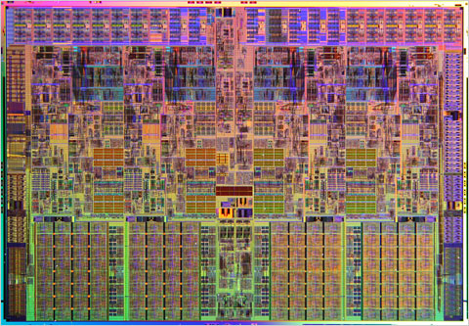
Getting to the Kernel
setuid(uid)
httpd
libc: setuid()
int 0x80
linux kernel: syscall
jumps into kernel code
sets supervisor mode

Slide 50
Traditional PC Design
Programmable Interrupt Controller
(PIC)
CPU
Keyboard
Timer
Notes:
draw INT instruction also

Slide 51
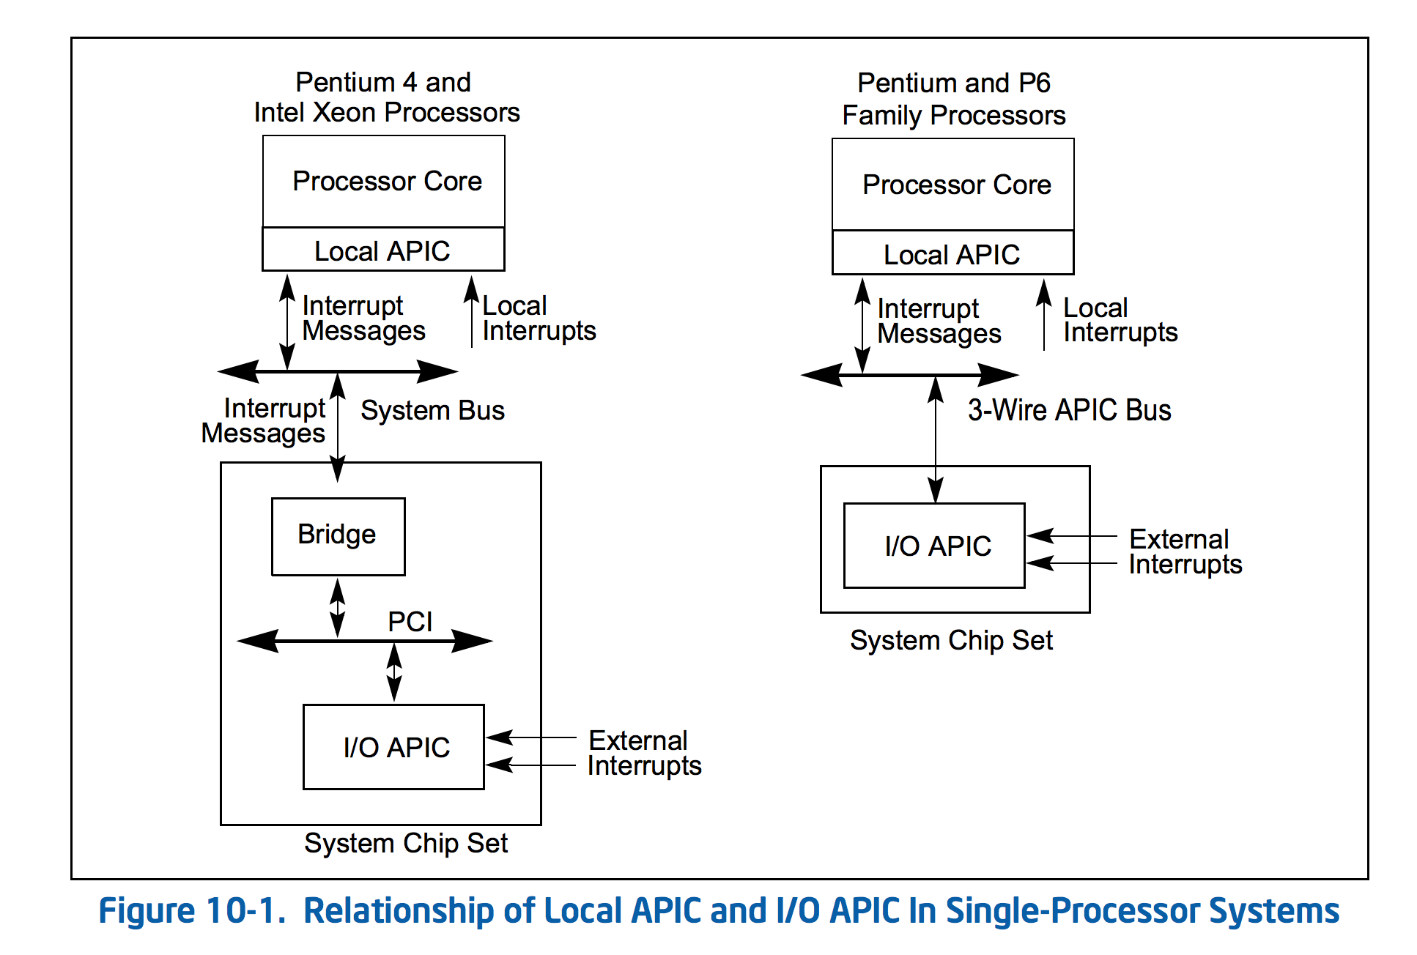
Page 2213 of Intel x86 Manual:
http://www.intel.com/content/dam/www/public/us/en/documents/manuals/64-ia-32-architectures-software-developer-manual-325462.pdf
Modern x86 Design:
“APIC” = “Advanced PIC”

Slide 52
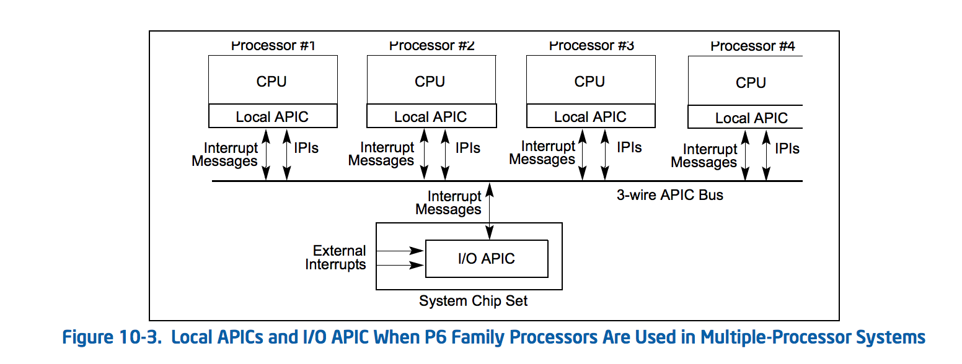
Page 2213 of Intel x86 Manual:
http://www.intel.com/content/dam/www/public/us/en/documents/manuals/64-ia-32-architectures-software-developer-manual-325462.pdf
What should generate a “Local Interrupt”?
What should generate an “External Interrupt”?

Slide 53
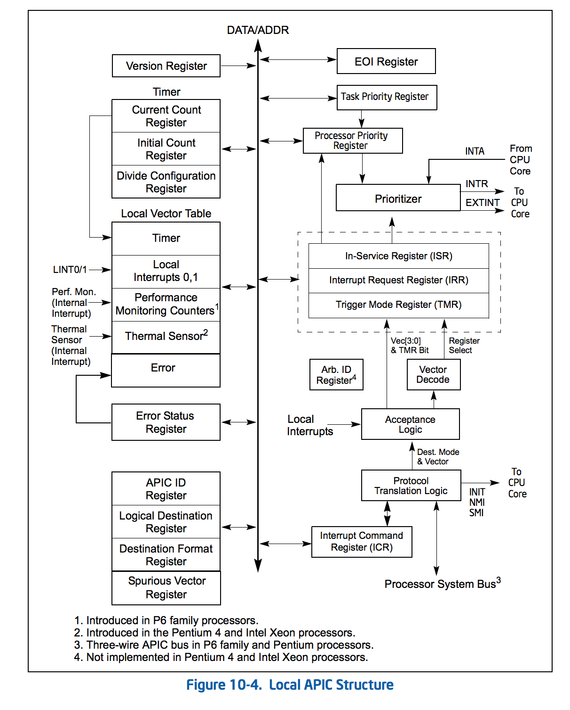

Slide 54
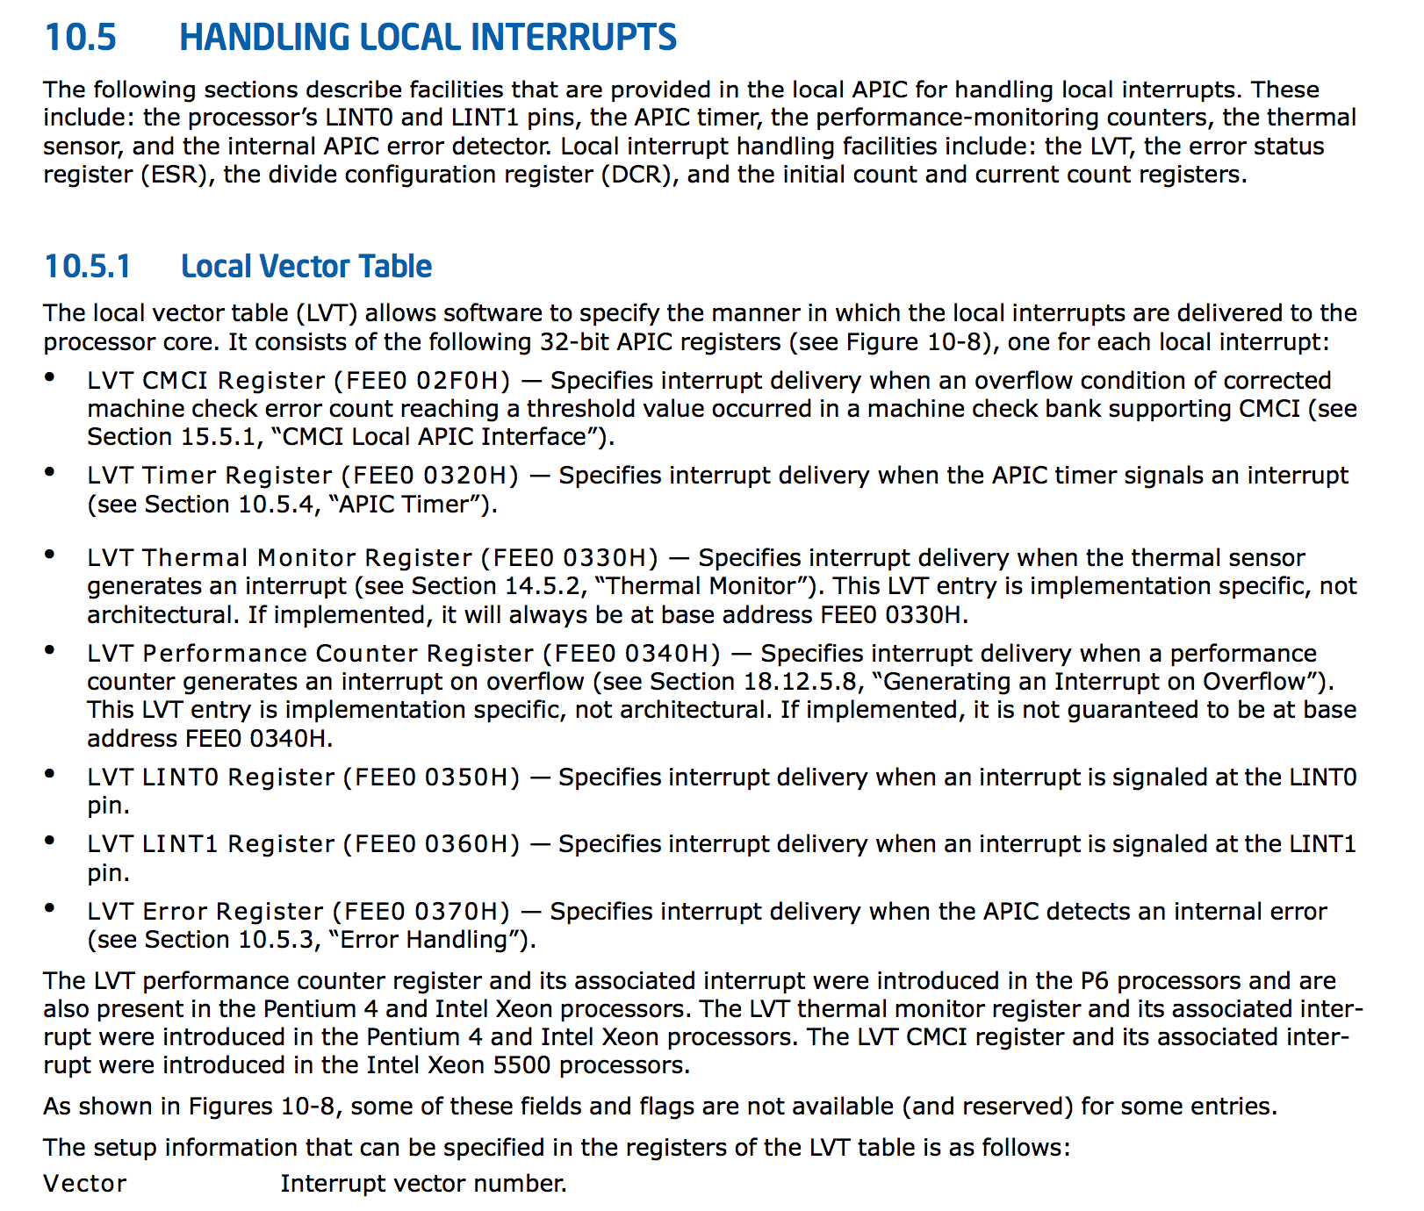
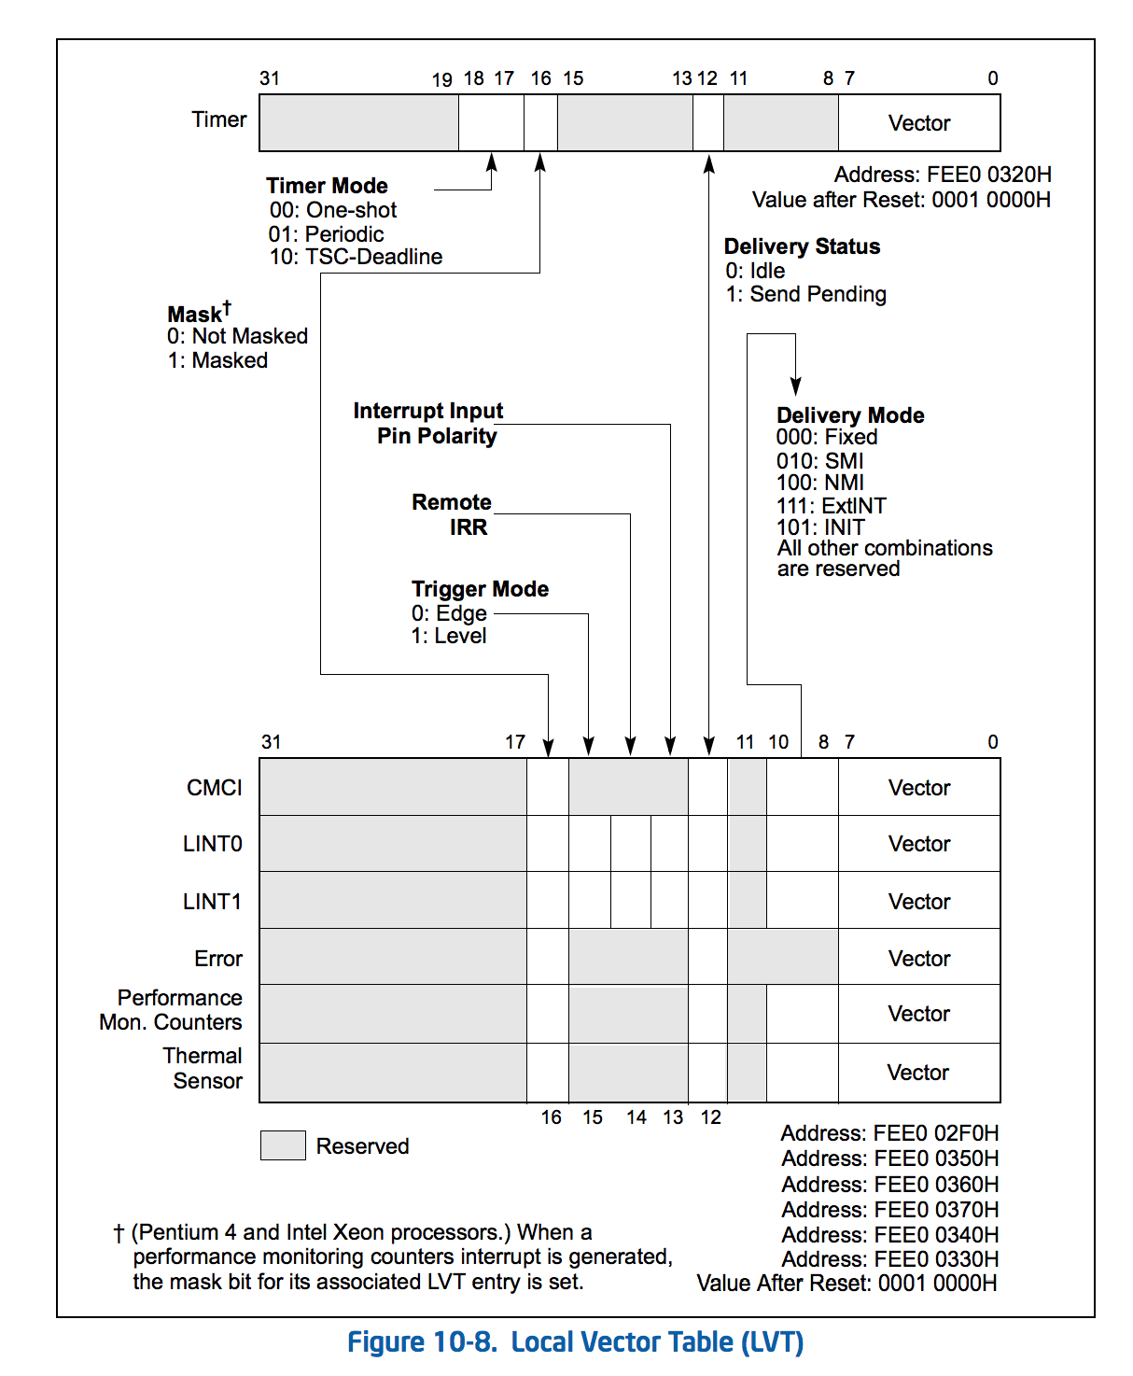

Slide 55
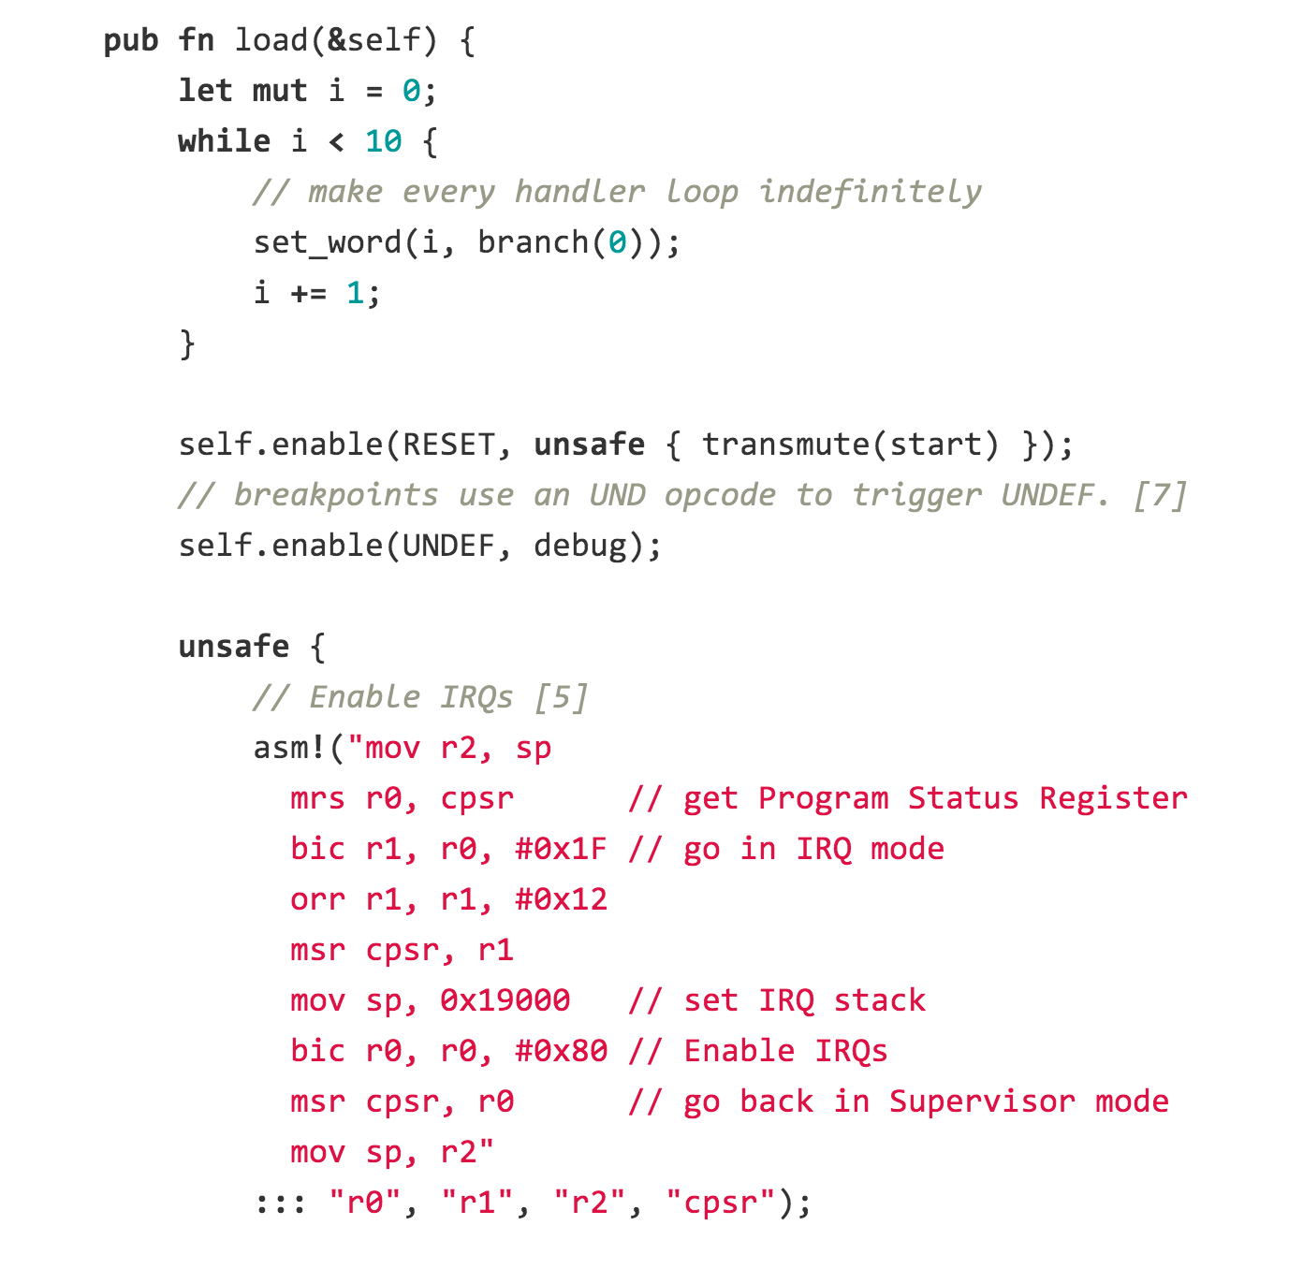
IronKernel:
arch/arm/cpu/interrupt.rs

Slide 56
Handling Syscall Interrupts
…
lea SYS_setuid,%rax
int $0x80
Programmable Interrupt Controller
(PIC)
CPU

Slide 57
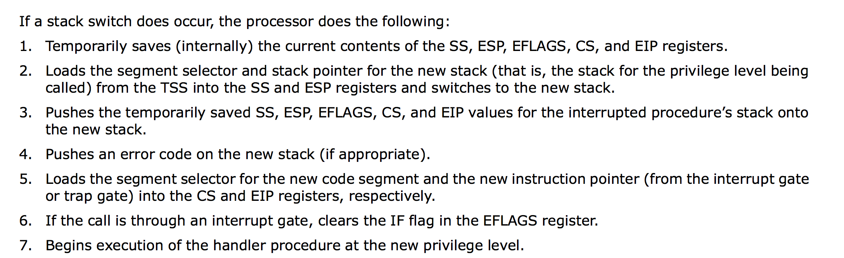
Intel manual, p. 146:

Slide 58
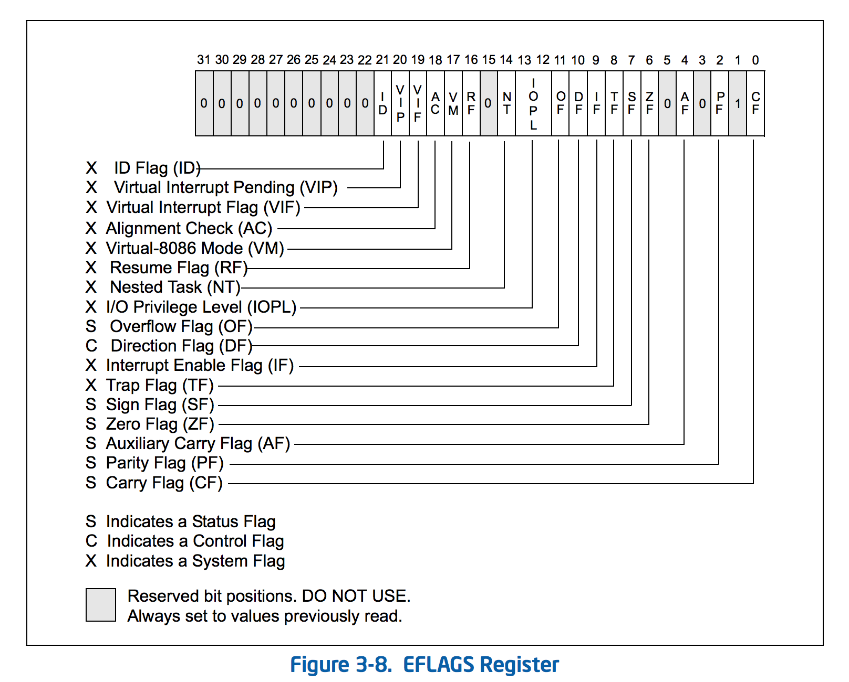

Slide 59
Context Switch!
setuid(uid)
httpd
libc: setuid()
int 0x80
linux kernel: syscall
jumps into kernel code
sets supervisor mode

Slide 60
void __init trap_init(void)
{
…
set_intr_gate(X86_TRAP_DE, &divide_error);
set_intr_gate_ist(X86_TRAP_NMI, &nmi, NMI_STACK);
…
set_intr_gate(X86_TRAP_BR, &bounds);
set_intr_gate(X86_TRAP_UD, &invalid_op);
…
/* Reserve all the builtin and the syscall vector: */
for (i = 0; i < FIRST_EXTERNAL_VECTOR; i++)
set_bit(i, used_vectors);
set_system_intr_gate(IA32_SYSCALL_VECTOR, ia32_syscall);
set_bit(IA32_SYSCALL_VECTOR, used_vectors);
…
cpu_init();
linux-3.2.0/arch/x86/kernel/traps.c

Slide 61
void __init trap_init(void)
{
…
set_intr_gate(X86_TRAP_DE, &divide_error);
set_intr_gate_ist(X86_TRAP_NMI, &nmi, NMI_STACK);
…
set_intr_gate(X86_TRAP_BR, &bounds);
set_intr_gate(X86_TRAP_UD, &invalid_op);
…
/* Reserve all the builtin and the syscall vector: */
for (i = 0; i < FIRST_EXTERNAL_VECTOR; i++)
set_bit(i, used_vectors);
set_system_intr_gate(IA32_SYSCALL_VECTOR, ia32_syscall);
set_bit(IA32_SYSCALL_VECTOR, used_vectors);
…
cpu_init();
linux-3.2.0/arch/x86/kernel/traps.c
gash> find . -name "*.h" -print | xargs grep "IA32_SYSCALL_VECTOR"
./arch/x86/include/asm/irq_vectors.h:#define IA32_SYSCALL_VECTOR 0x80

Slide 62
SYSCALL_DEFINE1(setuid, uid_t, uid)
{
const struct cred *old;
struct cred *new;
int retval;
new = prepare_creds();
if (!new)
return -ENOMEM;
old = current_cred();
retval = -EPERM;
linux-3.2.0/kernel/sys.c

Slide 63
…
if (nsown_capable(CAP_SETUID)) {
new->suid = new->uid = uid;
if (uid != old->uid) {
retval = set_user(new);
if (retval < 0) goto error;
}
} else if (uid != old->uid && uid != new->suid) { goto error; }
...
new->fsuid = new->euid = uid;
retval = security_task_fix_setuid(new, old, LSM_SETID_ID);
if (retval < 0) goto error;
return commit_creds(new);
error:
abort_creds(new);
return retval;
}

Slide 64
/**
* commit_creds - Install new credentials upon the current task
* @new: The credentials to be assigned
*
* Install a new set of credentials to the current task, using RCU to replace
* the old set. Both the objective and the subjective credentials pointers are
* updated. This function may not be called if the subjective credentials are
* in an overridden state.
*
* This function eats the caller's reference to the new credentials.
*
* Always returns 0 thus allowing this function to be tail-called at the end
* of, say, sys_setgid().
*/
int commit_creds(struct cred *new)
{
…

Slide 65
int commit_creds(struct cred *new)
{
struct task_struct *task = current;
/* do it
* RLIMIT_NPROC limits on user->processes have already been checked
* in set_user().
*/
alter_cred_subscribers(new, 2);
if (new->user != old->user)
atomic_inc(&new->user->processes);
rcu_assign_pointer(task->real_cred, new);
rcu_assign_pointer(task->cred, new);
if (new->user != old->user)
atomic_dec(&old->user->processes);
alter_cred_subscribers(old, -2);
…

Slide 66
Back to Apache
setuid(uid)
httpd
libc: setuid()
int 0x80
linux kernel: syscall
jumps into kernel code
sets supervisor mode

Slide 67
Project Idea?
Make system calls work in IronKernel

Slide 68
Charge
Sign up for PS4 demos today!
PS4 is due 11:59pm Sunday, 6 April
When writing security-sensitive code, emulate Apache’s suEXEC, not glibc or the Linux kernel.
(Note: any code that runs on the Internet is “security-sensitive”.)

