Slide 1
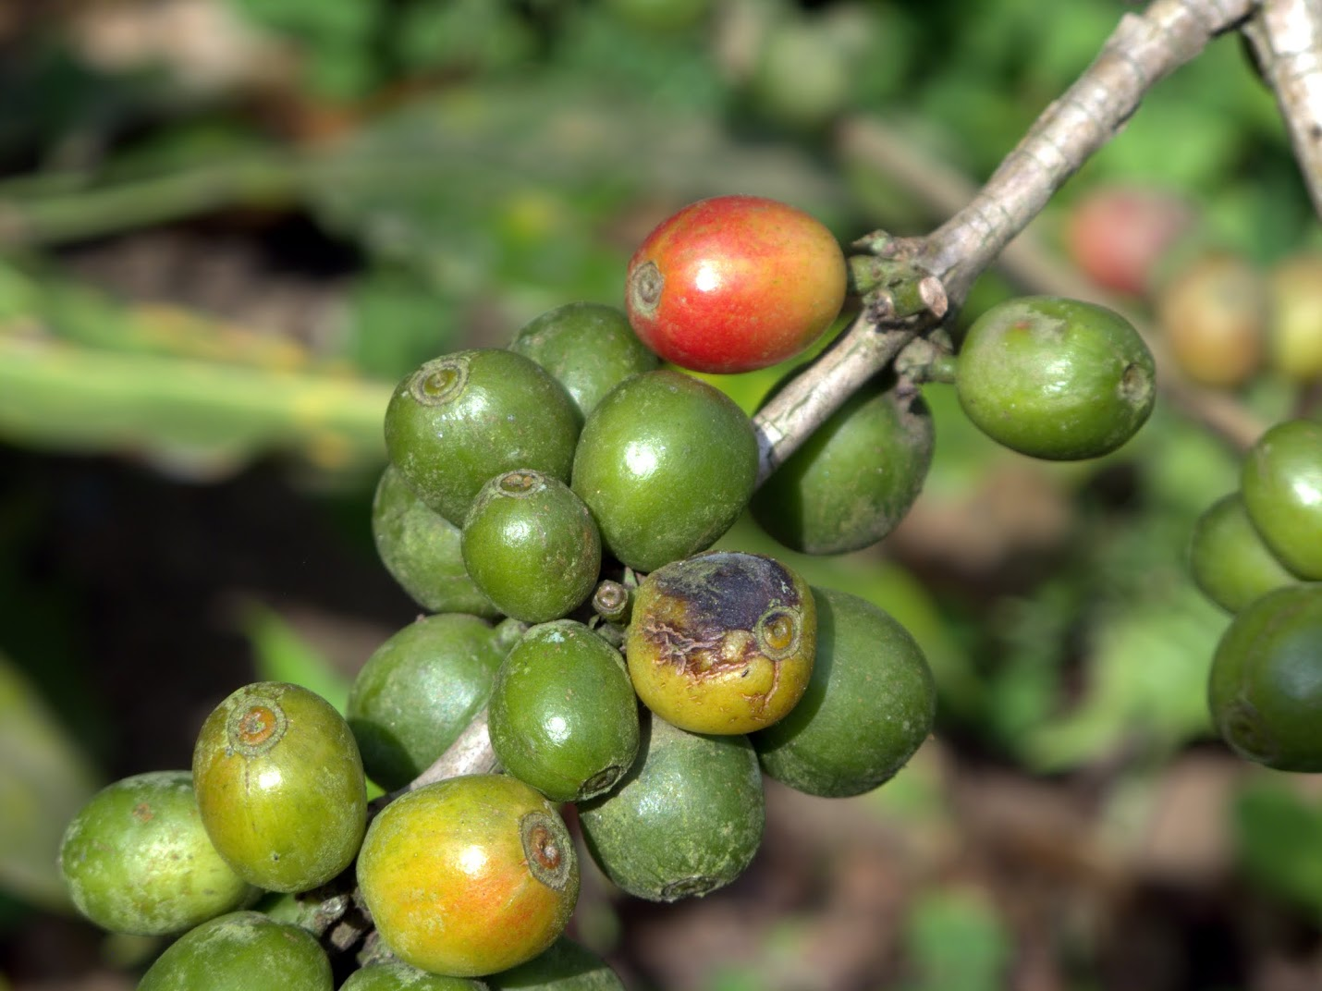
Class 20: Crossing into Kernel Space
cs4414 Fall 2013
University of Virginia
David Evans

Slide 2
Plan for Today
Between libc and the kernel
PS3 Benchmarking Results
Project Time

Slide 3
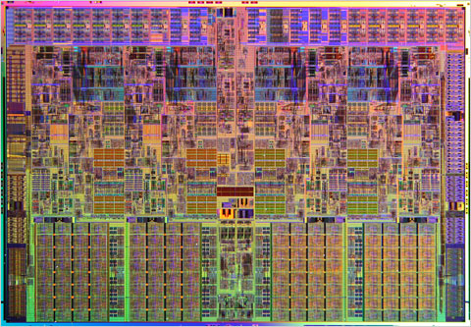
Recap
run::Process::new(program, argv, options)
Rust Runtime
spawn_process_os(prog, args, env, dir, in_fd, …)
fork()
Today
libc: fork()
linux kernel: fork syscall

Slide 4
libstd/rt/io/native/process.rs
#[cfg(unix)]
fn spawn_process_os(prog: &str, args: &[~str],
env: Option<~[(~str, ~str)]>, dir: Option<&Path>,
in_fd: c_int, out_fd: c_int, err_fd: c_int) -> SpawnProcessResult {
…
#[cfg(not(target_os = "macos"), not(windows))]
unsafe fn set_environ(envp: *c_void) {
extern {
static mut environ: *c_void;
}
environ = envp;
}
unsafe {
let pid = fork();
if pid < 0 {
fail!("failure in fork: {}", os::last_os_error());
} else if pid > 0 {
return SpawnProcessResult {pid: pid, handle: ptr::null()};
}
… // 25 lines of failure-handing code
}

Slide 5
Test Program
use std::libc::funcs::posix88::unistd::fork;
#[fixed_stack_segment]
fn main() {
let pid = unsafe { fork() } ;
println(fmt!("pid = %?", pid));
}
> rustc fork.rs
> ./fork
pid = 0i32
pid = 15039i32
$ ./fork
pid = 15043i32
pid = 0i32

Slide 6
use std::libc::funcs::posix88::unistd::fork;
#[fixed_stack_segment]
fn main() { unsafe { fork() } ; }
> rustc -O -S fork.rs
> wc -l fork.S
72 fork.S
.section __TEXT,__text,regular,pure_instructions
.align 4, 0x90
__ZN4main18h8b6694fe33a5855ag4v0.0E:
.cfi_startproc
leaq -2097152(%rsp), %r11
cmpq %gs:816, %r11
ja LBB0_2
movabsq $2097152, %r10
movabsq $0, %r11
callq ___morestack
ret
LBB0_2:
pushq %rbp
Ltmp2:
.cfi_def_cfa_offset 16
Ltmp3:
.cfi_offset %rbp, -16
movq %rsp, %rbp
Ltmp4:
.cfi_def_cfa_register %rbp
popq %rbp
jmp _fork
.cfi_endproc
.globl _main
.align 4, 0x90
_main:
.cfi_startproc
cmpq %gs:816, %rsp
ja LBB1_2
movabsq $8, %r10
movabsq $0, %r11
callq ___morestack
ret
LBB1_2:
pushq %rbp
Ltmp7:
.cfi_def_cfa_offset 16
Ltmp8:
.cfi_offset %rbp, -16
movq %rsp, %rbp
Ltmp9:
.cfi_def_cfa_register %rbp
movq %rsi, %rax
movq %rdi, %rcx
movq %rsi, %rax
movq %rdi, %rcx
leaq __ZN4main18h8b6694fe33a5855ag4v0.0E(%rip), %rsi
xorl %edi, %edi
movq %rcx, %rdx
movq %rax, %rcx
popq %rbp
jmp __ZN8unstable4lang5start17hf72eb8b3c3a0a9ac4v0.8E
.cfi_endproc
.section __DATA,__data
.globl __rust_crate_map_toplevel
.align 4
__rust_crate_map_toplevel:
.long 1
.space 4
.quad __rust_mod_map
.quad __rust_crate_map_std_0.8_6c65cf4b443341b1
.quad 0
.zerofill __DATA,__bss,__rust_mod_map,16,3
.section __TEXT,__const
.globl _rust_abi_version
.align 3
_rust_abi_version:
.quad 1
.subsections_via_symbols

Slide 7
Could actual call to kernel fork be a regular call?

Slide 8
Entering the Kernel
run::Process::new(program, argv, options)
Rust Runtime
spawn_process_os(prog, args, env, dir, in_fd, …)
fork()
libc: fork()
linux kernel: fork syscall

Slide 9
Supervisor Mode
Kernel code needs (or at least uses) special privileges!
What would happen if user-level code could just jump into kernel code?

Slide 10
Entering the Kernel
User-Level Code
…
movl $SYS_fork,%eax
int $0x80
int instruction generates an interrupt

Slide 11
Traditional PC Design
Programmable Interrupt Controller
(PIC)
CPU
Keyboard
Interval Timer

Slide 12
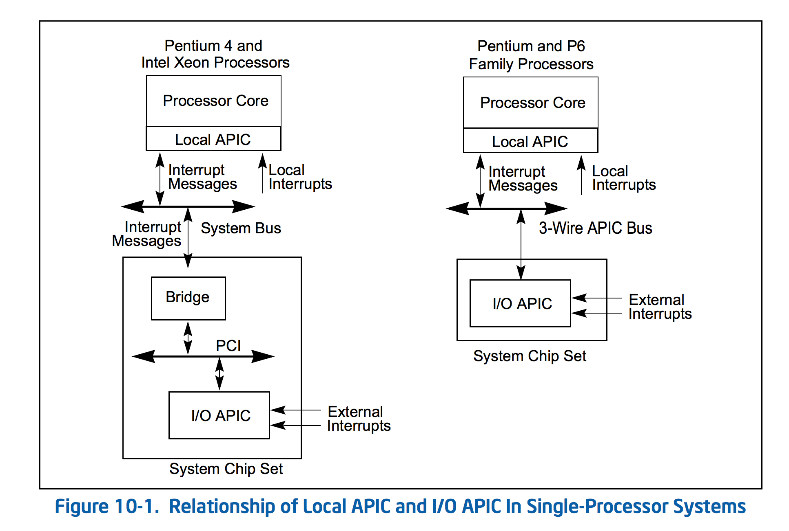
Page 2213 of Intel x86 Manual:
http://www.intel.com/content/dam/www/public/us/en/documents/manuals/64-ia-32-architectures-software-developer-manual-325462.pdf
Modern x86 Design:
“APIC” = “Advanced PIC”

Slide 13
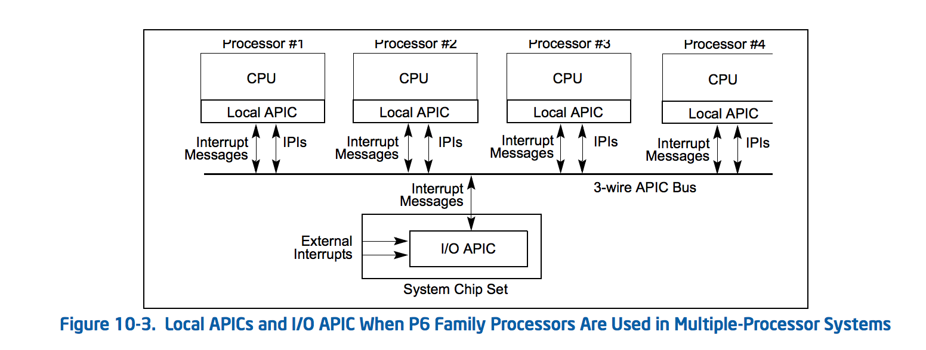
Page 2213 of Intel x86 Manual:
http://www.intel.com/content/dam/www/public/us/en/documents/manuals/64-ia-32-architectures-software-developer-manual-325462.pdf
What should generate a “Local Interrupt”?
What should generate an “External Interrupt”?

Slide 14
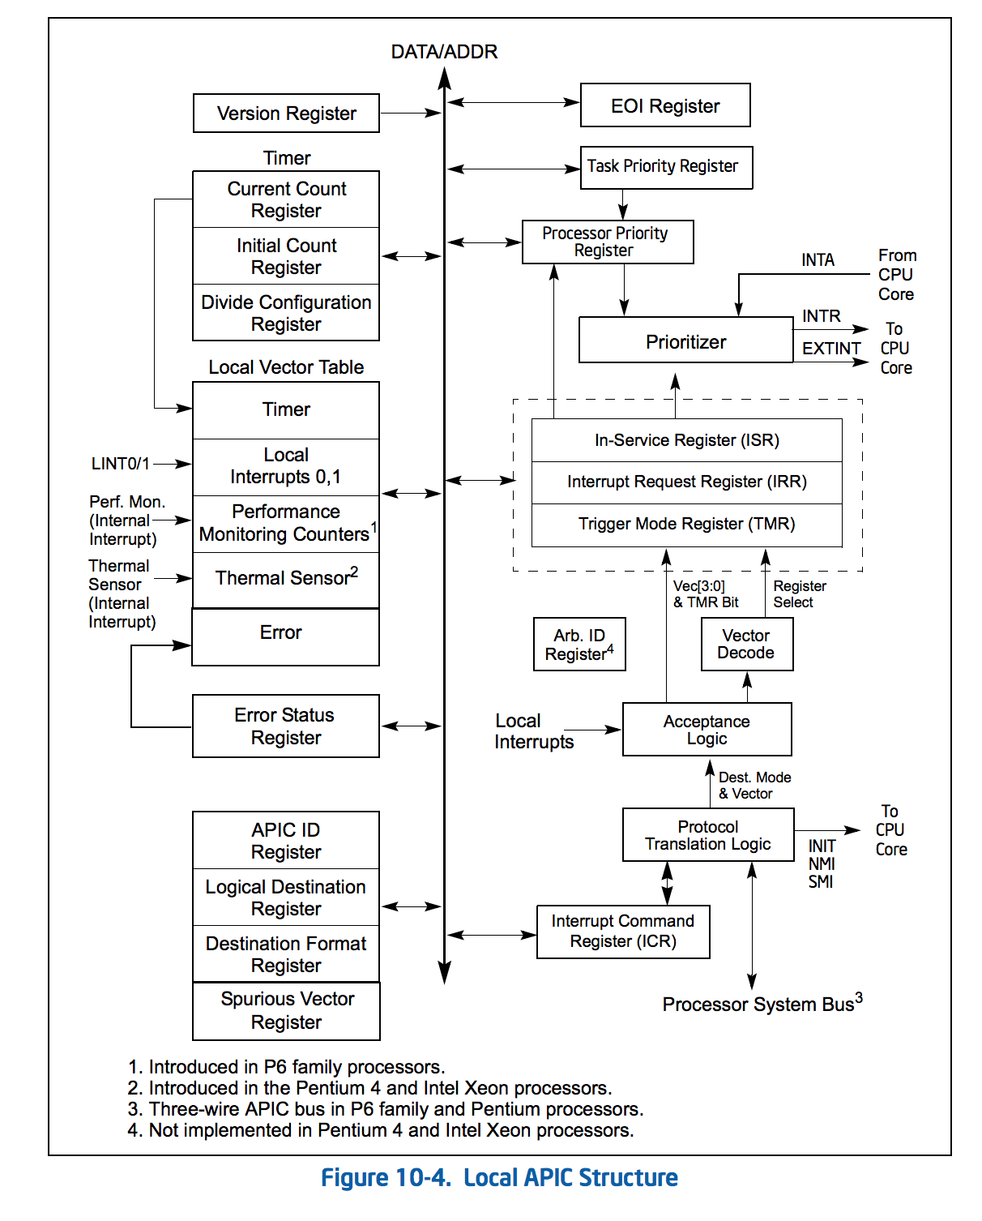

Slide 15
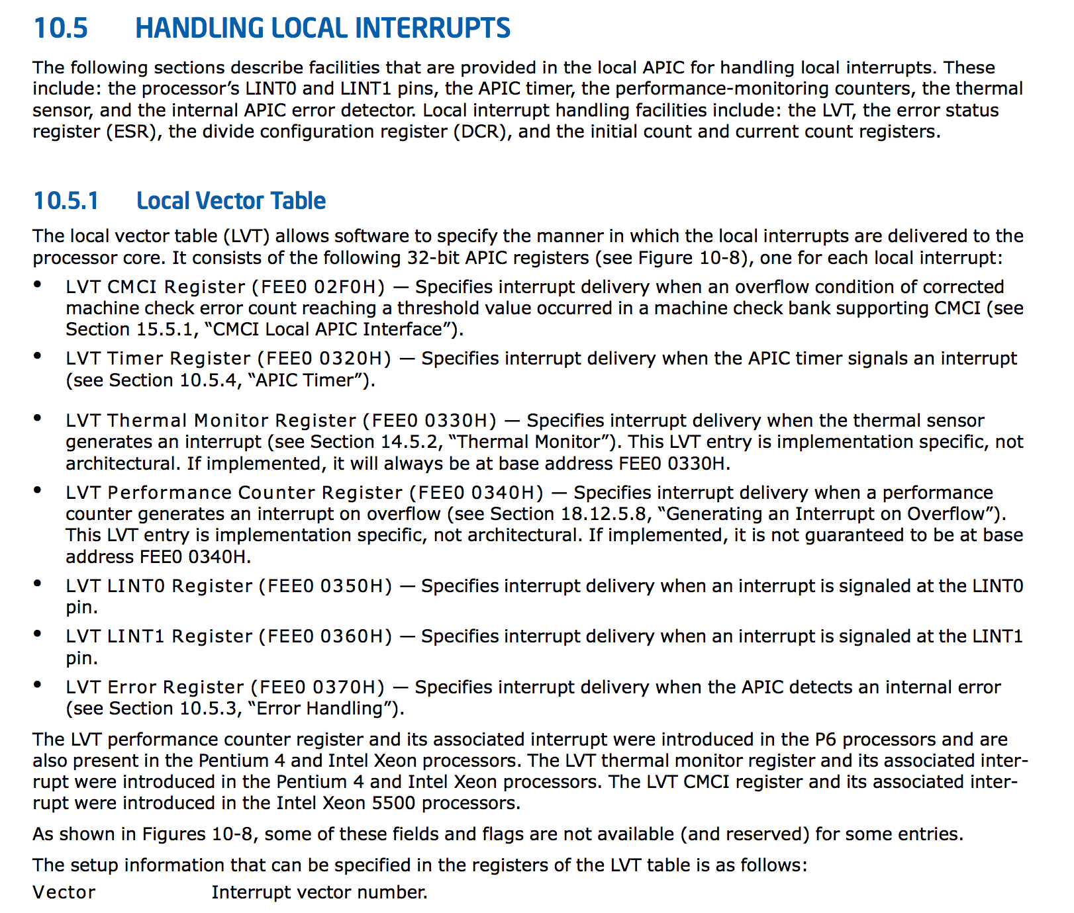
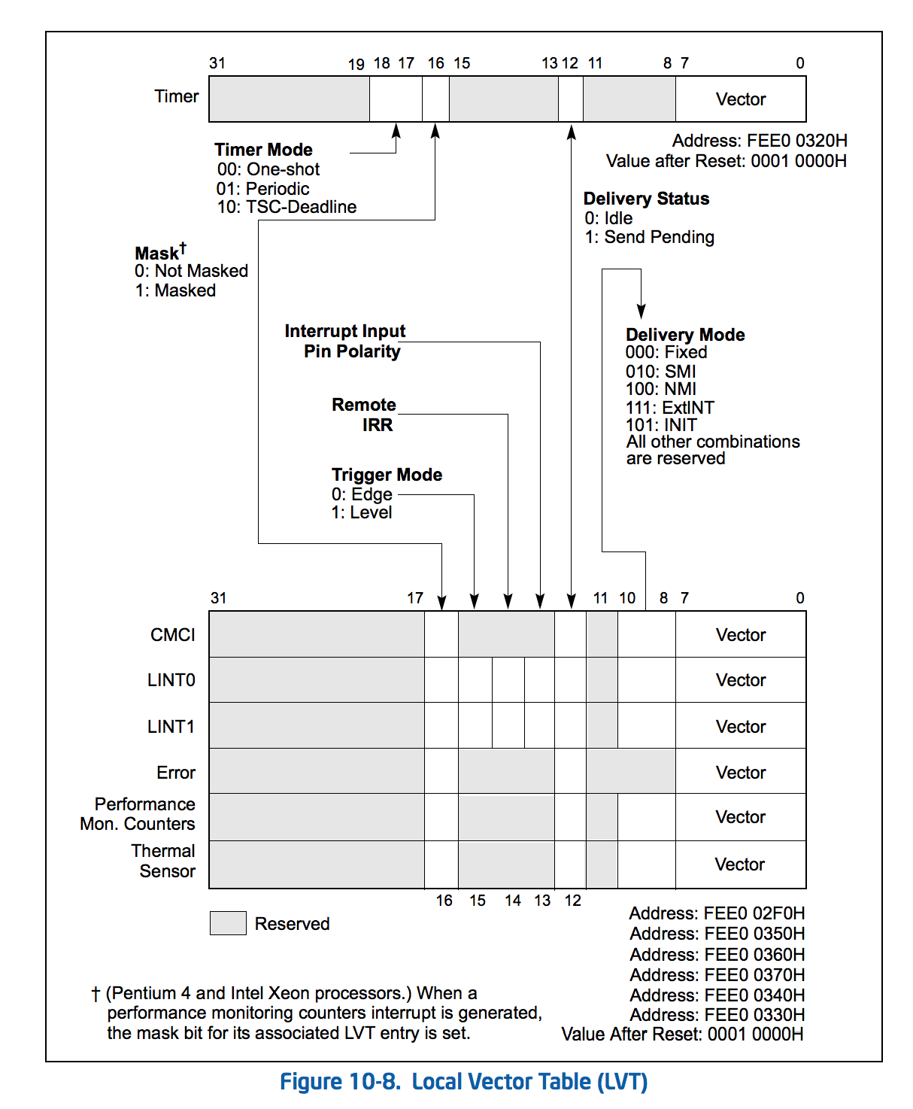

Slide 16
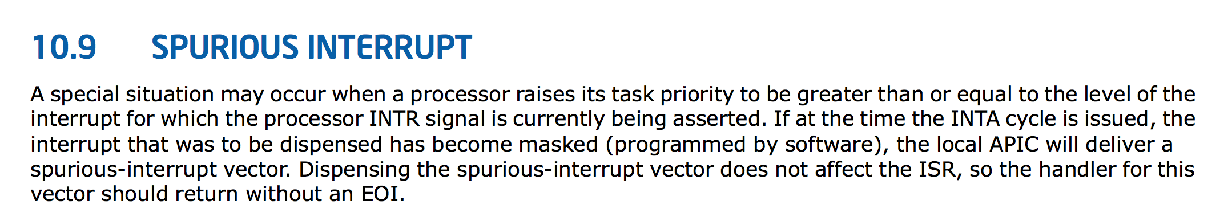
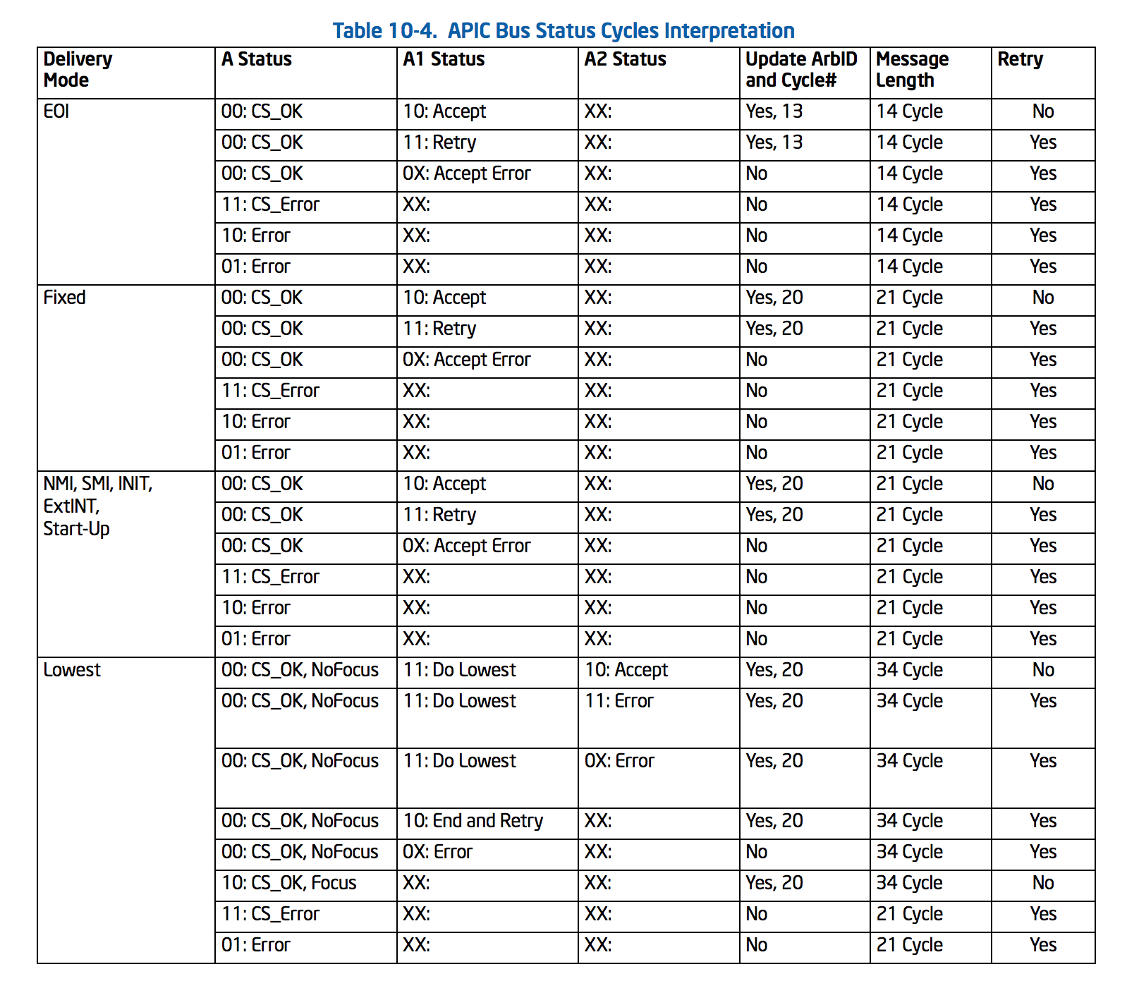

Slide 17
Handling Syscall Interrupts
…
movl $SYS_fork,%eax
int $0x80
Programmable Interrupt Controller
(PIC)
CPU

Slide 18
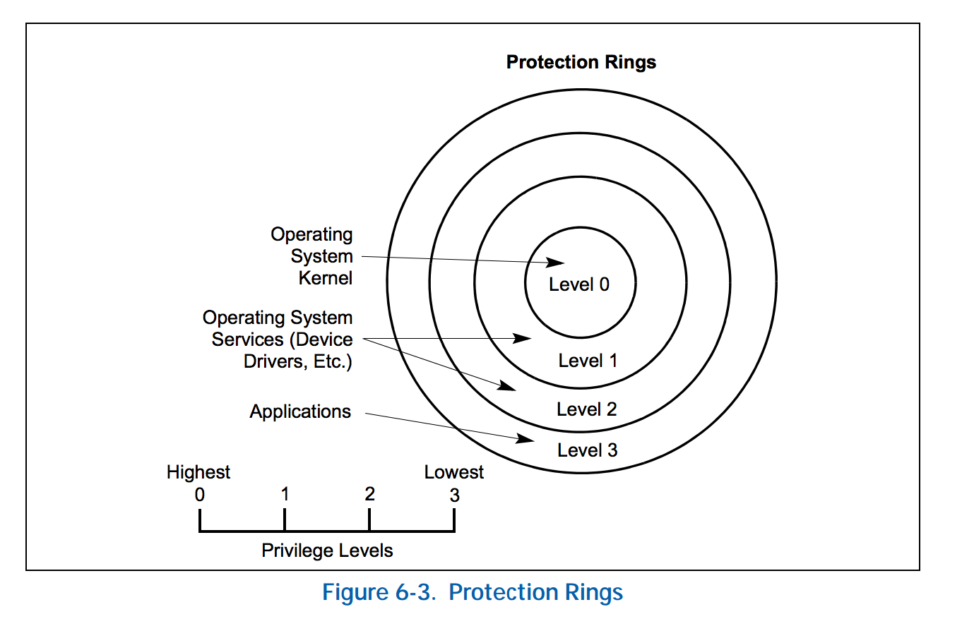

Slide 19
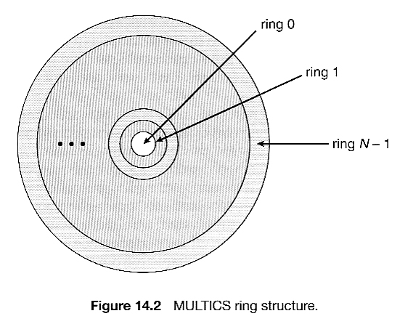


Slide 20
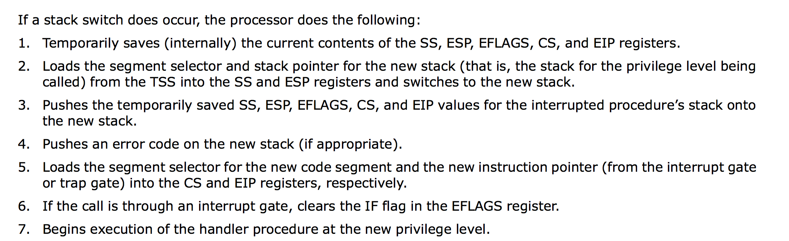
Intel manual, p. 146:

Slide 21
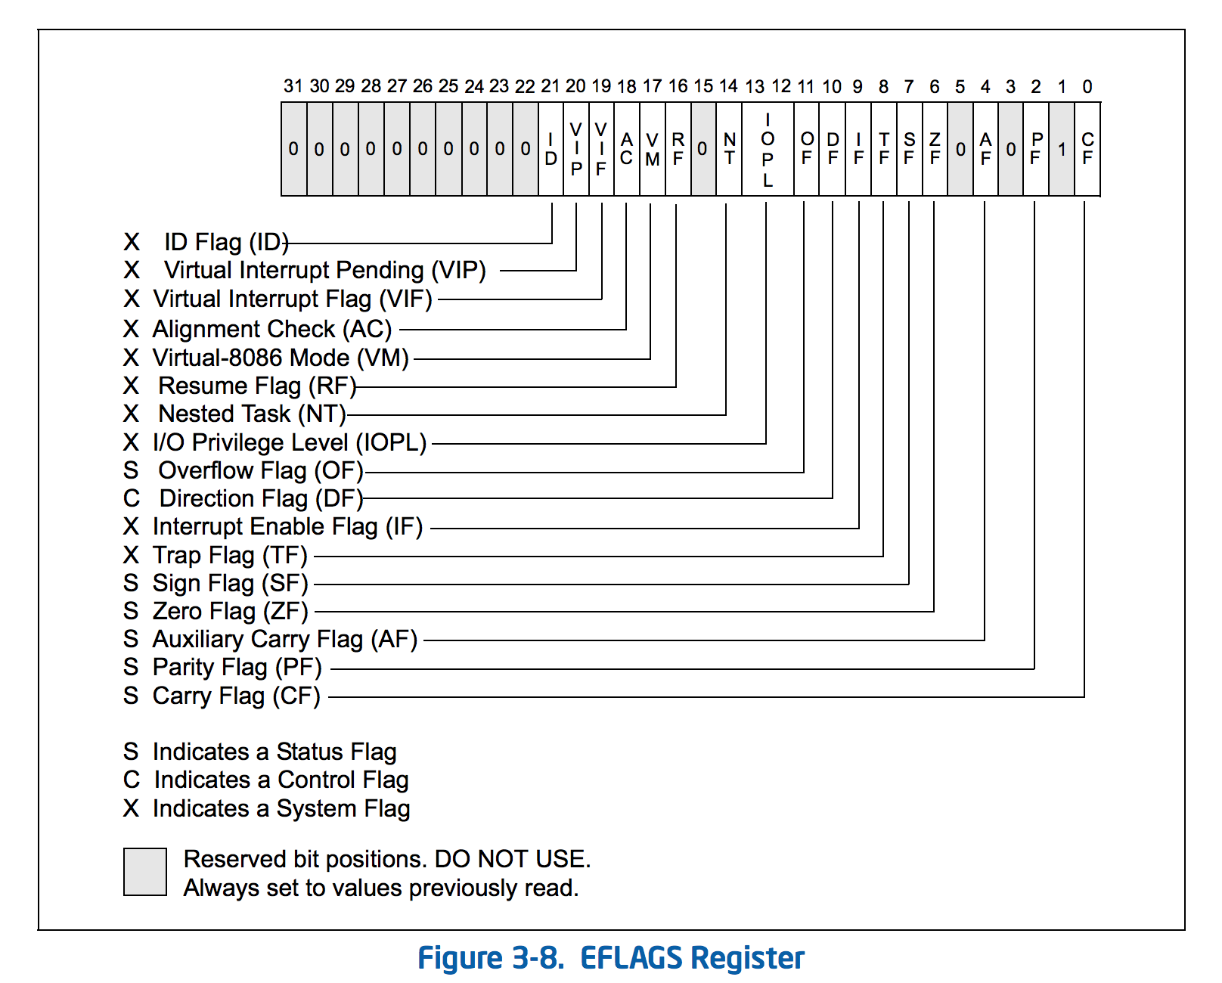

Slide 22
Running in Supervisor Mode
run::Process::new(program, argv, options)
Rust Runtime
spawn_process_os(prog, args, env, dir, in_fd, …)
fork()
int 0x80
libc: fork()
jumps into kernel code
sets supervisor mode
linux kernel: fork syscall

Slide 23
PS3 Bakeoff Winners

Slide 24

reference zhtta

Slide 25

8pm Friday
Rouss/Robertson Hall Room 120

Slide 26
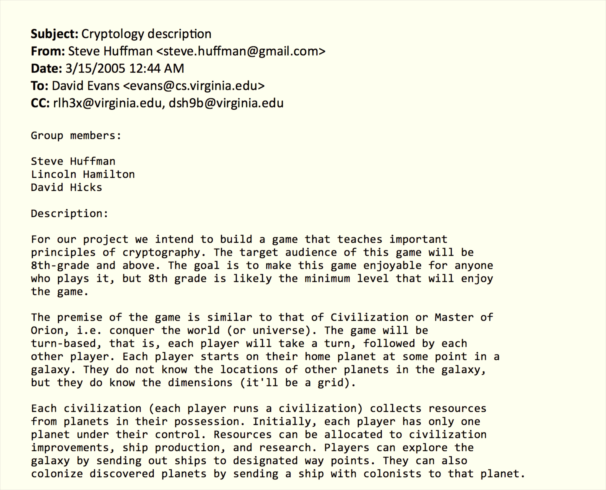

Slide 27



Slide 28
Kiet, Mark, Tanmoy
reference zhtta
Hong, Jireh, Marshall
Chris, Tong, Yicheng
Harriet, Kevin, Zeming

Slide 29
Charge
Find a team and project!
Decoy projects are only allowed in security classes.
Sneaking around my house is no longer permitted.

