Slide 1

Class 22:
Putting a Fork in It!
cs4414 Fall 2013
University of Virginia
David Evans

Slide 2


Updates
Progress updates and scheduling design reviews will be due Sunday 11:59pm
Tonight on Colbert Report!
Tuesday’s Class:
Yuchen Zhou on Authentication using Single Sign-On

Slide 3
Recap: Last Class
Translation Lookaside Buffer (Cache)
Segmentation Unit
Paging
Unit
Memory
Logical Address
Linear Address
Physical Address
Dir
Page
Offset
Physical Memory
GDTR
CR3
Page Directory
Page Table
Global Descriptor Table

Slide 4
#include <stdio.h>
#include <stdlib.h>
int main(int argc, char **argv) {
char *s = (char *) malloc (1);
int i = 0;
while (1) {
printf("%d: %x\n", i, s[i]);
i += 4;
}
}
What will this program do?
> ./a.out
0: 0
4: 0
8: 0
12: 0
…1033872: 0
1033876: 0
1033880: 0
1033884: 0
Segmentation fault: 11

Slide 5
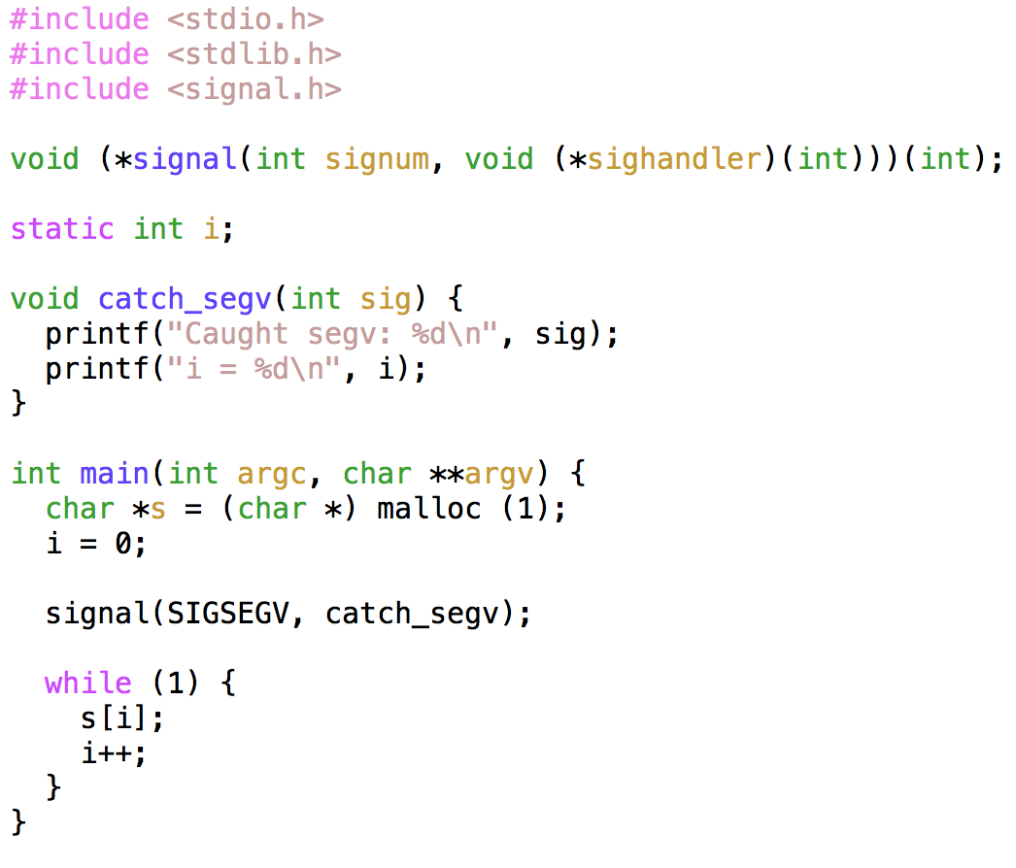

Slide 6
> clang segv.c
segv.c:22:8: warning: expression result unused [-Wunused-value]
s[i];
~ ~^
1 warning generated.
> ./a.out
^C

Slide 7
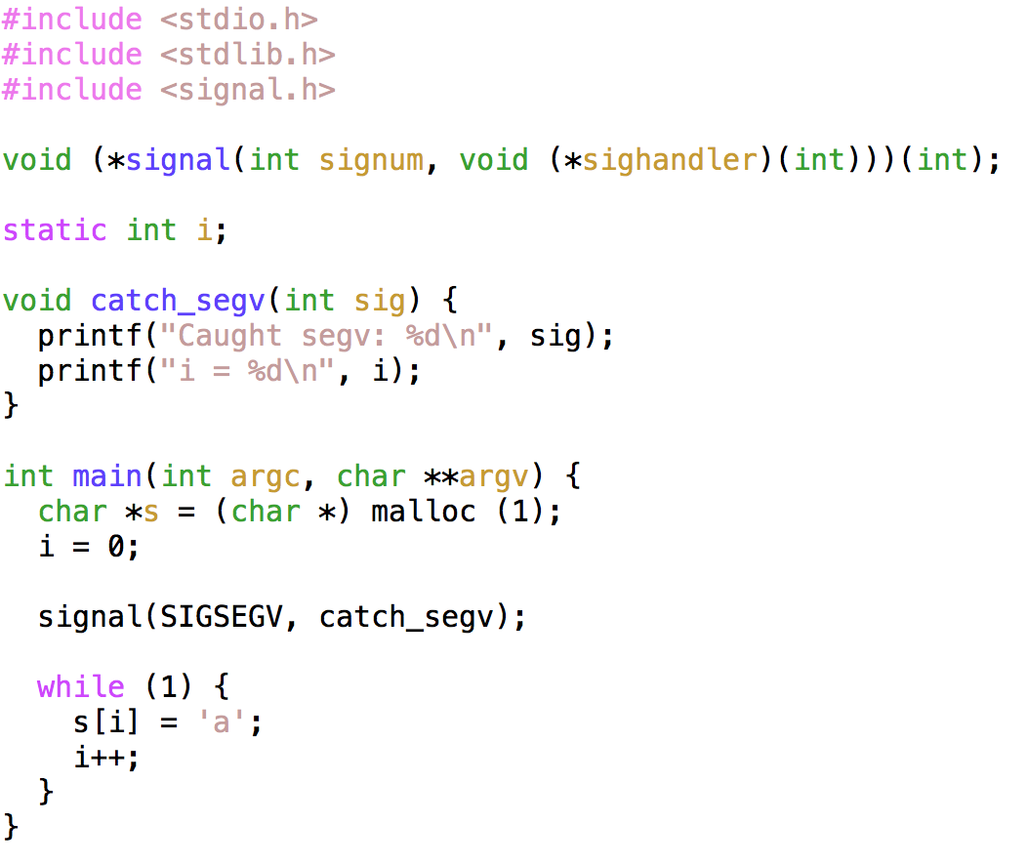
$ ./a.out
Caught segv: 11
i = 1033888
Caught segv: 11
i = 1033888
Caught segv: 11
i = 1033888
Caught segv: 11
i = 1033888
Caught segv: 11
i = 1033888
Caught segv: 11
i = 1033888
Caught segv: 11
i = 1033888
…

Slide 8
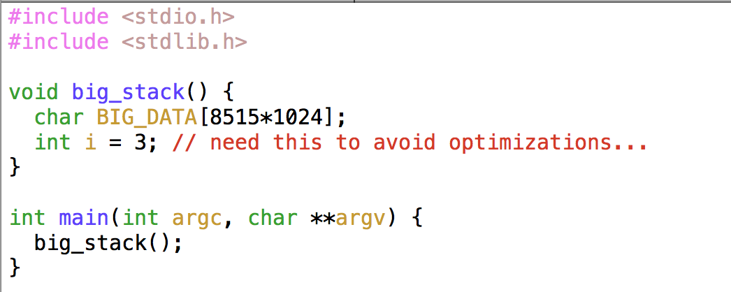
> ulimit -a
core file size (blocks, -c) 0
data seg size (kbytes, -d) unlimited
file size (blocks, -f) unlimited
max locked memory (kbytes, -l) unlimited
max memory size (kbytes, -m) unlimited
open files (-n) 256
pipe size (512 bytes, -p) 1
stack size (kbytes, -s) 8515
cpu time (seconds, -t) unlimited
max user processes (-u) 709
virtual memory (kbytes, -v) unlimited

Slide 9
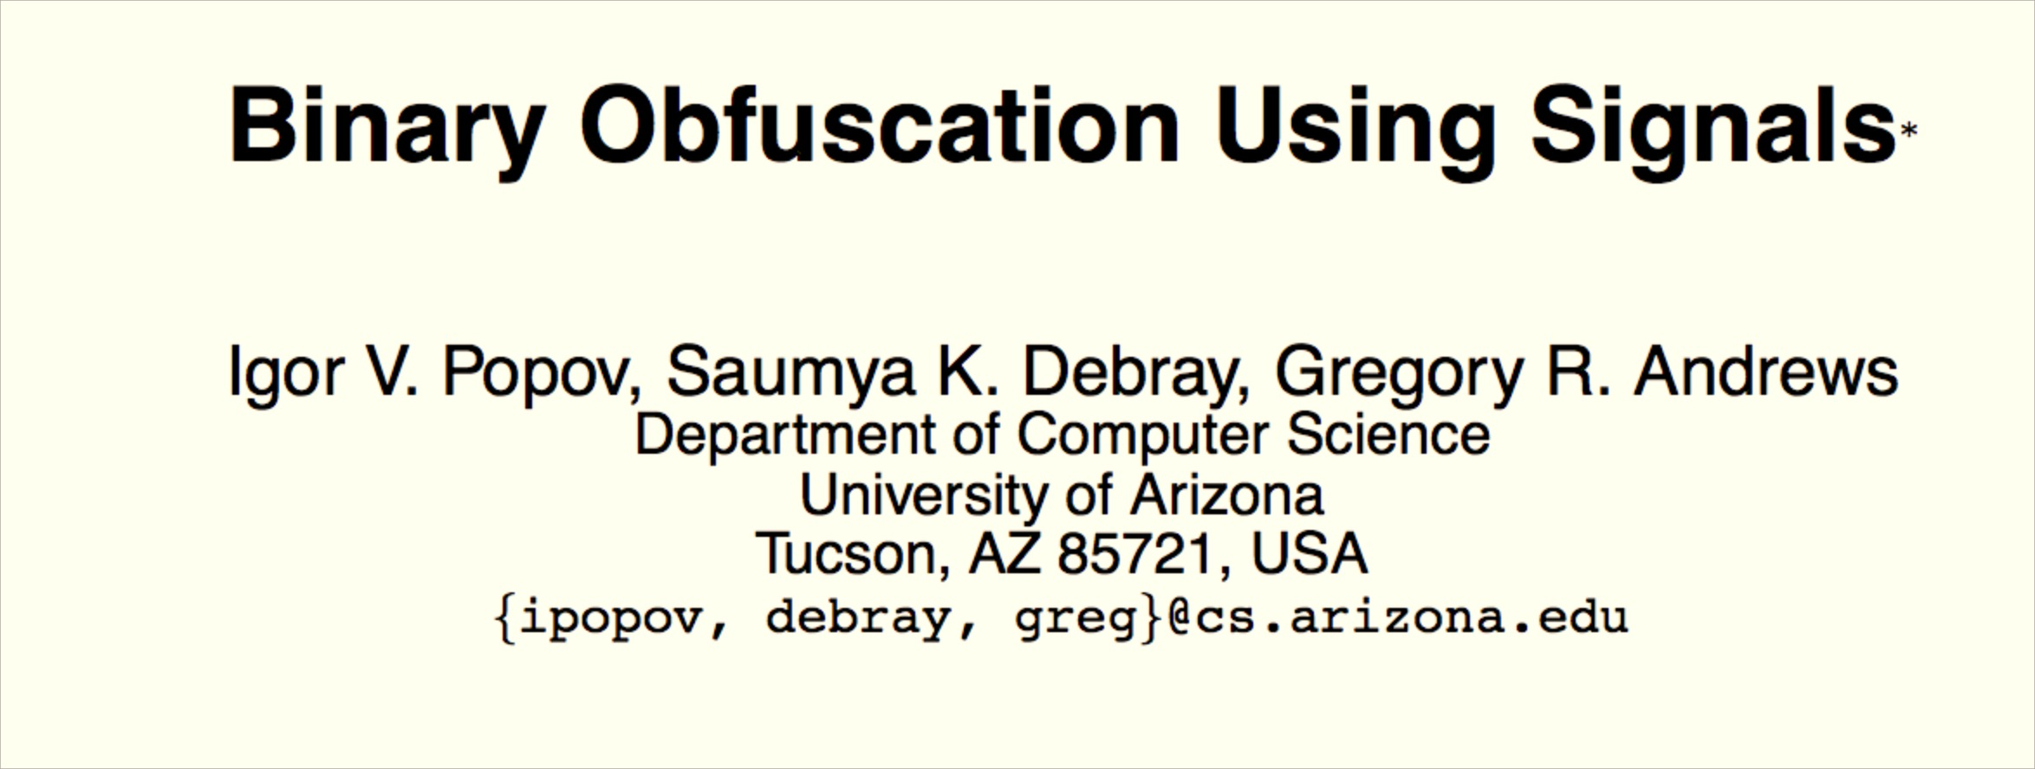
USENIX Security 2007

Slide 10
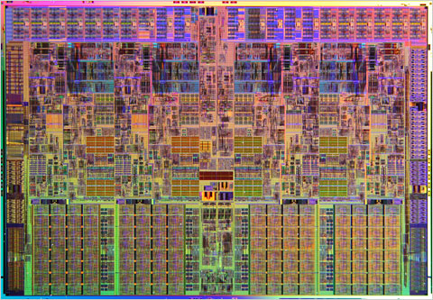
Forking Fork
run::Process::new(program, argv, options)
Rust Runtime
spawn_process_os(prog, args, env, dir, in_fd, …)
fork()
int 0x80
libc: fork()
jumps into kernel code
sets supervisor mode
linux kernel: fork syscall

Slide 11
/*
* linux/kernel/fork.c
*
* Copyright (C) 1991, 1992 Linus Torvalds
*/
/*
* 'fork.c' contains the help-routines for the 'fork' system call
* (see also entry.S and others).
* Fork is rather simple, once you get the hang of it, but the memory
* management can be a bitch. See 'mm/memory.c': 'copy_page_range()'
*/
#include <linux/slab.h>
#include <linux/init.h>
#include <linux/unistd.h>
#include <linux/module.h>
#include <linux/vmalloc.h>
#include <linux/completion.h>
…
1935 total lines

Slide 12
/*
* Ok, this is the main fork-routine.
*
* It copies the process, and if successful kick-starts
* it and waits for it to finish using the VM if required.
*/
long do_fork(unsigned long clone_flags,
unsigned long stack_start,
unsigned long stack_size,
int __user *parent_tidptr,
int __user *child_tidptr)
{
struct task_struct *p;
int trace = 0;
long nr;
/*
* Determine whether and which event to report to ptracer. When
* called from kernel_thread or CLONE_UNTRACED is explicitly
* requested, no event is reported; otherwise, report if the event
* for the type of forking is enabled.
*/
if (!(clone_flags & CLONE_UNTRACED)) { … }

Slide 13
long do_fork(unsigned long clone_flags,
unsigned long stack_start,
unsigned long stack_size,
int __user *parent_tidptr,
int __user *child_tidptr)
{
struct task_struct *p;
int trace = 0;
long nr;
/* Determine whether and which event to report to ptracer... */
p = copy_process(clone_flags, stack_start, stack_size,
child_tidptr, NULL, trace);
/*
* Do this prior (to) waking up the new thread – the thread pointer
* might get invalid after that point, if the thread exits quickly.
*/
if (!IS_ERR(p)) {
...

Slide 14
/*
This creates a new process as a copy of the old one, but does not actually start it yet. It copies the registers, and all the appropriate parts of the process environment (as per the clone flags). The actual kick-off is left to the caller.
*/
static struct task_struct *copy_process(unsigned long clone_flags,
unsigned long stack_start,
unsigned long stack_size,
int __user *child_tidptr,
struct pid *pid,
int trace)
{
int retval;
struct task_struct *p;
if ((clone_flags & (CLONE_NEWNS|CLONE_FS)) == (CLONE_NEWNS|CLONE_FS))
return ERR_PTR(-EINVAL);
... // lots more error cases based on flags
retval = security_task_create(clone_flags);
if (retval)
goto fork_out;
... // this is the interesting part we will look at next
fork_out:
return ERR_PTR(retval);
}

Slide 15
What should be in a task_struct?
“task” here means process (its what copy_process returns), not to be confused with a Rust task

Slide 16
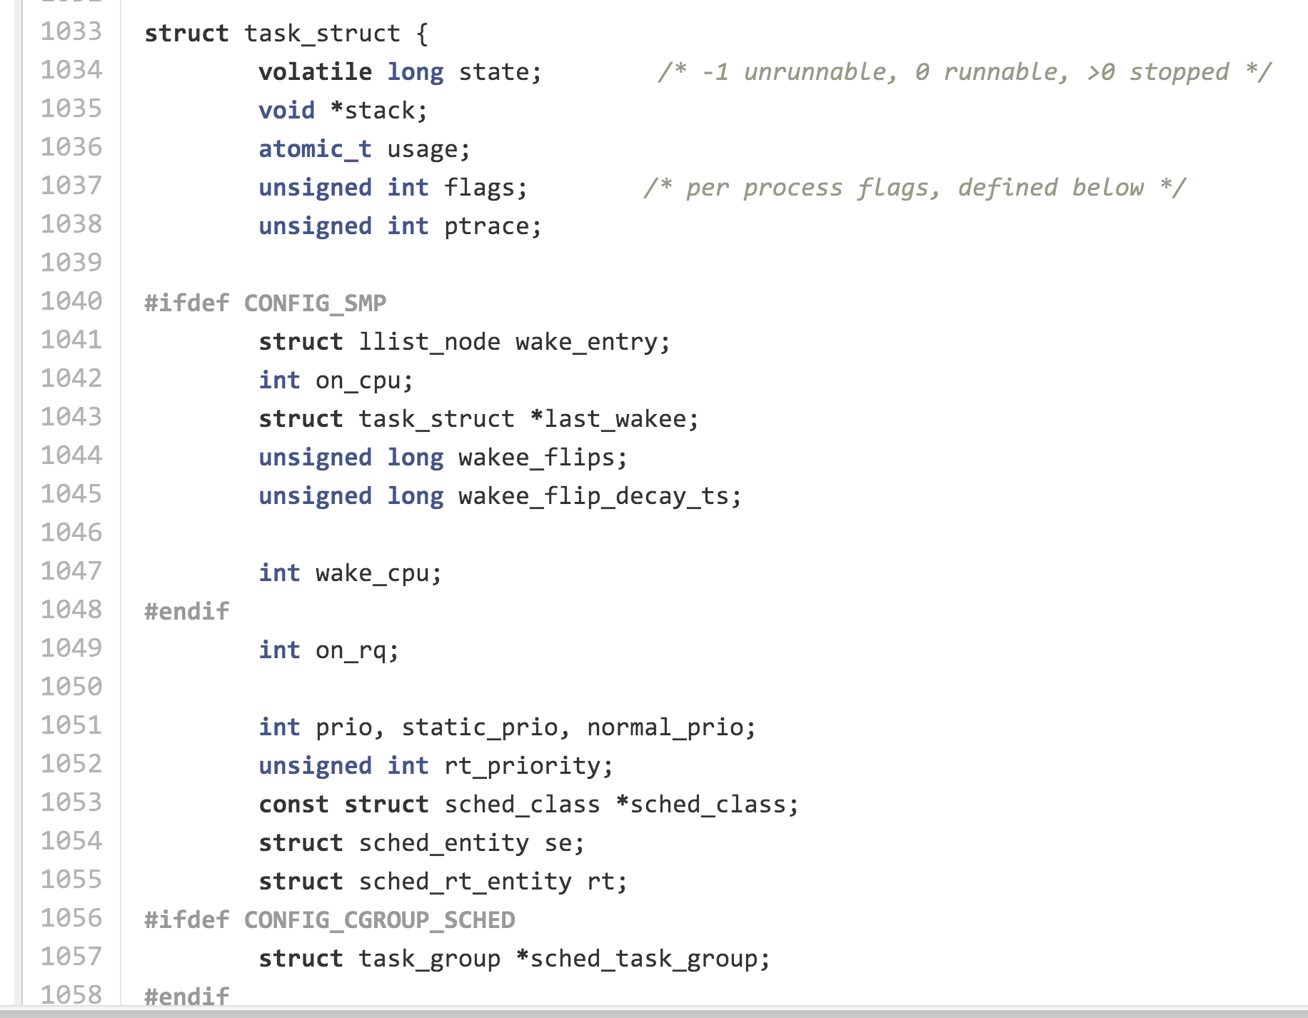
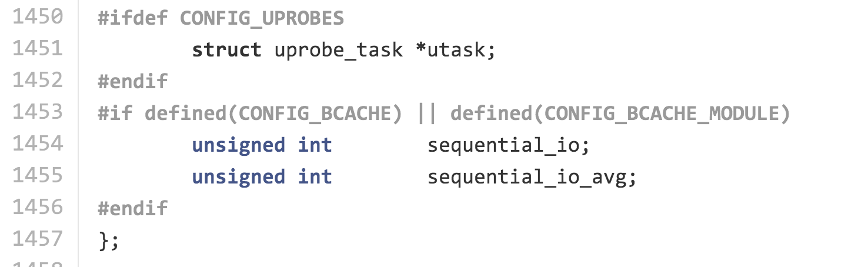
include/linux/sched.h
Definition of task_struct is over 400 lines!

Slide 17
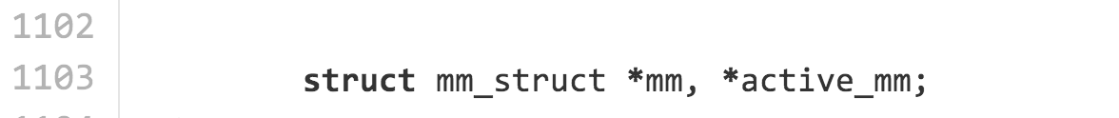
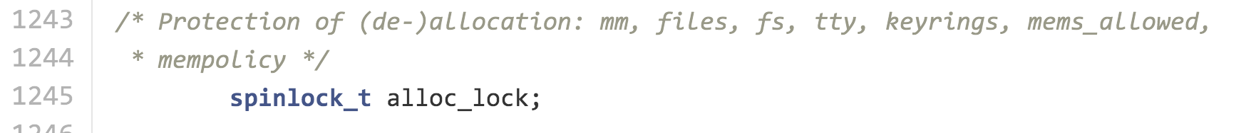
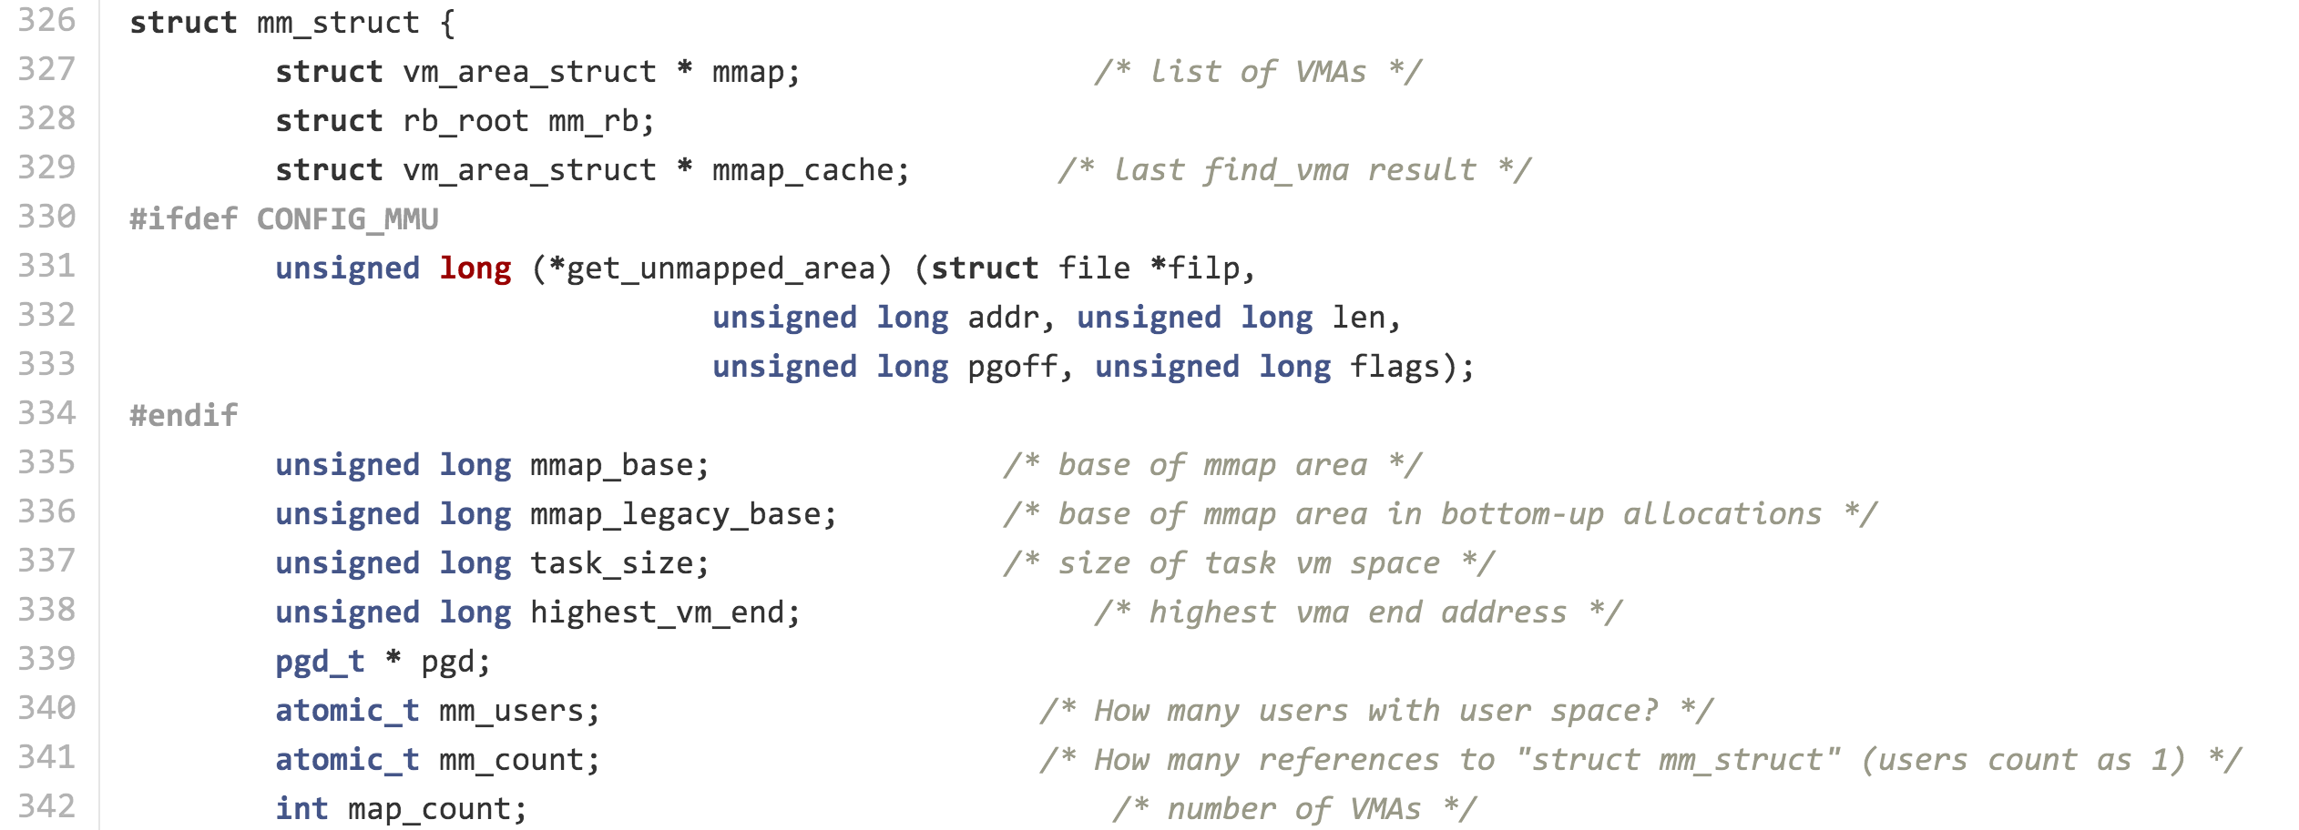
Memory Management
mm_struct is another huge data structure…we’ll look at later.

Slide 18
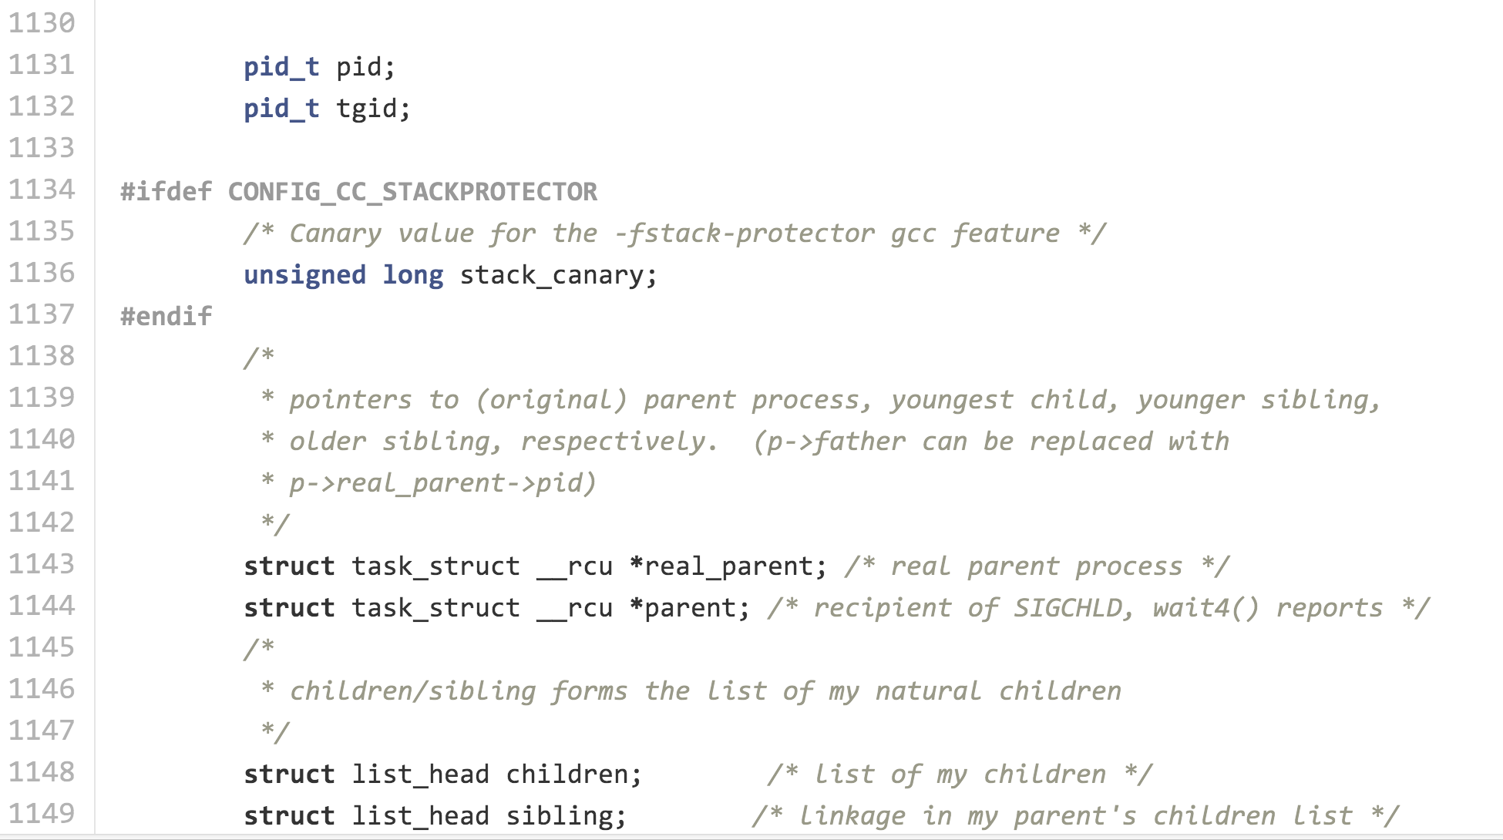

Slide 19
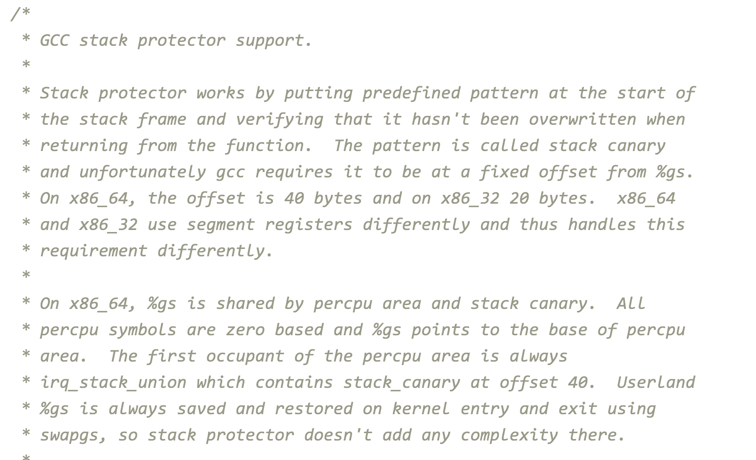
Stack Canary
arch/x86/include/asm/stackprotector.h

Slide 20
Protecting Stack Frames
Saved Registers
Saved Registers
Parameters
Parameters
Return Address
gcc –Wstack-protector
Return Address
Canary
Local Variables
Local Variables
Why does the kernel need code to support this?

Slide 21
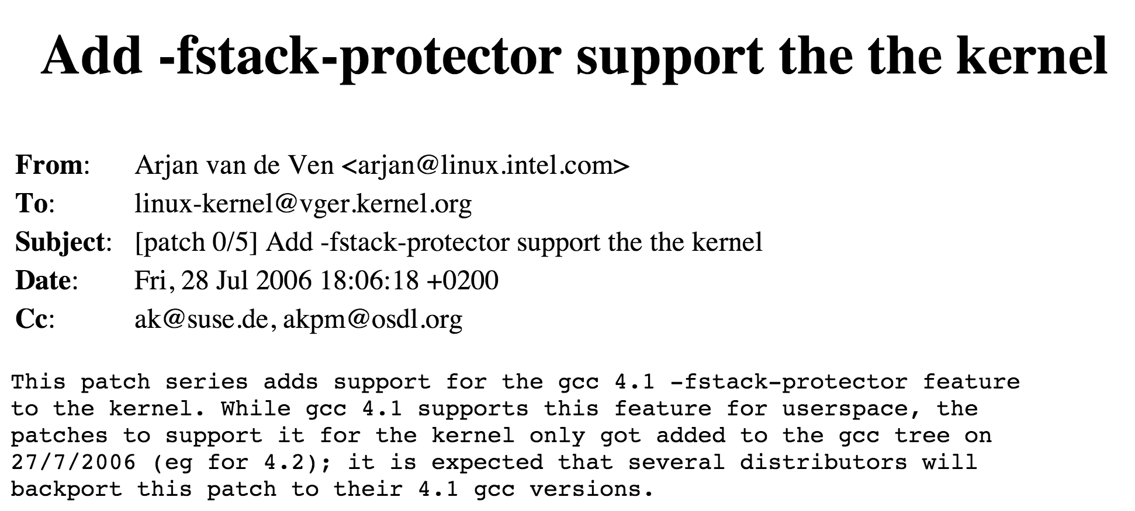
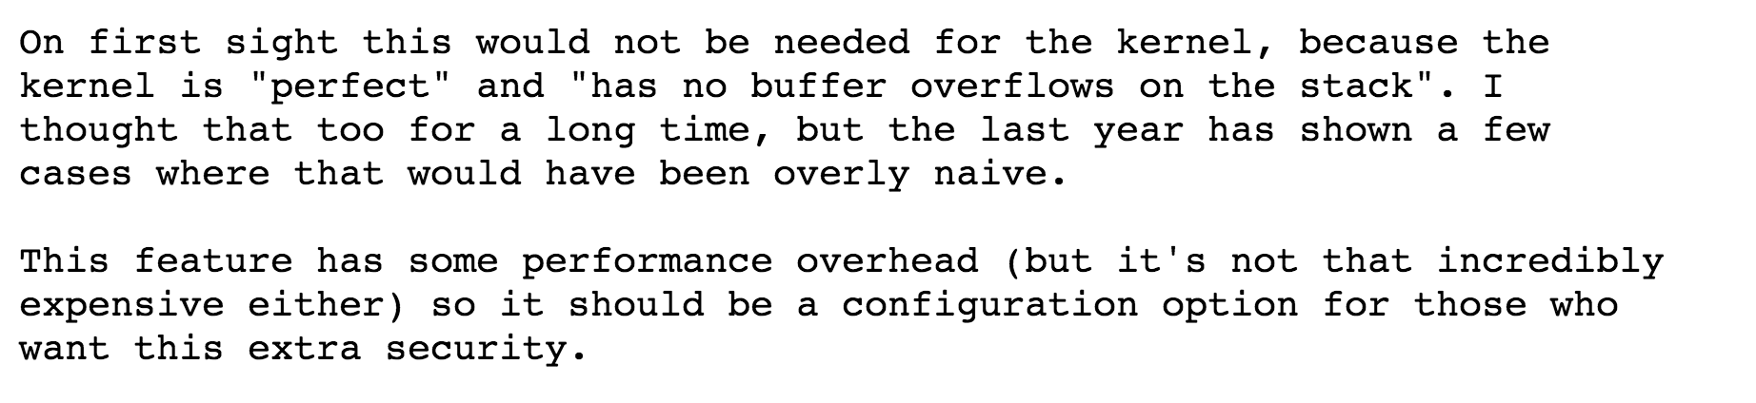

Slide 22
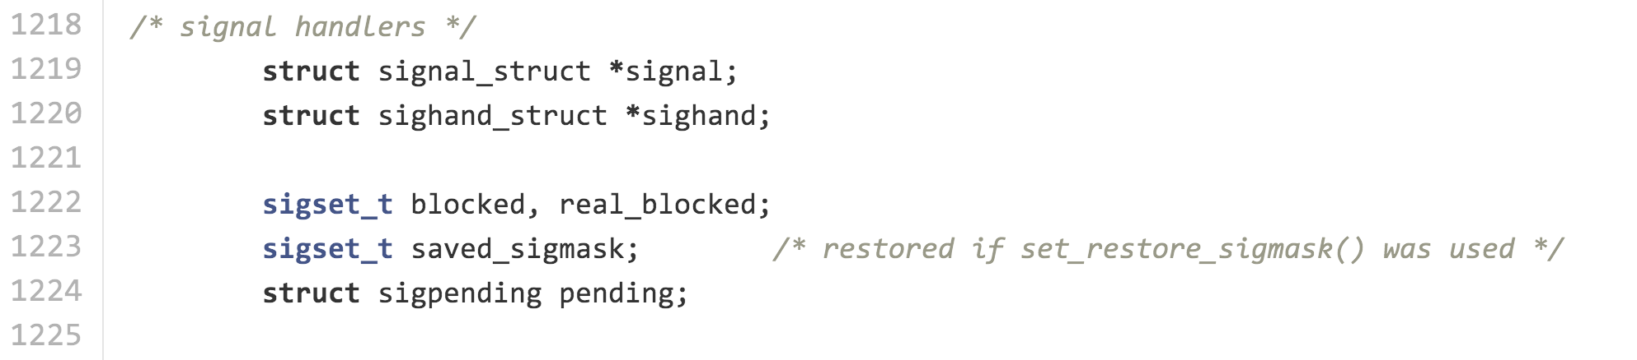
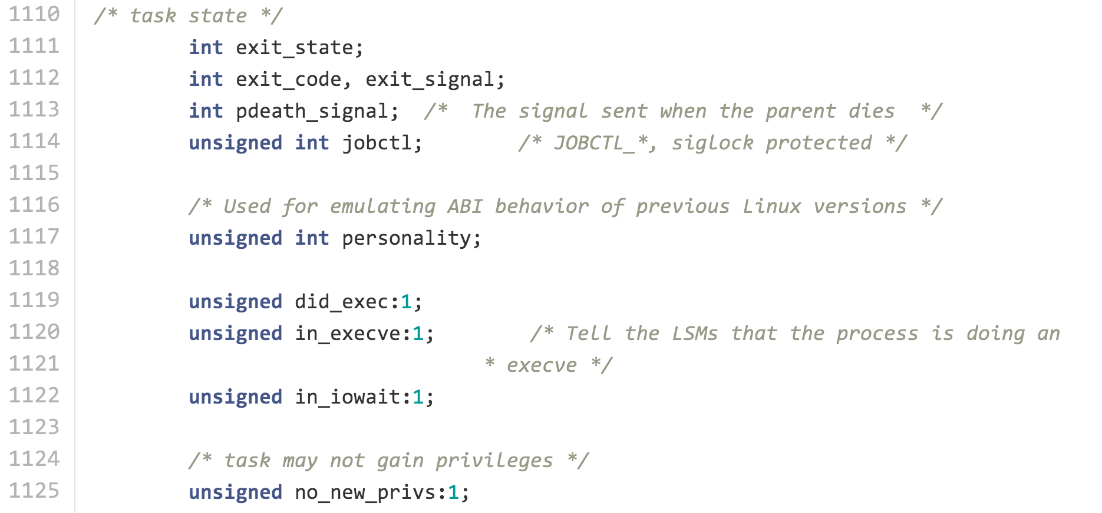
Other things in struct task:

Slide 23
static struct task_struct *copy_process(unsigned long clone_flags,
unsigned long stack_start,
unsigned long stack_size,
int __user *child_tidptr,
struct pid *pid,
int trace)
{
int retval;
struct task_struct *p;
... // lots more error cases based on flags
retval = security_task_create(clone_flags);
if (retval)
goto fork_out;
retval = -ENOMEM;
p = dup_task_struct(current);
if (!p)
goto fork_out;
...
fork_out:
return ERR_PTR(retval);
}
What is current?
#ifndef _ASM_X86_CURRENT_H
#define _ASM_X86_CURRENT_H
#include <linux/compiler.h>
#include <asm/percpu.h>
#ifndef __ASSEMBLY__
struct task_struct;
DECLARE_PER_CPU(struct task_struct *, current_task);
static __always_inline
struct task_struct *get_current(void)
{
return percpu_read_stable(current_task);
}
#define current get_current()
#endif /* __ASSEMBLY__ */
#endif /* _ASM_X86_CURRENT_H */
/linux-2.6.32-rc3/arch/x86/include/asm/current.h

Slide 24
static struct task_struct *dup_task_struct(struct task_struct *orig)
{
struct task_struct *tsk;
struct thread_info *ti;
unsigned long *stackend;
int node = tsk_fork_get_node(orig);
int err;
tsk = alloc_task_struct_node(node);
if (!tsk)
return NULL;
ti = alloc_thread_info_node(tsk, node);
if (!ti)
goto free_tsk;
err = arch_dup_task_struct(tsk, orig);
if (err)
goto free_ti;
tsk->stack = ti;
setup_thread_stack(tsk, orig);
clear_user_return_notifier(tsk);
clear_tsk_need_resched(tsk);
stackend = end_of_stack(tsk);
*stackend = STACK_END_MAGIC; /* for overflow detection */
#ifdef CONFIG_CC_STACKPROTECTOR
tsk->stack_canary = get_random_int();
#endif
...

Slide 25
static struct task_struct *dup_task_struct(struct task_struct *orig)
{
struct task_struct *tsk;
struct thread_info *ti;
unsigned long *stackend;
int node = tsk_fork_get_node(orig);
int err;
tsk = alloc_task_struct_node(node);
if (!tsk)
return NULL;
ti = alloc_thread_info_node(tsk, node);
if (!ti)
goto free_tsk;
err = arch_dup_task_struct(tsk, orig);
if (err)
goto free_ti;
tsk->stack = ti;
setup_thread_stack(tsk, orig);
clear_user_return_notifier(tsk);
clear_tsk_need_resched(tsk);
stackend = end_of_stack(tsk);
*stackend = STACK_END_MAGIC; /* for overflow detection */
#ifdef CONFIG_CC_STACKPROTECTOR
tsk->stack_canary = get_random_int();
#endif
...
Linux/include/linux/sched.h
...
#define task_thread_info(task) ((struct thread_info *)(task)->stack)
#define task_stack_page(task) ((task)->stack)
static inline void setup_thread_stack(struct task_struct *p, struct task_struct *org)
{
*task_thread_info(p) = *task_thread_info(org);
task_thread_info(p)->task = p;
}
static inline unsigned long *end_of_stack(struct task_struct *p)
{
return (unsigned long *)(task_thread_info(p) + 1);
}

Slide 26
static struct task_struct *dup_task_struct(struct task_struct *orig)
{
struct task_struct *tsk;
struct thread_info *ti;
unsigned long *stackend;
int node = tsk_fork_get_node(orig);
int err;
tsk = alloc_task_struct_node(node);
if (!tsk)
return NULL;
ti = alloc_thread_info_node(tsk, node);
if (!ti)
goto free_tsk;
err = arch_dup_task_struct(tsk, orig);
if (err)
goto free_ti;
tsk->stack = ti;
setup_thread_stack(tsk, orig);
clear_user_return_notifier(tsk);
clear_tsk_need_resched(tsk);
stackend = end_of_stack(tsk);
*stackend = STACK_END_MAGIC; /* for overflow detection */
#ifdef CONFIG_CC_STACKPROTECTOR
tsk->stack_canary = get_random_int();
#endif
...

Slide 27
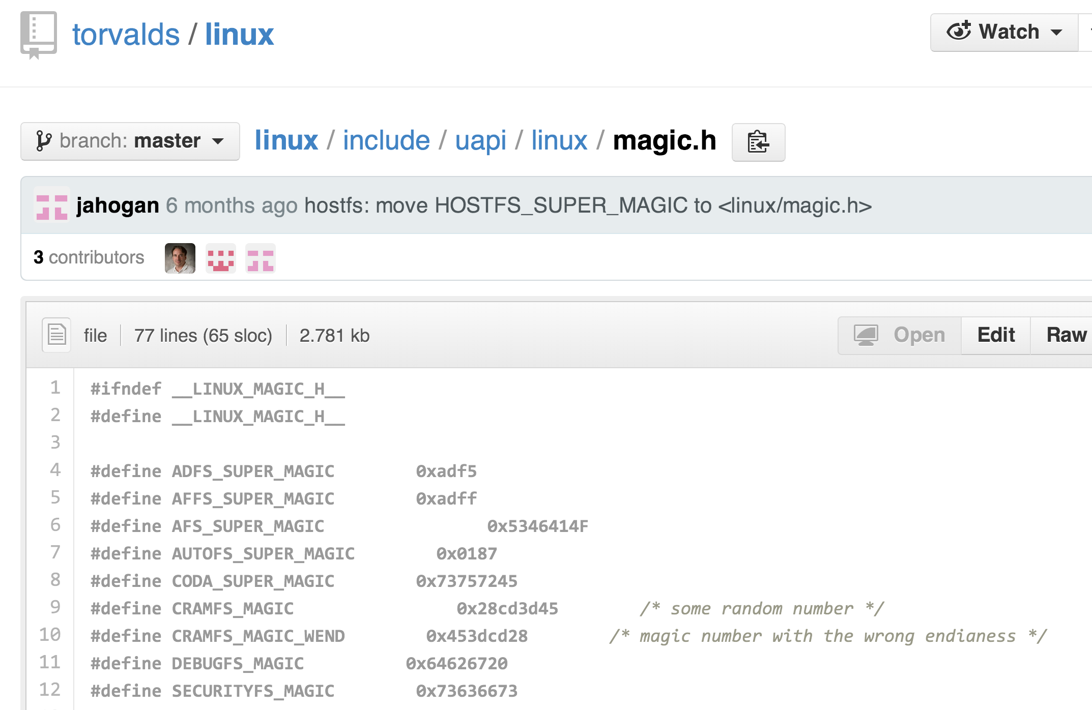
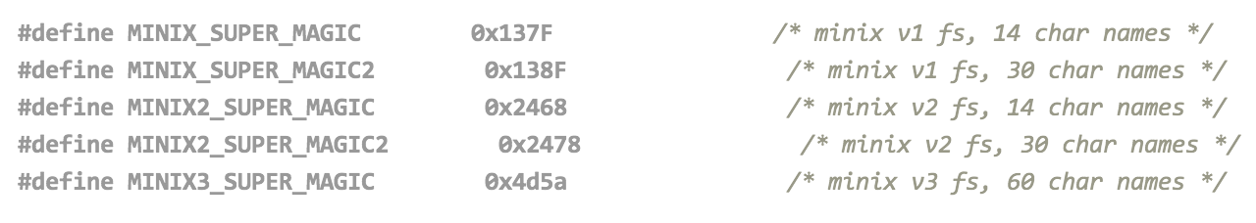

Slide 28
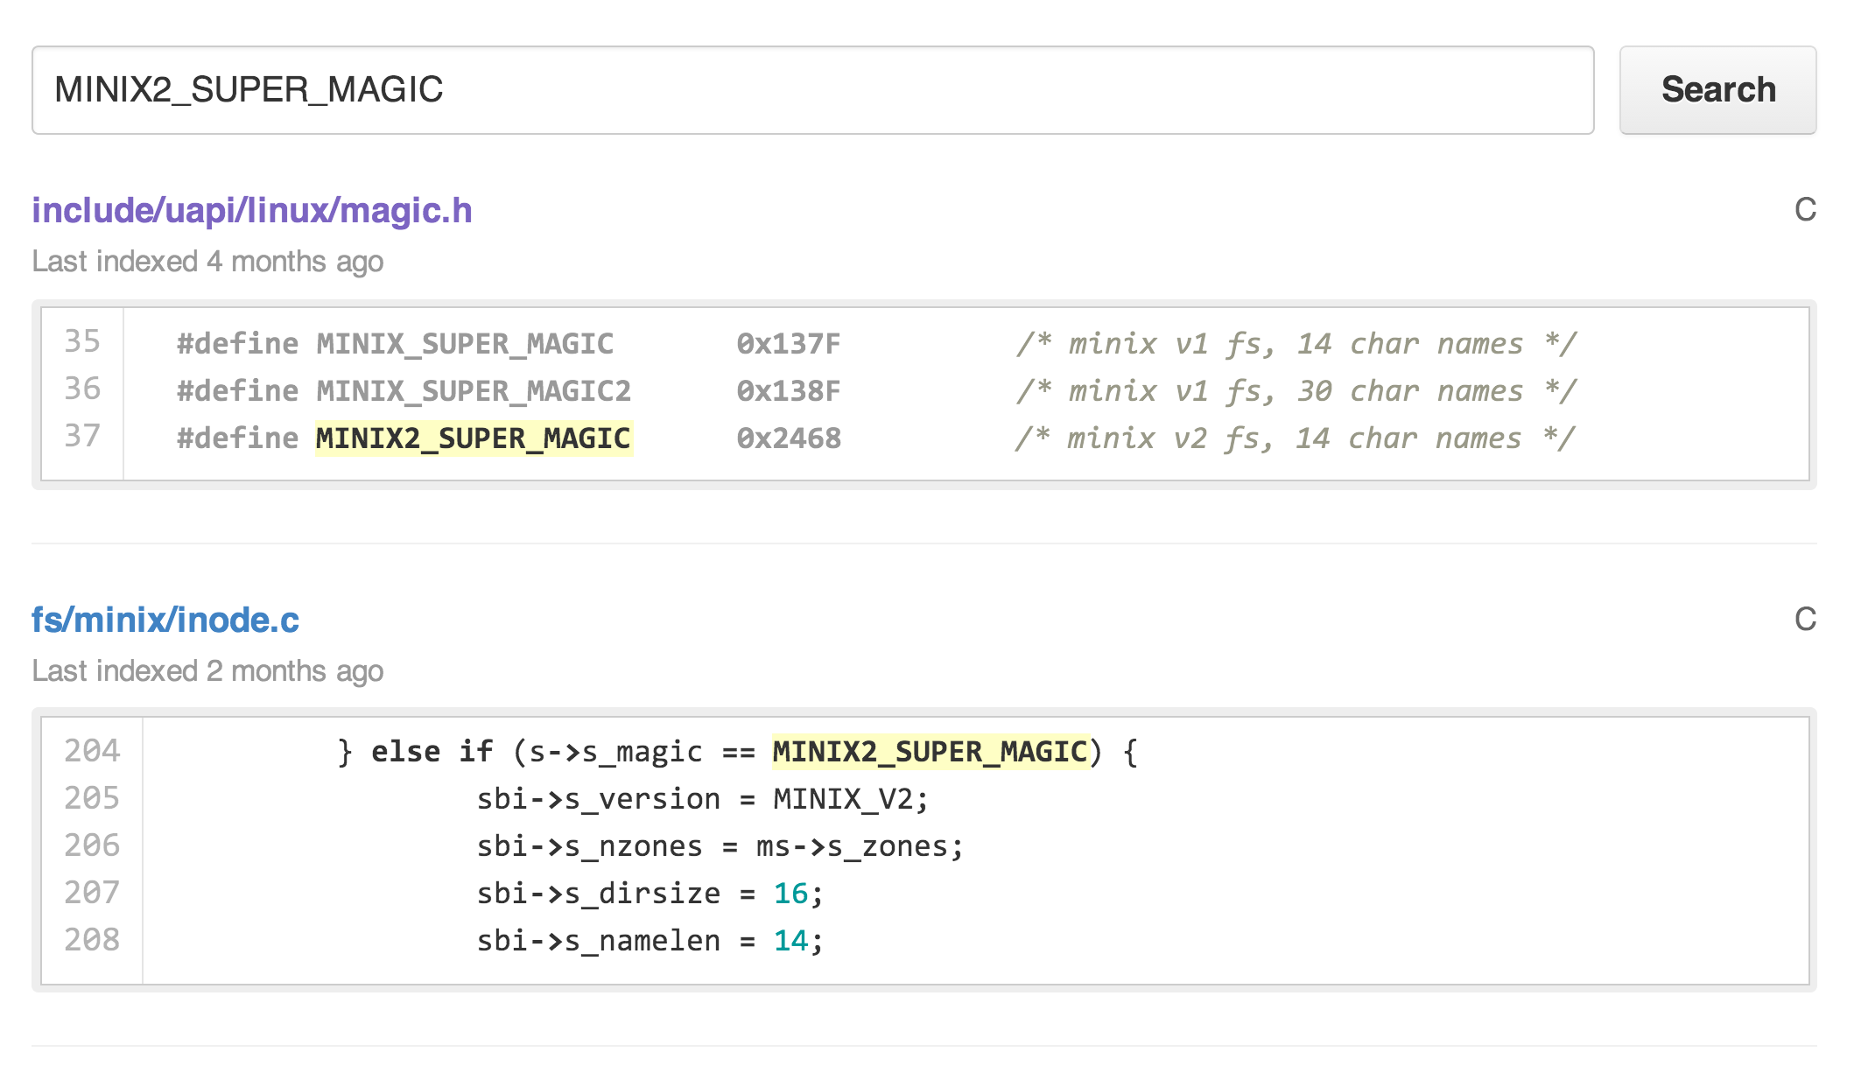

Slide 29
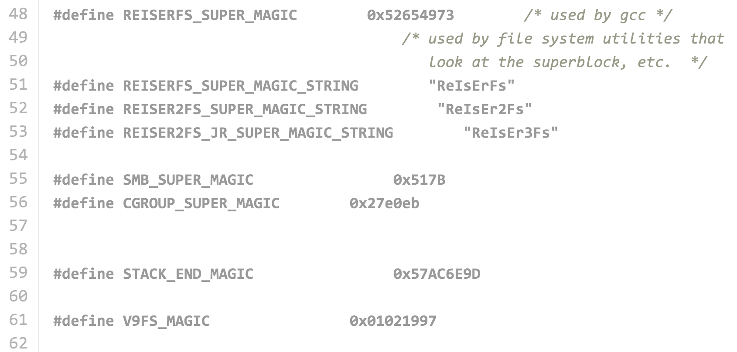

Slide 30
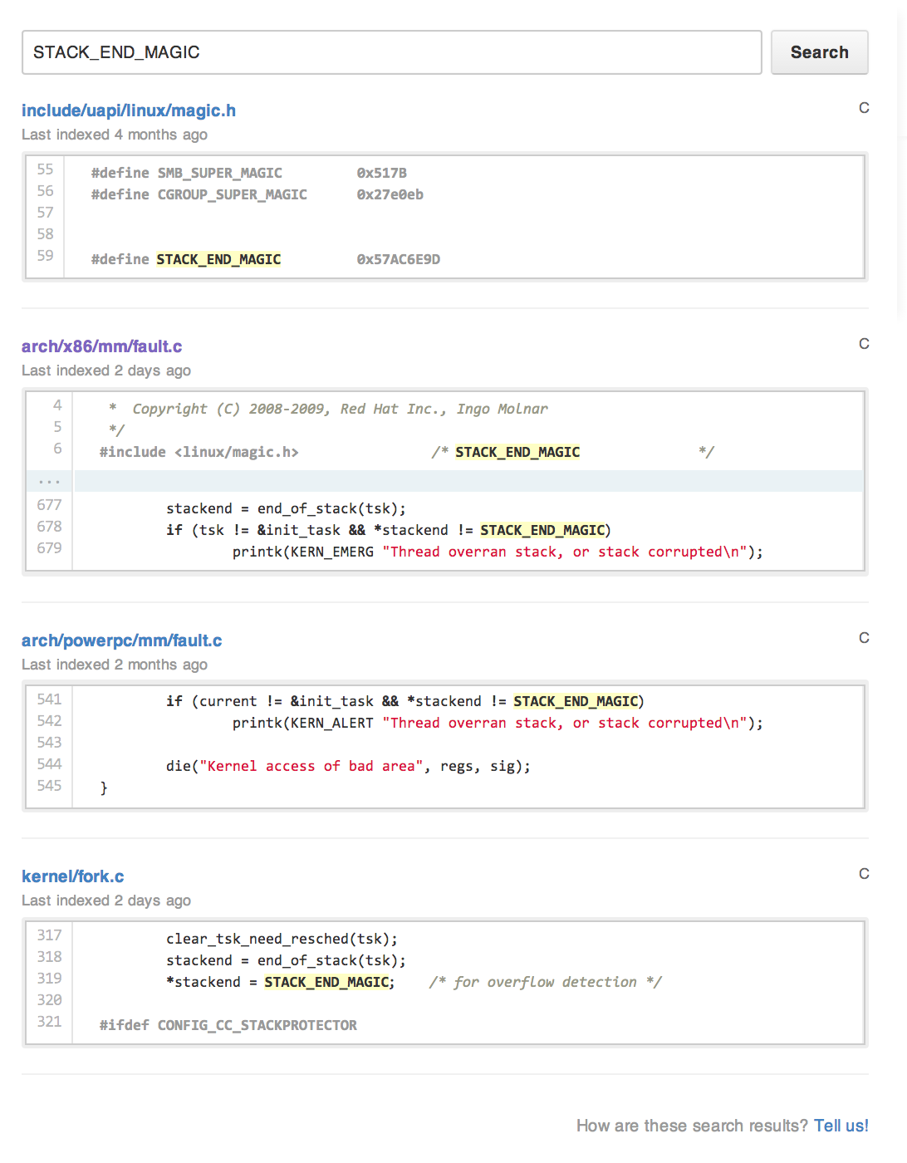
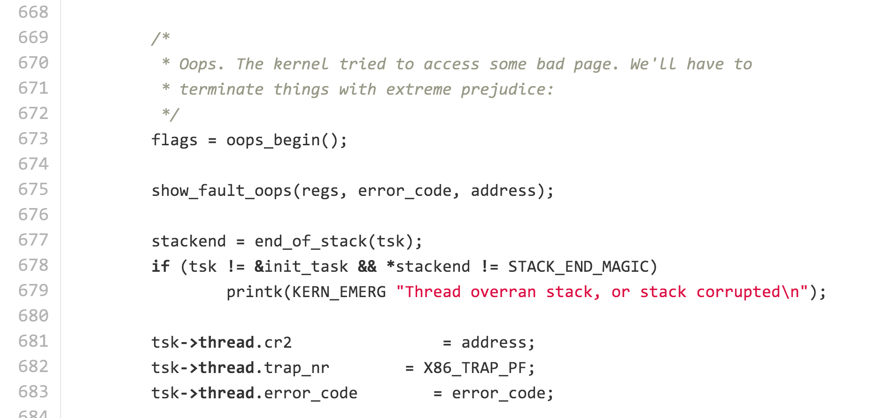
https://github.com/torvalds/linux/search?q=STACK_END_MAGIC&ref=cmdform
In no_context, called by mm_fault_error
Does this help defend against a stack-smashing buffer overflow attack?

Slide 31


Slide 32
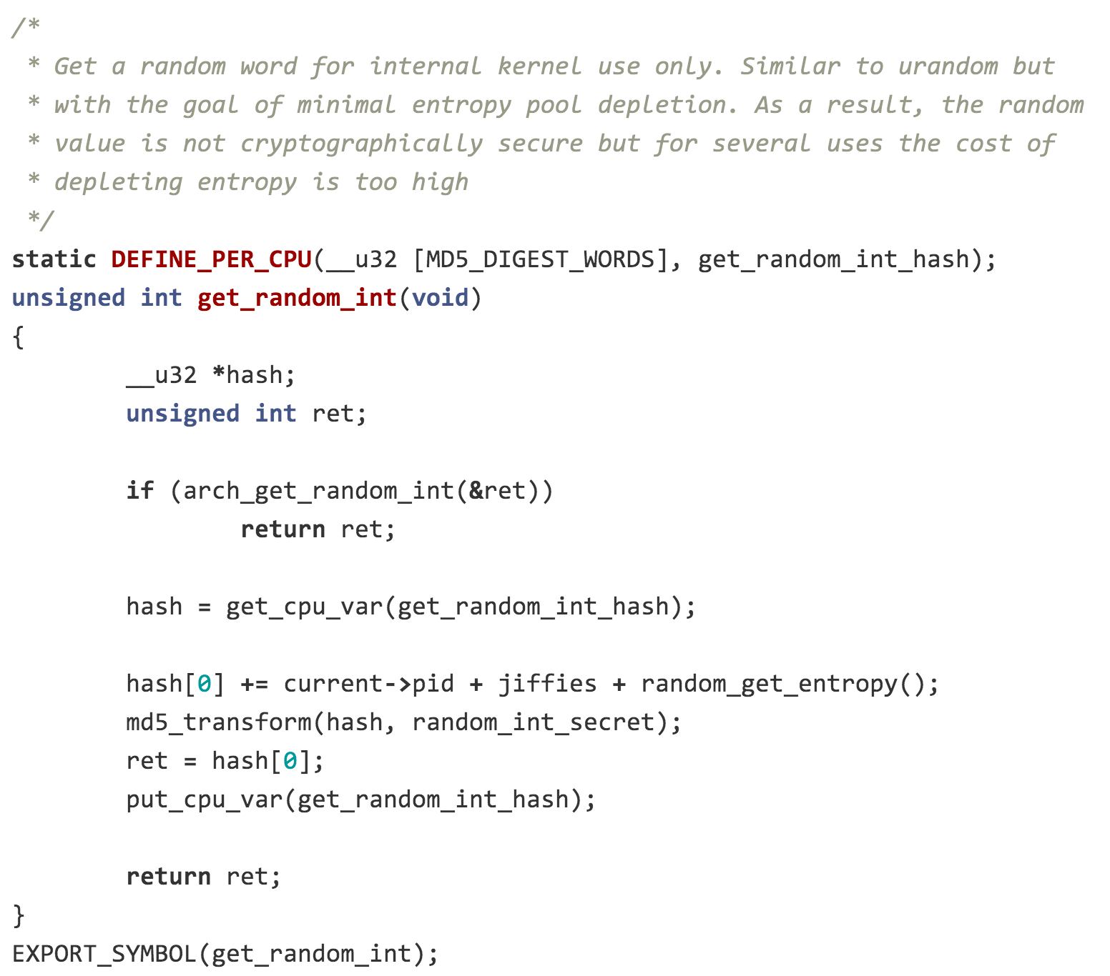
...
tsk->stack_canary = get_random_int();
...

Slide 33
static struct task_struct *dup_task_struct(struct task_struct *orig)
{
...
clear_tsk_need_resched(tsk);
stackend = end_of_stack(tsk);
*stackend = STACK_END_MAGIC; /* for overflow detection */
#ifdef CONFIG_CC_STACKPROTECTOR
tsk->stack_canary = get_random_int();
#endif
/*
* One for us, one for whoever does the "release_task()" (usually
* parent)
*/
atomic_set(&tsk->usage, 2);
#ifdef CONFIG_BLK_DEV_IO_TRACE
tsk->btrace_seq = 0;
#endif
tsk->splice_pipe = NULL;
tsk->task_frag.page = NULL;
account_kernel_stack(ti, 1);
return tsk;
free_ti:
free_thread_info(ti);
free_tsk:
free_task_struct(tsk);
return NULL;
}

Slide 34
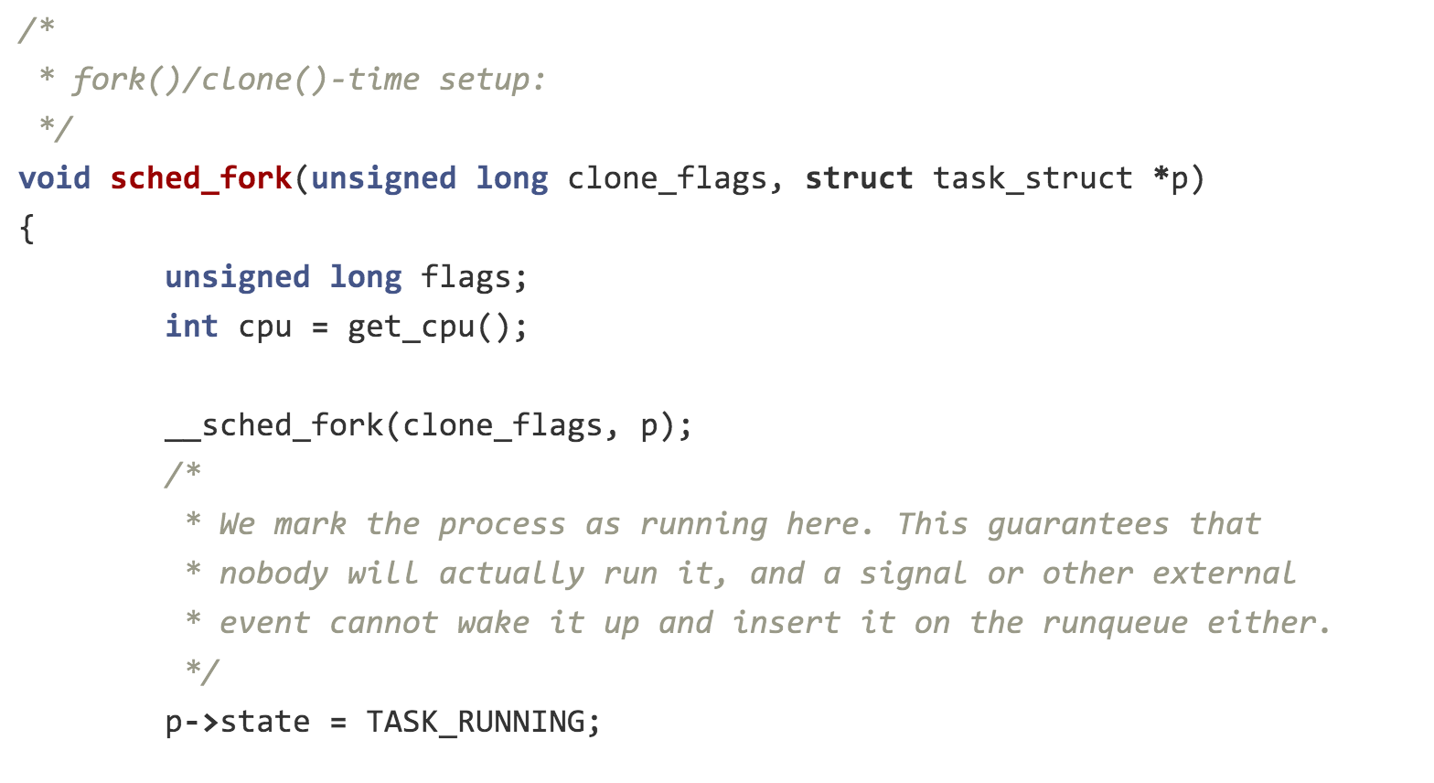
static struct task_struct *copy_process(...)
{
...
p = dup_task_struct(current);
...
/* Perform scheduler related setup. Assign this task to a CPU. */
sched_fork(p);
...
}
kernel/sched/core.c

Slide 35
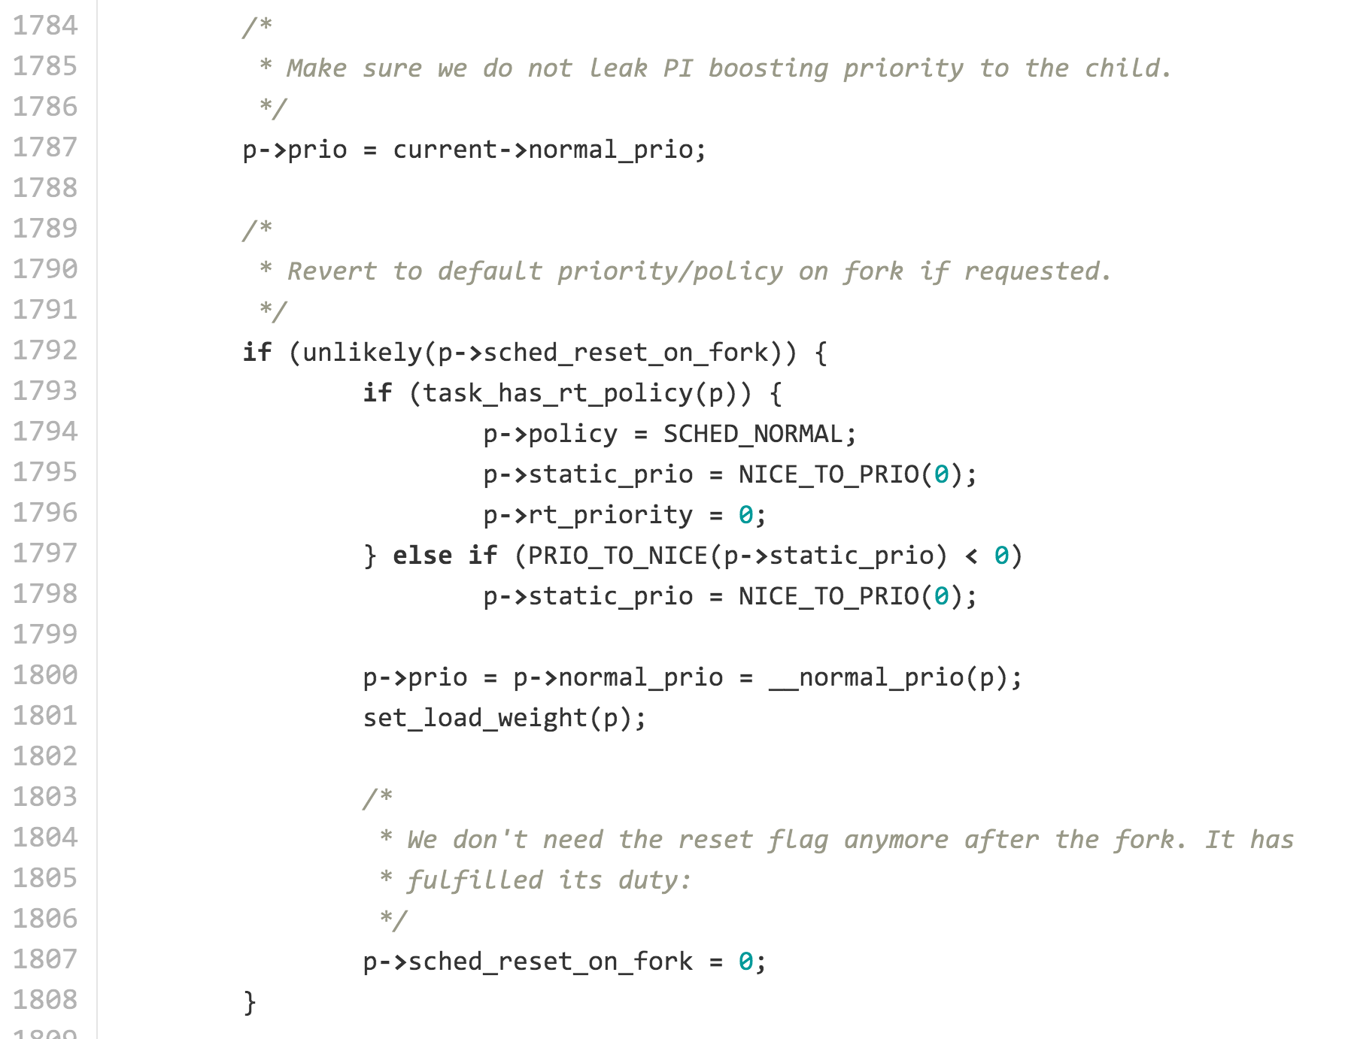

Slide 36
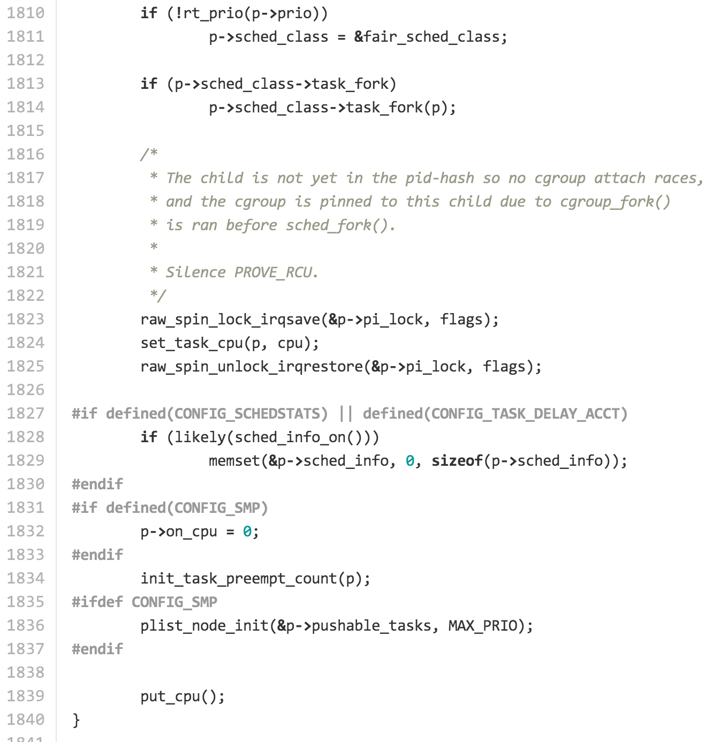

Slide 37
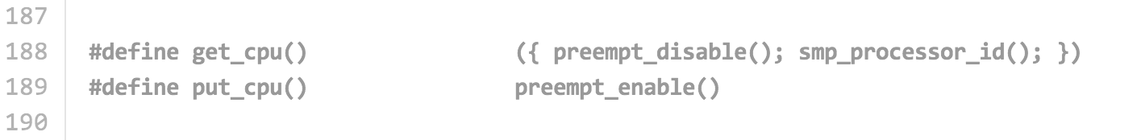
include/linux/smp.h

Slide 38
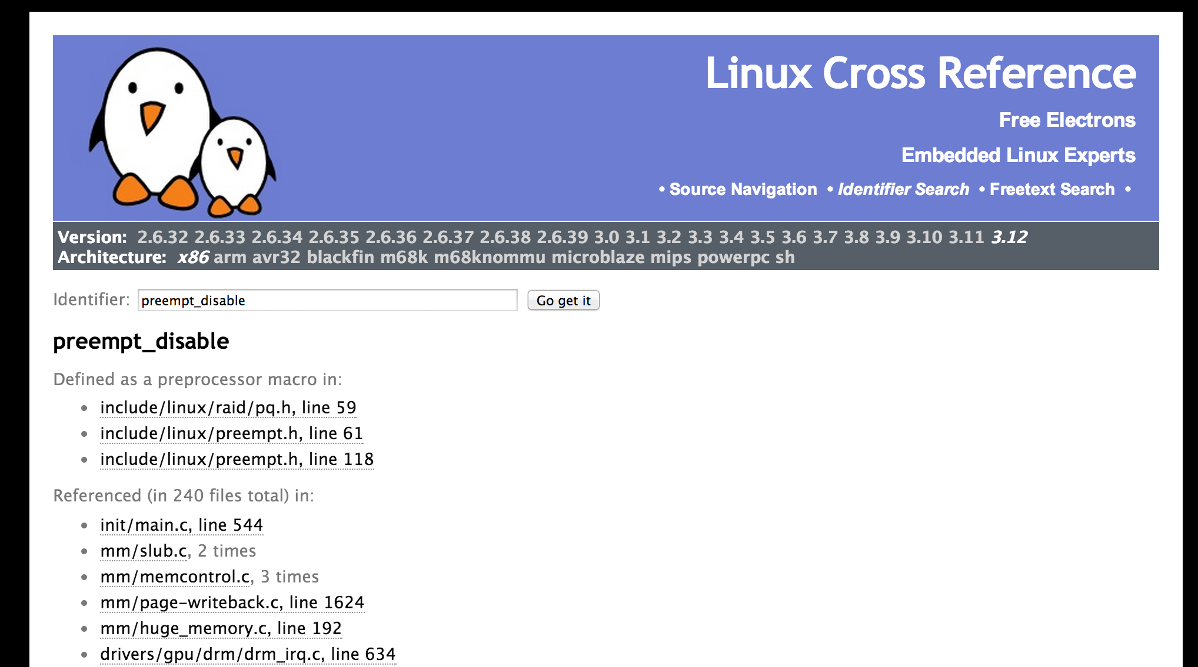
http://lxr.free-electrons.com/ident?i=preempt_disable

Slide 39
static struct task_struct *copy_process(...)
{
...
p = dup_task_struct(current);
...
/* Perform scheduler related setup. Assign this task to a CPU. */
sched_fork(p);
...
retval = copy_mm(clone_flags, p);
...
}
static int copy_mm(unsigned long clone_flags, struct task_struct *tsk)
{
struct mm_struct *mm, *oldmm;
int retval;
...
mm = dup_mm(tsk);
if (!mm)
goto fail_nomem;
good_mm:
tsk->mm = mm;
tsk->active_mm = mm;
return 0;
…

Slide 40
/*
* Allocate a new mm structure and copy contents from the
* mm structure of the passed in task structure.
*/
struct mm_struct *dup_mm(struct task_struct *tsk)
{
struct mm_struct *mm, *oldmm = current->mm;
int err;
if (!oldmm)
return NULL;
mm = allocate_mm();
if (!mm)
goto fail_nomem;
memcpy(mm, oldmm, sizeof(*mm));
...
#define allocate_mm() (kmem_cache_alloc(mm_cachep, GFP_KERNEL))
#define free_mm(mm) (kmem_cache_free(mm_cachep, (mm)))

Slide 41
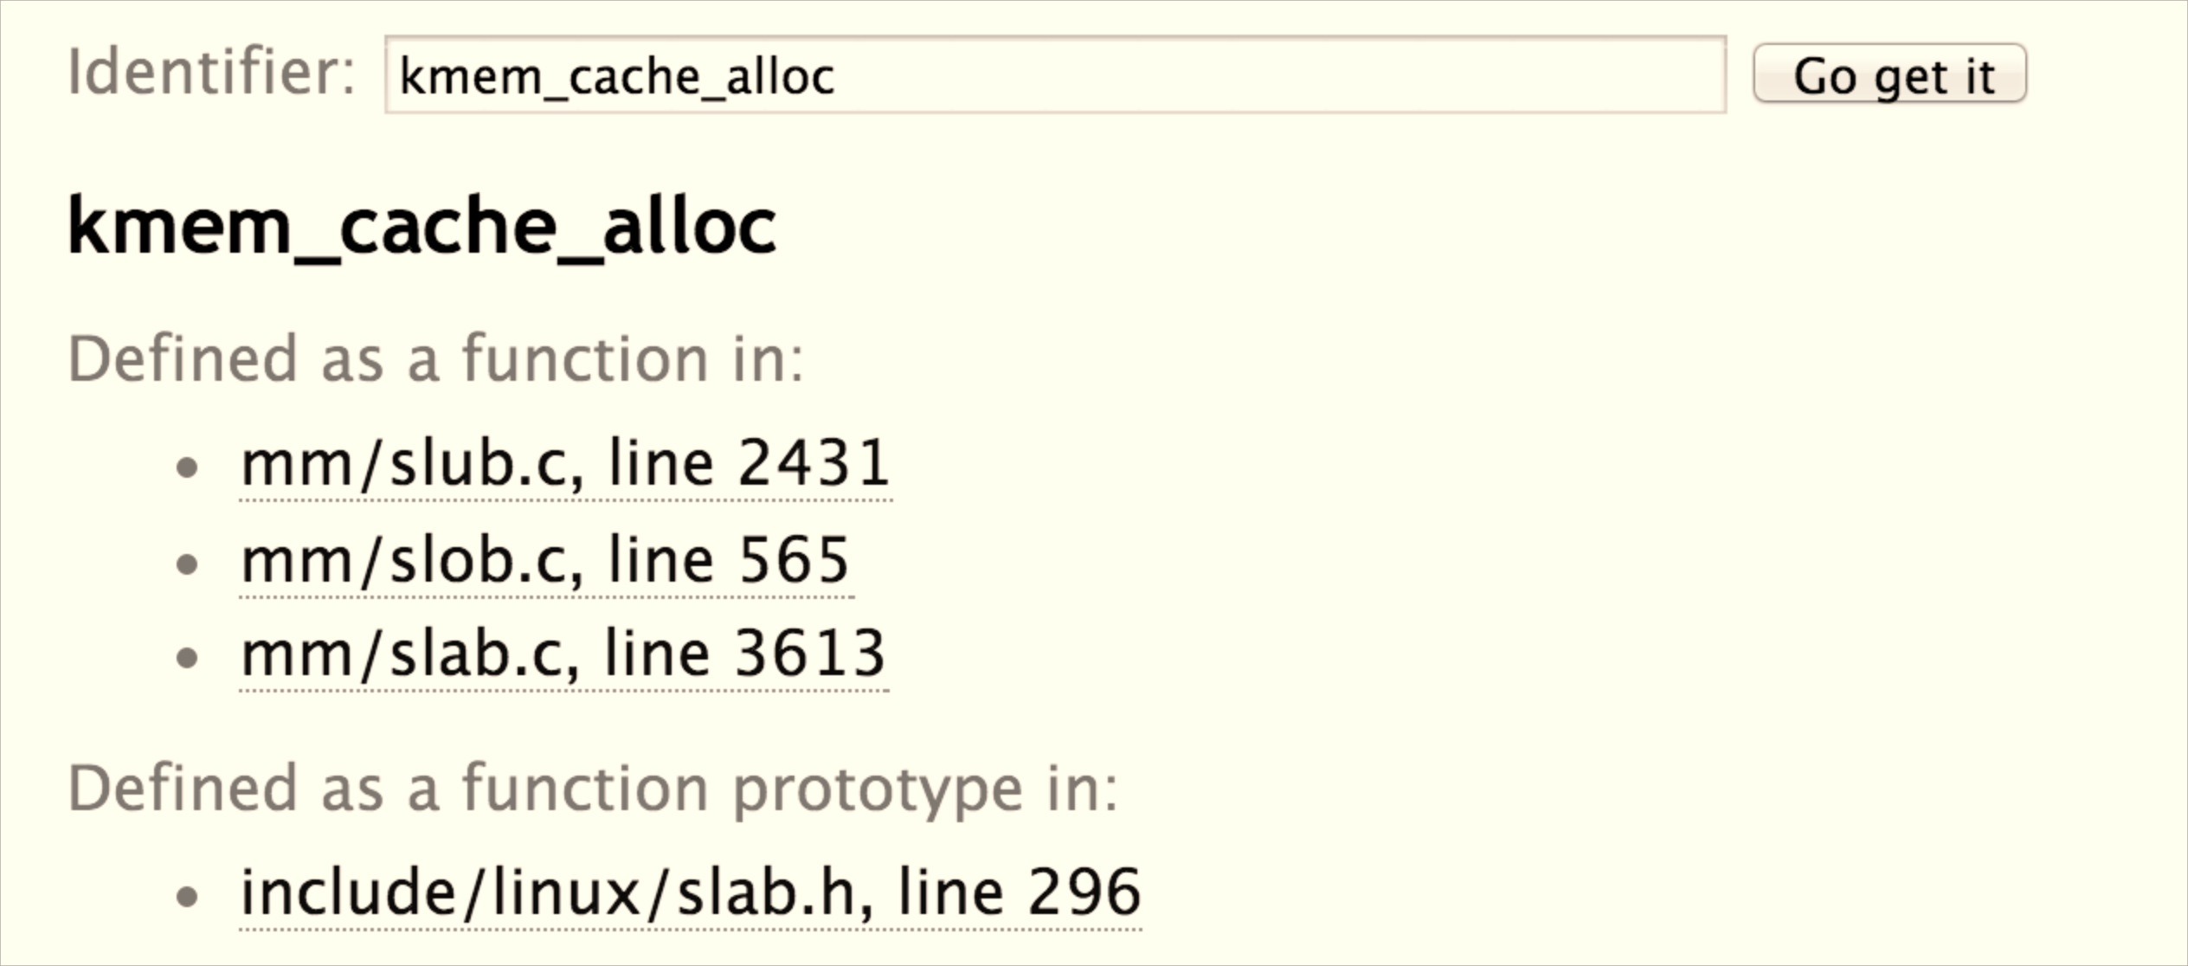
Three Linux memory allocators:
SLOB = “Simple List of Blocks”
SLAB = allocation with less fragmentation
SLUB = less fragmentation, better reuse (Default)

Slide 42
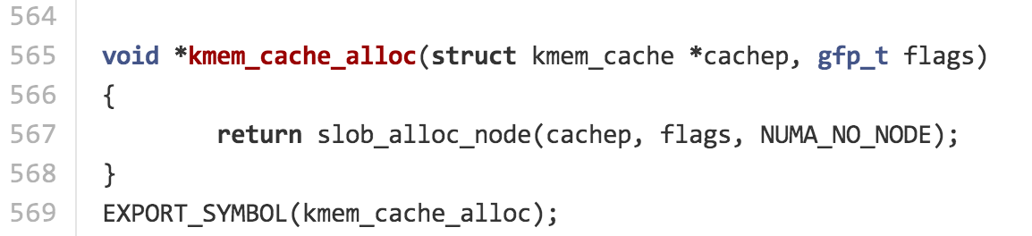
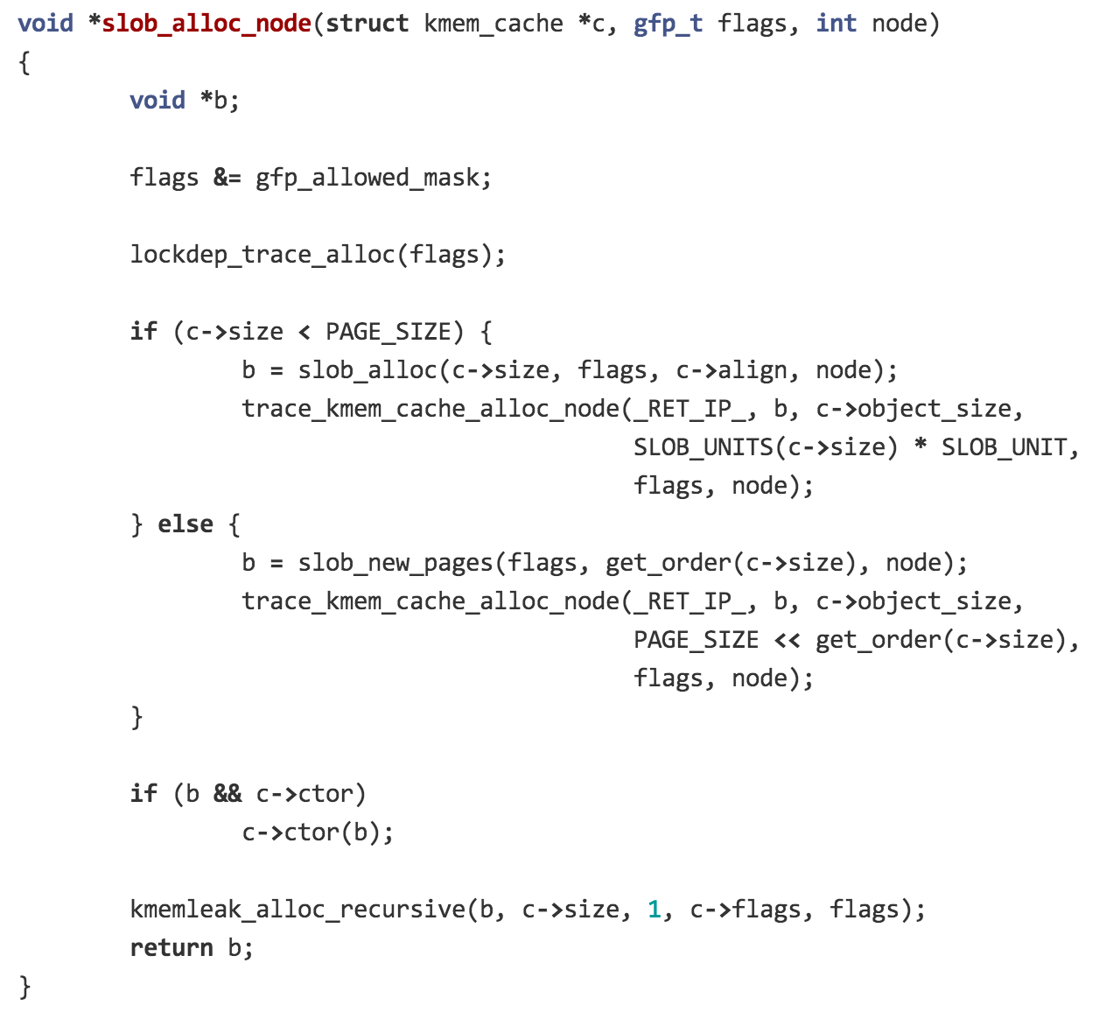

Slide 43
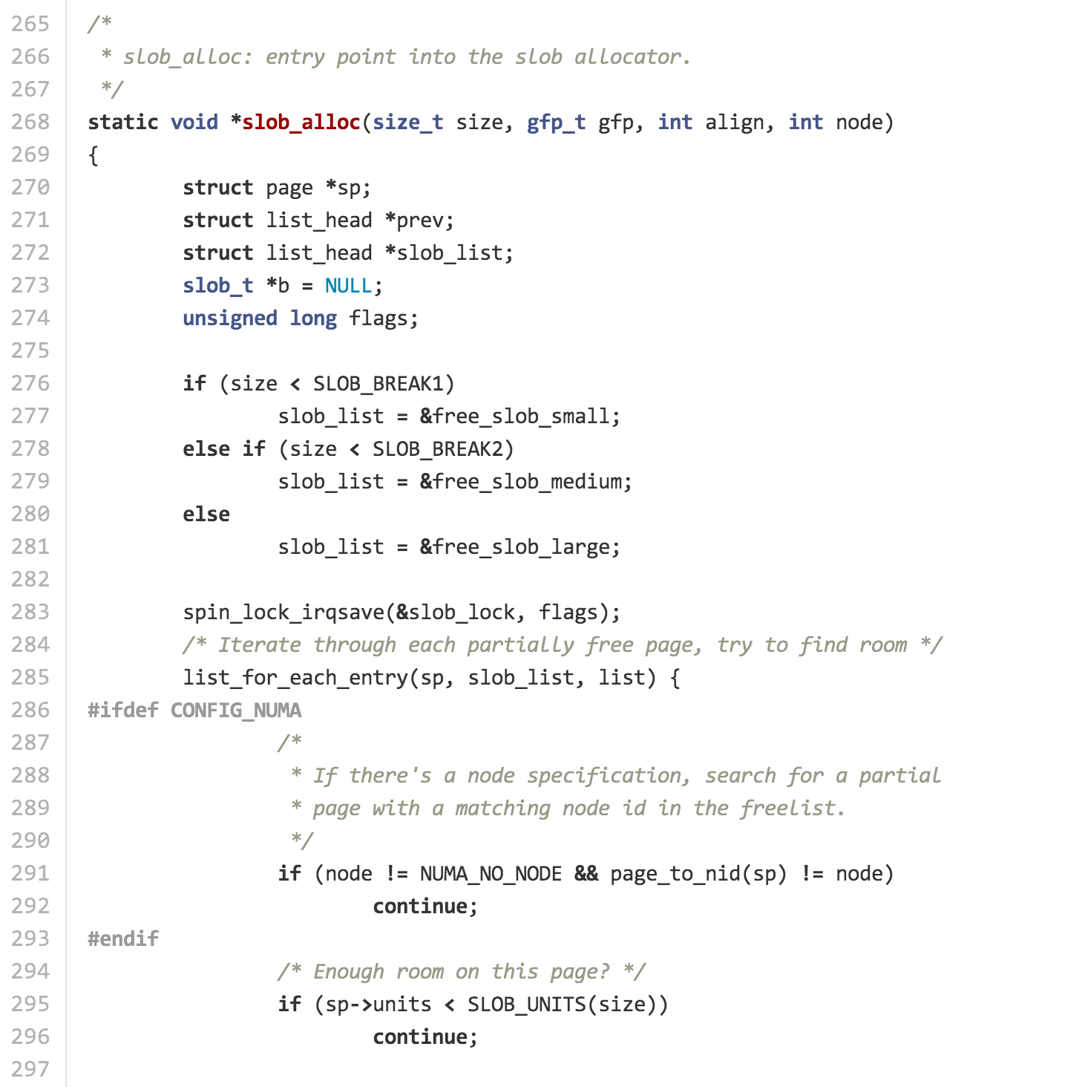

Slide 44
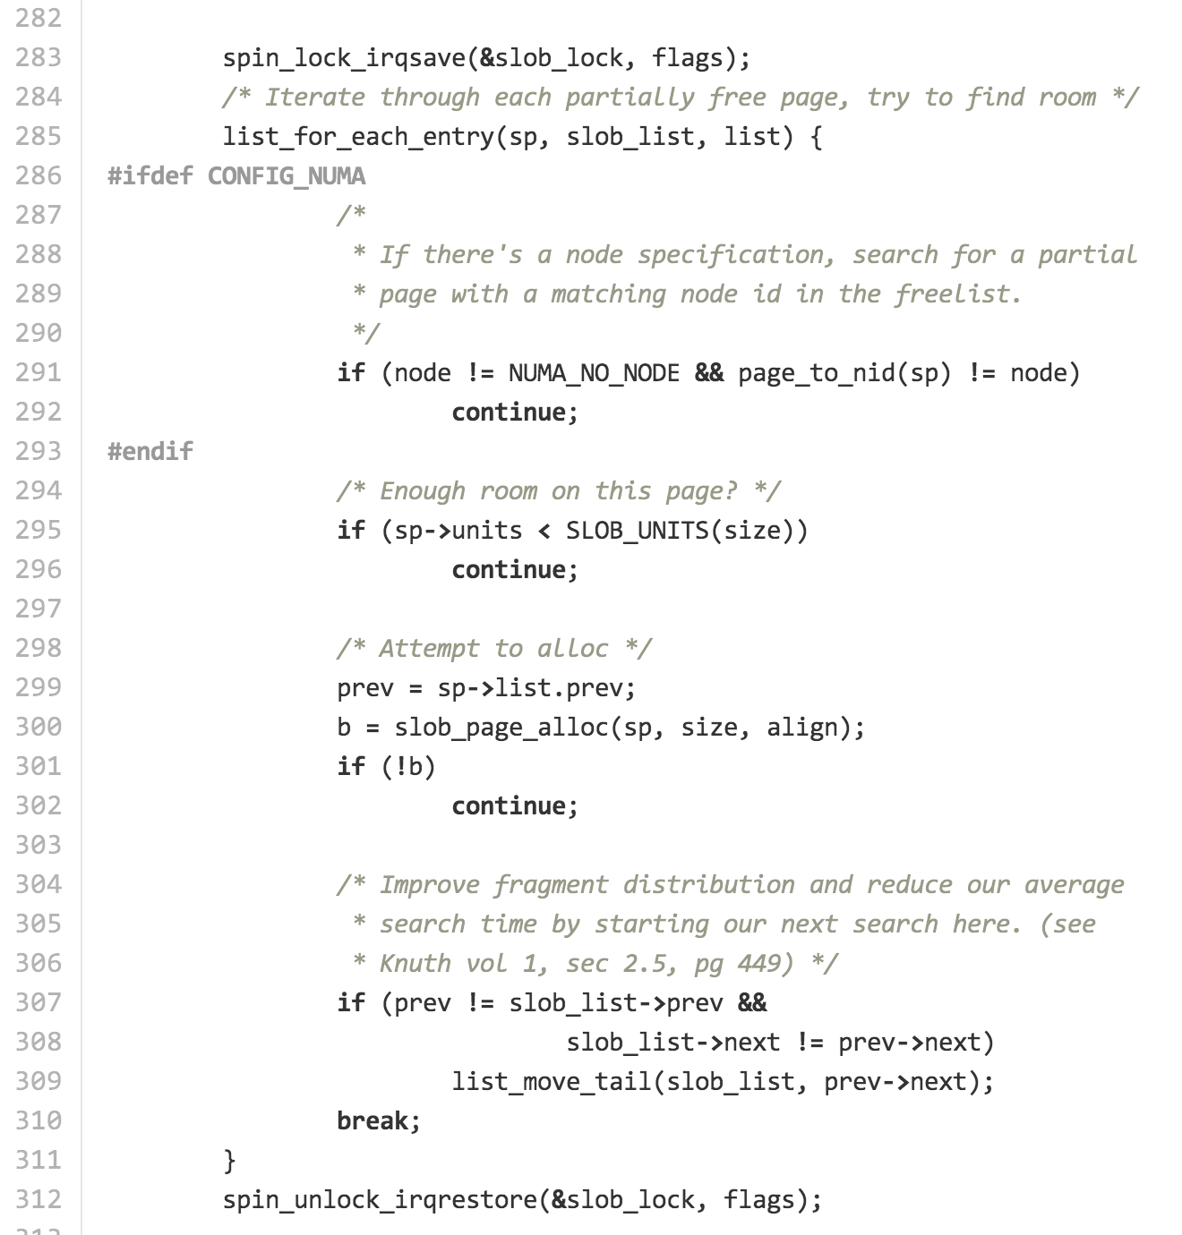

Slide 45
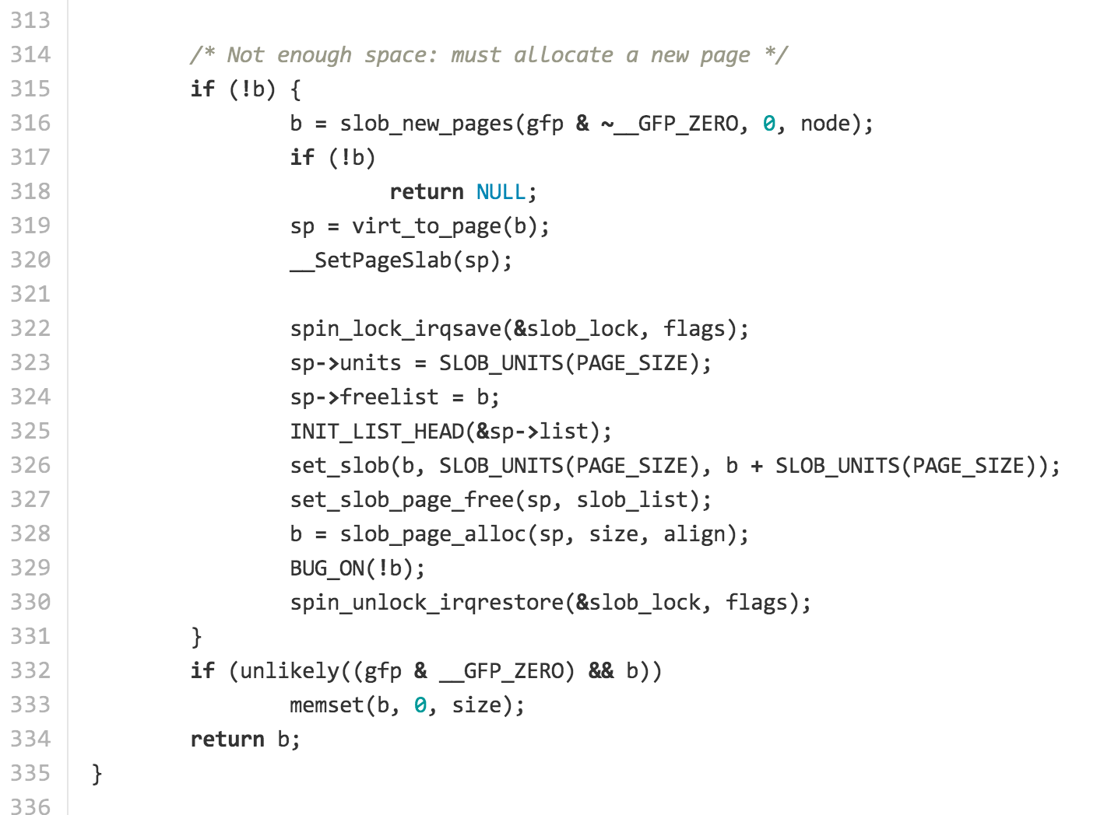

Slide 46
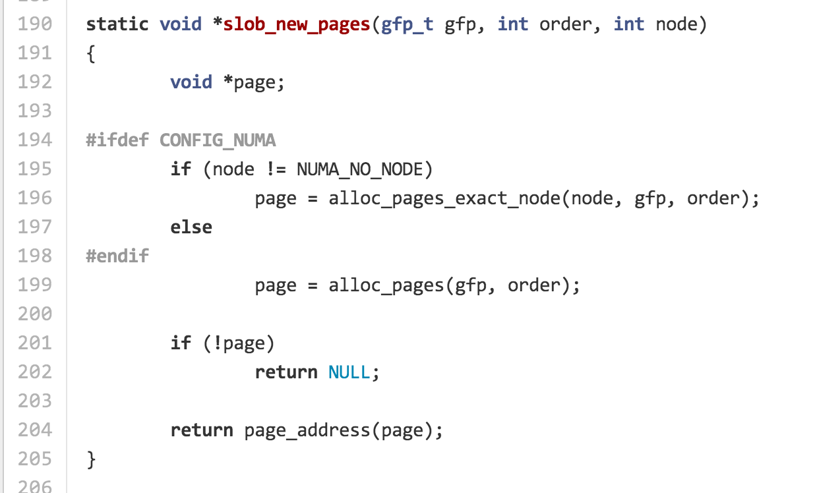

Slide 47
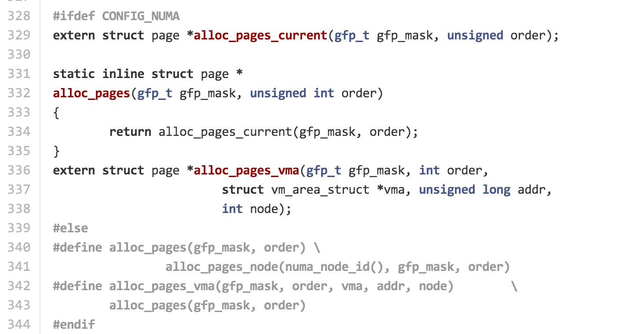
include/linux/gfp.h

Slide 48
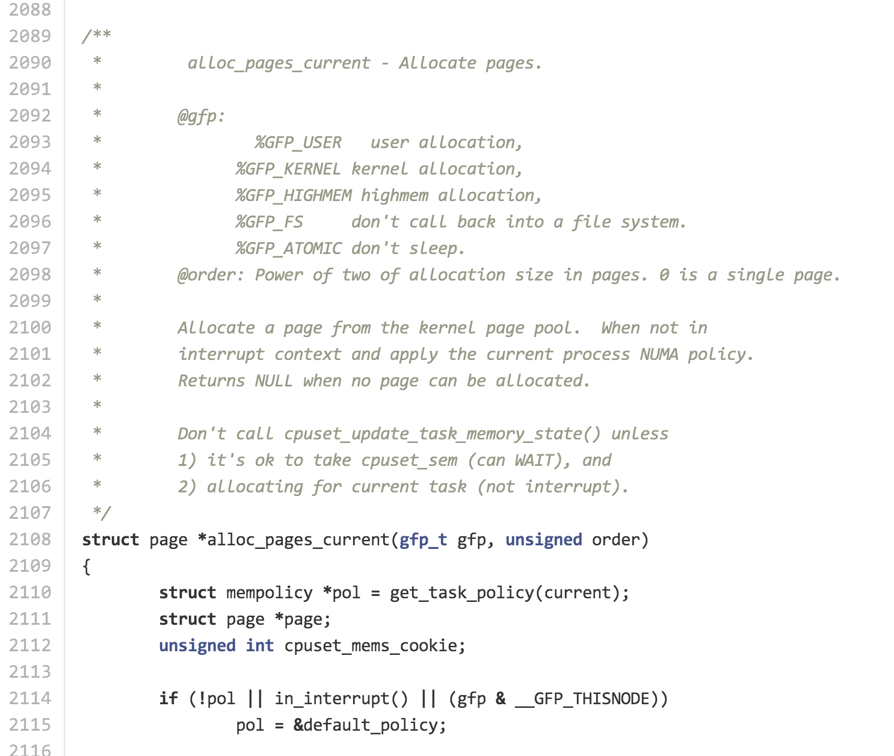

Slide 49
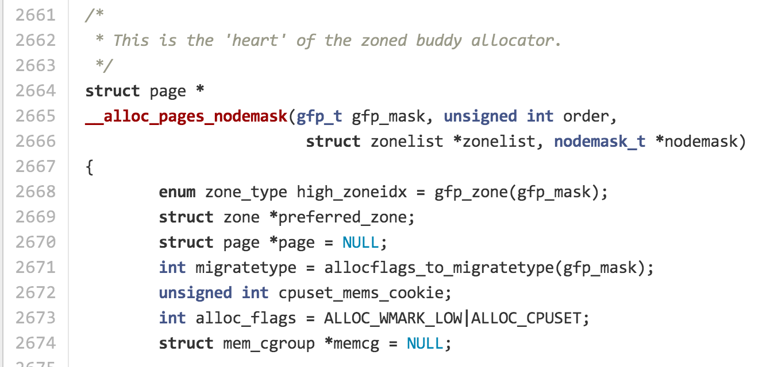
mm/page_alloc.c

Slide 50
Page Table
Physical Memory
32-bit linear address
CR3
Dir
Page
Offset
10 bits
(1K tables)
10 bits
(1K entries)
12 bits
(4K pages)
Page Directory
Page Table
Page Entry
Page + Offset
CR3+Dir

Slide 51
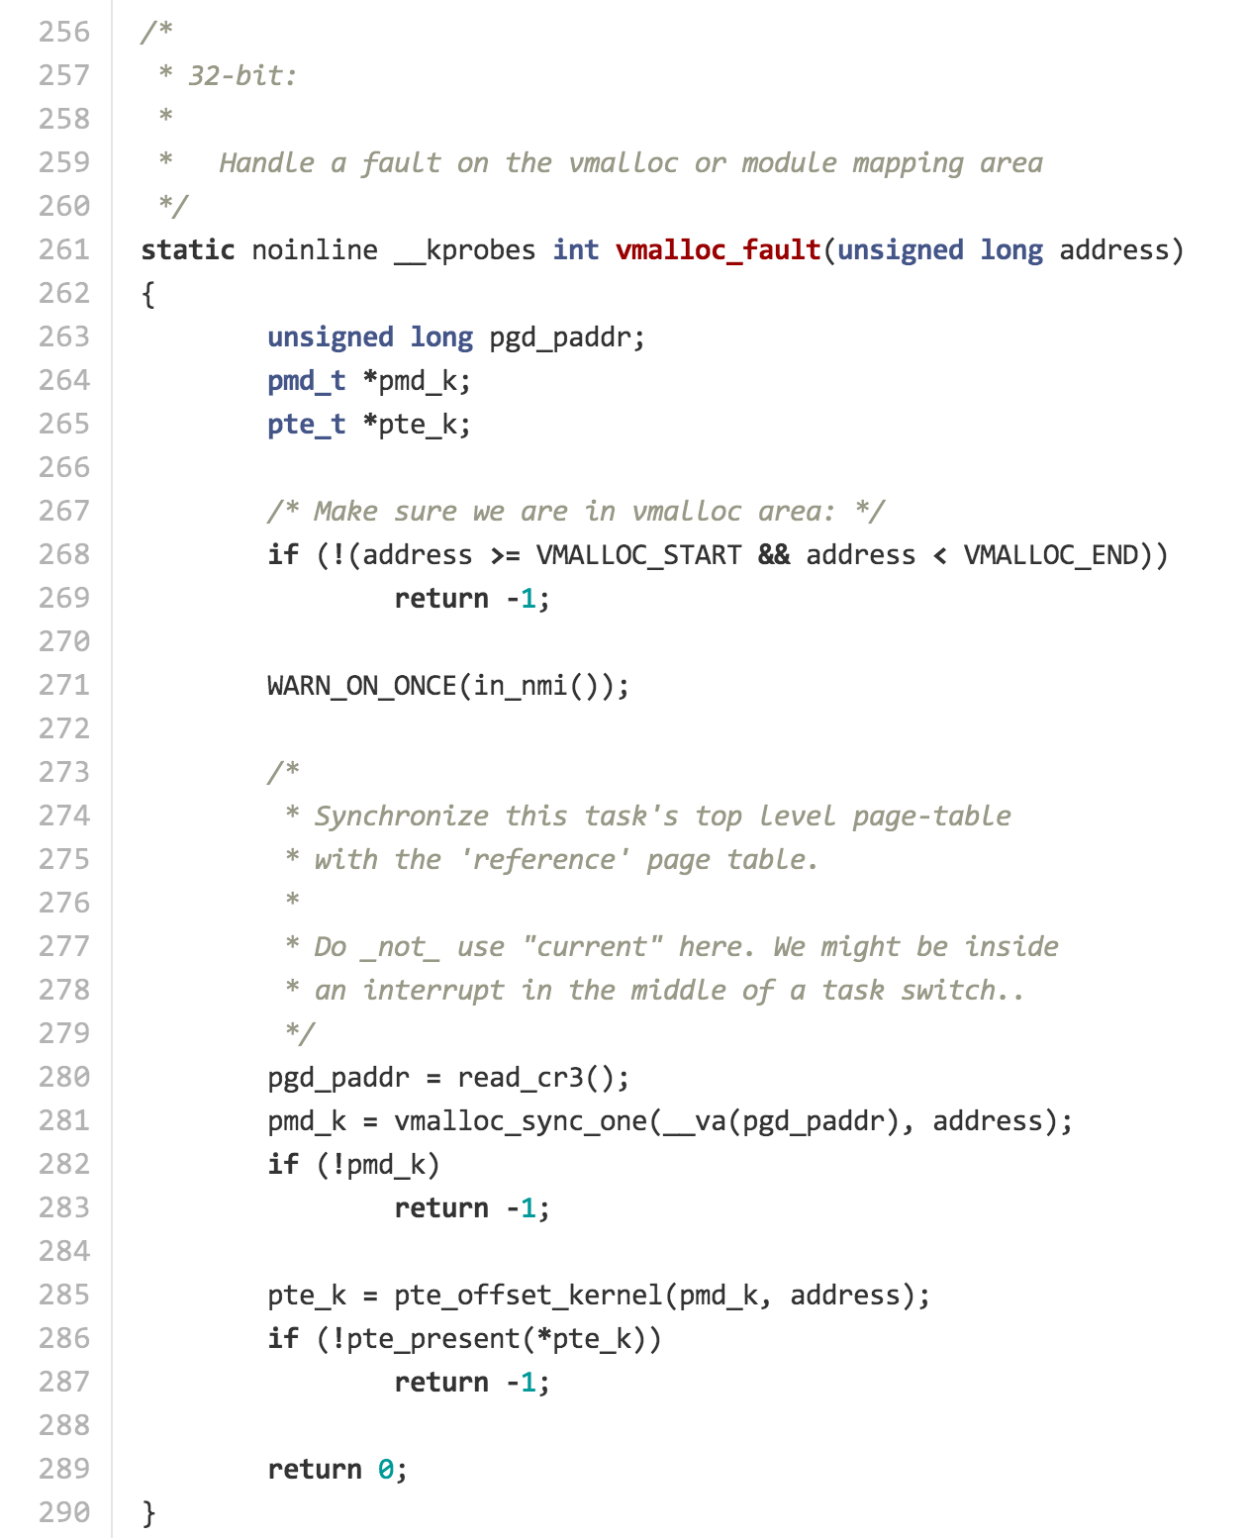

Slide 52
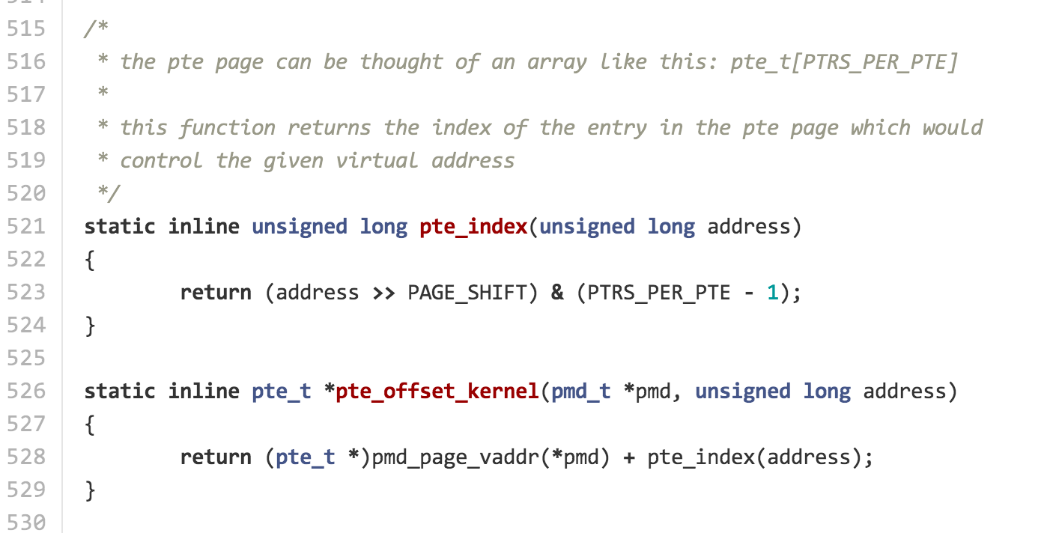
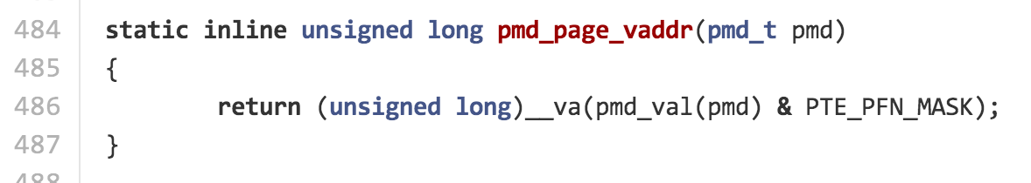
arch/x86/include/asm/pgtable.h

Slide 53
TLB
Segmentation Unit
Paging
Unit
Memory
Logical Address
Linear Address
Physical Address
32-bit linear address
What does the kernel need to do to flush the TLB?
CR3
Dir
Page
Offset
10 bits
(1K tables)
10 bits
(1K entries)
12 bits
(4K pages)
Page Directory
Page Table
Page Entry
CR3+Dir

Slide 54
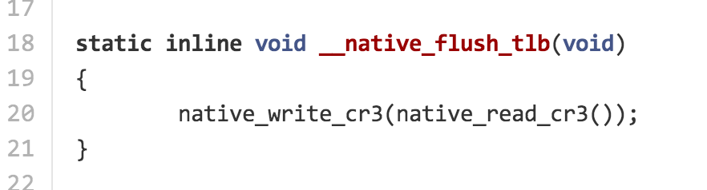
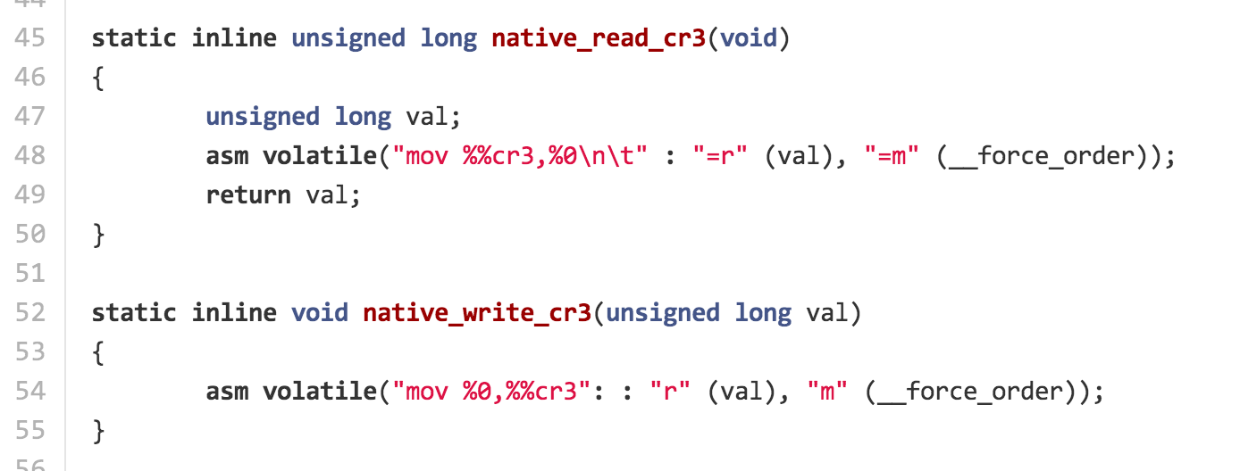
arch/x86/include/asm/tlbflush.h
arch/x86/include/asm/special_insns.h

Slide 55
Charge
Progress updates and scheduling design reviews will be due Sunday 11:59pm
Tuesday’s Class:
Yuchen Zhou on Authentication using Single Sign-On

Slide 56
static struct task_struct *dup_task_struct(struct task_struct *orig)
{
...
clear_tsk_need_resched(tsk);
stackend = end_of_stack(tsk);
*stackend = STACK_END_MAGIC; /* for overflow detection */
#ifdef CONFIG_CC_STACKPROTECTOR
tsk->stack_canary = get_random_int();
#endif
/*
* One for us, one for whoever does the "release_task()" (usually
* parent)
*/
atomic_set(&tsk->usage, 2);
#ifdef CONFIG_BLK_DEV_IO_TRACE
tsk->btrace_seq = 0;
#endif
tsk->splice_pipe = NULL;
tsk->task_frag.page = NULL;
account_kernel_stack(ti, 1);
return tsk;
free_ti:
free_thread_info(ti);
free_tsk:
free_task_struct(tsk);
return NULL;
}
include/asm-generic/atomic.h
/**
* atomic_set - set atomic variable
* @v: pointer of type atomic_t
* @i: required value
*
* Atomically sets the value of @v to @i.
*/
#define atomic_set(v, i) (((v)->counter) = (i))
in include/linux/types.h
typedef struct {
int counter;
} atomic_t;

Slide 57
static struct task_struct *copy_process(...)
{
...
retval = -ENOMEM;
p = dup_task_struct(current);
if (!p)
goto fork_out;
ftrace_graph_init_task(p);
get_seccomp_filter(p);
rt_mutex_init_task(p);
#ifdef CONFIG_PROVE_LOCKING
DEBUG_LOCKS_WARN_ON(!p->hardirqs_enabled);
DEBUG_LOCKS_WARN_ON(!p->softirqs_enabled);
#endif
retval = -EAGAIN;
if (atomic_read(&p->real_cred->user->processes) >=
task_rlimit(p, RLIMIT_NPROC)) {
if (p->real_cred->user != INIT_USER &&
!capable(CAP_SYS_RESOURCE) && !capable(CAP_SYS_ADMIN))
goto bad_fork_free;
}
...
}

Slide 58
static struct task_struct *copy_process(...)
{
...
retval = -ENOMEM;
p = dup_task_struct(current);
if (!p)
goto fork_out;
ftrace_graph_init_task(p);
get_seccomp_filter(p);
rt_mutex_init_task(p);
#ifdef CONFIG_PROVE_LOCKING
DEBUG_LOCKS_WARN_ON(!p->hardirqs_enabled);
DEBUG_LOCKS_WARN_ON(!p->softirqs_enabled);
#endif
retval = -EAGAIN;
if (atomic_read(&p->real_cred->user->processes) >=
task_rlimit(p, RLIMIT_NPROC)) {
if (p->real_cred->user != INIT_USER &&
!capable(CAP_SYS_RESOURCE) && !capable(CAP_SYS_ADMIN))
goto bad_fork_free;
}
...
}
static void rt_mutex_init_task(struct task_struct *p)
{
raw_spin_lock_init(&p->pi_lock);
#ifdef CONFIG_RT_MUTEXES
plist_head_init(&p->pi_waiters);
p->pi_blocked_on = NULL;
#endif
}

Slide 59
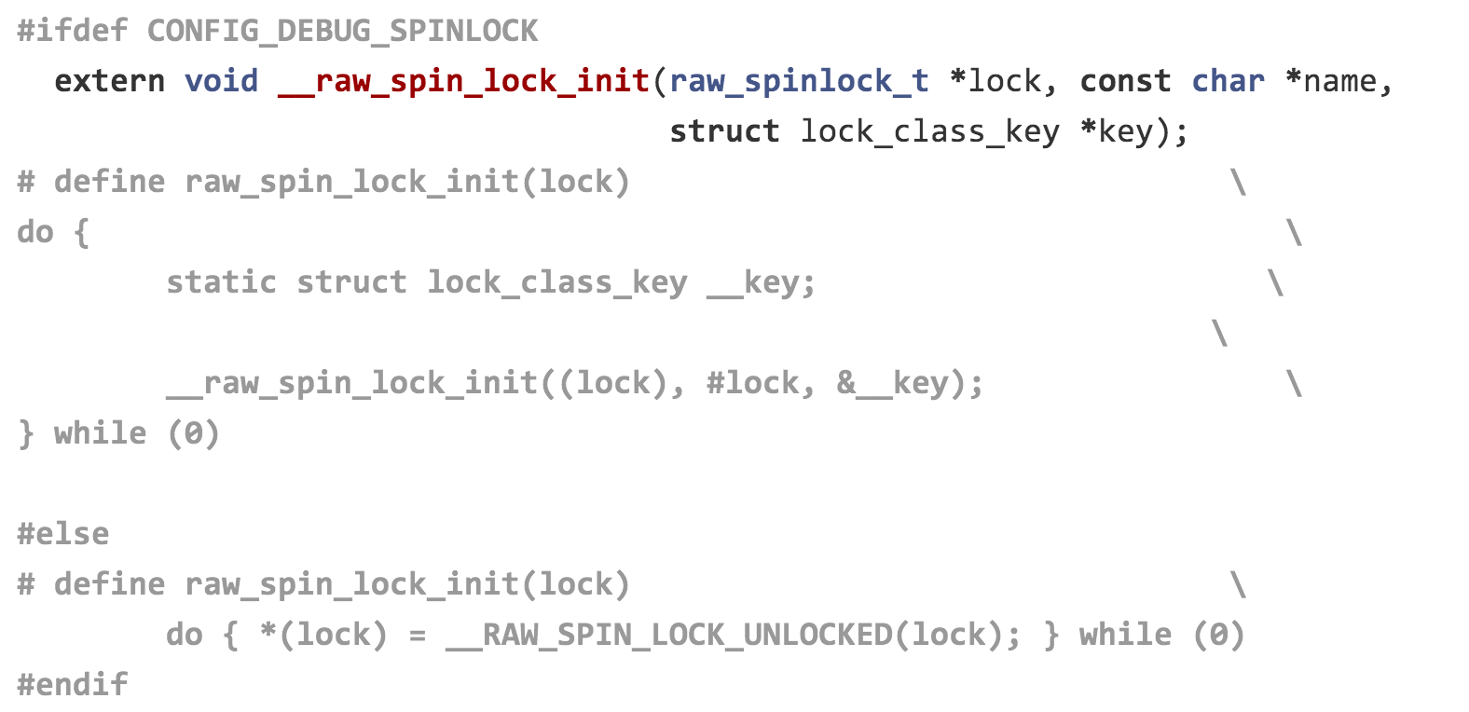
include/linux/spinlock.h

Slide 60
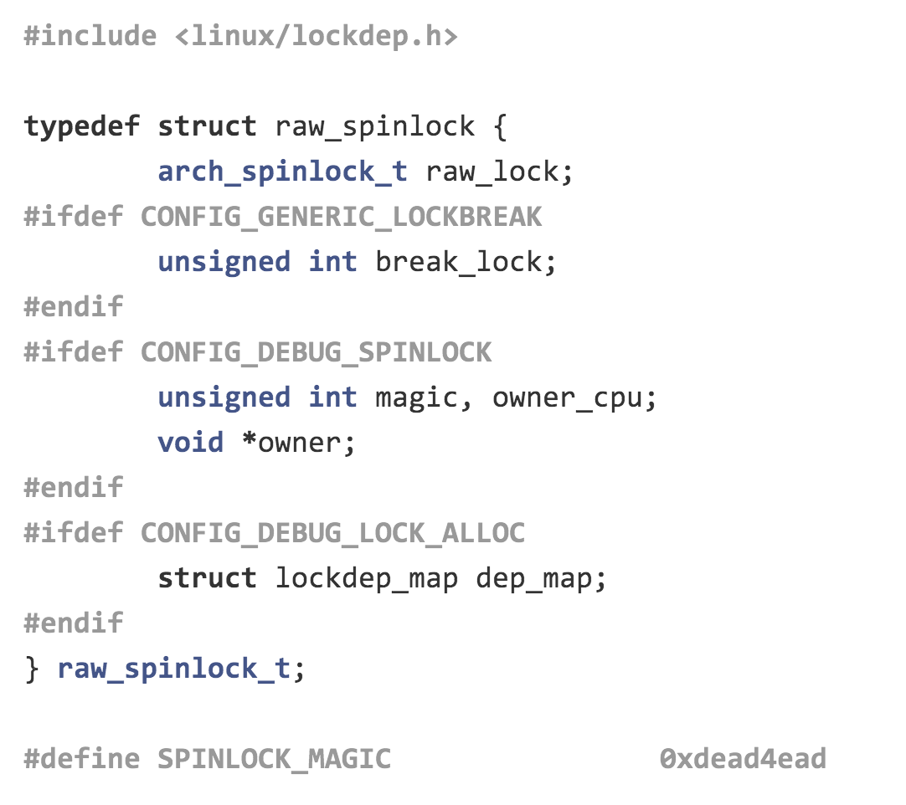
Not all magic is in magic.h!

Slide 61
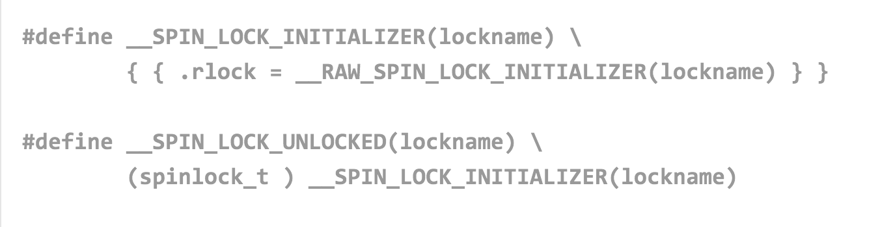
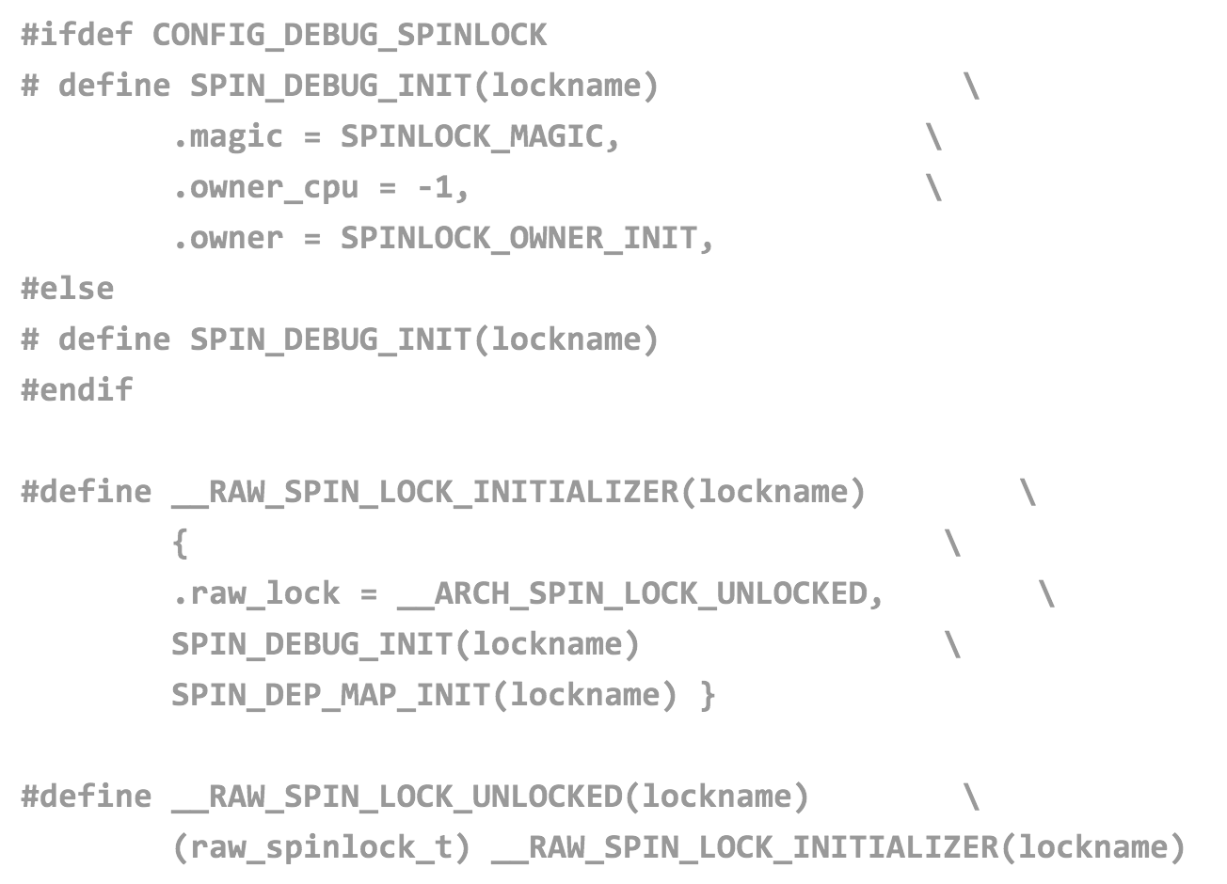

Slide 62
static struct task_struct *copy_process(...)
{
...
retval = -ENOMEM;
p = dup_task_struct(current);
if (!p)
goto fork_out;
ftrace_graph_init_task(p);
get_seccomp_filter(p);
rt_mutex_init_task(p);
#ifdef CONFIG_PROVE_LOCKING
DEBUG_LOCKS_WARN_ON(!p->hardirqs_enabled);
DEBUG_LOCKS_WARN_ON(!p->softirqs_enabled);
#endif
retval = -EAGAIN;
if (atomic_read(&p->real_cred->user->processes) >=
task_rlimit(p, RLIMIT_NPROC)) {
if (p->real_cred->user != INIT_USER &&
!capable(CAP_SYS_RESOURCE) && !capable(CAP_SYS_ADMIN))
goto bad_fork_free;
}
...
}
RLIMIT_NPROC – limit on the number of threads a user process can create

