Slide 1
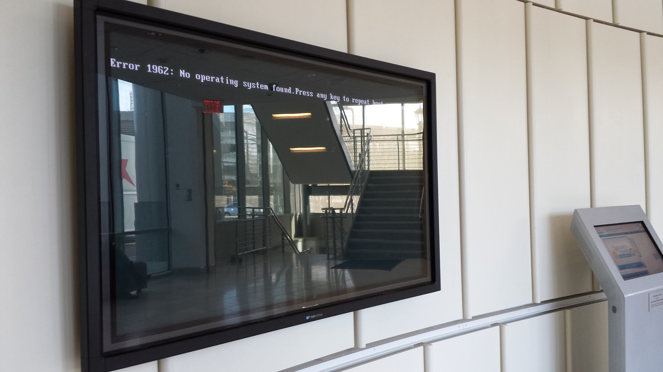
Class 22: Microkernels and Beyond
cs4414 Spring 2014
University of Virginia
David Evans

Slide 2
Plan for Today
Microkernels
L4
Exokernels
Reminder: don’t forget to sign up for your project submission/presentation option

Slide 3
From Class 3:
From: torv...@klaava.Helsinki.FI (Linus Benedict Torvalds)
Newsgroups: comp.os.minix
Subject: Re: LINUX is obsolete
Date: 31 Jan 92 10:33:23 GMT
…
>I still maintain the point that designing a monolithic kernel in 1991 is
>a fundamental error. Be thankful you are not my student. You would
>not get a high grade for such a design :-)
Well, I probably won't get too good grades even without you: I had an
argument (completely unrelated - not even pertaining to OS's) with the
person here at the university that teaches OS design. I wonder when
I'll learn :)
…
Andy Tanenbaum

Slide 4
Should a file system be in the kernel?

Slide 5
User Mode
Application
Application
Syscall Handler
File System
Device Drivers
Scheduler
Memory Manager
File System
Device Drivers
I/O Device
Display Device
User Mode
Minimal Kernel
Hardware
Hardware
Kernel Mode
Monolithic Kernel
Microkernel

Slide 6
What must be in the minimal kernel?
Application
File System
Device Drivers
I/O Device
Display Device
User Mode
Minimal Kernel
Hardware
Kernel Mode
Microkernel

Slide 7
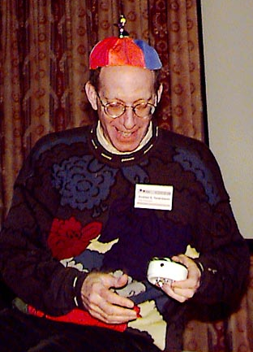
From: ast@cs.vu.nl (Andy Tanenbaum)
Newsgroups: comp.os.minix
Subject: LINUX is obsolete
Date: 29 Jan 92 12:12:50 GMT
I was in the U.S. for a couple of weeks, so I haven't commented much on LINUX (not that I would have said much had I been around), but for what it is worth, I have a couple of comments now.
As most of you know, for me MINIX is a hobby, something that I do in the evening when I get bored writing books and there are no major wars, revolutions, or senate hearings being televised live on CNN. My real job is a professor and researcher in the area of operating systems.
As a result of my occupation, I think I know a bit about where operating are going in the next decade or so. Two aspects stand out:
(Picture from 1998)

Slide 8
1. MICROKERNEL VS MONOLITHIC SYSTEM
Most older operating systems are monolithic, that is, the whole operating system is a single a.out file that runs in 'kernel mode.' This binary contains the process management, memory management, file system and the rest. Examples of such systems are UNIX, MS-DOS, VMS, MVS, OS/360, MULTICS, and many more.
The alternative is a microkernel-based system, in which most of the OS runs as separate processes, mostly outside the kernel. They communicate by message passing. The kernel’s job is to handle the message passing, interrupt handling, low-level process management, and possibly the I/O. Examples of this design are the RC4000, Amoeba, Chorus, Mach, and the not-yet-released Windows/NT.
While I could go into a long story here about the relative merits of the two designs, suffice it to say that among the people who actually design operating systems, the debate is essentially over. Microkernels have won.

Slide 9
Why didn’t microkernels actually win?
Application
Application
Syscall Handler
File System
Device Drivers
Scheduler
Memory Manager
File System
Device Drivers
I/O Device
Display Device
User Mode
Minimal Kernel
Hardware
Hardware
Kernel Mode
Monolithic Kernel
Microkernel

Slide 10
What is hard about making microkernels work?
Application
File System
Device Drivers
I/O Device
Display Device
User Mode
Minimal Kernel
Hardware
Kernel Mode
Microkernel

Slide 11
What is hard about making microkernels work?
Application
fopen
File System
Device Drivers
I/O Device
Display Device
Inter-process Communication
(IPC)
User Mode
Minimal Kernel
Hardware
Kernel Mode
Microkernel

Slide 12
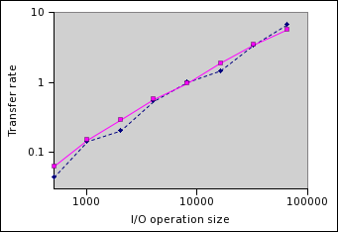
Comparing Linux and Minix Performance
MB/s
“The IOtest read test simply performs random reads of varying sizes.”
Linux
Minix
LWN.net, 5 Feb 2007

Slide 13
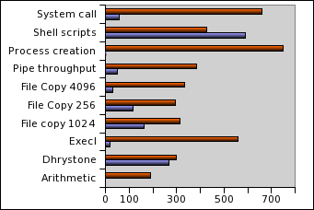
Really Comparing Linux and Minix
Minix
Linux
Linux is 8-50 times faster for things that matter!
LWN.net, 5 Feb 2007
“Throughput” (Indexed)

Slide 14

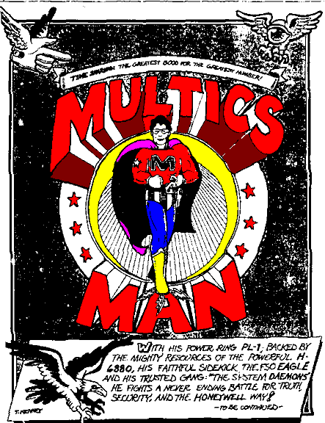

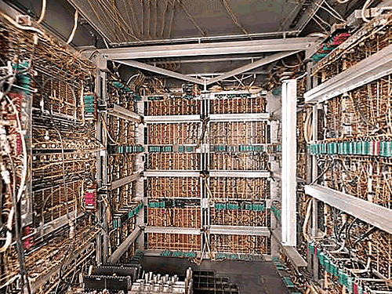
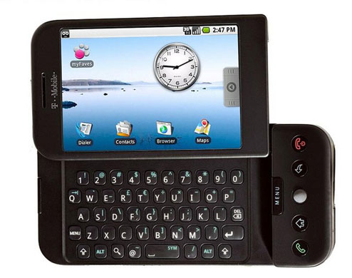
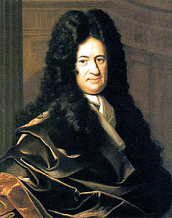

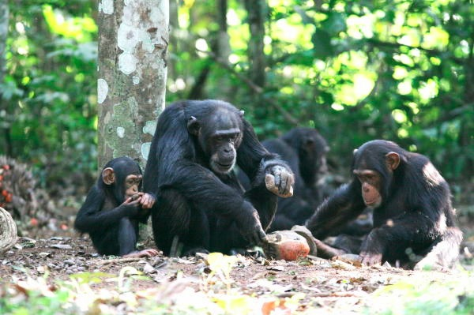
Did microkernels actually lose?
From Class 3:
1 000 000 000
Android Activations
Open Source OS, runs on cheap machines
Cheaper, faster, low-energy processors, Internet, web, $$$
Practical Universal Machines
Abstractions
Modern OS
Programmable Machines
Recursive Language
Tools
Altruism
Universe
S ::= NP V O
NP ::= N and NP
Monolithic Kernels
-13.8B
-5M
-300K
1679
1945
1950s
1969
1993
2008
2013
“Microkernels have won.”
1992

Slide 15
Did microkernels actually lose?
1 000 000 000
Android Activations
Open Source OS, runs on cheap machines
Cheaper, faster, low-energy processors, Internet, web, $$$
Practical Universal Machines
Abstractions
Modern OS
Programmable Machines
Recursive Language
Tools
Altruism
Universe
S ::= NP V O
NP ::= N and NP
Monolithic Kernels
-13.8B
-5M
-300K
1679
1945
1950s
1969
1993
2008
2013
“Microkernels have won.”
1992

Slide 16



> 1B Windows
machines in 2011
1B Android Activations
Sep 2013
1993
Open Source OS, runs on cheap machines
Cheaper, faster, low-energy processors, Internet, web, $$$
Practical Universal Machines
Abstractions
Modern OS
Programmable Machines
Tools
Altruism
Recursive Language
Universe
S ::= NP V O
NP ::= N and NP
-13.8B
-5M
-300K
1679
1945
1950s
1969
1993
2008
2013

Slide 17
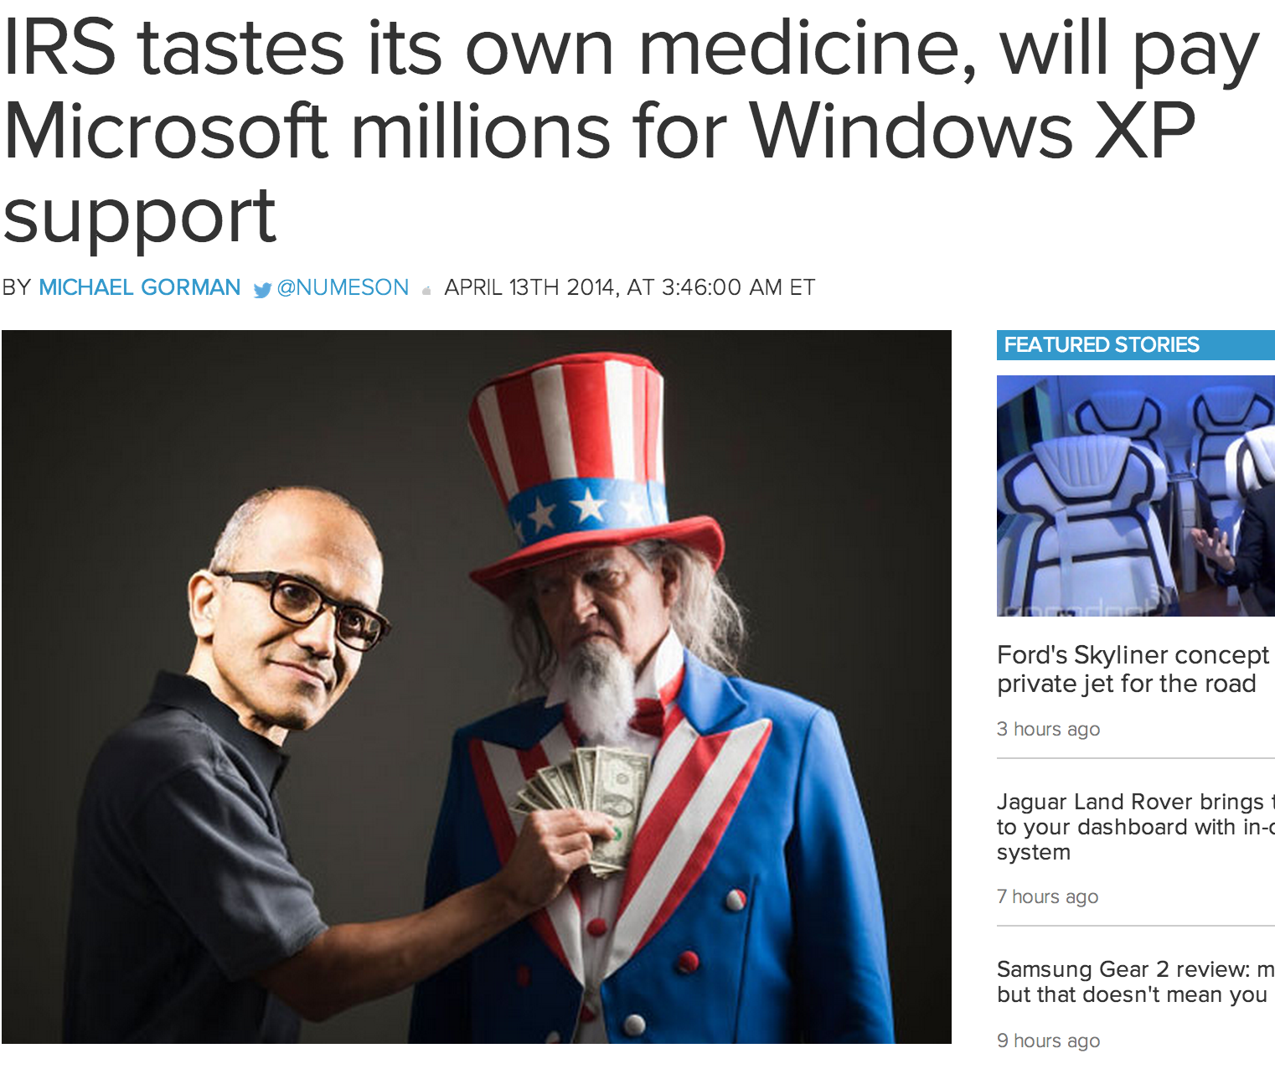
Is Windows NT/XP/7/8 really a microkernel?

Slide 18
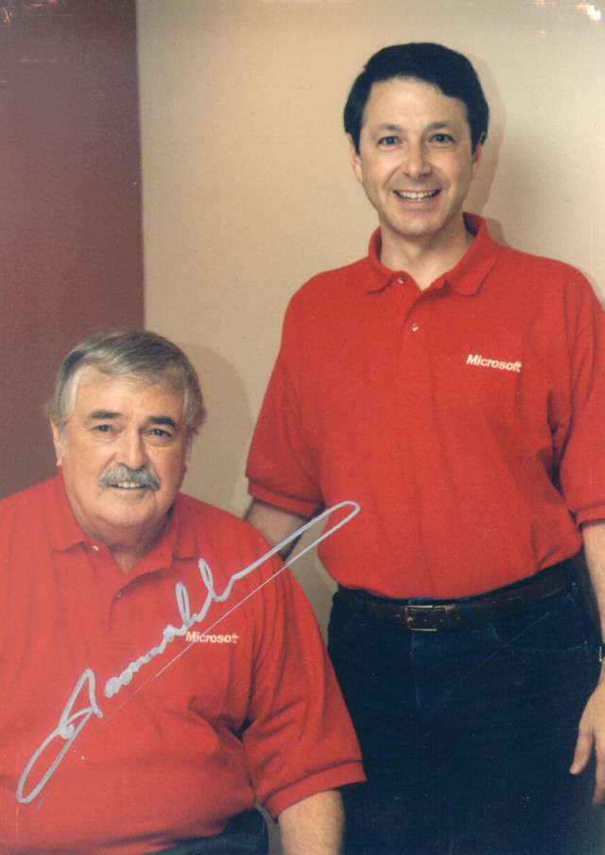
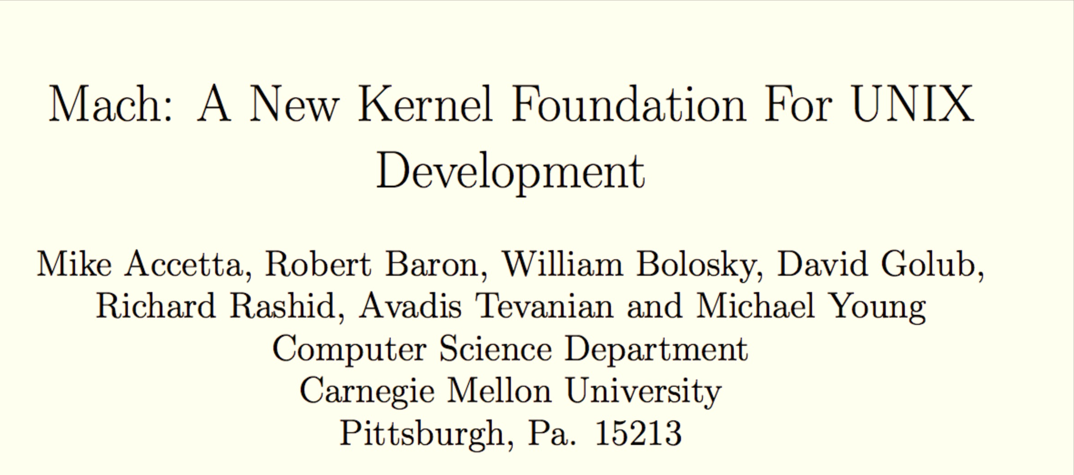
Is Windows NT/XP/7/8 really a microkernel?
Summer 1986 USENIX Conference

Slide 19
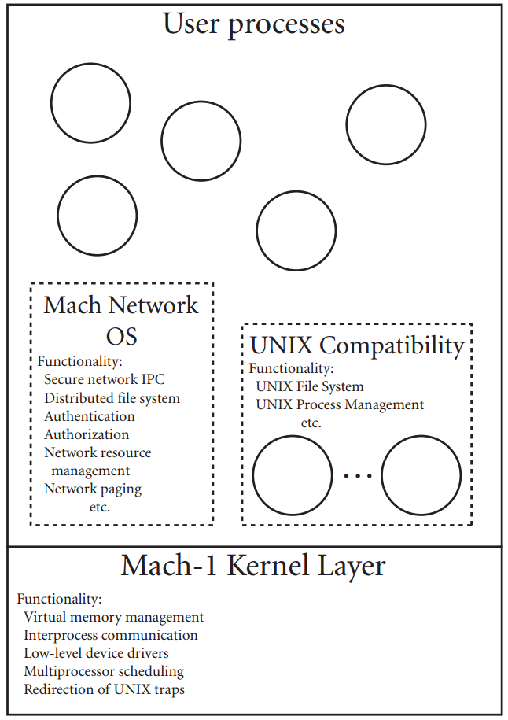
Summer 1986 USENIX Conference

Slide 20
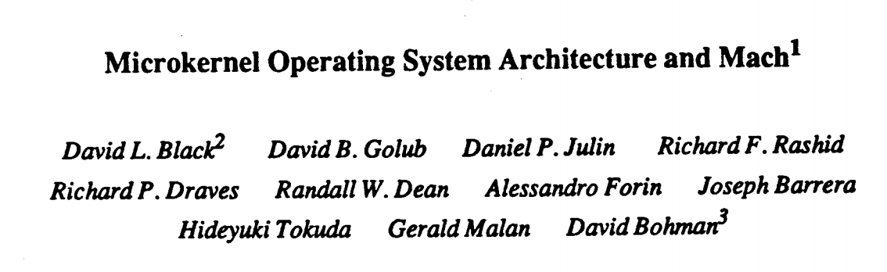
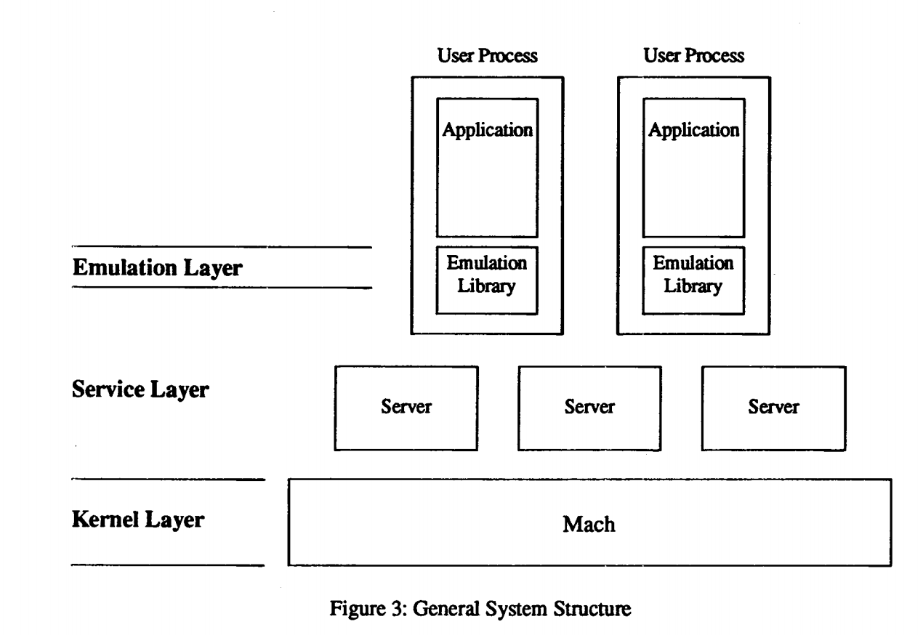
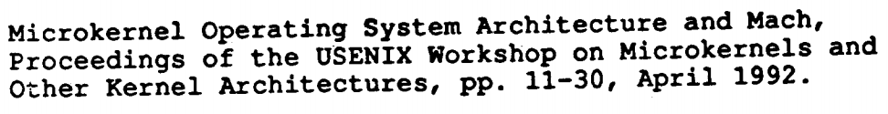

Slide 21
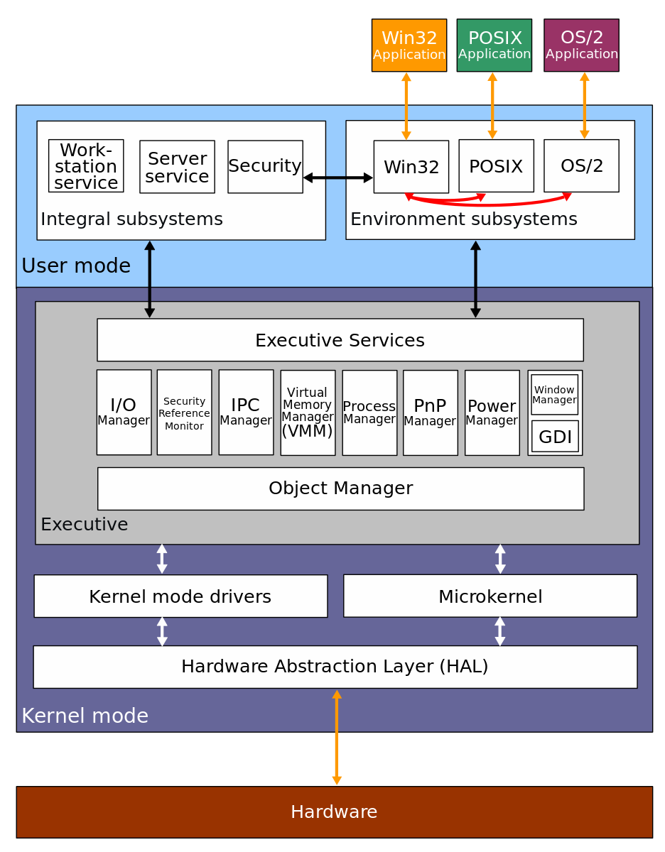
Is Windows NT/XP/7/8 really a microkernel?

Slide 22
1B Android Activations
Sep 2013
Open Source OS, runs on cheap machines
Cheaper, faster, low-energy processors, Internet, web, $$$
Practical Universal Machines
Abstractions
Modern OS
Programmable Machines
Tools
Altruism
Recursive Language
Universe
S ::= NP V O
NP ::= N and NP
-13.8B
-5M
-300K
1679
1945
1950s
1969
1993
2008
2013

Slide 23
1.5B L4 Microkernel Systems
Jan 2012
1B Android Activations
Sep 2013
Open Source OS, runs on cheap machines
Cheaper, faster, low-energy processors, Internet, web, $$$
Practical Universal Machines
Abstractions
Modern OS
Programmable Machines
Tools
Altruism
Recursive Language
Universe
S ::= NP V O
NP ::= N and NP
-13.8B
-5M
-300K
1679
1945
1950s
1969
1993
2008
2013

Slide 24
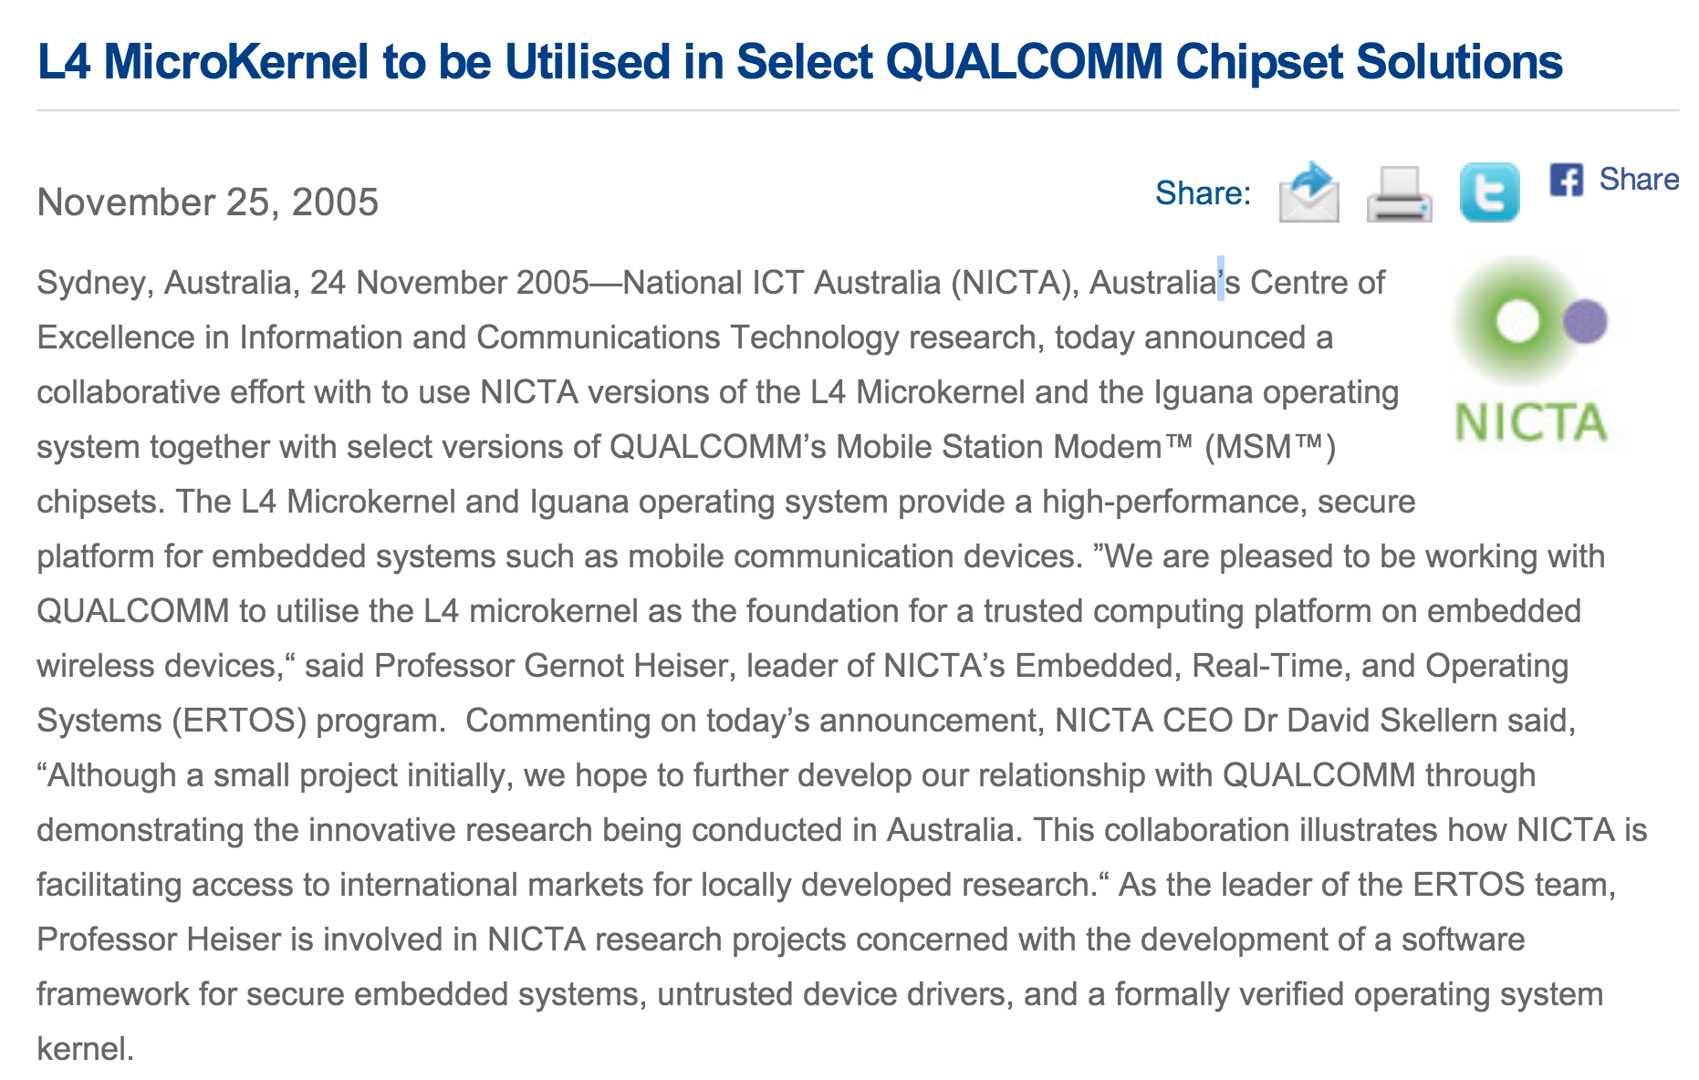

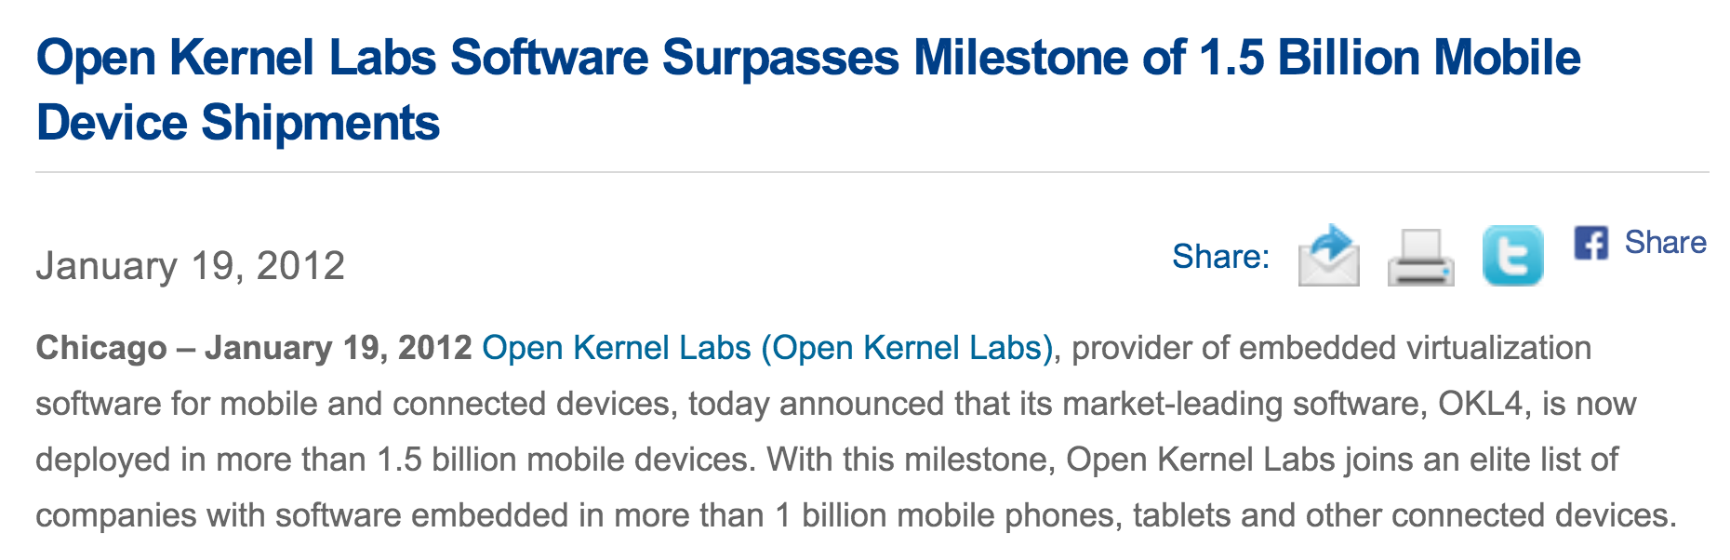

Slide 25
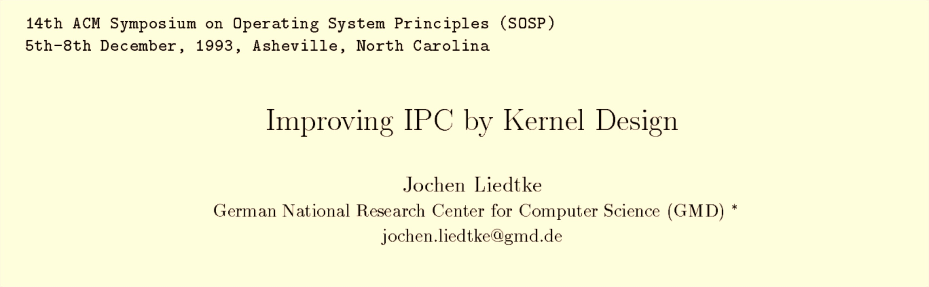
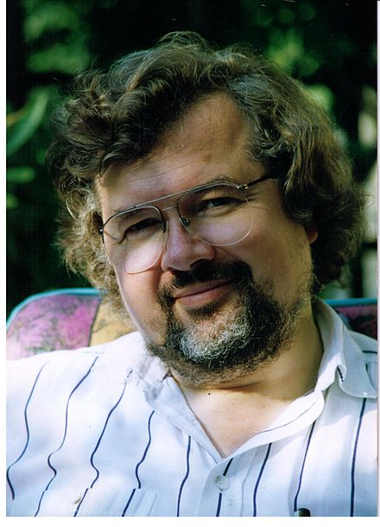
1953-10 June 2001

Slide 26
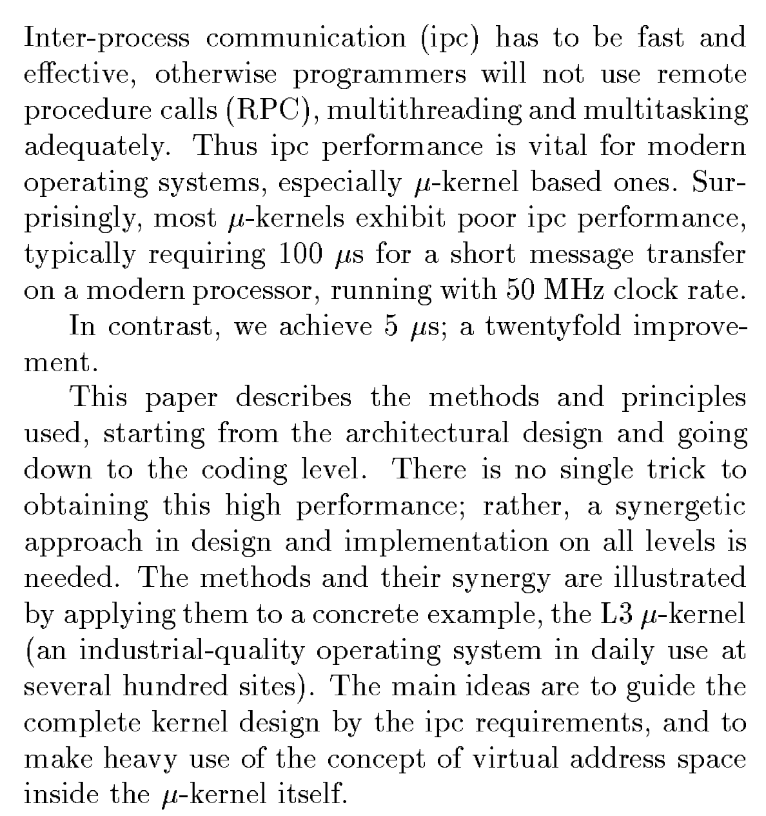

Slide 27
L3 Abstractions
Task
Threads: each has global, unique ID
Own Address Space
Shared data spaces
Message
From: thread ID
To: thread ID
Direct/Indirect String
Data (optional)
Microkernel
Manages Tasks
Sends messages between tasks

Slide 28
L3 Abstractions
Task
Threads: each has global, unique ID
Own Address Space
Shared data spaces
Message
From: thread ID
To: thread ID
Direct/Indirect String
Data (optional)
Microkernel
Manages Tasks
Sends messages between tasks
What is a hardware interrupt in L3?

Slide 29
Minimal IPC
Task A
Task B
Thread A1
Thread B1
Message
Kernel

Slide 30
Minimal IPC
Task A
Task B
Thread A1
Thread B1
load B1 ID
load message
call kernel
Kernel

Slide 31
Minimal IPC
Task A
Task B
Thread A1
Thread B1
load B1 ID
load message
call kernel
9. receive
4. access Thread B1
5. switch stack pointer
6. switch address space
7. load A’s ID
8. return to user mode
Kernel

Slide 32
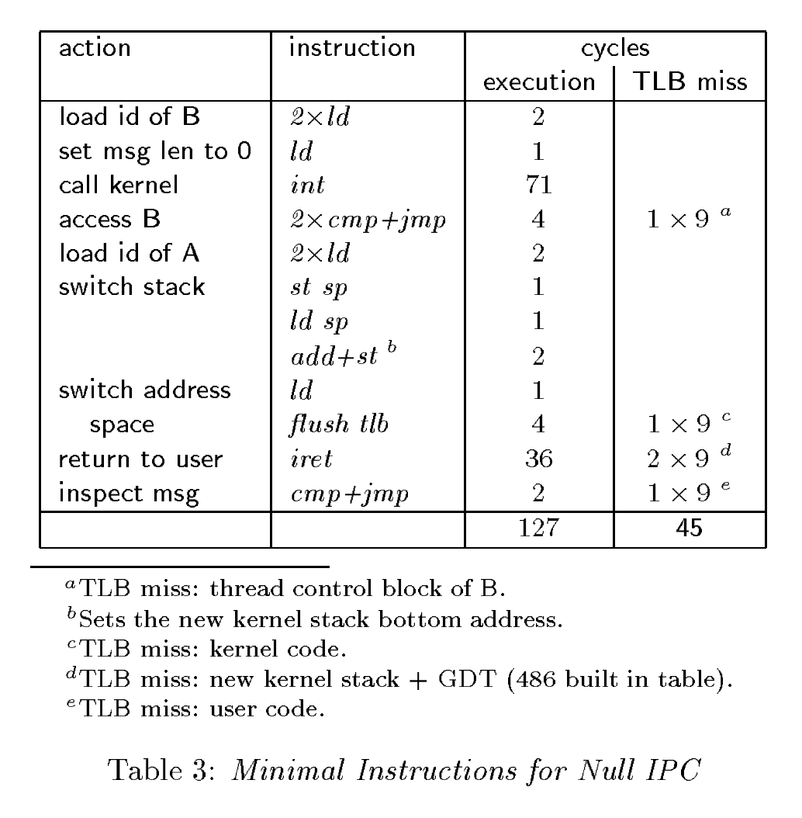
Implementation
Task A
Task B
load B1 ID
load message
call kernel
9. receive
4. access Thread B1
5. switch stack pointer
6. switch address space
7. load A’s ID
8. return to user mode
Kernel

Slide 33
Implementation
Task A
Task B
load B1 ID
load message
call kernel
9. receive
4. access Thread B1
5. switch stack pointer
6. switch address space
7. load A’s ID
8. return to user mode
Kernel

Slide 34
Implementation
What does this minimal implementation rely on?
Task A
Task B
load B1 ID
load message
call kernel
9. receive
4. access Thread B1
5. switch stack pointer
6. switch address space
7. load A’s ID
8. return to user mode
Kernel

Slide 35
Implementation
What does this minimal implementation rely on?
Task A
Task B
load B1 ID
load message
call kernel
Synchronous:
Receiving thread is waiting
Sender waits until reply
No timeouts: all IPC calls must guarantee termination
9. receive
4. access Thread B1
5. switch stack pointer
6. switch address space
7. load A’s ID
8. return to user mode
Kernel

Slide 36
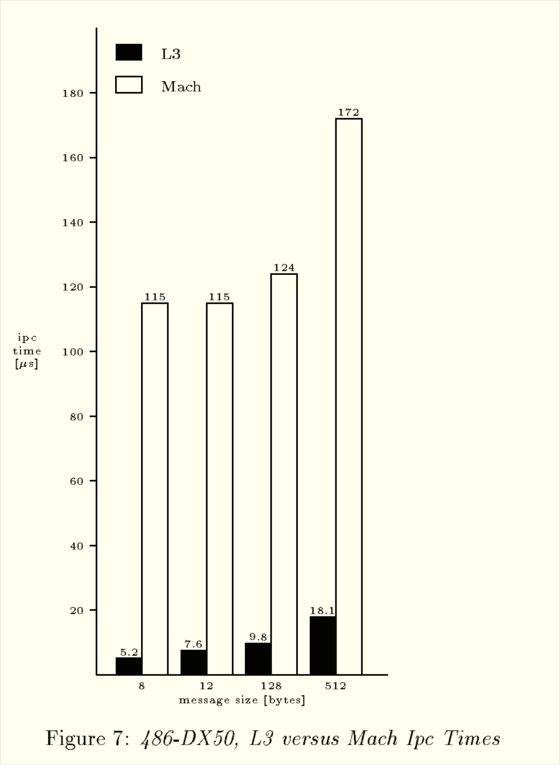
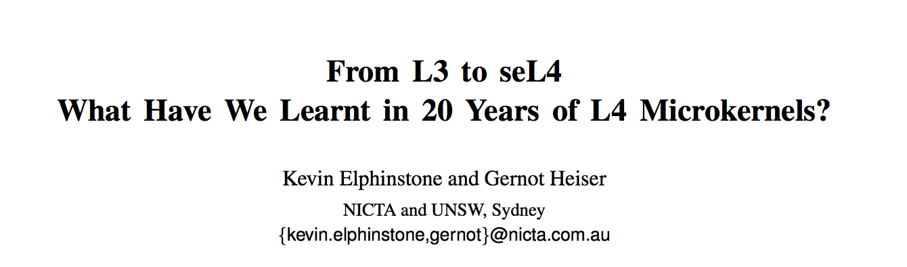
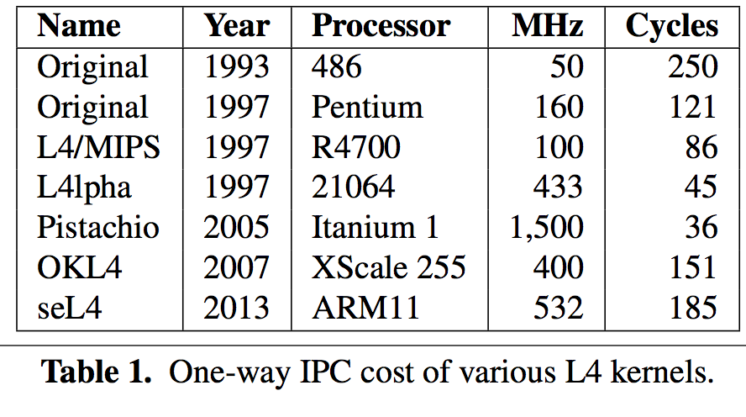

Slide 37
What if the message has data?
Task A
Screen Driver
“Hello L3!”
Thread A1
Thread B1
load B1 ID
load message
call kernel
9. receive
display “Hello L3!”
4. access Thread B1
5. switch stack pointer
6. switch address space
7. load A’s ID
8. return to user mode
Kernel

Slide 38
Copy Through Kernel
Task A
Screen Driver
“Hello L3!”
Thread A1
Thread B1
“Hello L3!”
load B1 ID
load message
call kernel
9. receive
display “Hello L3!”
4. access Thread B1
5. switch stack pointer
6. switch address space
7. load A’s ID
8. return to user mode
Kernel
“Hello L3!”

Slide 39
Copy Direct
Task A
Screen Driver
“Hello L3!”
“Hello L3!”
Thread A1
0. set up receive buffer
load B1 ID
load message
call kernel
Thread B1
9. receive
4. access Thread B1
5. switch stack pointer
6. switch address space
7. load A’s ID
8. return to user mode
Kernel

Slide 40
OS Design Tradeoffs
Monolithic (e.g., Linux)
Microkernel (e.g., L4)

Slide 41
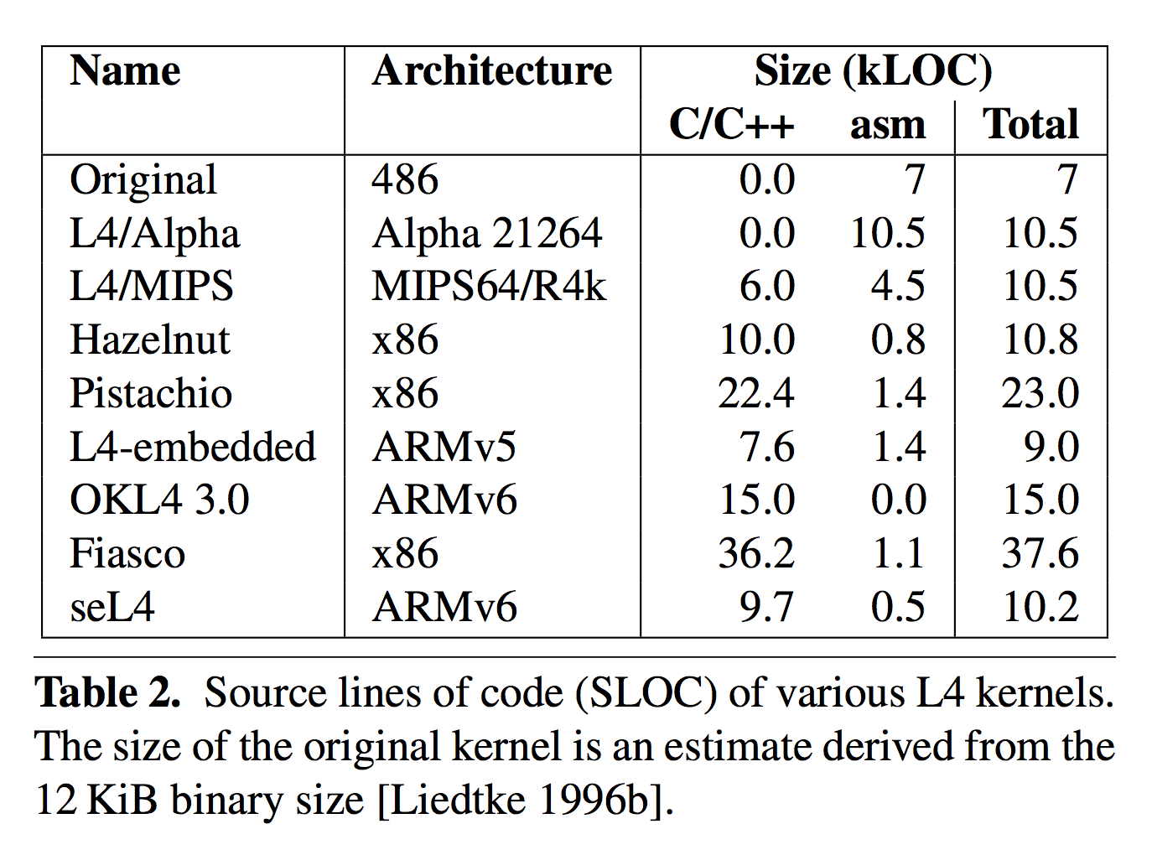
Biggest Advantage of Microkernels
Windows NT 3.1: 5M LOC
Linux kernel 3.6: 16M LOC
IronKernel:
9.8K lines of Rust
+ 273 lines of asm
rust-core: 6.5K

Slide 42
Biggest Advantage of Microkernels
IronKernel:
9.8K lines of Rust + 273 lines of asm
rust-core: 6.5K
arch: 2.1K (1.7K is font.rs)
kernel: 1178
63 fs.rs
38 int.rs
95 mod.rs
10 ptr.rs
351 rt.rs
343 sgash.rs (46 for printing logo!)
278 memory/*.rs

Slide 43
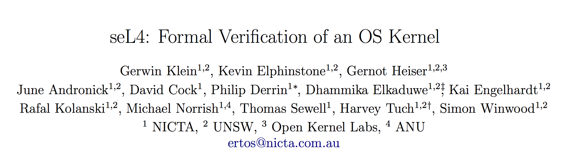
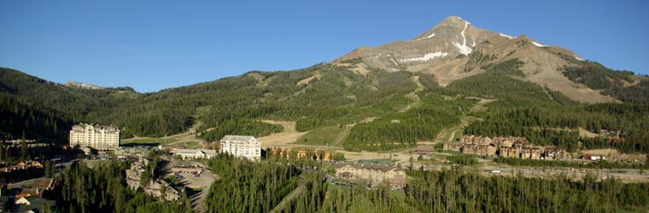
SOSP 2009

Slide 44
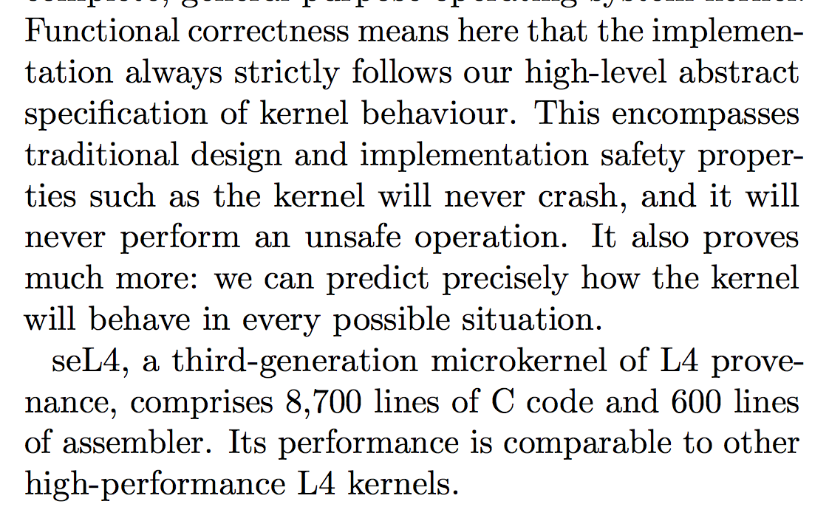
Size of code: 8,700 lines (2 person-months)
Size of proof: 200,000 lines (20 person-years ~ 11)

Slide 45
What should the specification for the scheduler look like?

Slide 46
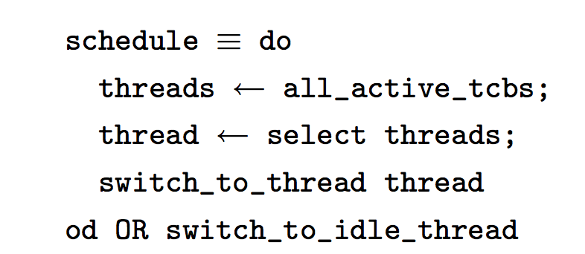
What should the specification for the scheduler look like?
Isabelle/HOL
scheduler spec

Slide 47
Application
Application
Application 2 (+ libraries)
Application 1
(+ libraries)
Syscall Handler
File System
Device Drivers
Scheduler
Memory Manager
File System
Device Drivers
I/O Device
Display Device
User Mode
User Mode
Minimal Kernel
Really Minimal Kernel
Hardware
Hardware
Kernel Mode
Hardware
Kernel Mode
Monolithic Kernel
Microkernel
Exokernel

Slide 48
Definition from Class 1:
An operating system is a program that manages resources and provides abstractions.

Slide 49
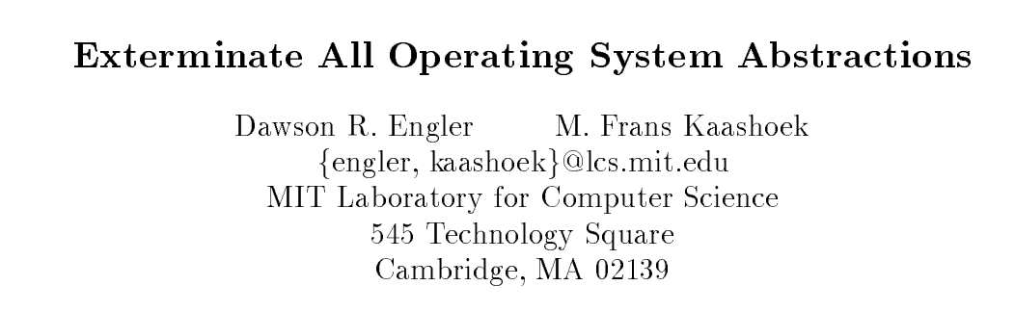

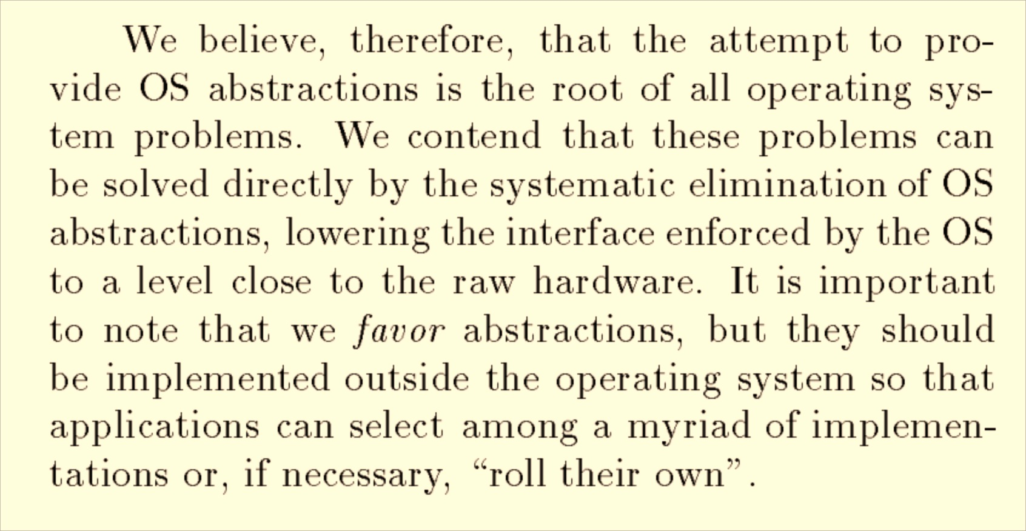
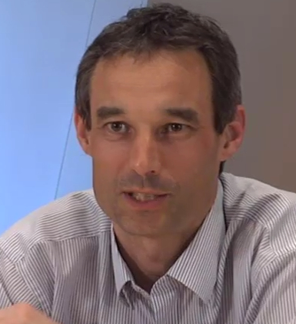
HotOS 1995

Slide 50
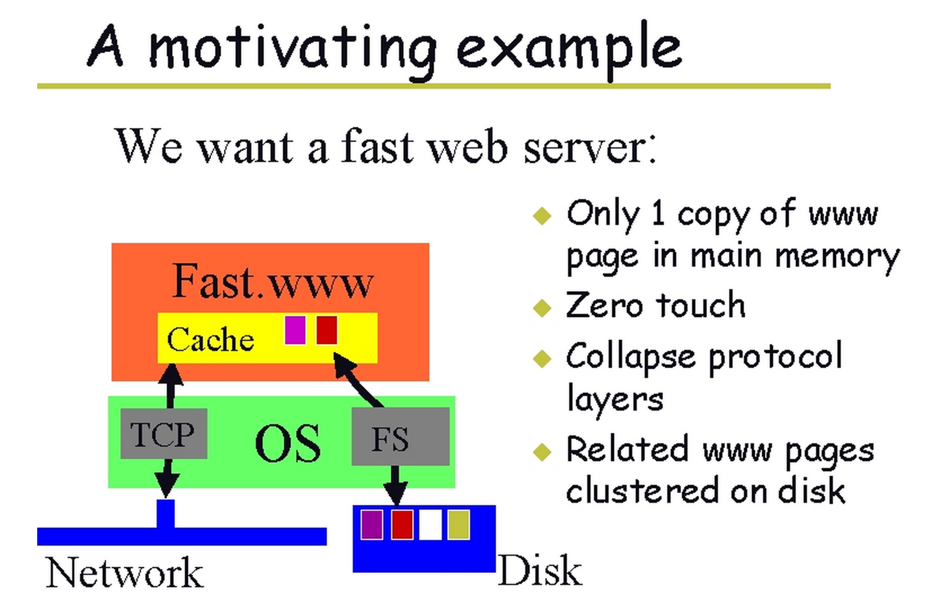
Slide from
Exokernels (or, making the operating system just another application library)
Dawson Engler
Frans Kaashoek
Greg Ganger
H. Briceño
R. Hunt
D. Mazières
T. Pinckney
J. Jannotti

Slide 51
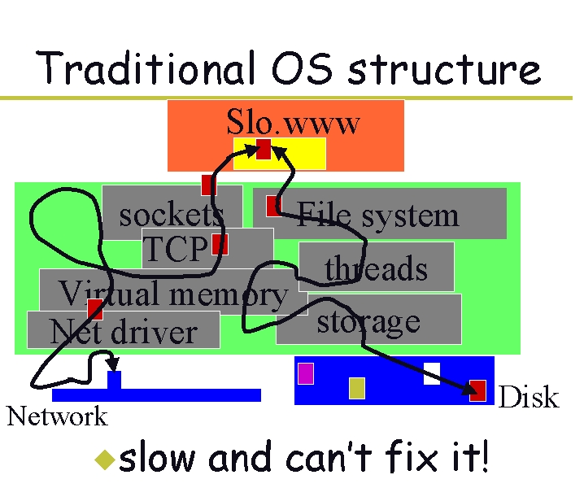

Slide 52
Multiplexing Resources
Application 2 (+ libraries)
Application 1
(+ libraries)
User Mode
Really Minimal Kernel
Kernel Mode
Hardware
Exokernel

Slide 53
Multiplexing Resources
Application 2 (+ libraries)
Application 1
(+ libraries)
User Mode
CPU Core: time share
Memory: share by allocating pages to processes
Persistent Storage (Disk): divide into blocks
Really Minimal Kernel
Kernel Mode
Hardware
How should exokernel decide if a process can read a disk block?
Exokernel

Slide 54
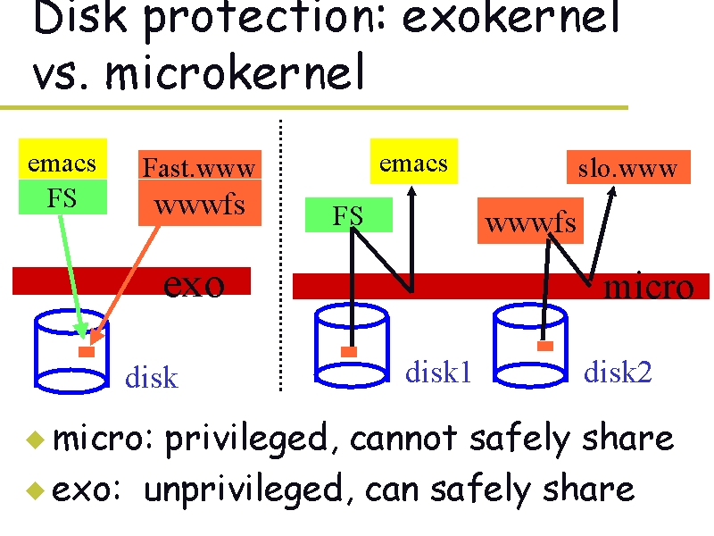
Kernel can query FS:
owns(meta) := set of blocks
owned by meta
Must be deterministic and persistent
Kernel checks after any modification!

Slide 55
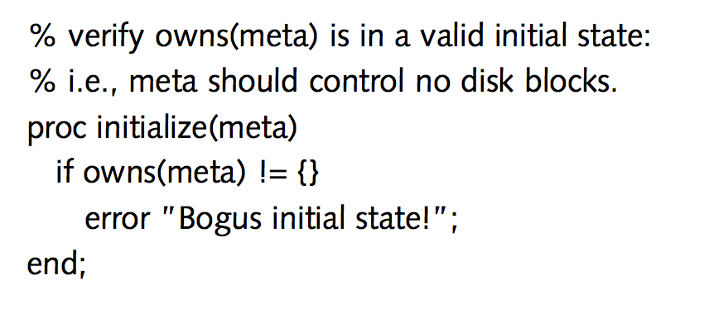
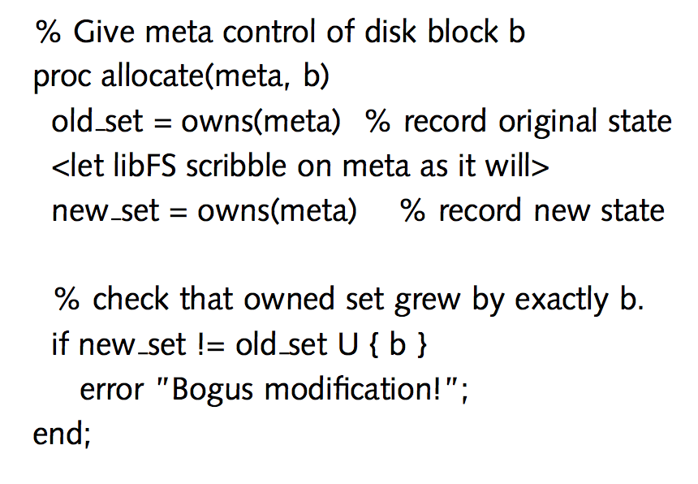
Examples from Dawson Engler’s PhD Thesis

Slide 56
1.5B L4 Microkernel Systems
Jan 2012
How many exokernels?
1B Android Activations
Sep 2013
Open Source OS, runs on cheap machines
Cheaper, faster, low-energy processors, Internet, web, $$$
Practical Universal Machines
Abstractions
Modern OS
Programmable Machines
Tools
Altruism
Recursive Language
Universe
S ::= NP V O
NP ::= N and NP
-13.8B
-5M
-300K
1679
1945
1950s
1969
1993
2008
2013

Slide 57




Companies (intellectually) derived from exokernel project:
1.5B L4 Microkernel Systems
Jan 2012
1B Android Activations
Sep 2013
Open Source OS, runs on cheap machines
Cheaper, faster, low-energy processors, Internet, web, $$$
Practical Universal Machines
Abstractions
Modern OS
Programmable Machines
Tools
Altruism
Recursive Language
Universe
S ::= NP V O
NP ::= N and NP
-13.8B
-5M
-300K
1679
1945
1950s
1969
1993
2008
2013

Slide 58
What’s Next?
“Bitter experience in the design of operating systems leads to the conclusion that radical changes must be made, both the way we think about functions of operating systems and in the way they are implemented.”

Slide 59
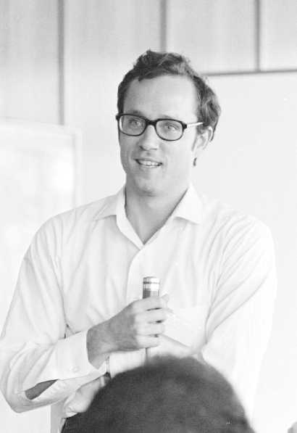
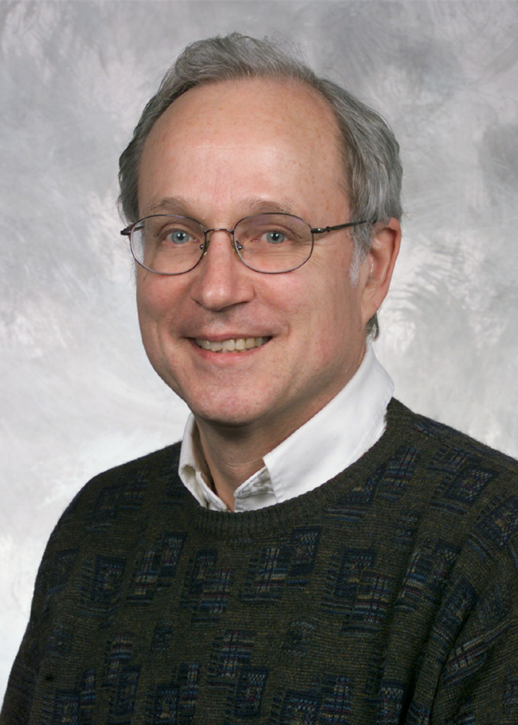
What’s Next?
“Bitter experience in the design of operating systems leads to the conclusion that radical changes must be made, both the way we think about functions of operating systems and in the way they are implemented.”
Butler Lampson
NATO Software Engineering Techniques Conference 1969

Slide 60
Hope for FeROS?
Kernel
(Rust) Task A
(Rust) Task B (File System)
Memory Isolation enforced by language mechanisms
IPC through safe, shared data
External resources managed through cryptography
No cost to calling between tasks, kernel: all in same address space!

Slide 61
Charge!
Tanenbaum was wrong about microkernels having won in 1992
Prevailing wisdom is wrong about microkernels having lost in 2014
Remember to sign up for your project submission option!
Butler is still right: The real OS of the future should be something radically different and you should help build it!

