Slide 1
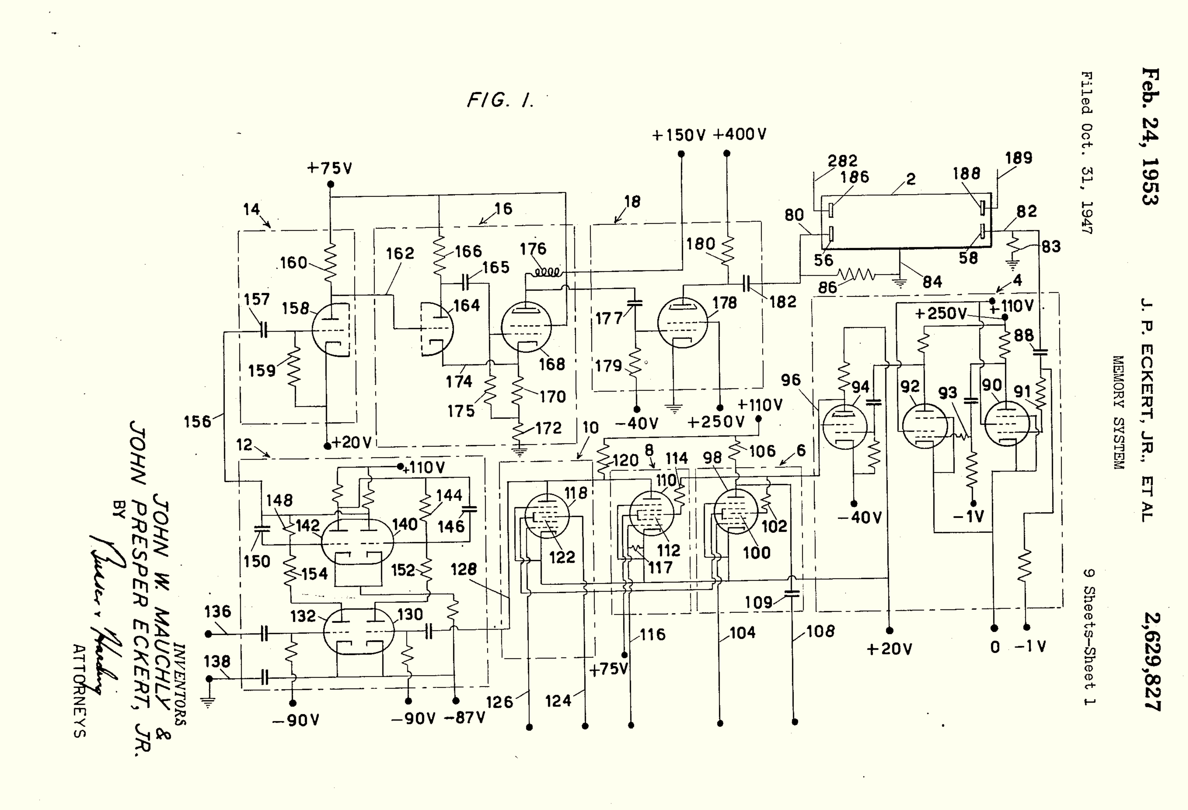
Class 24: Storage
cs4414 Fall 2013
University of Virginia
David Evans

Slide 2
Why is storage complicated?

Slide 3
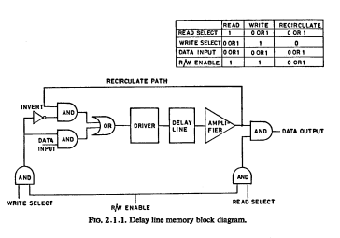
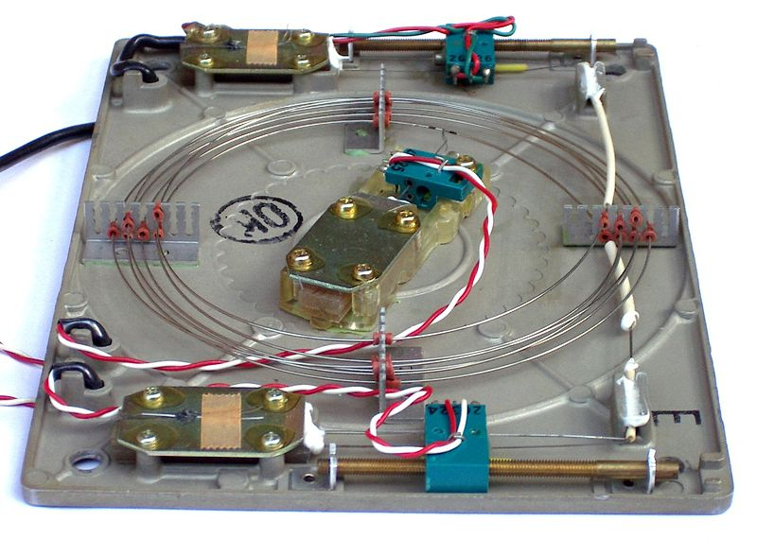
Delay Lines

Slide 4
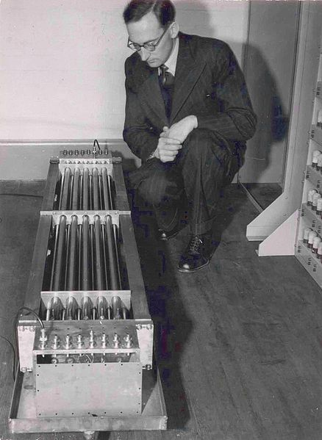
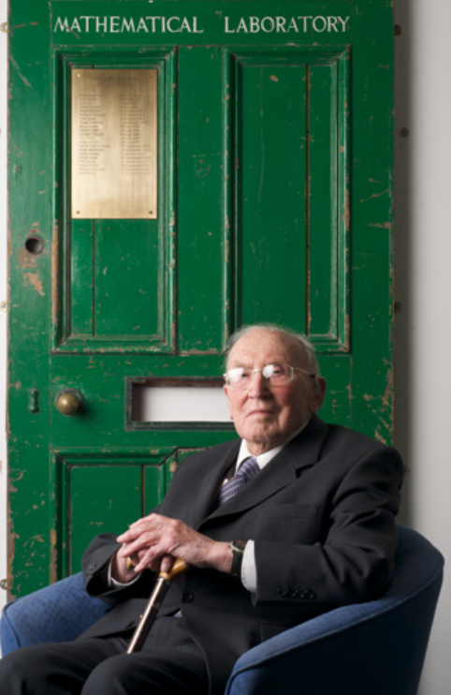
I do not imagine that many of the Turing lecturers who will follow me will be people who were acquainted with Alan Turing. … Although a mathematician, Turing took quite an interest in the engineering side of computer design… Turing’s contribution to this discussion was to advocate the use of gin, which he said contained alcohol and water in just the right proportions …
Sir Maurice Wilkes (1913-2010), Computers Then and Now
(1967 Turing Award Lecture)
flickr: rolandeva

Slide 5
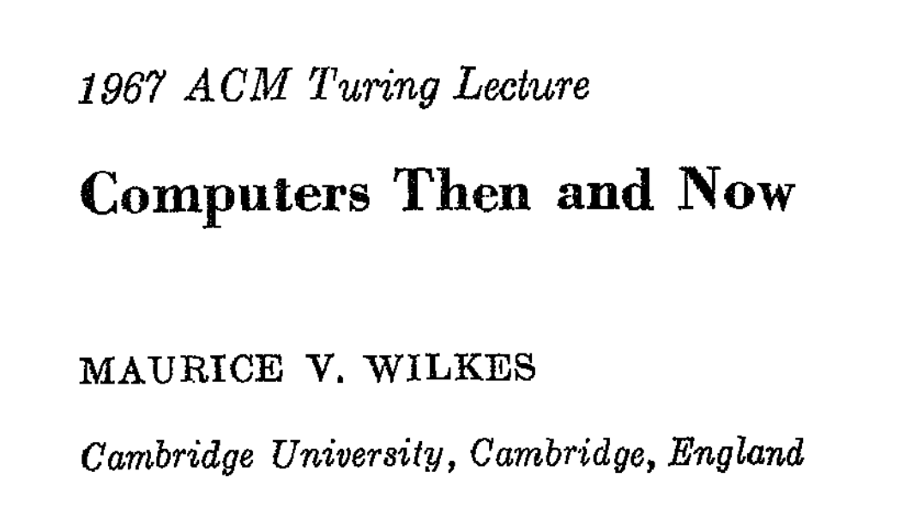
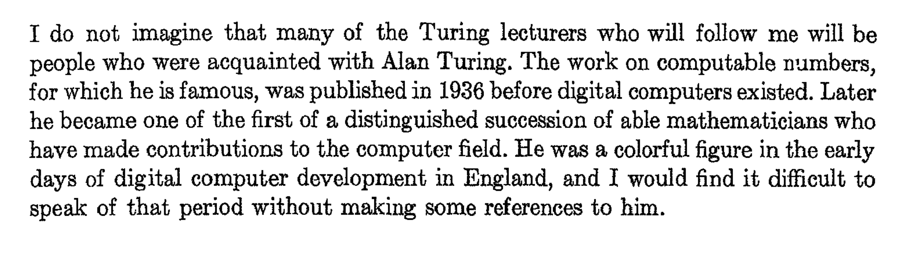

Slide 6
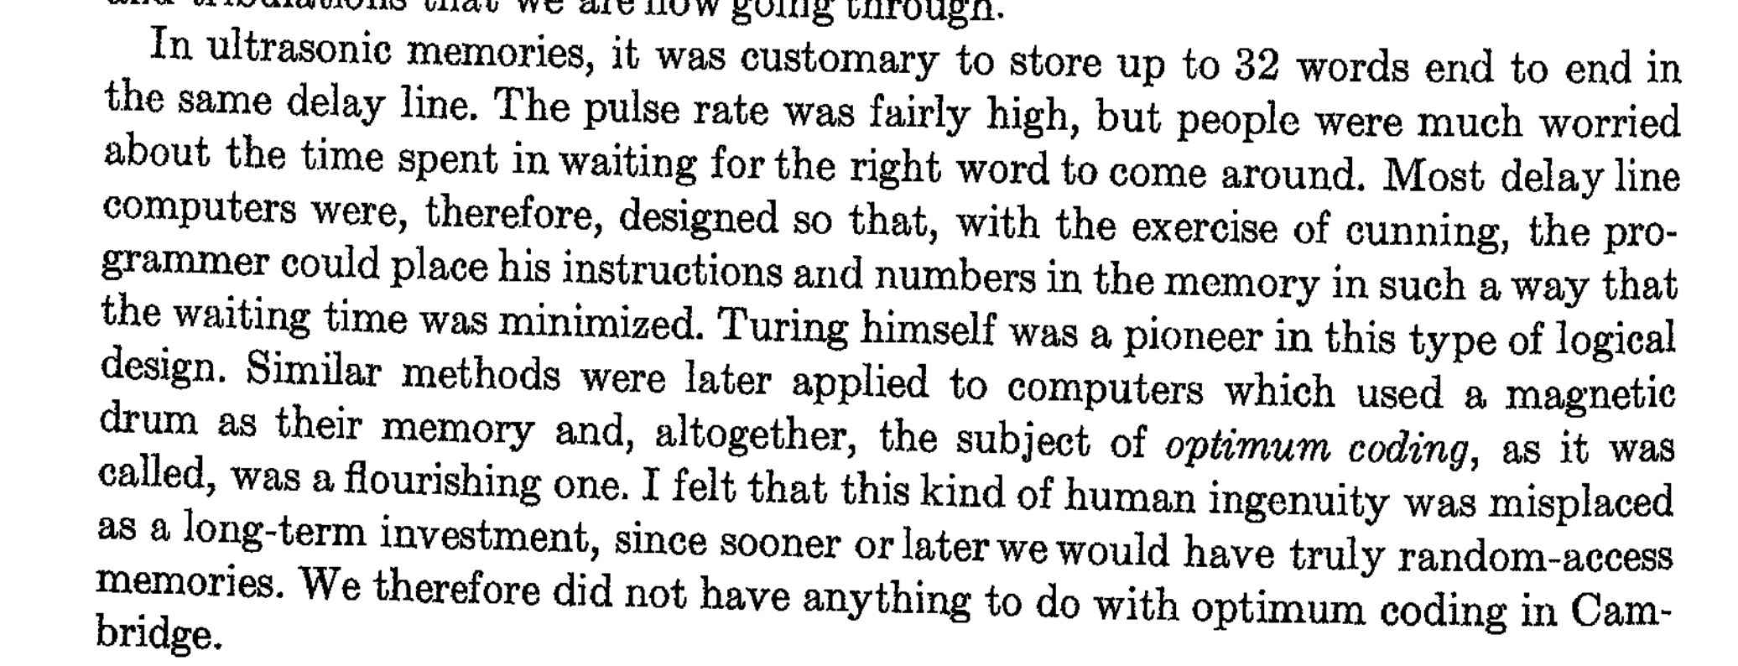

Slide 7
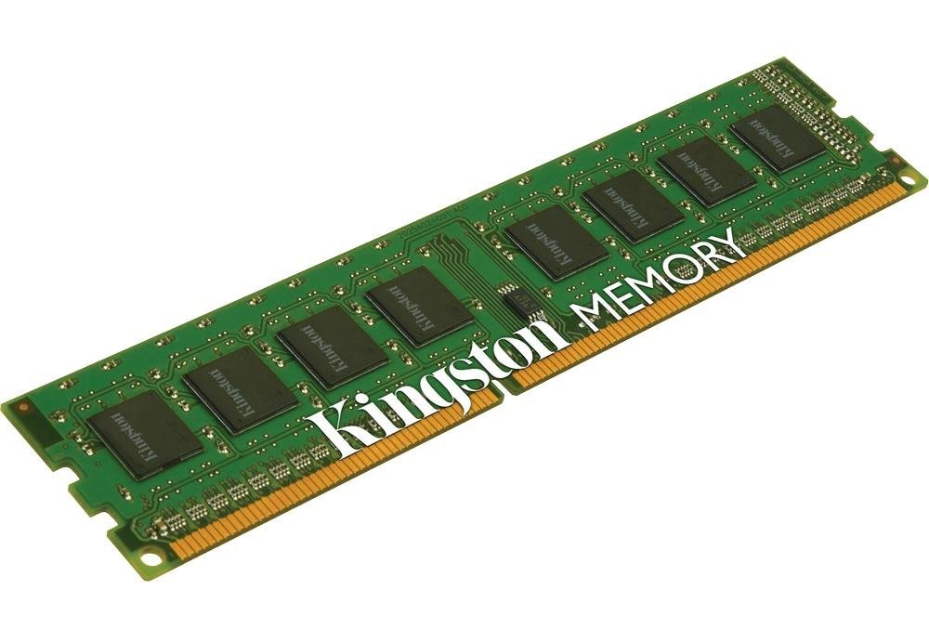
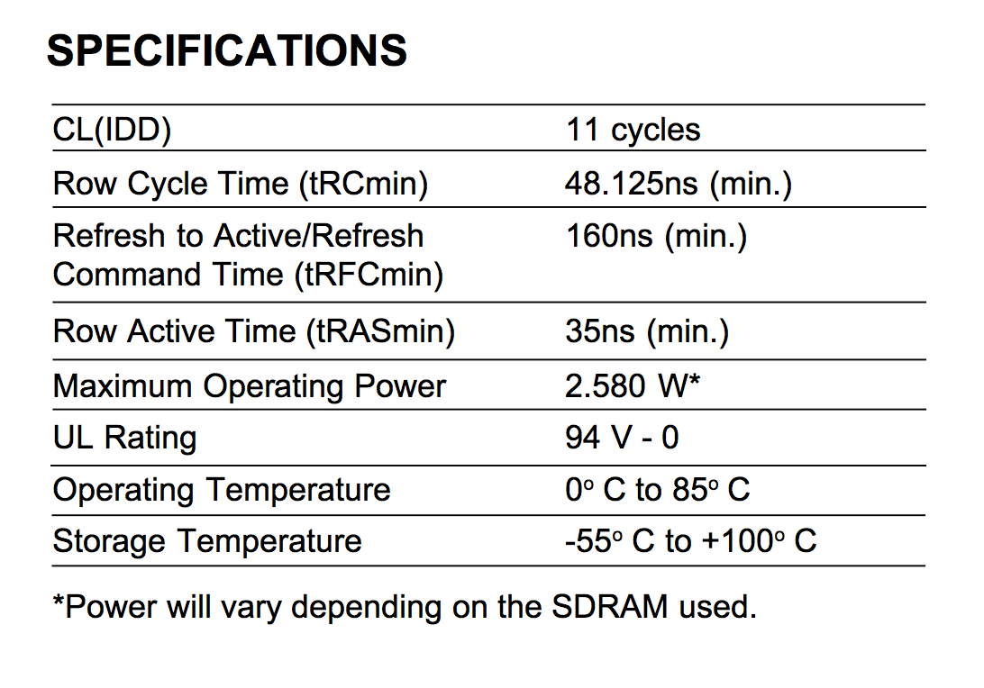
cycles (at 800MHz) to read a particular row = 13.75ns
= 185° F

Slide 8
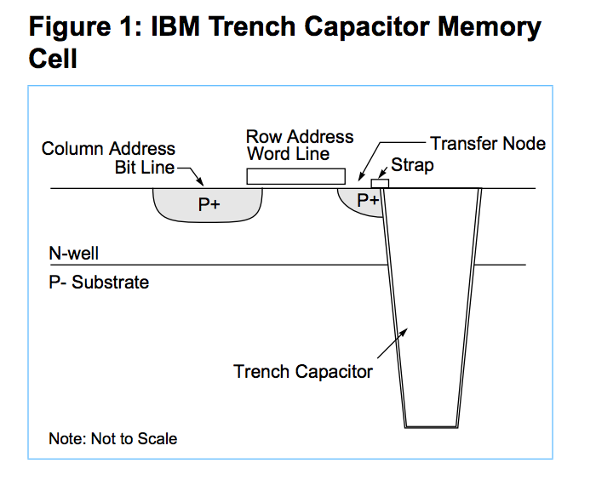

Slide 9
Storage Systems
Device | Example | Time to Access | Power Consumption | Cost per Bit
DRAM | Kingston KVR16N11/4 4GB DDR3 ($40) | 13.75ns

Slide 10
Storage Abstractions
Memory Location
File
Do we really need both?
What about: database, URI?

Slide 11
Storage “Abstractions”
File abstract: array of bytes
can be accessed arbitrarily
live forever
Before files:
application programs needed to worry about records, block sizes, etc.
Physical disk: collection of sectors, each is fixed size (512 bytes)
time to reach different sectors varies (a lot!)
inode: descriptor of a file
directory = just a file that is a mapping from names to inode numbers

Slide 12

Unix File Abstraction

Slide 13
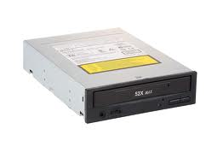

Which are files?
class24.pptx
/Users/dave/OS/classes/
OS-provided random numbers

Slide 14
“Everything is a File”
class24.pptx
/mnt/cdrom
/Users/dave/OS/classes/
OS-provided random numbers
/dev/tty0
/dev/random

Slide 15
inode represents a file
Size of File (bytes)
Device ID
User ID
Group ID
File Mode (permission bits)
Link count (number of hard links to node)
…
Diskmap

Slide 16
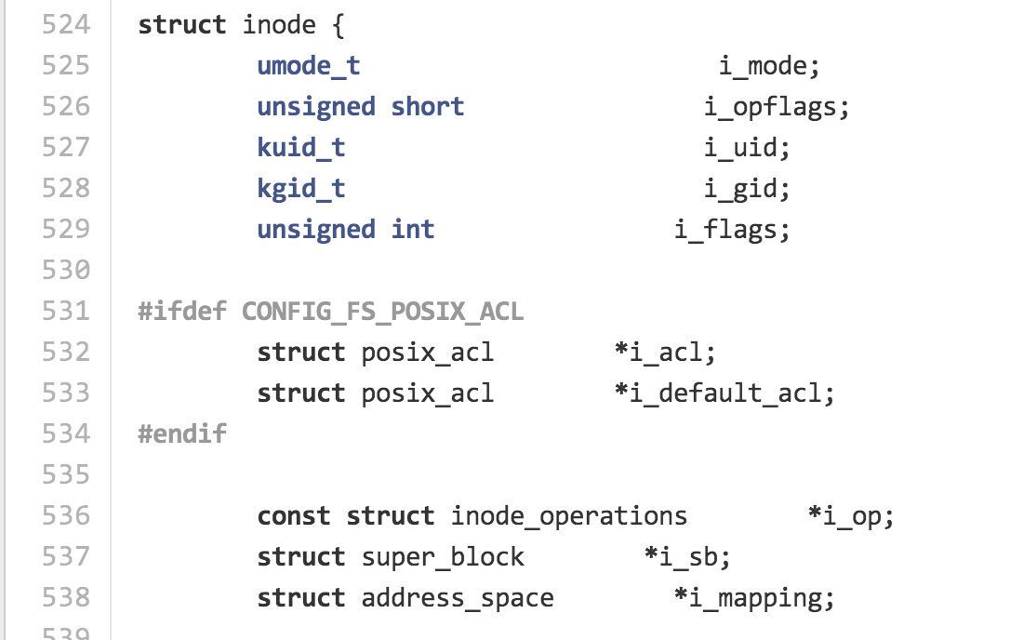
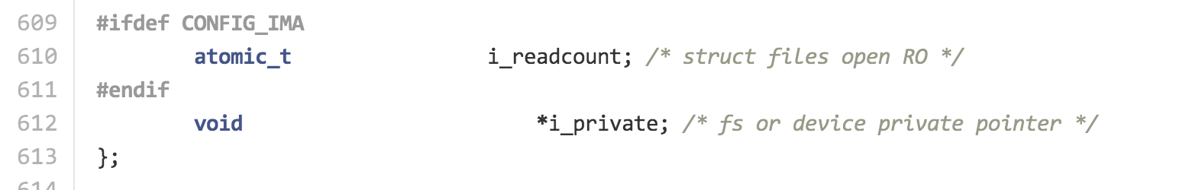
include/linux/fs.h

Slide 17
Size of File (bytes)
Device ID
User ID
Group ID
File Mode (permission bits)
Link count (number of hard links to node)
…
Diskmap
stat
> stat -x class24.pptx
File: "class24.pptx"
Size: 5855495 FileType: Regular File
Mode: (0644/-rw-r--r--) Uid: ( 501/ dave) Gid: ( 20/ staff)
Device: 1,2 Inode: 6706357 Links: 1
Access: Wed Nov 20 15:00:41 2013
Modify: Wed Nov 20 14:23:13 2013
Change: Wed Nov 20 14:23:13 2013

Slide 18
> ln class24.pptx todays-class.pptx
> stat -x class24.pptx
File: "class24.pptx"
Size: 5855495 FileType: Regular File
Mode: (0644/-rw-r--r--) Uid: ( 501/ dave) Gid: ( 20/ staff)
Device: 1,2 Inode: 6706357 Links: 2
Access: ..
> stat -x todays-class.pptx
File: "todays-class.pptx"
Size: 5855495 FileType: Regular File
Mode: (0644/-rw-r--r--) Uid: ( 501/ dave) Gid: ( 20/ staff)
Device: 1,2 Inode: 6706357 Links: 2
> rm class24.pptx
> stat -x class24.pptx
stat: class24.pptx: stat: No such file or directory
> stat -x todays-class.pptx
File: "todays-class.pptx"
Size: 5855495 FileType: Regular File
Mode: (0644/-rw-r--r--) Uid: ( 501/ dave) Gid: ( 20/ staff)
Device: 1,2 Inode: 6706357 Links: 1

Slide 19
Diskmap
(Unix System 5)
Size of File (bytes)
Device ID
User ID
Group ID
File Mode (permission bits)
Link count (number of hard links to node)
…
Diskmap
0
1
2
…
9
10
11
12
Disk Block (1K bytes)
Disk Block (1K bytes)
Disk Block (1K bytes)

Slide 20
Diskmap
(Unix System 5)
Disk Block (1K bytes)
Indirect
Disk Block (1K bytes)
Disk Block (1K bytes)
Disk Block (1K bytes)
0
1
2
…
9
10
11
12
4 bytes for each = 256 pointers
Disk Block (1K bytes)
Disk Block (1K bytes)
Disk Block (1K bytes)

Slide 21
Diskmap
(Unix System 5)
Disk Block (1K bytes)
Indirect
Disk Block (1K bytes)
Disk Block (1K bytes)
Disk Block (1K bytes)
0
1
2
…
9
10
11
12
4 bytes for each = 256 pointers
Indirect
Disk Block (1K bytes)
Double
Indirect
Disk Block
Indirect
Disk Block (1K bytes)
Disk Block (1K bytes)
Disk Block (1K bytes)
Disk Block (1K bytes)

Slide 22
Diskmap
(Unix System 5)
Disk Block (1K bytes)
Indirect
Disk Block (1K bytes)
Disk Block (1K bytes)
Disk Block (1K bytes)
0
1
2
…
9
10
11
12
4 bytes for each = 256 pointers
Indirect
Disk Block (1K bytes)
Double
Indirect
Disk Block
Indirect
Disk Block (1K bytes)
Disk Block (1K bytes)
Disk Block (1K bytes)
Disk Block (1K bytes)
How would you determine if your file system has this structure?

Slide 23
Diskmap
(Unix System 5)
Disk Block (1K bytes)
Indirect
Disk Block (1K bytes)
Disk Block (1K bytes)
Disk Block (1K bytes)
0
1
2
…
9
10
11
12
4 bytes for each = 256 pointers
Indirect
Disk Block (1K bytes)
Double
Indirect
Disk Block
Indirect
Disk Block (1K bytes)
Disk Block (1K bytes)
Disk Block (1K bytes)
Disk Block (1K bytes)
Disk Block (1K bytes)

Slide 24
Directories are Files Too!
Filename | Inode
. | 494211
.. | 494205
.DS_Store | 494212
class0 | 6565946
class1 | 6565826
class10 | 1467012
class11 | 2252968
… | …
class19 | 5649155
class2 | 494218
… | …
ls -ali

Slide 25
How to create a new file?

Slide 26
examining inodes
> brew install tree # needed on MacOS X, but builtin to most Unixes

Slide 27
Storage Abstractions
Memory Location
File
Do we really need both?
What about: database, URI?

Slide 28
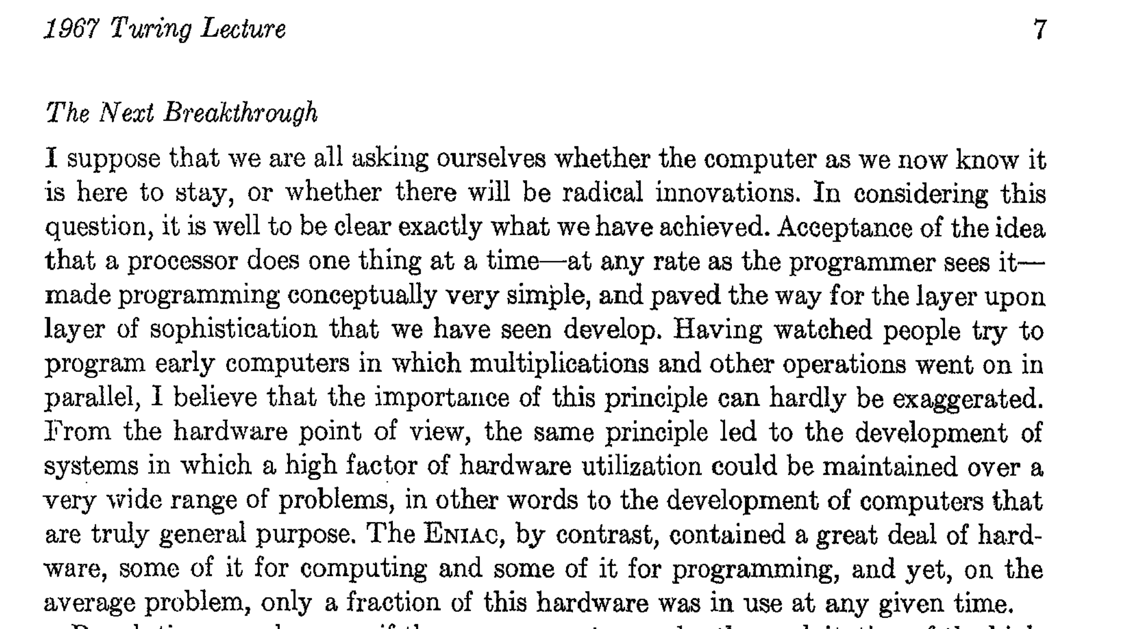

Slide 29
