Slide 1

Class 24: Project Presentations
cs4414 Spring 2014
University of Virginia
David Evans

Slide 2
Presentations Today
Chris Grochmal, Audrey Choi, Mark Valieras, Tommy Curley, Maggie Orr
Anat Gilboa, Jyotiska Biswas
Man Wang, Hangchen Qu, Zihao Wang
Brian Uosseph, Raymond Vargas
Patrick Ryan, Dan O'Connor, David Laden
Piyapath Siratarnsophon, Kamonphop Srisopha, Peeratham Techapalokul, Phanwadee Sinthong
James Wang, Mitchell Smith
Megan Kelly, Rainier Rabena
Muntaser Ahmed, Andrew Becker, Gautam Kanumuru
Andy Barron, Christine Danzi, Ami Jagodara, Alex Kuck
Jacob Baldwin, Stephen Boris, Garrett Durig, Karen Pan
Alex Looney, Ankit Gupta, Michael Paris, Babak Pourkazemi
Justin Ingram, Vikram Bhasin, Alex Aberman, Justin Dao
Britton Vermaaten
4.5 minutes each, strictly enforced
Be ready when it is your turn

Slide 3
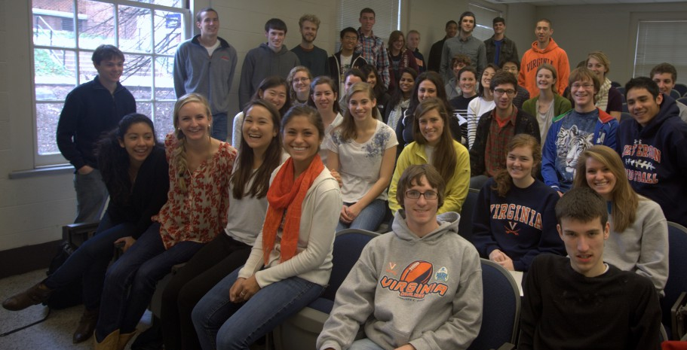
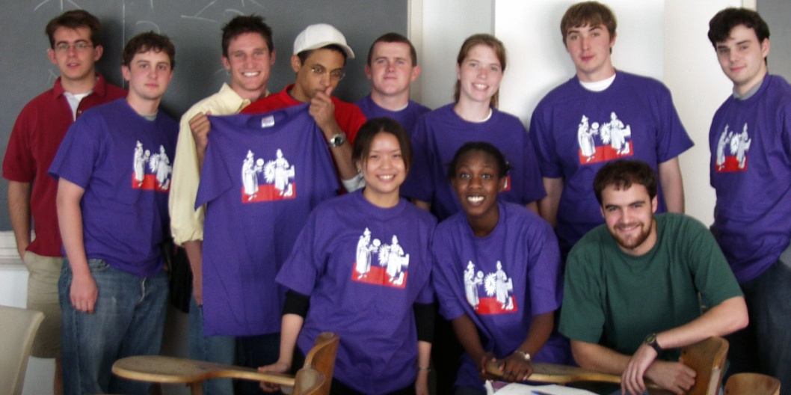
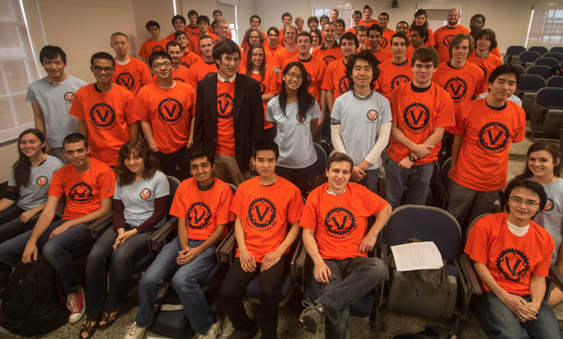
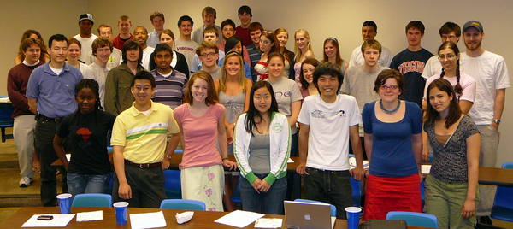
cs1120, Fall 2011
cs200, Spring 2002
cs150, Spring 2007
cs4414, Fall 2013

Slide 4




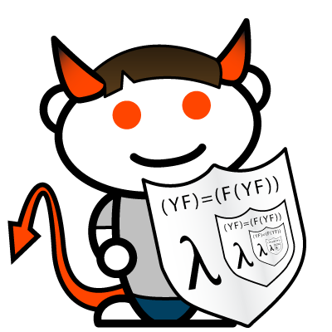
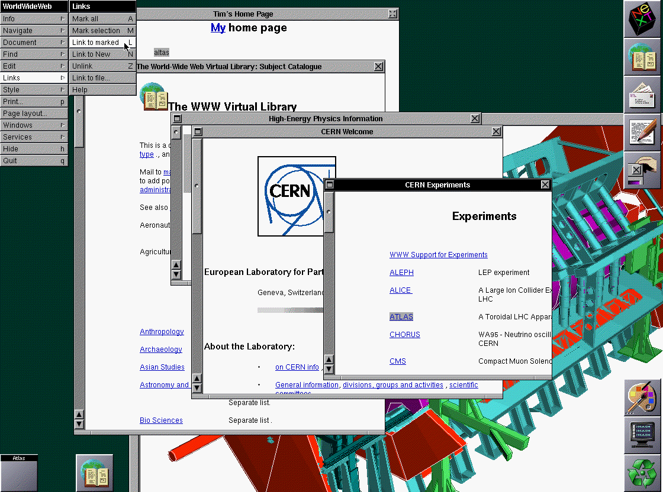

Small Programs that Changed the World
(Mark Zuckerberg and roomates)
Linux
(Linus Torvalds)
(Sergey Brin, Matthew Page)
Hipmunk
(Steve Huffman and Adam Goldstein)
?
Reddit
(Steve Huffman and Alexis Ohanian)
WorldWideWeb
(Tim Berners-Lee)
(3 Estonians)
(cs4414 Student)

Slide 5
From the course pledge:
I will provide useful feedback. I realize that this is the first time this course has been taught this way and it is important that I let the course staff know what they need to improve the course. I will not wait until the end of the course to make the course staff aware of any problems. I will provide feedback either anonymously or by contacting the course staff directly. I will fill out all course evaluation surveys honestly and thoroughly.
Please do this!

Slide 6
Thank you!

Slide 7
Graduation Photo

Slide 8
Now: Chris, Audrey, Mark, Tommy, Maggie
Next: Anat, Jyotiska
Man, Hangchen, Zihao
Brian, Raymond
Patrick, Dan, David
Piyapath, Kamonphop, Peeratham, Phanwadee
James, Mitchell
Megan, Rainier
Muntaser, Andrew, Gautam
Andy, Christine, Ami, Alex
Jacob, Stephen, Garrett, Karen
Alex, Ankit, Michael, Babak
Justin, Vikram, Alex, Justin
Britton Vermaaten

Slide 9
Now: Chris, Audrey, Mark, Tommy, Maggie
Next: Anat, Jyotiska
Man, Hangchen, Zihao
Brian, Raymond
Patrick, Dan, David
Piyapath, Kamonphop, Peeratham, Phanwadee
James, Mitchell
Megan, Rainier
Muntaser, Andrew, Gautam
Andy, Christine, Ami, Alex
Jacob, Stephen, Garrett, Karen
Alex, Ankit, Michael, Babak
Justin, Vikram, Alex, Justin
Britton Vermaaten

Slide 10
Now: Chris, Audrey, Mark, Tommy, Maggie
Next: Anat, Jyotiska
Man, Hangchen, Zihao
Brian, Raymond
Patrick, Dan, David
Piyapath, Kamonphop, Peeratham, Phanwadee
James, Mitchell
Megan, Rainier
Muntaser, Andrew, Gautam
Andy, Christine, Ami, Alex
Jacob, Stephen, Garrett, Karen
Alex, Ankit, Michael, Babak
Justin, Vikram, Alex, Justin
Britton Vermaaten
1 minute left

Slide 11
Now: Chris, Audrey, Mark, Tommy, Maggie
Next: Anat, Jyotiska
Man, Hangchen, Zihao
Brian, Raymond
Patrick, Dan, David
Piyapath, Kamonphop, Peeratham, Phanwadee
James, Mitchell
Megan, Rainier
Muntaser, Andrew, Gautam
Andy, Christine, Ami, Alex
Jacob, Stephen, Garrett, Karen
Alex, Ankit, Michael, Babak
Justin, Vikram, Alex, Justin
Britton Vermaaten
Finish

Slide 12
Anat, Jyotiska
Next: Man, Hangchen, Zihao
Brian, Raymond
Patrick, Dan, David
Piyapath, Kamonphop, Peeratham, Phanwadee
James, Mitchell
Megan, Rainier
Muntaser, Andrew, Gautam
Andy, Christine, Ami, Alex
Jacob, Stephen, Garrett, Karen
Alex, Ankit, Michael, Babak
Justin, Vikram, Alex, Justin
Britton Vermaaten

Slide 13
Anat, Jyotiska
Next: Man, Hangchen, Zihao
Brian, Raymond
Patrick, Dan, David
Piyapath, Kamonphop, Peeratham, Phanwadee
James, Mitchell
Megan, Rainier
Muntaser, Andrew, Gautam
Andy, Christine, Ami, Alex
Jacob, Stephen, Garrett, Karen
Alex, Ankit, Michael, Babak
Justin, Vikram, Alex, Justin
Britton Vermaaten
1 minute left

Slide 14
Anat, Jyotiska
Next: Man, Hangchen, Zihao
Brian, Raymond
Patrick, Dan, David
Piyapath, Kamonphop, Peeratham, Phanwadee
James, Mitchell
Megan, Rainier
Muntaser, Andrew, Gautam
Andy, Christine, Ami, Alex
Jacob, Stephen, Garrett, Karen
Alex, Ankit, Michael, Babak
Justin, Vikram, Alex, Justin
Britton Vermaaten
Finish

Slide 15
Man, Hangchen, Zihao
Brian, Raymond
Patrick, Dan, David
Piyapath, Kamonphop, Peeratham, Phanwadee
James, Mitchell
Megan, Rainier
Muntaser, Andrew, Gautam
Andy, Christine, Ami, Alex
Jacob, Stephen, Garrett, Karen
Alex, Ankit, Michael, Babak
Justin, Vikram, Alex, Justin
Britton Vermaaten

Slide 16
Man, Hangchen, Zihao
Brian, Raymond
Patrick, Dan, David
Piyapath, Kamonphop, Peeratham, Phanwadee
James, Mitchell
Megan, Rainier
Muntaser, Andrew, Gautam
Andy, Christine, Ami, Alex
Jacob, Stephen, Garrett, Karen
Alex, Ankit, Michael, Babak
Justin, Vikram, Alex, Justin
Britton Vermaaten
1 minute left

Slide 17
Man, Hangchen, Zihao
Brian, Raymond
Patrick, Dan, David
Piyapath, Kamonphop, Peeratham, Phanwadee
James, Mitchell
Megan, Rainier
Muntaser, Andrew, Gautam
Andy, Christine, Ami, Alex
Jacob, Stephen, Garrett, Karen
Alex, Ankit, Michael, Babak
Justin, Vikram, Alex, Justin
Britton Vermaaten
Finish

Slide 18
Brian, Raymond
Patrick, Dan, David
Piyapath, Kamonphop, Peeratham, Phanwadee
James, Mitchell
Megan, Rainier
Muntaser, Andrew, Gautam
Andy, Christine, Ami, Alex
Jacob, Stephen, Garrett, Karen
Alex, Ankit, Michael, Babak
Justin, Vikram, Alex, Justin
Britton Vermaaten

Slide 19
Brian, Raymond
Patrick, Dan, David
Piyapath, Kamonphop, Peeratham, Phanwadee
James, Mitchell
Megan, Rainier
Muntaser, Andrew, Gautam
Andy, Christine, Ami, Alex
Jacob, Stephen, Garrett, Karen
Alex, Ankit, Michael, Babak
Justin, Vikram, Alex, Justin
Britton Vermaaten
1 minute left

Slide 20
Brian, Raymond
Patrick, Dan, David
Piyapath, Kamonphop, Peeratham, Phanwadee
James, Mitchell
Megan, Rainier
Muntaser, Andrew, Gautam
Andy, Christine, Ami, Alex
Jacob, Stephen, Garrett, Karen
Alex, Ankit, Michael, Babak
Justin, Vikram, Alex, Justin
Britton Vermaaten
Finish

Slide 21
Patrick, Dan, David
Piyapath, Kamonphop, Peeratham, Phanwadee
James, Mitchell
Megan, Rainier
Muntaser, Andrew, Gautam
Andy, Christine, Ami, Alex
Jacob, Stephen, Garrett, Karen
Alex, Ankit, Michael, Babak
Justin, Vikram, Alex, Justin
Britton Vermaaten

Slide 22
Patrick, Dan, David
Piyapath, Kamonphop, Peeratham, Phanwadee
James, Mitchell
Megan, Rainier
Muntaser, Andrew, Gautam
Andy, Christine, Ami, Alex
Jacob, Stephen, Garrett, Karen
Alex, Ankit, Michael, Babak
Justin, Vikram, Alex, Justin
Britton Vermaaten
1 minute left

Slide 23
Patrick, Dan, David
Piyapath, Kamonphop, Peeratham, Phanwadee
James, Mitchell
Megan, Rainier
Muntaser, Andrew, Gautam
Andy, Christine, Ami, Alex
Jacob, Stephen, Garrett, Karen
Alex, Ankit, Michael, Babak
Justin, Vikram, Alex, Justin
Britton Vermaaten
Finish

Slide 24
Piyapath, Kamonphop, Peeratham, Phanwadee
James, Mitchell
Megan, Rainier
Muntaser, Andrew, Gautam
Andy, Christine, Ami, Alex
Jacob, Stephen, Garrett, Karen
Alex, Ankit, Michael, Babak
Justin, Vikram, Alex, Justin
Britton Vermaaten

Slide 25
Piyapath, Kamonphop, Peeratham, Phanwadee
James, Mitchell
Megan, Rainier
Muntaser, Andrew, Gautam
Andy, Christine, Ami, Alex
Jacob, Stephen, Garrett, Karen
Alex, Ankit, Michael, Babak
Justin, Vikram, Alex, Justin
Britton Vermaaten
1 minute left

Slide 26
Piyapath, Kamonphop, Peeratham, Phanwadee
James, Mitchell
Megan, Rainier
Muntaser, Andrew, Gautam
Andy, Christine, Ami, Alex
Jacob, Stephen, Garrett, Karen
Alex, Ankit, Michael, Babak
Justin, Vikram, Alex, Justin
Britton Vermaaten
Finish

Slide 27
James, Mitchell
Megan, Rainier
Muntaser, Andrew, Gautam
Andy, Christine, Ami, Alex
Jacob, Stephen, Garrett, Karen
Alex, Ankit, Michael, Babak
Justin, Vikram, Alex, Justin
Britton Vermaaten

Slide 28
James, Mitchell
Megan, Rainier
Muntaser, Andrew, Gautam
Andy, Christine, Ami, Alex
Jacob, Stephen, Garrett, Karen
Alex, Ankit, Michael, Babak
Justin, Vikram, Alex, Justin
Britton Vermaaten
1 minute left

Slide 29
James, Mitchell
Megan, Rainier
Muntaser, Andrew, Gautam
Andy, Christine, Ami, Alex
Jacob, Stephen, Garrett, Karen
Alex, Ankit, Michael, Babak
Justin, Vikram, Alex, Justin
Britton Vermaaten
Finish

Slide 30
Megan, Rainier
Muntaser, Andrew, Gautam
Andy, Christine, Ami, Alex
Jacob, Stephen, Garrett, Karen
Alex, Ankit, Michael, Babak
Justin, Vikram, Alex, Justin
Britton Vermaaten

Slide 31
Megan, Rainier
Muntaser, Andrew, Gautam
Andy, Christine, Ami, Alex
Jacob, Stephen, Garrett, Karen
Alex, Ankit, Michael, Babak
Justin, Vikram, Alex, Justin
Britton Vermaaten
1 minute left

Slide 32
Megan, Rainier
Muntaser, Andrew, Gautam
Andy, Christine, Ami, Alex
Jacob, Stephen, Garrett, Karen
Alex, Ankit, Michael, Babak
Justin, Vikram, Alex, Justin
Britton Vermaaten
Finish

Slide 33
Muntaser, Andrew, Gautam
Andy, Christine, Ami, Alex
Jacob, Stephen, Garrett, Karen
Alex, Ankit, Michael, Babak
Justin, Vikram, Alex, Justin
Britton Vermaaten

Slide 34
Muntaser, Andrew, Gautam
Andy, Christine, Ami, Alex
Jacob, Stephen, Garrett, Karen
Alex, Ankit, Michael, Babak
Justin, Vikram, Alex, Justin
Britton Vermaaten
1 minute left

Slide 35
Muntaser, Andrew, Gautam
Andy, Christine, Ami, Alex
Jacob, Stephen, Garrett, Karen
Alex, Ankit, Michael, Babak
Justin, Vikram, Alex, Justin
Britton Vermaaten
Finish

Slide 36
Andy, Christine, Ami, Alex
Jacob, Stephen, Garrett, Karen
Alex, Ankit, Michael, Babak
Justin, Vikram, Alex, Justin
Britton Vermaaten

Slide 37
Andy, Christine, Ami, Alex
Jacob, Stephen, Garrett, Karen
Alex, Ankit, Michael, Babak
Justin, Vikram, Alex, Justin
Britton Vermaaten
1 minute left

Slide 38
Andy, Christine, Ami, Alex
Jacob, Stephen, Garrett, Karen
Alex, Ankit, Michael, Babak
Justin, Vikram, Alex, Justin
Britton Vermaaten
Finish

Slide 39
Jacob, Stephen, Garrett, Karen
Alex, Ankit, Michael, Babak
Justin, Vikram, Alex, Justin
Britton Vermaaten

Slide 40
Jacob, Stephen, Garrett, Karen
Alex, Ankit, Michael, Babak
Justin, Vikram, Alex, Justin
Britton Vermaaten
1 minute left

Slide 41
Jacob, Stephen, Garrett, Karen
Alex, Ankit, Michael, Babak
Justin, Vikram, Alex, Justin
Britton Vermaaten
Finish

Slide 42
Alex, Ankit, Michael, Babak
Justin, Vikram, Alex, Justin
Britton Vermaaten

Slide 43
Alex, Ankit, Michael, Babak
Justin, Vikram, Alex, Justin
Britton Vermaaten
1 minute left

Slide 44
Alex, Ankit, Michael, Babak
Justin, Vikram, Alex, Justin
Britton Vermaaten
Finish

Slide 45
Justin, Vikram, Alex, Justin
Britton

Slide 46
Justin, Vikram, Alex, Justin
Britton
1 minute left

Slide 47
Justin, Vikram, Alex, Justin
Britton
Finish

Slide 48
Britton

Slide 49
Britton
1 minute left

Slide 50
Britton
Finish

