Slide 1
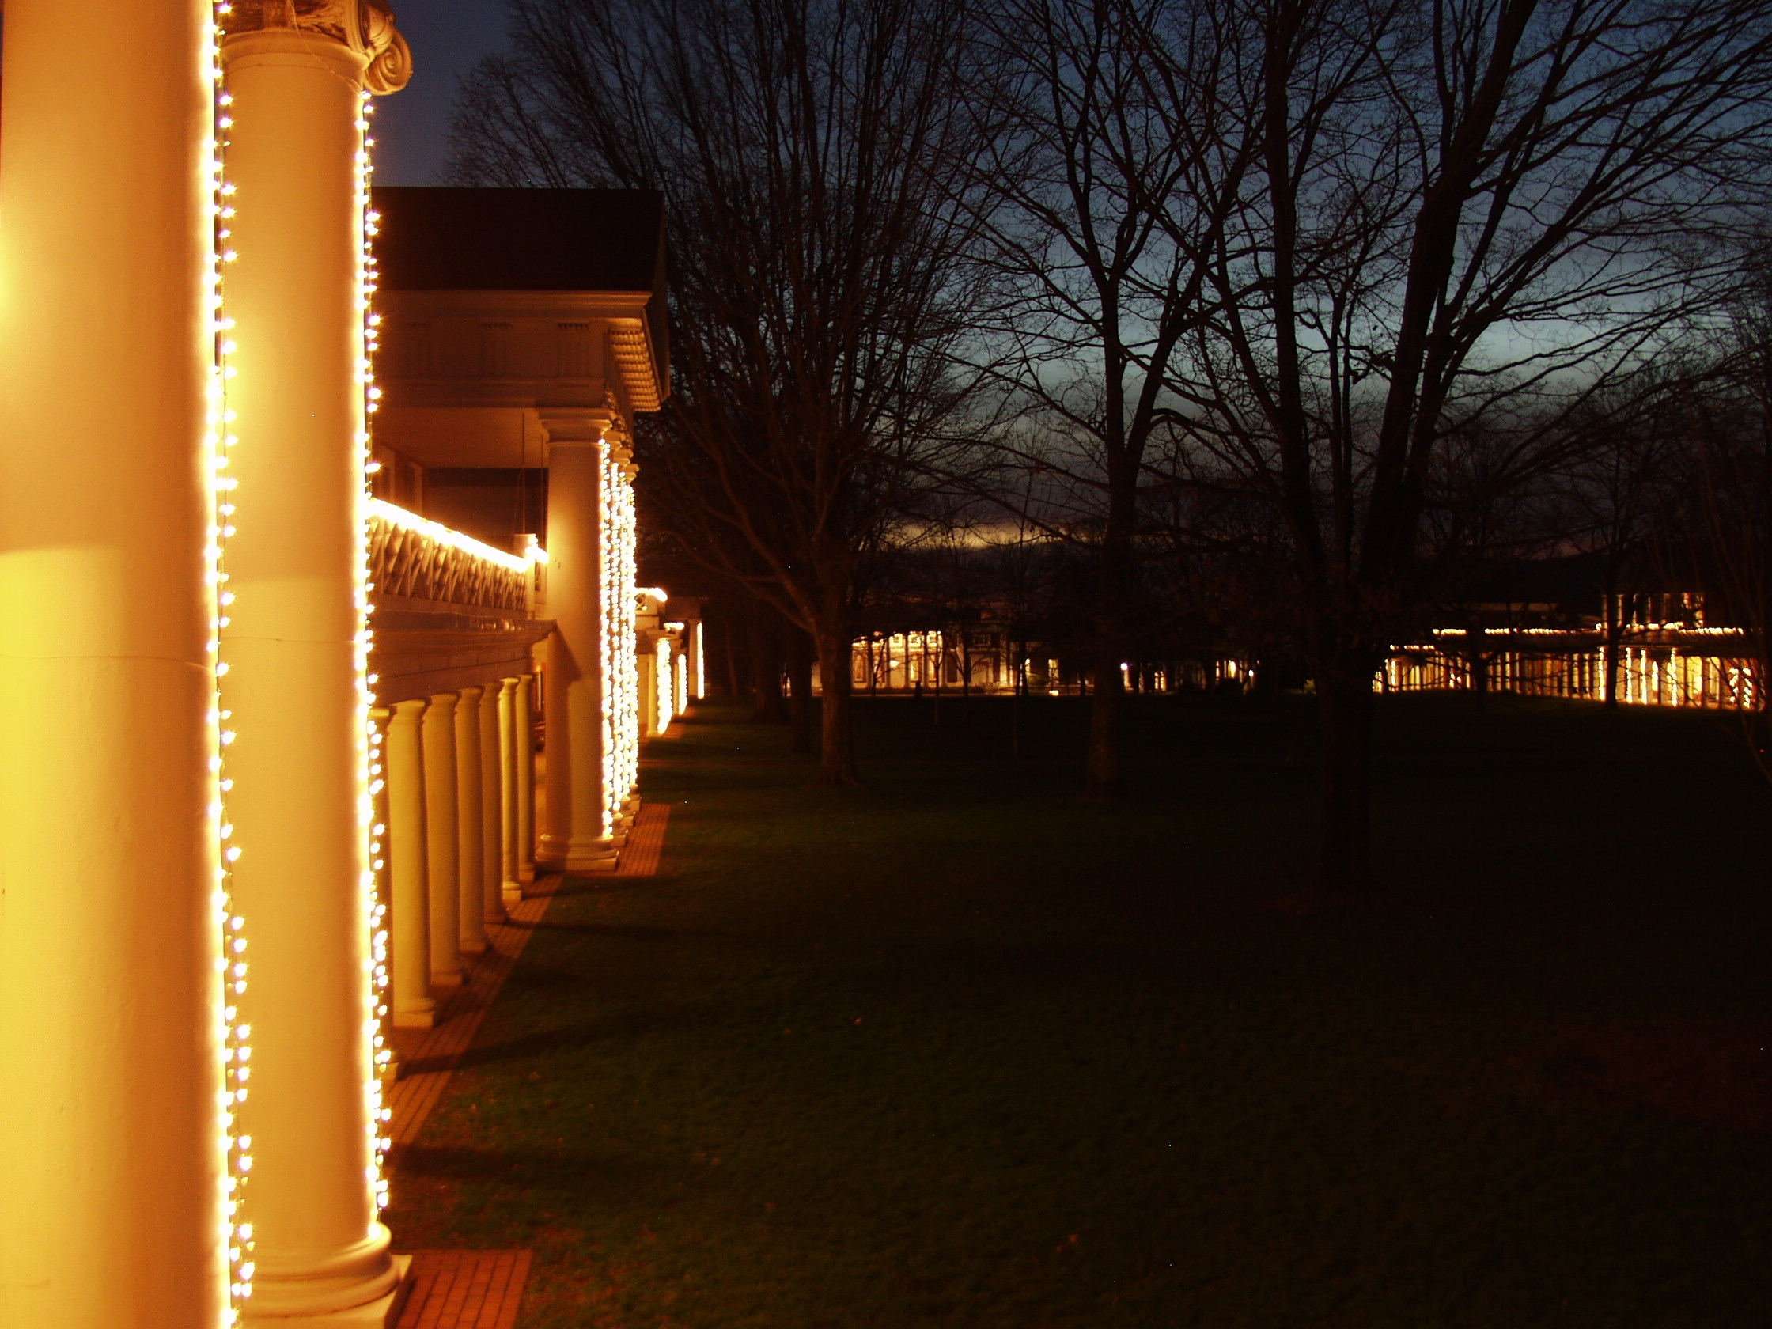
Class 27: Projects!
2013 Lighting of the Lawn
today at 7pm
cs4414 Fall 2013
University of Virginia
David Evans

Slide 2
First lighting of the lawn, 2001
Never doubt that a small group of thoughtful,
committed people can change the world.
Indeed, it is the only thing that ever has.
Margaret Mead

Slide 3
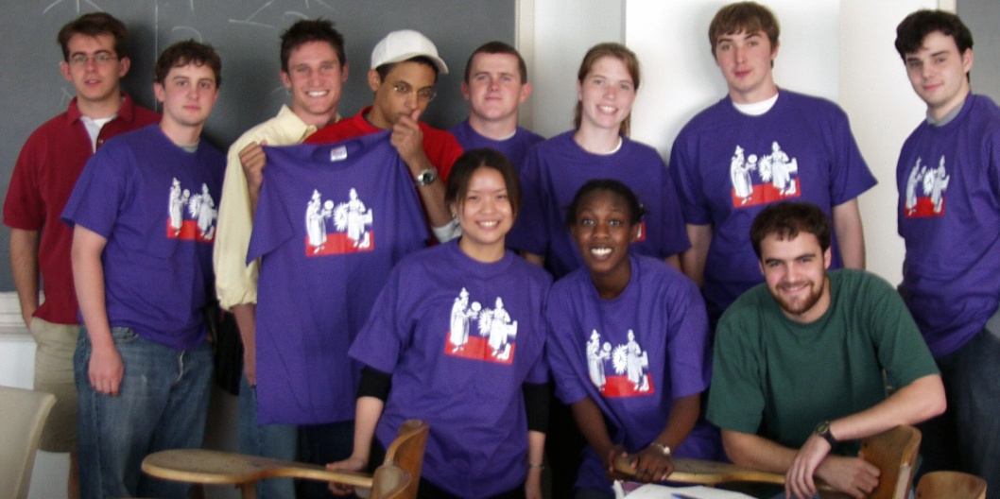
Portman Wills, started lawn-lighting
cs200 Graduates and Assistants, Spring 2002

Slide 4

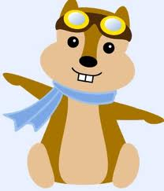



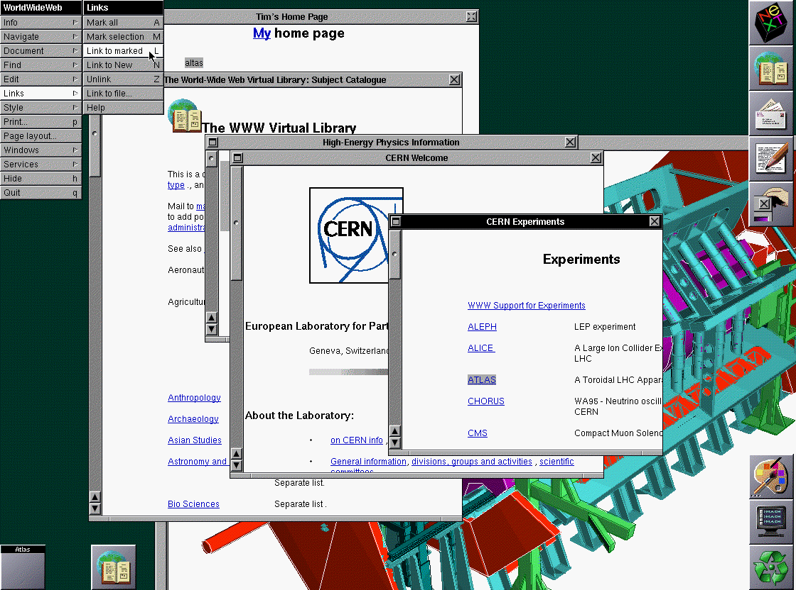

Small Programs that Changed the World
(Mark Zuckerberg and roomates)
Linux
(Linus Torvalds)
(Sergey Brin,
Matthew Page)
Hipmunk
(Steve Huffman and Alexis Ohanian)
Reddit
(Steve Huffman and Alexis Ohanian)
?
WorldWideWeb
(Tim Berners-Lee)
(3 Estonians)
(cs4414 Student)

Slide 5
Final Requests
From the course pledge:
I will provide useful feedback. I realize that this is the first time this course has been taught this way and it is important that I let the course staff know what they need to improve the course. I will not wait until the end of the course to make the course staff aware of any problems. I will provide feedback either anonymously or by contacting the course staff directly. I will fill out all course evaluation surveys honestly and thoroughly.
Please do this!

Slide 6
Final Requests
Make your project github site public (when its ready)
Recommend (waitlisted) students for next semester’s class (only 8 spaces for 50+ students)
Consider being an Assistant for next year’s class

Slide 7

Thank you!

Slide 8
Graduation Photo

Slide 9
Presentations

