Slide 1
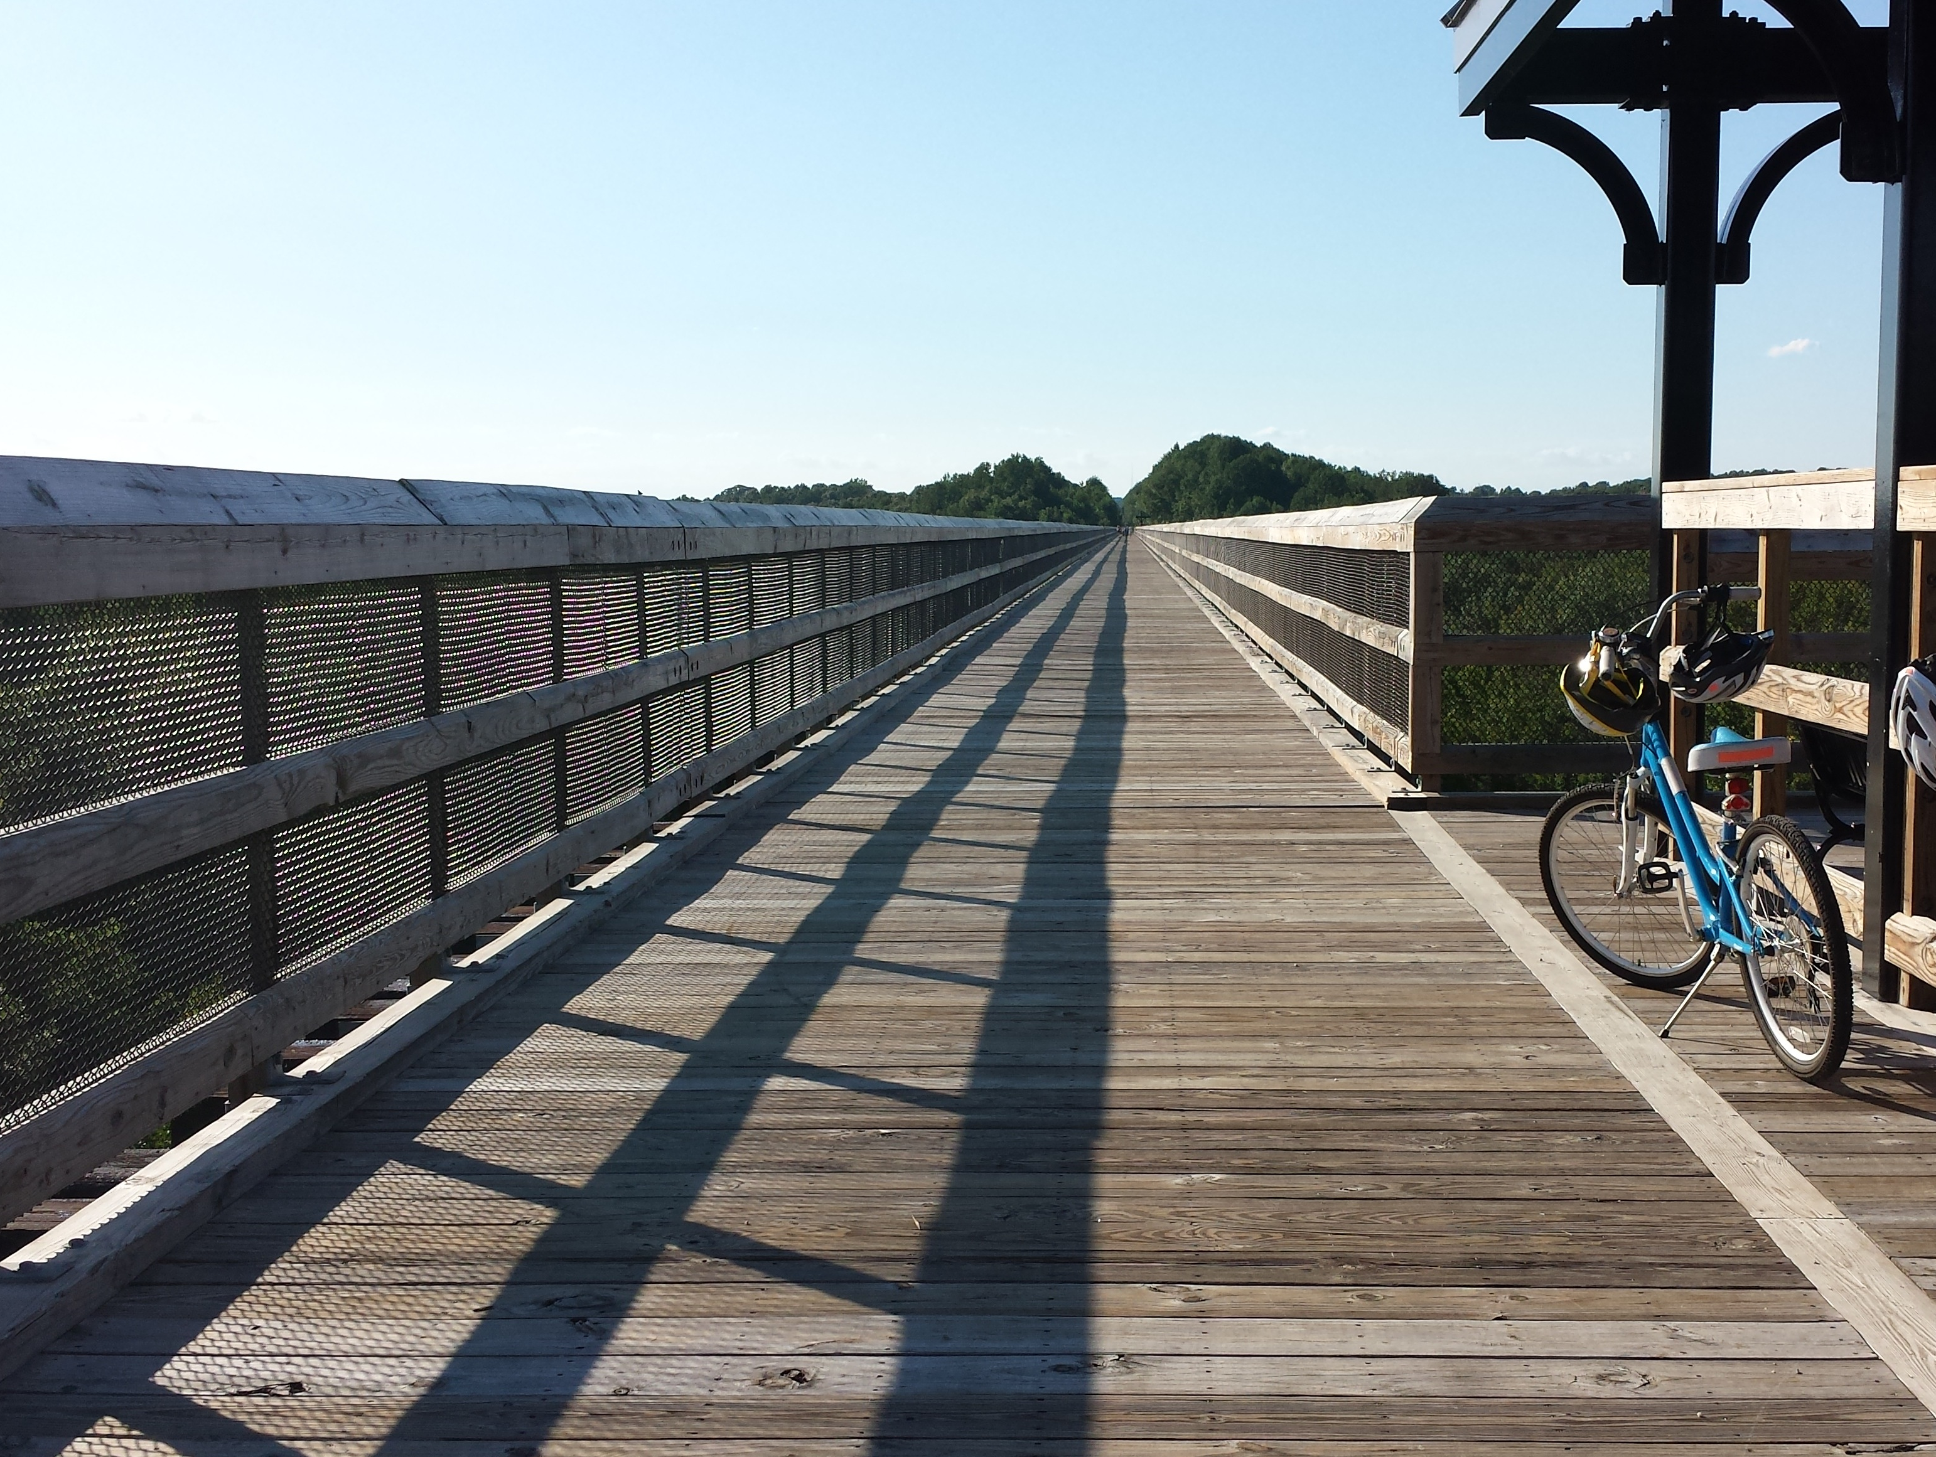
Class 3: Zero to a Billion in 4.86 Years
cs4414 Fall 2013
University of Virginia
David Evans

Slide 2
Today’s Class
Operating Systems present, past, and (maybe) future
Two prevailing technical themes:
kernel
process

Slide 3
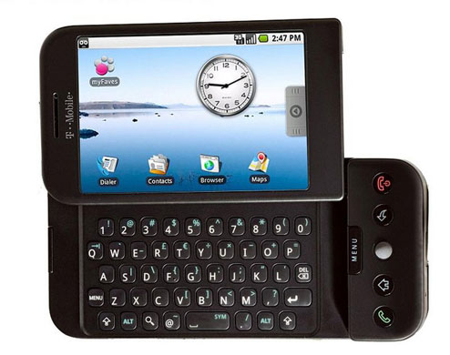
4.86 years ago…
“The long-awaited HTC Dream, the first commercial handset running Google’s Android operating system, will be coming to T-Mobile as the G1 for $179 on October 22nd. Featuring a 3-inch touchscreen, internet navigation buttons and a full QWERTY keypad, the smartphone market has finally broken free of Symbian, Windows Mobile and the sweet clutches of fruit companies.”
Mark Wilson, Gizmondo, 23 Sept 2008

Slide 4
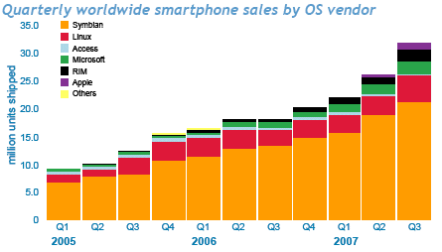
http://www.mobilephonedevelopment.com/archives/507

Slide 5
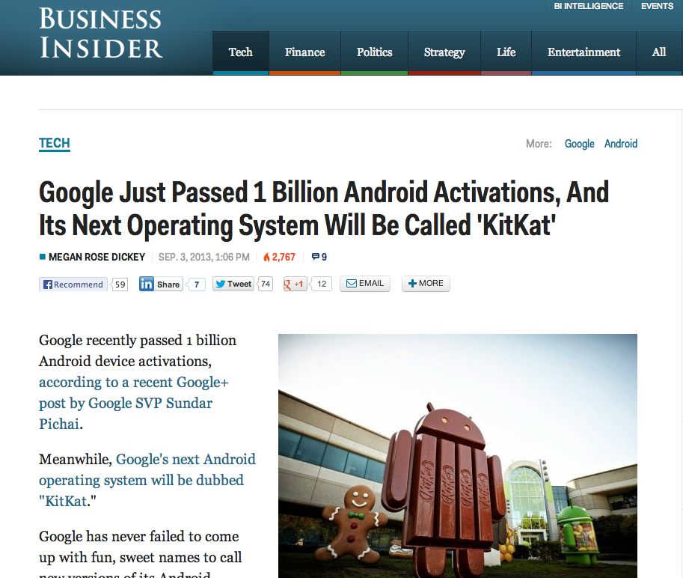
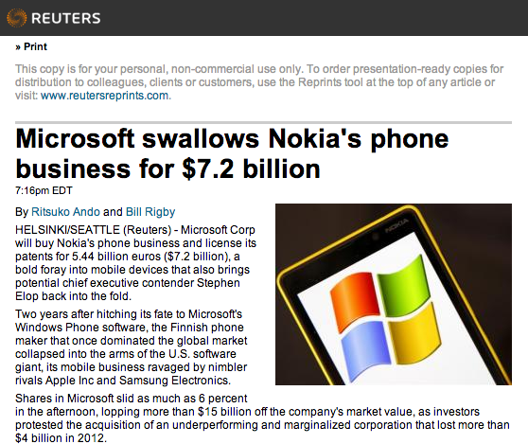
Earlier this week…

Slide 6
1 000 000 000
Android Activations
2008
yesterday
(2013)

Slide 7

about 13.8 Billion years ago…

Slide 8
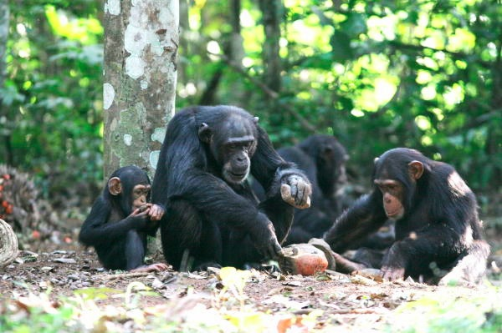
Chimpanzees (~5 million years ago):
Using tools to amplify physical abilities
Working in teams
Altruistic behavior
Notes:
Image: http://mindclockwork.com/ape-intelligence-can-monkeys-be-as-clever-as-humans/

Slide 9
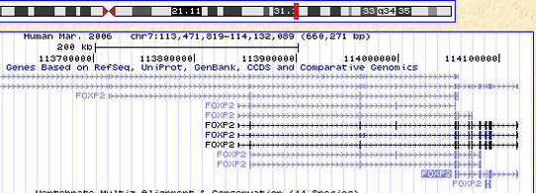
about 300,000 years ago…
Mutations to the FOXP2 gene enable development of brains that can handle recursive language
S ::= NP V
NP ::= N and NP
Caveat: This is speculative…best current theory.

Slide 10
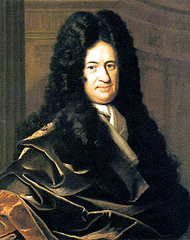
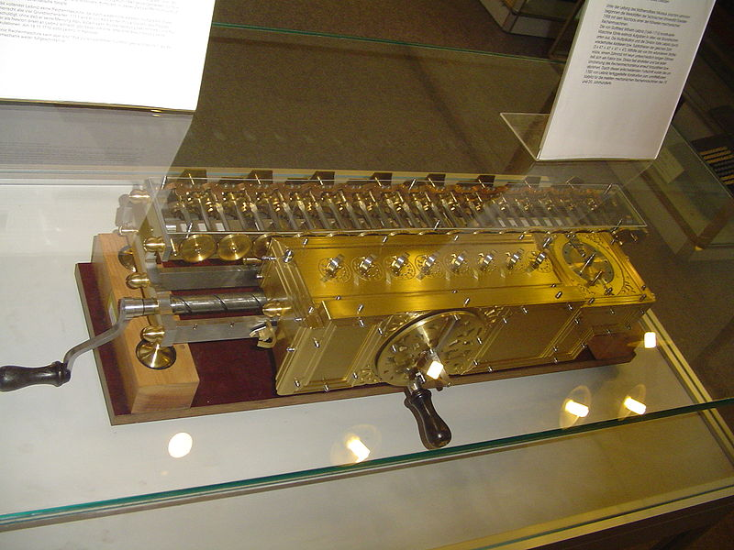
1679
Digital Mechanical Calculator: +, -, *, /
Gottfried Wilhelm Leibniz

Slide 11
...a general method in which all truths of reason would be reduced to a kind of calculation. At the same time, this would be a sort of universal language or script, but infinitely different from all those imagined previously, because its symbols and words would direct the reason, and errors – except those of fact - would be mere mistakes in calculation…
Gottfried Wilhelm Leibniz

Slide 12
Gottfried Wilhelm Leibniz (Universitat Altdorf, 1666) who advised:
Jacob Bernoulli (Universitdt Basel, 1684) who advised:
Johann Bernoulli (Universitdt Basel, 1694) who advised:
Leonhard Euler (Universitat Basel, 1726) who advised:
Joseph Louis Lagrange who advised:
Simeon Denis Poisson who advised:
Michel Chasles (Ecole Polytechnique, 1814) who advised:
H. A. (Hubert Anson) Newton (Yale, 1850) who advised:
E. H. Moore (Yale, 1885) who advised:
Oswald Veblen (U. of Chicago, 1903) who advised:
Philip Franklin (Princeton 1921) who advised:
Alan Perlis (MIT Math PhD 1950) who advised:
Jerry Feldman (CMU Math 1966) who advised:
Jim Horning (Stanford CS PhD 1969) who advised:
John Guttag (U. of Toronto CS PhD 1975) who advised:
David Evans (MIT CS PhD 2000)
my academic great-great-great-great-great-great-great-great-great-great-great-great-great-great-great-grandparent!
http://www.cs.virginia.edu/evans/academic-roots.html

Slide 13
1 000 000 000
Android Activations
Programmable Machines
Recursive Language
Tools
Altruism
Universe
S ::= NP V O
NP ::= N and NP
-13.8B
-5M
-300K
1679
2008
yesterday
(2013)

Slide 14
1 000 000 000
Android Activations
Programmable Machines
Tools
Altruism
Recursive Language
Universe
S ::= NP V O
NP ::= N and NP
-13.8B
-5M
-300K
1679
2008
yesterday
(2013)

Slide 15
Moral / Bet
It’s a very exciting time in operating systems!
Five years from now, there will be a billion computing devices running an operating system none of us has heard of
(but, it might be derived from things developed in the 1960s in Bell Labs)

Slide 16
Android Pre-History
October 2008

Slide 17
WWII
Cold War
MULTICS
Unix
1987: Andy Tanenbaum
Includes source code for Minix

Slide 18
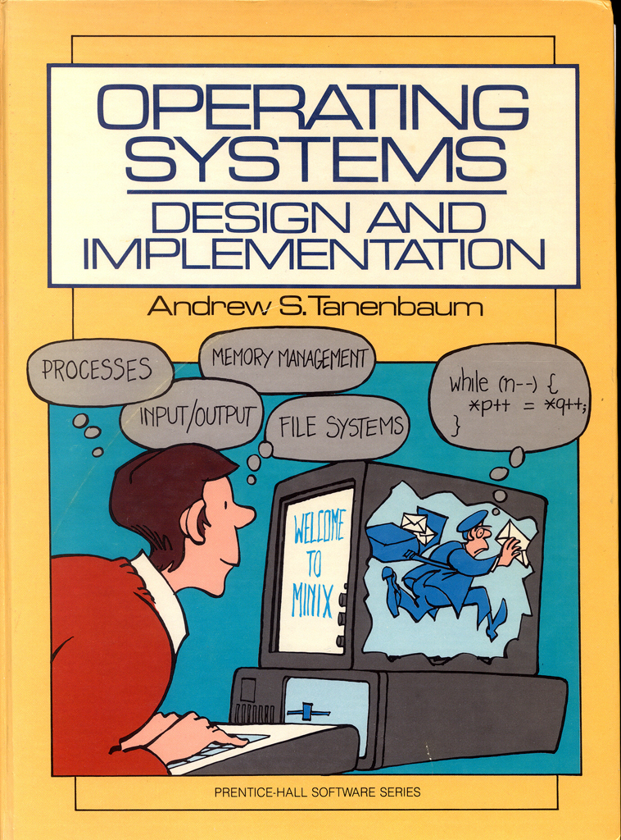
1987: Andy Tanenbaum
Includes source code for Minix (“toy” Unix)

Slide 19
From: torv...@klaava.Helsinki.FI (Linus Benedict Torvalds)
Newsgroups: comp.os.minix
Subject: What would you like to see most in minix?
Summary: small poll for my new operating system
Keywords: 386, preferences
Date: 25 Aug 91 20:57:08 GMT
Hello everybody out there using minix -
I'm doing a (free) operating system (just a hobby, won't be big and professional like gnu) for 386(486) AT clones. This has been brewing since april, and is starting to get ready. I'd like any feedback on things people like/dislike in minix, as my OS resembles it somewhat (same physical layout of the file-system (due to practical reasons) among other things).
I've currently ported bash(1.08) and gcc(1.40), and things seem to work. This implies that I'll get something practical within a few months, and I'd like to know what features most people would want. Any suggestions are welcome, but I won't promise I'll implement them :-)
Linus (torv...@kruuna.helsinki.fi)
PS. Yes - it's free of any minix code, and it has a multi-threaded fs. It is NOT protable (uses 386 task switching etc), and it probably never will support anything other than AT-harddisks, as that's all I have :-(.

Slide 20
From: torv...@klaava.Helsinki.FI (Linus Benedict Torvalds)
Newsgroups: comp.os.minix
Subject: Re: LINUX is obsolete
Date: 31 Jan 92 10:33:23 GMT
…
>I still maintain the point that designing a monolithic kernel in 1991 is
>a fundamental error. Be thankful you are not my student. You would not
>get a high grade for such a design :-)
Well, I probably won't get too good grades even without you: I had an
argument (completely unrelated - not even pertaining to OS's) with the
person here at the university that teaches OS design. I wonder when
I'll learn :)
…
Andy Tanenbaum

Slide 21
Really, I’m not out to destroy Microsoft. That will just be a completely unintentional side effect.
Linus Torvalds, 28 Sept 2003 (New York Times)

