Slide 1
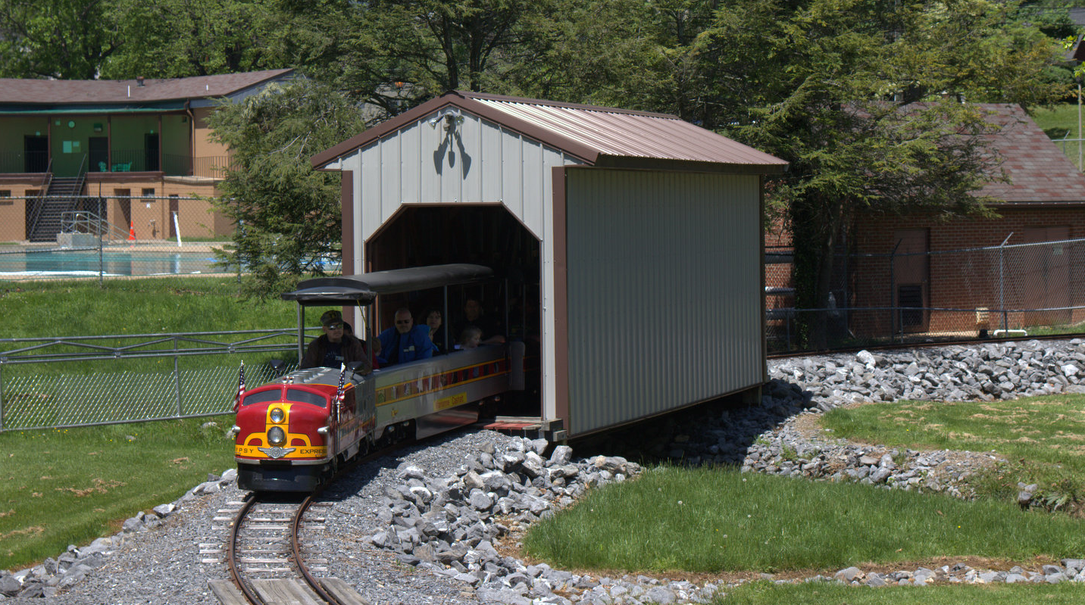
Class 4: Once Upon a Process
cs4414 Fall 2013
University of Virginia
David Evans

Slide 2
Plan for Today
Administrative Things
Communication, Grading, Recording
Learning Rust
How to Share a Processor

Slide 3
Human⇔Human Communication
IRC: quick and dirty
#cs4414: immediate responses
#rust: general Rust questions
Web: rust-class.org
Page-specific (e.g., PS1, Class 1 notes)
General forums
easiest for others to see
best for longer questions/responses
Email: evans@virginia.edu
Use only for things that don’t fit into other channels
Notify me if you asked something on web but didn’t get a response
Anything that you want to keep private

Slide 4
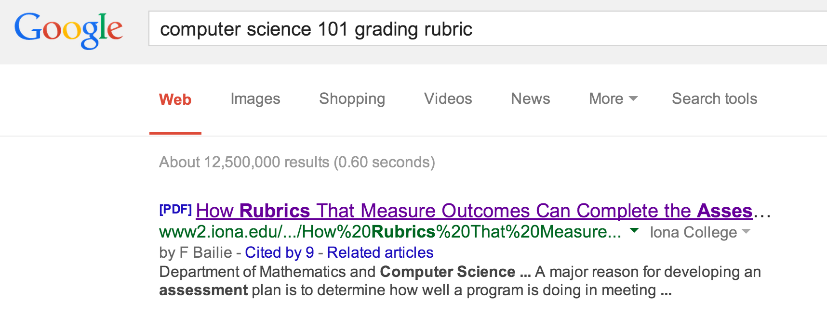
Grading
Don’t be stressed!

Slide 5
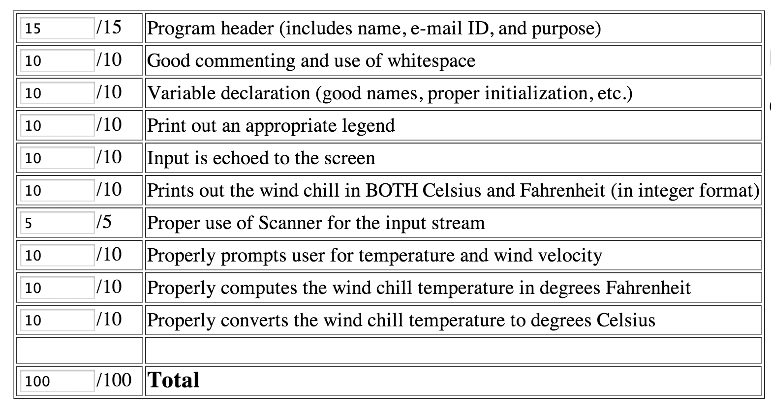

Slide 6
cs4414 Grading Form
1
/ 1
Your program pretty much works!
You will have plenty of ways to distinguish yourself as outstanding, but by doing something creating and extraordinary, not by being perfect on some checklist of minutiae.

Slide 7
For Future Problem Sets
Auto-grader
You’ll be able to confirm that your code behaves as expected before submitting (and can try as many times as you want)
Demos
All team members will answer questions about design decisions, concepts, how to extend, etc.
Teammate Ratings

Slide 8
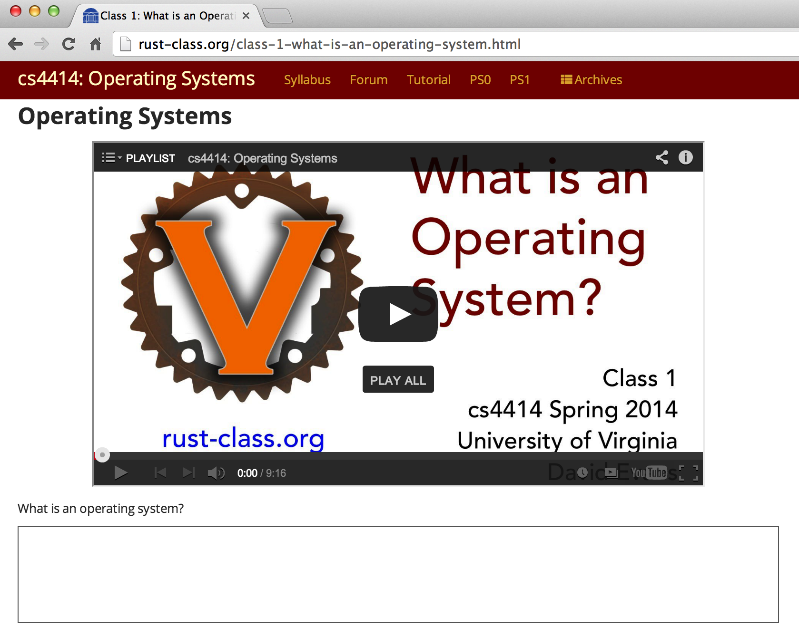
Recording Classes
Can’t promise to record everything
Recordings will be (somewhat) edited
Press the button in front of you unless you want to be recorded

Slide 9

Questions

Slide 10

Rust Expressions and Functions

Slide 11
Java / C / C++
Rust
IfStatement ::=
if (Expression)
Statement_{True}
[ else
Statement_{False}
]
IfExpression ::=
if Expression Block
[ else Block ]
Block ::= { [Statement* Expr] }
Expression ::= Block
Statement ::= Expression ;
Simplified: static.rust-lang.org/doc/master/rust.html#if-expressions.
Warning: “(looking for consistency in the manual's grammar is bad: it's entirely wrong in many places.)”

Slide 12
Quiz
IfExpression ::=
if Expression Block
[ else Block ]
Block ::= { [Statement* Expr] }
Expression ::= Block
fn max(a: int, b: int) -> int {
if { } { a } else { b }
}
Syntax Error
Type Error
Run-time Error

Slide 13
IfExpression ::=
if Expression Block
[ else Block ]
Block ::= { [Statement* Expr] }
Expression ::= Block
fn max(a: int, b: int) -> int {
if { } { a } else { b }
}
$ rustc block.rs
block.rs:2:7: 2:10 error: mismatched types: expected `bool` but found `()` (expected bool but found ())
block.rs:2 if { } {
^~~
If you get bad error messages from rustc,report them to Kiet!

Slide 14
(Trick) Quiz
IfExpression ::=
if Expression Block
[ else Block ]
Block ::= { [Statement* Expr] }
Expression ::= Block
fn max(a: int, b: int) -> int {
if { let x = 4414; x = x + a; x > b + 4414 } { a }
else { b }
}
Syntax Error
Type Error
Run-time Error

Slide 15
fn max(a: int, b: int) -> int {
if { let x = 4414; x = x + a; x > b + 4414 } { a }
else { b }
}
$ rustc block.rs
block.rs:2:23: 2:24 error: re-assignment of immutable variable `x`
block.rs:2 if { let x = 4414; x = x + a; x > b + 4414 } {
^
“Variables” are invariable…unless declared with mut.

Slide 16
fn max(a: int, b: int) -> int {
if { let mut x = 4414; x = x + a; x > b + 4414 } { a }
else { b }
}
$ rust run block.rs
Max: 5

Slide 17
Quiz
IfExpression ::=
if Expression Block
[ else Block ]
Block ::= { [Statement* Expr] }
Expression ::= Block
Statement ::= Expression ;
fn max(a: int, b: int) -> int {
if a > b { a } else { b; }
}
Syntax Error
Type Error
Run-time Error

Slide 18
fn max(a: int, b: int) -> int {
if a > b { a } else { b; }
}
The semi-colon makes it a statement – no value
block.rs:2:24: 2:30 error: mismatched types: expected `int` but found `()` (expected int but found ())
block.rs:2 if a > b { a } else { b; }
^~~~~~

Slide 19
Higher-Order Functions
Java
Rust
Java 8 (March 2014)
| <parameters> | Block
Scheme
proc(<parameters>) Block
(define (make-adder a)
(lambda (n)
(+ a n)))

Slide 20
Define a function, make_adder, that takes an int as input and returns a function that takes and int and returns the sum of the original and input int.
let increment = make_adder(1);
increment(3) => 4

Slide 21
fn make_adder(a: int) -> (fn(int) -> int) {
fn(b: int) { a + b }
}
fn main() {
let increment = make_adder(1);
println!("result: {:x}", increment(2));
}
Limitation: we can only use increment once!

Slide 22
Define a function, ntimes, that takes as inputs a function f (int -> int) and an integer n, and returns a function that applies f n-times.
fn double(a: int) -> int { a * 2 }
fn main() {
let quadruple = ntimes(double, 2);
println(fmt!("quad: %?", quadruple(2)));
}

Slide 23
fn double(a: int) -> int { a * 2 }
fn ntimes(f: proc(int) -> int, times: int) -> proc(int) -> int {
proc(x: int) {
match times { 0 => { x }
_ => { ntimes(f, times - 1)(f(x))}
}
}}
fn main() {
let quadruple = ntimes(double, 2);
println!("quad: {:d}", quadruple(2));
}

Slide 24
fn double(a: int) -> int { a * 2 }
fn ntimes(f: proc(int) -> int, times: int) -> proc(int) -> int {
proc(x: int) {
match times { 0 => { x }
_ => { ntimes(f, times - 1)(f(x))}
}
}}
fn main() {
let quadruple = ntimes(double, 2);
println!("quad: {:d}", quadruple(2));
}
bash-3.2$ rustc ntimes.rs
bash-3.2$ ./ntimes
Segmentation fault: 11
Note: when a C/C++ program gives a “Segmentation fault”, 99.9999% of the time it is the programmers “fault”. When a Rust program (that doesn’t use unsafe) does, 100% of the time it is Rust’s fault.

Slide 25
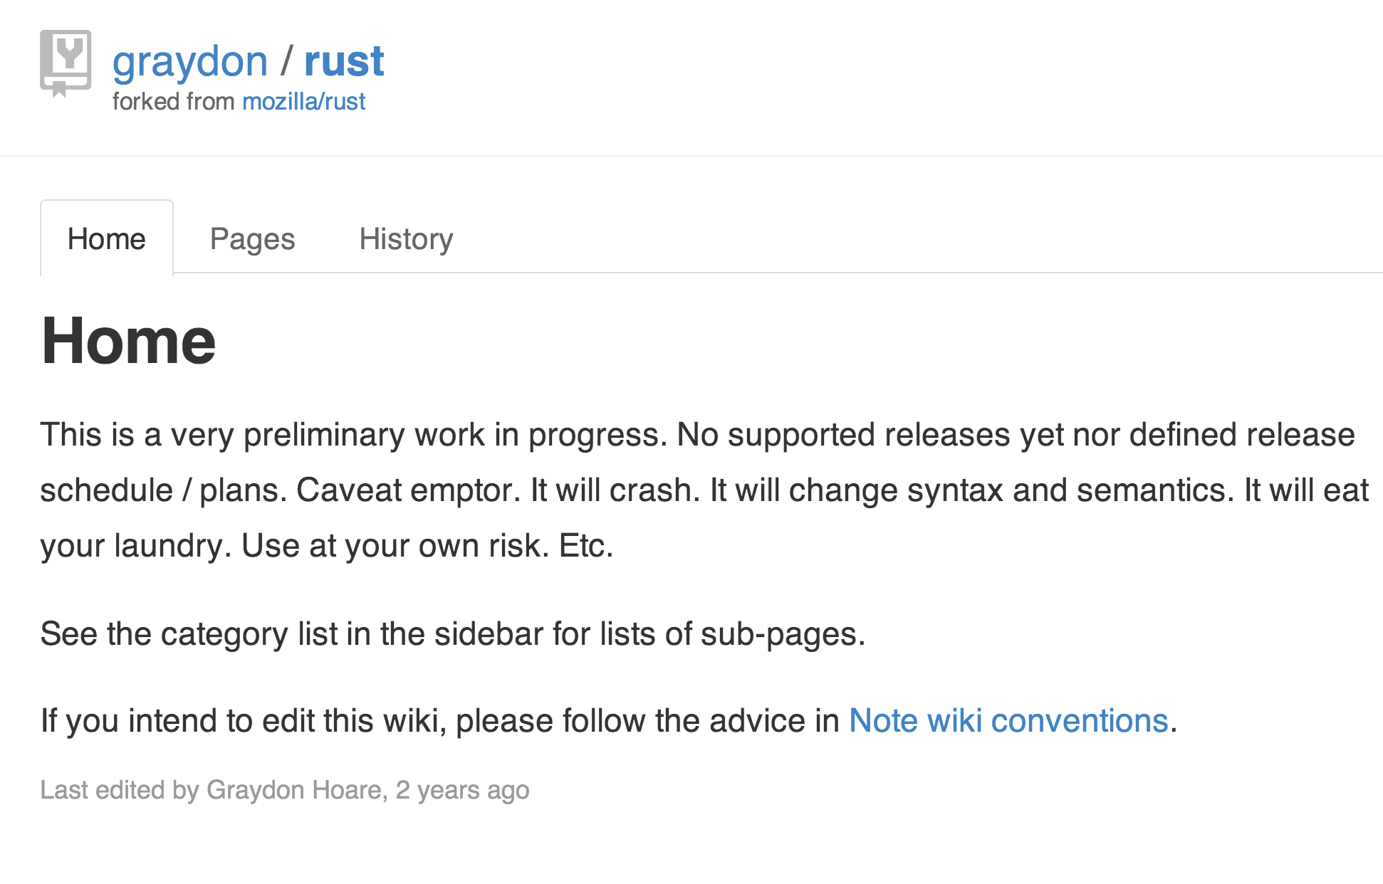

Slide 26
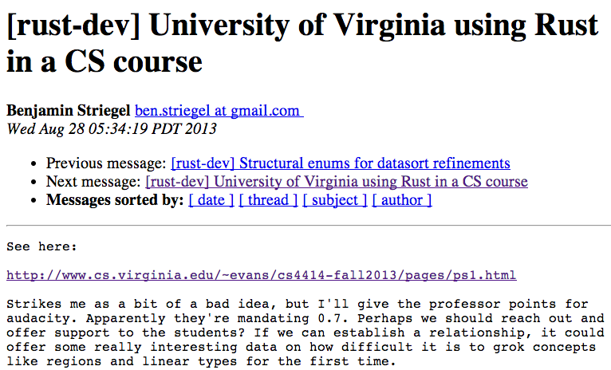

Slide 27
Rust or Bust?
Rust
Bust (C)
☹ Immature, Unstable
Poorly documented
Few open source projects (except Servo)
Not in high employer demand
No other courses
Mature, Stable
Hundreds of books, etc.
Lots of open source projects (incl. Linux)
Popular for interview questions
Nearly all OS courses

Slide 28
Rust
Bust (C)
Benefits from 30 years of language research
Chance to influence a new, exciting, fast-evolving language
Really cool features for memory management and concurrency
FUN!
Suffers from maintaining backwards compatibility
C++0x standard process began in 1998, released in 2011, over 40 meetings
Lots of complexity, but not designed for safety
Boring, Annoying

Slide 29
But what about the Lack of Documentation?!

Slide 30
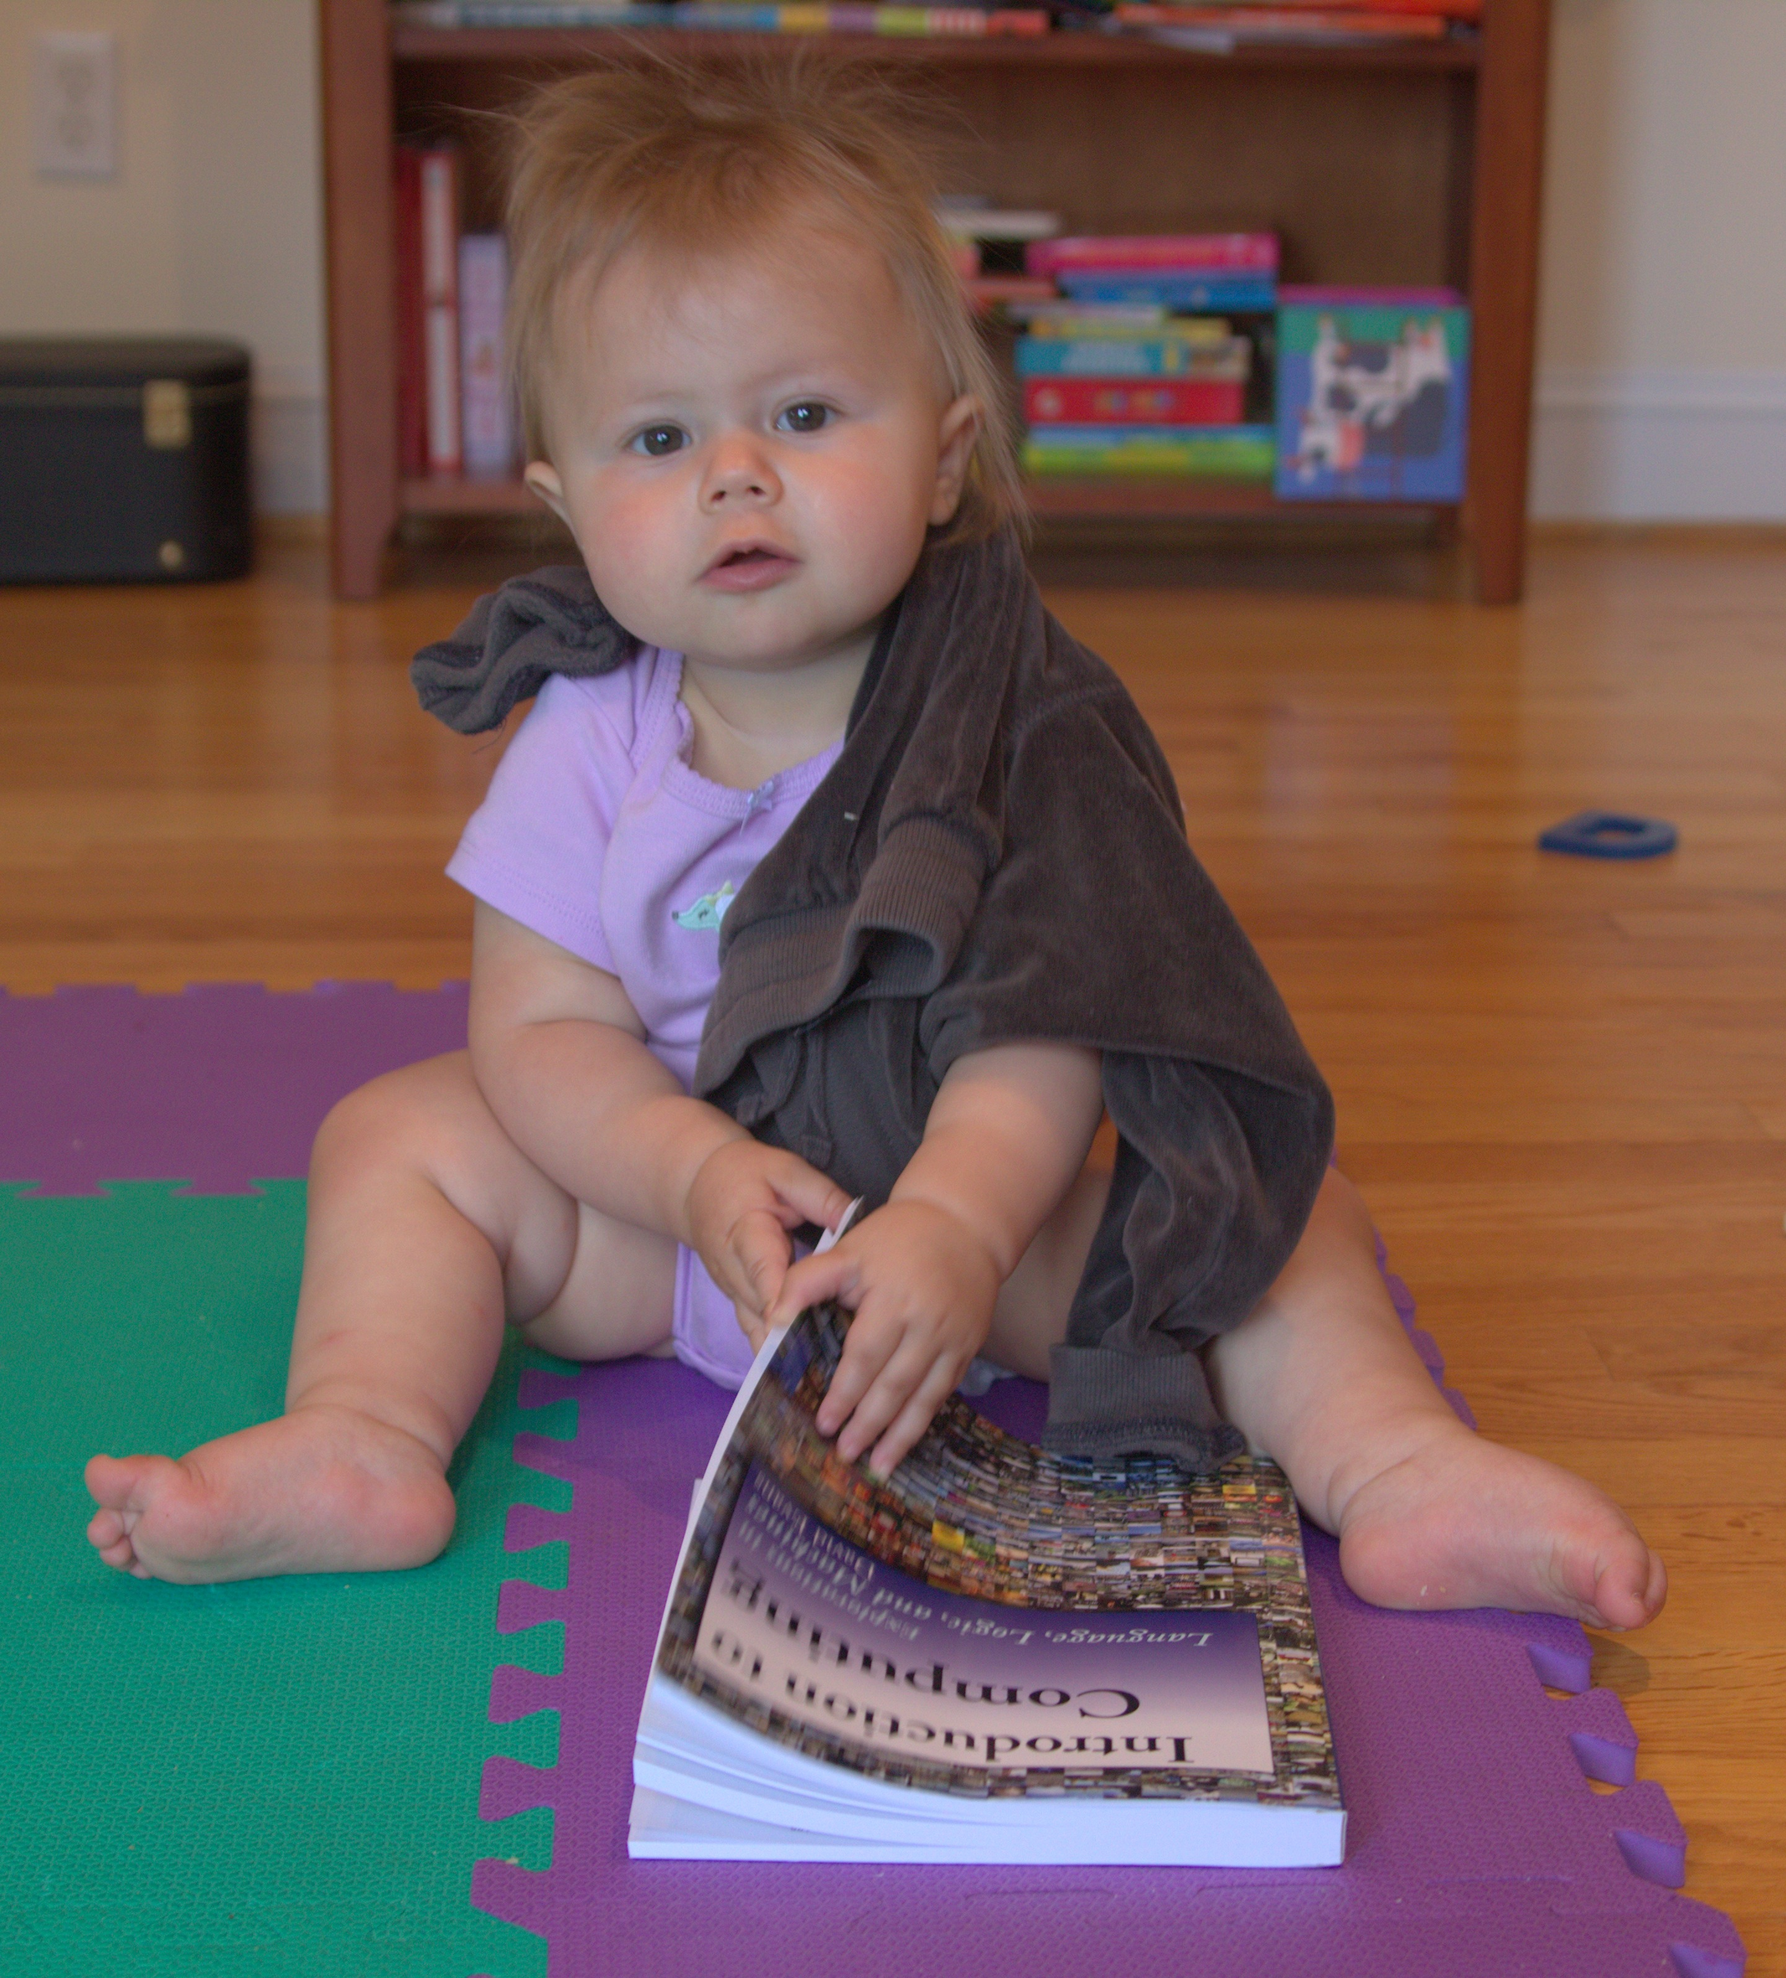
“Baby” programmer (cs1xxx)

Slide 31
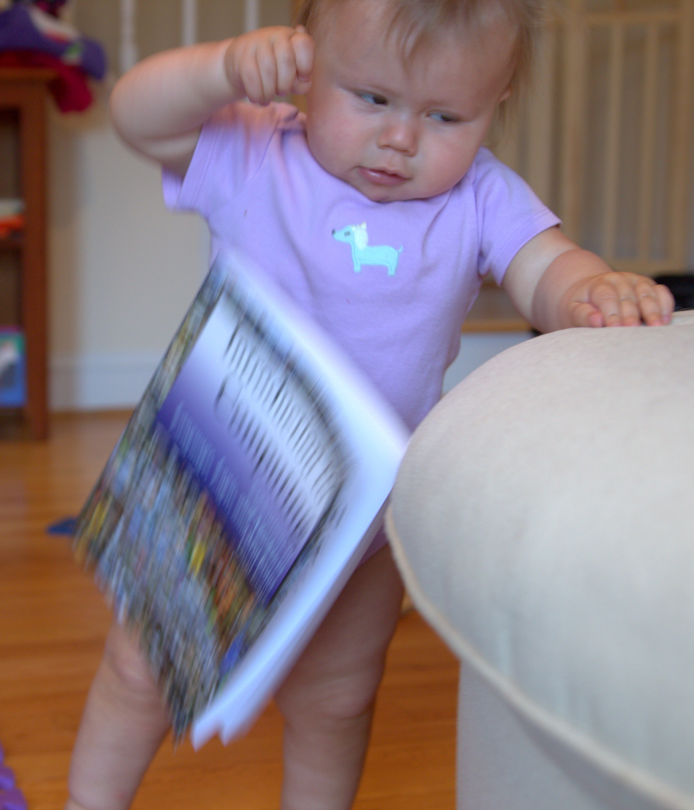
Give up in disgust!

Slide 32

cs4414 Student “Professional Amateur Programmer”

Slide 33
Solving Programming Mysteries
DuckDuckGo (or Google) is your friend!
stackoverflow [rust]
Experiment!
Ask for help:
IRC
rust-class.org
If you figure something useful out that is not well documented, document it: course forum comment, “blog” post

Slide 34
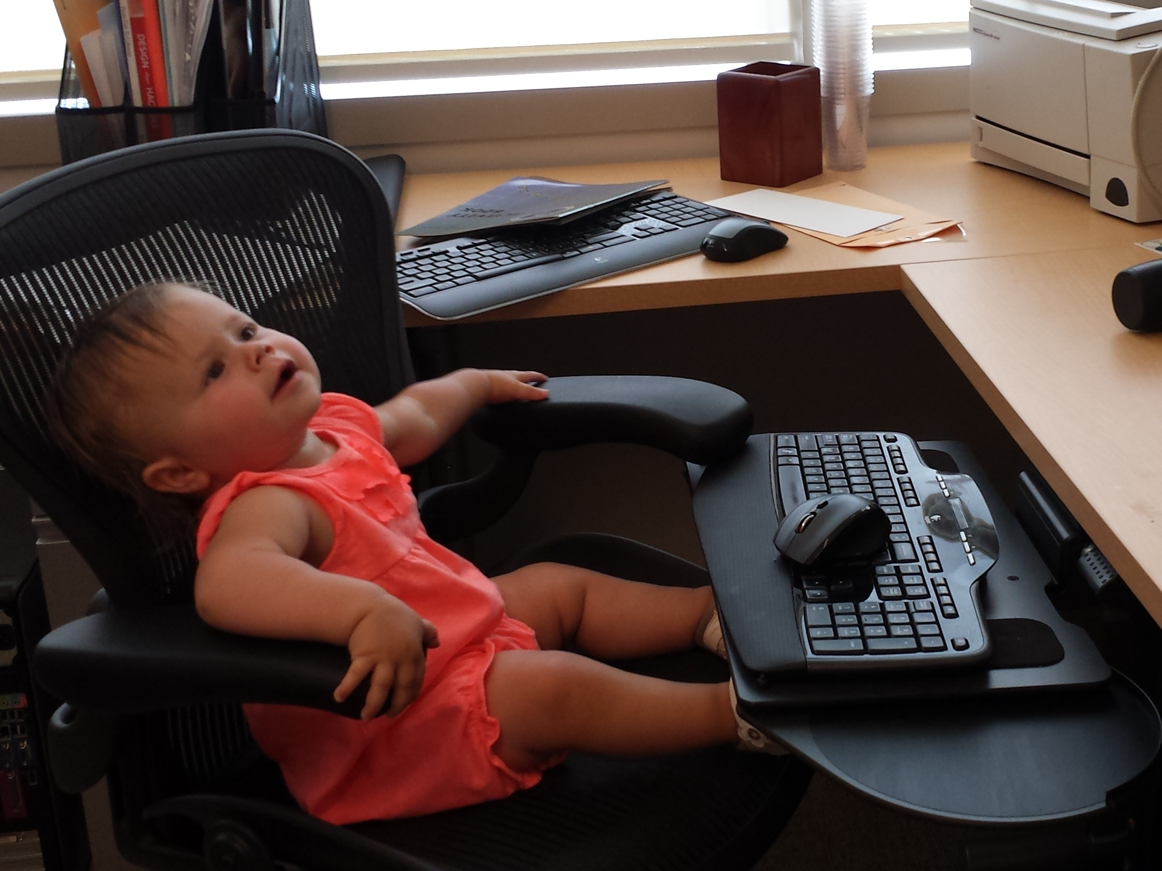
Instead of whinging about how bad the Rust documentation for strings is….

Slide 35
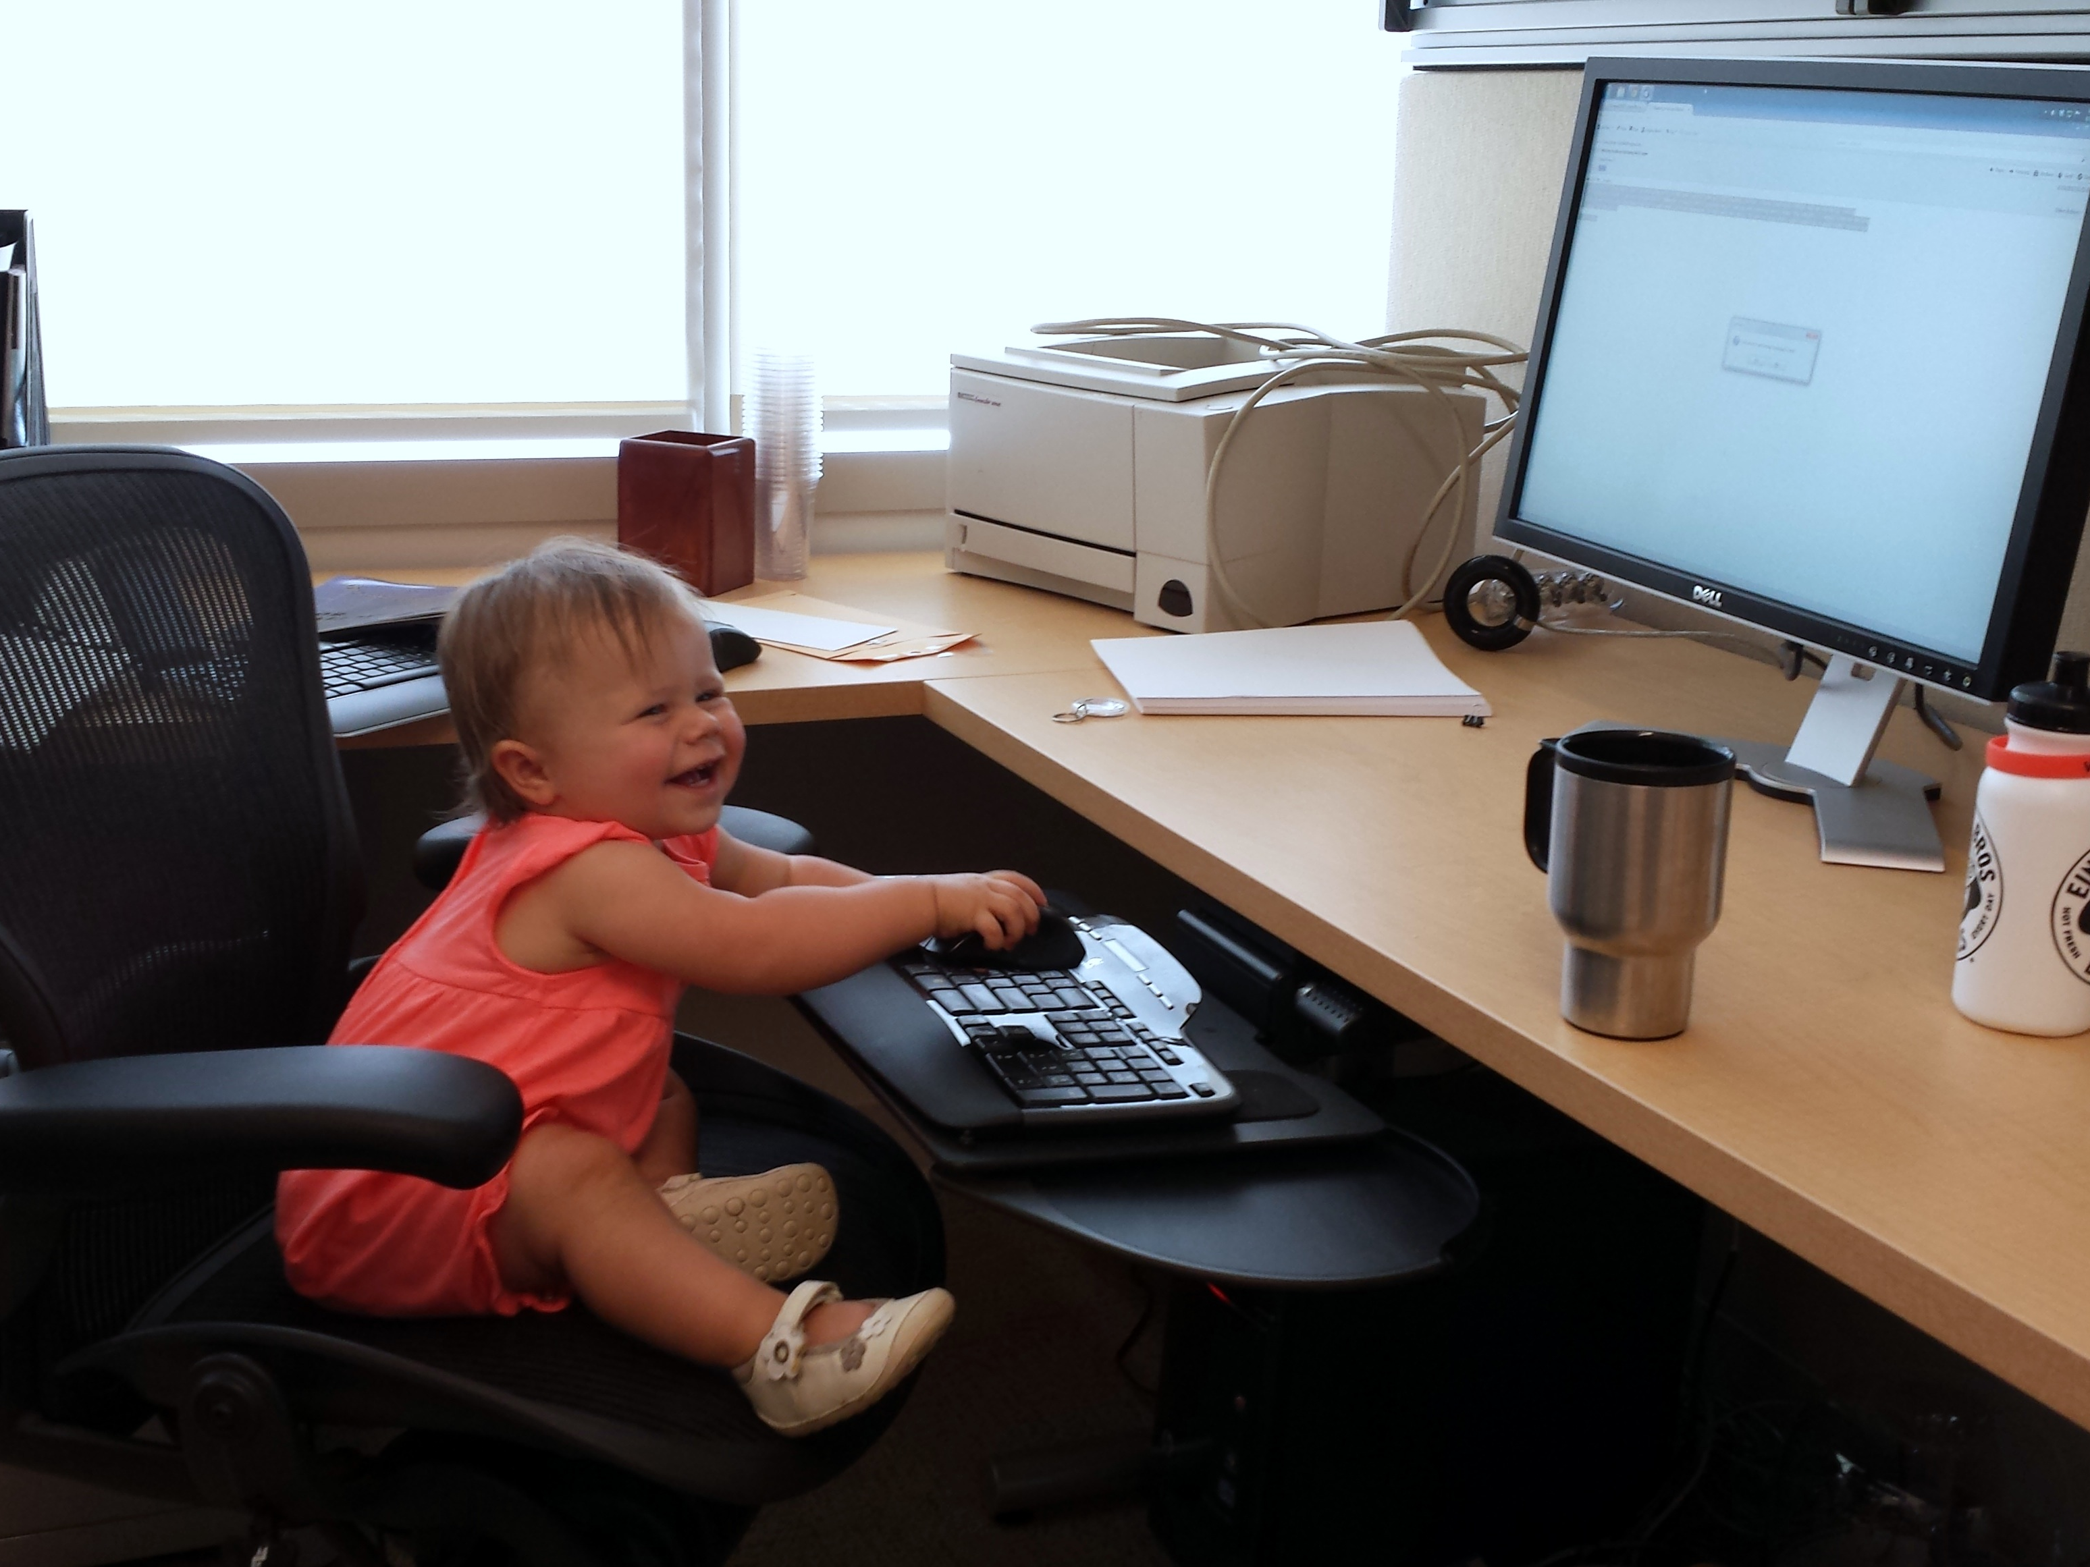
Be happy! You can be the first to write one!
STRINGS IN RUST

Slide 36
Be happy! You can be the first to write one!
STRINGS IN RUST
Note: last semester’s students had much less documentation, and an even more buggy compiler, but still survived! (And some did contribute to writing the tutorials and improving the compiler you are using now.)

Slide 37
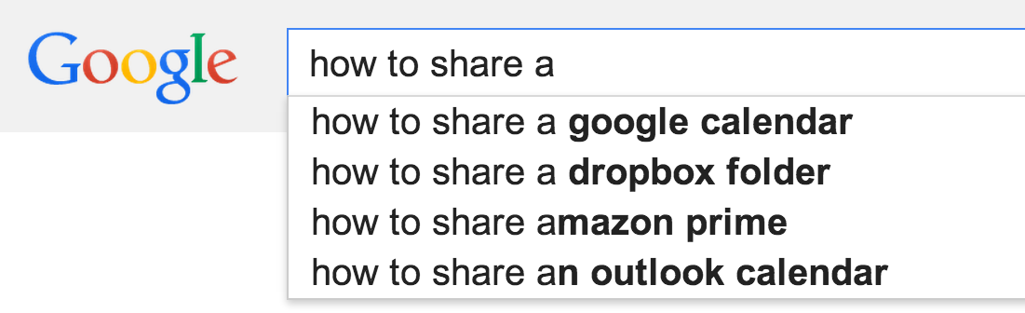
How can several programs share a processor?

Slide 38
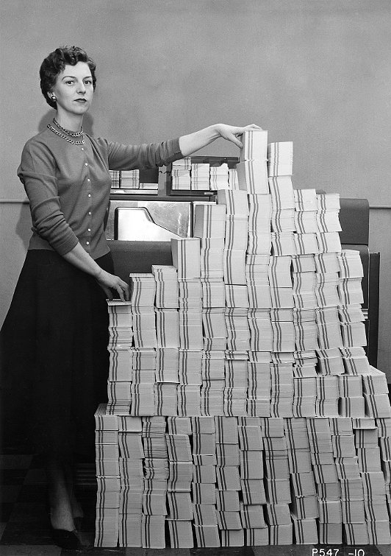
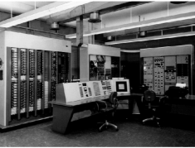

Recap Last Class
Batch Processing
Program
A
Program A
B
Program B
A
Multiprogramming
Program C
C

Slide 39
Kinds of Processor-Sharing
Multiprogramming
User program runs until it gets stuck, then supervisor runs.
Non-preemptive multi-tasking
User program runs until it decides to let the supervisor run.
Preemptive multi-tasking
User program runs until the (approximately) supervisor decides to let another program run.

Slide 40
Non-preemptive
Preemptive

Slide 41
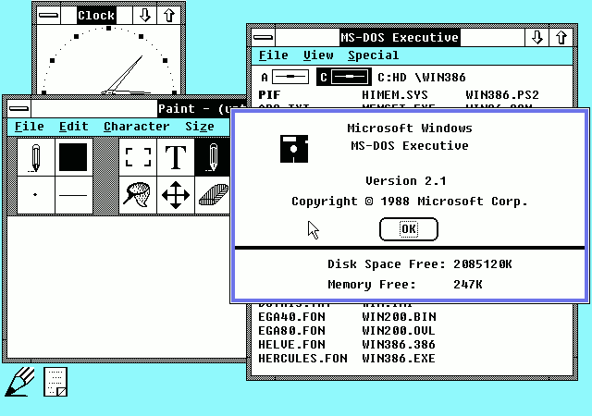
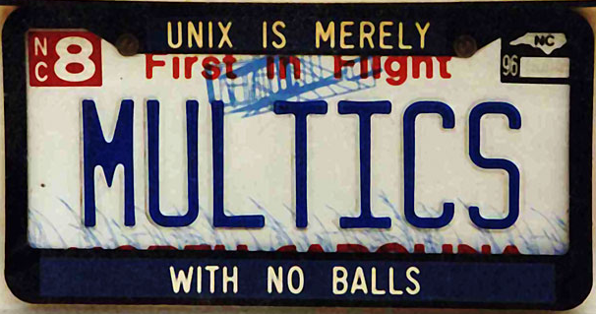

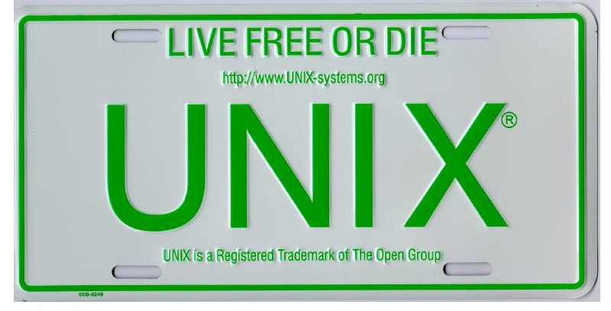

Which have preemptive multitasking?
Microsoft Windows 2.1x
1988
PowerMac G5
(Mac OS 9)
2006
MULTICS (1969)
MacBook Air
(Mac OS X)
2011
UNIX (1975)

Slide 42
Which have preemptive multitasking?
Microsoft Windows 2.1x
1988
PowerMac G5
(Mac OS 9)
2006
MULTICS (1969)
MacBook Air
(Mac OS X)
2011
UNIX (1975)

Slide 43
How could I prove it?
Mac OS X
42

Slide 44
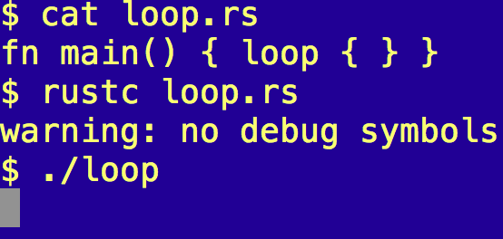
One-line “Proof”

Slide 45
Which are result from preemptive multitasking?
A computer running Mac OS X crashes less than one running Mac OS 9
A computer running Mac OS X needs fewer hard reboots than one running Mac OS 9
When you watch your favorite Eminem video for the 50th time, the video still (occasionally) jitters
Your zhttpto server can handle more than one request at a time

Slide 46
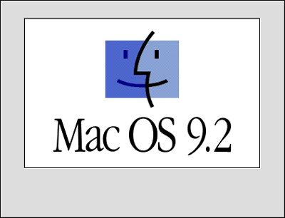
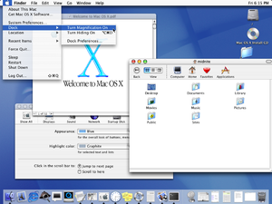
Mac OS 9.2.2
5 Dec 2001
Mac OS X (Cheetah)
24 March 2001
How did Apple add preemptive multitasking to Mac OS?

Slide 47

(The answer is probably not in this movie.)
http://www.youtube.com/watch?v=YsWBJ_usRck&t=2m18s

Slide 48

“Once you make them talk, they won’t be inanimate anymore.”
Steve Jobs (as quoted by Sorkin earlier in interview)

Slide 49
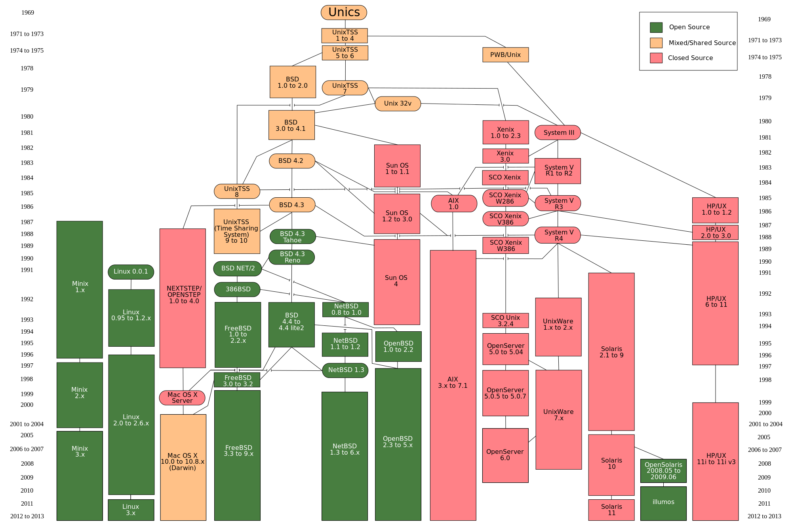
https://upload.wikimedia.org/wikipedia/commons/7/77/Unix_history-simple.svg

Slide 51
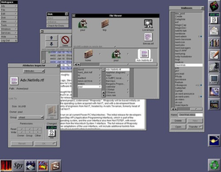
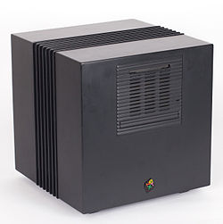

Slide 52
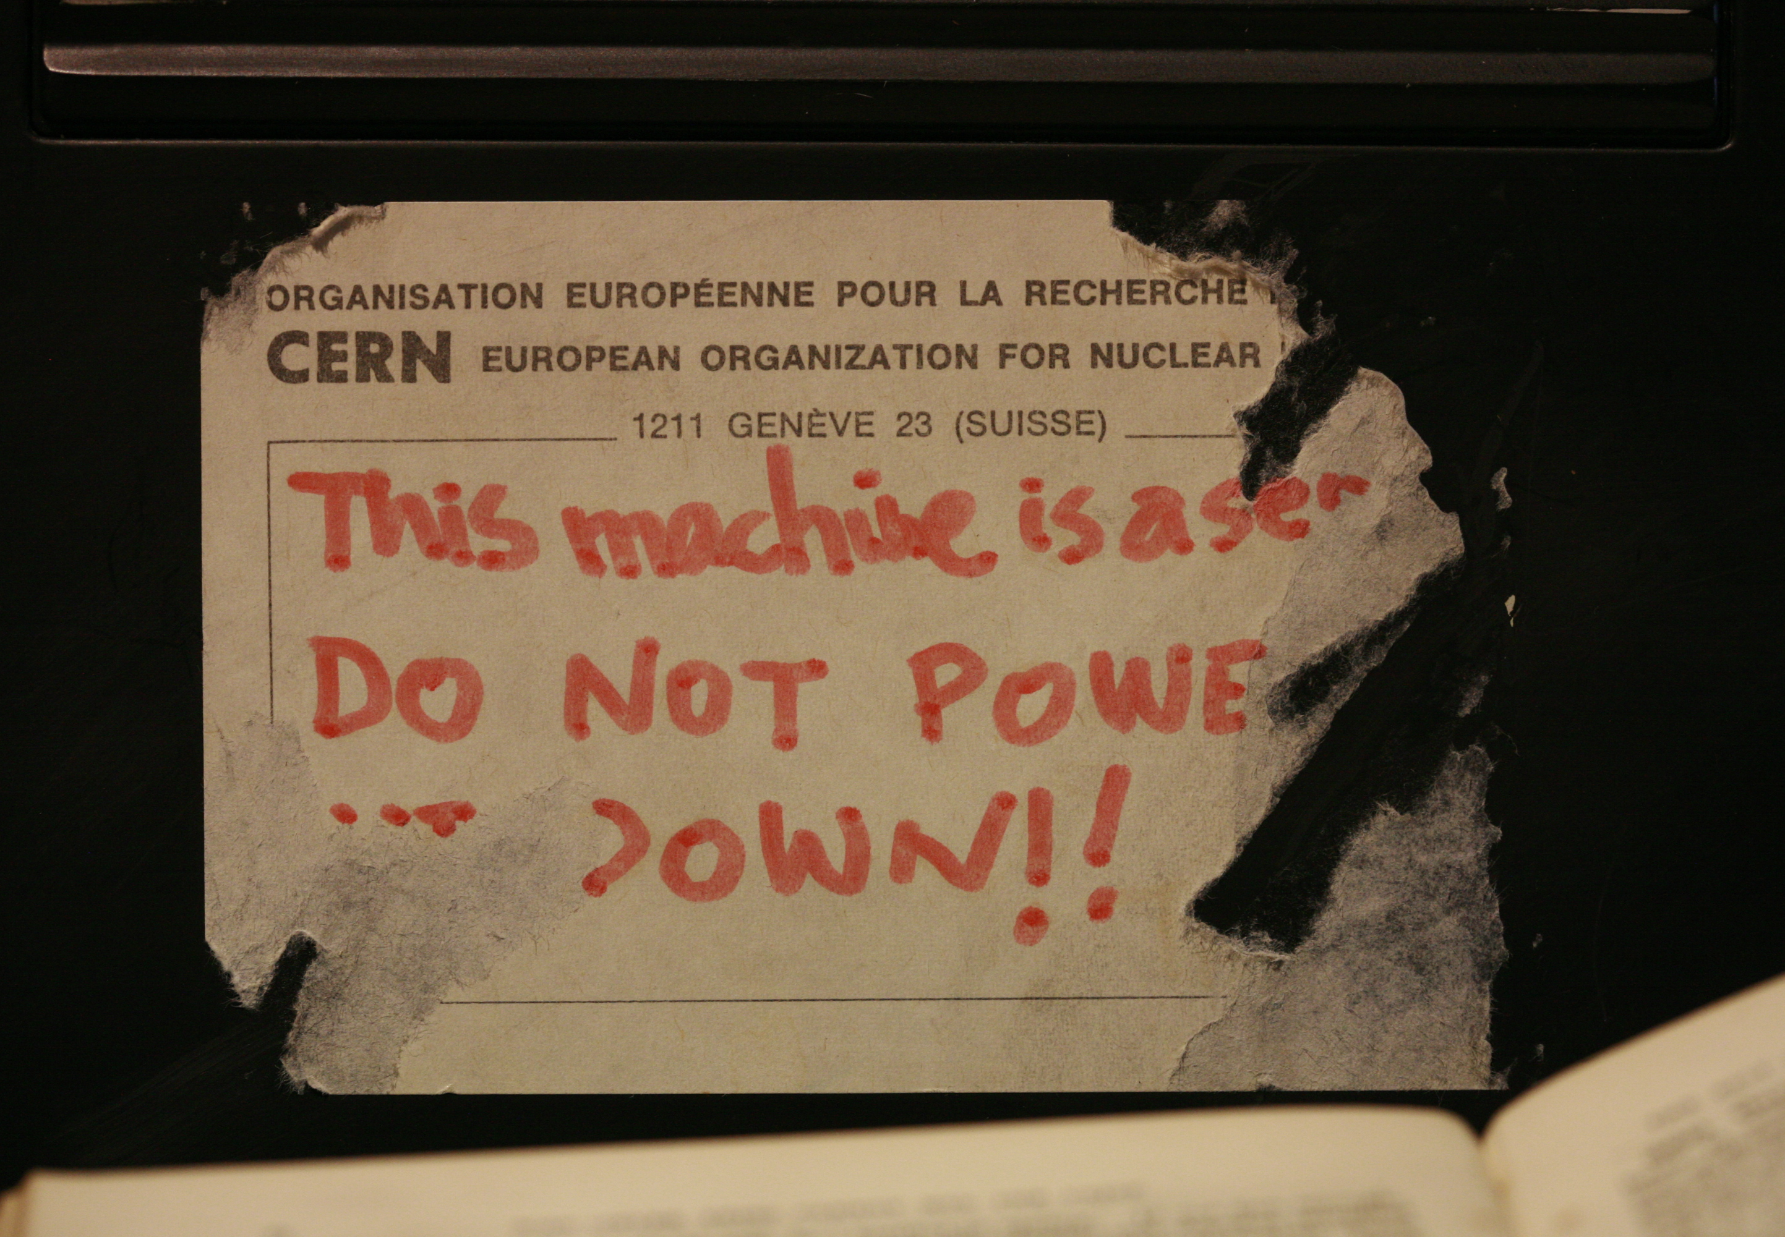

Slide 53
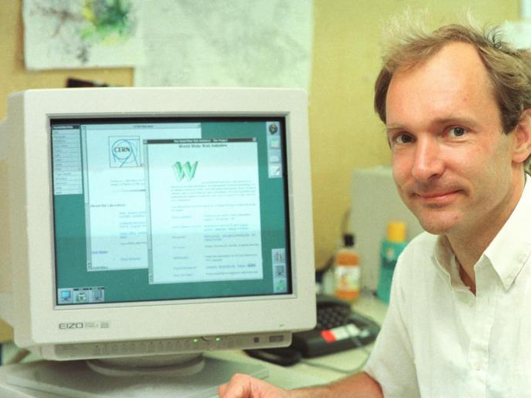
Sir Tim Berners Lee finishing PS1 24 years early!

Slide 54
MULTICS
Code (carries license)
“Ideas” (no license, possible patent lawsuits)
Unix
BSD
Minix
NextStep
FreeBSD
Linux
Mac OS X
Android
iOS

Slide 55
How can preemptive multitasking even be possible?!?
Preemptive multi-tasking
User program X runs until the supervisor decides to let another program run.

Slide 56
Preemptive (?) Multitasking
A
Program A
Supervisor
B
Program B
Supervisor
Program C
A
Supervisor
A

Slide 57


Slide 58
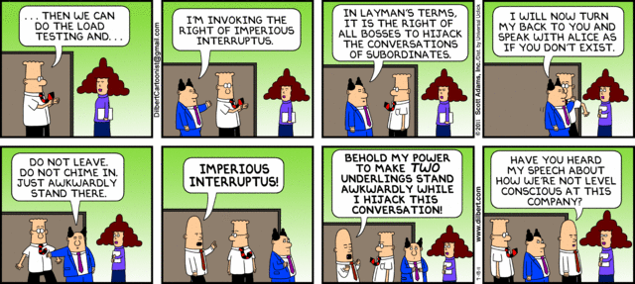

Slide 59

Interrupts
How frequently should the supervisor’s alarm clock (“kernel timer interrupt”) go off to check on the workers?

Slide 60
My MacBook (Ubuntu)
timer.c is a 50-line C program from
http://www.advenage.com/topics/linux-timer-interrupt-frequency.php (link on notes)
bash-3.2$ uname -a
Darwin Davids-MacBook-Air-2.local 11.4.2 Darwin Kernel Version 11.4.2: Thu Aug 23 16:25:48 PDT 2012; root:xnu-1699.32.7~1/RELEASE_X86_64 x86_64
bash-3.2$ gcc timer.c ; ./a.out
kernel timer interrupt frequency is approx. 4016 Hz or higher
Rust version by Wil Thomason

Slide 61
Timer Interrupts
Supervisor
A
Supervisor
B
Supervisor
set alarm clock
switch to program A
set alarm clock
switch to program B
What makes the alarm clock ring?

Slide 62
Who interrupts the supervisor?

Slide 63
The supervisor’s supervisor!
a.k.a. Hypervisor

Slide 64

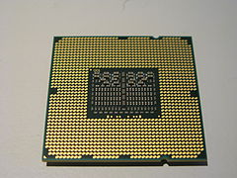
Support for hypervisor added to Intel x86 in 2005 (VT-x)

Slide 65

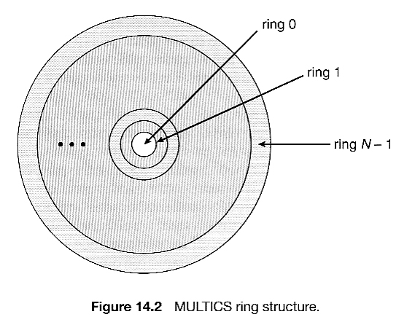
More general (quite similar) idea in MULTICS (but with 8-levels of supervision in hardware by 1975)

Slide 66
Charge
Tutorial Part 3 and Problem Set 2 will be posted later today
PS2 is due February 9
Longer and more challenging than PS1, don’t wait to get started
Read the Process API and Direct Execution sections of the OSTEP book

