Slide 1
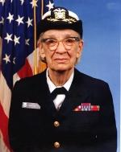
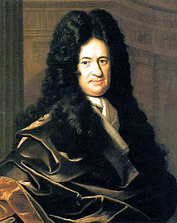
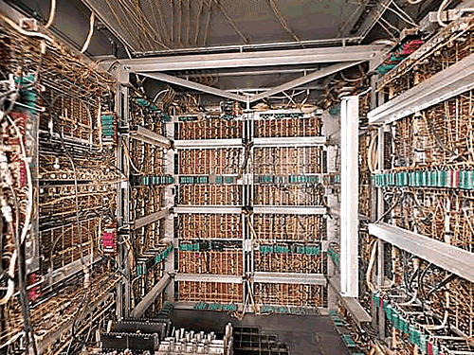
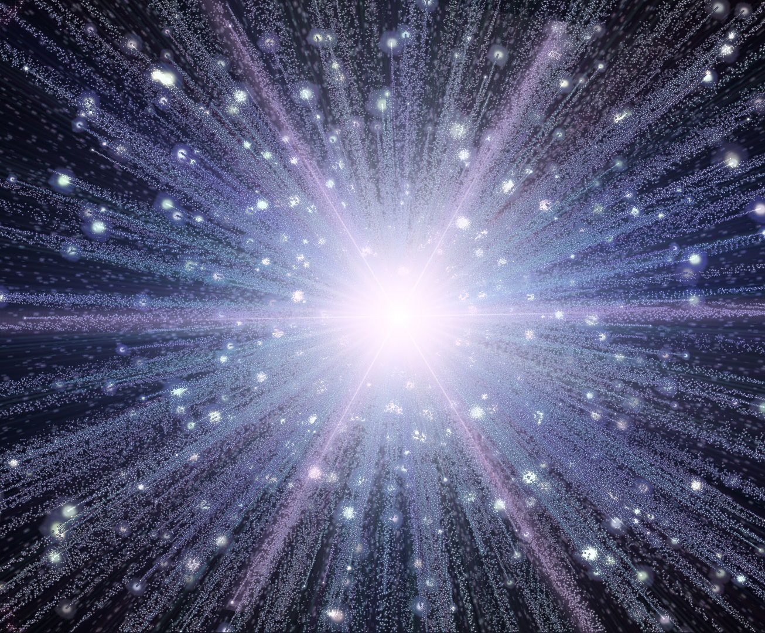
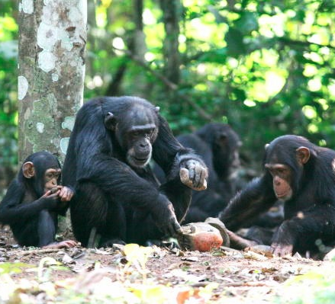
1 000 000 000
Android Activations
Practical Universal Machines
Abstractions
Programmable Machines
Tools
Altruism
Recursive Language
Universe
S ::= NP V O
NP ::= N and NP
-13.8B
-5M
-300K
1679
1945
1950s
2008
yesterday
(2013)

