Slide 1

Class 6: What the &~#@<!? (Pointers in Rust)
cs4414 Fall 2013
University of Virginia
David Evans

Slide 2
background
explicit vs. implicit memory management
pointers in Rust

Slide 3
What Dave was doing when you were learning to crawl…

Slide 4
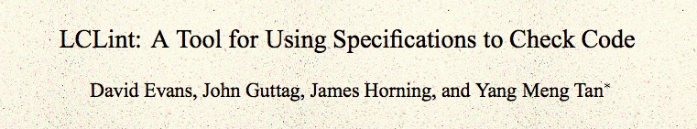
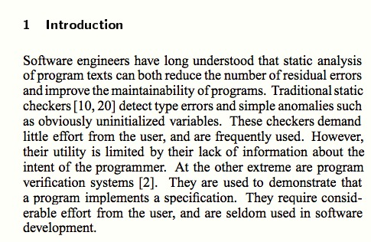
ACM Foundations in Software Engineering, 1994

Slide 5
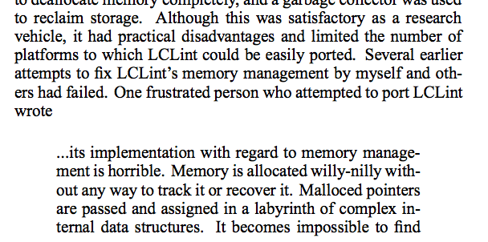
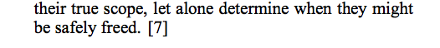

Slide 6
Memory management in C
$ man malloc # on my Macbook Air
MALLOC(3) BSD Library Functions Manual
SYNOPSIS
...
void free(void *ptr);
void *malloc(size_t size);
...
DESCRIPTION
The malloc(), calloc(), valloc(), realloc(), and reallocf() functions allocate memory. The allocated memory is aligned such that it can be used for any data type, …. The free() function frees allocations that were created via the preceding allocation functions.
The malloc() function allocates size bytes of memory and returns a pointer to the allocated memory.

Slide 7
# include <stdlib.h>
# include <stdio.h>
int main(int _argc, char **_argv) {
int *x = (int *) malloc (sizeof(*x));
*x = 4414;
printf("x = %d\n", *x);
return 0;
}
gash> gcc -Wall toofree.c
gash> ./a.out
x = 4414

Slide 8
# include <stdlib.h>
# include <stdio.h>
int main(int _argc, char **_argv) {
int *x = (int *) malloc (sizeof(*x));
*x = 4414;
free(x);
printf("x = %d\n", *x);
return 0;
}
gash> gcc -Wall toofree.c
gash> ./a.out
x = 4414

Slide 9
# include <stdlib.h>
# include <stdio.h>
int main(int _argc, char **_argv) {
int *x = (int *) malloc (sizeof(*x));
*x = 4414;
free(x);
free(x);
printf("x = %d\n", *x);
return 0;
}
Note: this is what happens to happen on my computer, but the C behavior is undefined. It would be “correct” for a C program like this to do absolutely anything!
gash> gcc -Wall toofree.c
gash> ./a.out
a.out(23685) malloc: *** error for object 0x10a1008d0: pointer being freed was not allocated
*** set a breakpoint in malloc_error_break to debug
Abort trap: 6

Slide 10
This gets tricky…
(from locale.h)
struct lconv
{
char *decimal_point;
char *thousands_sep;
char *grouping;
char *int_curr_symbol;
char *currency_symbol;
… } ;
// in my code…
struct lconv *local = localeconv (void);
…
free(local->decimal_point); // ?
free(local); // ?

Slide 11
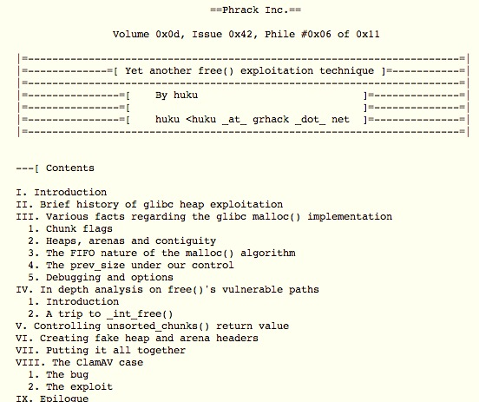
Should we really care?
November 2009

Slide 12
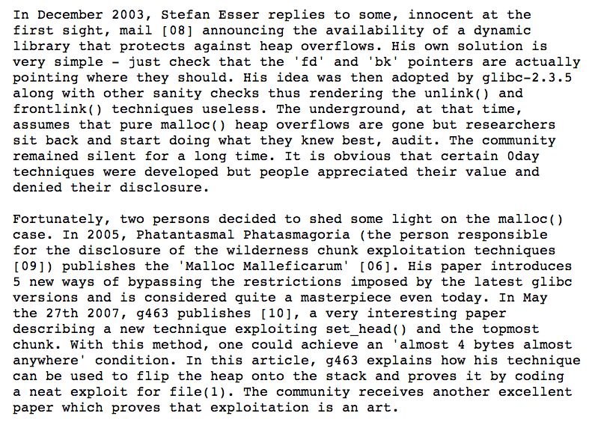

Slide 13
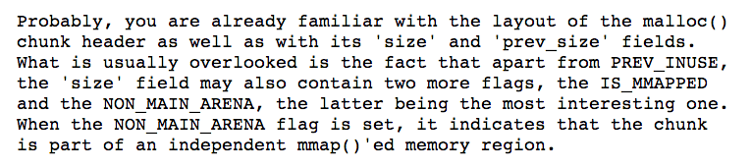
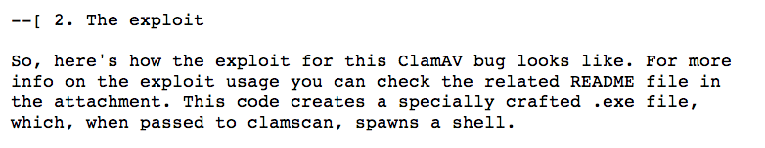
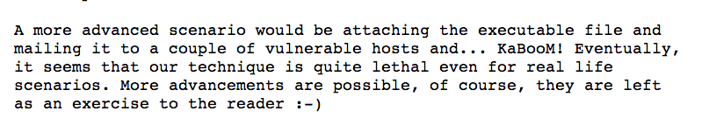

Slide 14
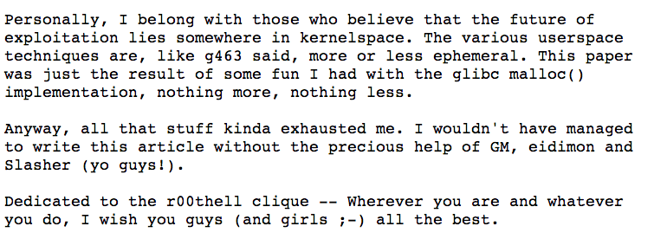
http://www.phrack.org/issues.html?issue=61&id=6

Slide 15
(Why) Doesn’t C++ solve this?
new = malloc
delete = free

Slide 16
Getting back to my story…

Slide 17
“Willy-Nilly” Memory Management
Systematic Memory Management

Slide 18
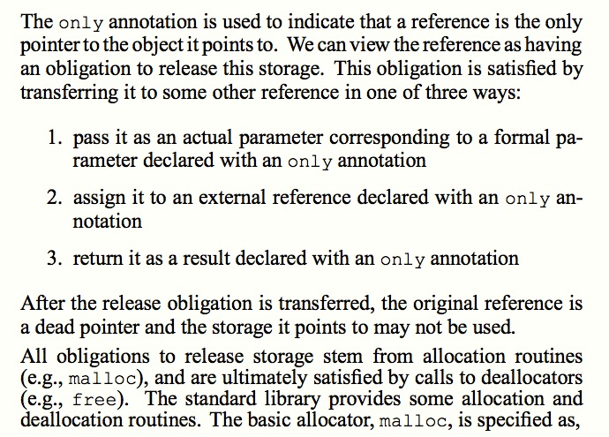
Static Detection of Dynamic Memory Errors, David Evans, PLDI May 1996

Slide 19
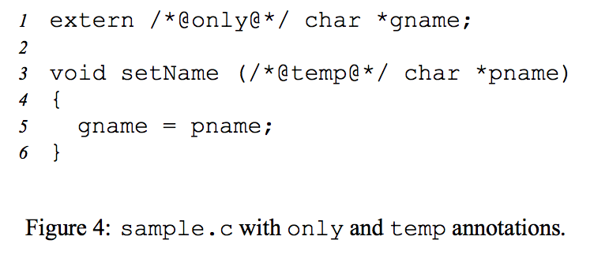
Static Detection of Dynamic Memory Errors, David Evans, PLDI May 1996

Slide 20
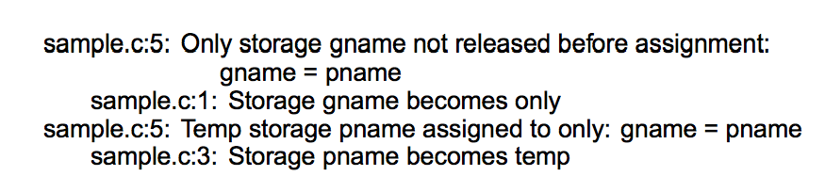
Static Detection of Dynamic Memory Errors, David Evans, PLDI May 1996
Note: these are “compile-time” errors (just produced by a separate tool).

Slide 21

Annotations?
Where we are going, we don’t need annotations!

Slide 22
A box is a reference to a heap allocation holding another value. There are two kinds of boxes: managed boxes and owned boxes.
An owned box type or value is constructed by the prefix tilde sigil ~.
Rust Manual, Section 9.1.4
extern /*@only@*/ char *gname;
void setName(/*@temp@*/ char *pname) {
gname = pname;
}

Slide 23
A box is a reference to a heap allocation holding another value. There are two kinds of boxes: managed boxes and owned boxes.
An owned box type or value is constructed by the prefix tilde sigil ~.
Rust Manual, Section 9.1.4
extern /*@only@*/ char *gname;
void setName(/*@temp@*/ char *pname) {
gname = pname;
}
static gname : ~str = ~"";
fn set_name(pname : &str) {
gname = pname;
}

Slide 24
extern /*@only@*/ char *gname;
void setName(/*@temp@*/ char *pname) {
gname = pname;
}
gash> splint sample.c
sample.c:5: Only storage gname not released before assignment:
gname = pname
sample.c:1: Storage gname becomes only
sample.c:5: Temp storage pname assigned to only: gname = pname
sample.c:3: Storage pname becomes temp
static gname : ~str = ~"Where we're going, we don't need roads!”;
fn set_name(pname : &str) {
gname = pname;
}
gash> rustc sample.rs
sample.rs:4:12: 4:17 error: mismatched types: expected `~str` but found `&str`
(str storage differs: expected ~ but found &)
sample.rs:4 gname = pname;

Slide 25
static gname : ~str = ~"annotations";
fn set_name(pname : ~str) {
gname = pname;
}
fn main() {
set_name("roads");
}
gash> rustc sample2.rs
sample2.rs:8:13: 8:20 error: mismatched types: expected `~str` but found `&'static str` (str storage differs: expected ~ but found &'static )
sample2.rs:8 set_name("roads");

Slide 26
static gname : ~str = ~"annotations";
fn set_name(pname : ~str) {
gname = pname;
}
fn main() {
set_name("roads");
}
gash> rustc sample2.rs
sample2.rs:8:13: 8:20 error: mismatched types: expected `~str` but found `&'static str` (str storage differs: expected ~ but found &'static )
sample2.rs:8 set_name("roads");

Slide 27
Free()s?
Where we are going, we don’t need free()s!

Slide 28
fn set_name(gname : @mut ~str, pname : ~str) {
*gname = pname;
}
fn main() {
let mut gname : ~str = ~"annotations";
set_name(@mut gname, ~"roads");
println(fmt!("gname = %s", gname));
}
rustc sample2.rs
sample2.rs:8:31: 8:36 error: use of moved value: `gname`
sample2.rs:8 println(fmt!("gname = %s", gname));
^~~~~
note: in expansion of fmt!
sample2.rs:8:12: 8:38 note: expansion site
sample2.rs:7:18: 7:23 note: `gname` moved here because it has type `~str`, which is moved by default (use `copy` to override)
sample2.rs:7 set_name(@mut gname, ~"roads");
^~~~~
error: aborting due to previous error

Slide 29
Correct!
fn set_name(gname : &mut ~str, pname : ~str) {
*gname = pname;
}
fn main() {
let mut gname : ~str = ~"annotations";
println(fmt!("gname = %s", gname));
set_name(&mut gname, ~"roads");
println(fmt!("gname = %s", gname));
}

Slide 30
Back to C…
# include <stdio.h>
void set_name(char **gname, char *pname) {
*gname = pname;
}
int main() {
while (1) {
char *gname = "annotations"; /* not allocated on stack or heap! its in the data segment */
gname[0] = 'b';
printf("gname = %s\n", gname);
set_name(&gname, "roads");
printf("gname = %s\n", gname);
}
}
first – demo without gname[0],
heap not increasing
what’s going on??

