Slide 1

Class 7
Segmentation Faults, Page Faults, Processes, Threads, and Tasks
cs4414 Fall 2013
University of Virginia
David Evans

Slide 2
Plan for Today
Recap: Virtualizing Memory
Segmentation Faults
Page Faults: Challenge winner!
Processes, Threads, Tasks
Exam 1 is out after class Tuesday (Feb 11) due 11:59pm Thursday (Feb 13) – open resources, most questions will be taken from notes
PS2 is Due Sunday

Slide 3
PS2 Demos
PS2 autograder and submission will be posted by Friday (if I forget, but no one reminds me, there won’t be an extension like for PS1!)
Everyone should be signed up
If you can’t find a time that works for your team, let me know by tomorrow
At the scheduled start time and place:
Your full team should be present
One of you should have:
Your code ready to show in your favorite editor
Your gash ready to run
If your team is not ready to go at your scheduled time (no grace period!), your demo is cancelled and you need to schedule a new one with me.

Slide 4
386 Checkup
2²² < 4.3M
32-bit linear address
Dir
Page
Offset
Physical Memory
10 bits
(1K tables)
10 bits
(1K entries)
12 bits
(4K pages)
CR3
Page Directory
Page Table
1024 entries
× 4 bytes/entry
= 4096 bytes = 1 page
20 bits addr / 12 bits flags
Page + Offset
How big is the page table on my MacBook Pro?

Slide 5
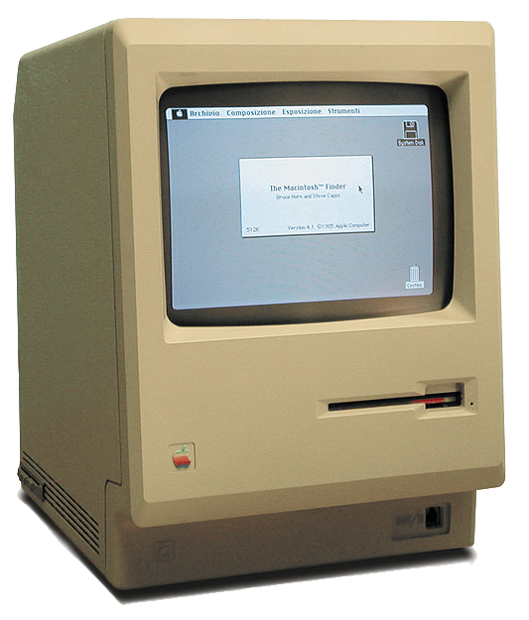
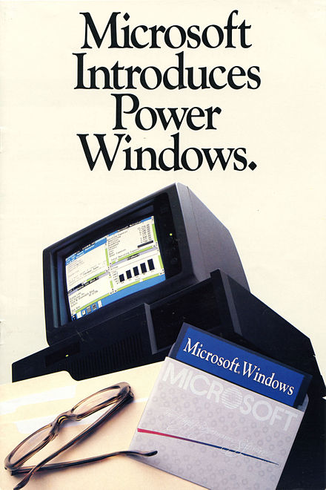
Intel 386
386 introduced in 1985:
1 MB ∼ $500
Windows 1.0 (Nov 1985)
required 192 KB of RAM
Original Macintosh (Jan 1984)
$2495
128KB RAM
(later in 1984: 512K version)

Slide 6
386 Design Checkup
Physical Memory
CR3
Page Directory
Page Table
20 bits addr / 12 bits flags
Page + Offset

Slide 7
386 Design Fail!
Physical Memory
CR3
2⁶⁴ addressable locations
/ 2¹² locations/page
= 2⁵² pages
Page Directory
Page Table
20 bits addr / 12 bits flags
Page + Offset
Page table would require 2⁵⁴ bytes ∼ $17B (eBay annual revenues) worth of RAM!

Slide 8
Solution?
Physical Memory
Page Table
20 bits addr / 12 bits flags
Page + Offset

Slide 9
Multi-Level (Hierarchical) Page Tables
64 (-16)-bit x86 linear address
Unused
L1 Page
L2 Page
L3 Page
L4 Page
Offset
CR3
16 bits
9 bits
9 bits
9 bits
9 bits
12 bits
L1 Page Table
L2 Page Table
L3 Page Table
L4 Page Table
+ L4 Index
Physical Memory
+ L1 Index
+ L3 Index
+ L2 Index
Page + Offset
Page + Offset
base
base
base
base

Slide 10
Do we still need segmentation?
Segmentation Unit
Paging
Unit
Memory
Logical Address
Linear Address
Physical Address

Slide 11
Unused
L1 Page
L2 Page
L3 Page
L4 Page
Offset
CR3
16 bits
9 bits
9 bits
9 bits
9 bits
12 bits
L1 Page Table
L2 Page Table
L3 Page Table
L4 Page Table
+ L4 Index
Physical Memory
+ L1 Index
+ L3 Index
+ L2 Index
Page + Offset
Page + Offset
base
base
base
base
Where are all the L2, L3, and L4 page tables?

Slide 12
Unused
L1 Page
L2 Page
L3 Page
L4 Page
Offset
CR3
16 bits
9 bits
9 bits
9 bits
9 bits
12 bits
L1 Page Table
L2 Page Table
L3 Page Table
L4 Page Table
+ L4 Index
Physical Memory
+ L1 Index
+ L3 Index
+ L2 Index
Page + Offset
Page + Offset
base
base
base
base
Why is each page 512 entries instead of 1024?

Slide 13
Unused
L1 Page
L2 Page
L3 Page
L4 Page
Offset
CR3
16 bits
9 bits
9 bits
9 bits
9 bits
12 bits
L1 Page Table
L2 Page Table
L3 Page Table
L4 Page Table
+ L4 Index
Physical Memory
+ L1 Index
+ L3 Index
+ L2 Index
Page + Offset
Page + Offset
base
base
base
base
Why is the page size still 4K? (x86 can support 2MB pages)

Slide 14
Unused
L1 Page
L2 Page
L3 Page
L4 Page
Offset
CR3
16 bits
9 bits
9 bits
9 bits
9 bits
12 bits
L1 Page Table
L2 Page Table
L3 Page Table
L4 Page Table
+ L4 Index
Physical Memory
+ L1 Index
+ L3 Index
+ L2 Index
Page + Offset
Page + Offset
base
base
base
base
What would you do instead if you cared about saving energy more than saving silicon?

Slide 15
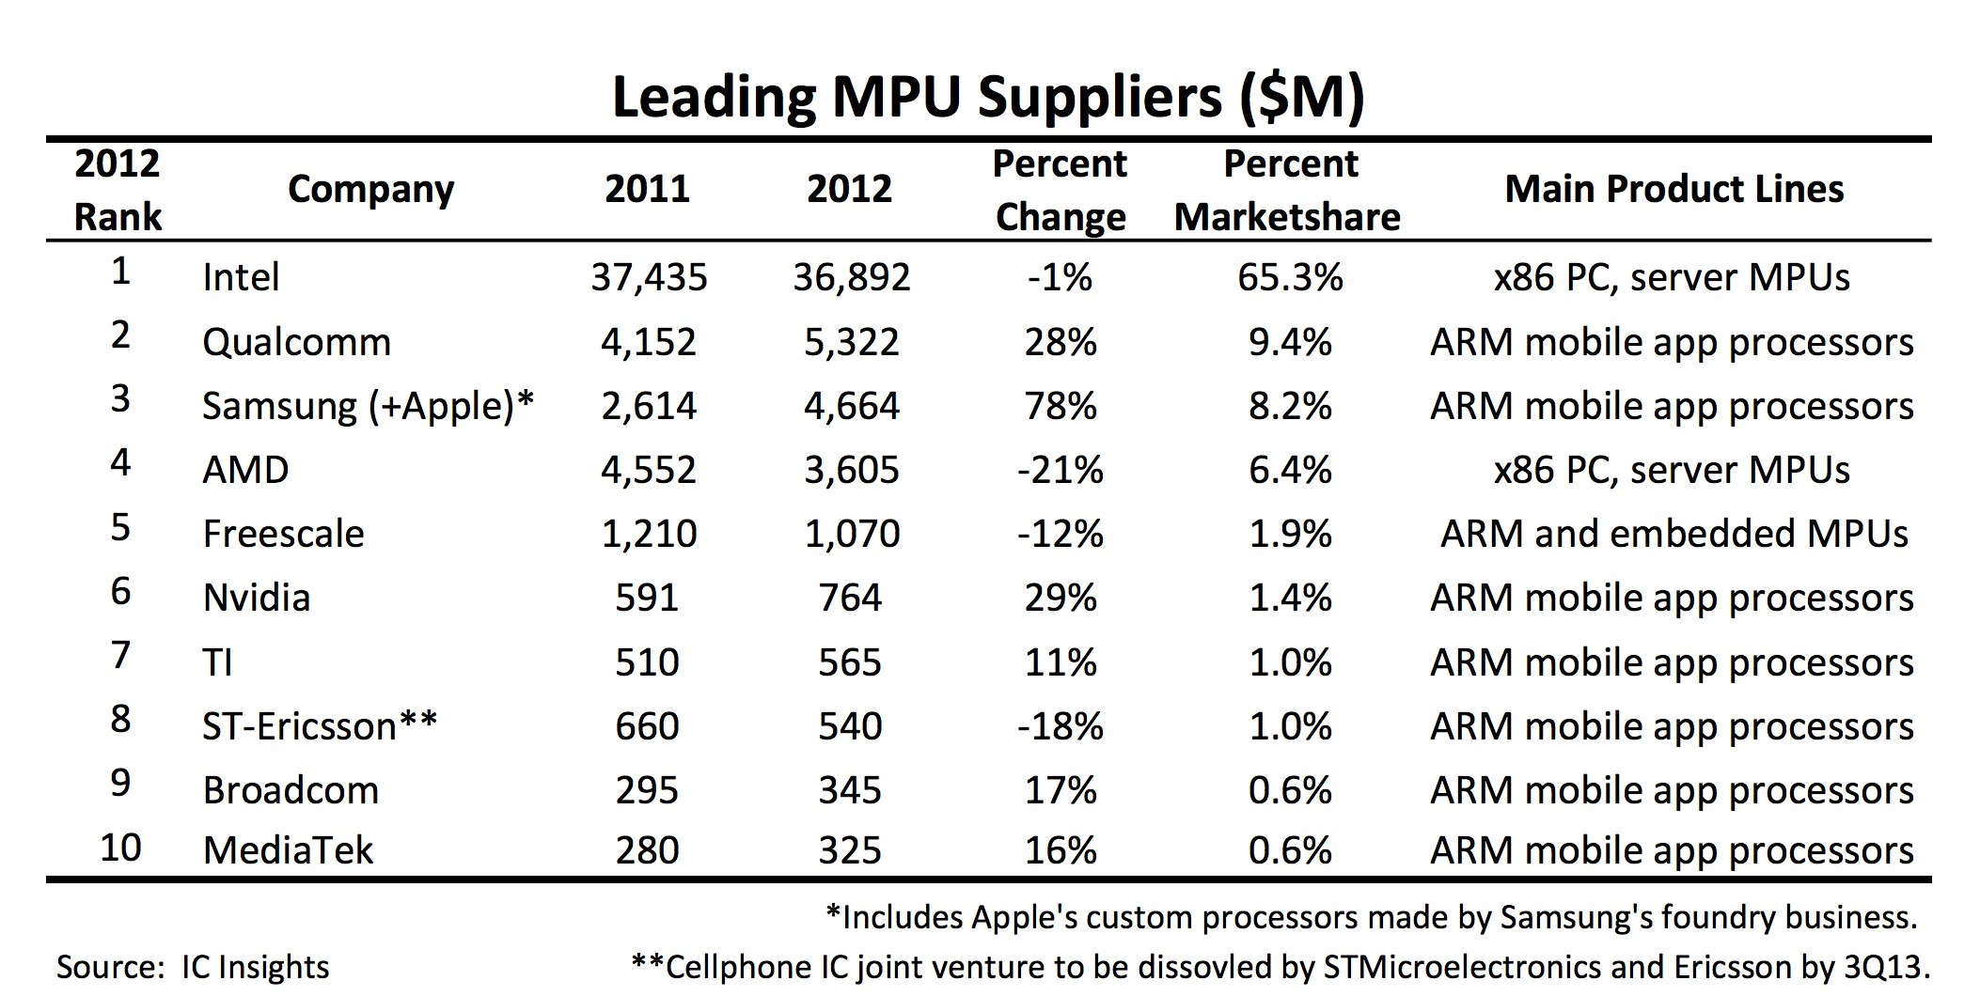
All x86 all the time?

Slide 16
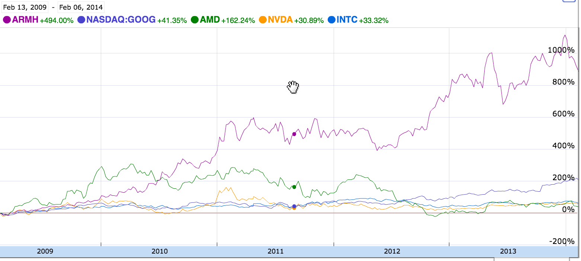

Slide 17
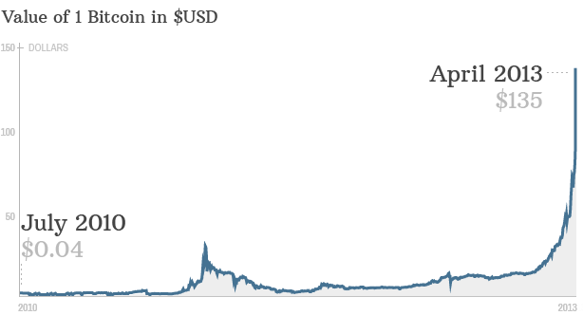
Dave: “Don’t buy bitcoins!”

Slide 18
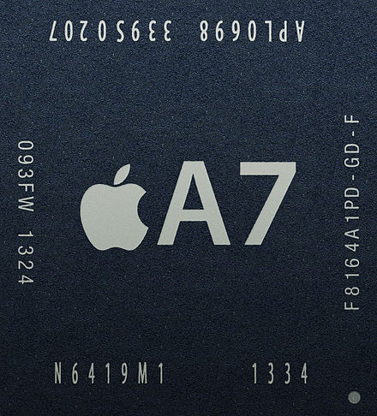

ARMv8-A 64-bit processor
(ISA licensed by ARM, designed by Apple, manufactured by Samsung)
iPhone 5s
(Sept 2013)

Slide 19
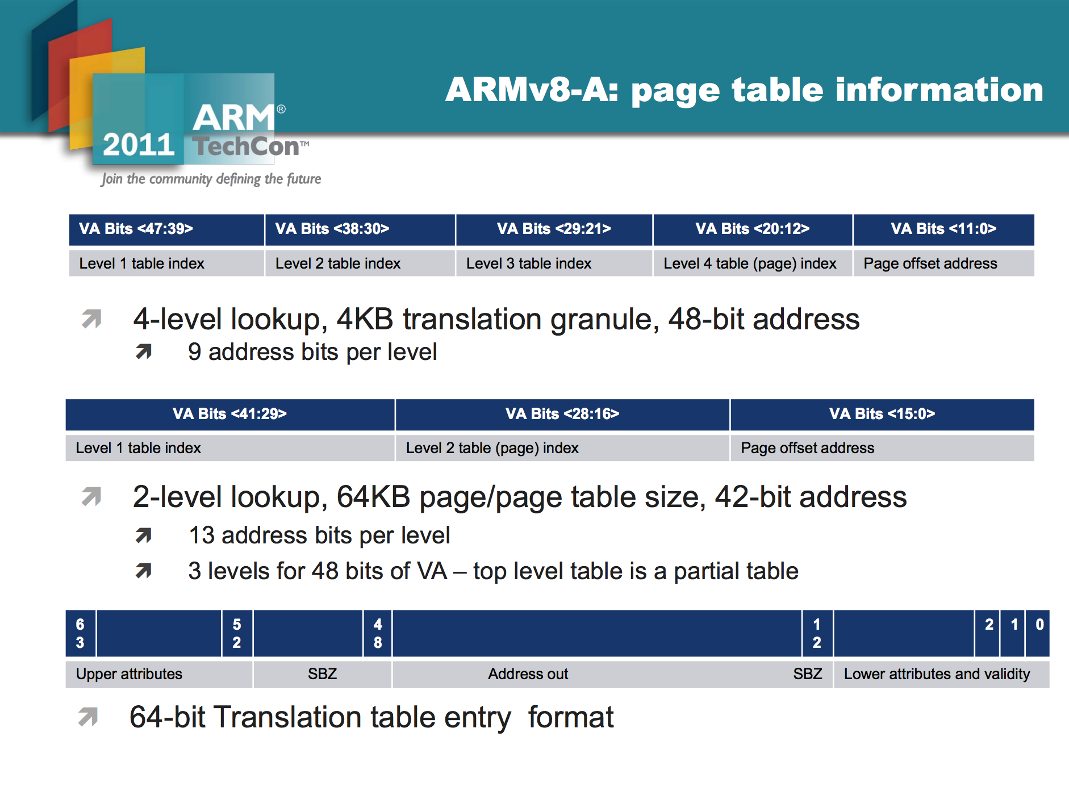

Slide 20
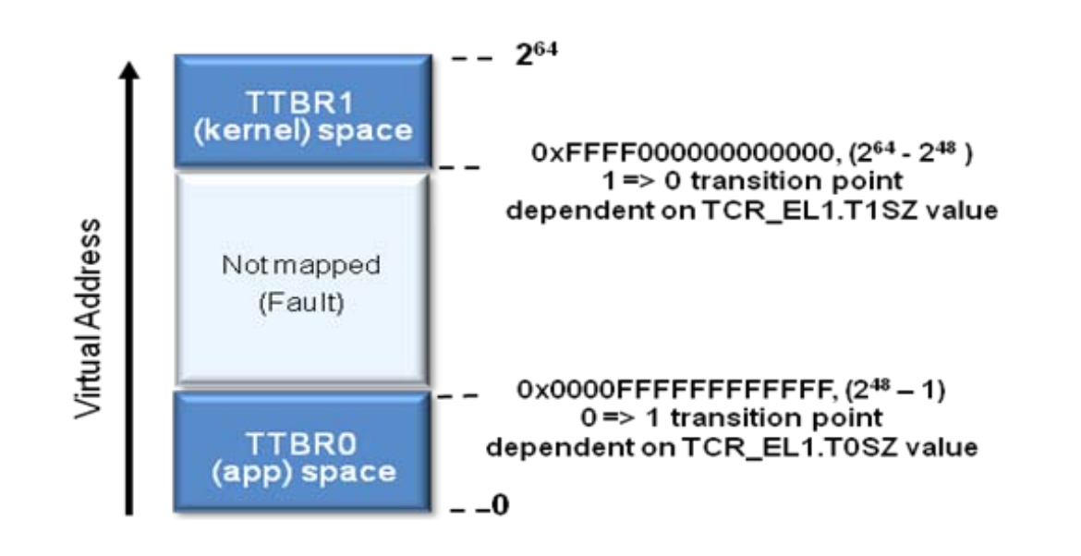
Is 256TB enough?

Slide 21
Is 256TB enough?
“This design gives us a 256TB address space, which should be enough for a while. If memory prices continue to fall so that the cost of memory halves every year (a bit faster than it has been doing historically), handheld computers will come with 256TB in about 20 years. By then, I expect ARMv9 to be released.”
David Chisnall, A Look at the 64-Bit ARMv8 Architecture

Slide 22
#include <stdio.h>
#include <stdlib.h>
int main(int argc, char **argv) {
char *s = (char *) malloc (1);
int i = 0;
while (1) {
printf("%d: %lx / %d\n", i, s + i, i[s]);
i += 1;
}
}
What will this program do?

Slide 23
int main(int argc, char **argv) {
char *s = (char *) malloc (1);
int i = 0;
while (1) {
printf("%d: %lx / %d\n", i, s + i, i[s]);
i += 1;
}
}
gash> gcc -Wall segfault.c
segfault.c: In function ‘main’:
segfault.c:8: warning: format ‘%lx’ expects type ‘long unsigned int’, but argument 3 has type ‘char *’
segfault.c:8: warning: format ‘%lx’ expects type ‘long unsigned int’, but argument 3 has type ‘char *’

Slide 24
What causes a segmentation fault?

Slide 25
What causes a segmentation fault?
Unused
L1 Page
L2 Page
L3 Page
L4 Page
Offset
CR3
16 bits
9 bits
9 bits
9 bits
9 bits
12 bits
L1 Page Table
L2 Page Table
L3 Page Table
L4 Page Table
+ L4 Index
Physical Memory
+ L1 Index
+ L3 Index
+ L2 Index
Page + Offset
Page + Offset
base
base
base
base

Slide 26
> ./a.out
0: 7ff7004039a0 / 0
1: 7ff7004039a1 / 0
2: 7ff7004039a2 / 0
…
95: 7ff7004039ff / 0
…
1033819: 7ff7004ffffb / 0
1033820: 7ff7004ffffc / 0
1033821: 7ff7004ffffd / 0
1033822: 7ff7004ffffe / 0
1033823: 7ff7004fffff / 0
Segmentation fault: 11
#include <stdio.h>
#include <stdlib.h>
int main(int argc, char **argv) {
char *s = (char *) malloc (1);
int i = 0;
while (1) {
printf("%d: %lx / %d\n",
i, s + i, i[s]);
i += 1;
}
}

Slide 27
What causes a page fault?
Unused
L1 Page
L2 Page
L3 Page
L4 Page
Offset
CR3
16 bits
9 bits
9 bits
9 bits
9 bits
12 bits
L1 Page Table
L2 Page Table
L3 Page Table
L4 Page Table
+ L4 Index
Physical Memory
+ L1 Index
+ L3 Index
+ L2 Index
Page + Offset
Page + Offset
base
base
base
base

Slide 28
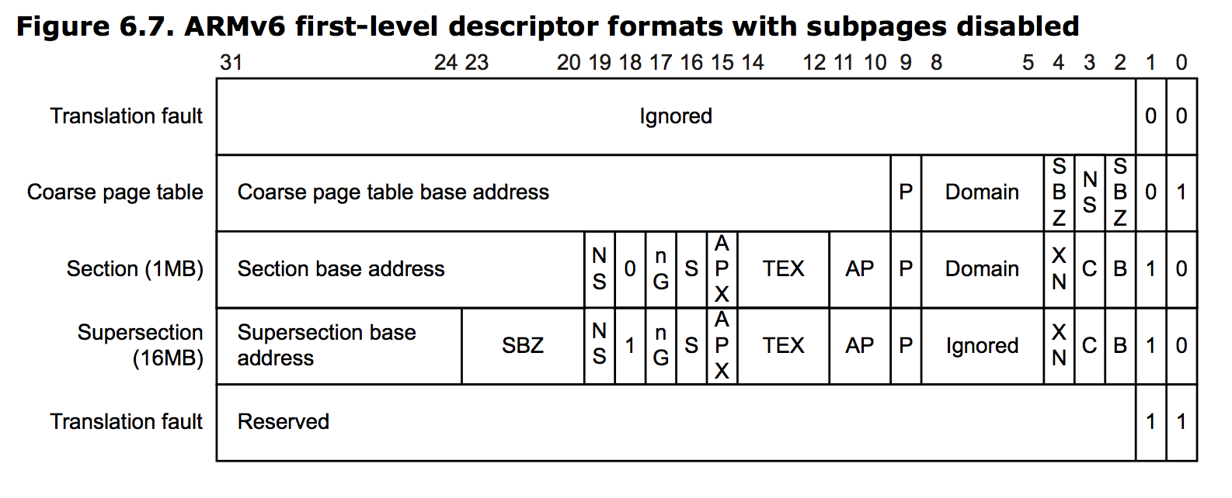
What causes a page fault?
Page Table
+ L1 Index
base

Slide 29
Challenge from Last Class
Challenge: Write a program that takes N as an input and produces (nearly) exactly N page faults. A good solution is worth a USS Hopper patch (even cooler than a Rust sticker!) or an exemption from Exam 1 or Exam 2.
Winner:
Michael Recachinas

Slide 30
Faults Summary
Segmentation Fault:
Process attempts to access memory that is not in its memory space (or write to memory that is read-only)
Should never happen
Page Fault:
Process attempts to access memory that is not currently available.
Happens hundreds of times before your code even starts running!

Slide 31
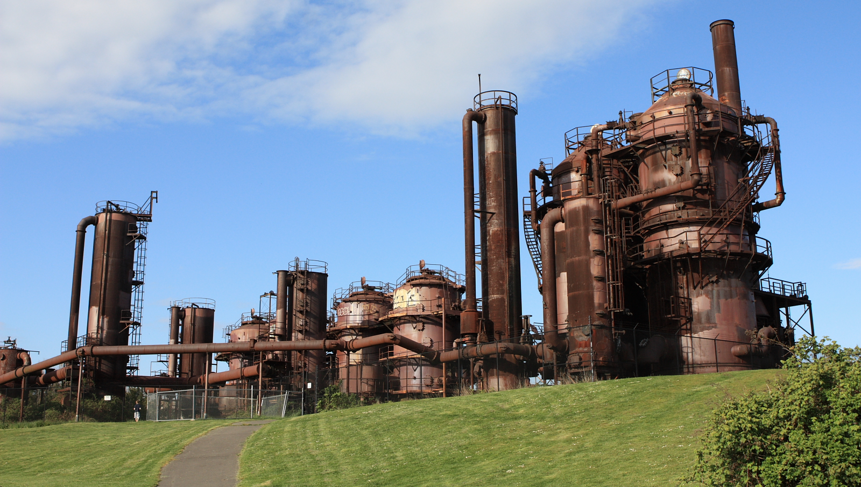
Processes, Threads, and Tasks

Slide 32
Process
Originally: abstraction for owning the whole machine
Thread
(Illusion or reality of) independent sequence of instructions
What do you need:

Slide 33
Process
Originally: abstraction for owning the whole machine
Thread
(Illusion or reality of) independent sequence of instructions
Own program counter
Own stack, registers
Own memory space
Own program counter
Own stack, registers
Shares memory space
What do you need:

Slide 34
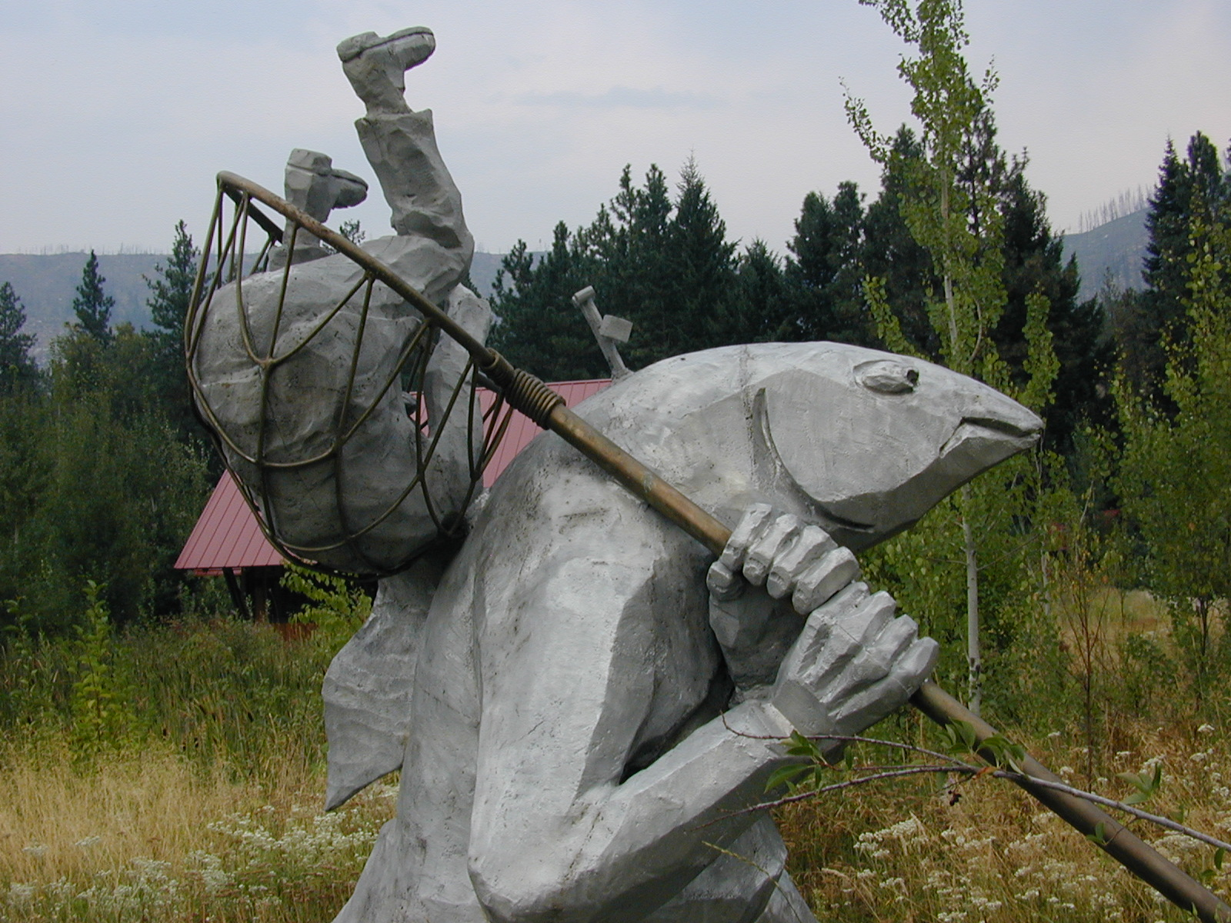
Tasks in Rust

Slide 35
Tasks
Thread
Own PC
Own stack, registers
Safely shared immutable memory
Safely independent own memory
fn spawn(f: proc ())
spawn( proc() {
println(“Get to work!”);
});
Task = Thread – unsafe memory sharing
or
Task = Process + safe memory sharing – cost of OS process

Slide 36
How can we take advantage of more cores to find Collatz results faster?
fn collatz_steps(n: int) -> int {
if n == 1 {
0
} else {
1 + collatz_steps(if n % 2 == 0 { n / 2 } else { 3 * n + 1 })
}
}
fn find_collatz(k: int) -> int {
// Returns the minimum value, n, with Collatz steps >= k.
let mut n = 1;
while collatz_steps(n) < k { n += 1; }
n
}

Slide 37
fn find_collatz(k: int) -> int {
let mut n = 1;
loop {
let val = n;
spawn(proc() {
if collatz_steps(val) > k {
println!("Result: {}", val);
}
});
n += 1;
}
}

Slide 38
Channels
let (port, chan) : (Port<T>, Chan<T>) = Chan::new();
chan.send(T);
T = port.recv();
Asynchronous
Synchronous

Slide 39
fn find_collatz(k: int) -> int {
let mut n = 1;
let (port, chan) : (Port<int>, Chan<int>) = Chan::new();
spawn(proc() {
loop {
let val = n;
spawn(proc() {
if collatz_steps(val) > k { chan.send(val); }
});
n += 1;
}
let n = port.recv();
n
}
Not going to work…

Slide 40
fn find_collatz(k: int) -> int {
let mut n = 1;
let max_tasks = 7; // keep all my cores busy
let mut found_result = false;
let mut result = -1; // need to initialize
while !found_result {
let mut ports = ~[];
for i in range(0, max_tasks) {
let val = n + i;
let (port, chan) : (Port<int>, Chan<int>) = Chan::new();
ports.push(port);
spawn(proc() {
let steps = collatz_steps(val);
println!("Result for {}: {}", val, steps);
chan.send(steps);
});
}
for i in range(0, max_tasks) {
let port = ports.pop();
let steps = port.recv();
if steps > k {
found_result = true;
result = n + i;
}
}
n += max_tasks;
}
assert!(result != -1);
result
}

Slide 41
Charge
Everyone should have scheduled PS2 demo!
Exam 1 is out after class Tuesday (Feb 11) due 11:59pm Thursday (Feb 13) – open resources, most questions will be taken from notes
PS2 is Due Sunday
or…Challenge: make a good multi-tasking find_collatz (at least 6x speedup)

