Slide 1

Class 8:
Git yer rusty pointers here
cs4414 Fall 2013
University of Virginia
David Evans

Slide 2
Plan for Today
Why and how to use git
Practice programming pointers (making a List)
(Paper) notes for today have some of the code. Posted notes will have all code.
I won’t be able to hold my usual office hours this afternoon, but can meet (briefly) after class today and/or arrange another time.

Slide 3
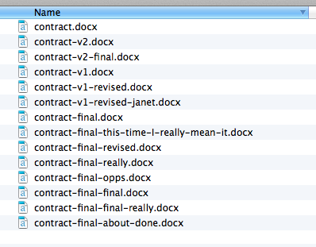
How (Not) to Manage Files
“Smart Lawyer” Version Control

Slide 4
Version Control
How can Alice find the last working version of her code before she broke everything trying to fix a little bug?
How can Alice and Bob work on a program together?
How can 10,000 developers work together on the Linux kernel?
Annual Linux Development Report

Slide 5
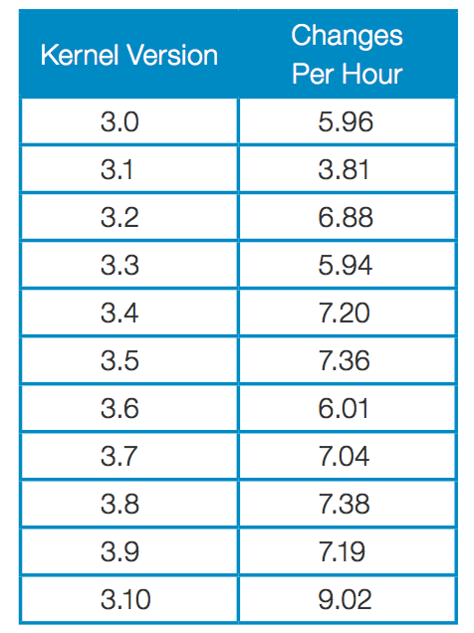
Number of Changes per Hour
“Since the beginning of the git era (the 2.6.11 release in 2005), a total of 9,784 developers have contributed to the Linux kernel; those developers worked for a minimum of 1,064 companies.”

Slide 6
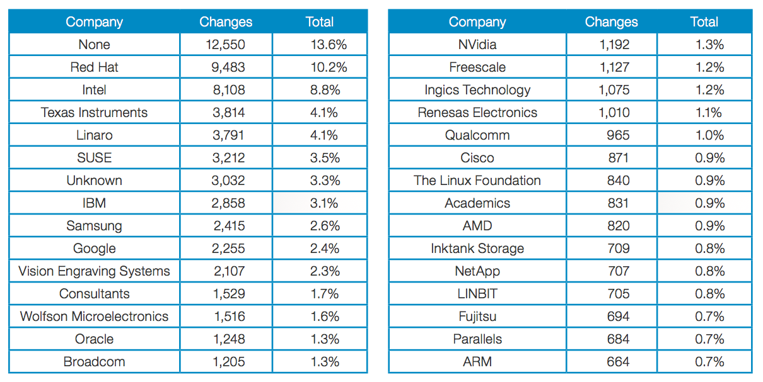
Top Companies

Slide 7
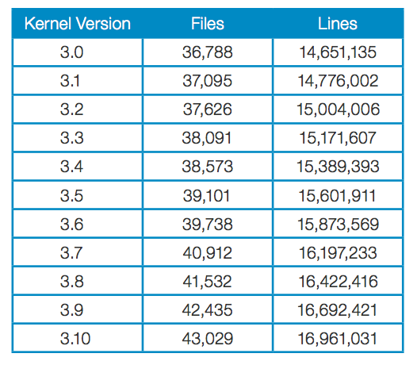
²⁰¹¹⁻⁰⁷⁻²¹
²⁰¹³⁻⁰⁶⁻³⁰

Slide 8
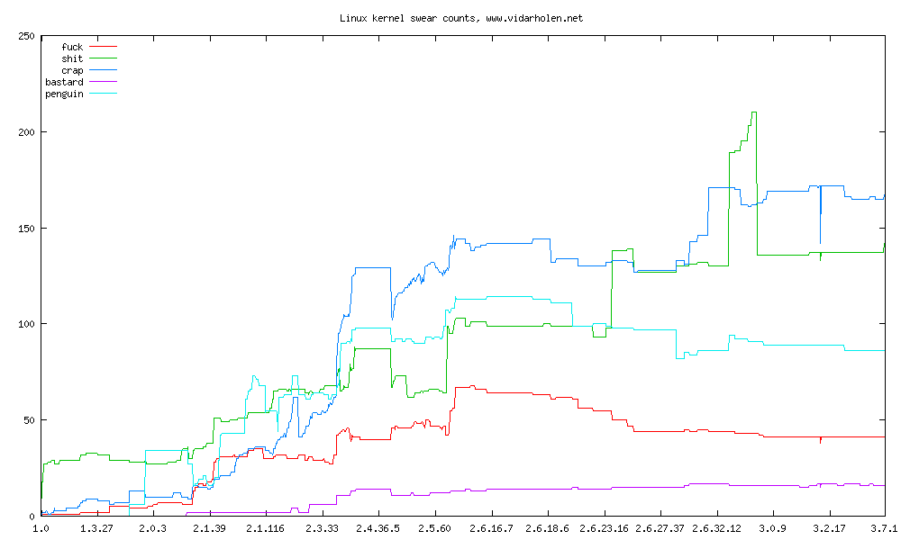
http://www.vidarholen.net/contents/wordcount/

Slide 9
Centralized Version Control
Repository
(cvs, subversion)
update
update
commit
commit
Bob:
gash> svn checkout
gash> svn update
[make changes]
gash> svn commit
Alice:
gash> svn checkout
gash> svn update
[make changes]
gash> svn commit

Slide 10
Distributed Version Control
Main Repository
(git, Mercurial)
clone, pull
clone, pull
Alice’s Local Repository
Bob’s Local Repository
push
push
commit
commit
update
update
[make changes]
[make changes]

Slide 11
Centralized: One Repo
Distributed
Main Repository
(Hg)
Repository
(svn)
clone, pull
clone, pull
update
update
Alice’s Local Repository
Bob’s Local Repository
push
push
commit
commit
update,
commit
update,
commit
[make changes]
[make changes]
[make changes]
[make changes]

Slide 12
What has to happen before Bob sees Alice’s changes?
Main Repository
(Hg)
pull
Alice’s Local Repository
Bob’s Local Repository
push
commit
update
changed gash.rs
see gash.rs
Alice
Bob

Slide 13
git pull = “pull” and “update”
pull is not the analog of push – it is analog of commit + push
Main Repository
(git)
pull
Alice’s Local Repository
Bob’s Local Repository
push
commit
changed gash.rs
see gash.rs
(I find this asymmetrical and confusing…but not many scenarios where pulling to local without updating is useful.)
Alice
Bob

Slide 14
What if Bob had modified his copy?
Main Repository
(git)
pull
gash> git pull
…
error: Your local changes to the following files would be overwritten by merge:
ps1/zhttpto.rs
Please, commit your changes or stash them before you can merge.
Aborting
Alice’s Local Repository
Bob’s Local Repository
push
commit
changed zhttpto.rs
changed zhttpto.rs
Alice
Bob

Slide 15
Okay, let’s commit:
Main Repository
(git)
pull
Alice’s Local Repository
Bob’s Local Repository
push
gash> git commit -a –m "Added a comment about lack of security."
[master 1347c1f] Fixed the notorious zombie process bug.
1 files changed, 3 insertions(+), 0 deletions(-)
gash> git pull
Auto-merging ps1/zhttpto.rs
CONFLICT (content): Merge conflict in ps1/zhttpto.rs
Automatic merge failed; fix conflicts and then commit the result.
commit
changed gash.rs
changed gash.rs
Alice
Bob

Slide 16
Observing Conflicts
//
// zhttpto.rs
//
// Reference solution for PS1
//
// Special thanks to Kiet Tran for providing code we incorporated into this.
//
<<<<<<< HEAD
// Note: it would be very unwise to run this server on a machine that is
// on the Internet and contains any sensitive files!
=======
// Warning: this is not a secure server!
>>>>>>> faf7829d3ab38459172b622351d68ac1f47bddd0
//
// University of Virginia - cs4414 Fall 2013
Notes:
HEAD is your repository (master branch); second is the main repository you tried to pull from

Slide 17
Resolving Conflicts (for Luddites)
gash> emacs zhttpto.rs
edit conflicted file manually (removing the <<<< and ====)
gash> git commit -a -m "Updated security message."
[master 1e6e684] Updated security message.
gash> git push
…
To https://github.com/cs4414/Reference-Solutions.git
faf7829..1e6e684 master -> master

Slide 18
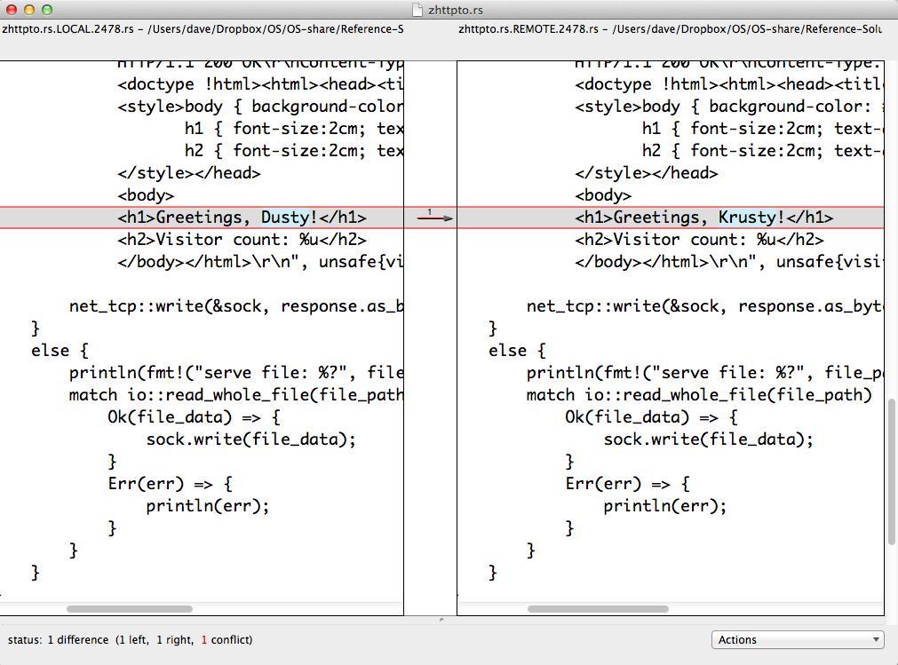
Resolving Conflicts (for Moderns)
git mergetool

Slide 19
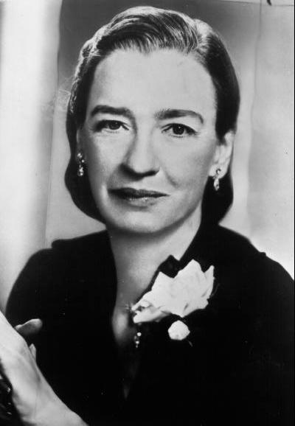
Avoiding Conflicts
It’s easier to ask forgiveness than it is to get permission.
Admiral Grace Hopper
With conflicts, it is better to avoid them than to resolve them!
pull before you start modifying, and often while working
commit early and often, use good messages
push whenever you have something worth sharing (but don’t push junk)
divide your project into small, coherent files
communicate well with your teammates!

Slide 20

Avoiding Major Conflicts with Teammates
Don’t resolve conflicts by just undoing others’ work!
At least make sure you understand it before replacing their changes with your own.

Slide 21



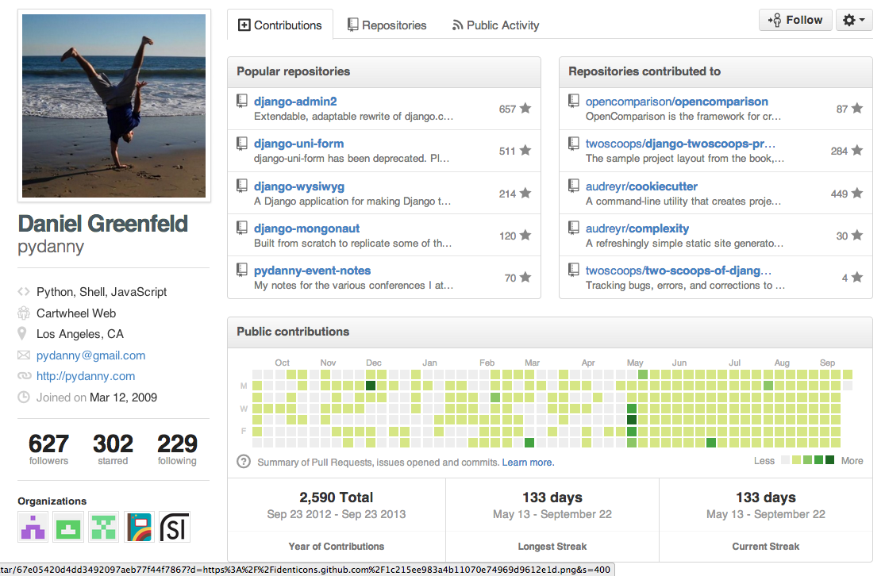

What’s more important for getting an interesting computing job?

Slide 22
Impressive Transcript from Prestigious Institution
Impressive Code and Record in Hacker Communities

Slide 23
Linked Lists in Rust

Slide 24
What’s a List?

Slide 25
Linked Lists
A List is an object that is either:
Null (a special value representing empty list)
or a pair whose second part is a List
struct Node {
head : int,
tail : Option<@Node>
}
type List = Option<@Node> ;
Keeping things simple for now!
@ = automatically managed

Slide 26
struct Node {
head : int,
tail : Option<@Node>
}
type List = Option<@Node> ;
let p: List =
Some(@Node{head: 1,
tail: Some(@Node{head : 2,
tail: Some(@Node{head: 3,
tail: None})})});

Slide 27
to_str
struct Node {
head : int,
tail : Option<@Node>
}
type List = Option<@Node> ;

Slide 28
fn to_str(lst: Option<@Node>) -> ~str {
fn elements_to_str(n: @Node) -> ~str {
match (n.tail) {
None => fmt!("%?", n.head),
Some(tail) => fmt!("%?, %s", n.head, elements_to_str(tail))
}
}
match(lst) {
None => ~"Null",
Some(n) => fmt!("[%s]", elements_to_str(n))
}
}

Slide 29
Using Traits
trait ToStr {
fn to_str (&self) -> ~str;
}
(ToStr is part of the core)
Similar to interface in Java (except Rust traits can include default implementations).

Slide 30
impl ToStr for List {
fn to_str(&self) -> ~str {
fn elements_to_str(n: @Node) -> ~str {
match (n.tail) {
None => fmt!("%?", n.head),
Some(tail) => fmt!("%?, %s", n.head, elements_to_str(tail))
}
}
match(*self) {
None => ~"Null",
Some(n) => fmt!("[%s]", elements_to_str(n))
}
}
}
fn main() {
let lst : List = Some(@Node{head: 1, tail: Some(@Node{head : 2,
tail: Some(@Node{head: 3, tail: None})})});
println(fmt!("%s", lst.to_str()));
}

Slide 31
Using our List (?)
fn main() {
let lst : List =
Some(@Node{head: 1,
tail: Some(@Node{head : 2,
tail: Some(@Node{head: 3, tail: None})})});
println(lst.to_str());
lst.head = 0;
println(lst.to_str());
}

Slide 32
Making it mutable
struct Node {
head : int,
tail : Option<@Node>
}
type List = Option<@Node> ;
Since Rust 0.6 – can’t make struct fields mut
struct Node {
head : int,
tail : Option<@mut Node>
}
type List = Option<@mut Node> ;

Slide 33
fn main() {
let lst : List = Some(@mut Node{head: 1,
tail: Some(@mut Node{head : 2,
tail: Some(@mut Node{head: 3, tail: None})})});
println(lst.to_str());
match lst {
None => fail!("Unexpected None!"),
Some(n) => n.head = 0
}
println(lst.to_str());
}

Slide 34
Increment All
Write a List method that increments the value of every element of the list.

Slide 35
Increment All
trait Increment {
fn incr(&self);
}
impl Increment for List {
fn incr(&self) {
let mut current = *self;
loop {
match(current) {
None => break,
Some(node) => { node.head += 1; current = node.tail },
}
}
}
}

Slide 36
Mapping
Define a higher-order mapr method that applies a function to all elements in a List.
self.mapr(|x: int| { x + 1 })

Slide 37
impl Map for List {
fn mapr(&self, f: &fn(int) -> int) {
let mut current = *self;
loop {
match(current) {
None => break,
Some(node) => { node.head = f(node.head);
current = node.tail },
}
}
}
}

Slide 38
Don’t we want to avoid @?

Slide 39
struct Node {
head : int,
tail : Option<~Node>
}
type List = Option<~Node> ;
What else needs to change to make a List with owned Nodes?

Slide 40
struct Node {
head : int,
tail : Option<~Node>
}
type List = Option<~Node> ;
trait Map {
fn mapr(&self, &fn(int) -> int)
}
-> List;

Slide 41
struct Node {
head : int,
tail : Option<~Node>
}
type List = Option<~Node> ;
trait Map {
fn mapr(&self, &fn(int) -> int) -> List;
}
impl Map for List {
fn mapr(&self, f: &fn(int) -> int) -> List {
match(*self) {
None => None,
Some(ref node) => { Some(~Node{ head: f(node.head),
tail: node.tail.mapr(f) }) },
}
}
}
Is this better or worse than the @mut version?

Slide 42
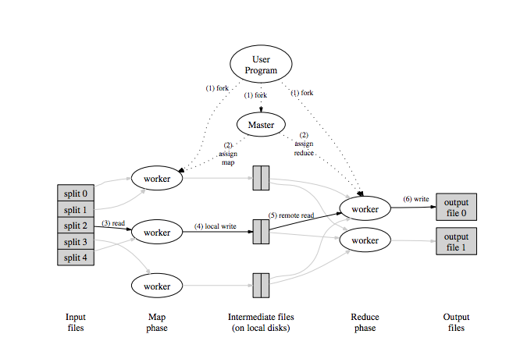

Next class: making map multi-threaded!
  Read the MapReduce paper (or at least the slides) before Thursday’s class
I won’t be able to hold my usual office hours this afternoon, but can meet after class today and/or arrange another time.
Posted notes (later today) will have all code.

