Slide 1
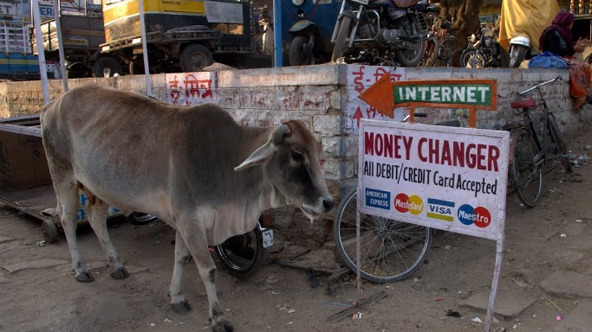
Multiparty Computation in 2029: Boom, Bust, or Bonanza!
David Evans
mightBeEvil.org
University of Virginia
Microsoft Research
Applied Multiparty Computation
21 February 2014

Slide 2
Why 2029?

Slide 3
Why 15 years?

Slide 4
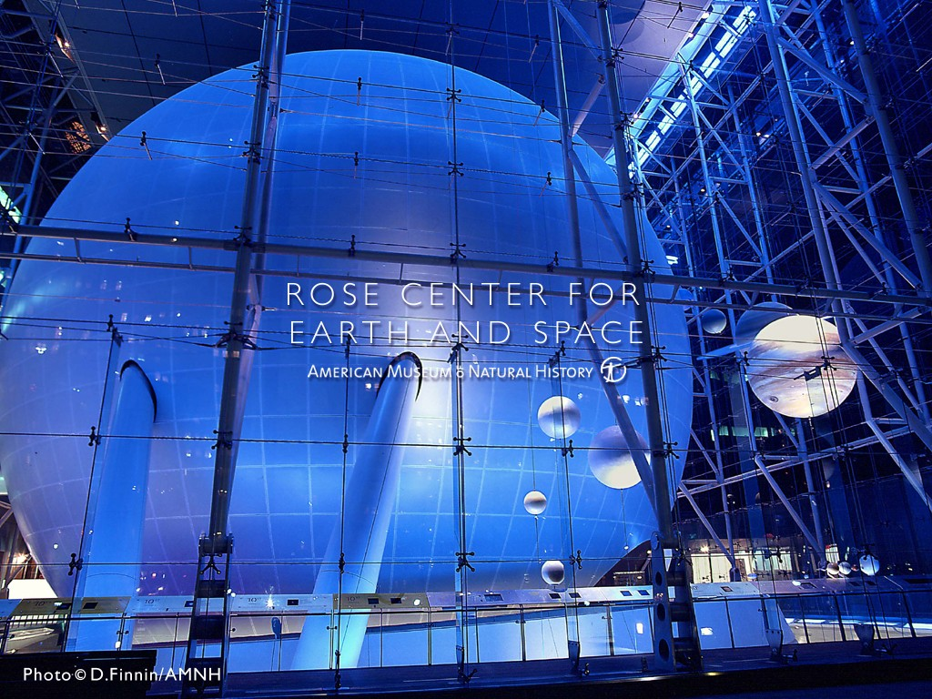
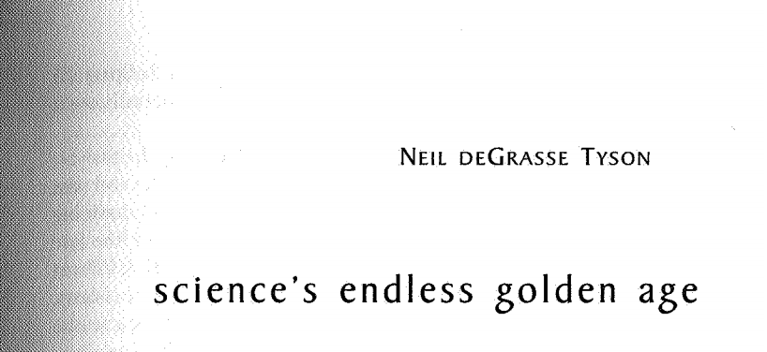
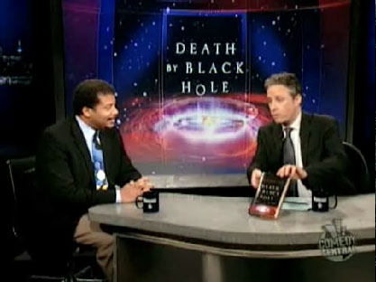

Slide 5
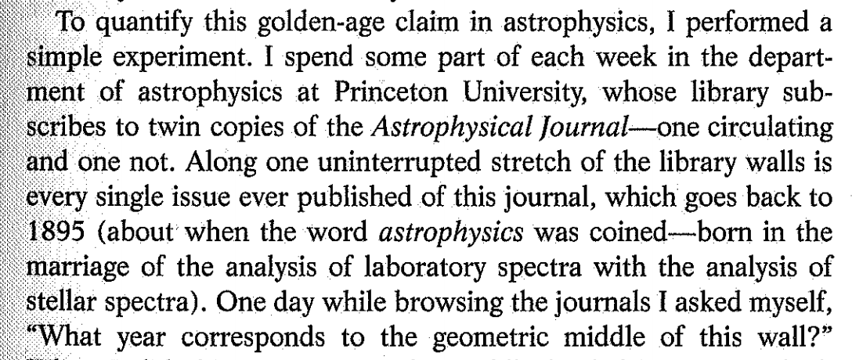
PODC '97

Slide 6
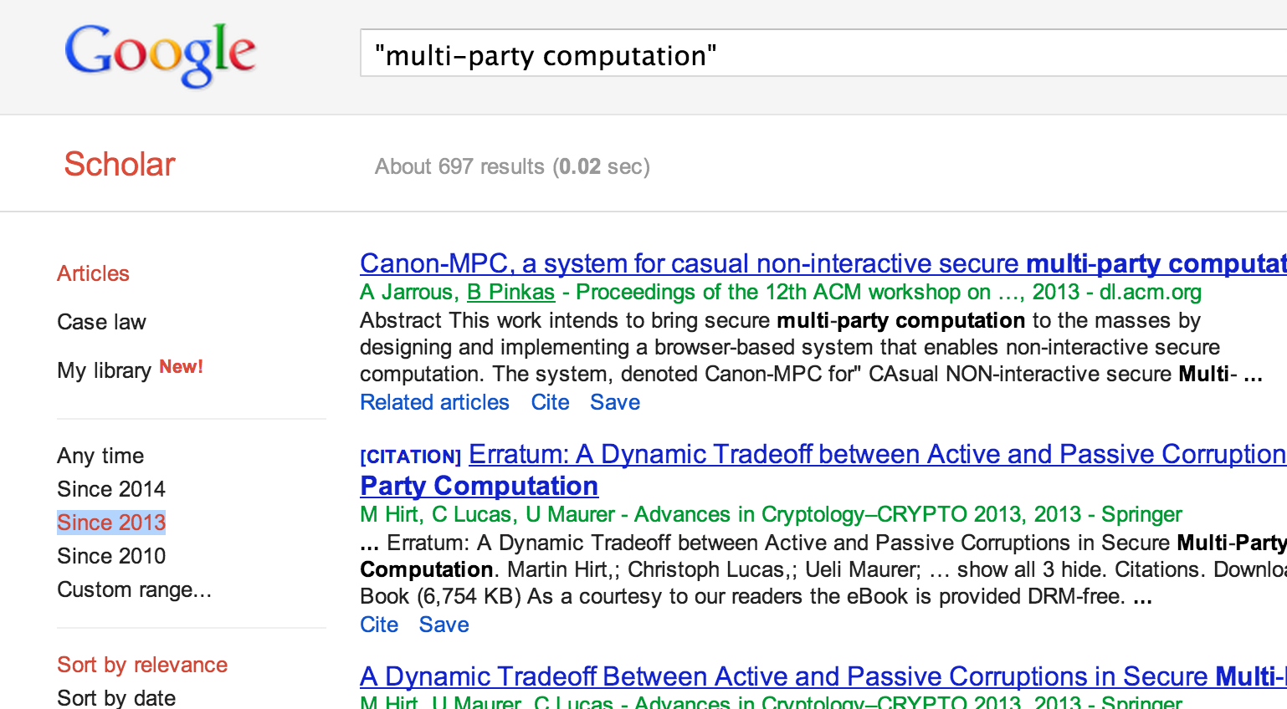
MPC in 2014
2014

Slide 7
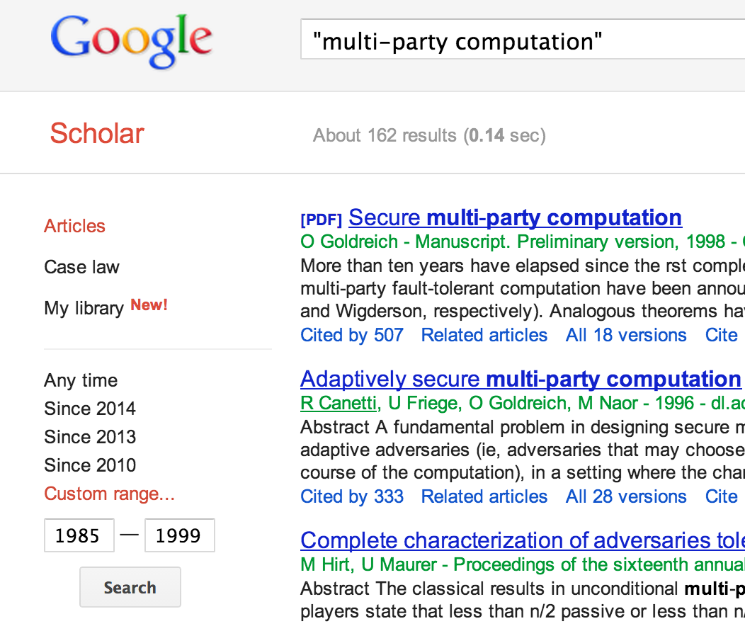
MPC in 1999
1999
2014

Slide 8
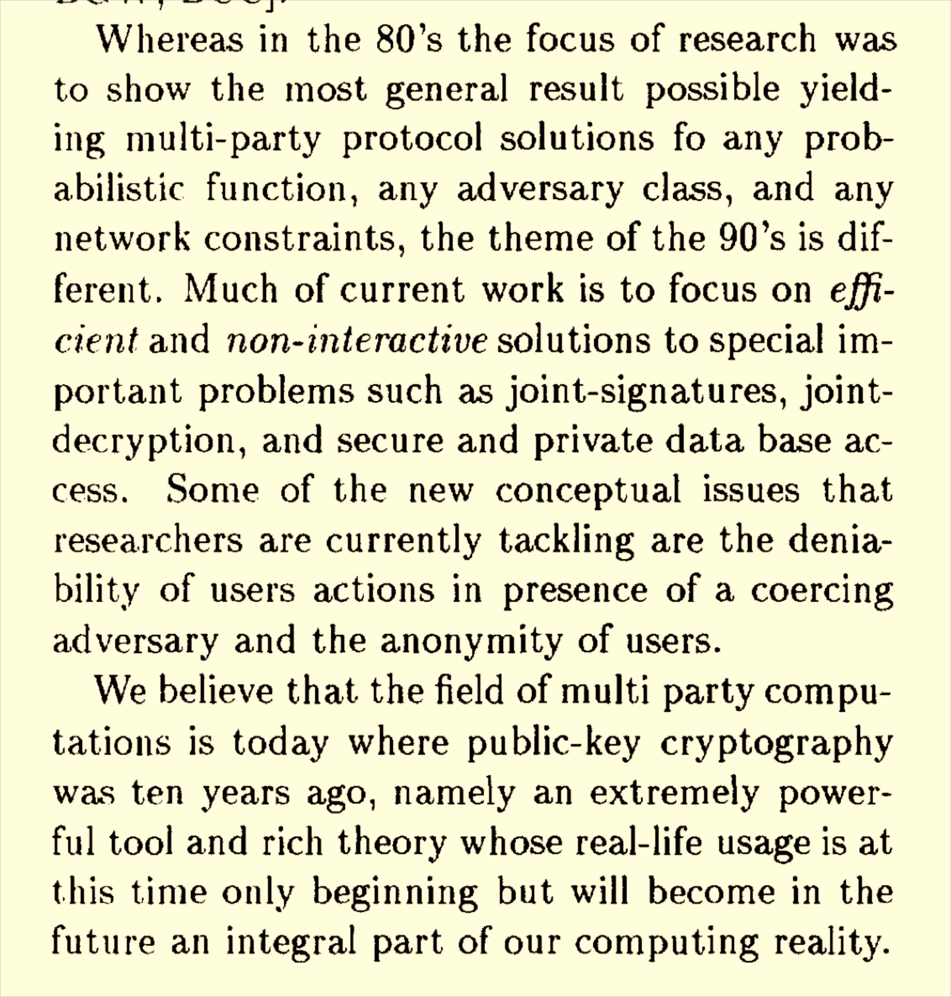
PODC 1997

Slide 9
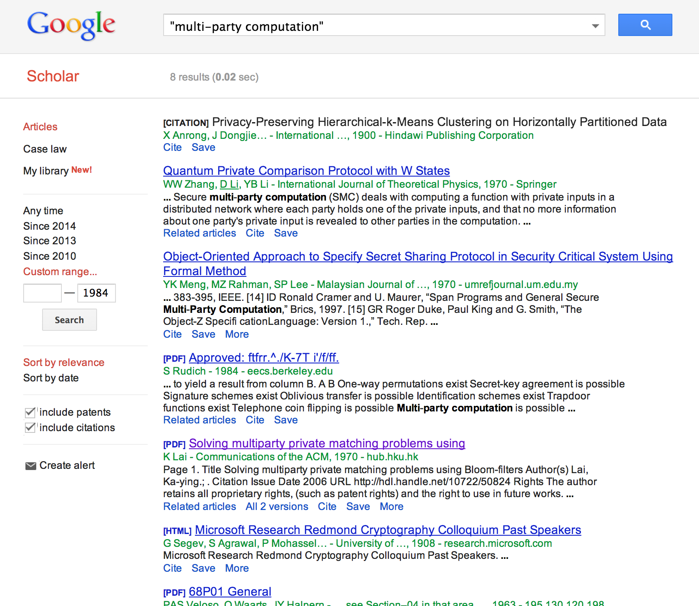
MPC in 1984
1984
1999
2014

Slide 10
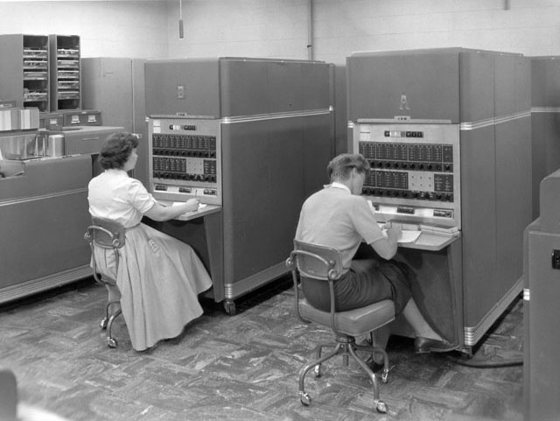
MPC in 1969
1969
1984
1999
2014

Slide 11
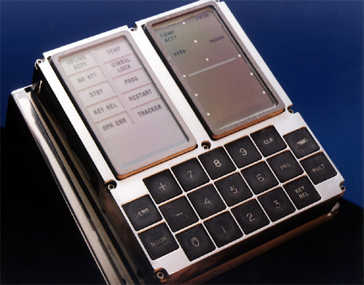
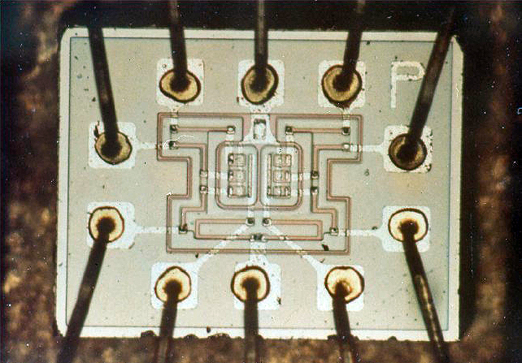
Non-free NOR gate (from Apollo Guidance Computer)

Slide 12
Where should multiparty computation be in 2029?

Slide 13
US Government Investment in MPC
NSF: ~$25M
DARPA: ~$25M
AFOSR: ~$15M
IARPA, NSA: ?
$100M?
National Endowment for the Arts
$130M/year

Slide 14
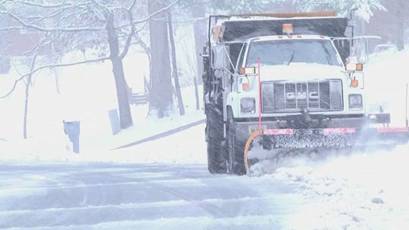
US Government Investment in MPC
NSF: ~$25M
DARPA: ~$25M
AFOSR: ~$15M
IARPA, NSA: ?
$100M?
Virginia Snow Removal Last Week
> $100M

Slide 15
“Acceptable” Result (for “Us”)
Photo credit: Benny Pinkas
some significant papers
interesting intellectual problems
students get good jobs

Slide 16
“Acceptable” Result (for Taxpayers)
Photo credit: Benny Pinkas
Multi-billion dollar industry
Things that make everyday life better

Slide 17
Where should multiparty computation be in 2029?

Slide 18
Claim #1
Secure multi-party computation industry should be bigger than malware industry in 2029.

Slide 19
Worldwide IT Security Market:
~$70B/year,
growing 8.7%/year
[Gartner]
projected continued 8.7% growth
Microsoft

Slide 20
Worldwide IT Security Market:
~$70B/year,
growing 8.7%/year
[Gartner]

Slide 21
Claim #2
High cost is no longer the main impediment to widespread use of secure (two-party) computation.

Slide 22
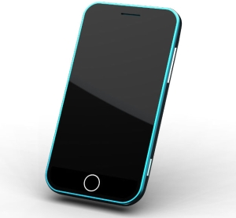
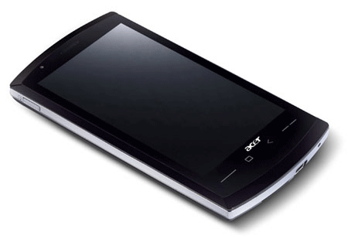
(De)Motivating Application: “Genetic Dating”
Bob
Alice
Genome Compatibility Protocol
Your offspring will have good immune systems!
Your offspring will have good immune systems!
WARNING!
Don’t Reproduce
WARNING!
Don’t Reproduce

Slide 23
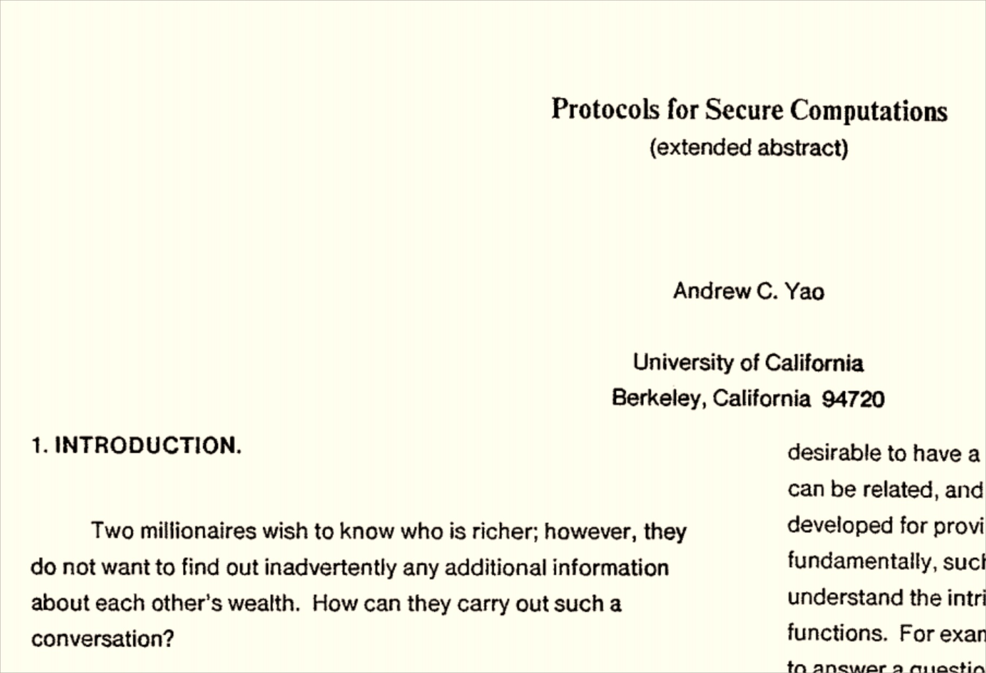
Progress in MPC!
1982
Genetic Dating
Millionaires’ Problem
1984
1999

Slide 24
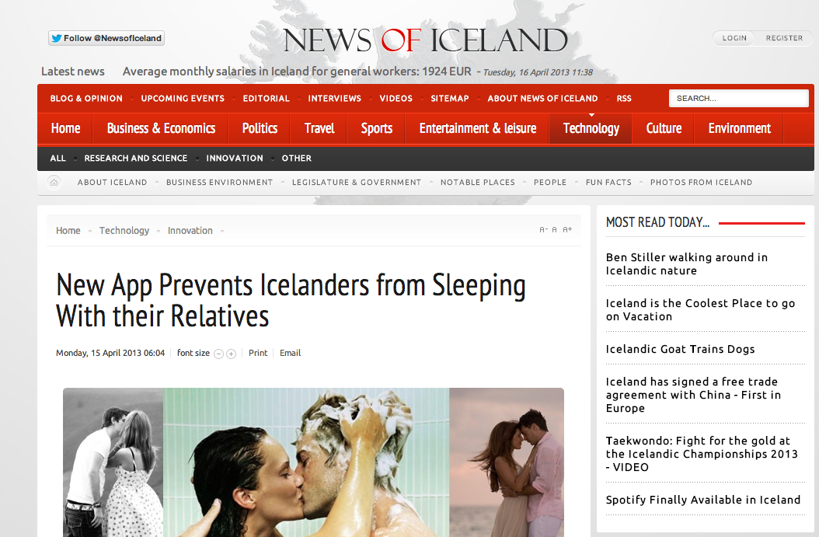
Link

Slide 25
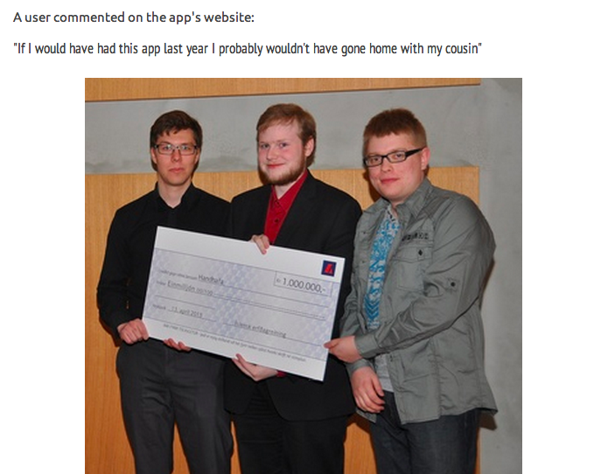

Slide 26
Cost to sequence genome
“Moore’s Law”

Slide 27
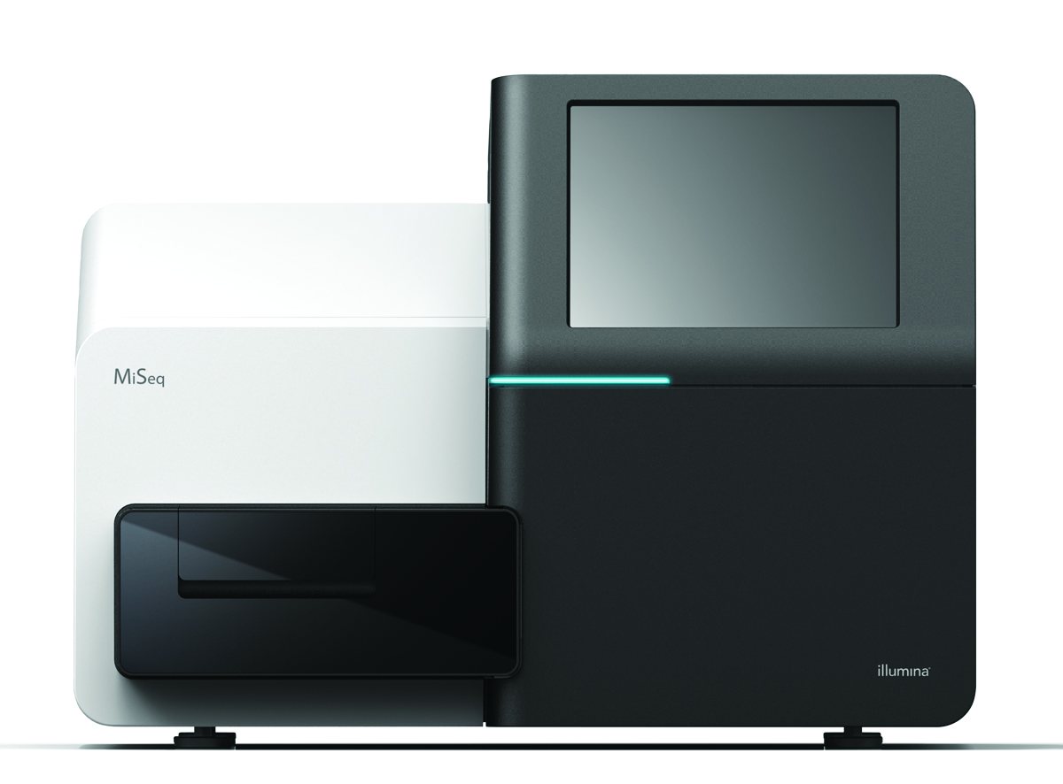
Cost to sequence genome
“Moore’s Law”

Slide 28
Pipelining, etc.
[HEKM 2011]
Fairplay [MNPS 2004]
Free XOR [KS 2008]
From $100M to $0.001
in less than a decade!
[SZ 2013]
JustGarble [BHKR 2013]

Slide 30
Active Security
From $80B to $0.005
in less than a decade!

Slide 31
Costs that Still Matter
Many Parties: costs for > 3 parties are still way off the charts (and interesting applications need millions of parties)
Energy: MPC requires 10,000x (?) energy of unencrypted computation
Data centers today ~5M homes

Slide 32
Things That Really Matter
Understanding what outputs leak
Embedding auditing? Privacy models?
Meaningful end-user value
How do I trust the client code?
(Human) cost to build MPC systems
Easy integration/separation with
standard computation

Slide 33
Claim #3
We don’t yet know what the “killer app” for MPC is.*
* Maybe we will after the Business Case panel today!

Slide 34
Claim #3
We don’t yet know what the “killer app” for MPC is and its probably not privacy.

Slide 36
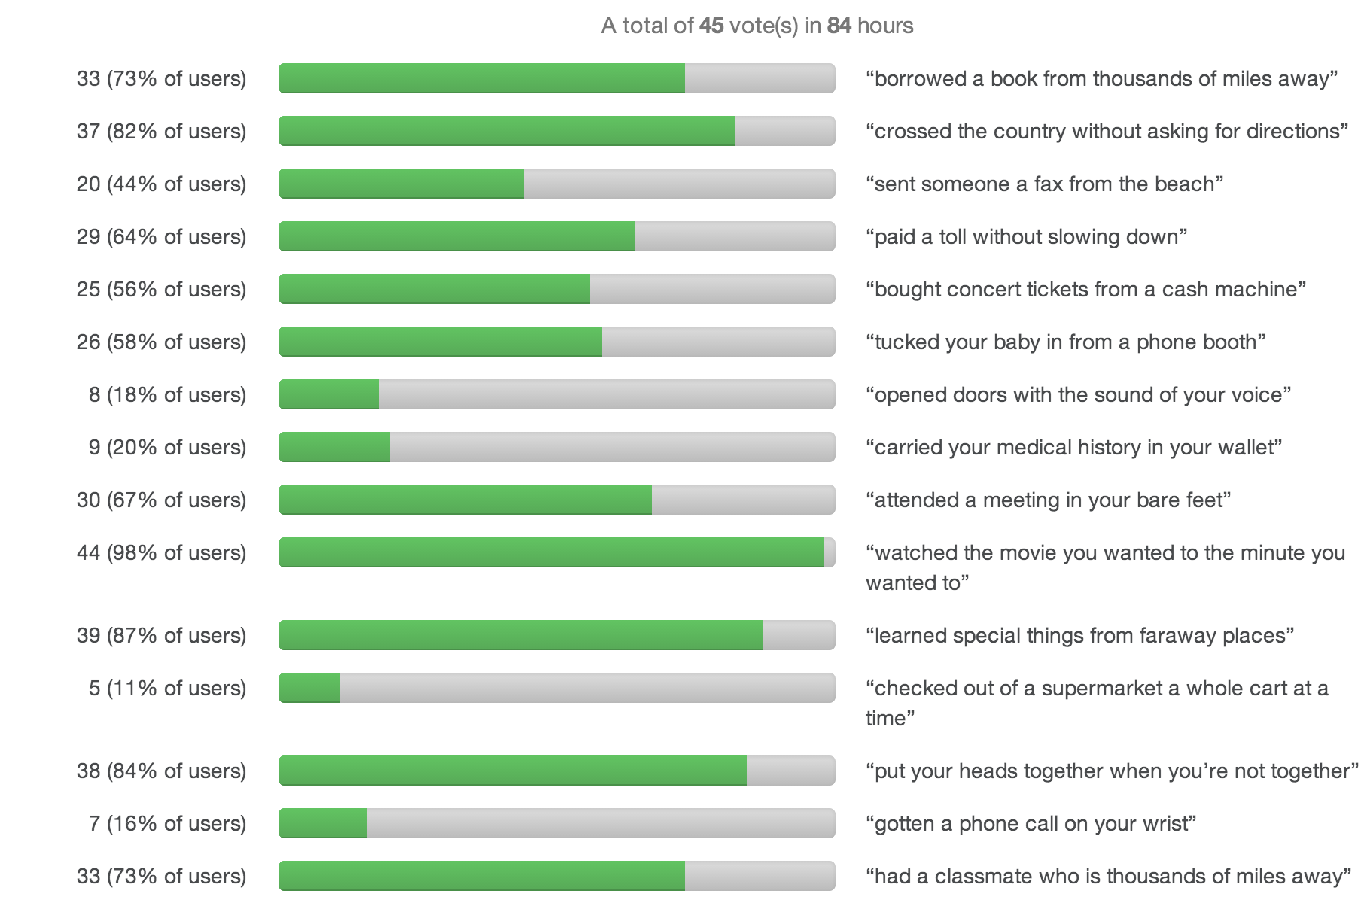

Slide 37
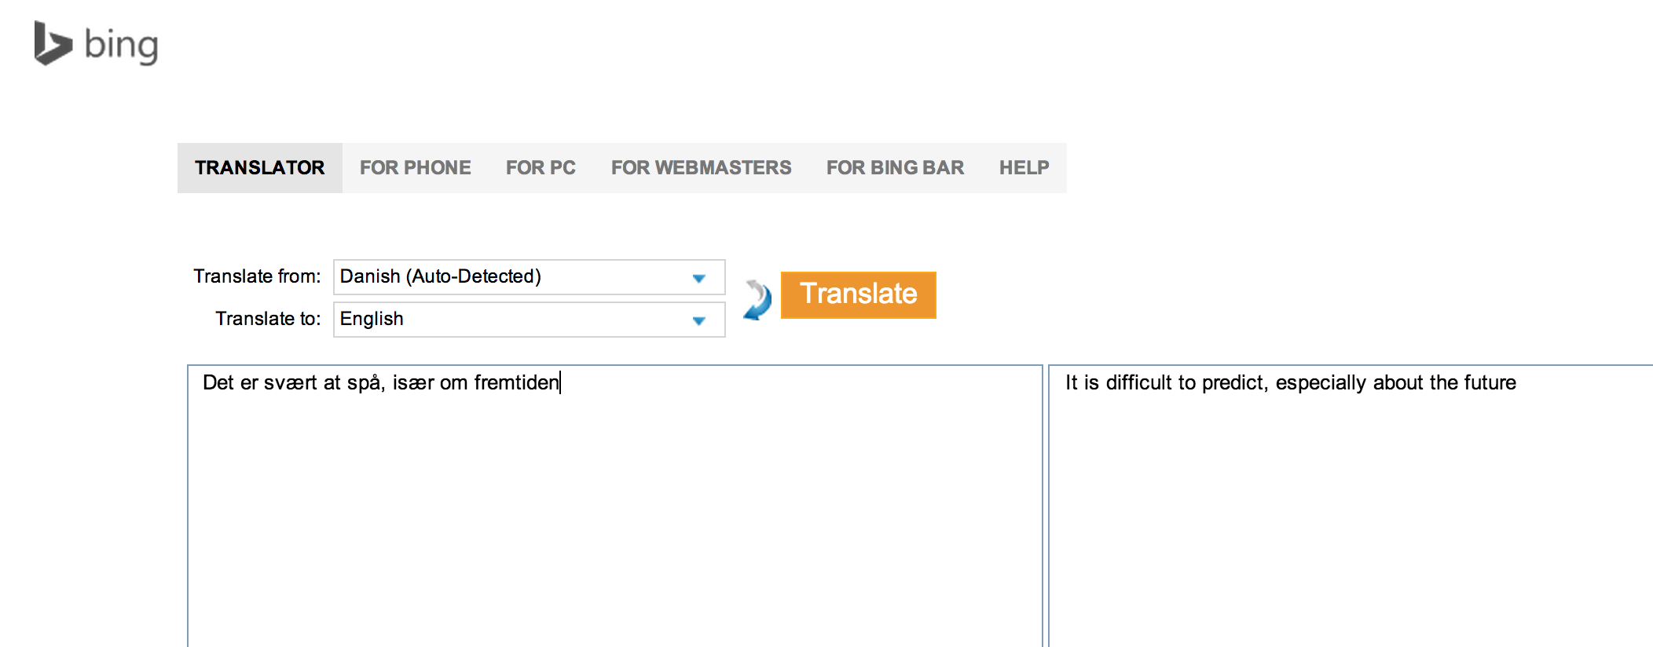
Det er svært at spå, især om fremtiden.
Robert Storm Petersen
It is difficult to predict, especially about the future

Slide 38
Theory vs. Practice

Slide 39
My New Theory of Computation Book!

Slide 40
plug book
A Tragicomic Tale of Combinatorics and Computability
for Curious Children of All Ages
Illustrations by Kim Dylla

Slide 41
dori-mic.org
“If only I had this book when I was a young student, I might have done something useful with my life like discover a new complexity class instead of dropping out and wasting my life flipping pancakes, playing with basic blocks, and eradicating polo.”
Gill Bates,
Founder of Mic-Soft Corporation
MiniLEGO [FJNNO 2013]

Slide 42
Finding the “killer app”
for MPC…

Slide 43
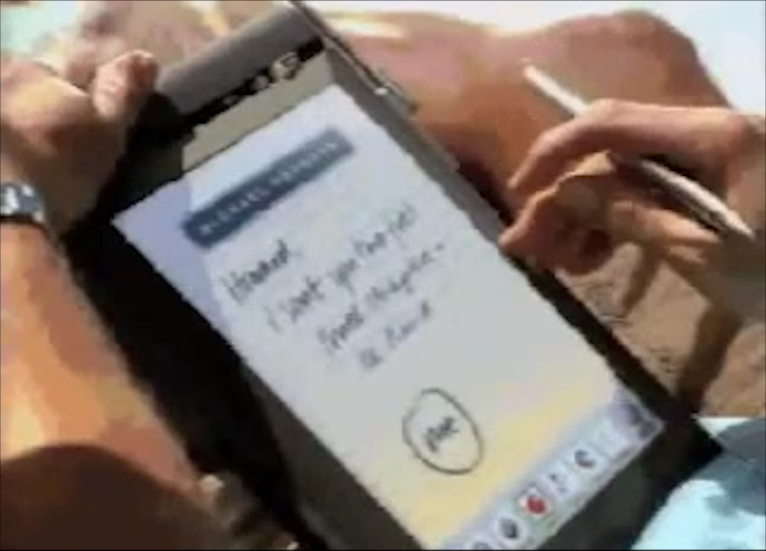
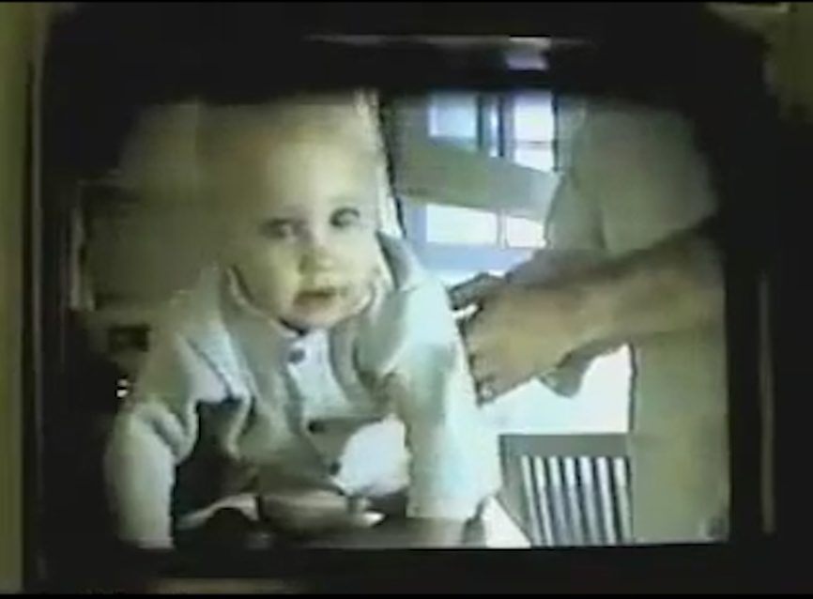
“sending faxes from the beach”
“tucking your baby in from a phone booth”

Slide 44
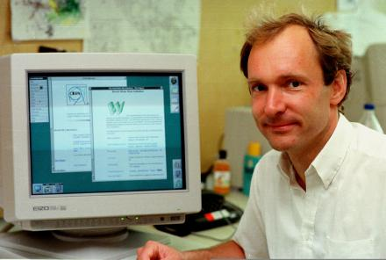
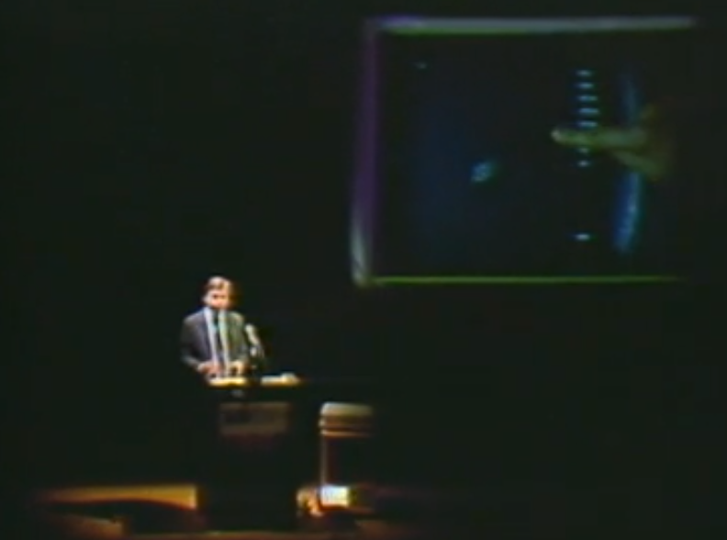
WorldWideWeb [Berners-Lee 1990]
multi-touch, pressure interface
[Negroponte 1984]

Slide 45
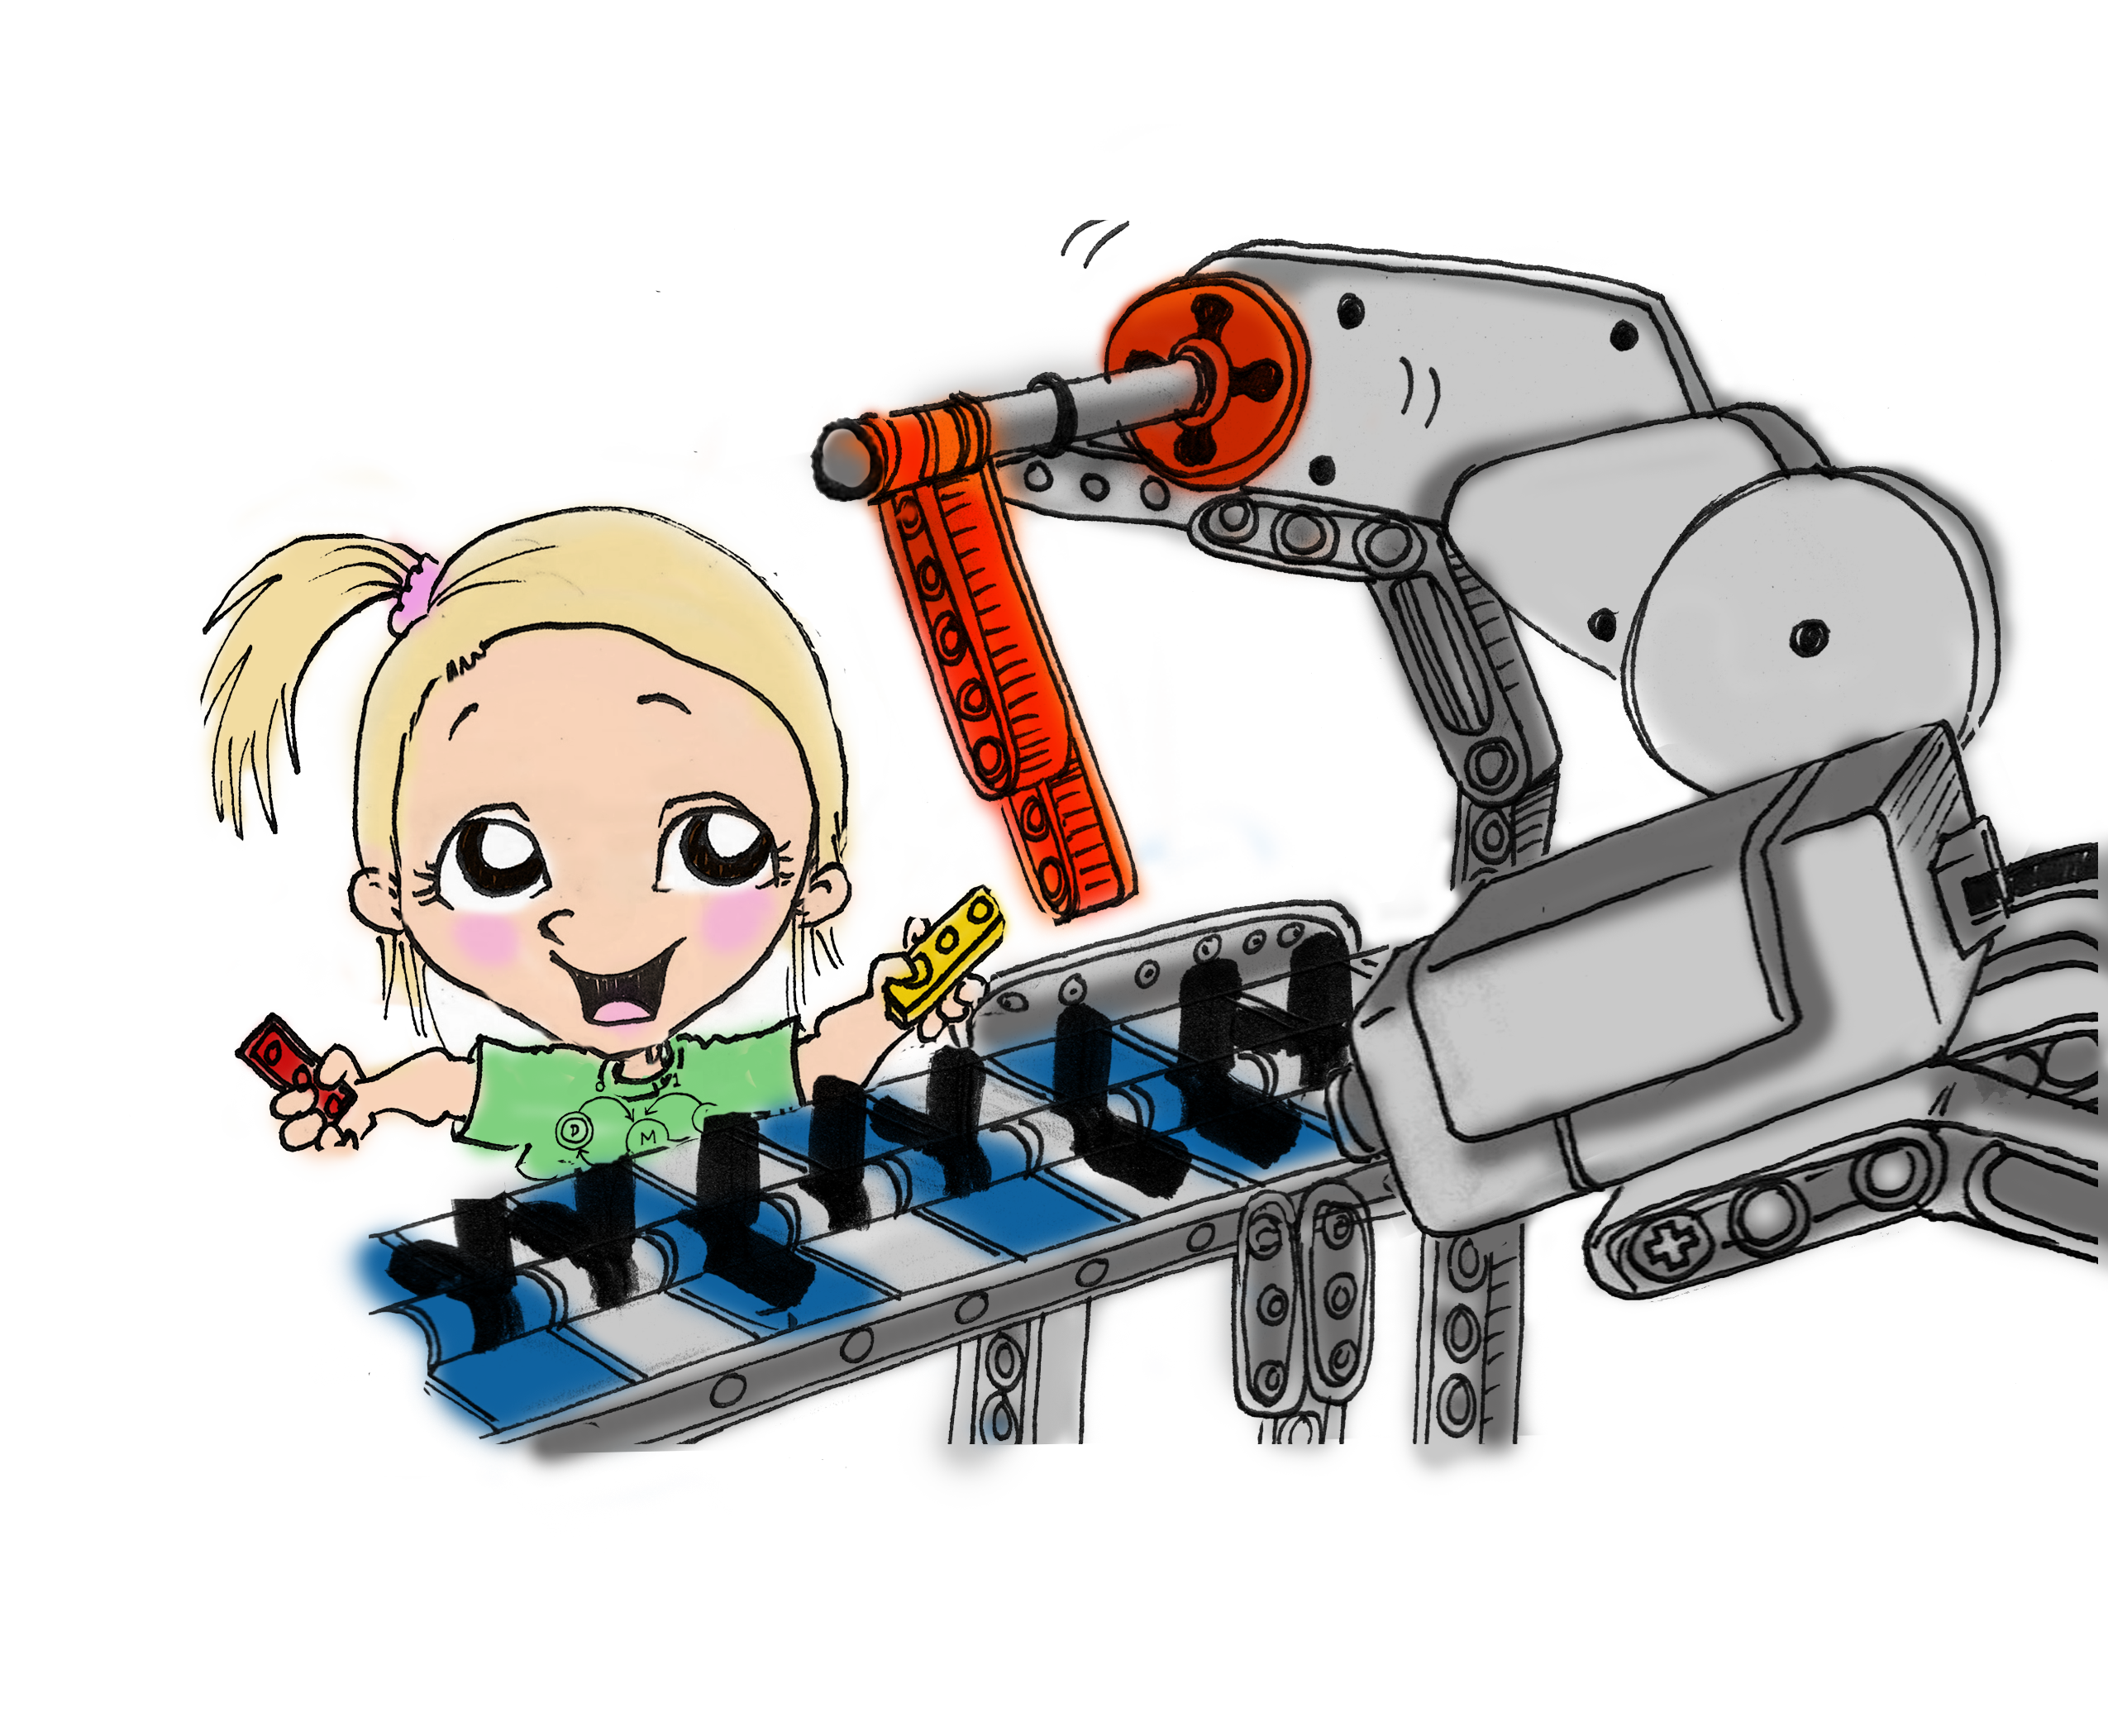
David Evans
evans@virginia.edu
MightBeEvil.com
dori-mic.org

