Slide 1
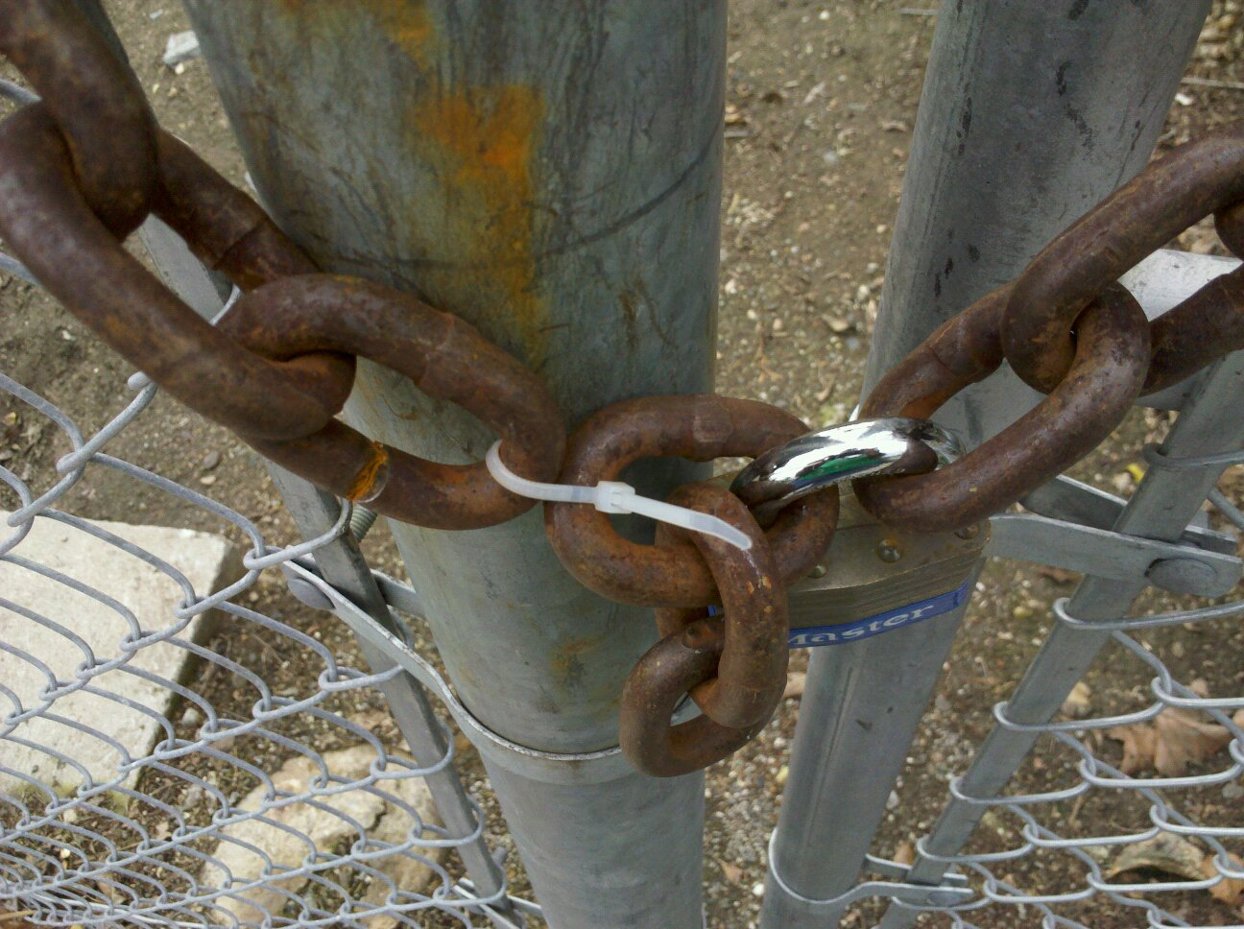
Security and Privacy
David Evans
www.cs.virginia.edu/evans
cs2190
3 March 2011
Image: Roger Halbheer

Slide 2
Today’s Menu
What Every Computer Scientist Should Know about Security
GuardRails
Jonathan Burket (BACS 2)
Patrick Mutchler (BSCS 4)
Michael Weaver (BSCS 4)
Muzzammil Zaveri (BACS 4)
Efficient Secure Computation
Yan Huang (CS PhD)
Yikan Chen (CpE PhD)
Jerry Ye (BSCS 3)
Samee Zahur (CS PhD)
I’m looking for new students for the summer for both projects (and other ideas)!

Slide 3
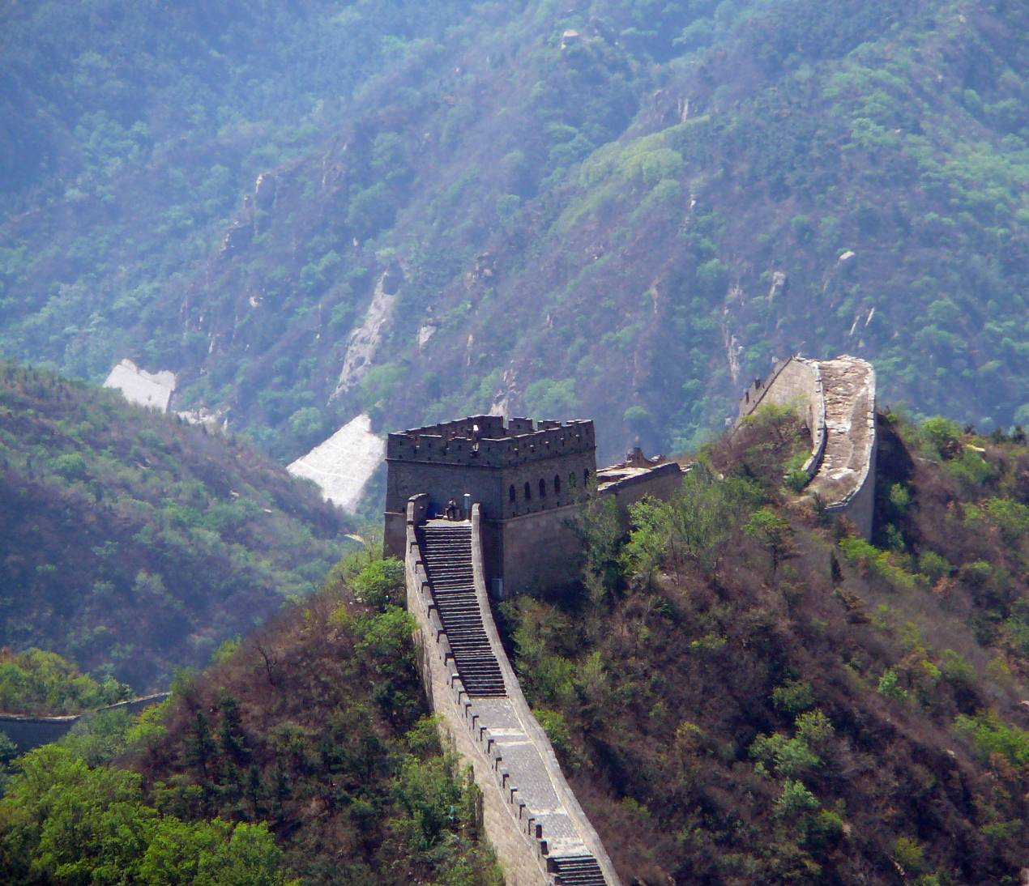
What Every Human Should Know About Security

Slide 4
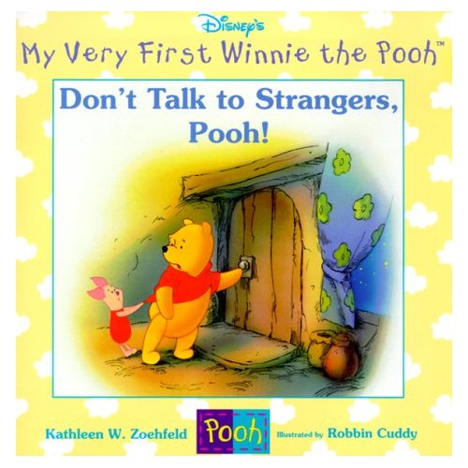

Slide 5
“Many children are taught never to talk to strangers, an extreme precaution with minimal security benefit.”

Slide 6
“Emma Lion loves to make new friends, but Mama tells her to be careful and never talk to strangers. Emma sees new people to meet everywhere she goes. How will she know who is a stranger?”

Slide 7
Security
Technical questions
Figuring out who is not a “stranger” (authentication)
Controlling access to resources (protection and authorization)
Value judgments
Managing risk vs. benefit (policy)
Deterrents
If you get caught, bad things happen to you
Protecting assets from misuse

Slide 8
Computer Security
Study of computing systems in the presence of adversaries
about what happens when people don’t follow the rules

Slide 9
Quiz Authentication, Protection, Authorization, Policy, or Deterrent?

Slide 10
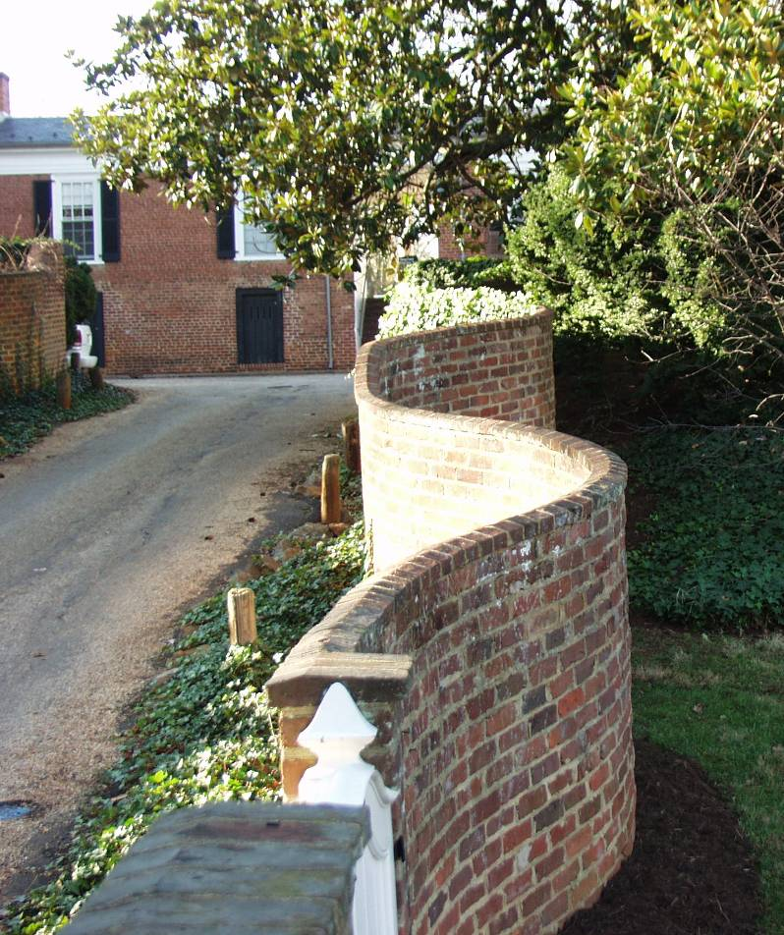
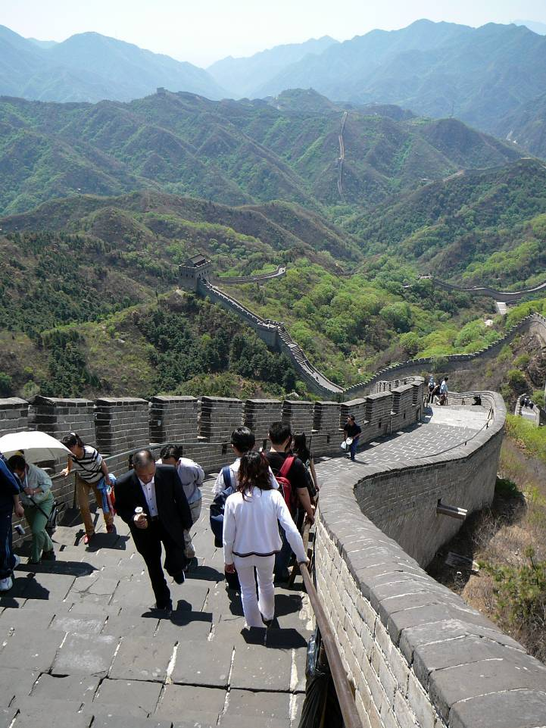
Authentication, Protection, Authorization, Policy, or Deterrent?

Slide 11
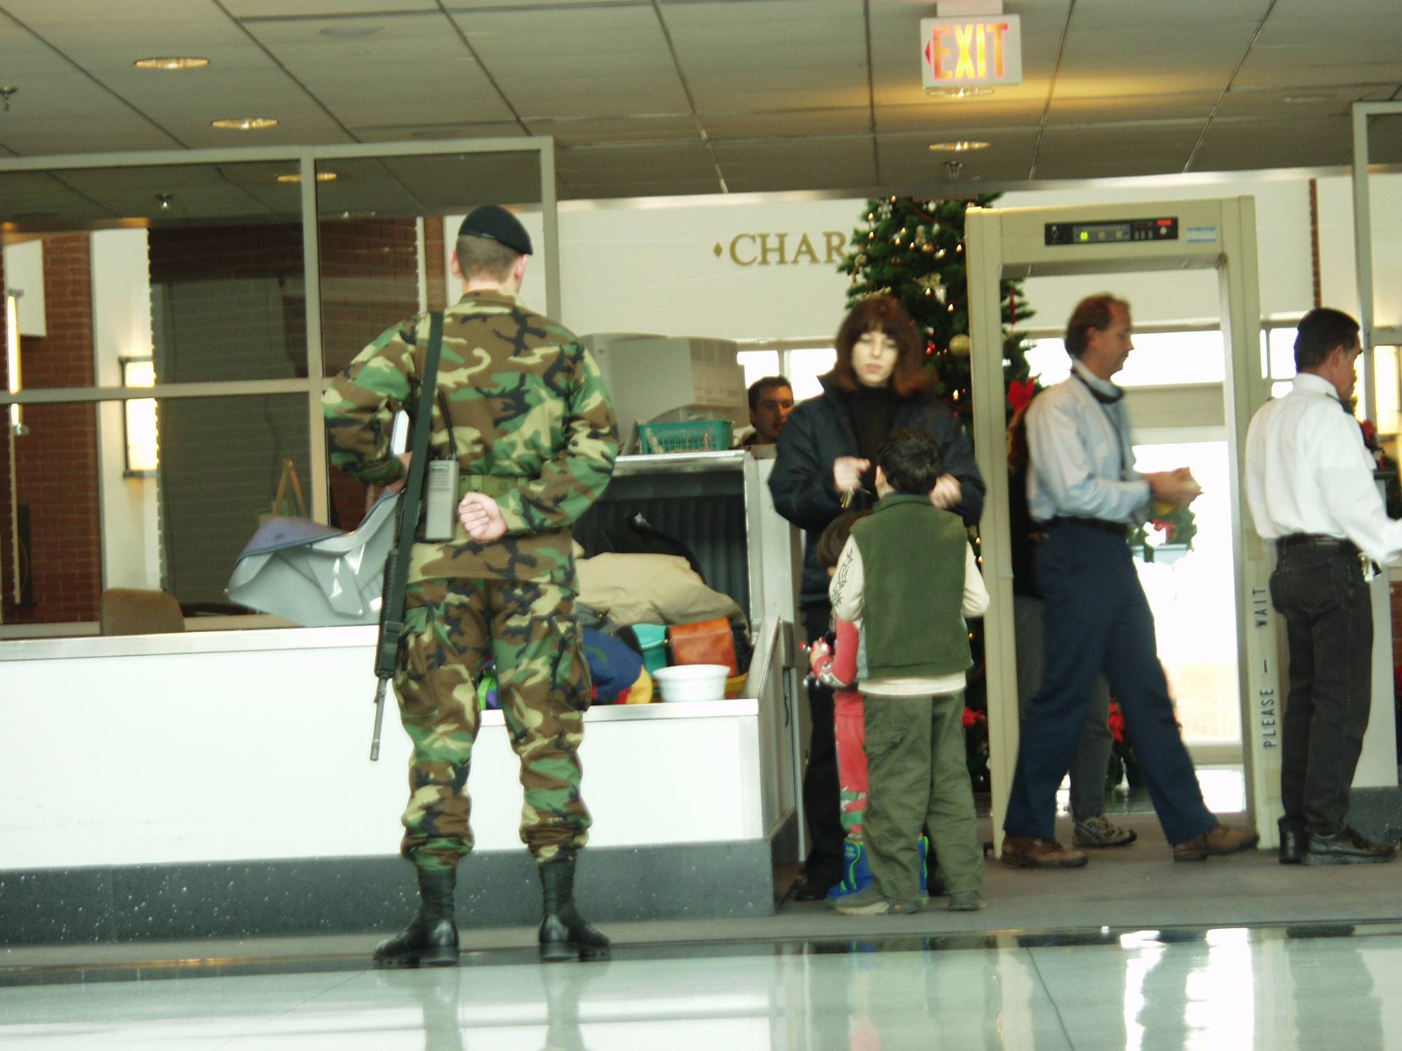
Authentication, Protection, Authorization, Policy, or Deterrent?
Charlottesville Airport, Dec 2001

Slide 12
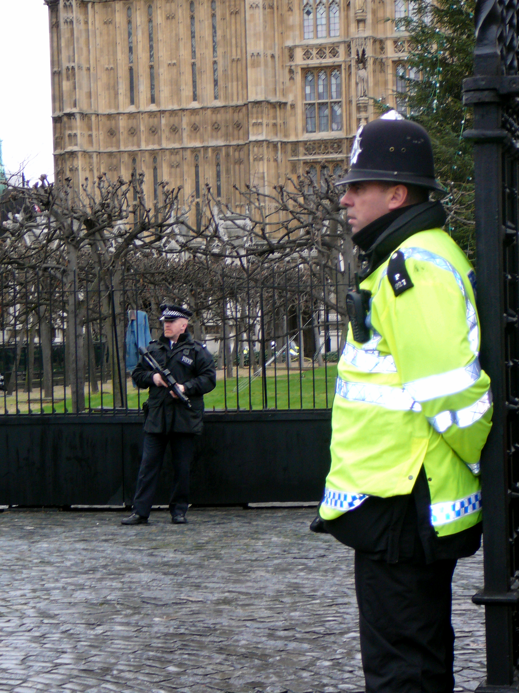
Authentication, Protection, Authorization, Policy, or Deterrent?
British Parliament, Dec 2007

Slide 13
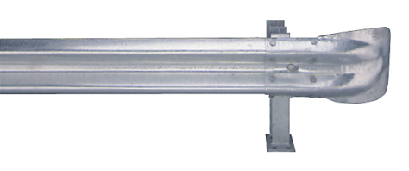
GuardRails
A (Nearly) Painless Solution
to Web Application Security
Jonathan Burket, Patrick Mutchler,
Michael Weaver, Muzzammil Zaveri

Slide 14
Web Security is Annoying and Tedious
Access Control
if include_subprojects && !active_children.empty?
ids = [id] + active_children.collect {|c| c.id}
conditions = ["#{Project.table_name}.id IN (#{ids.join(',')})"]
AND #{Project.visible_by}"]
(Example from Redmine project management tool)
Input Validation
“User: <a href=‘profile_page’>” + user_name + “</a>”
My user_name is “<script language=‘javascript’>doEvil();</script>”
(Cross-site scripting)

Slide 15
Ruby on Rails Code
GuardRails
Policy Annotations
Attach Policies to Data
Little developer effort
Improved readability and analyzability
Secure Web Application
Automatically enforce policies throughout application

Slide 16
Example Policies
Annotation | Meaning
@delete, :admin, :to login | Only administrators can delete this object
@edit, pswrd, self.id == user.id, :to login | Only the user may change that user’s password
@create, User, log_create; true | Whenever a User object is created, write to log
Policies are attached to classes or individual fields. Can perform arbitrary checking and actions based on read, edit, append, create, destroy events.

Slide 17
Enforcing Policies
GuardRails Proxy
Protected
Object
GuardRails Alias
Protected Field

Slide 18
Taint Tracking
URL Parameters
Controller
Model
Form Data
Other User Input
View
Database
Tainted HTML
Context-Sensitive
Sanitization
Data
Taint
Status
Safe HTML
“foo” + “bar” → “foobar”

Slide 19
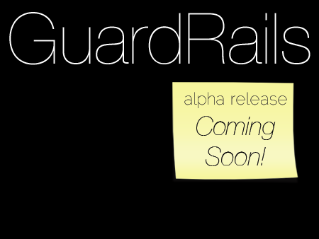
Possible Projects
Automating Annotations
Client/Server Side Integration
Evaluation

Slide 20
Secure Computation
in the Real(ish) World
Yan Huang (CS PhD)
Yikan Chen (CpE PhD)
Jerry Ye (BSCS 3)
Samee Zahur (CS PhD)

Slide 21
“Genetic Dating”
Bob
Alice
Genome Compatibility Protocol
Your offspring will have good immune systems!
Your offspring will have good immune systems!
WARNING!
Don’t Reproduce
WARNING!
Don’t Reproduce

Slide 23
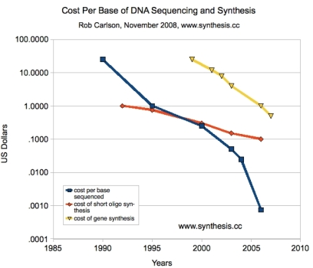
1990: Human Genome Project starts, estimate $3B to sequence one genome ($0.50/base)
2000: Human Genome Project declared success, cost ~$300M

Slide 24
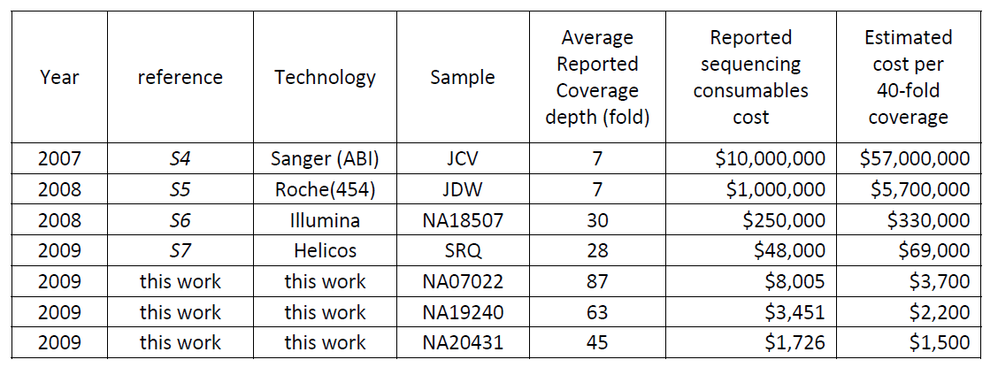
Human Genome Sequencing Using Unchained Base Reads on Self-Assembling DNA Nanoarrays. Radoje Drmanac, Andrew B. Sparks, Matthew J. Callow, Aaron L. Halpern, Norman L. Burns, Bahram G. Kermani, Paolo Carnevali, Igor Nazarenko, Geoffrey B. Nilsen, George Yeung, Fredrik Dahl, Andres Fernandez, Bryan Staker, Krishna P. Pant, Jonathan Baccash, Adam P. Borcherding, Anushka Brownley, Ryan Cedeno, Linsu Chen, Dan Chernikoff, Alex Cheung, Razvan Chirita, Benjamin Curson, Jessica C. Ebert, Coleen R. Hacker, Robert Hartlage, Brian Hauser, Steve Huang, Yuan Jiang, Vitali Karpinchyk, Mark Koenig, Calvin Kong, Tom Landers, Catherine Le, Jia Liu, Celeste E. McBride, Matt Morenzoni, Robert E. Morey, Karl Mutch, Helena Perazich, Kimberly Perry, Brock A. Peters, Joe Peterson, Charit L. Pethiyagoda, Kaliprasad Pothuraju, Claudia Richter, Abraham M. Rosenbaum, Shaunak Roy, Jay Shafto, Uladzislau Sharanhovich, Karen W. Shannon, Conrad G. Sheppy, Michel Sun, Joseph V. Thakuria, Anne Tran, Dylan Vu, Alexander Wait Zaranek, Xiaodi Wu, Snezana Drmanac, Arnold R. Oliphant, William C. Banyai, Bruce Martin, Dennis G. Ballinger, George M. Church, Clifford A. Reid. Science, January 2010.

Slide 25
Secure Two-Party Computation
Bob’s Genome: ACTG…
Markers (~1000): [A, T, … ]
Alice’s Genome: ACTG…
Markers (~1000): [A, G, … ]
Bob
Alice
Can Alice and Bob compute a function of their private data, without exposing anything about their data (other than the result)?

Slide 26
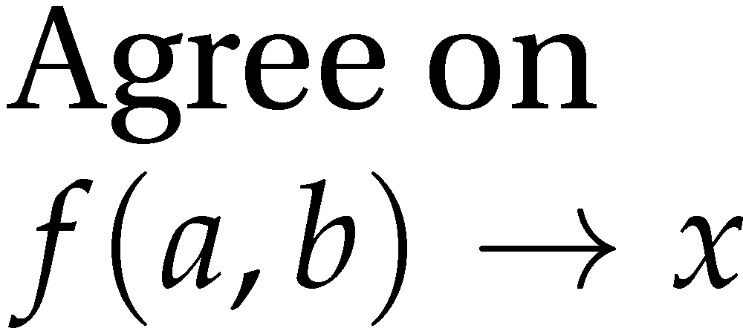
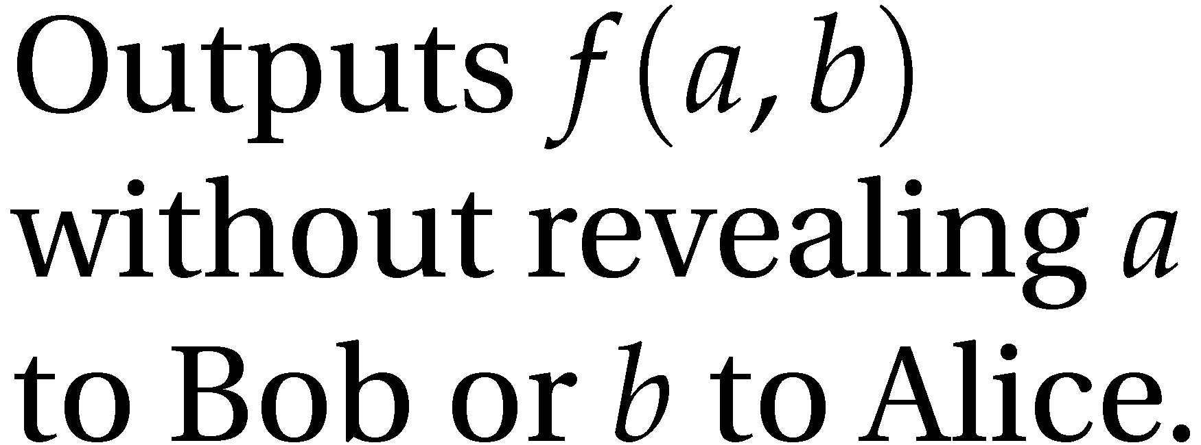
Secure Function Evaluation
Alice (circuit generator)
Bob (circuit evaluator)
Garbled Circuit Protocol
Andrew Yao, 1982/1986

Slide 27
Computing with Lookup Tables
Input 0 | Input 1 | Output
0 | 0 | 0
0 | 1 | 0
1 | 0 | 0
1 | 1 | 1
i₀
i₁
AND
o₀

Slide 28
Computing with Garbled Tables
Input 0 | Input 1 | Output
a₀ | b₀
a₀ | b₁
a₁ | b₀
a₁ | b₁

Slide 29
Computing with Garbled Tables
Input 0 | Input 1 | Output
a₀ | b₀ | Enc_{a0,b0}(o₀)
a₀ | b₁ | Enc_{a0,b1}(o₀)
a₁ | b₀ | Enc_{a1,b0}(o₀)
a₁ | b₁ | Enc_{a1,b1}(o₁)

Slide 30
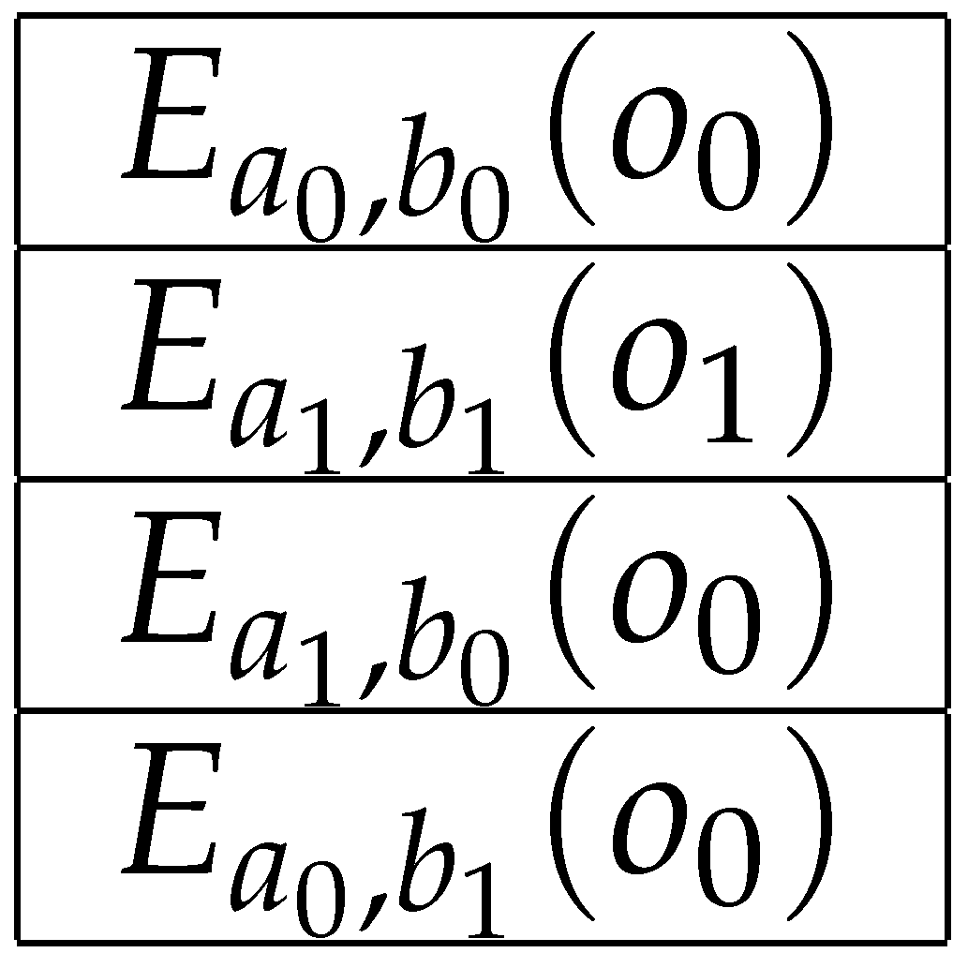
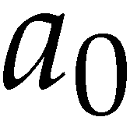
Garbled Circuit Protocol
Alice (circuit generator)
Bob (circuit evaluator)
Sends a_{i} to Bob based on her input value
How does the Bob learn his own input wires?

Slide 31
Primitive: Oblivious Transfer
Alice
Bob
Oblivious Transfer Protocol
Oblivious: Alice doesn’t learn which secret Bob obtains
Transfer: Bob learns one of Alice’s secrets
Rabin, 1981; Even, Goldreich, and Lempel, 1985; many subsequent papers

Slide 32
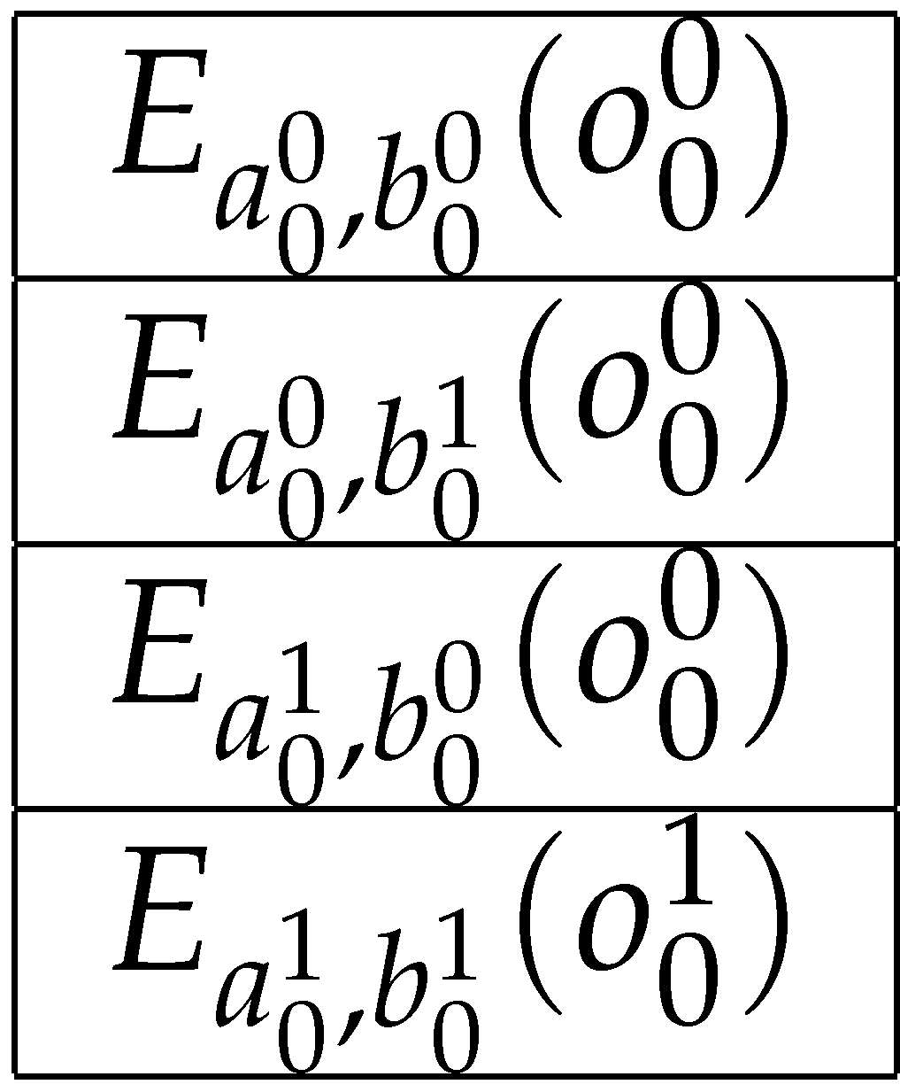
Chaining Garbled Circuits
a₁
b₁
a₀
b₀
AND
AND
o₁
o₀
AND
o₂

Slide 33
Alice: a₀a₁a₂ … a_{n}
Bob: b₀b₁b₂ … b_{n}
⊕
⊕
⊕
⊕
. . .
1-bit adder
0
1-bit adder
0
1-bit adder
0
1-bit adder
0
. . .
1-bit adder
0
. . .
1-bit adder
0
Hamming Distance

Slide 34
Building Secure Computing Systems
We can do any computation privately this way!
Cost metric very different from normal circuits
Generating/evaluating each gate requires several encryption operations
Can only execute each gate once
XOR is free (and NOT) is nearly free
Framework for Efficiently Executing Circuits
Pipeline generation and evaluation

Slide 35
Possible Projects
Design and implement a secure computation
Fingerprint matching
Genome analysis
Image recognition
Auctions
Improve garbled circuit evaluation
Multi-core, GPU
Stronger Adversary Model

Slide 36
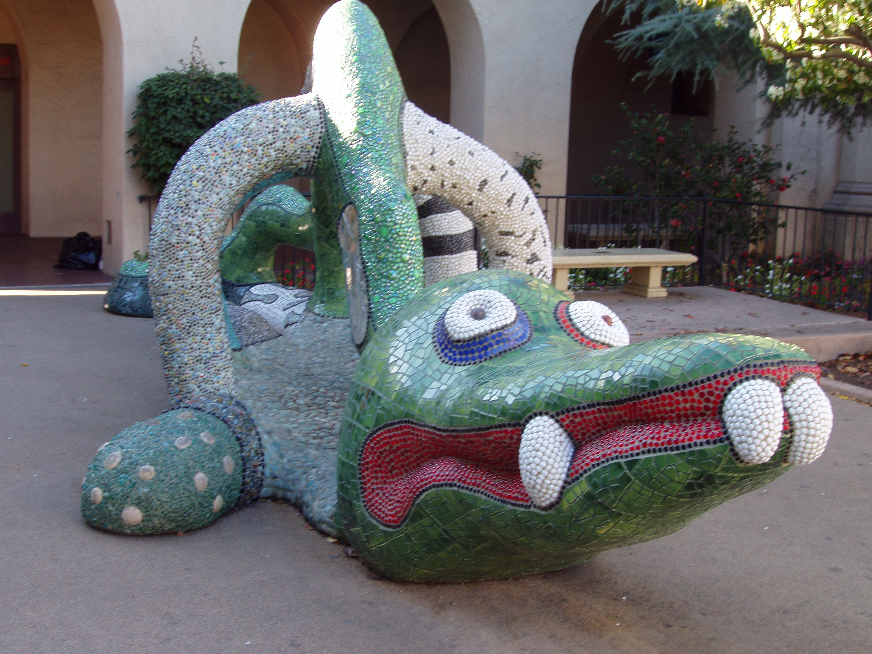
“If you have something that you don't want anyone to know, maybe you shouldn't be doing it in the first place.”
Eric Schmidt (then CEO of Google)
MightBeEvil.com

