Slide 1
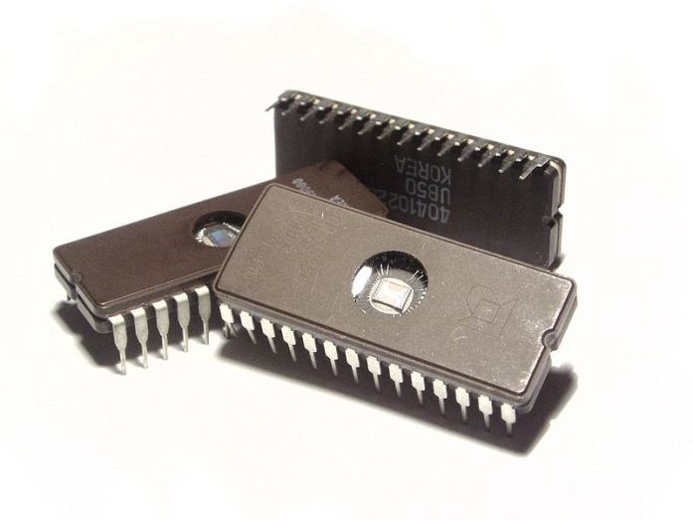
Understanding and Mitigating Supply Chain Risks for Computing and Communications (or: Who’s Driving Your Missiles?)
David Evans
DSSG Think Piece
University of Virginia

Slide 2
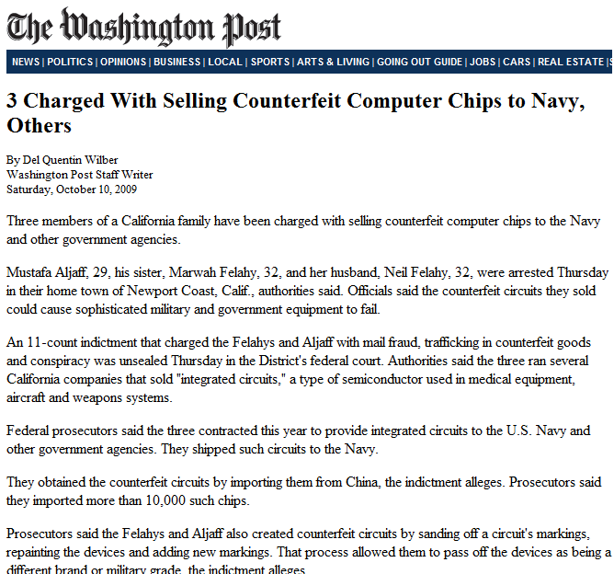
Federal prosecutors said the three contracted this year to provide integrated circuits to the U.S. Navy and other government agencies. They shipped such circuits to the Navy.
They obtained the counterfeit circuits by importing them from China, the indictment alleges. Prosecutors said they imported more than 10,000 such chips.
Notes:
"MVP Micro has added an extra layer of inspection to protect its customers," said MVP Micro Holdings Ceo, Mustafa Aljaff. "We are determined to go above and beyond what our competitors are doing and this x-ray inspection system does just that. This system is the Nexus of our QC process and it allows us to extend the OEM warranty by one full year. You are what you ship and MVP Micro refuses to send out anything that is not to OEM specifications."

Slide 3
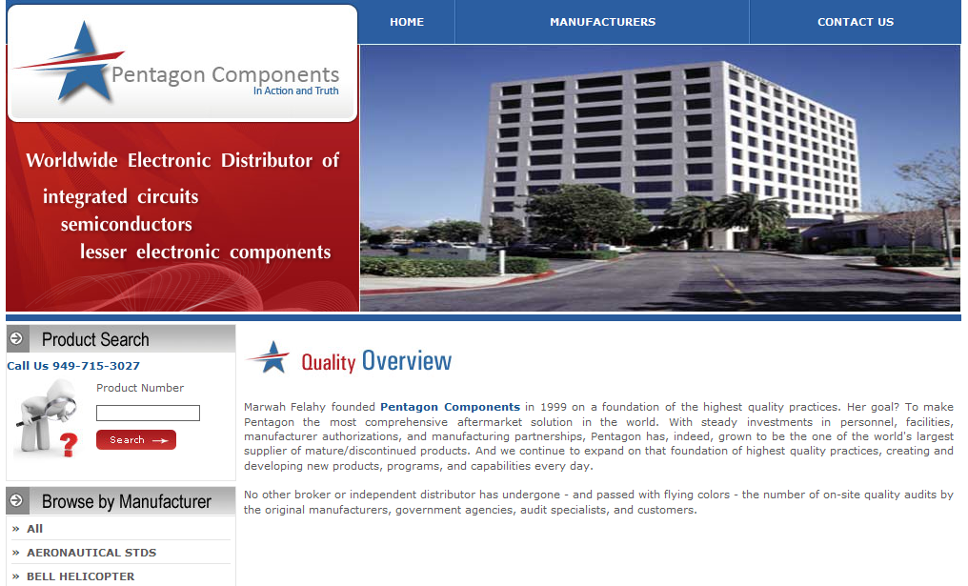

Slide 4
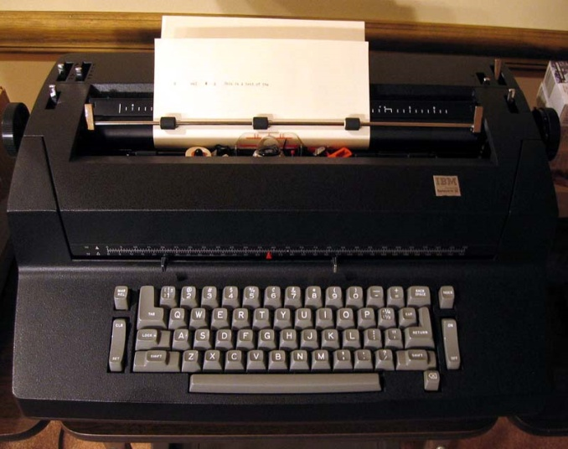
Defense Examples
Cold War Technology Trojans
Soviets tried to purchase pipeline software from Canadian company, request was denied
KGB then stole the software – but CIA learned of this and “updated” software
Trojan software created largest non-nuclear explosion ever, disrupted Soviet gas supply
Thomas Reed, “At the Abyss: An Insider’s History of the Cold War”
IBM Typewriters delivered to the US Embassy in Moscow
Israel / Syria

Slide 5
Integrated Circuit Supply Chain (simplified)
ASIC: Application-Specific Integrated Circuit
Design
Fabrication
Assembly
Deployment
Modern fab: ~$2B
Useful lifetime: ~3 years
Mostly overseas
1964: USAF Minuteman II ICBM – 2-4000 ICs, 40% of cost is electronics
95% of US production of ICs are for DoD
2002: DoD is < 0.5% of world IC market (~$0.5B direct per year)
[Brian Cohen, IDA]

Slide 6
Verifying Ics?
Design
Fabrication
Assembly
Deployment
Verifier
DARPA: Trust in ICs Program

Slide 7
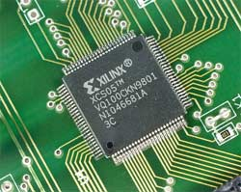
Impossibility of Black Box Verification
~2¹⁰⁰⁰⁰⁰ possible states, can design malicious logic that is triggered by one specific input

Slide 8
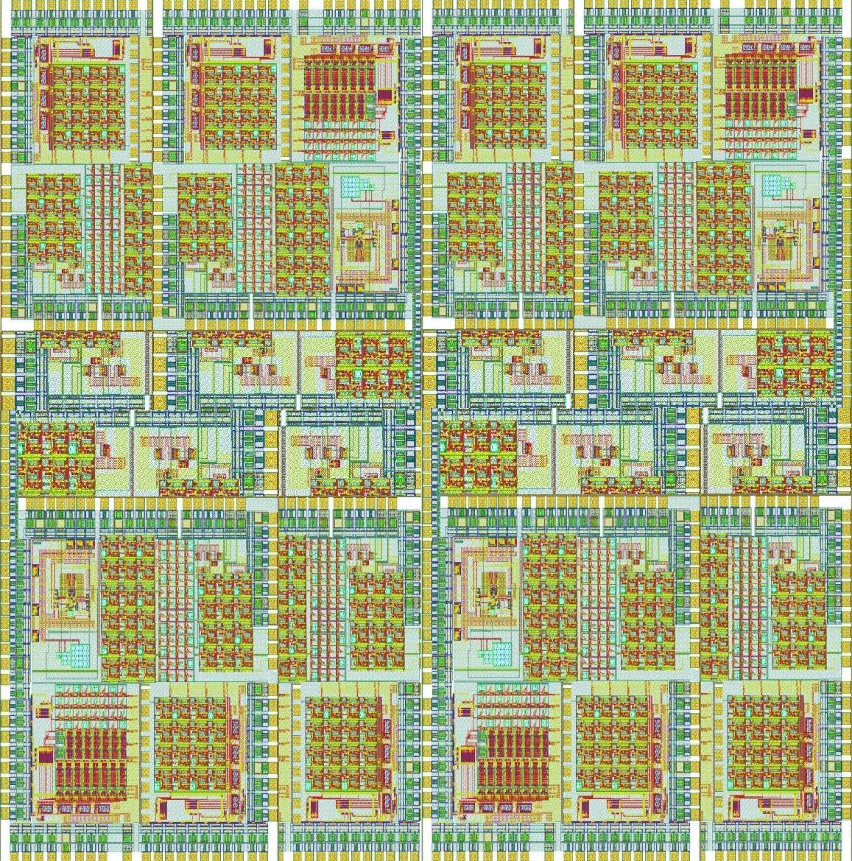
White Box Verification: DARPA-Hard++
Typical ASIC:
Millions of gates
Only need a few hundred to hide malicious logic
Known and trusted design: automated reverse engineering and inspection

Slide 9
Trusted Foundry Program
Trusted Foundry
Design
Fabrication
Assembly
Deployment
NSA/DoD program created in 2003
~12 accredited foundries: IBM, Northop Grumman, Sandia, etc.
personnel with access to foundry are cleared
same foundry can produce untrusted ICs
Guidance: all systems of Mission Assurance Category I must use Trusted Foundry (“Systems handling information that is determined to be vital to the operational readiness or mission effectiveness”)
Notes:
Systems handling information that is determined to be vital to the operational readiness or mission effectiveness of deployed and contingency forces in terms of both content and timeliness. The consequences of loss of integrity or availability of a MAC I system are unacceptable and could include the immediate and sustained loss of mission effectiveness.

Slide 10
Issues with Trusted Foundry
Trusted Foundry
Design
Fabrication
Assembly
Deployment
Libraries
Even trusted design relies on libraries, design software, etc. from possibly untrusted sources
Design Tools

Slide 11
Issues with Trusted Foundry
Trusted Foundry
Design
Fabrication
Assembly
Deployment
How do you know chip is the one that came from the trusted foundry?

Slide 12
Validating Trusted ICs
Trusted Foundry
Design
Fabrication
Assembly
Deployment
Record properties of trusted chip
interrogate chip
Secure Database

Slide 13
Chip Verification: Physically Unclonable Functions (PUFs)
Edward Suh (Cornell), Srinivas Devadas (MIT); Verayo
...
0 1
0 1
Signals “race” through circuit: outputs 1 if top path is faster, 0 otherwise.
...
1 0
1 0
Challenge
bits
x₀
x₁
Challenge bits: which delay path to take

Slide 14
Using PUFs to Validate Trusted IC
Trusted Foundry
Design
Fabrication
Assembly
Deployment
interrogate chip with set of random PUF challenges
interrogate chip with known challenge and check response
Secure Database
<chipID, <challenge₁, response₁>
<challenge₂, response₂>
...
<challenge_{n}, response>>

Slide 15
PUF Security Issues
How hard is it for an attacker to model the PUF?
More complex PUF designs
Cryptographic protections (one-way hash) on output
How hard is it for an attacker to tamper with the rest of the chip without effecting the PUF?
Integrate PUF into circuit (design complexity)
Deployment issues: when and how to validate
Opportunity for continuous end-to-end validation from foundry to deployment.

Slide 16
Alternate Direction: FPGAs
Custom ASICs
High Cost (application-specific)
High Performance
Fixed logic (not programmable)
Field-Programmable Gate Arrays
General-Purpose Processors
Low Cost (mass market)
Low Performance
Fully programmable

Slide 17
Secure FPGA
Bitstream
Control Core
Public Key
Field-Programmable
Logic
Encrypted and signed with
Private Key
Trusted Designer
Private Key
Generic, secure FPGA produced by Trusted Foundry

Slide 18
Advantages of FPGAs
Mass produced FPGA
One Trusted FPGA design could support many applications
Performance gap is shrinking (close to ASICs)
Core is simple compared to General-Purpose Processor
Limit size, can verify small core
Custom logic can be protected
Removed from chip when vulnerable
Protect and verify bitstream cryptographically
Public key stored in FPGA core

Slide 19
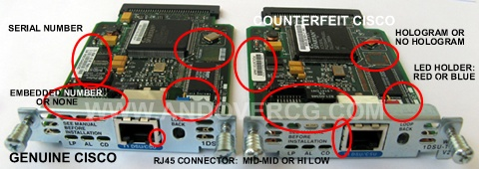
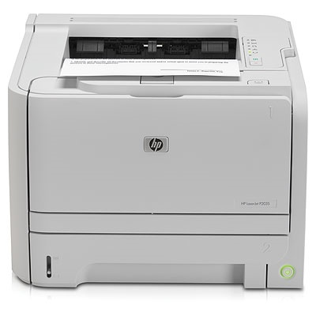
Using COTS Equipment
Counterfeit Cisco Routers
Operation “Cisco Raider”: $76M in fake Cisco routers
Top Secret

Slide 20
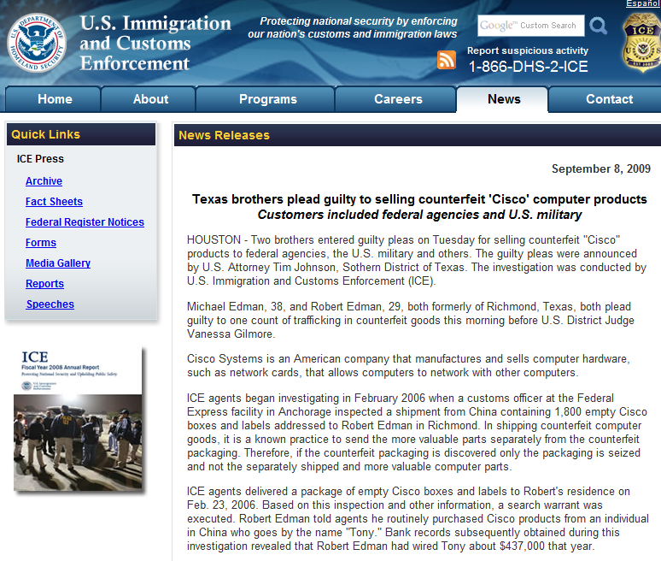
Two brothers entered guilty pleas on Tuesday for selling counterfeit “Cisco” products to federal agencies, the U.S. military and others….
Edman’s customers included the Marine Corps, Air Force, FBI, Federal Aviation Administration, Department of Energy, as well as defense contractors…

Slide 21
Strategies for Using COTS
Limited interface
Network device to monitor untrusted device
But how do you trust the monitoring device?
Redundancy
Multiple devices from disjoint supply chains
Monitor that they behave “identically”
Avoid targeted attacks
Sales channel should not know it is going to DoD
What are the risks for embedding Trojan in design?
Software updates
Protected by digital signatures…but how are internal processes protected?

Slide 22
Good News/Bad News?
“It’s certainly possible for the world’s major espionage services to secretly plant vulnerabilities in our microprocessors, but the threat is overblown. Why would anyone go through the effort and take the risk, when there are thousands of vulnerabilities in our computers, networks and operating systems waiting to be discovered with only a few hours work?”
Bruce Schneier (CTO of BT Counterpane)

Slide 23
Summary
Trusting ICs is essential: all of our computing and communications depends on them
This is a hard problem: Sophisticated attacker can easily hide a Trojan in IC, cannot be detected by testing
Trusted Foundry: control the supply chain
Impossible to completely isolate
Need ways to verify end-to-end trust
Minimize costs and size of trusted components: generic trusted FPGA, trusted bitstream
COTS equipment
Avoid targeted attacks

Slide 24
Thanks!
IDA Mike Adams, Brian Cohen,
Katie Gliwa, Anil Joglekar, Lee Hirsch
NSA Denise Peake, Jeri Selinger
Sandia Chuck Oien, Keith Vanderveen
LLNL Ron Kane, Debbie May
DSSG Mentors and Members

