Slide 1
Practical
Cryptographic
Secure
Computation
DHOSA MURI
PIs Meeting
Berkeley, CA
28 April 2011
David Evans
University of Virginia
http://www.cs.virginia.edu/evans
http://www.MightBeEvil.com

Slide 2
SVA
Cryptographic secure computation
Binary translation and emulation
e.g., Enforce properties on a malicious OS
Data-centric security
e.g., Enable complex distributed systems, with resilience to hostile OS’s
Formal methods
Secure browser appliance
transformation
Hardware support for isolation
Secure servers
e.g., Prevent data exfiltration
Dealing with malicious hardware
web-based architectures
HARDWARE
SYstem architectures

Slide 3
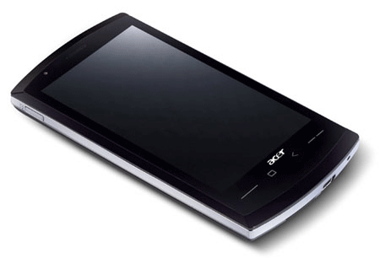
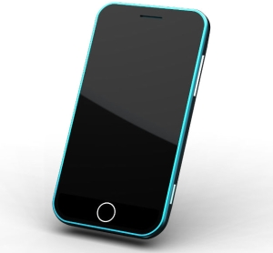
Secure Two-Party Computation
Bob’s Genome: ACTG…
Markers (~1000): [0,1, …, 0]
Alice’s Genome: ACTG…
Markers (~1000): [0, 0, …, 1]
Bob
Alice
Can Alice and Bob compute a function of their private data, without exposing anything about their data besides the result?

Slide 4
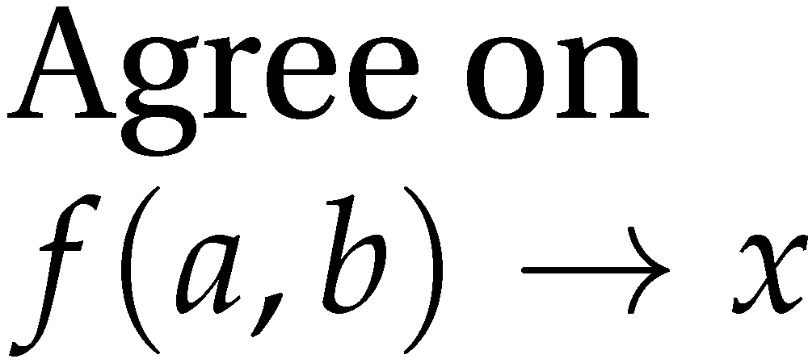
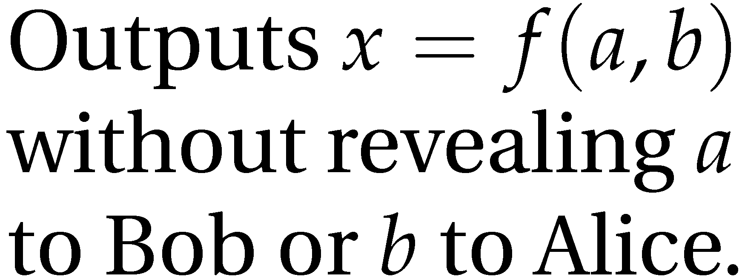
Secure Function Evaluation
Alice (circuit generator)
Bob (circuit evaluator)
Garbled Circuit Protocol
Andrew Yao, 1982/1986

Slide 5
Yao’s Garbled Circuits
Inputs |  | Output
a | b | x
0 | 0 | 0
0 | 1 | 0
1 | 0 | 0
1 | 1 | 1
a
b
AND
x

Slide 6
Computing with Meaningless Values?
Inputs |  | Output
a | b | x
a₀ | b₀ | x₀
a₀ | b₁ | x₀
a₁ | b₀ | x₀
a₁ | b₁ | x₁
a₀ or a₁
b₀ or b₁
a_{i}, b_{i}, x_{i} are random values, chosen by the circuit generator but meaningless to the circuit evaluator.
AND
x₀ or x₁

Slide 7
Computing with Garbled Tables
Inputs |  | Output
a | b | x
a₀ | b₀ | Enc_{a0,b0}(x₀)
a₀ | b₁ | Enc_{a0,b1}(x₀)
a₁ | b₀ | Enc_{a1,b0}(x₀)
a₁ | b₁ | Enc_{a1,b1}(x₁)
Bob can only decrypt one of these!
a₀ or a₁
b₀ or b₁
Garbled And Gate
Enc_{a0, b1}(x₀)
Enc_{a1,b1}(x₁)
Enc_{a1,b0}(x₀)
Enc_{a0,b0}(x₀)
a_{i}, b_{i}, x_{i} are random values, chosen by the circuit generator but meaningless to the circuit evaluator.
AND
x₀ or x₁

Slide 8
Chaining Garbled Circuits
And Gate 1
Enc_{a10, b11}(x1₀)
Enc_{a11,b11}(x1₁)
Enc_{a11,b10}(x1₀)
Enc_{a10,b10}(x1₀)
a0
b0
a1
b1
AND
AND
x0
x1
Or Gate 2
Enc_{x00, x11}(x2₁)
Enc_{x01,x11}(x2₁)
Enc_{x01,x10}(x2₁)
Enc_{x00,x10}(x2₀)
OR
x₂
…
We can do any computation privately this way!

Slide 9
Fairplay
Bob
Alice
SFDL Compiler
SFDL Compiler
Circuit
(SHDL)
SFDL Program
Garbled Tables Generator
Dahlia Malkhi, Noam Nisan, Benny Pinkas and Yaron Sella [USENIX Sec 2004]
Garbled Tables Evaluator

Slide 10
Our Approach: Faster Garbled Circuits
Circuit-Level Application
Circuit Structure
Circuit Structure
GC Framework (Generator)
GC Framework
(Evaluator)
Enc_{x00, x11}(x2₁)
Enc_{x01,x11}(x2₁)
Enc_{x01,x10}(x2₁)
Enc_{x20, x21}(x3₀)
Enc_{x21,x21}(x3₀)
Enc_{x21,x20}(x3₁)
x2₁
Enc_{x20, x31}(x4₁)
Enc_{x21,x31}(x4₁)
Enc_{x21,x30}(x4₀)
x3₁
Enc_{x40, x31}(x5₁)
Enc_{x41,x31}(x5₀)
Enc_{x41,x30}(x5₀)
Enc_{x40, x51}(x6₁)
Enc_{x41,x51}(x6₀)
Enc_{x41,x50}(x6₀)
x4₁
Enc_{x30, x61}(x7₁)
Enc_{x31,x61}(x7₀)
Enc_{x31,x60}(x7₁)
x5₁
x6₀
x7₁
Gates can be evaluated as they are generated: pipelining
Gates can be evaluated in any topological sort order: parallelizing
Garbled evaluation can be combined with normal execution

Slide 11
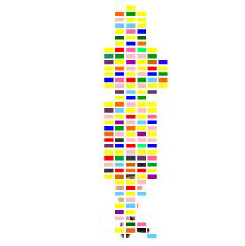
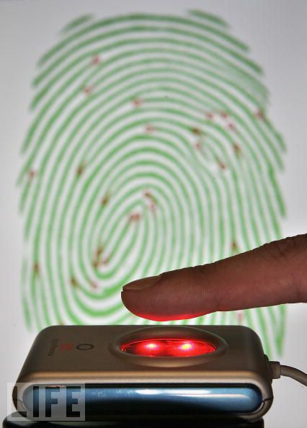
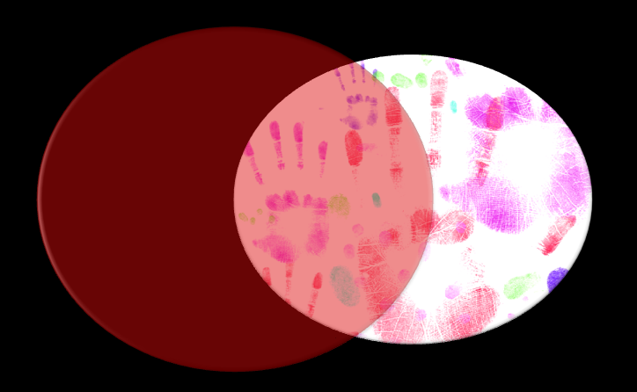
Applications
Private Personal Genomics
Privacy-Preserving Biometric Matching
Private AES Encryption
Private Set Intersection

Slide 12
Private Set Intersection
Do Alice and Bob have any contacts in common?
Two countries want to compare their miscreant lists
Identify common medical records across hospitals
Two companies want to do joint marketing to common customers

Slide 13
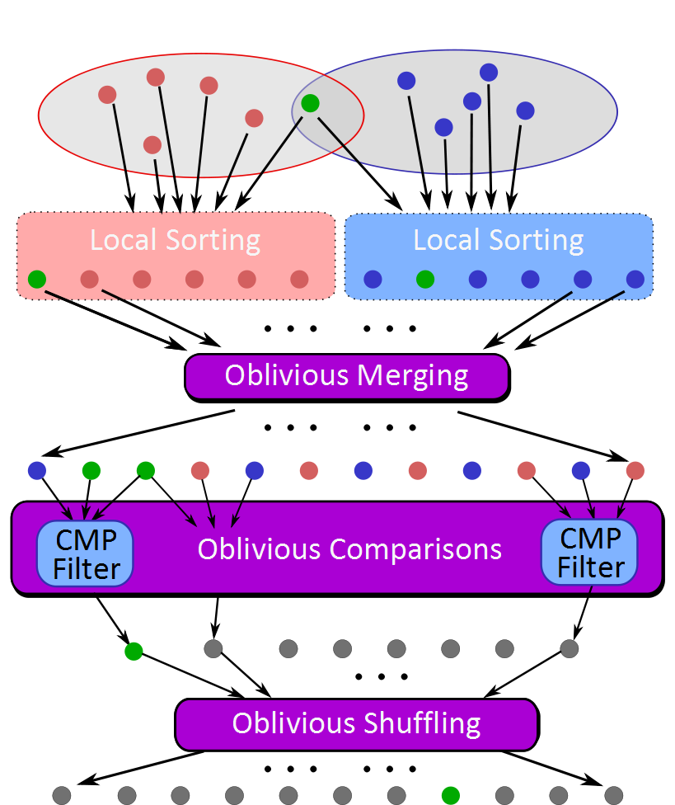
Sort-Compare-Shuffle
Sort: Take advantage of total order of elements
Compare adjacent elements
Shuffle to hide positions

Slide 14
Private Set Intersection Protocol
Gates to generate and evaluate
Free
Bitonic Sorting Circuit
Waksman Permutation Network

Slide 15
Private Set Intersection Results
32-bit values
Seconds
Set Size (each set)

Slide 16
Some Other Results
Problem | Best Previous Result | Our Result | Speedup
Hamming Distance (Face Recognition) – 900-bit vectors | 213s [SCiFI, 2010] | 0.051s | 4176
Levenshtein Distance (genome, text comparison) – two 200-character inputs | 534s [Jha+, 2008] | 18.4s | 29
Smith-Waterman (genome alignment) – two 60-nucleotide sequences | [Not Implementable] | 447s | -
AES Encryption | 3.3s [Henecka, 2010] | 0.2s | 16.5
Fingerprint Matching (1024-entry database, 640x8bit vectors) | ~83s [Barni, 2010] | 18s | 4.6
USENIX Security 2011
NDSS 2011
Scalable: 1 Billion gates evaluated at ~100,000 gates/second on laptop

Slide 17
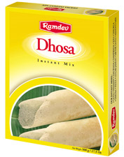
Collaborators
Yan Huang (UVa PhD Student),
Yikan Chen (UVa PhD Student),
Samee Zahur (UVa MS Student),
Peter Chapman (UVa BACS Student)
Jonathan Katz (University of Maryland)
Aaron Mackey (UVa Public Health Genomics)
David Evans
evans@cs.virginia.edu
http://www.cs.virginia.edu/evans

