Slide 1
Oakland 2010 Program Committee Meeting

Slide 3
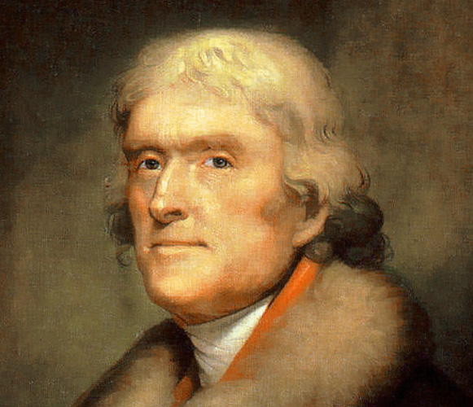

Slide 4
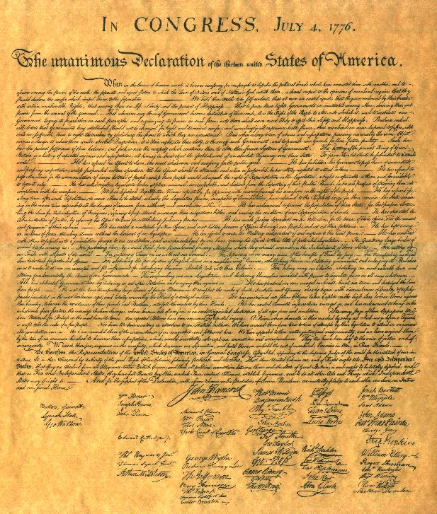

Slide 5
authentication
belittle
dischargeable
bid
electioneer
indecipherable
inheritability
inexactitude
public relations
sanction
vomit-grass

Slide 6
Avail yourself of these means to communicate to us at seasonable intervals a copy of your journal, notes & observations of every kind, putting into cipher whatever might do injury if betrayed.
Jefferson’s instructions to Captain Lewis

Slide 7
Review Process
SoK
One more review
One-two more reviews
Two Reviews

Slide 9
Reviewing Lowlights/Highlights
Out of 237+30 research+SoK submissions:
Number of papers with no “weak reject” (3) or worse reviews:
Number of papers with no “reject” (2) or worse reviews:
Total number of reviews with overall merit 6:
0
For every submitted paper, there is at least one PC member who thinks that paper should be rejected!
3+5
3+1
300% improvement from last year!

Slide 10
Plan for Meeting
Today: (now-~5:30)
Discuss each “discuss” paper
Classify as: accept, reject, revisit
Research papers first, SoK papers
Tomorrow: (8:30-1pm)
Make final decisions on all papers
To see the discussion order:
Search: order:order
Target: Accept ~30 research papers, 2-5 SoK papers
2009: 26
2008: 28

Slide 11
Discussion Lead
Summarize neutrally what the paper is about
Summarize the non-attending reviews
Present your own views
Update your review to reflect any important issues that come up in discussion

Slide 12
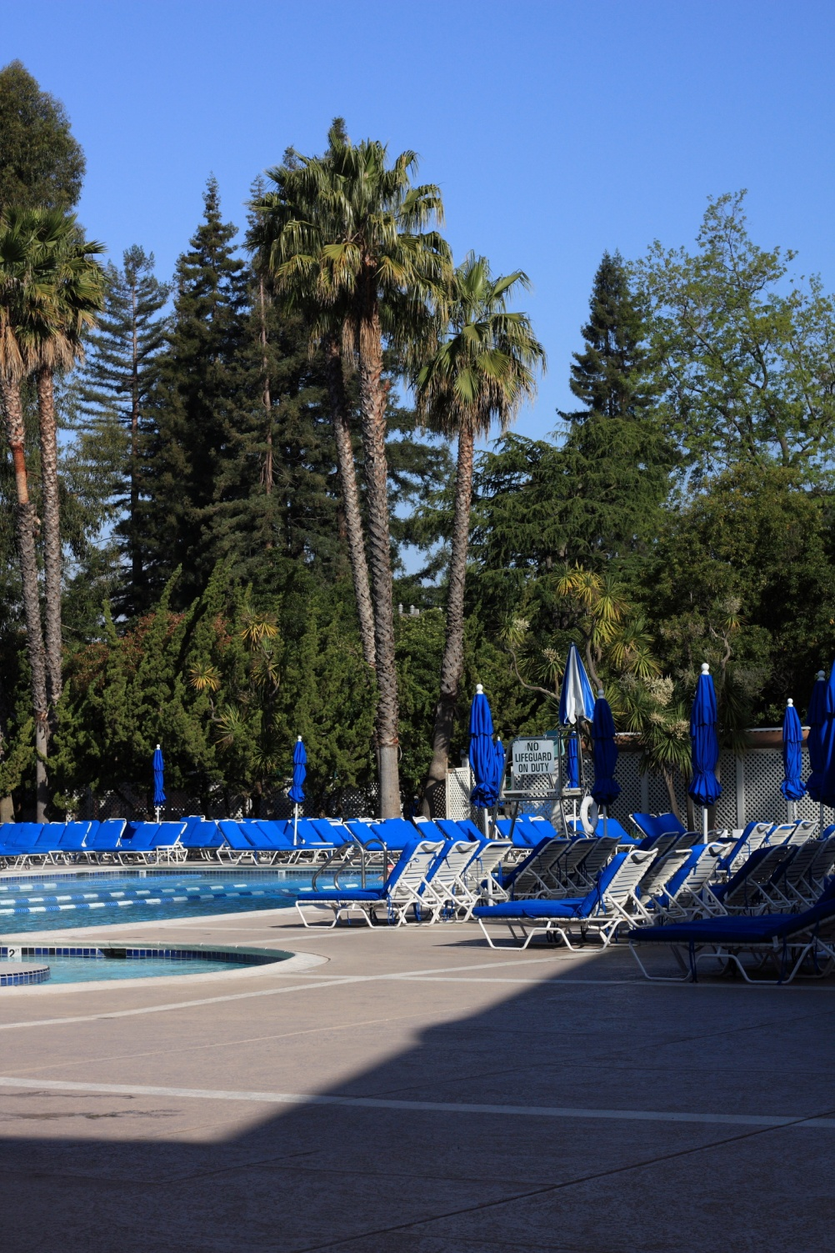
Reminders
No decision is final until meeting closes
People in the room may have conflicts with other papers: avoid making unnecessary comparisons
Please don’t leak information that compromises reviewer anonymity

Slide 13
