Slide 1
Computing Without Exposing Data
Radford University
CSAT STEM Club
17 March 2011
David Evans
University of Virginia
http://www.cs.virginia.edu/evans
http://www.MightBeEvil.com

Slide 2
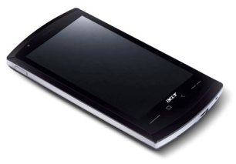
“Genetic Dating”
Bob
Alice
Genome Compatibility Protocol
Your offspring will have good immune systems!
Your offspring will have good immune systems!
WARNING!
Don’t Reproduce
WARNING!
Don’t Reproduce

Slide 3
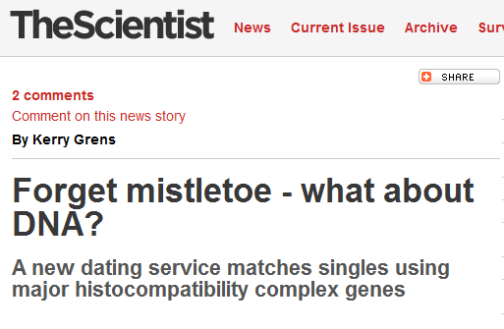

Slide 4
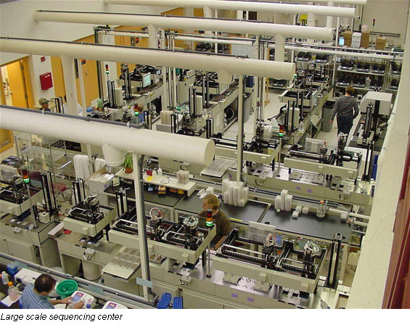
Genome Sequencing
1990: Human Genome Project starts, estimate $3B to sequence one genome ($0.50/base)
2000: Human Genome Project declared complete, cost ~$300M
Whitehead Institute, MIT

Slide 5
Cost to sequence human genome
Moore’s Law prediction
(halve every 18 months)
Data from National Human Genome Research Institute: http://www.genome.gov/sequencingcosts

Slide 6
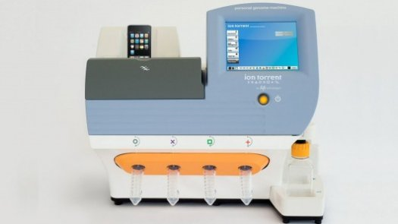
Cost to sequence human genome
Moore’s Law prediction
(halve every 18 months)
Ion torrent Personal Genome Machine
Data from National Human Genome Research Institute: http://www.genome.gov/sequencingcosts

Slide 7
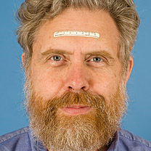
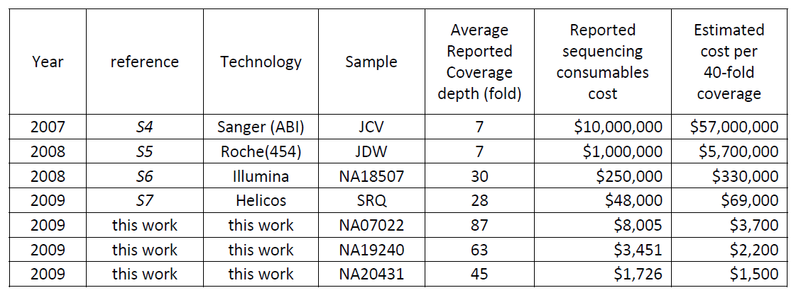
Human Genome Sequencing Using Unchained Base Reads on Self-Assembling DNA Nanoarrays. Radoje Drmanac, Andrew B. Sparks, Matthew J. Callow, Aaron L. Halpern, Norman L. Burns, Bahram G. Kermani, Paolo Carnevali, Igor Nazarenko, Geoffrey B. Nilsen, George Yeung, Fredrik Dahl, Andres Fernandez, Bryan Staker, Krishna P. Pant, Jonathan Baccash, Adam P. Borcherding, Anushka Brownley, Ryan Cedeno, Linsu Chen, Dan Chernikoff, Alex Cheung, Razvan Chirita, Benjamin Curson, Jessica C. Ebert, Coleen R. Hacker, Robert Hartlage, Brian Hauser, Steve Huang, Yuan Jiang, Vitali Karpinchyk, Mark Koenig, Calvin Kong, Tom Landers, Catherine Le, Jia Liu, Celeste E. McBride, Matt Morenzoni, Robert E. Morey, Karl Mutch, Helena Perazich, Kimberly Perry, Brock A. Peters, Joe Peterson, Charit L. Pethiyagoda, Kaliprasad Pothuraju, Claudia Richter, Abraham M. Rosenbaum, Shaunak Roy, Jay Shafto, Uladzislau Sharanhovich, Karen W. Shannon, Conrad G. Sheppy, Michel Sun, Joseph V. Thakuria, Anne Tran, Dylan Vu, Alexander Wait Zaranek, Xiaodi Wu, Snezana Drmanac, Arnold R. Oliphant, William C. Banyai, Bruce Martin, Dennis G. Ballinger, George M. Church, Clifford A. Reid. Science, January 2010.
George Church (Personal Genome Project)
Richmond Forum, Saturday

Slide 8
Dystopia
Personalized Medicine

Slide 9
Secure Two-Party Computation
Bob’s Genome: ACTG…
Markers (~1000): [0,1, …, 0]
Alice’s Genome: ACTG…
Markers (~1000): [0, 0, …, 1]
Bob
Alice
Can Alice and Bob compute a function of their private data, without exposing anything about their data besides the result?

Slide 10
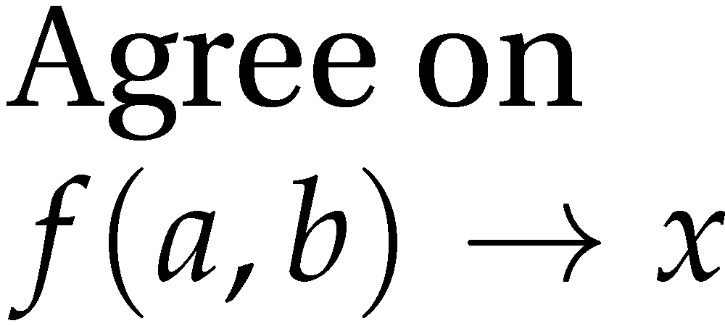
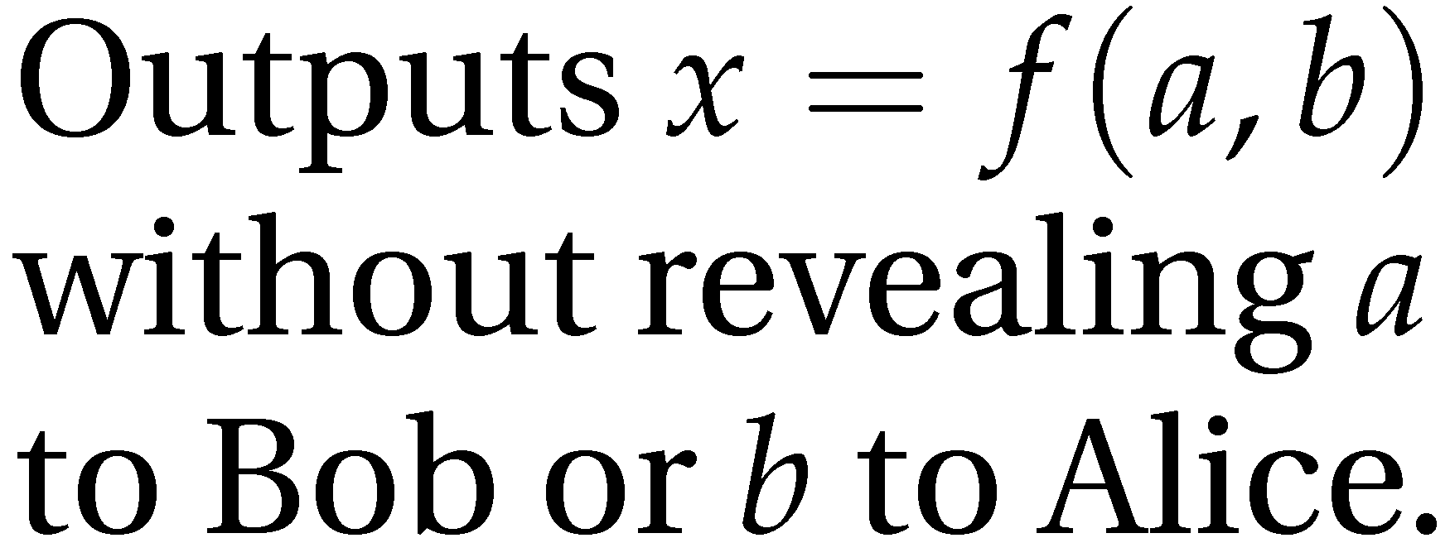
Secure Function Evaluation
Alice (circuit generator)
Bob (circuit evaluator)
Garbled Circuit Protocol
Andrew Yao, 1982/1986

Slide 11
Computing with Lookup Tables
Inputs |  | Output
a | b | x
0 | 0 | 0
0 | 1 | 0
1 | 0 | 0
1 | 1 | 1
a
b
AND
x

Slide 12
Computing with Meaningless Values?
Inputs |  | Output
a | b | x
a₀ | b₀ | x₀
a₀ | b₁ | x₀
a₁ | b₀ | x₀
a₁ | b₁ | x₁
a₀ or a₁
b₀ or b₁
a_{i}, b_{i}, x_{i} are random values, chosen by the circuit generator but meaningless to the circuit evaluator.
AND
x₀ or x₁

Slide 13
Computing with Garbled Tables
Inputs |  | Output
a | b | x
a₀ | b₀ | Enc_{a0,b0}(x₀)
a₀ | b₁ | Enc_{a0,b1}(x₀)
a₁ | b₀ | Enc_{a1,b0}(x₀)
a₁ | b₁ | Enc_{a1,b1}(x₁)
Bob can only decrypt one of these!
a₀ or a₁
b₀ or b₁
Garbled And Gate
Enc_{a0, b1}(x₀)
Enc_{a1,b1}(x₁)
Enc_{a1,b0}(x₀)
Enc_{a0,b0}(x₀)
a_{i}, b_{i}, x_{i} are random values, chosen by the circuit generator but meaningless to the circuit evaluator.
AND
x₀ or x₁

Slide 14
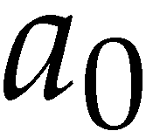
Garbled Circuit Protocol
Alice (circuit generator)
Bob (circuit evaluator)
And Gate
Enc_{a0, b1}(x₀)
Enc_{a1,b1}(x₁)
Enc_{a1,b0}(x₀)
Enc_{a0,b0}(x₀)
Sends a_{i} to Bob based on her input value
How does the Bob learn his own input wires?

Slide 15
Primitive: Oblivious Transfer
Alice
Bob
Oblivious Transfer Protocol
Oblivious: Alice doesn’t learn which secret Bob obtains
Transfer: Bob learns one of Alice’s secrets
Rabin, 1981; Even, Goldreich, and Lempel, 1985; many subsequent papers

Slide 16
Chaining Garbled Circuits
And Gate 1
Enc_{a10, b11}(x1₀)
Enc_{a11,b11}(x1₁)
Enc_{a11,b10}(x1₀)
Enc_{a10,b10}(x1₀)
a0
b0
a1
b1
AND
AND
x0
x1
Or Gate 2
Enc_{x00, x11}(x2₁)
Enc_{x01,x11}(x2₁)
Enc_{x01,x10}(x2₁)
Enc_{x00,x10}(x2₀)
OR
x₂
…
We can do any computation privately this way!

Slide 17
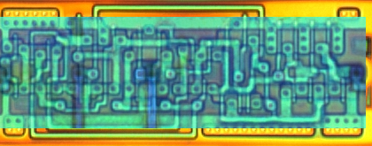
Building Computing Systems
Enc_{x00, x11}(x2₁)
Enc_{x01,x11}(x2₁)
Enc_{x01,x10}(x2₁)
Enc_{x00,x10}(x2₀)
Digital Electronic Circuits | Garbled Circuits
Operate on known data | Operate on encrypted wire labels
One-bit logical operation requires moving a few electrons a few nanometers (many Billions per second) | One-bit logical operation requires performing (up to) 4 encryption operations (~100,000 gates per second)
Reuse is great! | Reuse is not allowed!
All basic operations have similar cost | Some logical operations nearly free (XOR)

Slide 18
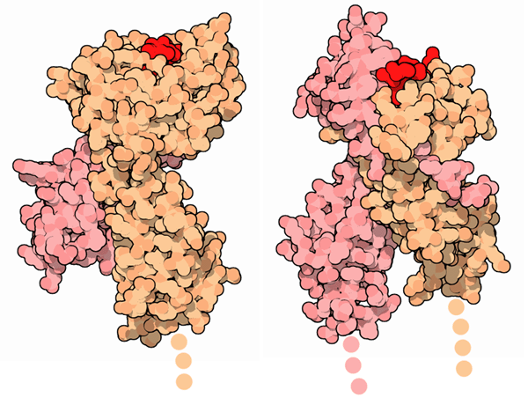
Offspring Immune System Test
Major Histocompatibility Complex (MHC)
Alice’s MHC genes: [0 1 1 0 … 0 1 1]
Bob’s MHC genes: [1 1 1 0 … 1 0 1]
Diversity is key to good immune systems!
Goal: count number of indices where A[i] ≠ B[i]

Slide 19
XOR Every Cryptographer’s Favorite Function
⊕
XOR
a | b | x
0 | 0 | 0
0 | 1 | 1
1 | 0 | 1
1 | 1 | 0
a ⊕ a = 0
a ⊕ r is uniformly random
a ⊕ r ⊕ r = a
Can compute a ⊕ b on garbled inputs without and encryptions (“free”).

Slide 20
Alice: a₀a₁a₂ … a_{n}
Bob: b₀b₁b₂ …b_{n}
⊕
⊕
⊕
⊕
. . .
1-bit adder
0
1-bit adder
0
1-bit adder
0
1-bit adder
0
. . .
1-bit adder
0
. . .
1-bit adder
0
Hamming Distance

Slide 21
Alice: a₀a₁a₂ … a_{n}
Bob: b₀b₁b₂ …b_{n}
⊕
⊕
⊕
⊕
. . .
1-bit adder
1-bit adder
1-bit adder
1-bit adder
1-bit adder
. . .
1-bit adder
Hamming Distance
GreaterThan
t
H(r₀), H(r₁)
r
Your offspring will have good immune systems!

Slide 22
Heterozygous Recessive Risk
Alice
 | A | a
A | AA | Aa
a | aA | aa
carrier
Bob
cystic fibrosis
Alice’s Heterozygous Recessive genes: { 5283423, 1425236, 839523, … }
Bob’s Heterozygous Recessive genes: { 5823527, 839523, 169325, … }
Goal: find the intersection of A and B

Slide 23
Bit Vector Intersection
Alice’s Recessive genes:
{ 5283423, 1425236, 839523, … }
Bob’s Recessive genes:
{ 5823527, 839523, 169325, … }
[ PAH, PKU, CF, … ]
[ 0, 0, 1, 0, 0, 0, 1, 0, 1, 1, 0]
[ 0, 0, 1, 0, 0, 0, 0, 0, 1, 0, 0]
. . .
AND
AND
AND
. . .
Bitwise AND

Slide 24
Scaling
What if there are millions of possible diseases?
Length of bit vector:
number of possible values
(2^{L} where L is number of bits for each value)
Other private set intersection problems:
Do Alice and Bob have any friends in common?
Data mining problems: combine medical records across hospitals
Two companies want to do joint marketing to common customers

Slide 25
Pairwise Comparison
for i in range(0, n-1):
for j in range(0, n-1):
if A[i] = B[j] output A[i]
A[1]
A[2]
A[0]
A[3]
n² comparisons
B[0]
B[3]
B[1]
B[2]

Slide 26
Sort-Compare-Shuffle
[ A[0], A[1], … , A[n-1] ]
CMP
0
EQUAL?
CMP
Sort
MUX
CMP
CMP
CMP
CMP
[ B[0], B[1], … , B[n-1] ]
Problem: the position where a matching element is revealed leaks information!
CMP
CMP

Slide 27
Bitonic Sorting
1
1
1
1
1
4
2
2
2
4
9
3
3
3
3
2
4
4
7
4
5
5
5
4
4
4
4
4
5
5
3
9
9
7
7
2
7
7
9
9

Slide 28
(Imperfect) Shuffling
CMP
CMP
Sort
CMP
CMP
CMP
CMP
CMP

Slide 29
Some Results
Problem | Best Previous Result | Our Result | Speedup
Hamming Distance (Face Recognition, Genetic Dating) – two 900-bit vectors | 213s [SCiFI, 2010] | 0.051s | 4176
Levenshtein Distance (genome, text comparison) – two 200-character inputs | 534s [Jha+, 2008] | 18.4s | 29
Smith-Waterman (genome alignment) – two 60-nucleotide sequences | [Not Implementable] | 447s | -
AES Encryption | 3.3s [Henecka, 2010] | 0.2s | 16.5
Fingerprint Matching (1024-entry database, 640x8bit vectors) | ~83s [Barni, 2010] | 18s | 4.6
Scalable: 1 Billion gates evaluated at ~100,000 gates/second on laptop

Slide 30
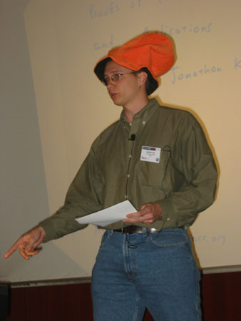
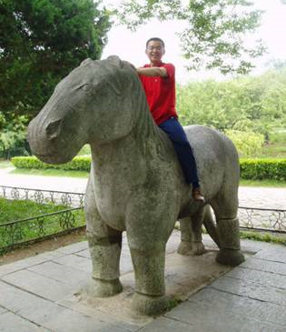
Jonathan Katz
(University of Maryland)
Yan Huang
(UVa Computer Science PhD Student)
Aaron Mackey
(UVa Center for Public Health Genomics)

Slide 31
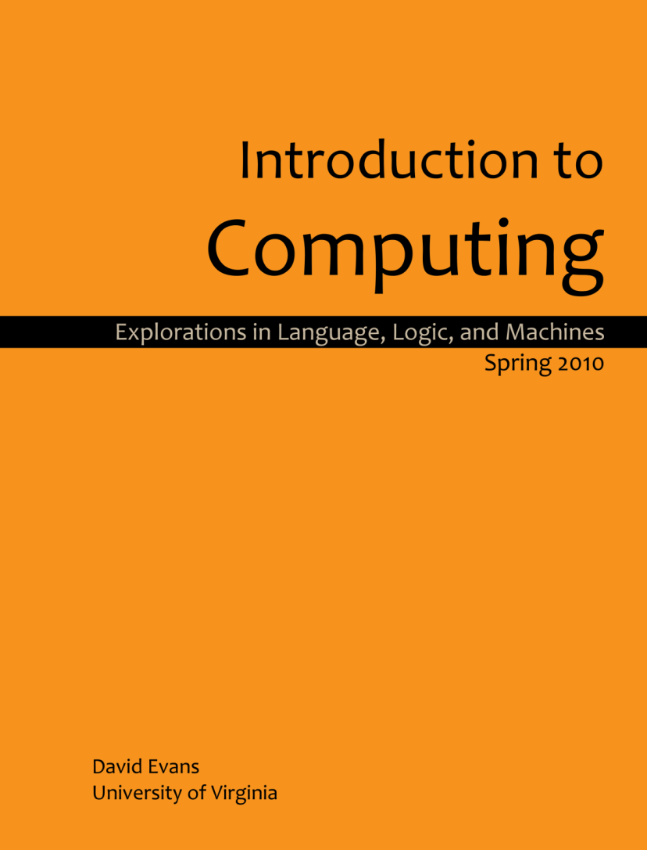
Shameless Plug #1
www.computingbook.org

Slide 32
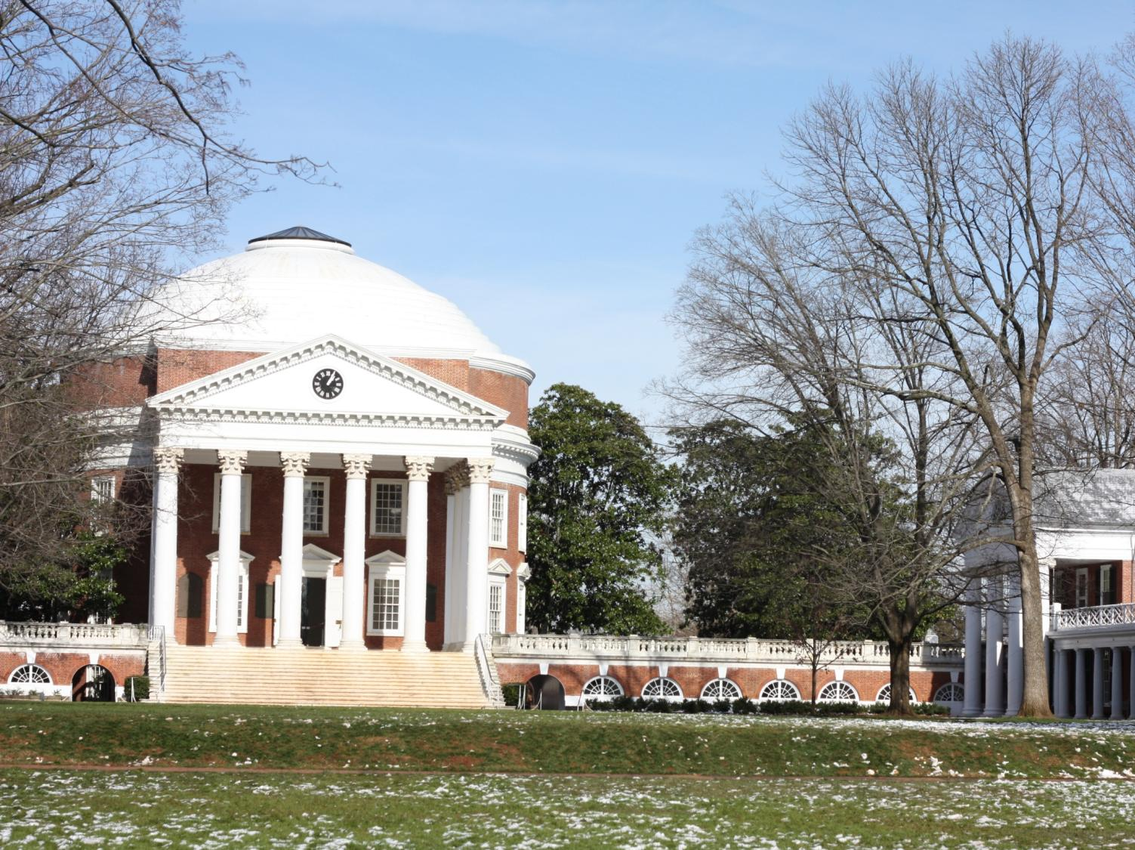
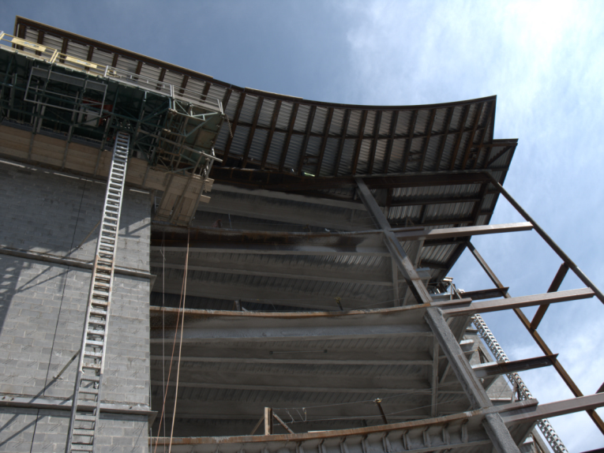
Shameless Plug #2
Rice Hall, Computer Science Building
Opening August 2011

Slide 33
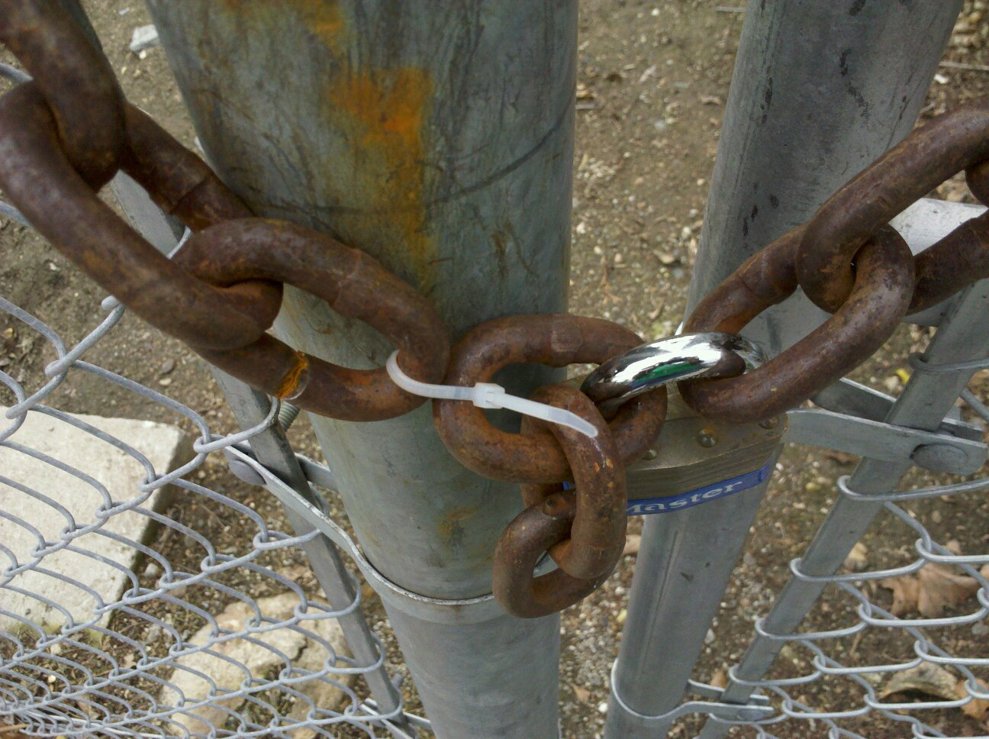
David Evans
evans@cs.virginia.edu
http://www.cs.virginia.edu/evans

