Slide 1
Next steps towards a Science of Security David Evans University of Virginia IARPA Visit 11 January 2010

Slide 2
Things I won’t talk about…
Producer 1
Code
Data
Policy
Producer 2
Code
Data
Policy
Data-Centric Policy Enforcement [MURI 2009]
Implementable RFID Privacy & Security [NSF]
User-Intent Based Access Control

Slide 3
Outline
Workshop recap
Description, participants, format
Main ideas
Outcomes
Discussion of what to do next

Slide 4
Workshop
Stated Goals:
Identify scientific questions regarding computer security
Stimulate new work toward defining and answering those questions.
Encourage work that goes beyond ad hoc point solutions and informal security arguments to discover foundational scientific laws for reasoning about and designing secure computing systems.
2-day workshop in Berkeley, CA (Nov 2008)
Premise: need new ideas from outside traditional infosec research community

Slide 5
Participant Background
David Bray, IDA
Fred Chang, U. of Texas/NSA
Byron Cook, MSR/Cambridge
Son Dao, HRL Laboratories
Anupam Datta, CMU
John Doyle, Caltech
Anthony Ephremides, UMd
David Evans (organizer), UVa
Manfai Fong, IARPA
Stephanie Forrest, UNM
John Frink, ODUSD
Joshua Guttman, MITRE
Robert Herklotz, AFOSR
Alfred Hero, U. of Michigan
Sampath Kannan, NSF
Steven King, ODUSD
Carl Landwehr, IARPA
Greg Larsen, IDA
Karl Levitt (organizer), NSF
Brad Martin (organizer), NSA
John Mallery, MIT CSAIL
Roy Maxion, CMU
Robert Meushaw, NSA
John Mitchell, Stanford
Pierre Moulin, U. Illinois
Timothy Murphy, IARPA
Dusko Pavlovic, Kestrel/Oxford
Nick Petroni, IDA
Lisa Porter, IARPA
Michael Reiter, UNC
Phillip Rogaway, UC Davis
John Rushby, SRI
Stuart Russell, UC Berkeley
Fred Schneider, Cornell
Jim Silk (organizer), IDA
Dawn Song, UC Berkeley
Pieter Swart, Los Alamos NL
Vicraj Thomas, BBN/GENI
Hal Varian, Berkeley/Google
Cliff Wang, ARO
Rebecca Wright, Rutgers
Shouhuai Xu, UT San Antonio
Ty Znati, NSF
Lenore Zuck, NSF
Traditional Infosec Researchers
Computer Scientists
Outside Area

Slide 6
Format
2 days
Keynotes: Fred Schneider, Frederick Chang
Panels:
What is a science of security?
What can we learn from other fields?
How can we reason about impossible things?
Are scientific experiments in security possible?
Breakout groups on various topics including:
Metrics, provable security, managing complexity, composition, experimentation

Slide 7
Philosophical Questions (Usually Not Worth Discussing)
Is there science in computer system security?
Yes, but of course there should be more.

Slide 8
Meaning of “Science”
Systematization of Knowledge
Ad hoc point solutions vs. general understanding
Repeating failures of the past with each new platform, type of vulnerability
Scientific Method
Process of hypothesis testing and experiments
Building abstractions and models, theorems
Universal Laws
Widely applicable
Make strong, quantitative predictions

Slide 9
Realistic Goal
Can we be a science like physics or chemistry?
Unlikely – humans will always be a factor in security.
How far can we get without modeling humans?
How far can we get with simple models of human capabilities and behavior?
Workshop charge: avoid human behavior issues as much as possible.

Slide 10
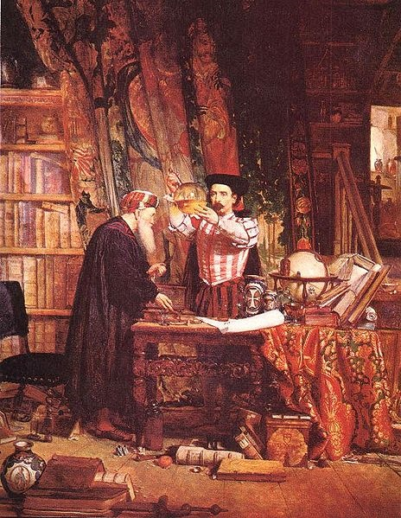
Alchemy (700-~1660)
Well-defined, testable goal (turn lead into gold)
Established theory (four elements: earth, fire, water, air)
Methodical experiments and lab techniques (Jabir ibn Hayyan in 8th century)
Wrong and unsuccessful...but led to modern chemistry.

Slide 11
Questions for a “Science” of Security
Resilience: Given a system P and an attack class A, is there a way to:
Prove that P is not vulnerable to any attack in A?
Construct a system P' that behaves similarly to P except is not vulnerable to any attack in A?
Establishing Improvement: How can we determine if a system A is more secure than system f(A) (where f is some function that transforms an input program or system definition)?

Slide 12
Metrics
Scientific understanding requires quantification
For most interesting security properties, not clear what to measure or how to measure it
Comparative metrics may be more useful/feasible than absolute metrics:
How can we quantify the security of two systems A and B in a way that establishes which is more secure for a given context?
Quantify the security of a system A and a system f(A) (where f is some function that transforms an input program or system definition)?

Slide 13
Metrics: Promising Approaches
Experimental metrics: more systematic “red team” approaches (hard to account for attacker creativity)
Economic metrics: active research community
Epidemiological metrics: good at modeling spread over network, but need assumptions about vulnerabilities
Computational complexity metrics: define attacker search space (promising for automated diversity)

Slide 14
Formal Methods and Security
Lots of progress in reasoning about correctness properties
Byron Cook: reasoning about termination and liveness
Systems fail when attackers find ways to violate assumptions used in proof
Need formal methods that make assumptions explicit in a useful way
Combining formal methods with enforcement mechanisms that enforce assumption

Slide 15
Formal Methods vs. Complexity
(Loosely) Due to Fred Chang
Pessimist’s View
Complexity
Deployed Systems
Formal Techniques Capability
2010
Time

Slide 16
Formal Methods vs. Complexity
(Loosely) Due to Fred Chang
Optimist’s View
Complexity
Deployed Systems
TCB of Deployed
Formal Techniques Capability
2010
Time

Slide 17
Formal Methods Questions
Refinement: Can we use refinement approaches (design → ... → implementation) that preserve security properties the way they are used to preserve correctness properties now?
Program analysis: What security properties can be established by dynamic and static analysis? How can computability limits be overcome using hybrid analysis, system architectures, or restricted programming languages?

Slide 18
Experimentation
Security experiments require adversary models
Need to improve adversary models
Coalesce knowledge of real adversaries
Canonical attacker models (c.f., crypto)
Design for reproducibility

Slide 19
Recap Summary
Systematization of Knowledge
Ad hoc point solutions vs. general understanding
Repeating failures of the past with each new platform, type of vulnerability
Scientific Method
Process of hypothesis testing and experiments
Building abstractions and models, theorems
Universal Laws
Widely applicable
Make strong, quantitative predictions
Valuable and achievable: need the right incentives for community
Progress in useful models; big challenges in constructing security experiments
Uncertainty if such laws exist; long way to go for meaningful quantification.

Slide 20
Concrete Outcomes
INFOSEC Research Council (meeting focus, July 2009)
31st IEEE Symposium on Security and Privacy (Oakland 2010): Systematization of Knowledge track
“The goal of this call is to encourage work that evaluates, systematizes, and contextualizes existing knowledge. These papers will provide a high value to our community but would otherwise not be accepted because they lack novel research contributions.”
IEEE Security and Privacy Magazine, Special Issue on the Science of Security (planned for May/June 2011)
Guest editors: Sal Stolfo/David Evans

Slide 21
Discussion
What are the next steps?
Would another meeting be useful?
What kind, how organized?
Funding programs?
Focus areas:
Metrics
Experimentation
Formal methods
Challenge problems?

