Slide 1
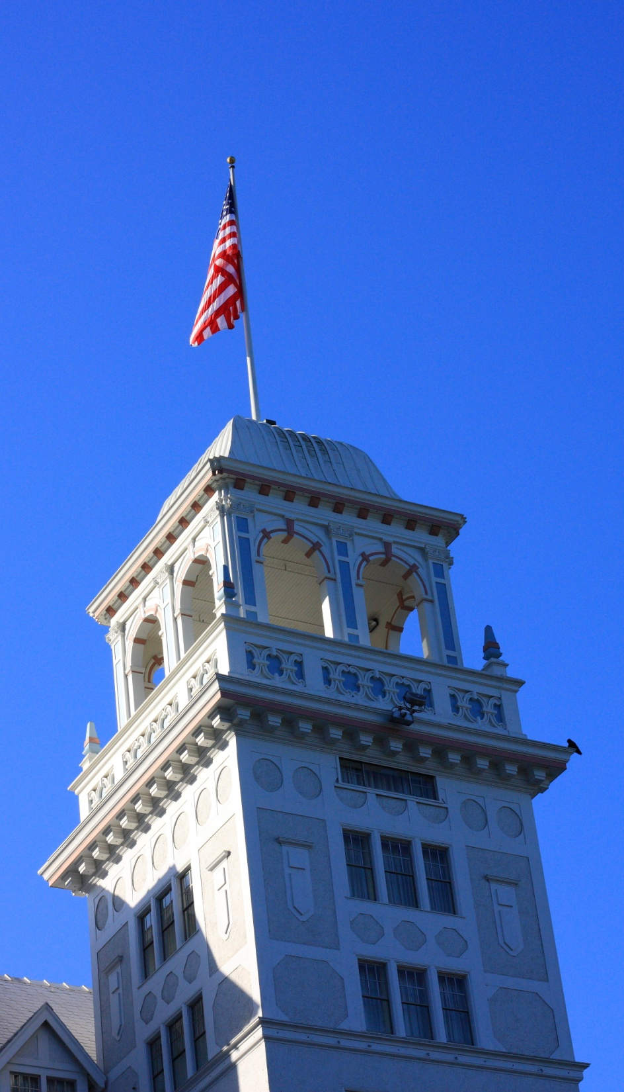
Summary of the NSF/IARPA/NSA Workshop on the Science of Security David Evans University of Virginia INFOSEC Research Council 16 July 2009

Slide 2
Outline
Workshop description, participants, format
Summary of prevailing consensus
Highlight some key ideas
What next?

Slide 3
Workshop
Stated Goals:
Identify scientific questions regarding computer security
Stimulate new work toward defining and answering those questions.
Encourage work that goes beyond ad hoc point solutions and informal security arguments to discover foundational scientific laws for reasoning about and designing secure computing systems.
2-day workshop in Berkeley, CA (Nov 2008)
Premise: need new ideas from outside traditional infosec research community

Slide 4
44 Participants
David Bray, IDA
Fred Chang, U. of Texas/NSA
Byron Cook, MSR/Cambridge
Son Dao, HRL Laboratories
Anupam Datta, CMU
John Doyle, Caltech
Anthony Ephremides, UMd
David Evans (organizer), UVa
Manfai Fong, IARPA
Stephanie Forrest, UNM
John Frink, ODUSD
Joshua Guttman, MITRE
Robert Herklotz, AFOSR
Alfred Hero, U. of Michigan
Sampath Kannan, NSF
Steven King, ODUSD
Carl Landwehr, IARPA
Greg Larsen, IDA
Karl Levitt (organizer), NSF
Brad Martin (organizer), NSA
John Mallery, MIT CSAIL
Roy Maxion, CMU
Robert Meushaw, NSA
John Mitchell, Stanford
Pierre Moulin, U. Illinois
Timothy Murphy, IARPA
Dusko Pavlovic, Kestrel/Oxford
Nick Petroni, IDA
Lisa Porter, IARPA
Michael Reiter, UNC
Phillip Rogaway, UC Davis
John Rushby, SRI
Stuart Russell, UC Berkeley
Fred Schneider, Cornell
Jim Silk (organizer), IDA
Dawn Song, UC Berkeley
Pieter Swart, Los Alamos NL
Vicraj Thomas, BBN/GENI
Hal Varian, Berkeley/Google
Cliff Wang, ARO
Rebecca Wright, Rutgers
Shouhuai Xu, UT San Antonio
Ty Znati, NSF
Lenore Zuck, NSF

Slide 5
Participant Affiliation
David Bray, IDA
Fred Chang, U. of Texas/NSA
Byron Cook, MSR/Cambridge
Son Dao, HRL Laboratories
Anupam Datta, CMU
John Doyle, Caltech
Anthony Ephremides, UMd
David Evans (organizer), UVa
Manfai Fong, IARPA
Stephanie Forrest, UNM
John Frink, ODUSD
Joshua Guttman, MITRE
Robert Herklotz, AFOSR
Alfred Hero, U. of Michigan
Sampath Kannan, NSF
Steven King, ODUSD
Carl Landwehr, IARPA
Greg Larsen, IDA
Karl Levitt (organizer), NSF
Brad Martin (organizer), NSA
John Mallery, MIT CSAIL
Roy Maxion, CMU
Robert Meushaw, NSA
John Mitchell, Stanford
Pierre Moulin, U. Illinois
Timothy Murphy, IARPA
Dusko Pavlovic, Kestrel/Oxford
Nick Petroni, IDA
Lisa Porter, IARPA
Michael Reiter, UNC
Phillip Rogaway, UC Davis
John Rushby, SRI
Stuart Russell, UC Berkeley
Fred Schneider, Cornell
Jim Silk (organizer), IDA
Dawn Song, UC Berkeley
Pieter Swart, Los Alamos NL
Vicraj Thomas, BBN/GENI
Hal Varian, Berkeley/Google
Cliff Wang, ARO
Rebecca Wright, Rutgers
Shouhuai Xu, UT San Antonio
Ty Znati, NSF
Lenore Zuck, NSF
14 Government
9 Governmentish
21 Academia

Slide 6
Participant Background
David Bray, IDA
Fred Chang, U. of Texas/NSA
Byron Cook, MSR/Cambridge
Son Dao, HRL Laboratories
Anupam Datta, CMU
John Doyle, Caltech
Anthony Ephremides, UMd
David Evans (organizer), UVa
Manfai Fong, IARPA
Stephanie Forrest, UNM
John Frink, ODUSD
Joshua Guttman, MITRE
Robert Herklotz, AFOSR
Alfred Hero, U. of Michigan
Sampath Kannan, NSF
Steven King, ODUSD
Carl Landwehr, IARPA
Greg Larsen, IDA
Karl Levitt (organizer), NSF
Brad Martin (organizer), NSA
John Mallery, MIT CSAIL
Roy Maxion, CMU
Robert Meushaw, NSA
John Mitchell, Stanford
Pierre Moulin, U. Illinois
Timothy Murphy, IARPA
Dusko Pavlovic, Kestrel/Oxford
Nick Petroni, IDA
Lisa Porter, IARPA
Michael Reiter, UNC
Phillip Rogaway, UC Davis
John Rushby, SRI
Stuart Russell, UC Berkeley
Fred Schneider, Cornell
Jim Silk (organizer), IDA
Dawn Song, UC Berkeley
Pieter Swart, Los Alamos NL
Vicraj Thomas, BBN/GENI
Hal Varian, Berkeley/Google
Cliff Wang, ARO
Rebecca Wright, Rutgers
Shouhuai Xu, UT San Antonio
Ty Znati, NSF
Lenore Zuck, NSF
Traditional Infosec Researchers
Computer Scientists
Outside Area

Slide 7
Format
2 days
Keynotes: Fred Schneider, Frederick Chang
Panels:
What is a science of security?
What can we learn from other fields?
How can we reason about impossible things?
Are scientific experiments in security possible?
Breakout groups on various topics including:
Metrics, provable security, managing complexity, composition, experimentation

Slide 8
Philosophical Questions (Usually Not Worth Discussing)
Is there science in computer system security?
Yes, but of course there should be more.

Slide 9
Meaning of “Science”
Systematization of Knowledge
Ad hoc point solutions vs. general understanding
Repeating failures of the past with each new platform, type of vulnerability
Scientific Method
Process of hypothesis testing and experiments
Building abstractions and models, theorems
Universal Laws
Widely applicable
Make strong, quantitative predictions

Slide 10
Realistic Goal
Can we be a science like physics or chemistry?
Unlikely – humans will always be a factor in security.
How far can we get without modeling humans?
How far can we get with simple models of human capabilities and behavior?
Workshop charge: avoid human behavior issues as much as possible.

Slide 11
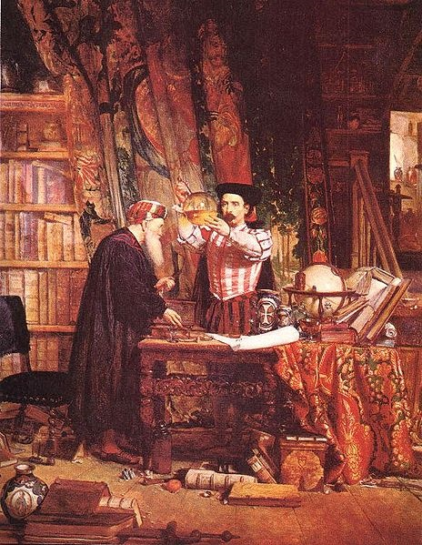
Alchemy (700-~1660)
Well-defined, testable goal (turn lead into gold)
Established theory (four elements: earth, fire, water, air)
Methodical experiments and lab techniques (Jabir ibn Hayyan in 8th century)
Wrong and unsuccessful...but led to modern chemistry.

Slide 12
Questions for a Science of Security
Resilience: Given a system P and an attack class A, is there a way to:
Prove that P is not vulnerable to any attack in A?
Construct a system P' that behaves similarly to P except is not vulnerable to any attack in A?
How can we determine if a system A is more secure than system f(A) (where f is some function that transforms an input program or system definition)?

Slide 13
Metrics
Scientific understanding requires quantification
For most interesting security properties, not clear what to measure or how to measure it
Comparative metrics may be more useful/feasible than absolute metrics:
How can we quantify the security of two systems A and B in a way that establishes which is more secure for a given context?
Quantify the security of a system A and a system f(A) (where f is some function that transforms an input program or system definition)?

Slide 14
Metrics: Promising Approaches
Experimental metrics: more systematic “red team” approaches (hard to account for attacker creativity)
Economic metrics: active research community
Epidemiological metrics: good at modeling spread over network, but need assumptions about vulnerabilities
Computational complexity metrics: define attacker search space (promising for automated diversity)

Slide 15
Formal Methods and Security
Lots of progress in reasoning about correctness properties
Byron Cook: reasoning about termination and liveness
Systems fail when attackers find ways to violate assumptions used in proof
Need formal methods that make assumptions explicit in a useful way
Combining formal methods with enforcement mechanisms that enforce assumption

Slide 16
Formal Methods Questions
Refinement: Can we use refinement approaches (design → ... → implementation) that preserve security properties the way they are used to preserve correctness properties now?
Program analysis: What security properties can be established by dynamic and static analysis? How can computability limits be overcome using hybrid analysis, system architectures, or restricted programming languages?

Slide 17
Experimentation
Security experiments require adversary models
Need to improve adversary models
Coalesce knowledge of real adversaries
Canonical attacker models (c.f., crypto)
Design for reproducibility
Roy Maxion later today

Slide 18
Some Highlights
Caveat: I won’t do justice to these ideas...but (almost) all the presentation materials are here:
http://sos.cs.virginia.edu/agenda.html

Slide 19
Towards Scientific Defenses
Due to Fred Schneider
Target for 2015: “Defense class D enforces policy class P when facing attacks from class A.”
Defining classes of policies:
System behavior: infinite trace of states (or events)
t = s₀ s₁ s₂ ... s_{i} ...
System property: set of traces
P = { t | pred(t) }
A system S satisfies property P if S ⊆ P
Formal way to reason about what system properties different mechanisms can enforce

Slide 20
Example: Execution Monitoring
Due to Fred Schneider
Ideal reference monitor: sees all policy-relevant events, cannot be circumvented, can block execution immediately
EM-enforceable policies ≡ Safety Properties
Implementation approaches:
Inlined reference monitor (SASI, Naccio)
Proof-carrying code: prove the automaton necessary to enforce policy is correctly embedded in program
Combine approaches for improved performance and small TCB

Slide 21
Limitations of Execution Monitoring
Due to Fred Schneider
Liveness properties: something good eventually happens
Requires reasoning about all possible future paths
Non-interference: low-level users get same outputs regardless of high-level actions
Requires reasoning about all possible executions

Slide 22
Hyper-Properties
Clarkson & Schneider, 2008
Hyper-property: set of sets of traces
System satisfies HP is set of traces it can produce is in the HP set
Claim: can define all security properties as Hyper-properties
Open questions:
Is there a way to enforce/verify them?
Are there restricted property classes between EM-enforceable and Hyper-properties?
k-safety hyperproperties: property that can be refuted by observing ≤ k traces

Slide 23
Formal Methods vs. Complexity
(Loosely) Due to Fred Chang
Pessimist’s View
Complexity
Deployed Systems
Formal Techniques Capability
2009
2050
Time

Slide 24
Formal Methods vs. Complexity
(Loosely) Due to Fred Chang
Optimist’s View
Complexity
Deployed Systems
TCB of Deployed
Formal Techniques Capability
2009
2050
Time

Slide 25
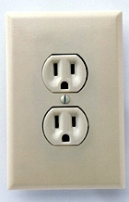
Ideas from Networks and Biological Systems
Due to John Doyle
Bowtie architecture in:
Internet
Applications – TCP/IP – Link
Power distribution
Power plants – Stan – Many Devices
Biological Systems
Cell Metabolism (next slide)
Diverse
function
Universal
Control
Diverse
components
“Constraints that De-Constrain”

Slide 26
John Doyle’s slide
Same
12
in all
cells
Taxis and
transport
Core metabolism
Sugars
Catabolism
Amino Acids
Nutrients
Precursors
Nucleotides
Fatty acids
Co-factors
≈100
same
in all
organisms
Carriers
Huge
Variety
Same
8
in all
cells

Slide 27
Robustness/Fragility Tradeoff
Due to John Doyle
Systems tradeoff robustness and fragility:
Robustness for some set of permutations implies fragility for other set of permutations
Some fragilities are inevitable for complex systems
Seems to hold for biological evolved systems, must it for engineered systems?
Fragile
Robust

Slide 28
Recap Summary
Systematization of Knowledge
Ad hoc point solutions vs. general understanding
Repeating failures of the past with each new platform, type of vulnerability
Scientific Method
Process of hypothesis testing and experiments
Building abstractions and models, theorems
Universal Laws
Widely applicable
Make strong, quantitative predictions
Valuable and achievable: need the right incentives for community
Progress in useful models; big challenges in constructing security experiments
Uncertainty if such laws exist; long way to go for meaningful quantification.

Slide 29
What Next?: Systematization of Knowledge
IEEE Symposium on Security and Privacy (Oakland 2010): call for systematization papers
“The goal of this call is to encourage work that evaluates, systematizes, and contextualizes existing knowledge. These papers will provide a high value to our community but would otherwise not be accepted because they lack novel research contributions.”

Slide 30
Discussion
What next?
Metrics
Experimentation
Formal methods
Challenge problems?

