Slide 1
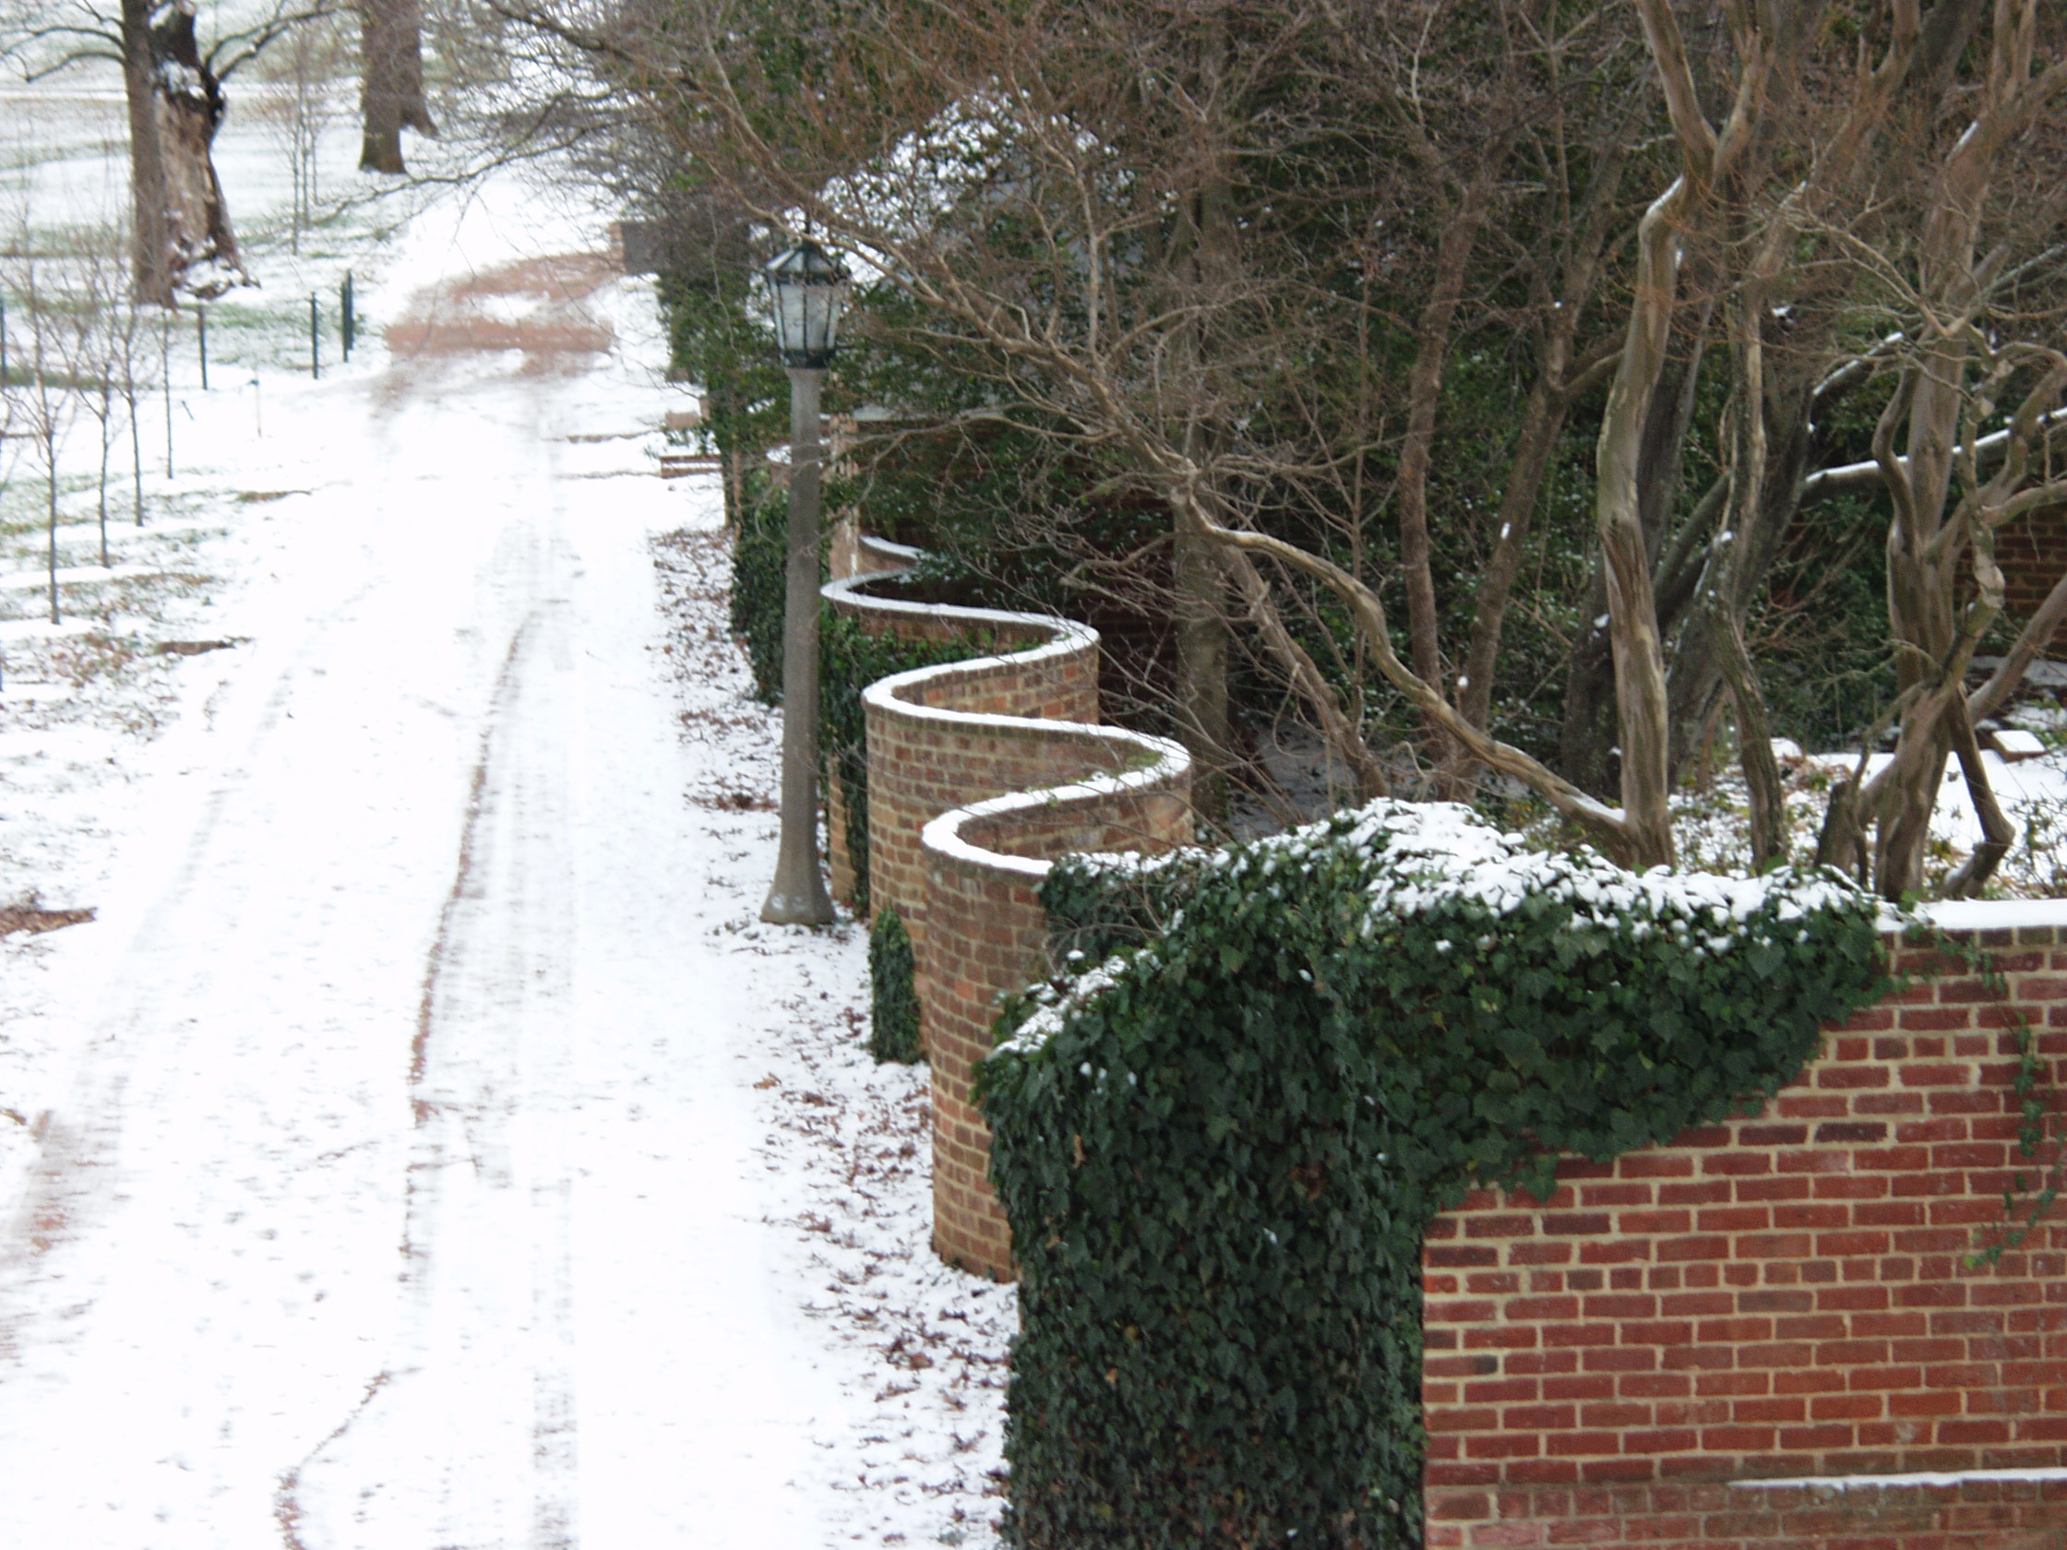
(A Somewhat Self-Indulgent) Splint Retrospective
David Evans
University of Virginia
25 October 2010

Slide 2
Splint Pre-History
Pre-history
1973: Steve Ziles – algebraic specification of set
1975: John Guttag’s PhD thesis: algebraic specifications for abstract datatypes
1983: Jeanette Wing’s PhD thesis: two-tiered specifications – separate program interface from underlying semantics
1993: John Guttag/Jeanette Wing seminar
Larch family specification, theorem prover
interface specification languages (including LCL)

Slide 3
Formal verifiers are too expensive and time consuming…
all
Formal Verifiers
Bugs Detected
Compilers
none
Low
Unfathomable
Effort Required

Slide 4
Splint offers a low-effort Alternative
all
Formal Verifiers
Bugs Detected
Splint
Compilers
none
Low
Unfathomable
Effort Required

Slide 5
Security Flaws
190 Vulnerabilities
Only 4 having to do with crypto
108 of them could have been detected with simple static analyses!
Reported flaws in Common Vulnerabilities and Exposures Database, Jan-Sep 2001.
[Evans & Larochelle, IEEE Software, Jan 2002.]

Slide 6
(Almost) Everyone Hates Specifications
Hard to understand
Lots of strange notations
Don’t match what the code does
Can’t even run them

Slide 7
(Almost) Everyone Likes Types
Easy to Understand
Easy to Use
Quickly Detect Many Programming Errors
Useful Documentation
…even though they are lots of work!
1/4 of text of typical C program is for types

Slide 8
Types
Attributes
Type of reference never changes
State changes along program paths
Language defines checking rules
System or programmer defines checking rules
One type per reference
Many attributes per reference

Slide 9
Approach
Programmers add “annotations” (formal specifications)
Simple and precise
Describe programmers intent:
Types, memory management, data hiding, aliasing, modification, null-ity, buffer sizes, security, etc.
Splint detects inconsistencies between annotations and code
Simple (fast!) dataflow analyses
Intraprocedural: except for annotations
Unsound and incomplete

Slide 10
Sample Annotation: only
extern only char *gptr;
extern only out null void *malloc (int);
Reference (return value) owns storage
No other persistent (non-local) references to it
Implies obligation to transfer ownership
Transfer ownership by:
Assigning it to an external only reference
Return it as an only result
Pass it as an only parameter: e.g.,
extern void free (only void *);

Slide 11
Example
extern only null void *malloc (int); in library
1 int dummy (void) {
2 int *ip= (int *) malloc (sizeof (int));
3 *ip = 3;
4 return *ip;
5 }
Splint output:
dummy.c:3:4: Dereference of possibly null pointer ip: *ip
dummy.c:2:13: Storage ip may become null
dummy.c:4:14: Fresh storage ip not released before return
dummy.c:2:43: Fresh storage ip allocated
Notes:
Note:
user didn’t have to write any annotations to discover these bugs!

Slide 12
Example: Buffer Overflows
Most commonly exploited security vulnerability
1988 Internet Worm
Still the most common attack
Code Red exploited buffer overflow in IIS
>50% of CERT advisories, 23% of CVE entries in 2001
Attributes describe sizes of allocated buffers
Heuristics for analyzing loops
Found several known and unknown buffer overflow vulnerabilities in wu-ftpd

Slide 13
Adding Data Abstraction to C
typedef /*@abstract@*/ /*@immutable@*/ char *mstring;
Warnings if code depends on the representation of an abstract type
Biggest payoff in maintainability for minimal effort

Slide 14
Defining Properties to Check
Many properties can be described in terms of state attributes
A file is open or closed
fopen: returns an open file
fclose: open → closed
fgets, etc. require open files
Reading/writing – must reset between certain operations

Slide 15
Defining Openness
attribute openness
context reference FILE *
oneof closed, open
annotations
open ==> open closed ==> closed
transfers
open as closed ==> error
closed as open ==> error
merge open + closed ==> error
losereference
open ==> error "file not closed"
defaults
reference ==> open
end
Object cannot be open
on one path, closed on
another
Cannot abandon FILE
in open state

Slide 16
Specifying I/O Functions
/*@open@*/ FILE *fopen
(const char *filename,
const char *mode);
int fclose (/*@open@*/ FILE *stream) /*@ensures closed stream@*/ ;
char *fgets (char *s, int n,
/*@open@*/ FILE *stream);

Slide 17
Checking
Simple dataflow analysis
Intraprocedural – except uses annotations to alter state around procedure calls
Integrates with other Splint analyses (e.g., nullness, aliases, ownership, etc.)

Slide 18
Splint Success/Failure
splint.org visits (last 12 months)
Academic impact: over 1000 citations (4 papers with > 200 each)
Practice impact:
still used, mostly in embedded software development (C)
incorporated in popular Linux distributions, commercial products
“Splint-inspired” tools are widely used: PREfix/PREfast, Fortify, FindBugs
Failures:
no slippery slope to more advanced uses of formal methods
did not build a self-maintaining open source community

Slide 19
FindBugs
http://findbugs.sourceforge.net
Slide from Bill Pugh’s talk (2009)

Slide 20
Static/Dynamic Analysis: Past, Present and Future
Verification Grand Challenge Workshop
SRI Menlo Park
22 February 2005
Original slides: with updates in orange boxes
David Evans
University of Virginia
Computer Science

Slide 21
The Past: Trends
Lines of Source Code
Splint
LCLint
“Faster Machines”
“Loss of Ambition”
FL Proofs

Slide 22
The Present
Microsoft PREfix/fast, SLAM→SDV
ASTRÉE (Cousot) – Airbus A380
Acquired by MathWorks, 2007
$35M in 2008
$41M in 2008
Acquired by IBM, 2009

Slide 23
The Present
Static Analysis: good at checking generic requirements (types, buffer overflows, …)
Dynamic Analysis: good at checking assertions inserted by programmer
Bad at knowing what properties to check
Automatic inference techniques
Grand Challenge Repository
No good techniques for combining static and dynamic analyses
A few since 2005!
Concolic Testing [Sen et al., 2007], SAGE (MSR)

Slide 24
The Future: Predictions for 2015
Software vendor will lose a major lawsuit because of a program bug
Someone will come up with a cool name like “VerXifiedProgramming” and sell a lot of books on program verification
No more buffer overflows in major commercial software
Brian Snow at 20th Oakland conference (1999) predicted we will still be talking about buffer overflows in 2019
Has this happened?
Still waiting…but 5 years left!
SANS list 2010: Buffer overflows are still #3
but…not in OWASP top ten

Slide 25
Predictions for 2015
Standard compilers prevent most concurrency problems
Programmers will still make dumb mistakes and resist change
“Good” CS degree programs will:
Incorporate verification into their first course
Include a course on identifying and checking program properties
Still a long way off…but lots of work going on

Slide 26
Making Predictions
Never make predictions, especially about the future.
– Casey Stengel
The best way to predict the future is to invent it.
– Alan Kay, 1971
Our plan and our hope was that the next generation of kids would come along and do something better than Smalltalk around 1984 or so… But a variety of different things conspired together, and that next generation actually didn’t show up.
– Alan Kay, 2005

