Slide 1


TSearch: Target-Oriented Low-Delay Node Searching in DTNs with Social Network Properties
Presenter: Fangming Liu
Authors: Li Yan, Haiying Shen and
Kang Chen
Dept. of Electrical and Computer Engineering
Clemson University, SC, USA
Notes:
Hello, everyone! I’m going to present the paper: TSearch: Target-Oriented Low-Delay Node Searching in DTNS with Social Network Properties. The authors are Li Yan, Haiying Shen and Kang Chen

Slide 2
Outline
Introduction
Related work
Rationale of TSearch design
System design of TSearch
Evaluation
Conclusion
Notes:
I am the presenter Fangming Liu and…introduce yourself
Here is the outline of the presentation. First is the introduction, second will be the related work of this paper, then I will explain the rationale of our design and the detailed design of TSearch. Next I will present the performance evaluation of TSearch. Finally the conclusion.

Slide 3




Introduction
Nodes form delay tolerant networks in distributed manner
  Without infrastructure for communication
Nodes move autonomously in the network
  Example 1: malfunctioning sensors on animals
  Example 2: malicious nodes in the network
  Example 3: mobile devices held by people on campus
Notes:
In recent few years, Delay Tolerant Networks (DTNs) attract much attention from researchers. Various mobile devices form delay tolerant networks in distributed manner. In DTNs, nodes move autonomously in the network.
For example, in a DTN that consists of animals for various purposes, we may need to ﬁnd an animal to upgrade or repair the sensor attached to it. For a DTN in battleﬁeld, the system administrator needs to not only isolate a malicious device but also ﬁnd the person who carries the device. In a DTN formed by mobile device holders in a hospital, a campus, a disaster area or a national park, a user needs to find another user in person.

Slide 4
Introduction (cont.)
Node searching is important
  Find a node carrying a malfunctioning device
  Locate malicious nodes timely
  Enable the search of device holders
Node searching is also non-trivial
  No central controller to guide node movement
  No infrastructure to collect node location information
  Information transmission follows the “delay tolerant” manner
Notes:
In such sparsely distributed networks, node searching, in which a locator node finds a target node in person, is important for node management and many applications. For example, locating the malfunctioning device or malicious node; the search of specific device holders.
However, node searching is also non-trivial. This is because DTNs have no central controller to collect location information or guide node movement. Meanwhile, the connection in DTNs is intermittent and must follow the “delay-tolerant” manner.

Slide 5
Related Work
Infrastructure-based methods [SIGCOMM’07, ICNP’13]
  Rely on infrastructure to collect node mobility information
  Drawbacks:
    Not applicable to the DTN scenario
DTN routing methods [SIGCOMM’07, INFOCOM’10]
  Can achieve node searching
  Drawbacks:
    Low efficiency due to hop-by-hop routing
DTN node searching methods [INFOCOM’14]
  Summarize node mobility information
  Let nodes store & distribute mobility information in the network for node searching
Notes:
Object searching in DTNs has been paid much attention in research. The first category of these works is the infrastructure-based methods. They utilize the opportunisitic encounters among nodes to forward location information to infrastructures. However, these methods need extra infrastructures or central servers, which is not practical for DTNs.
Several DTN routing methods can be indirectly applied for node searching, but the hop-by-hop routing is not efficient for node searching in DTNs.
Recently, a node searching method (DSearching) was proposed specifically for DTNs. It summarizes node mobility information, let nodes store and distribute mobility information in the network for node searching.

Slide 6
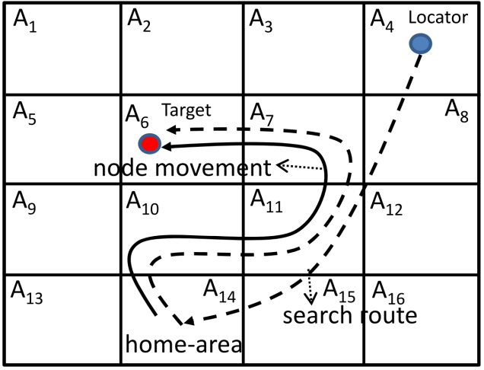
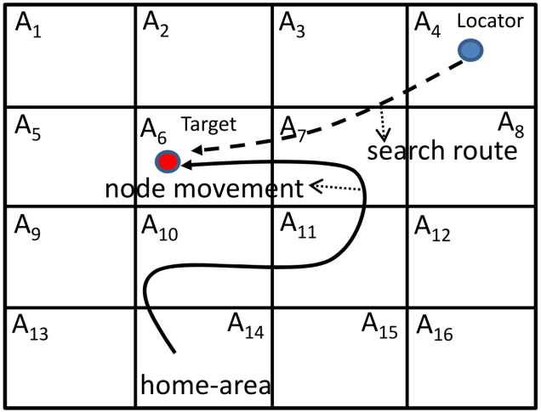
Related Work (cont.)
DTN node searching methods [INFOCOM’14]
  Drawbacks:
    Tracing target along its movement is not sufficiently efficient
Proposed method
  Locators move to the most recent location of target
  Use nodes’ preference in specific locations for search
  Use nodes’ friends for search
Notes:
However, Dsearching provides insufficiently efficient node searching by aiming to enable a locator to trace the target along its movement path from its home-area. Like what is shown in the top right figure.
Unlike these previous methods, TSearch aims to let locators move to the most recent location of target. Besides, it also uses nodes’ friends and preference in specific locations for search. Tsearch does not need an infrastructure or a central server. It is the first work that enables locators to directly move towards targets to achieve low search delay and overhead.

Slide 7
Rationale of TSearch Design
Real traces for analysis
  Dartmouth trace (DART) [1]:
    A 119-day record for wireless devices carried by students on Dartmouth College campus
    Initial period: 30 days
    70 locators were generated periodically (1 day) for 90 times
  DieselNet trace (DNET) [2]:
    A 20-day record for WiFi nodes attached to the buses in the downtown area of UMass college town
    Initial period: 2.5 days
    70 locators were generated periodically (4 hours) for 90 times
[1] T. Henderson, etc. “The changing usage of a mature campus-wide wireless network,” in Proc. of MobiCom, 2004.
[2] X. Zhang, etc. “Study of a bus-based disruption-tolerant network: mobility modeling and impact on routing,” in Proc. of MobiCom, 2007.
Notes:
The rationale of the design of TSearch is supported by trace analysis. The traces we used are the DART trace (DART) and the DieselNet AP trace (DNET).
The DART trace is a 119-day record for wireless devices carried by students on Dartmouth College campus. The initial period is 30 days, during which nodes collect information for node searching. Totally, 70 locators were generated periodically (1 day) for 90 times.
The DNET trace is a 20-day record for WiFi nodes attached to the buses in the downtown area of UMass college town. The initial period is 2.5 days. Totally, 70 locators were generated periodically (4 hours) for 90 times.

Slide 8
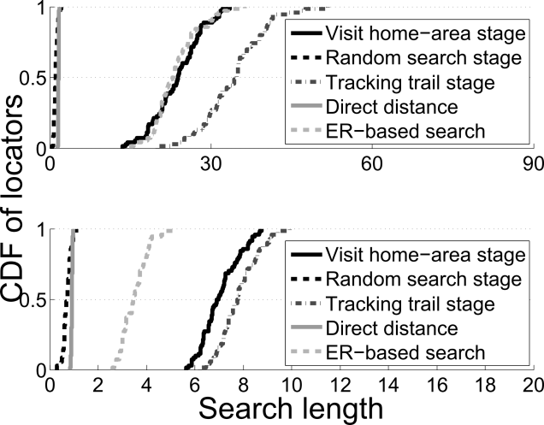
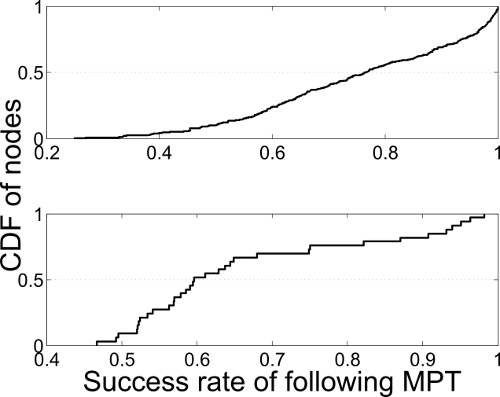
Rationale of TSearch Design
  Drawback of DSearch
  Long distances to the home-area and movement trail of the target node
  Solution: let locator move directly to the most recent locations of the targets.
Effectiveness of preferred locations on searching
  Nodes have preference on multiple locations
Notes:
DSearch may travel long distance in the process of node searching. We measured the cumulative distribution function (CDF) of different stages in Dsearch, which is as shown in the top right figure.
We see that the direct distance is very short (within 3 sub-areas in DART and 2 sub-areas in DNET). However, 50% of locators need to travel more than 24 and 6 sub-areas to reach the target’s home-area, and also travel more than 35 and 8 sub-areas in the tracking stage in DART and DNET, respectively.
These results demonstrate that locators must travel many sub-areas in the first two stages in DSearch. Therefore, we aim to design a method that avoids the unnecessary travel and enables a locator to directly move to current location of the target.
Nodes’ preferred location is effective for node searching. We searched the node’s next sub-area from its previous sub-area in its entire movement path, and calculated the success rate. The bottom right figure shows the CDF of the success rate. We see that 20% of the nodes have success rate less than 60% and 50% of the nodes have success rate less than 75% in DART, while 25% of the nodes have success rate less than 55% and 75% of the nodes have success rate less than 70% in DNET.
Moreover, the results also demonstrate that nodes usually have preference on multiple locations. Besides nodes’ most preferred location, a locator should not ignore the other preferred locations that a target has high probability to move to.

Slide 9
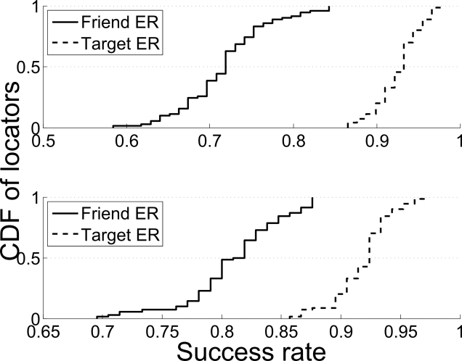
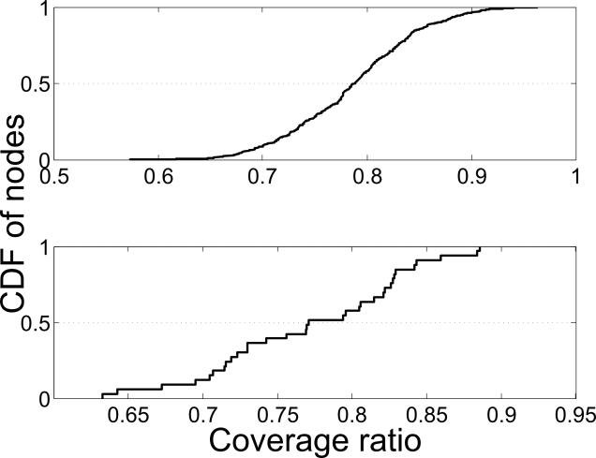
Rationale of TSearch Design (cont.)
  Friends
  Each node has certain frequently meeting nodes
  ERs of the target’s friends can be used as complementary method for node searching.
Search range constraint
  Nodes’ possible locations can be determined based on the normal node velocity and the time and location in the nodes’ latest ER
Notes:
By reaching the friends of target, it is likely to find the target. To verify this conjecture, we draw the top right figure that shows the CDF of success rate of following the ERs of the target and the target’s friends, respectively.
We see that following the targets’ ERs, about 60% of the locators have success rate higher than 92% in DART and 91% in DNET. Following the ERs of the target’s friends, about 60% of the locators have success rate higher than 70% in DART and 80% in DNET.
The result confirms that the ERs of the target’s friends can be used for node searching as a complementary method.
The possible movement range of a node is constrained by the node velocity and the time and location in the node’s latest ER. The bottom right figure shows the CDF of the coverage ratio defined as the ratio of the number of locations in the coverage areas. We see that 80% of nodes have coverage ratio higher than 70% in DART and DNET.
The result shows that the coverage area can be used to limit the searching areas of the locators to reduce search delay and overhead.

Slide 10
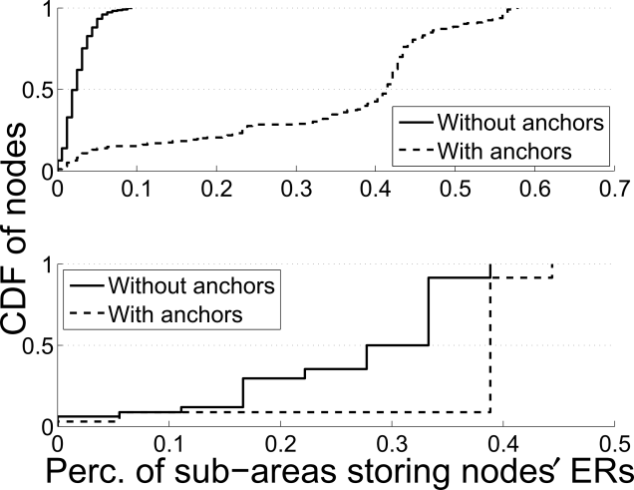
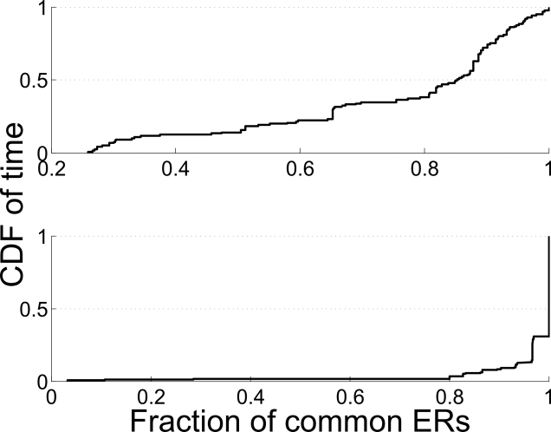
Rationale of TSearch Design (cont.)
  Information dissemination
  Anchors: nodes that stay in certain sub-area for a long time
  Anchors store mobility information of nodes for easy access.
  Ambassadors: nodes that frequently transit between two sub-areas
  Ambassadors help maintain consistency of mobility information among anchors
Notes:
To make mobility information globally accessible, we assign nodes with different roles. Anchors, which stay in certain sub-areas for a long time, are responsible for collecting information. Ambassadors, which frequently transit between two sub-areas, are responsible for record updates between anchors.
In order to see the effectiveness of anchors in collecting information, we measured the percent of sub-areas that have the ERs of a certain percent of nodes at the time point of 120 hours and 20 hours in DART and DNET, respectively. The top right figure shows that 50% of nodes have their ERs disseminated to less than 2% and less than 40% of all the sub-areas without and with the anchors in DART, and to less than 27% and less than 39% of all the sub-areas without and with the anchors in DNET.
The result confirms the importance of using anchors for easy information access.
To see degree of consistency maintained by the ambassadors, in each hour during the 120 hours and 20 hours in DART and DNET, respectively, we measured the ratio of common ERs among all anchors. The bottom right figure shows that about 80% of the time, the ratio of common ERs among anchors is higher than 40% in DART, and higher than 90% in DNET.
The result confirms that the ambassadors can help maintain a high degree of consistency among anchors.

Slide 11

Design: Problem Definition
  A DTN with $n$ nodes
  $N_{i}$, $i=1,2,3,⋯, n$
Whole DTN is split into sub-areas
  Each sub-area contains one landmark, e.g., a popular place
  The area between two landmarks is evenly split
  No overlap among sub-areas
Node searching
  Enabling the locator to find the sub-area where the target node resides in
Notes:
Similar to Dsearch, we consider a DTN with n nodes. We partition the whole network area into several sub-areas to represent node positions. For example, each sub-area contains one landmark. The sub-areas are evenly split without overlap. The problem is to enable the locator to find the sub-area where the target node resides in.

Slide 12

Design: Info. for Searching
Encounter record (ER)
  Generated when nodes encounter with each other
  Shows a historical location of the node
  $$<N_{i}, N_{j}, L_{ij},T_{ij}>$$
  $N_{i}$ and $N_{j}$ represent the two encountering nodes
  $L_{ij}$ and $T_{ij}$ represent the current sub-area and the current time, respectively
Purpose of ER
  Providing the information on recent locations of the target
Notes:
A node generates an ER for each of its neighbors (i.e., the nodes in its transmission range) upon encountering. The ER shows a historical location of the node. $N_{i}$ and $N_{j}$ represent the two encountering nodes. $L_{ij}$ and $T_{ij}$ represent the current sub-area and the current time, respectively.
With ER, the locator can have the information on recent locations of the target.

Slide 13
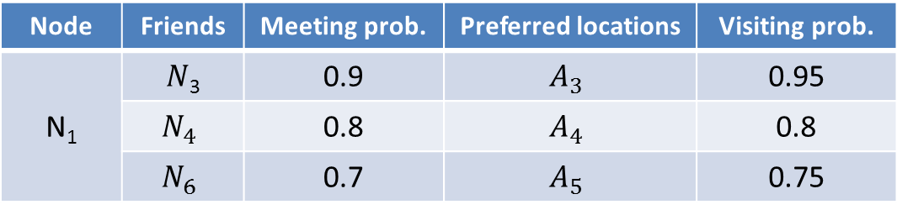
Design: Info. for Searching
Friends and preferred locations
  Friends: nodes that take up at least a high percentage (60%) of all contacts with the node
  Preferred locations: The top ranked sub-areas that constitute 60% of visiting frequency of the target node.
Purpose of friends and preferred locations
  Providing the information on target’s preference in meeting nodes and visiting sub-areas
Node | Friends | Meeting prob. | Preferred locations | Visiting prob.
N₁ | $N$₃ | 0.9 | $$A_{3}$$ | 0.95
 | $$N_{4}$$ | 0.8 | $$A_{4}$$ | 0.8
 | $$N_{6}$$ | 0.7 | $$A_{5}$$ | 0.75
Notes:
Besides, we also uses nodes’ friends and preferred locations as complementary searching tools. Friends are nodes that take up at least a high percentage (60%) of all contacts with the node. Preferred locations are the top ranked sub-areas that constitute 60% of visiting frequency of the target node.
With such information, the locator knows the target’s preference in meeting nodes and visiting sub-areas. A summary of such information is as shown in the table.

Slide 14
Design: Distribute Mobility Info.
Anchor
  Stable node with high storage and computing capacity
  Collect ERs, friends and preferred locations of nodes
  Once locator moves into a sub-area, it can quickly access the information of nodes that once visited the sub-area from the anchors of the sub-area
Ambassador
  Nodes frequently transiting between two sub-areas
  Maintain the consistency of information among anchors
Notes:
To enable the information for node searching to be globally accessed, we assign nodes with various roles. Anchors are stable nodes with high storage and computing capacity. They are responsible for collecting ERs, friends and preferred locations of nodes. When a node moves into a sub-area, it reports its stored ERs, friends and preferred locations to the sub-area’s anchor. An anchor only stores the latest ER of each node. Therefore, once a locator moves into a sub-area, it can quickly access the information of its target from the sub-area’s anchor.
Ambassadors are nodes frequently transiting between two sub-areas. They are responsible for maintaining the consistency of information among anchors.

Slide 15
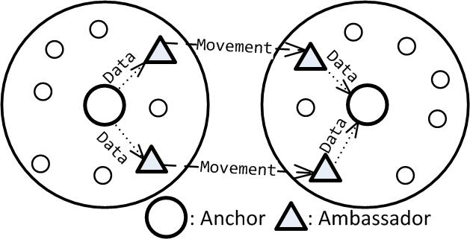
Design: Distribute Mobility Info.
Role determination
  Anchor: staying probability of a node is larger than a threshold
  Ambassador: frequency of transiting between two sub-areas is higher than a threshold
Notes:
To determine anchors, we use the staying probability of a node as the metric. If the staying probability of a node in a sub-area is larger than a threshold, it can be the anchor for this sub-area.
For ambassadors, we use the frequency of transiting between two sub-areas as the metric. If the transit probability is larger than a threshold, this node can be an ambassador between these two sub-areas.
The tasks of different roles can be described with the figure.

Slide 16
Design: Node Searching
Node searching based on ERs
  Locator moves to the location in the ER
  Changes destination if newer ER is found
Node searching based on friends’ ERs
  Locator moves to the location in the ER of the friend that has the highest meeting probability with the target
Node searching based on target’s preferred locations
  Locator moves to the nearest preferred location
  Locator relies on M nodes (as agents) to search the next top M preferred locations
  Agents have common preferred locations with the target
  If an agent finds the target, it uses a routing algorithm to notify the locator
Notes:
The priority to use the three types of information is ordered by ERs, friends’ ERs and preferred locations.
If a locator has or can access the ER of its target, it directly moves to the location in the ER. If the locator receives a newer ER which represents a more recent appearance place of the target, it moves to this new place.
If the most recent ERs of the target are not transmitted to the locator or its local anchor in time, the locator queries the ER of the target’s friends. Then the locator moves to the location in the ER of the friend that has the highest meeting probability with the target.
If the above information is not available, the locator uses the preferred locations of the target for searching. The locator itself moves to the nearest preferred location. The locator relies on several nodes, say M, as agents to search the target in the other top M preferred locations of the target.
The agents should have common preferred locations with the target. If an agent finds the target, it uses a routing algorithm to notify the locator.

Slide 17
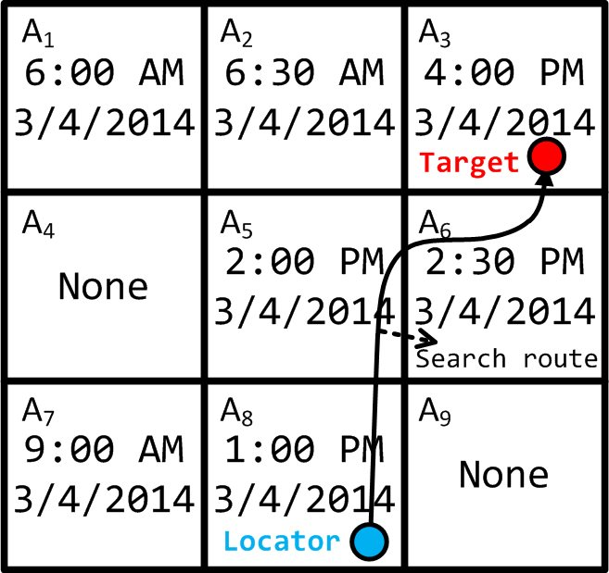
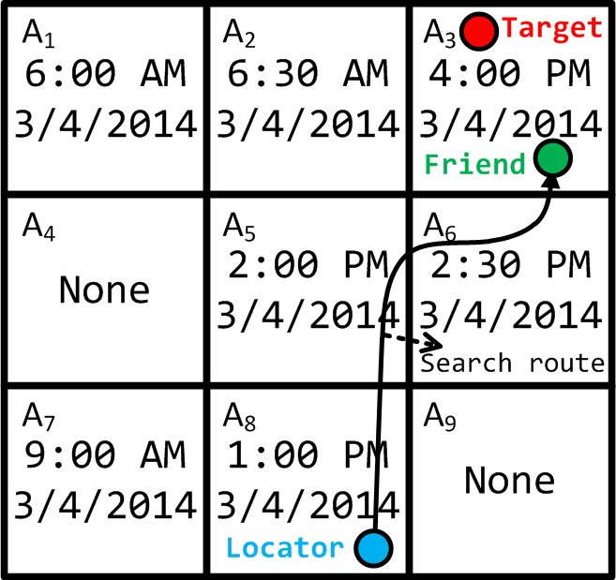
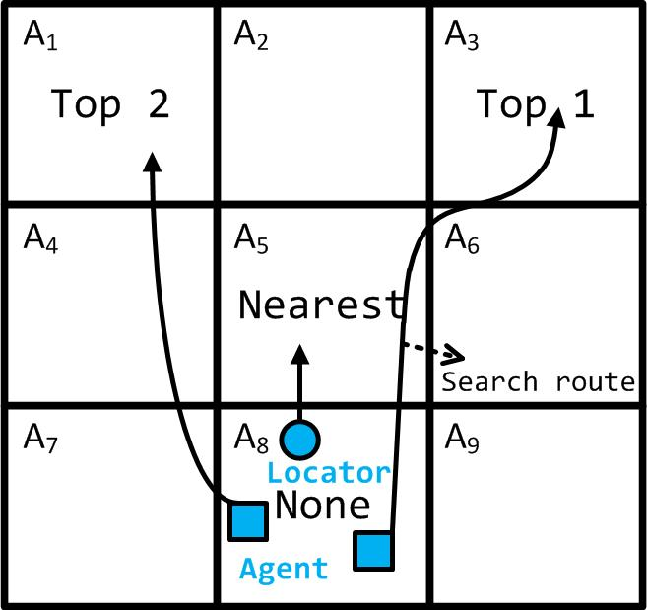
Design: Node Searching
Based on ERs
Based on friends’ ERs
Based on preferred locations
Notes:
The three steps of TSearch node searching process are depicted with the three figures.
In the left figure, the locator knows the latest ER of the target. We see that the latest ER of the target, which records 4:00 PM 3/4/2014, shows its present location. Therefore, the locator directly moves to the present sub-area of the target.
In the middle figure, the locator does not have the latest ER of the target, but has the latest ER of the target’s friend. On the way of reaching the friend, the locator finally finds the target.
In the right figure, the locator only knows the preferred sub-areas of the target. The locator itself moves to the nearest preferred sub-area, and asks two agents that will move to the top 1 and top 2 preferred sub-area, respectively, to help assist node searching.

Slide 18
Performance Evaluation
Simulator
  Event driven simulator
Node Mobility Traces
  Dartmouth trace (DART): records of mobile devices on campus [1]
  DieselNet trace (DNET): records of buses in a college town [2]
Comparison Methods
  TS*: TSearch with ER exchange
  TS: TSearch without ER exchange
  DS: DSearch distributed node searching [INFOCOM 14’]
  Routing: a routing based method [SIGMOBILE 03’]
  ER: TSearch using ER only
[1] T. Henderson, etc. “The changing usage of a mature campus-wide wireless network,” in Proc. of MobiCom, 2004.
[2] X. Zhang, etc. “Study of a bus-based disruption-tolerant network: mobility modeling and impact on routing,” in Proc. of MobiCom, 2007.
Notes:
We conducted trace-driven experiments on an event driven simulator based on the DART and DNET traces introduced before.
We evaluated TSearch with and without the ER exchanges between nodes, denoted by TS* and TS, in comparison with two representative algorithms: the DSearching distributed node searching method, denoted by DS, and a routing based method, denoted by Routing. In order to show the effect of ERs in node searching in TSearch,
we also evaluated TSearch that only uses ERs without anchors, denoted by ER. That is, nodes record the ERs with their encountering nodes and exchange the records.

Slide 19
Metrics
Success rate
  The percentage of locators that can successfully locate the target nodes within the TTL
Average delay
  The average time used by successful locators
Average transmission overhead
  The average number of all packets transmitted among nodes
Average node memory usage
  The average number of memory units used by each node
Notes:
We measured the following metrics in the experiments.
The first metric is the success rate, which is the percentage of locators that can successfully locate the target nodes within the TTL.
The second metric is the average delay, which is the average time used by successful locators.
The third metric is the average transmission overhead, which is the average number of all packets transmitted among nodes.
The fourth metric is the average node memory usage, which is the average number of memory units used by each node.

Slide 20
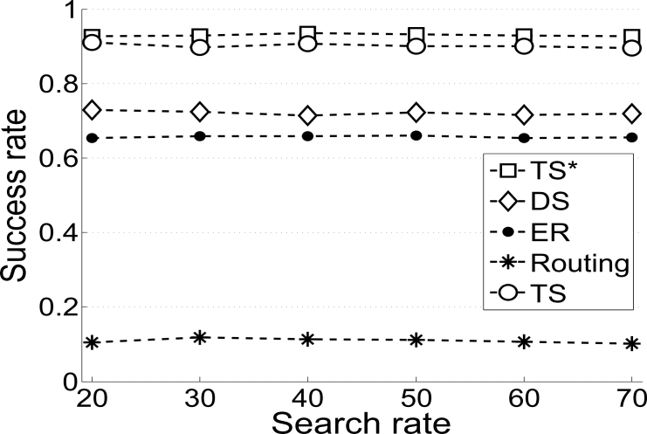
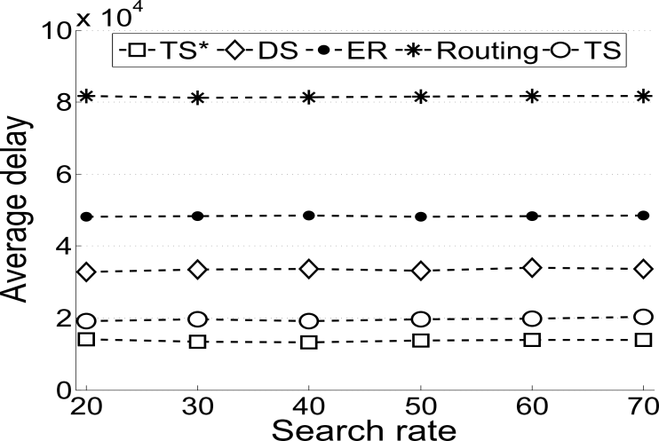
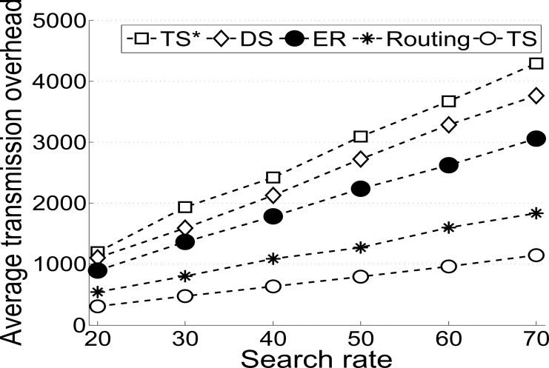
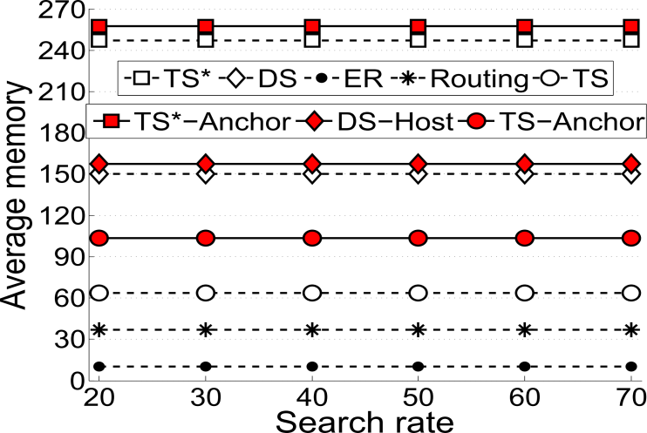
Experiment with Different Search Rates (DART)
Success rate: TS*>TS>DS>ER>>Routing
Ave. delay: TS*<TS<DS<ER<<Routing
Ave. trans. overhead: TS<Routing<ER<DS<TS*
Ave. memo. usage: ER<Routing<TS<DS<TS*
Notes:
We made experiments with different search rates and search TTLs. For simplicity, we show the experiment with different search rates in DART trace and the experiment with different search TTLs in DNET trace.
Firstly, for the experiment with different search rates in DART trace, we see that TSearch excels others in major metrics such as success rate and average delay, although with higher transmission overhead and memory usage. This results demonstrate the effectiveness of TSearch and its components under various search rates.

Slide 21
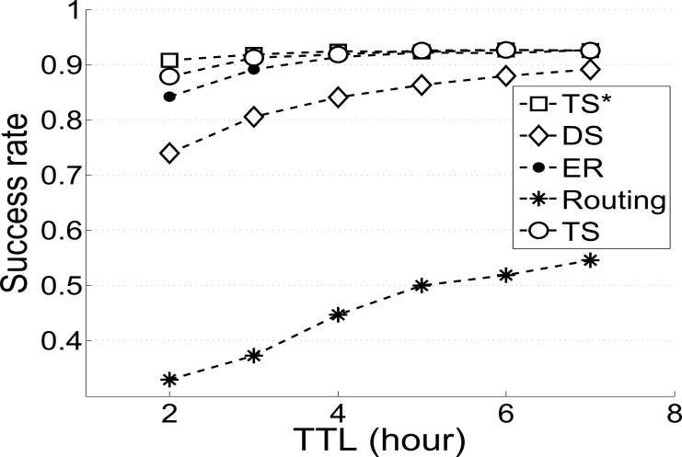
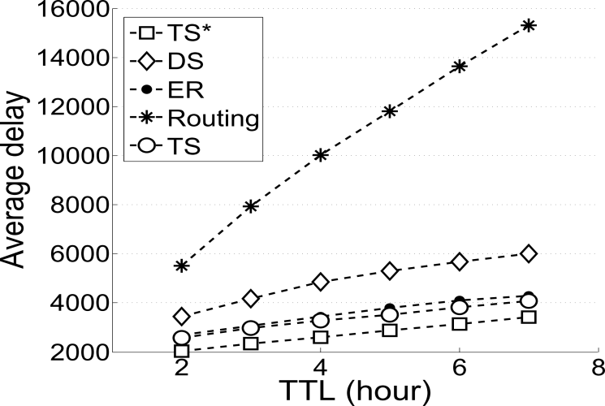
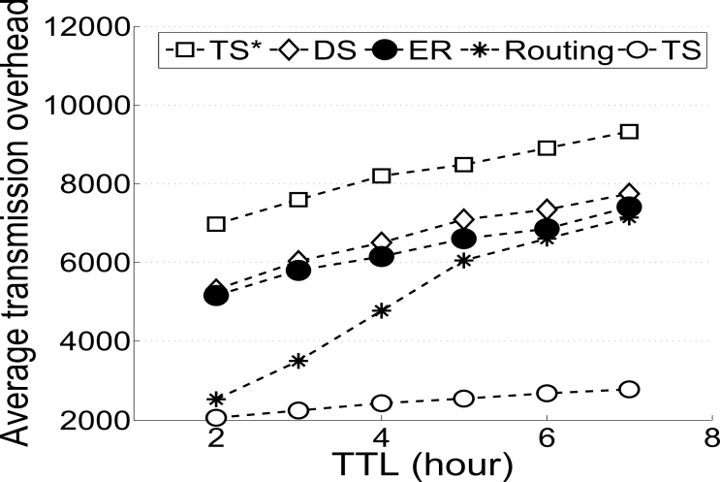
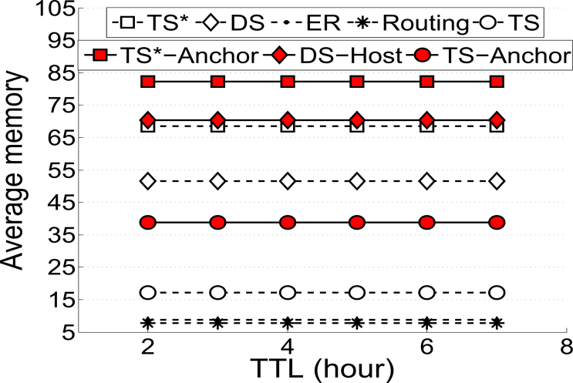
Experiment with Different TTLs (DNET)
Success rate: TS*>TS>DS>ER>>Routing
Ave. delay: TS*<TS<DS<ER<<Routing
Ave. trans. overhead: TS<Routing<ER<DS<TS*
Ave. memo. usage: ER<Routing<TS<DS<TS*
Notes:
Secondly, for the experiment with different search TTLs in DNET trace, we see that TSearch also have better performance than other algorithms. This results demonstrate the effectiveness of TSearch and its components under various search TTLs, especially under small TTLs.

Slide 22
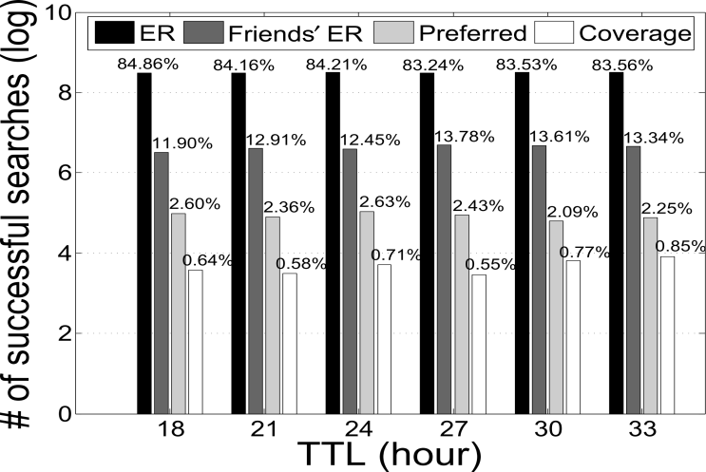
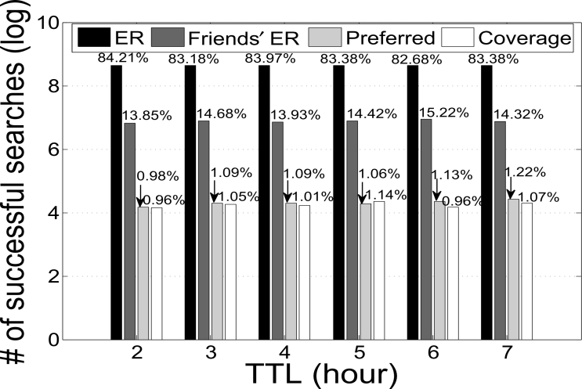
Contribution of Different Stages in TSearch
  Most of the successful searches are achieved by following the target’s ERs.
  The ERs of the target’s friends have the second highest contribution on the success rate.
  The target’s preferred location information has the third highest contribution on success rate.
DART
DNET
Notes:
To better illustrate the respective contribution of different search methods on success rate, we break down the total success rate into 4 stages by using different information of the target in node searching: ERs, friends’ ERs, preferred locations and coverage area.
These two figures show the number of successful searches in log format. We see that most of the successful searches are achieved by following the target’s ERs. The ERs of the target’s friends have the second highest contribution on the success rate. The target’s preferred location information has the third highest contribution on success rate. Finally, searching the coverage area contributes the least on the success rate, which means that the locators do not need to launch this searching stage in most cases. These results indicate the effectiveness of using the different information in node searching.

Slide 23
Conclusions
Our real trace analysis confirms the drawbacks of previous node searching methods in DTNs
We proposed TSearch, it
  enables a locator to always move to the target’s latest appearance place known by itself
  enables a locator to find the target through its friends
  enables a locator to ask a limited number of nodes that share common preferred locations with the target to assist node searching
In our future work, we plan to further exploit nodes’ social network properties to reduce node searching delay and overhead.
Notes:
To conclude, in this paper, we applied trace analysis based on real trace and confirmed the drawbacks of previous node searching methods in DTNs.
Based on a series of observations, we proposed TSearch, which enables a locator to always move to the target’s latest appearance place known by itself; find its target through friends and ask multiple agents to assist node searching.
In our further work, our plan is to exploit more nodes’ social network properties to increase the performance of TSearch.

Slide 24
Thank you!
Questions & Comments?
Li Yan, PhD Candidate
lyan@clemson.edu
Pervasive Communication Laboratory
Clemson University
Notes:
24

