Slide 1
Fading-Resistant Link Scheduling in Wireless Networks
Chenxi Qiu* and Haiying Shen†
*College of Information Science and Technology, Pennsylvania State University
†Department of Computer Science, University of Virginia

Slide 2
Outline
Introduction
Algorithm Design
Performance Evaluation
Conclusion
Notes:
This is the outline of the presentation.
First, I will briefly introduce the background of the link scheduling problem we are going to study, along with some related work in this area.
And then, I will introduce two algorithms we design to solve the problem. After that, I will give some experimental results to show the performance of our algorithms.
Finally, I will make a conclusion.

Slide 3
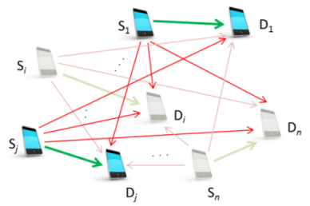
Introduction
The link scheduling problem
Definition: given a set of links, the link scheduling problem is to determine which subset of links should be activated such that the total throughput is maximized in one time slot.
Notes:
In wireless networks, the link scheduling problem has been a subject of significant research interest over the past years. Given a set of transmission links, each of which is from a sender to a receiver and associated with a specific data rate, this problem is to determine which links should be active at what times in order to optimize throughput and delay. Due to the broadcast nature of wireless communication, when a sender transmits a packet to a specific receiver, it could become interference to other receivers. Thus, when scheduling links, we need to consider how to select links such that the interference among the links will not fail transmissions.

Slide 4
Introduction
Related work
Graph based scheduling.
If two nodes are within each other’s transmission range, then build an edge between the two nodes.
E.g., [Sharma, Mobicom 2006] [Lin, ToN 2006] [Joo, Infocom 2008] [Wang, Mobicom 2006]
Drawback: the accumulated interference from far-away senders can be sufficiently high to corrupt a transmission.
SINR based scheduling.
A message is received successfully iff the SINR is no smaller than a hardware-defined threshold.
E.g., [Huang, JSAC 2009] [Goussevskaia, Mobihoc 2007] [Goussevskaia, Infocom 2009]
Notes:
One of the most commonly used interference model in the traditional scheduling problem is graph based model. It only considers the interference on a receiver from other
senders within the transmission range. However, although the interference from a single far-away sender can be relatively small, the accumulated interference from several such senders can be sufficiently high to corrupt a transmission. Hence, the scheduling problem solutions based on the graph based model cannot be guaranteed to work in many real scenarios.
Another interference model, named physical interference model or Signal-to-Interference-plus-Noise Ratio (SINR) model, offers a more realistic representation of wireless networks. In this model, a message is received successfully iff the SINR is no smaller than a hardware-defined threshold. This definition of a successful transmission, as opposed to the graph based definition, accounts for interference generated by senders located far away.

Slide 5
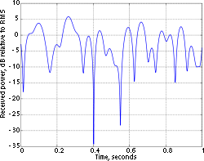
Introduction
Fading resistant link scheduling
Problem: the current SINR based methods do not consider fading effect.
Solution: we formulate a link scheduling problem called Fading-Resistant Link Scheduling problem (Fading-R-LS).
* In the Rayleigh-fading
model, the signal strength is modeled by an exponentially
distributed random variable.
Notes:
However, the SINR model still uses a limited view of signal propagation. Its main assumption is that any signal transmitted at power level P is always received at distance d with strength Pd^alpha, where alpha is path loss exponent. The real signal propagation is actually not deterministic, e.g., the links may become susceptible to fading fluctuations in
signal strength due to mobility in a multi-path propagation environment. Therefore, some advanced models using stochastic approaches to consider fading effects have been
proposed.
To address this problem, in this paper, we formulate a link scheduling problem called Fading-Resistant Link Scheduling problem (Fading-R-LS), in which the interferences among
links are modeled by the Rayleigh-fading channel model. Our objective is to determine which subset of L should be activated such that the total throughput is maximized in one time slot. To solve this problem, we propose two approximation algorithms and demonstrate the superiority of our methods in both theoretical analysis and simulation.

Slide 6
Introduction
Contributions
Fading-R-LS formulation and analysis. The Fading-R-LS problem takes into account the fading effect. We give an ILP formulation and prove it is NP-hard.
Link diversity partition algorithm (LDP). LDP builds several link classes based on link lengths and schedule the links in each class separately. We prove that LDP has the performance guarantee of O(g(L)).
Recursive link elimination algorithm (RLE). RLE iteratively picks up the unpicked link with the shortest link length and eliminates other links that interfere with the picked link.
Notes:
In summary, our contribution can be summarized as follows:
1) Fading-R-LS formulation and analysis. We formulate the Fading-R-LS problem that takes into account the fading effect, which is not considered in previous scheduling problems.
In addition, we give an integer linear programming (ILP) formulation of Fading-R-LS and prove it is NP-hard.
2) Link diversity partition algorithm (LDP). According to the geometric structure of Fading-R-LS, we propose the LDP algorithm. It builds several link classes based on link
lengths and schedule the links in each class separately. We prove that LDP has the performance guarantee of O(g(L)), where g(L) denotes the link diversity, i.e., the number of
length magnitudes of link set L.
3) Recursive link elimination algorithm (RLE). We then consider a special case of Fading-R-LS, in which the data rate of each link is the same, and propose the RLE algorithm accordingly. RLE iteratively picks up the unpicked link with the shortest link length and eliminates other links that interfere with the picked link. We prove RLE has the constant approximation ratio.
4) Finally, we conduct simulation to demonstrate the superiority of our methods compared with the existing link scheduling methods.

Slide 7
Outline
Introduction
Algorithm Design
Performance Evaluation
Conclusion
Notes:
Now, let me introduce our algorithms.

Slide 8
Algorithm Design
System model
Network model: a wireless network with N communication links L = {(s₁, r₁), ..., (s_{N}, r_{N})}, where (s_{i}, r_{i}) represents a transmission link from sender s_{i} to receiver r_{i}.
Fading model: We use Z_{i,j} to represent the instantaneous signal power received by r_{i} from s_{i}. Z_{i,j} is a random variable with Cumulative Distribution Function (CDF) of
(1)
Theorem 1: Given an active link (s_{j}, r_{j}) and active sender set P, the probability of successful transmission from s_{j} to r_{j} is:
Notes:
Now, let me introduce the mathematical model.
We consider a wireless network with N communication links L = {(s₁, r₁), ..., (s_{N}, r_{N})}, where (s_{i}, r_{i}) represents a transmission link from sender s_{i} to receiver r_{i}.
We consider time-varying and frequency-flat fading wireless channels. The channel effects from sender s_{i} to receiver r_{j} can be modeled by a single, complex and random channel
coefficient h_{i,j}. We consider the Rayleigh fading channel model, in which all h_{i,j} are independen t and exponentially distributed. We use Z_{i,j} to represent the instantaneous signal power received by r_{i} from s_{i}. Z_{i,j} is a random variable with Cumulative Distribution Function (CDF) of Equ. (1).
We then derive Theorem 1, which gives the closed form of the probability distribution of the SINR received by each receiver. Theorem 1 shows that checking transmission success
is equivalent to checking whether the sum interference factor from all the senders to this receiver is lower than a threshold.

Slide 9
Algorithm Design
System model
The Fading-R-LS problem:
Instance: A finite set of senders S and their respective receivers R in a geometric plane, decoding threshold γ_{th}, acceptable error rate ϵ, and a constant Λ.
Question: Existence of a subset of senders P, namely a schedule, such that the total successful transmission rate is no smaller than Λ.
Notes:
We formally formulate the fading resistant link scheduling (Fading-R-LS) as follows:
We are given a finite set of senders S and their respective receivers R in a geometric plane, decoding threshold γ_{th}, acceptable error rate ϵ, and a constant Λ.
The question is to find an Existence of a subset of senders P, namely a schedule, such that the total successful transmission rate is no smaller than Λ.
In other words, we attempt to use one time slot to its full capacity.

Slide 10
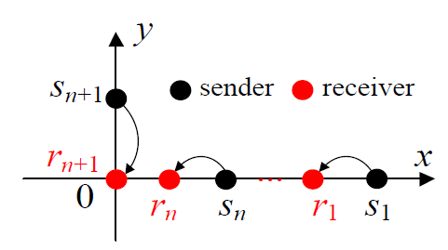
Algorithm Design
Problem Analysis
Theorem 2: The Fading-R-LS problem is NP-hard.
Knapsack
Knapsack: given n kinds of items, x₁, …, x_{n}; each x_{i} has a value p_{i} and a weight w_{i}, and a bag that can carry weight W maximally, the goal is to put the items into the bag s.t. the sum of the items’ values is no larger than a constant C.
Proof: We construct a polynomial time reduction from the well-known Knapsack NP-hard problem to Fading-R-LS.
Notes:
We prove the Fading-R-LS problem is NP-hard by constructing a polynomial time reduction from the Knapsack NP-hard problem to Fading-R-LS.
Here, in the knapsack problem, we are given n kinds of items, x₁, …, x_{n}; each x_{i} has a value p_{i} and a weight w_{i}, and a bag that can carry weight W maximally, the goal is to put the items into the bag s.t. the sum of the items’ values is no larger than a constant C.

Slide 11
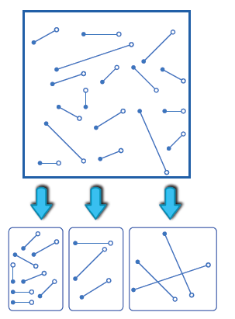
Algorithm Design
Link Diversity Partition Algorithm
Step 1: Partition the links into a collection of classes S₁, …, S_{N}, where the length of the links in each class S_{i} is up bounded and lower bounded by a value.
Notes:
Since Fading-R-LS is a NP-hard problem, there are no polynomial time solutions for determining the optimal schedule. To solve this problem, in this section, we propose the Link
Diversity Partition algorithm (LDP).
This algorithm starts by building g(L) disjoint link classes, where each class includes the links with lengths no larger than a specific magnitude. Thus, for each link class, the length of links is upper bounded. Then, the desired signal power for each link class has a lower bound.

Slide 12
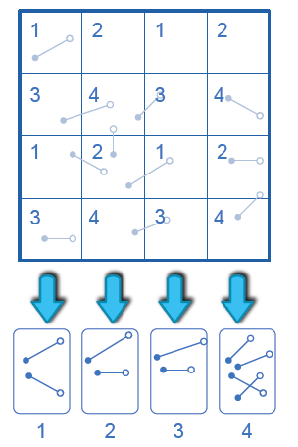
Algorithm Design
Link Diversity Partition Algorithm
Step 1: Grid the whole region and color the grid and each time pick up the links in the same color.
Notice: The distance from interference
sender is lower bounded by a value.
=> Hence, the interference factor is upper bounded by a value.
Notes:
Next, for each link class, LDP grid the whole region and color the grid and each time pick up the links in the same color. The size of the squares is calculated based on the SINR model to ensure the successful transmissions of a selected link from each same-color square when all these selected links transmit simultaneously. Then, all the selected links from the same-color squares form a feasible schedule. This algorithm selects the schedule with the highest data rate among all the feasible schedules.

Slide 13
Algorithm Design
Link Diversity Partition Algorithm
Feasibility and approximation
ratio:
Proposition 1
The LDP algorithm is feasible.
Proof: sum all the interference factor of the activated senders in the same color, we will find the sum interference factor is
smaller than the decoding threshold.
Proposition 2
The approximation ratio of LDP is O(g(L)).
Notes:
Then, we analyze the feasibility of LDP.
Proposition 1 claims that The LDP algorithm is feasible. We demonstrate that, when summing all the interference factor of the activated senders in the same color, the sum interference factor is
smaller than the decoding threshold.
We also proved that the approximation ratio of LDP is O(g(L)) in proposition 2.

Slide 14
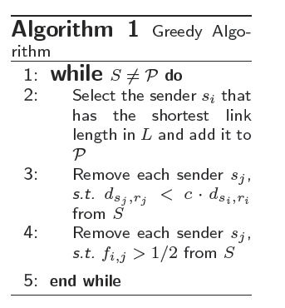
Algorithm Design
Recursive Link Elimination Algorithm
Step 1: Pick up a link (shortest length indicates strongest
signal power.)
Step 2: Remove all the links that may interfere with the picked links.
Notes:
Now, we consider a special case of Fading-R-LS, in which the transmission rate of each link is the same. We propose a greedy algorithm, namely recursive link elimination algorithm (RLE), for this special case.
Algorithm 1 gives the pseudo code:
In each iteration, the algorithm first greedily selects the unpicked sender with the shortest link length, say si. The rationale of this strategy is that the signal power received by
the receiver with a shorter link is always stronger, and hence the receiver is more likely to successfully receive the packet. Then, all links whose senders are within the radius c_1 d_{s_i,r_i} of the receiver r_i are removed from L, where c_1 is a constant.
Second, all senders whose receivers have interference factors above c_2 from the selected senders are removed, where c_2 is a constant smaller than 1.
This process is repeated until all links in L have been either active or deleted.

Slide 15
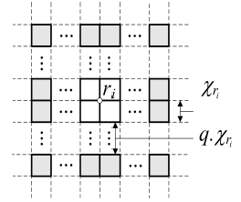
Algorithm Design
Recursive Link Elimination Algorithm
Feasibility and approximation
ratio:
Proposition 1
The greedy algorithm is feasible.
Proof: still partition the whole region into grid and sum all the interference factor of the activated senders.
Notes:
Similarly, we proved that RLE is feasible: we partition the whole region into grid and sum all the interference factor of the activated senders, and consequently find that the sum interference factor is smaller than the threshold.

Slide 16
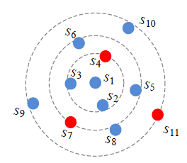
Algorithm Design
Recursive Link Elimination Algorithm
Proposition 2
The approximation ratio of the Greedy algorithm is O(1).
Proof: Blue-dominant centers lemma [Goussevskaia, 2009]
Notes:
We also proved that the RLE can achieve a constant approximation ratio. Here, we apply blue-dominant center lemma and more details of this proof can be found in the paper.

Slide 17
Outline
Introduction
Algorithm Design
Performance Evaluation
Conclusion
Notes:
Finally, we present experimental results to better illustrate the practical appeal of our scheduling algorithms.

Slide 18
Performance Evaluation
Experiment settings
Each sender was given a random location in a 500×500 square;
Each receiver was located from its sender with a distance randomly selected from [5; 20] in a random direction;
The accepted error rate = 0.01;
The decoding threshold = 1;
The data rate of every link = 1.
Measured metrics:
(1) Throughput (or the total data rate successfully received by receivers)
(2) the number of failed transmissions.
Compared methods:
(1) ApproxLogN [Mobihoc 2007]
(2) ApproxDiversity [Infocom 2009]
Notes:
In the experiment, each sender was given a random location in a 500 times 500 square, and each receiver was located from its sender with a distance randomly selected from [5, 20] in a random direction. The accepted error rate was set to 0.01, the decoding threshold was set to 1, and the data rate of every link was set to 1.
We measured the following two metrics: (1) throughput (or the total data rate successfully received by receivers) and (2) the number of failed transmissions.
We compare our algorithms with two other link scheduling algorithms: ApproxLogN and ApproxDiversity. ApproxLogN partitions the link set into disjoint link classes and schedules the links in each class separately. ApproxDiversity always picks up the shortest link and excludes links conflicted with the picked links in each iteration. Unlike our algorithms, ApproxLogN and ApproxDiversity are not fading-resistant although they are also polynomial time algorithms based on the SINR model.

Slide 19
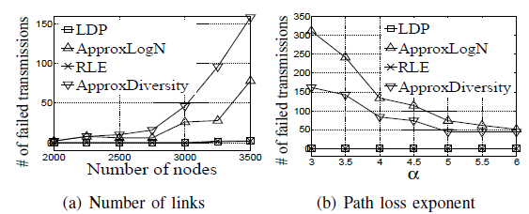
Performance Evaluation
Experimental results
Observation
1. LDP and RLE have almost no failed transmissions;
2. # of failed transmissions increases as the number of nodes increases
3. # of failed transmissions decreases as increases.
Notes:
These two figures show the number of failed transmissions of different algorithms versus the number of links and path loss exponent, respectively.
We see that LDP and RLE have almost no failed transmissions, because they always select the links that can guarantee successful transmissions with high probability with fading consideration. ApproxLogN and ApproxDiversity assume that the channel is non-fading, which makes them fading-susceptible.
Fig (a) shows that the number of failed transmissions increases as the number of nodes increases. This is because more nodes cause more transmissions hence severer interference,
thus increasing the probability of a transmission failure.
An interesting observation from Fig (b) is that the number of failed transmissions decreases as increases. This is because when fading is more severe, the interference factors from all undesired remote nodes are smaller, which reduces the probability of a transmission failure.

Slide 20
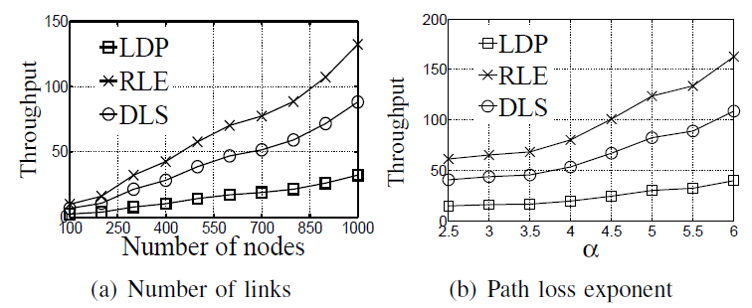
Performance Evaluation
Experimental results
Observation
1. Throughput follows RLE>LDP in both figures;
2. Throughput increases as # of links increases;
3. Throughput increases as the path loss exponent increases.
Notes:
We then measure the throughput of LDP and RLE.
These two figures show that the throughput follows RLE>LDP with different number of links or different values. Though LDP is a centralized algorithm, only the links in the same class with the same color can be scheduled at the same time. Though such a mechanism can prevent the conflict among the links, it reduces the number of links that can be scheduled simultaneously.
Fig (a) shows that the throughput increases as the number of links increases since more transmissions lead to higher throughput.
From Fig. 6(b), we find that the throughput increases as increases. For LDP, it is because when alpha increases, the partitioned square size decreases, which leads to more partitioned squares and hence more links to be scheduled. For RLE, it is because smaller alpha makes fewer nodes eliminated in each iteration.

Slide 21
Conclusions
Fading-R-LS formulation and analysis.
closed form of the probability distribution of received SINR
NP-hardness
LDP and RLE.
Approximation ratio
Experimental results: outperform the previous methods
Recursive link elimination algorithm (RLE). RLE iteratively picks up the unpicked link with the shortest link length and eliminates other links that interfere with the picked link.
Notes:
Conclusion: In this paper, by incorporating Rayleigh fading model into the link scheduling problem, we formulated a Fading-Resistant Link Scheduling problem (Fading-R-LS)
with the objective to maximize the network throughput. The challenge for this problem is its complicated judgment for a successful transmission.
As a solution, we derived the closed form of the probability distribution of the SINR received by each receiver, and found that checking transmission success is equivalent to checking whether the sum interference factor from all the senders to this receiver is lower than a threshold.
Based on this finding, we proved Fading-R-LS to be NP-hard and proposed two centralized algorithms (LDP and RLE).
Both theoretical analysis and experimental results demonstrate that LDP and RLE can substantially improve packet delivery ratio in fading environments compared to previous algorithms, and DLS performs even better than DLS in terms of throughput.
In our future work, we will further consider how to schedule all the links with the minimum number of time slots, not just to maximize the throughput in one time slot. We will also consider the SINR link scheduling problem in a general case not limited to the geometric model.

Slide 22
QUESTIONS ???
Thank you! Questions & Comments?

