Slide 1






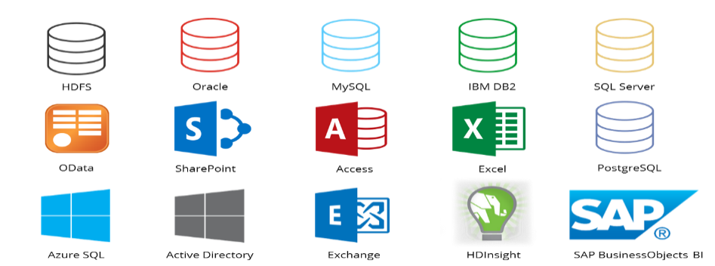




Job Scheduling for Data-Parallel Frameworks with Hybrid Electrical/Optical Datacenter Networks
Zhuozhao Li and Haiying Shen
Department of Computer Science, University of Virginia
zl5uq, hs6ms@virginia.edu
Background and Motivation
Design Objective
Job manager
Then, the job manager finds out the best (map-width, reduce-width) for the shortest completion time of each shuffle-heavy recurring job, and also generates the global schedule including which racks to run the map/reduce tasks of each recurring job, and the sequence to run the map/reduce tasks of recurring jobs in each rack that yields the best performance (i.e., high throughput for batch jobs and short completion time for online jobs).
Optical circuit switch (OCS) is a solution to increase network capacity with low CapEx and OpEx. Recently, several studies [1, 2, 3] propose to augment the traditional electrical packet switch (EPS) datacenter net-work with an on-demand rack-to-rack network using the OCS (namely Hybrid-DCN). In Hybrid-DCN, OCS can be used only for large data transfers (e.g., 1.125GB) between racks, so that the overhead (on the order of 𝜇𝑠-to-𝑚𝑠) used to reconfigure the input-to-output connections of OCS is negligible.
We aim to design a job scheduler for data-parallel frameworks in Hybrid-DCN. The job scheduler generates traffic matrices with properties that can take full advantage of the OCS, which maximizes the throughput and shortens the job completion time.
SchedOCS Design
Real-time scheduler
SchedOCS attempts to aggregate the shuffle data transfers of a job in order to use OCS effectively. SchedOCS consists of an offline scheduler and a real-time scheduler.
Based on the schedule from offline scheduler, the real-time cluster scheduler places the input data and schedules the recurring jobs to the racks accordingly. The non-recurring jobs then use the idle resources that are not assigned to the recurring jobs. As the recurring jobs can finish earlier by more efficiently utilizing OCS, it leaves more computing resources and network bandwidth to ad-hoc jobs for them to complete earlier.
EPS Core Switch
OCS
Offline scheduler
Job Profiler
ToR Switch
All feasible (map-width, reduce-width) pairs
$${bw}_{e}$$
Job Manager
References:
[1] K. Chen, A. Singla, A. Singh, K. Ramachandran, L. Xu, Y. Zhang, X. Wen, and Y. Chen. OSA: An optical switching architecture for data center networks with unprecedented flexibility. In Proc. of NSDI, 2012.
[2] N. Farrington, G. Porter, S. Radhakrishnan, H. H. Bazzaz, V. Subramanya, Y. Fainman, G. Papen, and A. Vahdat. Helios: A Hybrid Electrical/Optical Switch Architecture for Modular Data Centers. In Proc. of SIGCOMM, 2010
[3] G. Wang, D.G. Andersen, M. Kaminsky, K. Papagiannaki, TS Ng, M. Kozuch, and M. Ryan. c-Through: Part-time optics in data centers. In Proc. of SIGCOMM, 2010.
[4] V. Jalaparti, P. Bodik, I. Menache, S. Rao, K. Makarychev, and M. Caesar. Network-Aware Scheduling for Data-Parallel Jobs: Plan When You Can. In Proc. of SIGCOMM, 2015.
[5] M. Zaharia, D. Borthakur, S. Sen, K. Elmeleegy, S. Shenker, and I. Stoica. Delay scheduling: a simple technique for achieving locality and fairness in cluster scheduling. In Proc. of EuroSys, 2010.
Servers
Find the schedule that yields the best performance
$${bw}_{o}$$
Figure 1: Hybrid-DCN architecture.
Task placement strategy
Data placement strategy
Current job schedulers
Job schedulers for data-parallel frameworks must keep pace to meet the needs of such hybrid networks. However, current job schedulers for the data-parallel frameworks [4, 5] are not designed for the Hybrid-DCN and fail to use OCS to accelerate the data transfer. To take full advantage of Hybrid-DCN, we could aggregate the data to be transferred by placing the tasks of a job (e.g., map and reduce tasks in MapReduce) in only a few racks. However, it may sacrifice the basic principle of data-parallel frameworks – parallelism (i.e., the tasks of a job running concurrently). There is a tradeoff between parallelism and traffic aggregation. If a rack does not have sufficient available resources to run all the assigned tasks concurrently, it increases the latency of the job (i.e., the duration from the start of a job until its completion).
Real-time scheduler
Submit job
Upload data
Figure 2: System architecture.
Offline scheduler
Future Work
The offline scheduler is responsible for deciding the schedule for the recurring jobs in the next unit period and has two main components – job profiler and job manager.
Job profiler
The job profiler explores the tradeoff between parallelism and traffic aggregation, and returns all feasible (map-width, reduce-width) pairs of each shuffle-heavy recurring job that can leverage OCS effectively while achieving sufficient parallelism.
As the future work, we plan to implement and evaluate SchedOCS in simulation and real cluster.
Acknowledgments
This research was supported in part by U.S. NSF grants ACI-1719397 and CNS-1733596, and Microsoft Research Faculty Fellowship 8300751.

