Slide 1
Interactive Information Retrieval with Bandit Feedback
Huazheng Wang, Yiling Jia, Hongning Wang
Department of Computer Science
University of Virginia

Slide 2
Outline of this tutorial
Motivation
Background: bandit algorithms
Bandit learning for recommender systems
Bandit learning for retrieval systems
Ethical considerations in IR with bandit learning
Conclusion & future directions

Slide 3
Information retrieval is everywhere
A predominant interface between users and massive amount of information indexed in modern online systems
Check media feeds
Listen to music and podcasts
Attend to emails
Find a restaurant
Online shopping
Search online
Apply for jobs
Take courses

Slide 4
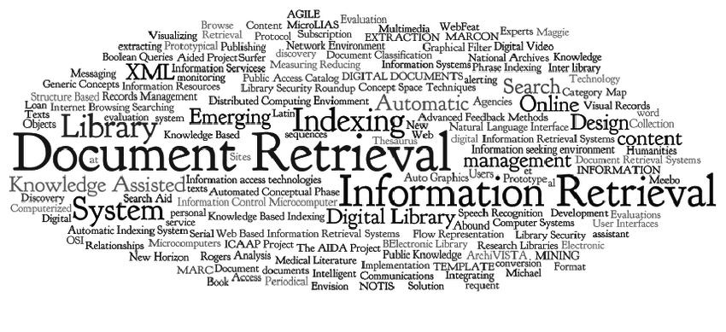
Goal of information retrieval
Satisfy users’ information need

Slide 5
Result ranking is essential
Probability ranking principle ^{[1]} – a theoretical justification
The overall utility of the system to its users is maximized when the results are ranked in a descending order of usefulness to the users
Sequential examination
Independent relevance evaluation

Slide 6
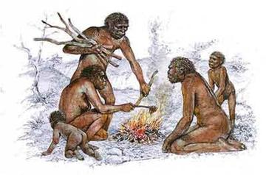
How do we rank results?
Classical IR methods
Document retrieval
BM25, language models, page rank
Recommendation
Content-based recommendation, collaborative filtering
Unsupervised, and rely on empirical parameter tuning

Slide 7
How do we rank results?
Learning-based methods
Document retrieval
Learning to rank
Recommendation
Latent factor models, neural network models
Supervised, hungry for labeled training data!

Slide 8
Learning from users’ implicit feedback
User behavior oriented result feedback
Low cost
Large scale
Natural usage context and utility

Slide 9
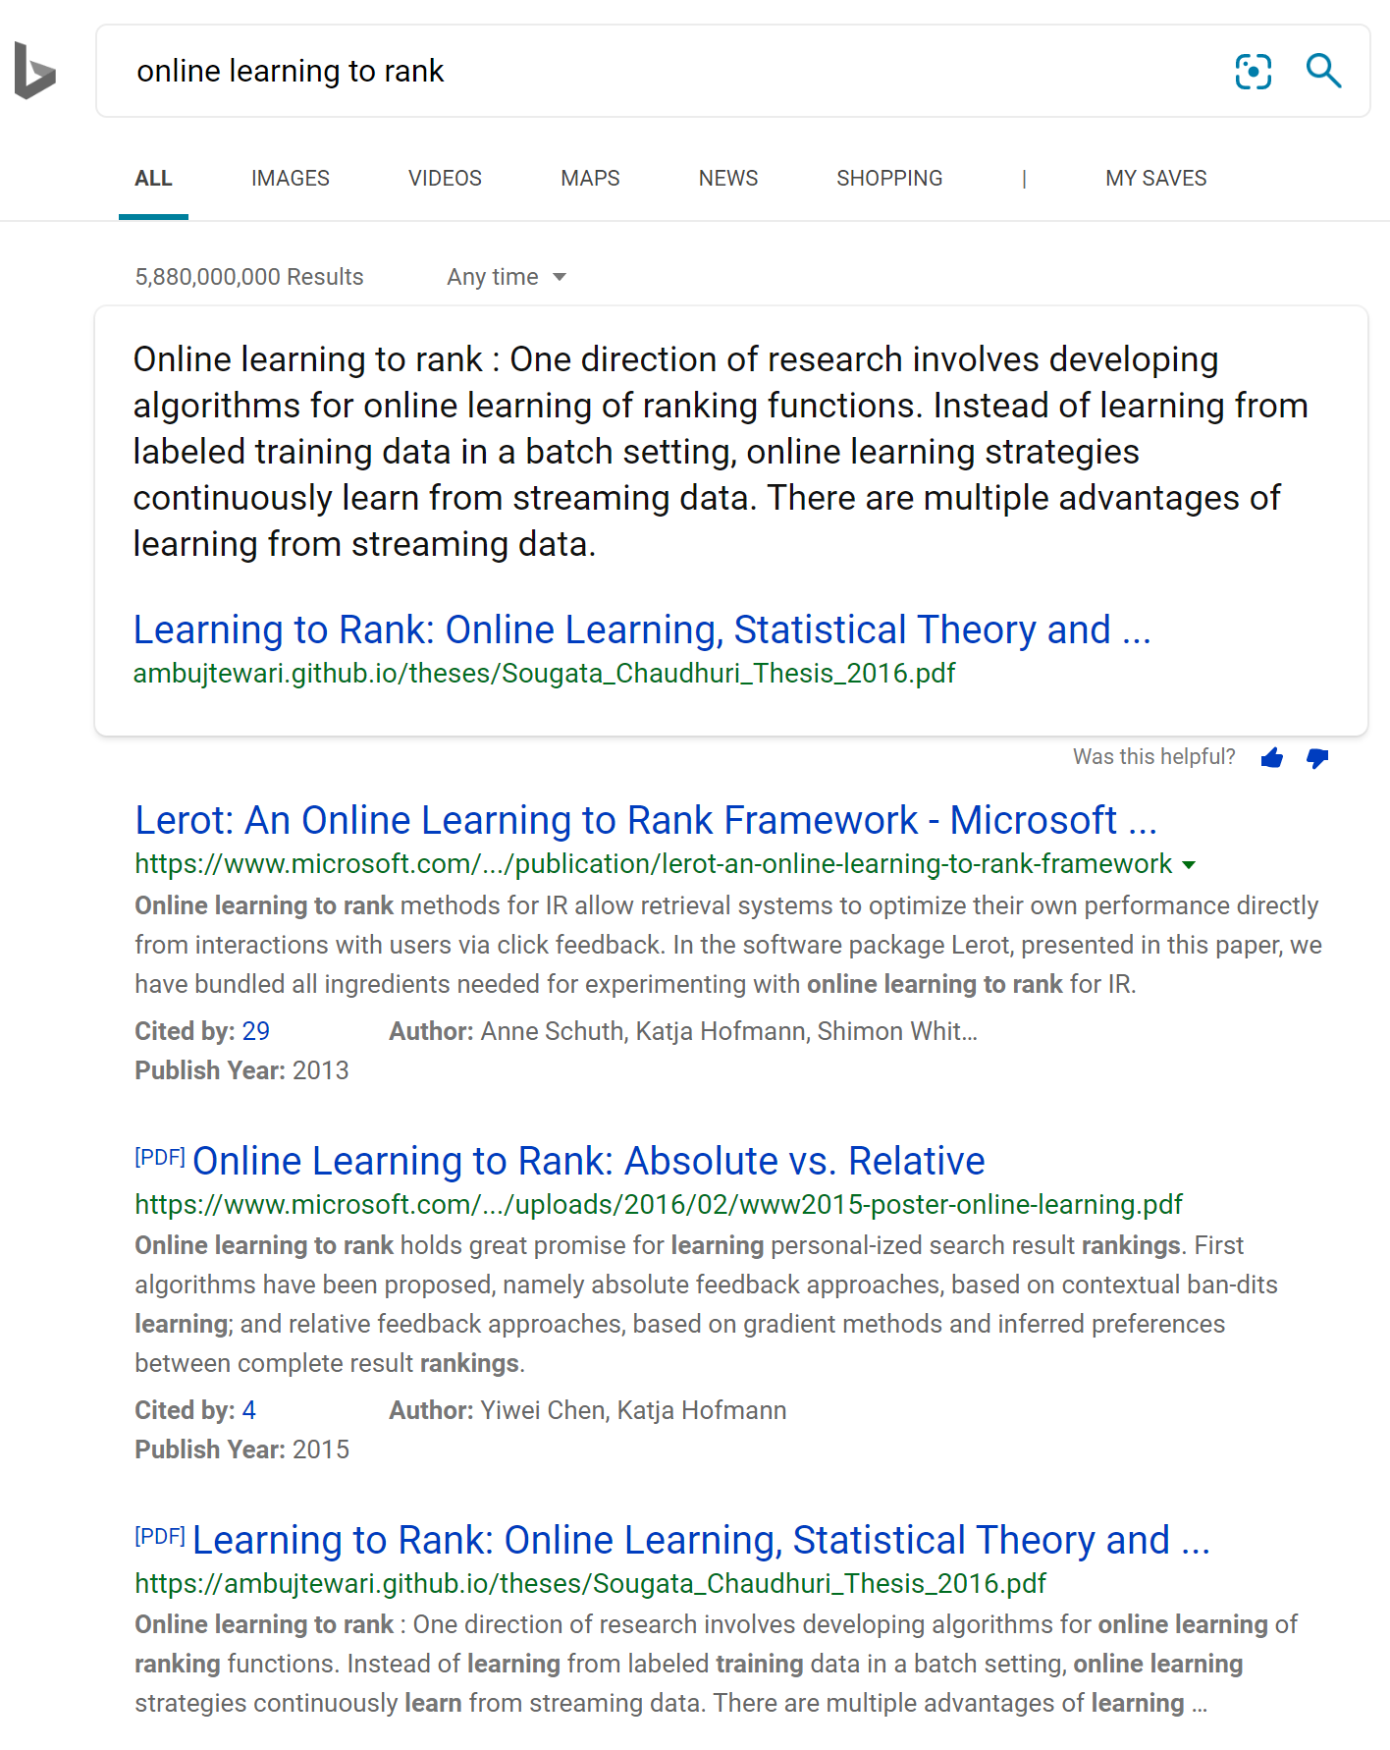
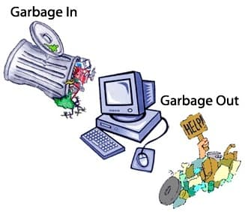
Interactive information retrieval
Learning by interacting with users
Eliminates offline methods’ heavy dependency on manual relevance annotations
NOT simply update an offline model online
Various types of biases in users’ feedback
d1
d3
d4
d2

Slide 10
Limitations in users’ implicit feedback
In a recommender system
Presentation bias
Horror
Romance
Drama
Figure credit: Schnabel et al. 2016 ^{[SSSCJ16]}
Matthew effect: we still don’t know what we don’t know!

Slide 11
Limitations in users’ implicit feedback
In a retrieval system
Position bias
Presentation bias
Trust bias

Slide 12
Interactive information retrieval
Learning by interacting with users
Eliminates offline methods’ heavy dependency on manual relevance annotations
NOT simply update an offline model online
Various types of biases in users’ feedback
Learning while serving the users
Exploitation
Exploration
Present the best results estimated so far to satisfy users
Present currently underestimated results to best improve the ranker
Interactive IR System

Slide 13
Efficient exploration is crucial
Huge search space
Exploration is costly
Even the offline IR models are NOT immune to this!

Slide 14
Efficient exploration is crucial
One only gets answers to the questions she asked
Bandit feedback
Horror
Romance
Drama

Slide 15
Efficient exploration is crucial
The problem space can be structured
The observations might not be independent
Clustered, correlated responses?
Horror
Romance
Drama
Social influence?
Figure credit: Schnabel et al. 2016 ^{[SSSCJ16]}

Slide 16
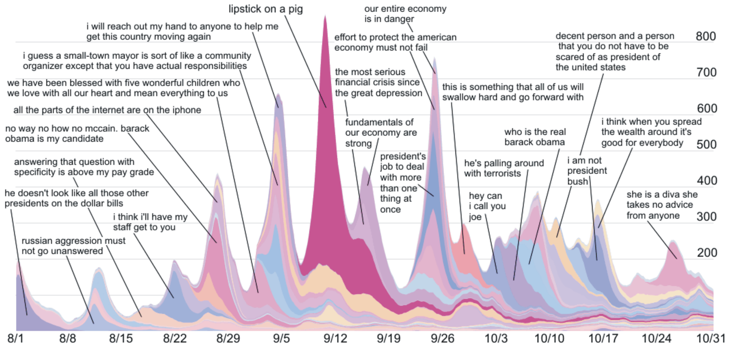
Efficient exploration is crucial
The problem space is evolving over time
Any real-world environment is non-stationary
Recognize outdated model is important

Slide 17
Exploration also induces risks
There are also privacy, fairness, and ethic concerns in exploration

Slide 18
Outline of this tutorial
Motivation
Background: bandit algorithms
Bandit learning for recommender systems
Bandit learning for retrieval systems
Ethical considerations in IR with bandit learning
Conclusion & future directions

Slide 19
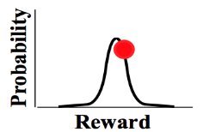
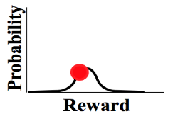
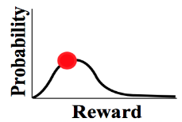
Problem formulation
(stochastic) Multi-arm bandit
…
Goal: maximize the accumulated reward over T rounds
Reward distribution
…
Actions
Agent/learner/policy
Reward
Map it to an IR problem (e.g., recommender systems):
Environment: a user or users
Actions/arms: recommendation candidates
Reward: click, purchase
Agent: recommendation algorithm
History

Slide 20
Problem formulation
(stochastic) Multi-arm bandit
…
Goal: maximize the accumulated reward over T rounds
Reward distribution
(Pseudo) Regret: expected loss due to not playing the best arm
…
Actions
Regret
Agent/learner/policy
Reward
Lower regret bound [LR85]:
Lower regret bound [Aue95]:
Time
History
Finite variance is required!
Sub-linear regret is preferred!
Difficulty of the problem

Slide 21
Problem formulation
In linear contextual bandit [LCLS10],
Contextual/structured bandit
…
Goal: maximize the accumulated reward over T rounds
Reward distribution
(Pseudo) Regret: expected loss due to not playing the best arm
…
Actions
Agent/learner/policy
Reward
Lower regret bound in linear contextual bandit [CLRS11]:
History

Slide 22
Problem formulation
Out of scope of this tutorial
Reinforcement learning [SB18]
State
Reward
Action

Slide 23
Problem formulation
In linear contextual bandit [LCLS10],
Ridge regression, closed form solution exists!
Key problems
Reward estimation
Arm selection
Reward
Action
Convergence matters!
Exploration matters!
Multi-arm bandit:
Contextual bandit:
Adaptive v.s., non-adaptive
Independent v.s., collaborative
Unconstrained v.s., constrained
Loss function Regularization

Slide 24
Problem formulation
Map to IR problems
Reward estimation
Document retrieval: document relevance under a given query
Recommendation: item utility for a given user
Arm selection
Document retrieval: ranked list of documents (i.e., top-k ranking)
Recommendation: the item of choice (i.e., top-1 ranking)

Slide 25
Classical bandit learning algorithms
Random exploration
Optimism in the face of uncertainty
Posterior sampling
Perturbation-based

Slide 26
Random exploration
Lower regret bound of MAB:
Reward estimation in MAB:
Constant leads to linear regret!
$ε$-greedy [Aue02]
By setting , we have
Arm selection
Non-adaptive; often leads to sub-optimal performance in practice.

Slide 27
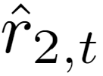
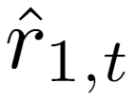
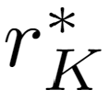
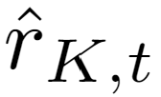
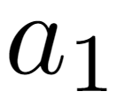
Optimism in the face of uncertainty
Chernoff-Hoeffding bound
Lower regret bound of MAB:
UCB1 [Aue02]
Upper confidence bound based
Reward
Encourage underestimated arms
…

Slide 28
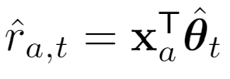
Optimism in the face of uncertainty
Lower regret bound in linear contextual bandit [CLRS11]:
In linear contextual bandit,
LinUCB [LCLS10]
Upper confidence bound based
Confidence ellipsoid
Reward
Encourage underestimated arms
…
Closed form estimator

Slide 29
Optimism in the face of uncertainty
In generalized linear bandit,
In linear contextual bandit [LCLS10],
GLM-UCB [FCGS10]
A generalized linear model
Link function, e.g.,
Confidence ellipsoid
Reward
Encourage underestimated arms
No closed form solution for
…
Using gradient descent to solve
where

Slide 30
Posterior sampling
In linear contextual bandit [LCLS10],
Predictive distribution:
Thompson sampling [AG13]
Source of uncertainty
A Bayesian perspective of reward estimation:
prior
related to prior
Reward
…
Analytic form of posterior
Prior:

Slide 31
Posterior sampling
No formal regret known yet; and some analysis from Bayesian regret perspective
Thompson sampling [RVKOW18]
No analytic posterior?
Approximate posterior inference!
Gibbs sampling
Particle sampling
Laplace approximation
Bootstrapping

Slide 32
References I
[SSSCJ16] Schnabel, T., Swaminathan, A., Singh, A., Chandak, N., & Joachims, T. (2016, June). Recommendations as treatments: debiasing learning and evaluation. In Proceedings of the 33rd International Conference on International Conference on Machine Learning-Volume 48 (pp. 1670-1679).
[LR85] Lai, T. L., & Robbins, H. (1985). Asymptotically efficient adaptive allocation rules. Advances in applied mathematics, 6(1), 4-22.
[Aue95] Auer, P., Cesa-Bianchi, N., Freund, Y., & Schapire, R. E. (1995, October). Gambling in a rigged casino: The adversarial multi-armed bandit problem. In Proceedings of IEEE 36th Annual Foundations of Computer Science (pp. 322-331). IEEE.
[LCLS10] Li, L., Chu, W., Langford, J., & Schapire, R. E. (2010, April). A contextual-bandit approach to personalized news article recommendation. In Proceedings of the 19th international conference on World wide web (pp. 661-670).
[CLRS11] Chu, W., Li, L., Reyzin, L., & Schapire, R. (2011, June). Contextual bandits with linear payoff functions. In Proceedings of the Fourteenth International Conference on Artificial Intelligence and Statistics (pp. 208-214).
[SB18] Sutton, R. S., & Barto, A. G. (2018). Reinforcement learning: An introduction. MIT press.
[Aue02] Auer, P. (2002). Using confidence bounds for exploitation-exploration trade-offs. Journal of Machine Learning Research, 3(Nov), 397-422.
[LZ08] Langford, J., & Zhang, T. (2008). The epoch-greedy algorithm for multi-armed bandits with side information. In Advances in neural information processing systems (pp. 817-824).
[FCGS10] Filippi, S., Cappe, O., Garivier, A., & Szepesvári, C. (2010). Parametric bandits: The generalized linear case. In Advances in Neural Information Processing Systems (pp. 586-594).
[GC11] Garivier, A., & Cappé, O. (2011, December). The KL-UCB algorithm for bounded stochastic bandits and beyond. In Proceedings of the 24th annual conference on learning theory (pp. 359-376).

Slide 33
References II
[AG13] Agrawal, S., & Goyal, N. (2013, February). Thompson sampling for contextual bandits with linear payoffs. In International Conference on Machine Learning (pp. 127-135).
[RVKOW18] Russo, D. J., Van Roy, B., Kazerouni, A., Osband, I., & Wen, Z. (2018). A Tutorial on Thompson Sampling. Foundations and Trends® in Machine Learning, 11(1), 1-96.
[KSGB19a] Kveton, B., Szepesvári, C., Ghavamzadeh, M., & Boutilier, C. (2019, August). Perturbed-history exploration in stochastic multi-armed bandits. In Proceedings of the 28th International Joint Conference on Artificial Intelligence (pp. 2786-2793). AAAI Press.
[KSGB19b] Kveton, B., Szepesvari, C., Ghavamzadeh, M., & Boutilier, C. (2019). Perturbed-history exploration in stochastic linear bandits. arXiv preprint arXiv:1903.09132.
[KMRWW18] Kannan, S., Morgenstern, J. H., Roth, A., Waggoner, B., & Wu, Z. S. (2018). A smoothed analysis of the greedy algorithm for the linear contextual bandit problem. In Advances in Neural Information Processing Systems (pp. 2227-2236).

Slide 34
Outline of this tutorial
Motivation
Classical exploration strategies
Efficient exploration in complicated real-world environments
Exploration in non-stationary environments
Ethical considerations of exploration
Conclusion & future directions

Slide 35
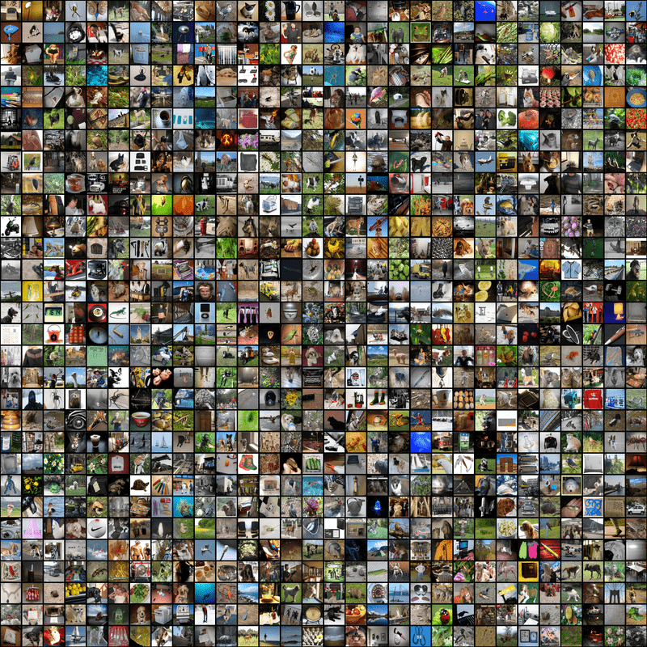
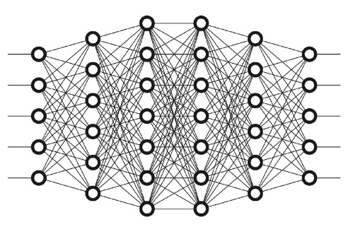
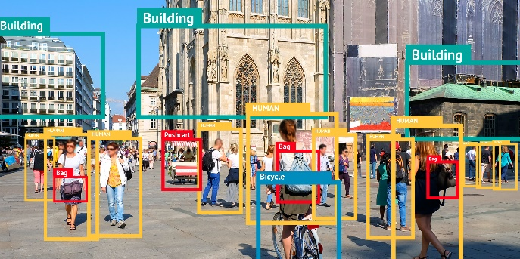
Conclusions
Learning by exploration
Efficiency matters
Accuracy matters
Training
Inference
Exploration matters
Knowing what we do not know

Slide 36
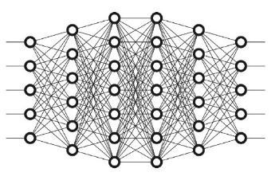
Future research directions
Going beyond linear models
How about deep models?
Reward
Action
Convergence matters!
Exploration matters!
Some preliminary studies exist: [ZLG19, AFB14]

Slide 37
Future research directions
Online deployment
Policy update driven by every interaction in real-time
Reward
Action
Convergence matters!
Exploration matters!
Some recent work: [WHCW19, KSL16, MWLS20]

Slide 38
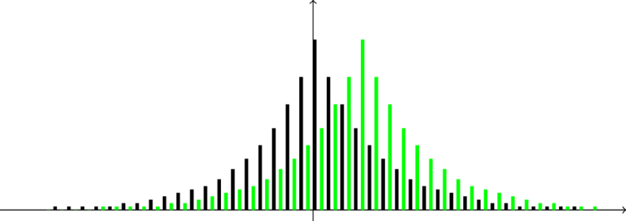
Future research directions
Learning under adversarial contexts
Privacy breach under extraction attacks
Exploration reconciles the need for learning and the need for privacy protection
[CKNFS11, Kor10]

Slide 39
Future research directions
Learning under adversarial contexts
Robustness under poisoning attacks
Action
Action
Feedback
Feedback
Action
Feedback
Randomness in exploration hardens the model against adversary; dependence structure among users improves privacy utility trade-off.

Slide 40
Future research directions
Incentivize the exploration
No regret under information gap
Latent factors
Semantic features
{Romance, Cameron}
Explanations?
{Drama, Damon}
{Drama, Korean}

Slide 41
References VII
[ZLG19] Zhou, D., Li, L., & Gu, Q. (2019). Neural Contextual Bandits with Upper Confidence Bound-Based Exploration. arXiv preprint arXiv:1911.04462.
[AFB14] Allesiardo, R., Féraud, R., & Bouneffouf, D. (2014, November). A neural networks committee for the contextual bandit problem. In International Conference on Neural Information Processing (pp. 374-381). Springer, Cham.
[WHCW19] Wang, Y., Hu, J., Chen, X., & Wang, L. (2019). Distributed bandit learning: Near-optimal regret with efficient communication. arXiv preprint arXiv:1904.06309.
[KSL16] Korda, N., Szorenyi, B., & Li, S. (2016, June). Distributed clustering of linear bandits in peer to peer networks. In International Conference on Machine Learning (pp. 1301-1309).
[MWLS20] Mahadik, K., Wu, Q., Li, S., & Sabne, A. (2020, June). Fast distributed bandits for online recommendation systems. In Proceedings of the 34th ACM International Conference on Supercomputing (pp. 1-13).
[CKNFS11] Calandrino, J. A., Kilzer, A., Narayanan, A., Felten, E. W., & Shmatikov, V. (2011, May). " You might also like:" Privacy risks of collaborative filtering. In 2011 IEEE symposium on security and privacy (pp. 231-246). IEEE.
[Kor10] Korolova, A. (2010, December). Privacy violations using microtargeted ads: A case study. In 2010 IEEE International Conference on Data Mining Workshops (pp. 474-482). IEEE.

Slide 42
Acknowledgement
IIS-1553568
IIS-1618948

Slide 43
Back-up slides
Simulation-based evaluation
Simulate the non-stationary environment
Semi-simulation-based evaluation
Real-world datasets (that do not have non-stationarity) + simulated changes
Evaluation on real-world datasets
On real-world datasets that have non-stationarity
Non-stationary environments

Slide 44
Empirical evaluations
Simulation-based evaluation
Simulate the non-stationary environment
Semi-simulation-based evaluation
Real-world datasets (that do not have non-stationarity) + simulated changes
Evaluation on real-world datasets
On real-world datasets that have non-stationarity
Non-stationary environments

Slide 45
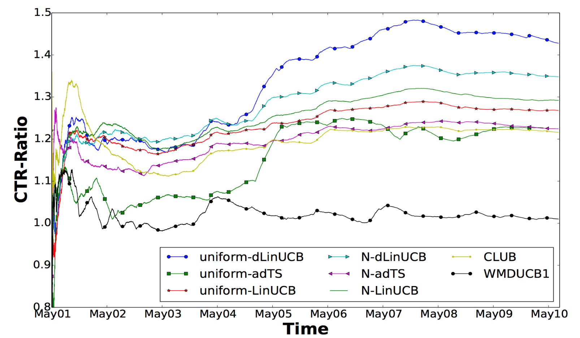
Empirical evaluations
Yahoo! Today Module
dLinUCB
LinUCB
adTS
WMDUCB1
Figure 4. Real time CTR ratio in 10 days on Yahoo dataset
Non-stationary environments

Slide 46
Empirical evaluations
LastFM dataset
Simulate a non-stationary environment by attaching different users’ observations[]
Change Points
Non-stationary environments

Slide 47
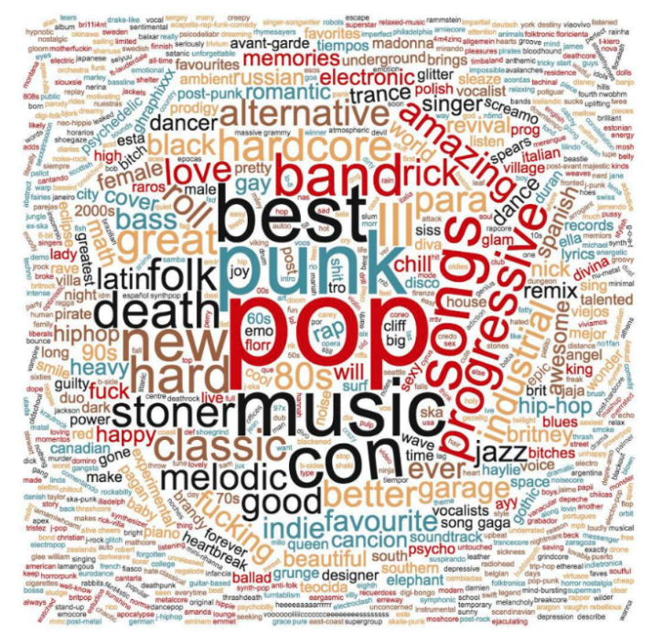
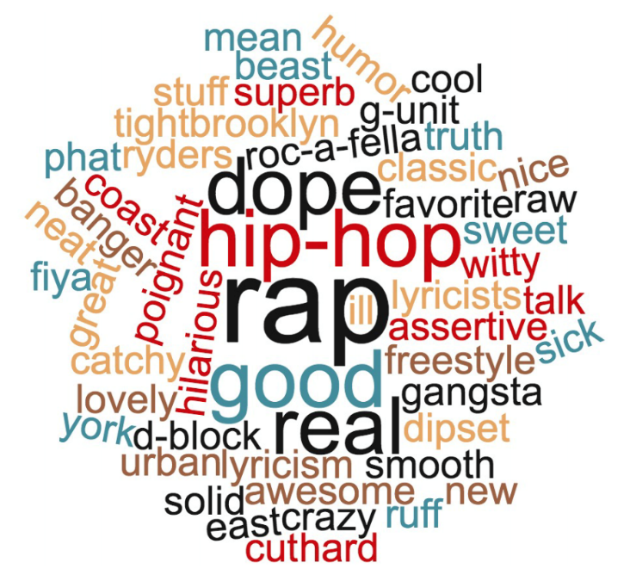
Empirical evaluations
Figure 5. Word cloud of tags from high reward actions in the four identified environments by dLinUCB on LastFM dataset.
Non-stationary environments

Slide 48
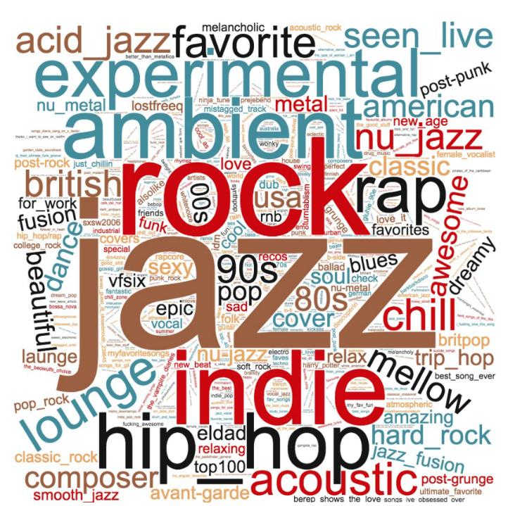
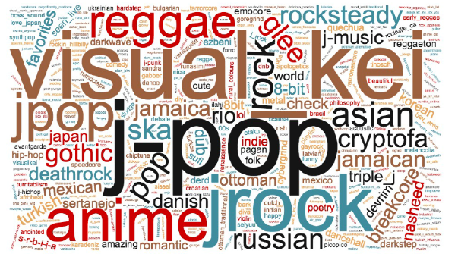
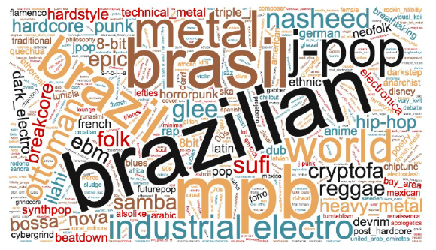
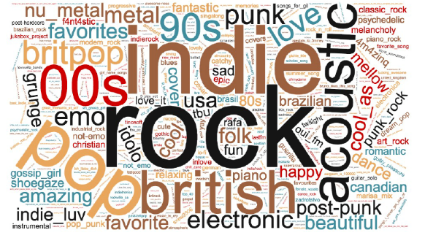
Empirical evaluations
Learner 1
Learner 2
Change-invariant actions
Change-invariant actions
change sensitive actions
change sensitive actions
Figure 5. Word cloud of tags from high reward actions in the four identified environments by dLinUCB on LastFM dataset.
Non-stationary environments

