Slide 1
Outline of this tutorial
Motivation
Background: bandit algorithms
Bandit learning for recommender systems
Bandit learning for retrieval systems
Ethical considerations in IR with bandit learning
Conclusion & future directions

Slide 2
Bandit learning for retrieval systems
Why the bandit algorithms for recommendation systems do not apply?
Recommender systems
Top-1 ranking
Treat each item as an arm
Linear exploration space
Presentation bias
No position bias, as the recommended item will always be examined
Retrieval systems
Top-K ranking
Treat each ranking as an arm?
Exponential exploration space
Presentation bias
Position bias due to users’ examination behavior on a ranked list

Slide 3
Online learning to rank
OL2R under specific click models
Dueling bandit gradient descent
Online pairwise methods
OL2R vs. offline unbiased learning to rank

Slide 4
OL2R under specific click models
Assume users’ behavior follows some specific click models, e.g., cascade model, position-based model
Deal with the exponential ranking space document space

Slide 5
Cascading bandits [KSWA15]
Cascade model is a popular model of user behavior in web search
A set of L documents
Attraction probabilities
User sequentially scan a list of $K$ documents
Document is not attractive with prob
User examine item
User examine document
There is at most one click
Attracted with prob
Click on document
User exits the system

Slide 6
Cascading bandits
Compute UCB on the attraction probability of each document.
Rank the documents according to UCB and return the top-K documents.
One model for each query
Interaction at time $t:$
Environment draws attraction weights $w_{t}$ for $L$ candidates
The model chooses an ordered list of $K$ documents,
User clicks first attractive item in $π_{t}$, $C_{t}$
Update the weights of all observed items according to the feedback
Learning agent receives reward $f(π_{t}, w_{t})$
Goal: minimize the expected cumulative regret over $T$ steps
At least one document is attractive.
The probability that none of the K documents is attractive.

Slide 7
DCM bandits [KKSW16]
Dependent click model (DCM)
Extend from cascade model where user may click on multiple documents
Attraction probability:
termination probability:
Position-dependent
Document is not attractive with prob
User examine item
User examine document
Attracted with prob
unsatisfied with prob
Click on document
User exits the system
satisfied with prob

Slide 8
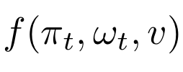
DCM bandits [KKSW16]
Dependent click model (DCM)
Extend from cascade model where user may click on multiple documents
Attraction probability:
termination probability:
The probability that at least one document in $π$ is satisfactory:
At each step, select the list that maximizes
Position-dependent

Slide 9
TopRank: OL2R by topological sort [LKLS18]
Observation: no single existing click model captures the behaviors of an entire population of users
Motivation: to eliminate the dependency on click models, TopRank assumes,
The click probability does not factor into the examination probability of the position and the attractiveness of the documents at that position
an unknown function

Slide 10
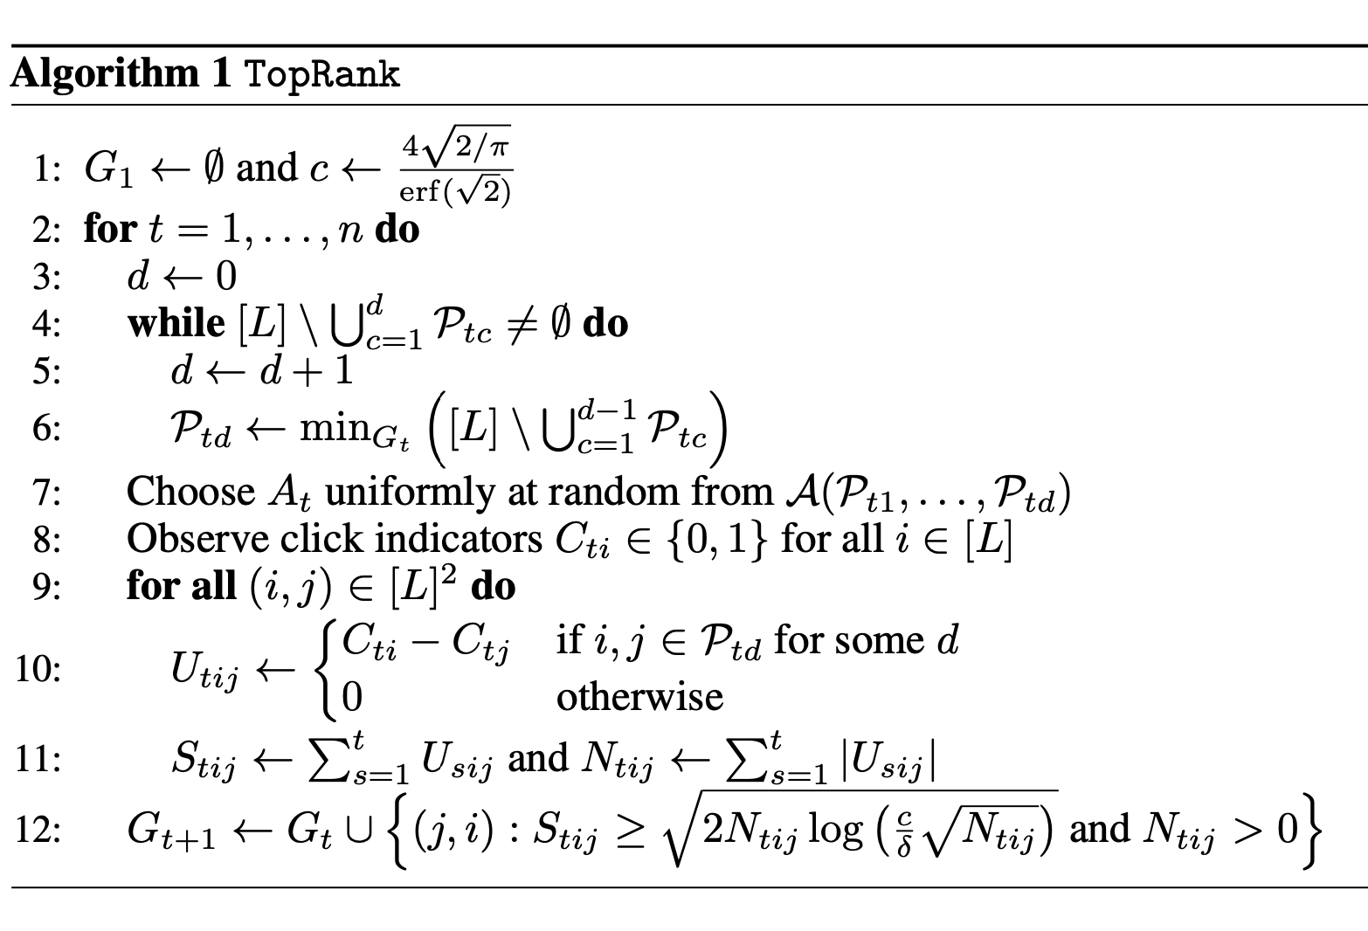
TopRank: OL2R by topological sort
The difference of the feedback received by document $i$ and $j$ at round $t$
The cumulative difference of the feedback received by document $i$ and $j$until $t$
Document pair $(j, i)$is added to $G_{t}$ when item $i$ receives sufficiently more clicks than $j$

Slide 11
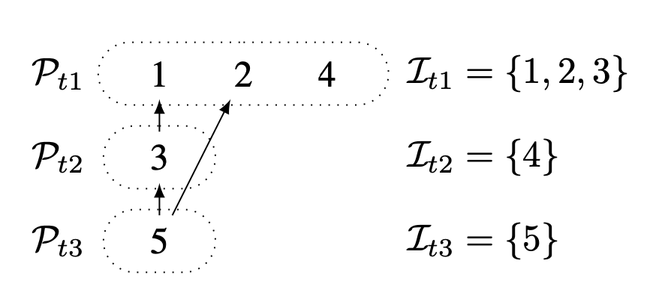
TopRank: OL2R by topological sort
Ranking example
i.e., Sufficient observations are received that document 1 is better than document 3
One possible ranking: 2, 1, 3, 4, 5

Slide 12
Mini summary
Cascading bandits
Assume user behavior follows cascade model: only one click
Maximize the probability that at least one document is attractive
DCM bandits
Assume user behavior follows DCM model to allow multiple clicks
Maximize the probability that at least one document is attractive
TopRank
No specific click model assumption
Rank documents with topological sort with respect to the confidence of the preference between documents

Slide 13
Dueling bandit gradient descent [YJ09]
DBGD is built on interleaving, an online evaluation method for rankings
Infer preference between two ranking lists based on clicks on the interleaved ranking
DBGD: online gradient descent based on the inferred preference between models explore the model space
Ranking A
d1
Interleaved ranking
d2
d3
d4
d1
Ranking A receives one click. Ranking B receives two clicks.
d3
d2
d1
d4
Winner!
Ranking B
d3
d2
d4

Slide 14
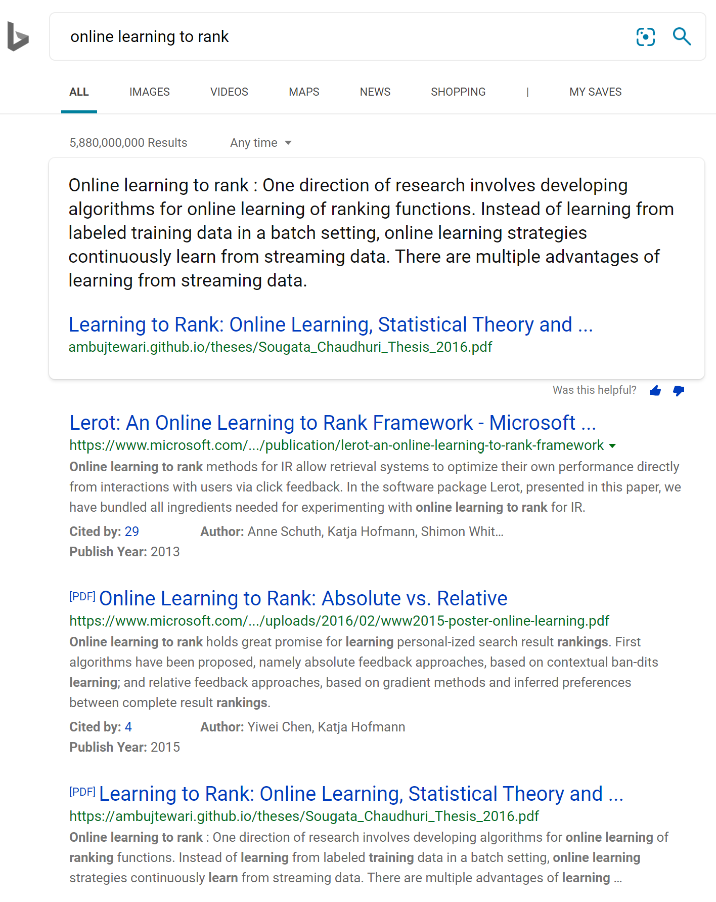
Dueling bandit gradient descent [YJ09]
Interleaving method offers a reliable mechanism for deriving relative preferences between retrieval functions
d1
d3
d1
Dueling Bandit Gradient Descent
d4
d2
d2
d3
d4
d1
d3
d1
d2
d3
d4
d1
d4
d3
d2
d2
d4

Slide 15
Dueling bandit gradient descent [YJ09]
Unform exploration by random sampling: unbiased gradient estimation
Perform online gradient descent in expectation
DBGD has a sublinear regret upper bound:
Regret:
$d$ is the number of feature dimensions, T is the number of interaction rounds
$ε$ quantify the difference between two models
d1
Problems:
One single direction is explored at a time
$μ_{t}$ is uniformly sampled in the d-dimension feature space: high variance and slow convergence
d3
d4
d2

Slide 16
Multileave gradient descent [SOWR16]
Compared to DBGD, MGD explores multiple directions uniformly from parameter space simultaneously
Reduce the updates
Multileaved comparison among candidate rankers
d1
d1
d2
d3
Winners are
Winner takes all: randomly choose one winner
Mean winner: compute the mean of the winner
d2
d3
d1
d1
d3
d2
d3
d4
d4
d4
d4
d2
d3
d1
d2
d4

Slide 17
Dual-Point DBGD [ZK16]
Dual-Point DBGD: explore two opposite directions simultaneously
Explore more efficiently than DBGD
Reduce uncertainty in the exploration with MGD
d1
d1
d2
d2
d3
d1
d3
d2
d3
d4
d4
d4
Update the model
d2
d1
d3
d4

Slide 18
Null space gradient descent [WLKMW18]
Intuition: avoid making similar mistakes again
Null space exploration:
Maintain a collection of recently explored gradients that performed poorly
Sample new directions from the null space of these gradients
Avoid repeatedly exploring poorly performing directions
Top K worst performing historical directions:
At time $t$, sample $μ_{t}$ from

Slide 19
Null space gradient descent [WLKMW18]
Intuition: avoid making similar mistakes again
Context-dependent ranker preselection
Construct the candidate ranker to maximize the chance that thy can be differentiated from the current ranker
At time $t$, sample ${\left\{μ_{t}^{i}\right\}}_{i=1}^{n}$ from
Select top $m$ directions that maximize $|{\overline{x}}^{T}μ_{t}^{i}|$ from ${\left\{μ_{t}^{i}\right\}}_{i=1}^{n}$
$θ_{t}$ and $θ_{t}^{1}$ rank the candidate documents in the same order
No interleaved test can differentiate the ranking quality for current query
NSGD favors $θ_{t}^{2}$ as it ranks the documents in a different order than $θ_{t}$
d1
d1
d3
d1
d1
d2
d2
d3
d4
d3
d3
d2
d2
d4
d4
d4

Slide 20
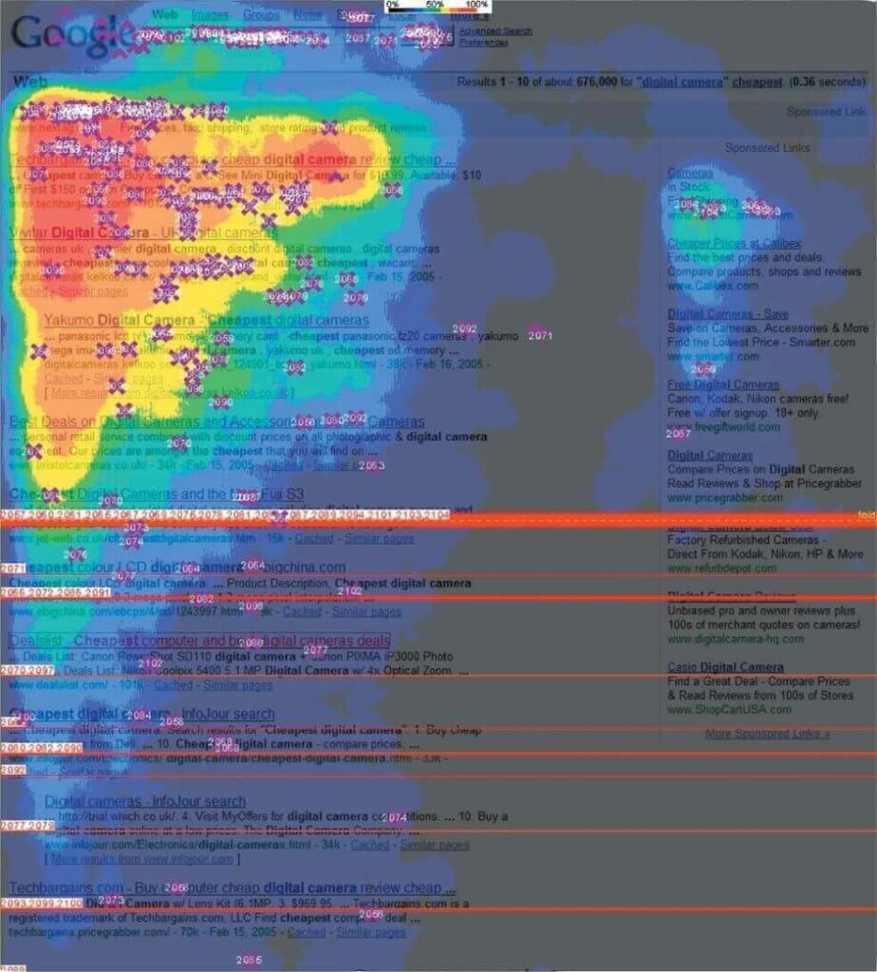
DBGD-document space projection [WKMWW19]
Observation: users only examine $m$ documents ($m ≪d$)
Intuition: only consider the gradient belongs to the document space
Figure credit: Baeza-Yates, 2018 ^{[3]}

Slide 21
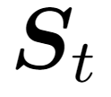
DBGD-document space projection [WKMWW19]
Observation: users only examine $m$ documents ($m ≪d$)
Intuition: only consider the gradient belongs to the document space
Considerable regret reduction:
1000s 10s
Uniformly sampled!
d1
d3
d2
d4
d1
d3
d2
d4

Slide 22
Mini summary
Explore in the entire model space
DBGD: randomly sample one single direction
MGD: randomly sample multiple directions
DP-BGD: randomly sample two opposite directions
NSGD: maintain a set of “bad” directions, and sample from the null space of them
DBGD-DSP: project the gradient into document space and use it to update model
DBGD and its extensions
Explore in the entire model space
High variance and slow convergence
The assumption for theoretical analysis does not hold for all models
There is a single optimal model
The utility space is smooth

Slide 23
PDGD [OR18]
Pairwise differentiable gradient descent
Optimize a Plackett Luce ranking model, which models a probabilistic distribution over documents
Infer the preference between document pairs
Intuition: provide an unbiased pairwise gradient to update the ranking model

Slide 24
PDGD [OR18]
At each time $t$
Observe user query
Sample a ranking from the document distribution:
Present the ranking to the user
Infer pairwise preference from user clicks
d1
d2
d3
d4
$d_{i}$receives click and $d_{j}$ does not receive click.
Biased!!
Some preferences are more likely to be observed due to position/selection bias.

Slide 25
PDGD [OR18]
At each time $t$
Observe user query
Sample a ranking from the document distribution:
Present the ranking to the user
Infer pairwise preference from user clicks
Update model according to the estimated unbiased pairwise gradient:
d1
d2
d3
d4
Weighting function to deal with bias: the ratio between the probability of the ranking and the reversed pair ranking
Compared to $π_{t}$, $d_{i}$ and $d_{j}$ are swapped.
The presented ranking

Slide 26
PairRank [JWGW21]
Online learning to rank by divide-and-conquer
Key insights:
A complete ranking can be decomposed into a series of pairwise comparisons
Only explore the pairs the ranker is currently still uncertain about the order
Divide-and-Conquer
Reduce exponentially sized action space to quadratic
1
Uncertain rank orders
2
1
2
Explore the uncertain rank orders
Exploit the certain rank orders
Document graph
3
5
3
4
5
4
5
Notes:
In this work, we propose to perform the pairwise exploration with respect to the ranker’s current estimation uncertainty.
The key insight is for any ranking list, it can be decomposed into a series of pairwise comparisons.
Based on the model’s uncertainty, we only need to explore the document pairs that the ranker is still uncertain about the order
For example, suppose we have the docuemtn grepah where each node presenting a document, and the link between them represents the stimated preference. The lblack lin represents the stimation is certain , while the red dash lin indicates the ranker is still uncertain about the estimation. For all the uncertain rank orders, we perform the exploration, while for all the certain rank order, we perform the exploitation. We can later construct the ranked list by a divide-and conquer strategy.
This would reduce the exponentially sized action space to quadratic.

Slide 27
Pairwise learning to rank
Learn a pairwise ranking model online
Ranking model: a single layer RankNet[10] model with sigmoid activation function
Loss function at time t:
Regularization term
Training data observed so far
$x_{ij}^{s}=x_{i}^{s}−x_{j}^{s}$: feature difference between document i and document j
$y_{ij}^{s}$: whether the document i is preferred over document j in the click feedback
Sigmoid function to model the pairwise preference probability:$σ\left(s\right)= \frac{1}{1+exp⁡(−s)}$
Notes:
For the model training we adopted a single layer rank net model with sigmoid activation function the loss function at the time T
….
By optimizing the objective function, we can get the ranking model learned so far.

Slide 28
Pairwise estimation uncertainty
Pairwise feedback is noisy:
Given the documents are examined, the click feedback is independent from each other
Confidence interval of pairwise preference estimation
At round t, with probability at least $1 − δ_{1}$,
Covariance matrix constructed with previous observations
Estimated pairwise preference between i and j
Ground truth pairwise preference between i and j
Notes:
However the estimated model is uncertain
the main reason is the pairwise of feedback is noisy /
Given the document is examined, the feedbacks that the examined documents received are independent from each other
Therefore, the pairwise feedback can be modelled with the optimal preference and the pairwise noise, which follows a sub-gaussian distribution.
in this case the confidence interval of the estimation would have a high probability upper bound.

Slide 29
Certain rank order & uncertain rank order
With high probability, the optimal value belongs to
Pairwise preference estimation
Estimation uncertainty
Uncertain rank order:
true preference may present an opposite order from the estimated order.
Estimated pairwise preference
1.0
$$CB_{ij}^{t}$$
$$CB_{i^{′}j^{′}}^{t}$$
Certain rank order:
true preference is consistent with the estimated preference: $i ≻j$.
$$σ({x_{ij}^{t}}^{T}θ_{t})$$
estimated preference: $i^{′} ≻j^{′}$
$$CB_{ij}^{t}$$
$$σ({x_{i^{′}j^{′}}^{t}}^{T}θ_{t})$$
0.5
$$CB_{i^{′}j^{′}}^{t}$$
true preference might be: $j^{′} ≻i^{′}$
$$σ(0)$$
Lower confidence bound
document pair (i, j)
document pair (i’, j’)
Notes:
Therefore, with a high probability the optimal value of the pairwise preference belongs to this term, where the sigmoid value represents the estimated pairwise preference and the CB represents the estimation uncertainty.
now let's see an example suppose we have two document pairs document I, j and document I’,j’.
blue bar is estimated value and grey rectangular is the confidence interval.
The estimated pairwise preference indicates the probability that the first document is more relevant than the second one under the given query. With probability 0.5, it means the two documents will have the same relevance.
for document pair I and j, we consider the estimated pairwise preference is certain because its lower confidence bound of the estimation is larger than 0.5 which means the true preference will also be consistent with the estimated one
while for document I’ and j’, we would consider the estimation is uncertain because the estimated preference is I’ better than j’ , however the true preference might fall into this area where document j’ is more relevant than document I’, which means true preference may present an opposite order from the estimated one . And we need to explore this pair for more information.

Slide 30
PairRank: explore via divide and conquer
1
Block 1
Block 1
2
1
2
1
2
2
1
Block 2
Block 2
4
3
3
3
3
4
4
5
4
5
5
5
Document graph
Uncertain order graph
Block graph
Ranked list (possible one)
Constructed with the certain and uncertain rank orders between document pairs.
Explore the uncertain rank orders: construct blocks with the connected components.
Topological sort between blocks: exploit the certain rank orders.
Randomly shuffle the order of documents within each block: explore the uncertain rank orders.

Slide 31
Pairwise regret
Pairwise regret for OL2R
The cumulative number of mis-ordered pairs from the presented ranking to the ideal one, i.e., the Kendall tau rank distance
Most ranking metrics deployed in real-world retrieval systems, such as ARP and NDCG, can be decomposed into pairwise comparisons
Sublinear upper regret bound of PairRank:
Notes:
To evaluate the theoretical property of the proposed pairrank, we first proposed a pairwise regret defined for online learning to rank with the cumulative number of miss ordered pairs from the presented ranking to the ideal one.
As most ranking metrics employed in real world retrieval systems can be decomposed into pairwise comparisons, our defined regret directly connects the online learning to rank algorithm’s online performance with classical ranking evaluations
we prove a sublinear upper regret bound of PairRank.

Slide 32
OL2R vs. offline unbiased L2R
Goal: to find the best models that rank documents based on their utility
Learn from user interactions, implicit feedback, e.g., clicks

Slide 33
OL2R vs. offline unbiased L2R
OL2R
Interactively optimize and update a ranking model after every interaction
Combat bias by interventions, i.e., exploration
User experience might be hurt due to exploration
Offline unbiased L2R
Learn a ranking model from a historical interaction log
Remove data bias by re-weighting strategies
There is no presentation bias
Do not affect user experience but cannot explore and limited to rankings in the historical log

Slide 34
OL2R vs. offline unbiased L2R
To model or to intervene [JOR19]
Compare the counterfactual L2R and OL2R methods under different experimental conditions
Performance of OL2R and counterfactual L2R depend on the presence of selection bias, the degree of position bias and interaction noise
Counterfactual method performs best when there is litter bias or noise in the feedback
OL2R methods are more robust to bias and noise, but they may hurt user experience
Unbiased learning to rank: online or offline [AYWM21]
Are counterfactual L2R and OL2R are two sides of the same coin for unbiased L2R?
Almost all unbiased L2R algorithms in offline learning can be directly applied to online learning

Slide 35
Unifying online and counterfactual learning to rank [OR21]
Intervention-aware estimator
Bridge the online and counterfactual L2R divisions
Key insights
Use the offline policy-aware estimator to correct position bias, presentation bias and user trust bias
Online intervention: take the entire collection of logging policies into consideration

Slide 36
Unifying online and counterfactual learning to rank [OR21]
Intervention-oblivious estimator
Clicks follow an affine model, for item $d$ displayed at rank $k:$
Conditioned on logging policy $π$, the click probability is:
The estimator is based on the inverse:

Slide 37
Unifying online and counterfactual learning to rank [OR21]
Intervention-aware estimator
Clicks follow an affine model, for item $d$ displayed at rank $k:$
Conditioned on the set of logging policies $Π$, the click probability is:
The estimator is based on the inverse:

Slide 38
Open questions
How to balance the efficiency and effectiveness of OL2R?
online stochastic gradient descent
Perturbation-based/randomization-based exploration

Slide 39
References
[KSWA15] Kveton, Branislav, Csaba Szepesvari, Zheng Wen, and Azin Ashkan. “Cascading Bandits: Learning to Rank in the Cascade Model.” In International Conference on Machine Learning, 767–76. PMLR, 2015.
[KKSW16] Katariya, Sumeet, Branislav Kveton, Csaba Szepesvari, and Zheng Wen. “DCM Bandits: Learning to Rank with Multiple Clicks.” In International Conference on Machine Learning, 1215–24. PMLR, 2016.
[LKLS18] Lattimore, Tor, Branislav Kveton, Shuai Li, and Csaba Szepesvári. "TopRank: A practical algorithm for online stochastic ranking." In NeurIPS. 2018.
[YJ09] Yue, Yisong, and Thorsten Joachims. "Interactively optimizing information retrieval systems as a dueling bandits problem." In Proceedings of the 26th Annual International Conference on Machine Learning, pp. 1201-1208. 2009.
[SOWR16] Schuth, Anne, Harrie Oosterhuis, Shimon Whiteson, and Maarten de Rijke. "Multileave gradient descent for fast online learning to rank." In Proceedings of the Ninth ACM International Conference on Web Search and Data Mining, pp. 457-466. 2016.
[ZK16] Zhao, Tong, and Irwin King. "Constructing reliable gradient exploration for online learning to rank." In Proceedings of the 25th ACM International on Conference on Information and Knowledge Management, pp. 1643-1652. 2016.
[WLKMW18] Wang, Huazheng, Ramsey Langley, Sonwoo Kim, Eric McCord-Snook, and Hongning Wang. "Efficient exploration of gradient space for online learning to rank." In The 41st International ACM SIGIR Conference on Research & Development in Information Retrieval, pp. 145-154. 2018.
[WKMWW19] Wang, Huazheng, Sonwoo Kim, Eric McCord-Snook, Qingyun Wu, and Hongning Wang. "Variance reduction in gradient exploration for online learning to rank." In Proceedings of the 42nd International ACM SIGIR Conference on Research and Development in Information Retrieval
[OR18] Oosterhuis, Harrie, and Maarten de Rijke. "Differentiable unbiased online learning to rank." In Proceedings of the 27th ACM International Conference on Information and Knowledge Management, pp. 1293-1302. 2018.
[JWGW21] Jia, Yiling, Huazheng Wang, Stephen Guo, and Hongning Wang. "PairRank: Online Pairwise Learning to Rank by Divide-and-Conquer." In Proceedings of the Web Conference 2021, pp. 146-157. 2021.
[JOR19] Jagerman, Rolf, Harrie Oosterhuis, and Maarten de Rijke. "To model or to intervene: A comparison of counterfactual and online learning to rank from user interactions." In Proceedings of the 42nd international ACM SIGIR conference on research and development in information retrieval
[AYWM21] Ai, Qingyao, Tao Yang, Huazheng Wang, and Jiaxin Mao. "Unbiased Learning to Rank: Online or Offline?." ACM Transactions on Information Systems (TOIS) 39, no. 2 (2021): 1-29.
[OR21] Oosterhuis, Harrie, and Maarten de Rijke. "Unifying Online and Counterfactual Learning to Rank: A Novel Counterfactual Estimator that Effectively Utilizes Online Interventions." In Proceedings of the 14th ACM International Conference on Web Search and Data Mining, pp. 463-471. 2021.

